Slide 1
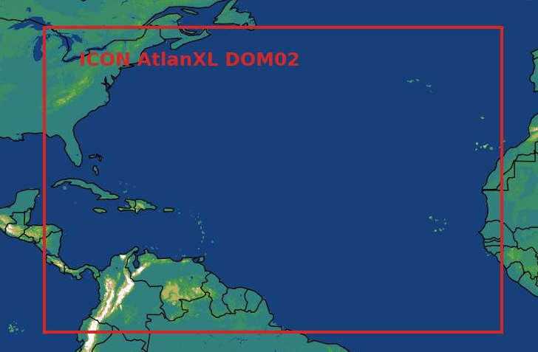
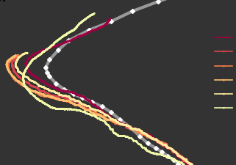
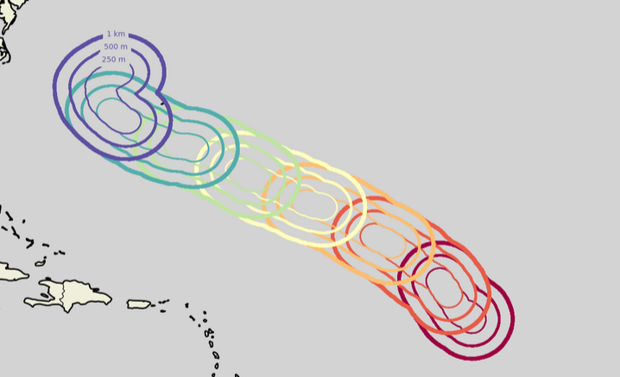

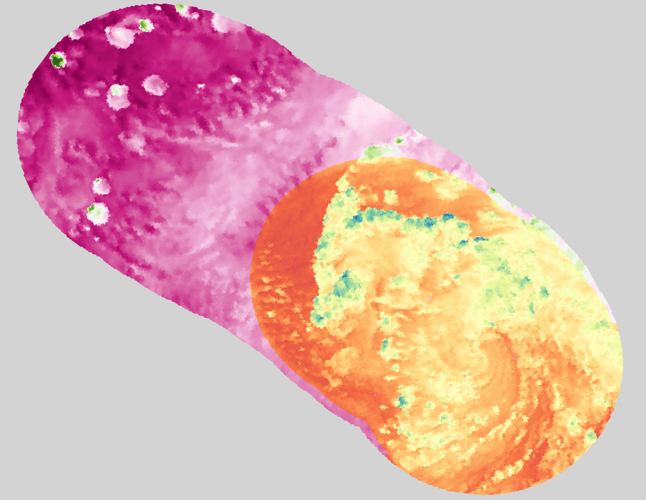
(a) Flexible Refinement Workflow
Base Simulation
Tracking
Flexible Grids
1
2
3
Simulated Segment
IC Merging
5
4

Slide 2
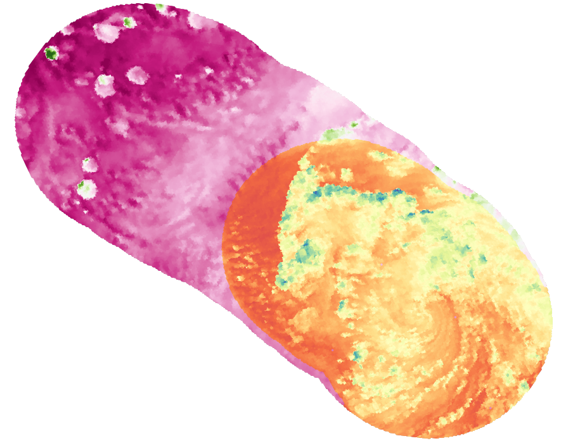
Flexible Refinement Workflow
Base Simulation
Tracking
Flexible Grids
1
2
3
Simulated Segment
IC Merging
5
4

Slide 3
Flexible Refinement Workflow
Base Simulation
Tracking
Flexible Grids
1
2
3
Simulated Segment
IC Merging
5
4

Slide 4
Flexible Refinement Workflow
Base Simulation
Tracking
Flexible Grids
1
2
3
Simulated Segment
IC Merging
5
4

