Slide 1
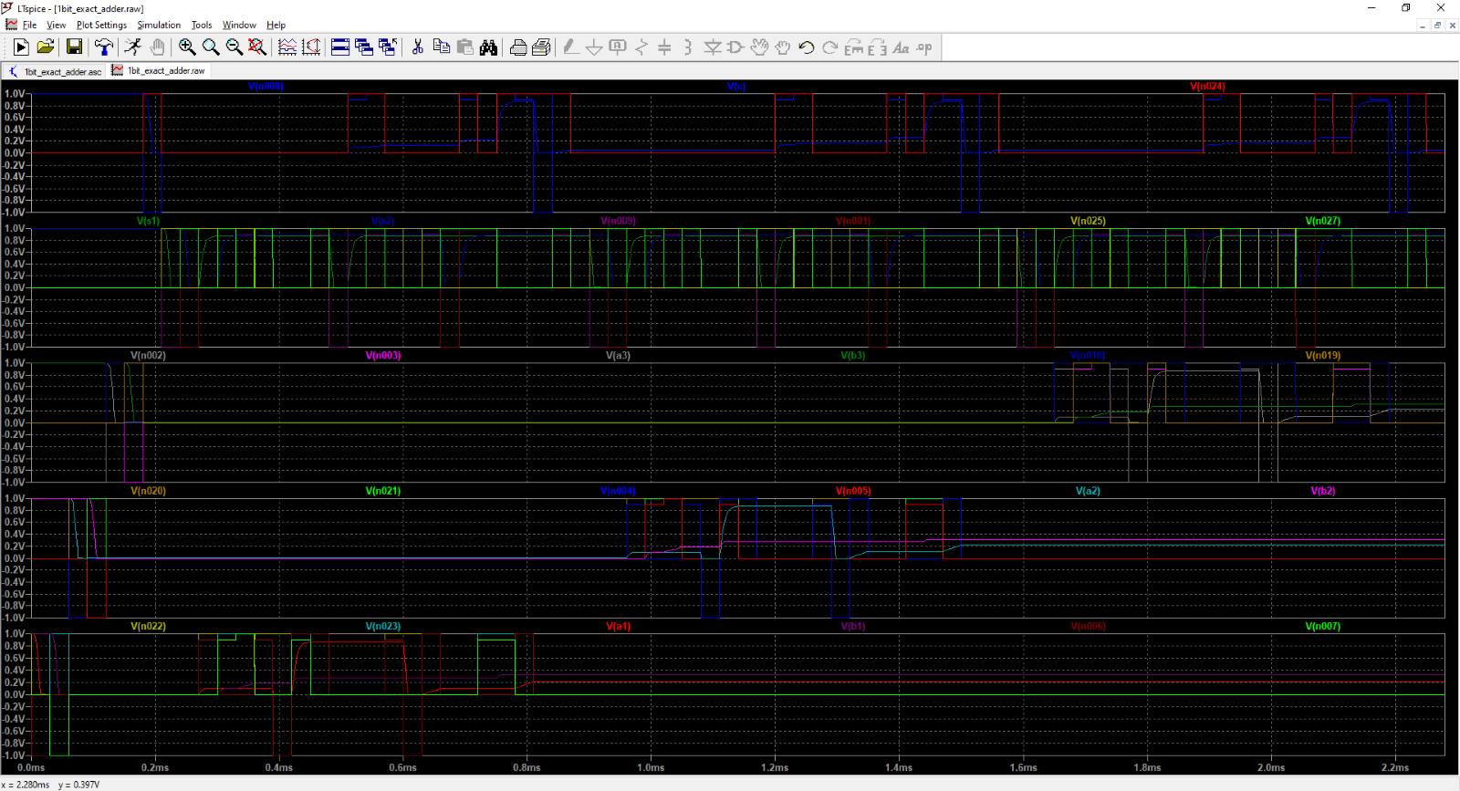
Carry ( c )
work ( s1 + s2 )
a3 + b3
a2 + b2
a1 + b1
load data
compute first stage
compute second stage
compute third stage

