Slide 1
Adobe
Edge Delivery Services
How to Configure an Edge Function with EDS
Adobe Experience Manager — Developer Guide

Slide 2
Agenda
• What is an Edge Function in EDS?
• Folder & File Structure
• Worker Configuration — wrangler.toml
• CORS & Caching Strategy
• Environment Variables & Secrets
• Deploying the Worker
• Connecting a Block to the Edge Function
• Best Practices & Summary
Adobe
©2024 Adobe. All Rights Reserved. Adobe Confidential.

Slide 3
What is an Edge Function in EDS?
• A Cloudflare Worker that acts as a secure API proxy between the EDS page and external services
• Runs at the network edge — low latency, no origin server needed
• Handles CORS so browser pages on aem.live / aem.page can call protected APIs
• Adds response caching (Cloudflare Cache API) to reduce upstream API calls
• Keeps secrets (API tokens, keys) out of the browser and out of the codebase
•
• Why not call the API directly from the block?
– API tokens would be exposed in the browser
– No control over CORS headers on third-party services
– No caching layer — every page view hits the upstream API
Adobe
©2024 Adobe. All Rights Reserved. Adobe Confidential.

Slide 4
Folder & File Structure
• All edge function code lives under /edge/ at the project root
• wrangler.toml (project root) points to the entry file and configures the Worker
• Secrets are never committed — stored in .dev.vars locally and via wrangler secret put in production
myeds-xwalk/
├── edge/
│ └── api-proxy.js ← Worker entry point (fetch handler)
├── wrangler.toml ← Worker name, entry, vars (committed)
├── .dev.vars ← Local secrets (git-ignored)
└── blocks/
└── weather/
└── weather.js ← Block that calls the Worker via /api/*
Adobe
©2024 Adobe. All Rights Reserved. Adobe Confidential.

Slide 5
Worker Configuration — wrangler.toml
• name — the Worker subdomain: <name>.workers.dev
• main — path to the JS entry file
• compatibility_date — locks the Workers runtime behaviour
• [vars] — non-secret environment variables (safe to commit)
• Secrets (tokens, keys) are set separately with: npx wrangler secret put MY_SECRET
name = "myeds-xwalk-api"
main = "edge/api-proxy.js"
compatibility_date = "2024-09-23"
[dev]
port = 8787 # local: http://localhost:8787
[vars]
API_BASE_URL = "https://author-p12345.adobeaemcloud.com/graphql/execute.json/..."
# Secret — never in this file:
# npx wrangler secret put AEM_TOKEN
# Local dev — add to .dev.vars (git-ignored):
# AEM_TOKEN=eyJ...
Adobe
©2024 Adobe. All Rights Reserved. Adobe Confidential.

Slide 6
CORS & Caching Strategy
• CORS — only allow requests from your own AEM origins (aem.live, aem.page, localhost)
• Always whitelist both .aem.live and .aem.page — they serve the same content on different CDNs
• Caching — use caches.default (Cloudflare Cache API) to avoid hammering upstream APIs
– Geocoding data: 24 h TTL (location coordinates are stable)
– Weather / forecast data: 15 min TTL (changes frequently)
– Financial rates: 5 min TTL (can change during the day)
const ALLOWED_ORIGINS = [
'https://main--myproject--owner.aem.live',
'https://main--myproject--owner.aem.page',
'http://localhost:3000',
];
function corsHeaders(origin) {
const allow = ALLOWED_ORIGINS.includes(origin) ? origin : ALLOWED_ORIGINS[0];
return { 'Access-Control-Allow-Origin': allow,
'Access-Control-Allow-Methods': 'GET, OPTIONS' };
}
async function cachedFetch(url, ttl) {
const cache = caches.default;
const hit = await cache.match(new Request(url));
if (hit) return hit;
const res = await fetch(url);
const response = new Response(res.body, res);
response.headers.set('Cache-Control', \`public, max-age=\${ttl}\`);
await cache.put(new Request(url), response.clone());
return response;
}
Adobe
©2024 Adobe. All Rights Reserved. Adobe Confidential.

Slide 7
Environment Variables & Secrets
• Two types of config values: plain vars ([vars] in wrangler.toml) and secrets
• Plain vars — non-sensitive, committed to git (API base URLs, feature flags)
• Secrets — tokens, API keys; never committed; injected at deploy time by Cloudflare
•
• Setting a production secret (run once, stored encrypted in Cloudflare):
– npx wrangler secret put AEM_TOKEN
•
• Local dev secret — create .dev.vars in the project root (git-ignored):
– AEM_TOKEN=eyJhbGci...
•
• Accessing a secret inside the Worker — available on the env object:
– env.AEM_TOKEN
Adobe
©2024 Adobe. All Rights Reserved. Adobe Confidential.

Slide 8
Deploying the Worker
• One command deploys the Worker to Cloudflare's global edge network
• Credentials come from the global wrangler OAuth login (~/.config/wrangler/)
• Worker is live at: https://<name>.<account>.workers.dev
• Re-deploy any time you change edge/api-proxy.js or wrangler.toml
# 1. Login once (opens browser — stores OAuth token globally)
npx wrangler login
# 2. Deploy
npm run deploy:edge
# └─ runs: wrangler deploy
# 3. Verify
npx wrangler tail # stream live request logs
curl https://myeds-xwalk-api.fsevin.workers.dev/api/geocode?name=Paris
# package.json shortcut
"scripts": {
"dev:edge": "wrangler dev", # local: http://localhost:8787
"deploy:edge": "wrangler deploy"
}
Adobe
©2024 Adobe. All Rights Reserved. Adobe Confidential.

Slide 9
Connecting a Block to the Edge Function
• The block JS must point to the Worker URL in production and localhost in dev
• Content structure: EDS renders table rows as nested <div> elements — no <p> tags
– Query with: block.querySelector('div:first-child p, div:first-child div')
• Always set Content-Type: application/json; charset=utf-8 on Worker responses
– Prevents mojibake on accented characters (e.g. Île-de-France)
// blocks/myblock/myblock.js
const EDGE_ORIGIN = window.location.hostname === 'localhost'
? 'http://localhost:8787'
: 'https://myeds-xwalk-api.fsevin.workers.dev';
async function fetchJSON(url) {
const res = await fetch(url);
if (!res.ok) throw new Error(\`HTTP \${res.status}\`);
return res.json();
}
export default async function decorate(block) {
// Read location from first cell (works with both <p> and <div> content)
const location = block.querySelector('div:first-child p, div:first-child div')
?.textContent?.trim() || '';
const data = await fetchJSON(\`\${EDGE_ORIGIN}/api/geocode?name=\${encodeURIComponent(location)}\`);
block.innerHTML = \`<p>\${data.results?.[0]?.name}</p>\`;
}
Adobe
©2024 Adobe. All Rights Reserved. Adobe Confidential.

Slide 10
Best Practices & Summary
Step
Action
Notes
1. Create Worker
Add edge/api-proxy.js
Export a fetch handler
Handle OPTIONS preflight
Return JSON with charset=utf-8
2. Configure
Set name, main, vars
in wrangler.toml
Never put secrets in toml
Use wrangler secret put
3. CORS & Cache
Whitelist aem.live +
aem.page origins
Cache stable data longer
(geocode 24h, rates 5min)
4. Local dev
npx wrangler dev
→ localhost:8787
Put AEM_TOKEN in .dev.vars
(git-ignored)
5. Deploy
npm run deploy:edge
Verify with wrangler tail
or curl the worker URL
6. Connect block
Set EDGE_ORIGIN by hostname
Query div, p selectors
Purge AEM CDN cache after
pushing JS changes
Adobe
©2024 Adobe. All Rights Reserved. Adobe Confidential.

Slide 11
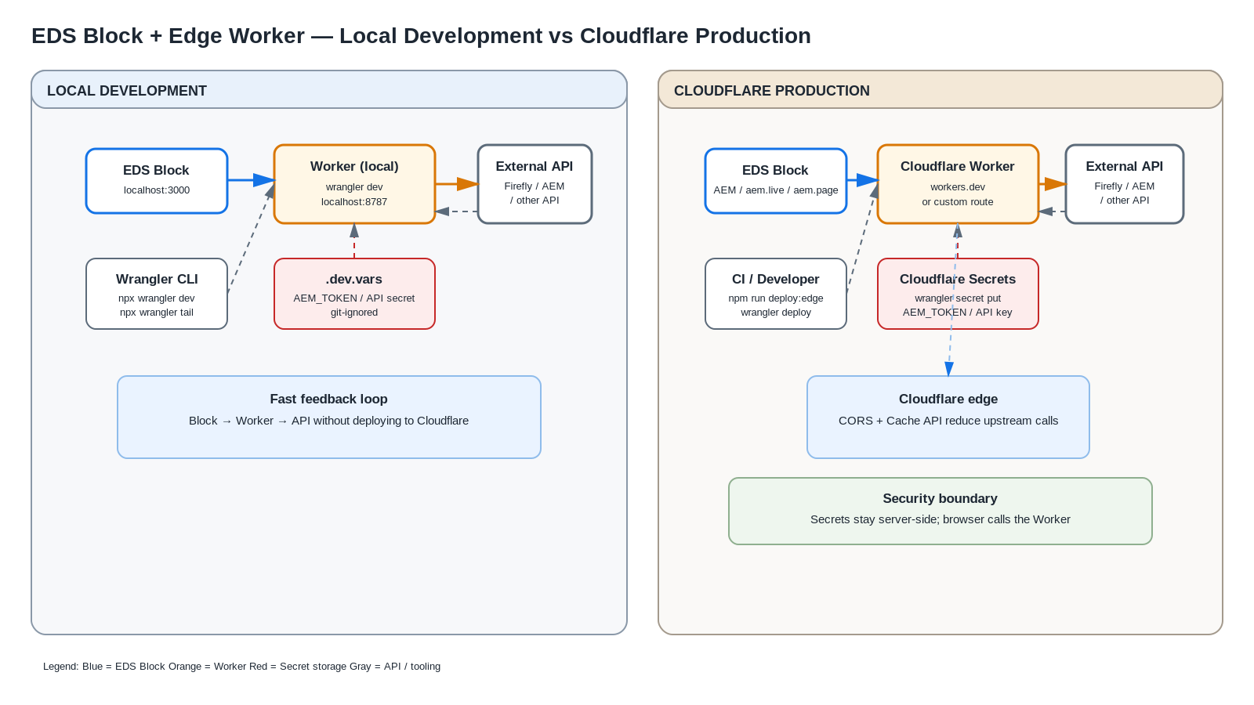

Slide 12
Adobe

