Slide 1
Adobe Experience Manager
The ai-image Block
Author-generated, DAM-persisted Firefly images in Universal Editor
Illustrated redesign for an Adobe team share-out
Author once
Persist in DAM
Render zero-API
Designed to feel polished, visual, and ready to present

Slide 2
Org
EMEA Consulting
Cloud Manager
https://experience.adobe.com/#/@emeaaem/cloud-manager/home.html/program/42808
AEMaaCS Author Prod
https://author-p42808-e1367915.adobeaemcloud.com/ui#/aem/
Git Repo
https://github.com/fsevin/myeds-xwalk
Console (Project 45)
https://developer.adobe.com/console/projects/916550/4566206088345730291/overview
CloudFlare
https://dash.cloudflare.com/0579dbc1b9f0cdcaef70870e5c585897/workers/services/view/myeds-xwalk-api/production
EDS Live
https://main--myeds-xwalk--fsevin.aem.live/demo-tn

Slide 3
Agenda
A visual walkthrough of the ai-image block
1
Why separate from Firefly
2
Architecture overview
3
Authoring model
Why separate from Firefly
Architecture overview
Authoring model
01
02
03
4
Edge Worker byte streaming
5
Universal Editor context
6
Auto-generate flow
Edge Worker byte streaming
Universal Editor context
Auto-generate flow
04
05
06
7
AEM DAM upload
8
Patch the content node
9
Bugs, status, best practices
AEM DAM upload
Patch the content node
Bugs, status, best practices
07
08
09
Adobe Confidential
02

Slide 4
Why a Separate Block From Firefly
Generate once in the editor, then render a persisted asset on every later view.
Original Firefly block
ai-image block
•
Calls Firefly on every render
•
Generates once in Universal Editor
•
Consumes a credit per page view
•
Persists the result as a real AEM DAM asset
•
Produces a different image each time
•
Published pages render the stored asset with zero API calls
•
Returns a presigned S3 URL that expires quickly
Persist once
•
Keeps the original Firefly block untouched
render many
A new folder keeps the existing Firefly block unchanged while this version stores assets inside DAM.
Adobe Confidential
03

Slide 5
Architecture Overview
The request path is short: authoring -> byte stream -> preview -> DAM upload -> persisted render.
1
2
3
4
5
6
7
Author types prompt
ai-image.js
Edge Worker
Inline preview
DAM upload
Patch block node
Reload and render
The block streams image bytes from the Worker, uploads them to AEM DAM, then writes the DAM path back onto its own content node.
Later renders simply detect the persisted <picture> and exit early — no Firefly call is needed.
Adobe Confidential
04

Slide 6
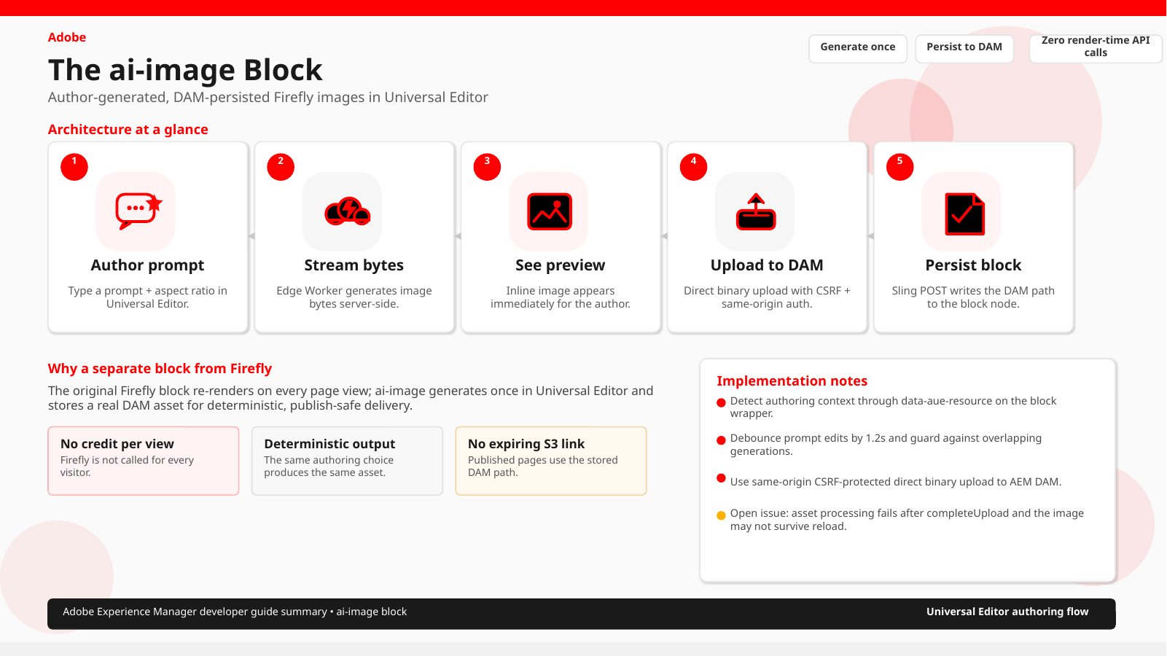

Slide 7
Step 1 — Authoring Model
Same prompt + aspect ratio shape as the original block, with a writable image reference field.
Model fields
// blocks/ai-image/_ai-image.json
{
"models": [{
"id": "ai-image",
"fields": [
{ "component": "richtext", "name": "prompt", "label": "Prompt" },
{ "component": "select", "name": "aspectRatio", "label": "Aspect ratio" },
{ "component": "reference", "name": "image", "label": "Generated image" }
]
}]
}
prompt
Prompt
required
aspectRatio
Aspect ratio
1024x1024 | 1344x768 | 768x1344
image
Generated image
reference field
Written programmatically, but still manually overridable in the asset picker UI.
The model stays close to the original Firefly block, with the image asset slot added for persistence.
Adobe Confidential
05

Slide 8
Step 2 — Edge Worker: Stream Image Bytes
Reuse the same IMS auth, but return the image bytes directly rather than a presigned URL.
Shared auth
async function handleFireflyGenerateImage(request, env, cors) {
const { prompt, size } = parsePromptAndSize(await request.json());
const url = await fireflyGenerate(prompt, size, env);
const imageRes = await fetch(url);
return new Response(imageRes.body, {
status: 200,
headers: { 'Content-Type': imageRes.headers.get('Content-Type') || 'image/png', ...cors },
});
}
•
Uses the same getFireflyToken helper as the original block
•
Token is cached in-isolate
•
No duplicated auth logic
Route
POST /api/firefly/generate-image
The Worker fetches the image server-side, which avoids S3 CORS uncertainty and the presigned URL expiry window.
Adobe Confidential
06

Slide 9
Step 3 — Detecting Universal Editor Context
Use the block wrapper attribute; do not guess by hostname or page type.
Universal Editor canvas
Published page behavior
•
The attribute is absent entirely on published pages
data-aue-resource present
author canvas
•
Never call Firefly there
If the attribute exists, strip the urn prefix to get the Sling resource path that later gets patched.
•
Only render an already-persisted <picture>
const resource = block.getAttribute('data-aue-resource');
// Published page: absent -> return immediately.
if (!resource) return;
const resourcePath = resource.replace('urn:aemconnection:', '');
// → /content/.../jcr:content/root/.../firefly
Adobe Confidential
07

Slide 10
Step 4 — Auto-Generate on Prompt Entry
A 1.2s debounce keeps the authoring flow responsive while preventing redundant requests.
No Generate button
const pendingTimers = new Map();
const inFlight = new Set();
const DEBOUNCE_MS = 1200;
if (pendingTimers.has(resource)) clearTimeout(pendingTimers.get(resource));
if (inFlight.has(resource)) return;
const timerId = setTimeout(async () => {
inFlight.add(resource);
await generateAndPersist(preview, prompt, aspectRatio, resource);
window.location.reload();
}, DEBOUNCE_MS);
•
First version had a button, but it felt clunky for this flow
•
decorate() reruns on each properties-rail edit
•
Without debounce, a single prompt would trigger many Firefly calls
1.2 seconds after the last edit, generation starts.
debounce
in-flight guard
reload once
Adobe Confidential
08

Slide 11
Step 5 — Upload to AEM DAM
Use the supported 3-step direct binary upload flow with CSRF and same-origin credentials.
3-step flow
1
initiateUpload
2
PUT blob
3
completeUpload
Create the upload record and get a token
Upload the bytes to blob storage
Finalize the asset and attach metadata
credentials: 'include'
CSRF token
same-origin fetch
folder auto-create
no service token
The upload target folder auto-creates on first use if missing; every mutating call carries the Granite CSRF token.
Adobe Confidential
09

Slide 12
Step 6 — Patch the Block's Own Content Node
Write the DAM path back onto the block resource using a same-origin Sling POST.
Additive write
await fetch(resourcePath, {
method: 'POST',
credentials: 'include',
headers: { 'Content-Type': 'application/x-www-form-urlencoded', 'CSRF-Token': csrfToken },
body: new URLSearchParams({ image: assetPath }),
});
// resourcePath = /content/.../firefly
// assetPath = /content/dam/.../generated/firefly-<timestamp>.jpg
•
POST form fields named after JCR properties update the target node
•
The same CSRF token and same-origin credentials are reused
•
Only the image property changes — prompt and aspectRatio remain intact
This writes only the persisted DAM reference, never the original authoring inputs.
Adobe Confidential
10

Slide 13
Bugs Hit Along the Way
A compact debugging log: symptom, root cause, fix.
Symptom
Root cause
Fix
Broken image icon before generation
.ai-image-preview display:block overrode hidden
Add .ai-image-preview[hidden]{ display:none; }
Generate button had invisible text
Global button{} rule set color to background color
Explicitly set button text color; later remove the button
“Something went wrong…” with no detail
Catch block swallowed the real error
Surface e.message in status and console.error
Failed to fetch from the editor
CORS allowlist missed the AEM author origin
Add the author domain to ALLOWED_ORIGINS
The same small set of culprits kept recurring: CSS, error handling, and CORS on the Worker route.
Adobe Confidential
11

Slide 14
Current Status & Open Issue
What works now, and what still needs investigation.
Working today
Open issue
•
Prompt entry
After completeUpload succeeds, the asset-processing workflow starts and has been observed to fail.
•
Debounced auto-generate
•
Inline preview
This appears to be server-side AEM workflow behavior, not block code. Next check: Tools → Operations → Workflow → Failures, or the Assets UI, for the actual processing error.
•
CSRF token fetch
•
DAM upload initiateUpload step
workflow
ACL / launcher
folder
The folder was auto-created by code, so it may not inherit the same ACLs or workflow launcher config as a normal authored DAM folder.
Adobe Confidential
12

Slide 15
Best Practices & Summary
A concise checklist for the final implementation.
1. Model
prompt, aspectRatio, image
image is written programmatically, not picked
2. Worker route
Stream bytes instead of a presigned URL
Reuse existing IMS auth — do not duplicate it
3. Author context
Check data-aue-resource on the block
Absent on published pages — never call Firefly there
4. Auto-generate
Debounce + in-flight guard
Prevents redundant calls while the author is editing
5. DAM upload
initiateUpload / PUT / completeUpload + CSRF
Same-origin, cookie auth — no extra service token
6. Persist
Sling POST the block’s own resource path
Additive — only touches the image property
7. Debug
Surface real error text, not a generic message
CORS / CSRF / workflow failures can look identical
Adobe Confidential
13

Slide 16
persist once
render many
A polished way to explain the ai-image block to the Adobe team
authoring
DAM
zero API
Adobe Confidential

