Slide 1
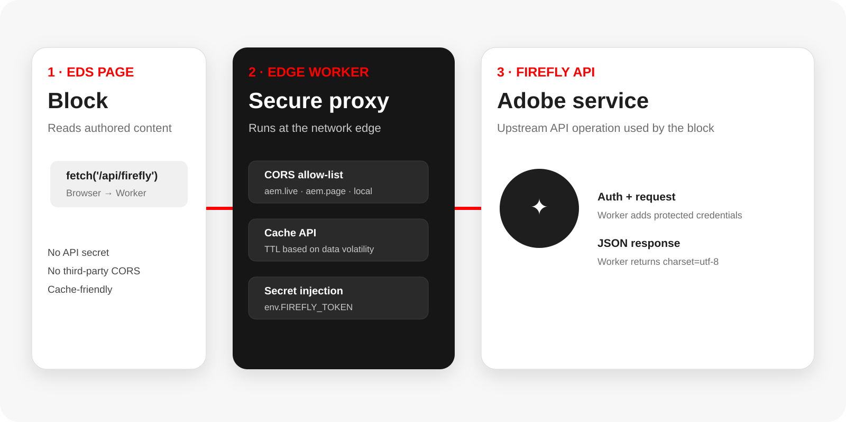
ADOBE EXPERIENCE MANAGER
EDS + Firefly API
Build a secure, cache-aware block with an Edge Worker
Developer guide
Internal enablement
Source: supplied EDS Edge Function guide
Notes:
[Sources] - Supplied source deck: EDS-EdgeFunction-Guide.pptx - Architecture and content adapted from the supplied deck. - Firefly API is used here as the upstream external service named in the requested scenario.

Slide 2
01 • THE STORY
A simple pattern: Block → Worker → Firefly
The block stays thin. The Worker absorbs security, CORS, caching and upstream API concerns.
01
02
03
Authoring & block UI
Edge control plane
Firefly API
Read authored content and turn it into a request.
Validate origin, protect secrets, cache when useful.
Call the upstream Adobe API and return JSON.
The rest of the deck is the implementation path.
1. Create Worker 2. Configure 3. Add CORS/cache 4. Run locally 5. Deploy 6. Connect block
Notes:
[Sources] - Supplied source deck: EDS-EdgeFunction-Guide.pptx - Agenda and implementation sequence adapted from the supplied deck.

Slide 3
02 • ARCHITECTURE
Why not call Firefly directly from the block?
Direct browser → API calls create three avoidable problems.
01
02
03
Secrets leak
CORS is upstream-owned
Every view can hit upstream
API tokens would be exposed in the browser.
You cannot control third-party CORS headers from the block.
Without a caching layer, every page view reaches the API.
Worker = secure API proxy at the network edge
Low latency
CORS
Cache
Secrets
Notes:
[Sources] - Supplied source deck: EDS-EdgeFunction-Guide.pptx - Source deck states the Worker acts as a secure API proxy, runs at the edge, handles CORS, adds Cloudflare Cache API caching, and keeps secrets out of browser/code.

Slide 4
03 • PROJECT SETUP
Keep the Worker close to the block, but outside the block code
myeds-xwalk/
Rule of thumb
Secrets never live in git.
edge/
api-proxy.js← Worker entry point
Production: use wrangler secret put.
Local development: use .dev.vars (git-ignored).
wrangler.toml contains only non-sensitive configuration.
wrangler.toml← committed configuration
.dev.vars← local secret, git-ignored
blocks/
firefly/
firefly.js← block calls /api/*
This structure keeps the browser-facing block simple while the Worker owns the trust boundary.
Notes:
[Sources] - Supplied source deck: EDS-EdgeFunction-Guide.pptx - Folder/file structure and secret handling adapted from the supplied deck.

Slide 5
04 • CONFIGURATION
wrangler.toml: make the Worker predictable
1 name = "myeds-xwalk-api" 2 main = "edge/api-proxy.js" 3 compatibility_date = "2024-09-23" 4 5 [dev] 6 port = 8787 7 8 [vars] 9 API_BASE_URL = "https://…" 10 11 # secret — never commit 12 # npx wrangler secret put FIREFLY_TOKEN
What belongs here?
name
Worker subdomain
main
JS entry file
compatibility_date
Runtime behavior lock
[vars]
Non-secret values
secrets
Separate encrypted config
Port 8787
Git-safe
Notes:
[Sources] - Supplied source deck: EDS-EdgeFunction-Guide.pptx - wrangler.toml fields and examples adapted from the supplied deck.

Slide 6
05 • SECURITY & PERFORMANCE
CORS + cache: the two controls every Worker should own
1
CORS allow-list
2
Cache API
Allow your AEM origins only.
Whitelist both .aem.live and .aem.page.
Keep localhost:3000 for local browser testing.
Use caches.default to reduce upstream calls.
TTL follows how quickly data changes.
Examples from the guide: geocode 24 h; weather 15 min; financial rates 5 min.
Origins
Design principle
aem.live
aem.page
localhost
Cache stable data longer; volatile data shorter.
Notes:
[Sources] - Supplied source deck: EDS-EdgeFunction-Guide.pptx - CORS allow-list and cache TTL examples adapted from the supplied deck.

Slide 7
06 • SECRETS
One secret lifecycle: local → deploy → env
LOCAL
DEPLOY
RUNTIME
.dev.vars
→
wrangler secret put
→
env.FIREFLY_TOKEN
FIREFLY_TOKEN=…
Encrypted in Cloudflare
Worker reads secret
Never commit a token to wrangler.toml or block JavaScript.
The browser sees only the Worker endpoint—not the secret.
Notes:
[Sources] - Supplied source deck: EDS-EdgeFunction-Guide.pptx - Secret lifecycle and env access adapted from the supplied deck.

Slide 8
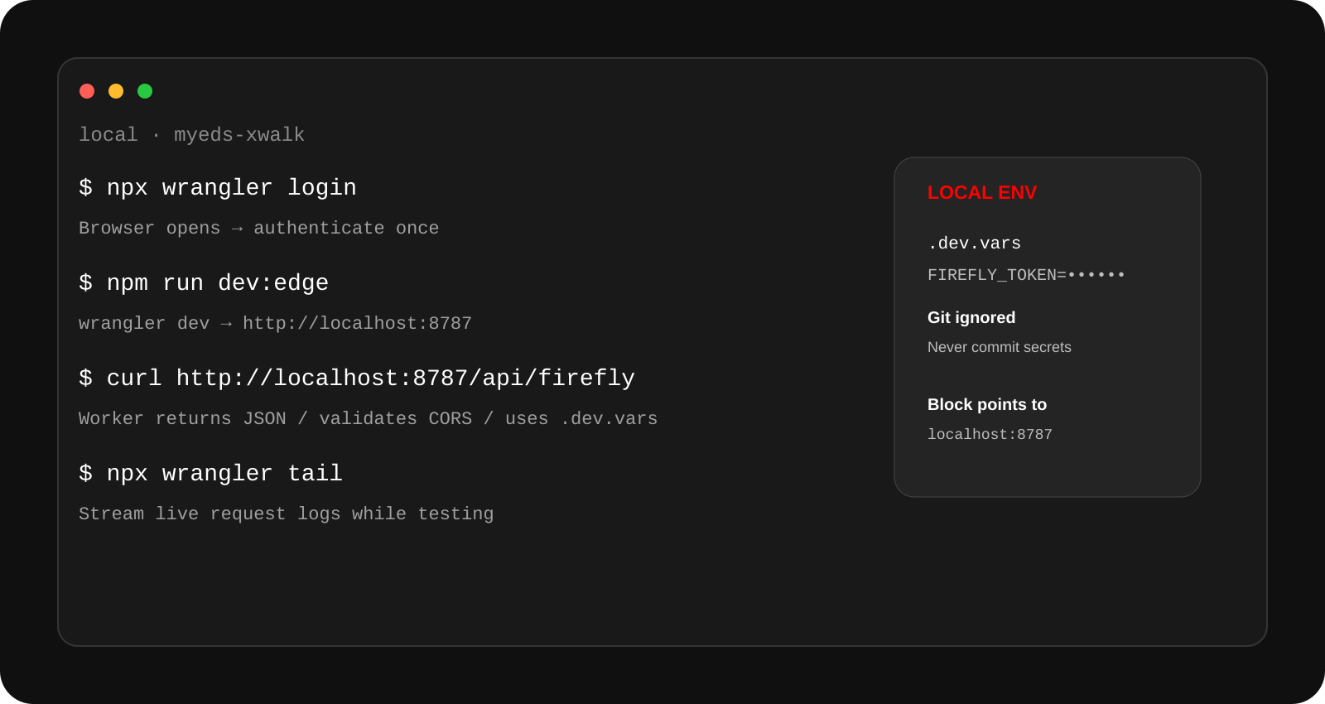
07 • NEW
Deploying the Worker locally
Local endpoint: http://localhost:8787
.dev.vars is git-ignored
Test the Worker before deploy
Notes:
[Sources] - Supplied source deck: EDS-EdgeFunction-Guide.pptx - Local development commands and port 8787 adapted from the supplied deck. - The Firefly endpoint name is a requested scenario label; adapt the route to the actual Worker implementation.

Slide 9
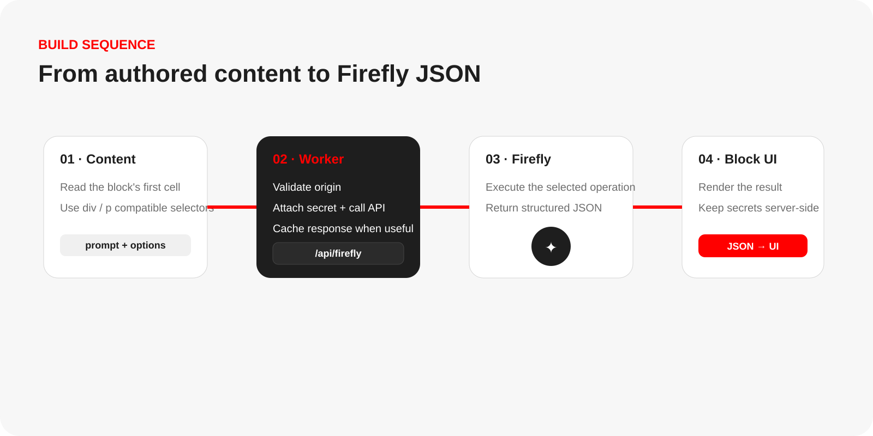
08 • BUILD THE BLOCK
The implementation sequence
Notes:
[Sources] - Supplied source deck: EDS-EdgeFunction-Guide.pptx - Sequence adapts the supplied guidance on creating the Worker, connecting the block, and returning JSON. - Firefly naming is the user-requested upstream service for this deck.

Slide 10
09 • CLOUD DEPLOYMENT
Deploy once, then verify at the edge
1
npx wrangler login
OAuth login stored globally
LIVE
2
npm run deploy:edge
Runs: wrangler deploy
https://<name>.<account>.workers.dev
3
npx wrangler tail
Stream live request logs
Global edge
4
curl https://<worker>/api/firefly
Verify the production response
Re-deploy when edge/api-proxy.js or wrangler.toml changes.
Notes:
[Sources] - Supplied source deck: EDS-EdgeFunction-Guide.pptx - Deployment commands and Worker URL pattern adapted from the supplied deck.

Slide 11
10 • BLOCK INTEGRATION
Point the block at localhost in dev, Worker URL in prod
1 const EDGE_ORIGIN = window.location.hostname === 'localhost' 2 ? 'http://localhost:8787' 3 : 'https://<worker>.workers.dev'; 4 5 async function fetchJSON(url) { 6 const res = await fetch(url); 7 if (!res.ok) throw new Error(`HTTP ${res.status}`); 8 return res.json(); 9 } 10 11 const data = await fetchJSON( 12 `${EDGE_ORIGIN}/api/firefly` 13 );
EDS-specific details to preserve
Query nested div/p content in EDS table rows.
Return application/json; charset=utf-8 from the Worker.
Keep the production origin in one place (EDGE_ORIGIN).
Purge AEM CDN cache after pushing JS changes.
dev → localhost:8787
prod → workers.dev
Notes:
[Sources] - Supplied source deck: EDS-EdgeFunction-Guide.pptx - Block integration details adapted from the supplied deck, including div/p selectors, JSON charset, localhost vs production origin, and cache purge guidance. - Firefly route shown as a conceptual integration point for the requested scenario.

Slide 12
12 • TWO REFERENCE SAMPLES
Same EDS pattern — two useful API-backed blocks
The architecture stays the same: the block is thin, the Worker owns security/CORS/cache, and the upstream API stays behind the edge.
Sample A — Firefly API
Sample B — Weather block
Protected Adobe / Firefly API behind the Worker
Original EDS example using the Worker pattern
EDS block
Worker
Firefly API
Weather block
Worker
Upstream API
fetch /api/firefly
auth + CORS + cache
upstream service
read location
/api/geocode + cache
geocode / weather data
Use when the block needs a protected Adobe API or Firefly capability without exposing credentials in browser code.
The original deck places the Worker under /edge and the block under /blocks/weather. The sample code calls /api/geocode and returns JSON.
Pattern to reuse →
block → Worker → protected/cached API
Notes:
[Sources]
- User-provided original deck: EDS-EdgeFunction-Guide.pptx, pages 4, 8, 9 and 10.
- Firefly endpoint pattern follows the redesigned deck; the original deck documents the Worker-to-block pattern and secrets/CORS/cache controls.
[/Sources]

Slide 13
13 • SAMPLE B WALKTHROUGH
Weather block: from authored content to Worker response
Read the first block cell, call the local/production Worker, then render the returned JSON.
01
const EDGE_ORIGIN = window.location.hostname === 'localhost'
What the audience should remember
02
? 'http://localhost:8787'
03
: 'https://<worker>.workers.dev';
1 Read block content
04
EDS authored content supplies the location value.
05
const location = block.querySelector(
06
'div:first-child p, div:first-child div'
2 Switch endpoint by environment
07
)?.textContent?.trim() || '';
localhost in development; Worker URL in production.
08
09
const data = await fetchJSON(
3 Let the Worker call upstream
10
`${EDGE_ORIGIN}/api/geocode?name=${encodeURIComponent(location)}`
The browser never receives the protected upstream credential.
11
);
12
4 Return JSON and render
13
block.innerHTML = `<p>${data.results?.[0]?.name}</p>`;
The block stays focused on DOM transformation.
Source note: the original “weather” example is wired to /api/geocode; cache guidance separately calls out weather / forecast data as a 15-minute TTL use case.
Notes:
[Sources]
- User-provided original deck: EDS-EdgeFunction-Guide.pptx, page 9 (Connecting a Block to the Edge Function) and page 6 (cache TTL examples).
[/Sources]

Slide 14
14 • TAKEAWAY
A six-step recipe your team can reuse
01
Create
02
Configure
03
Protect
edge/api-proxy.js + fetch handler
wrangler.toml without secrets
CORS allow-list + Cache API
04
Run locally
05
Deploy
06
Connect
wrangler dev + .dev.vars
npm run deploy:edge + tail
Block → Worker → Firefly JSON
The Worker is the trust boundary. The block is the experience.
Notes:
[Sources] - Supplied source deck: EDS-EdgeFunction-Guide.pptx - Summary adapted from the supplied deck best-practices table.

Slide 15
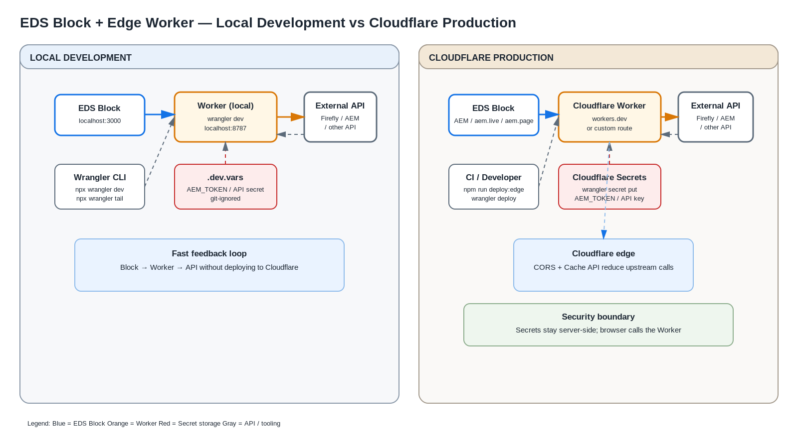

Slide 16
Adobe
Build fast.
Keep secrets server-side.
EDS block → Edge Worker → Firefly API
Developer enablement • Internal presentation
Notes:
[Sources] - Supplied source deck: EDS-EdgeFunction-Guide.pptx - Closing slide created for internal presentation use.

