Slide 1
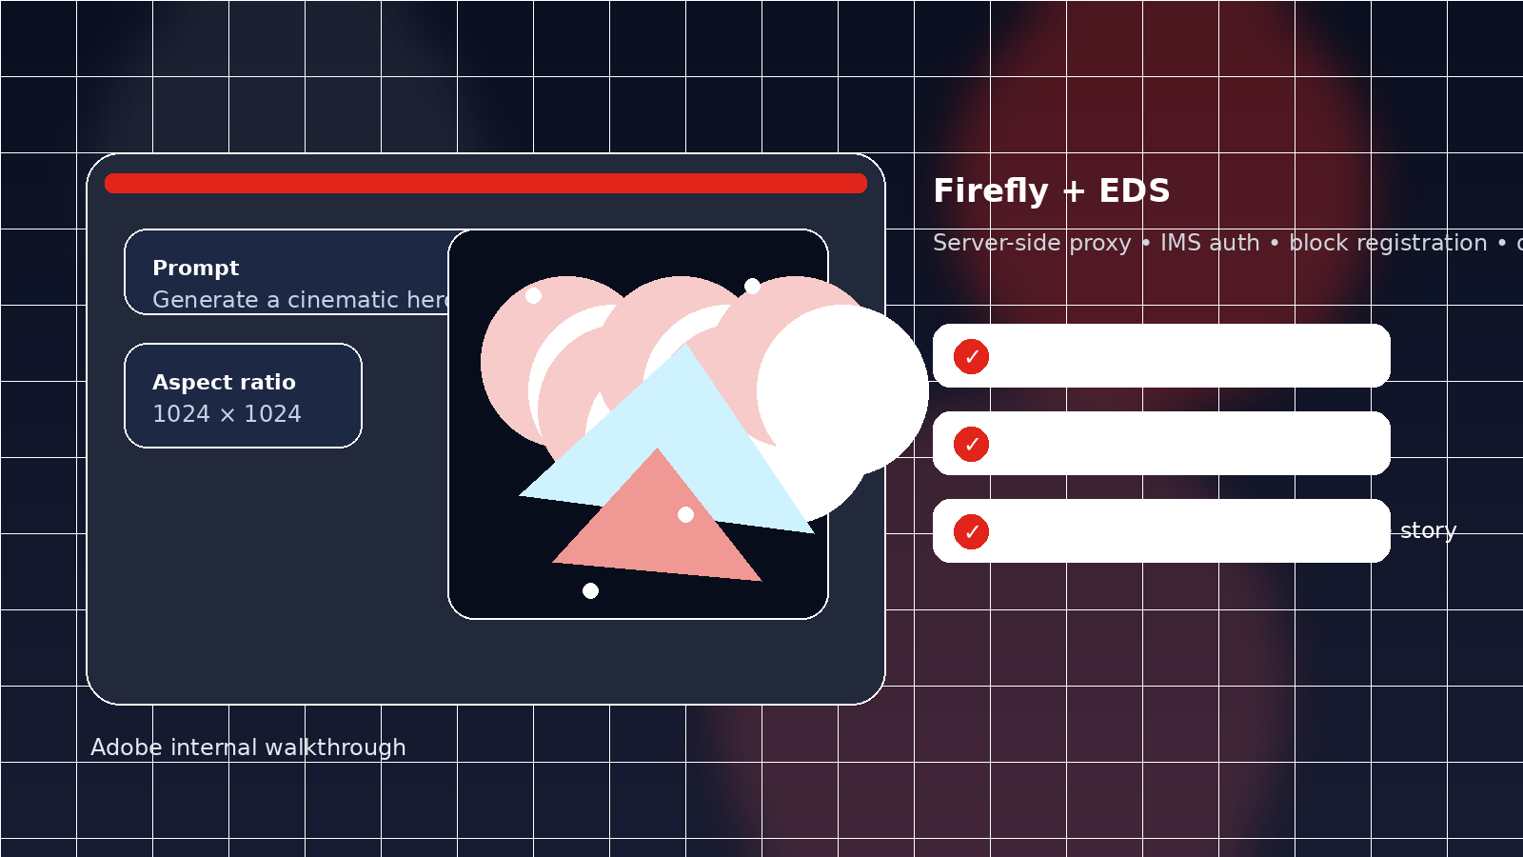
Adobe Firefly Image Block
Building an AI image-generation block for Edge Delivery Services
A practical walkthrough for Adobe internal teams
Server-side proxy
IMS auth
Universal Editor
Deploy + troubleshoot
What you will see: the route, the auth flow, the block files, deployment, and the real issues we hit while wiring Firefly into EDS.
Adobe Experience Manager — Developer Guide
Adobe internal • 1

Slide 2
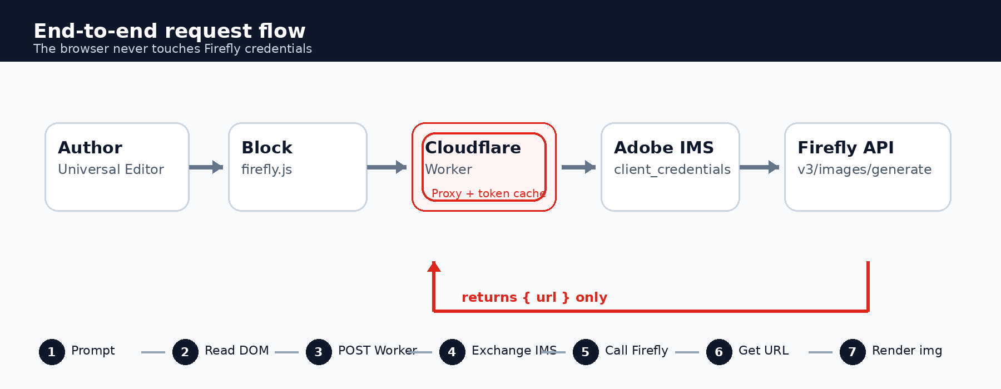
Why Firefly needs a server-side proxy
Security
The Firefly Generate Image API needs two credentials on every call:
Security principle
Keep secrets in the Worker and return only the image URL to the browser.
Authorization: Bearer <IMS access token>
x-api-key: <client_id>
The access token is obtained via client_credentials
client_secret must never reach the browser
The block should call our Worker, not Firefly directly
This mirrors the same server-side pattern already used for other EDS integrations.
Adobe internal • 2
Notes:
https://developer.adobe.com/console/projects/916550/4566206088345730291/credentials/1016648/details/oauthservertoserver?generateToken=true

Slide 3
End-to-end architecture overview
Flow
A single block turns authored content into a generated image URL through the Worker.
Universal Editor authoring
block JS reads DOM content
Worker exchanges IMS token and calls Firefly
block renders the returned image URL
Adobe internal • 3

Slide 4
Step 1 and Step 2: edge route + IMS auth
Build
Step 1 — add the Firefly route to the existing Worker
Step 2 — Adobe IMS client_credentials authentication
Extend edge/api-proxy.js rather than creating a second Worker. Validate the prompt, resolve a supported size, and return only the URL.
Cache the access token in a module-level variable inside the Worker
async function handleFireflyGenerate(request, env, cors) {
const body = await request.json();
const prompt = body?.prompt?.trim();
if (!prompt) return jsonError('Missing prompt', 400, cors);
const size = FIREFLY_VALID_SIZES.includes(body?.size)
? body.size : '1024x1024';
const [width, height] = size.split('x').map(Number);
const token = await getFireflyToken(env);
const res = await fetch('https://firefly-api.adobe.io/v3/images/generate', {
method: 'POST', headers: {
'Content-Type': 'application/json',
Accept: 'application/json',
Authorization: `Bearer ${token}`,
'x-api-key': env.FIREFLY_CLIENT_ID,
},
body: JSON.stringify({ prompt, size: { width, height }, numVariations: 1 }),
});
return new Response(JSON.stringify({ url: data.outputs[0].image.url }), ...);
}
Refresh about a minute before expiry to avoid mid-flight failures
Keep every secret out of the browser and out of the block code
POST is allowed only for this Firefly route; the other routes stay GET-only
Key reminder
The browser should only receive the pre-signed image URL, never the token or the client_secret.
Adobe internal • 4

Slide 5
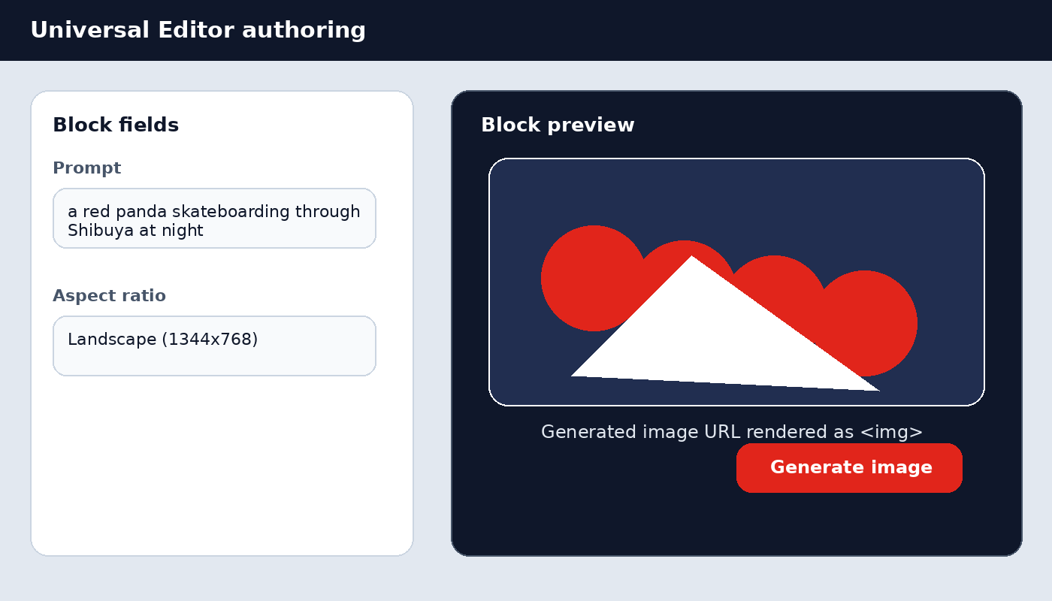
Step 3 and Step 4: wrangler.toml + authoring model
Build
Step 3 — configure wrangler.toml & secrets
Step 4 — declare the Universal Editor model
client_id is not sensitive and can live in [vars]
client_secret must be stored as an encrypted Worker secret
Use .dev.vars for local wrangler dev; keep it git-ignored
Follow the same secret pattern used by the other EDS integrations
[vars]
FIREFLY_CLIENT_ID = "..."
FIREFLY_SCOPES = "openid,AdobeID,session,additional_info,read_organizations,firefly_api,ff_apis"
# secret, never commit
# npx wrangler secret put FIREFLY_CLIENT_SECRET
# local dev only
# FIREFLY_CLIENT_SECRET=<your-client-secret>
blocks/firefly/_firefly.json defines two fields:
prompt
aspectRatio
The model is auto-merged into the component JSON files at build time, so the block shows up in the editor without manual registry work.
Adobe internal • 5

Slide 6
Step 4: firefly.js and the authoring experience
Build
The block should stay thin: read authored text, call the Worker, then swap in the returned <img>.
Authoring preview
const EDGE_ORIGIN = window.location.hostname === 'localhost'
? 'http://localhost:8787'
: 'https://myeds-xwalk-api.fsevin.workers.dev';
export default async function decorate(block) {
const prompt = block.querySelector('div:first-child p, div:first-child div')
?.textContent?.trim() || '';
const aspectRatio = block.querySelector('div:nth-child(2) p, div:nth-child(2) div')
?.textContent?.trim() || '1024x1024';
block.innerHTML = '<div class="firefly-loading">Generating image…</div>';
const res = await fetch(`${EDGE_ORIGIN}/api/firefly/generate`, {
method: 'POST', headers: { 'Content-Type': 'application/json' },
body: JSON.stringify({ prompt, size: aspectRatio }),
});
const { url } = await res.json();
const img = document.createElement('img');
img.src = url; img.alt = prompt;
block.innerHTML = ''; block.append(img);
}
Loading state first, then image URL resolution
Same localhost / production edge origin switch as other blocks
Keep the browser logic focused on rendering, not auth
Adobe internal • 6

Slide 7
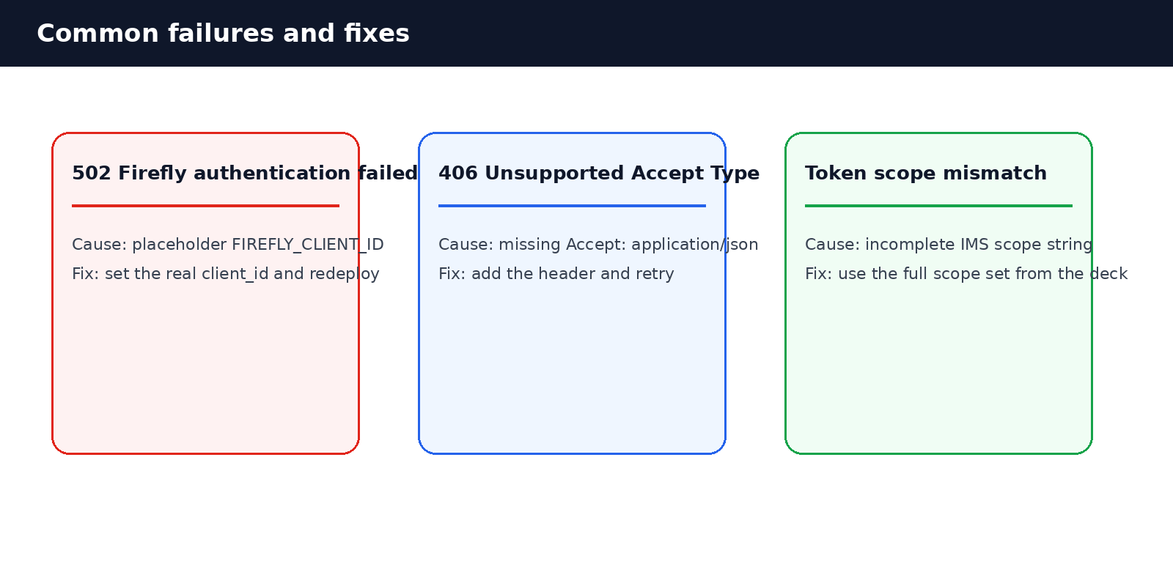
Step 5 and Step 6: deploy, test, and troubleshoot
Operate
Step 5 — register and deploy
Commands
No manual registry: blocks/<name>/ is auto-discovered by aem.js
npm run build:json
# writes component-models.json
# component-definition.json
# component-filters.json
npm run deploy:edge
# runs wrangler deploy
Run npm run build:json to merge the block model into component JSON
Deploy the Worker separately; the site still deploys through AEM Code Sync
Step 6 — test and troubleshoot the real failures we hit
The two most useful checks were the Accept header on the Firefly fetch() and the IMS scope string. Debugging directly against the Worker isolates browser issues from backend issues.
curl -s -X POST https://.../api/firefly/generate \
-H "Content-Type: application/json" \
-H "Origin: https://...aem.live" \
-d '{"prompt":"a red panda skateboarding through Shibuya at night"}'
Adobe internal • 7

Slide 8
Best practices and summary
Summary
The implementation works best when the security boundary stays in the Worker and the block stays author-friendly.
1
Worker route
Add handleFireflyGenerate() to edge/api-proxy.js
Never return the IMS token or client_secret
2
IMS auth
client_credentials exchange and in-isolate token cache
Refresh 60s before expiry
3
Secrets
client_id in [vars]; client_secret via wrangler secret
Keep .dev.vars and cache files out of git
4
Block files
_firefly.json, firefly.js, firefly.css
Read authored text with div:nth-child selectors
5
Register
npm run build:json
Auto-merges into the root component JSON files
6
Deploy & test
npm run deploy:edge and curl the Worker directly
Check Accept header + IMS scopes on 406/502s
7
Commit
git add source + regenerated JSON
Exclude local state and .dev.vars
Takeaway: keep secrets in the edge Worker, keep the block light, and use PNG-based diagrams when presenting the flow to a broader internal audience.
Adobe internal • 8

