Slide 1
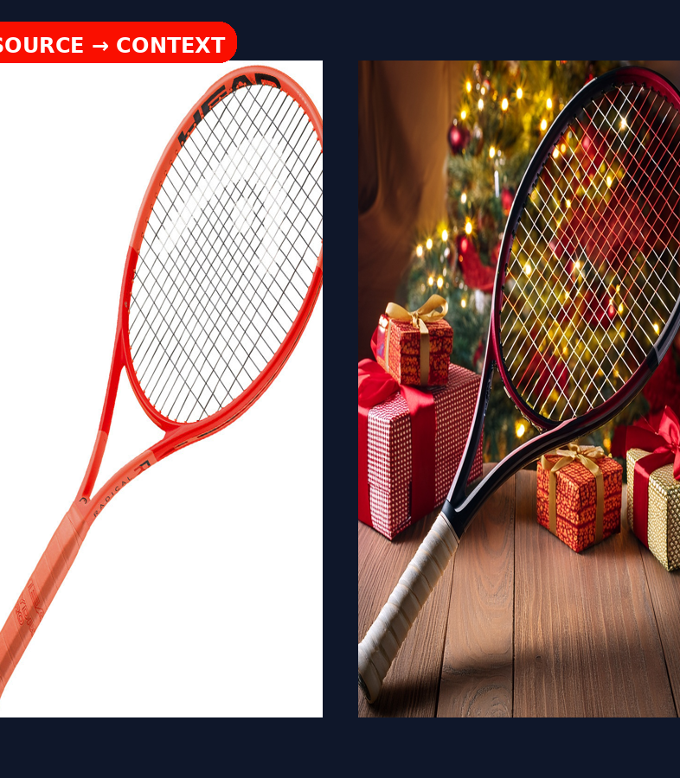
Adobe
THE PRODUCT-VARIANT BLOCK
Contextual product photo variants via Firefly Structure Reference
AEM Edge Delivery Services • internal developer walkthrough
SOURCE → VARIANT → DAM
Keep the product recognizable. Change the context.
Notes:
[Sources] Source: uploaded Product-Variant-Block-Build-Guide.pptx (user-provided) [/Sources]

Slide 2
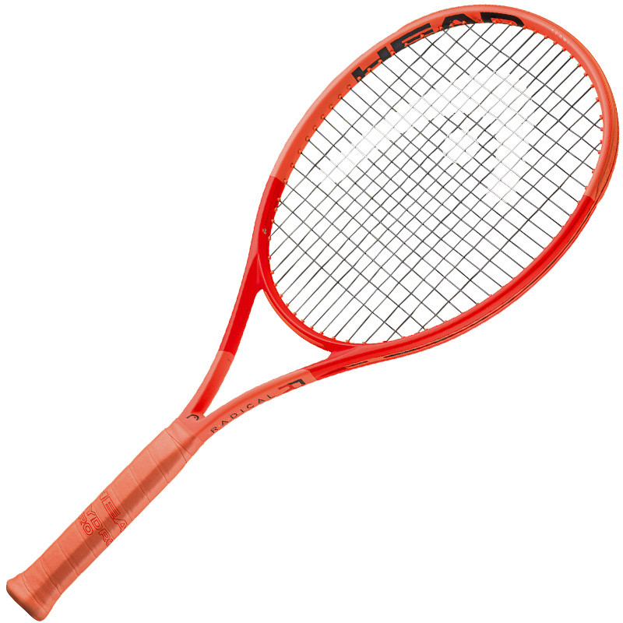
1 • THE IDEA
Turn one product photo into many contextual variants
The source image anchors shape + composition while the prompt controls the scene.
FIREFLY STRUCTURE REFERENCE
WHAT THE AUTHOR GETS
Preserve the silhouette
Change the context
1
Pick product photo
2
Write a variation prompt
Seasonal / promotional scenes
Regional / lifestyle scenes
3
Preview + persist result
SOURCE PRODUCT
Existing product photo
Same Firefly credentials as ai-image
Required reference field in the block.
V1 explicitly chose Structure Reference. Generative Fill + Photoshop API was rejected for a separate entitlement/credential path.
Notes:
[Sources] Source: uploaded Product-Variant-Block-Build-Guide.pptx (user-provided) [/Sources]

Slide 3
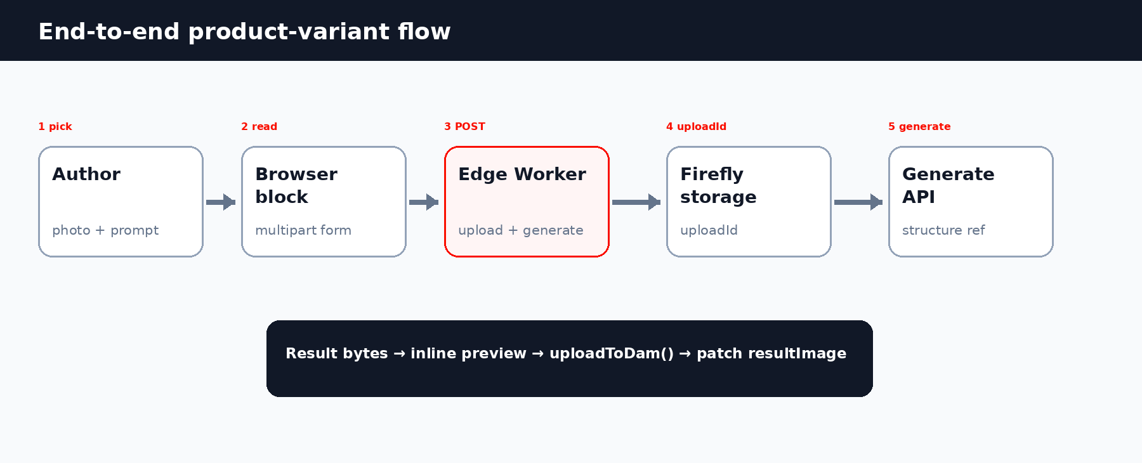
2 • ARCHITECTURE
The browser supplies the image; the Worker owns the Firefly call
The critical boundary: multipart upload in, image bytes out.
Key detail
The Worker uploads the source photo to Firefly storage first, receives an uploadId, then passes that id as structure.imageReference.
Notes:
[Sources] Source: uploaded Product-Variant-Block-Build-Guide.pptx (user-provided) [/Sources]

Slide 4
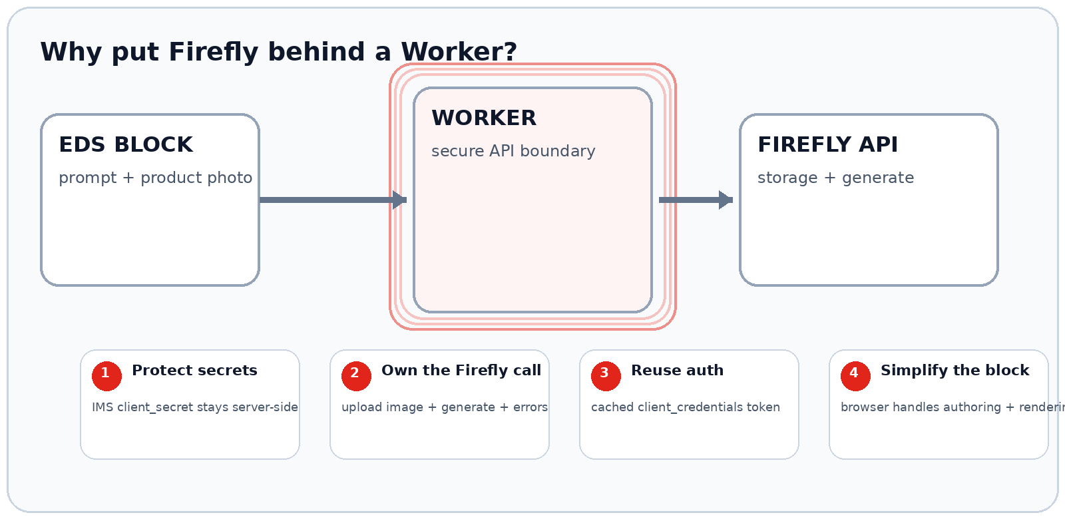
ARCHITECTURE DECISION
Why use a Worker for the Firefly integration?
The Worker is the secure integration boundary between the EDS block and Firefly Services.
Key tradeoff: EDS and Worker are separate deploy targets — git push does not redeploy the Worker.

Slide 5
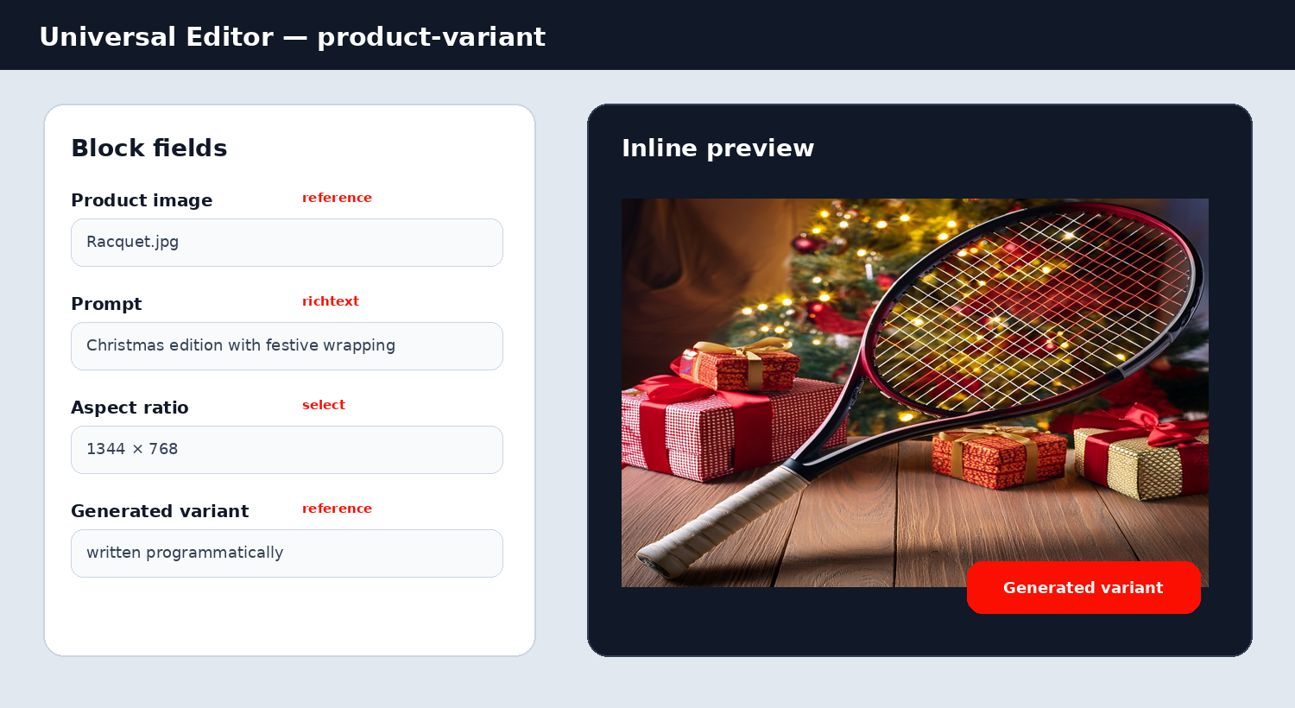
3 • STEP 1
Keep the authoring model intentionally small
xwalk caps a block at four top-level fields; fold advanced guidance into the prompt rather than adding more controls.
4 FIELDS
productImage
reference • required
source product photo
prompt
richtext • required
what should change
aspectRatio
select
1024×1024 / 1344×768 / 768×1344
resultImage
reference • programmatic
generated variant; never picked by author
Design lesson
variationType + strength were removed from the authoring UI to stay under the four-cell limit.
Notes:
[Sources] Source: uploaded Product-Variant-Block-Build-Guide.pptx (user-provided) [/Sources]

Slide 6
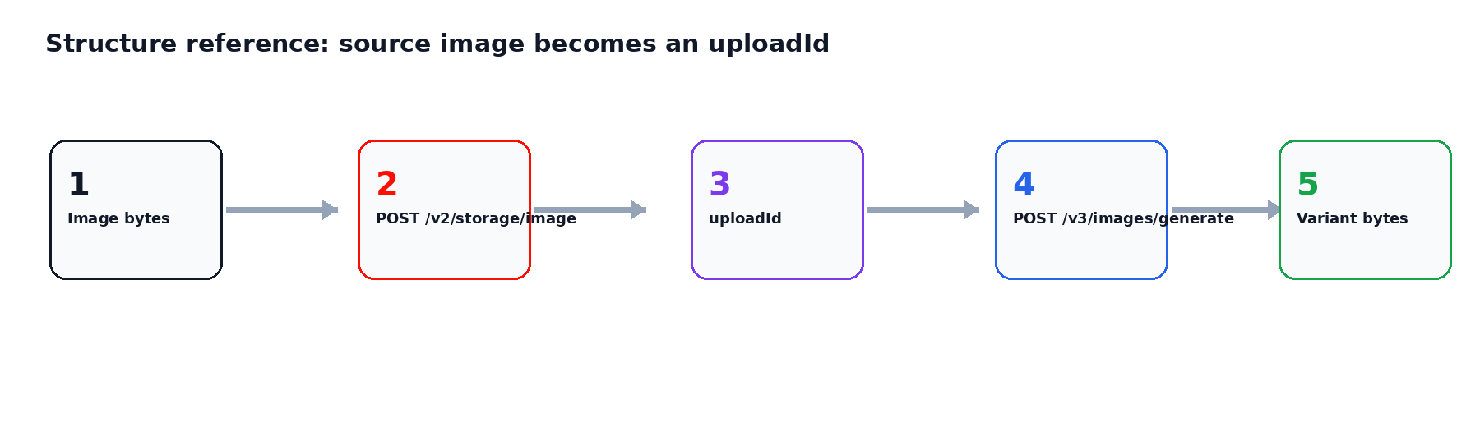
4 • STEP 2
Upload once, then generate with Structure Reference
The route differs from the JSON-based ai-image route because the source photo travels as multipart form data.
async function uploadImageToFirefly(bytes, mimeType, env) {
const token = await getFireflyToken(env);
const res = await fetch('https://firefly-api.adobe.io/v2/storage/image', {
method: 'POST',
headers: { 'Content-Type': mimeType,
Authorization: `Bearer ${token}`, 'x-api-key': env.FIREFLY_CLIENT_ID },
body: bytes,
});
return (await res.json()).images[0].id; // uploadId
}
// generate: structure.imageReference.source.uploadId
Reuse getFireflyToken() — do not duplicate the IMS auth flow.
Security boundary: client_secret remains in Worker secrets; only the rendered image bytes return to the browser.
Notes:
[Sources] Source: uploaded Product-Variant-Block-Build-Guide.pptx (user-provided) [/Sources]

Slide 7
5 • STEP 3
Render the right state: source, result, or neither
Two image reference fields mean the block must distinguish the persisted result from the original product photo.
RESULT EXISTS
EDITOR / NO RESULT
PUBLISHED / NO RESULT
Show persisted variant
Generate from source
Show original product
render resultImage and stop — this is also what published pages use.
read productImage + prompt + size, then call the Worker.
no UE resource → fall back to source so the page is never empty.
resultPicture
sourcePicture → Worker
sourcePicture
Implementation detail
Field lookup is positional: productImage = 1, prompt = 2, aspectRatio = 3, resultImage = 4.
Notes:
[Sources] Source: uploaded Product-Variant-Block-Build-Guide.pptx (user-provided) [/Sources]

Slide 8
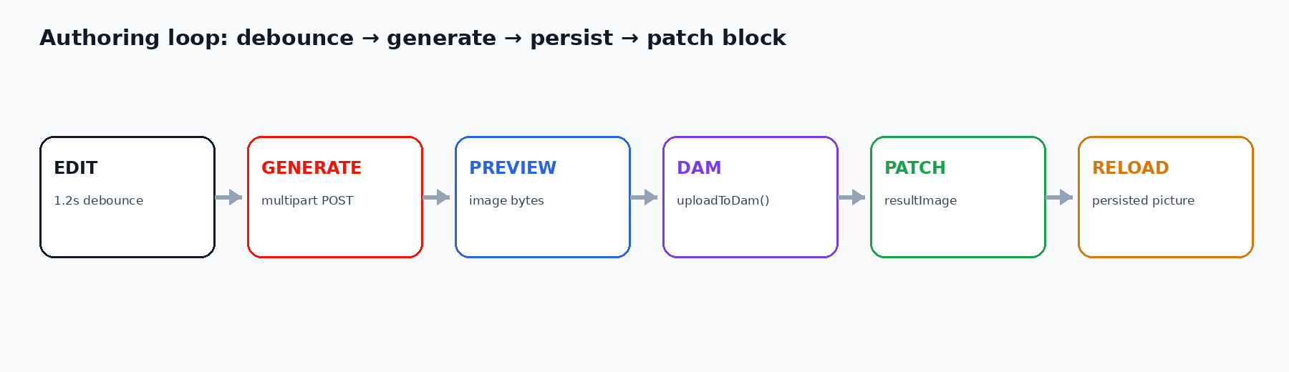
6 • STEP 4
Auto-generate, then persist to AEM DAM
A 1.2s debounce prevents a Firefly call on every keystroke; shared DAM helpers remove duplicate code.
const sourceBlob = await (await fetch(sourceImg.src,
{ credentials: 'include' })).blob();
const form = new FormData();
form.append('image', sourceBlob, 'product.jpg');
form.append('prompt', prompt);
form.append('size', size);
const blob = await (await fetch(
`${EDGE_ORIGIN}/api/firefly/generate-variant`,
{ method: 'POST', body: form })).blob();
const assetPath = await uploadToDam(blob, mimeType,
csrfToken, 'product-variant');
await patchBlockImage(resourcePath, 'resultImage',
assetPath, csrfToken);
Shared helper extraction: getCsrfToken(), uploadToDam(), patchBlockImage() now live in scripts/dam-persist.js.
Notes:
[Sources] Source: uploaded Product-Variant-Block-Build-Guide.pptx (user-provided) [/Sources]

Slide 9
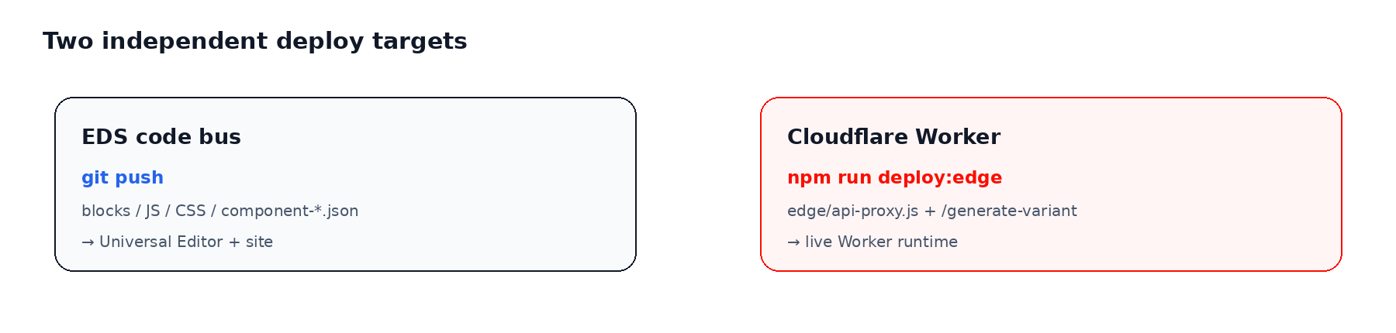
7 • STEPS 5–6
Registration and deployment are two different paths
A push updates the EDS code bus. A Worker route update requires wrangler deploy.
REGISTER
REGISTER
DEPLOY
• Exact block id: product-variant
• Add id to each relevant section filter
• npm run build:json
• git push → EDS code bus
• npm run deploy:edge → Cloudflare Worker
• curl Worker route before UE
Notes:
[Sources] Source: uploaded Product-Variant-Block-Build-Guide.pptx (user-provided) [/Sources]

Slide 10


8 • REAL EXAMPLE
One racquet, two product stories
The source silhouette stays recognizable while the context shifts from holiday retail to summer lifestyle.
SOURCE
VARIANT A
VARIANT B
Original product photo
“Christmas edition with festive wrapping”
“On a beach in summer with sunshine and palm trees”
Notes:
[Sources] Source: uploaded Product-Variant-Block-Build-Guide.pptx (user-provided) Assets reused from the user-provided source deck.[/Sources]

Slide 11
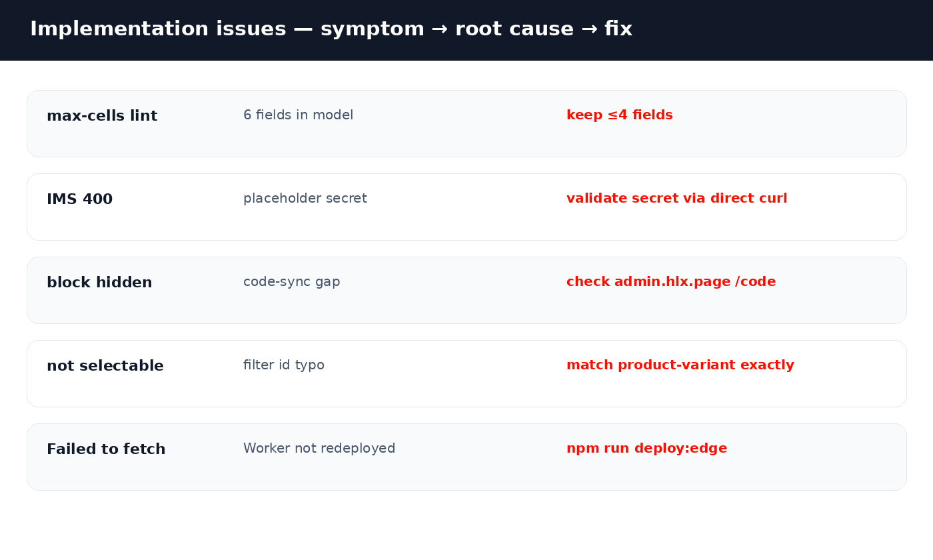
9 • LESSONS LEARNED
Where the implementation actually failed — and what fixed it
The highest-value lessons are about boundaries: field limits, code sync, exact ids, and separate Worker deployment.
BEST-PRACTICE CHECKLIST
≤ 4 authoring fields
Reuse cached IMS auth
Use field positions for dual-image state
Debounce + in-flight guard
Share DAM persistence helpers
Exact block id in every filter
git push AND wrangler deploy
curl Worker before UE
Outcome
A reusable EDS pattern for turning existing product imagery into contextual variants without exposing Firefly credentials.
Notes:
[Sources] Source: uploaded Product-Variant-Block-Build-Guide.pptx (user-provided) [/Sources]

