Slide 1
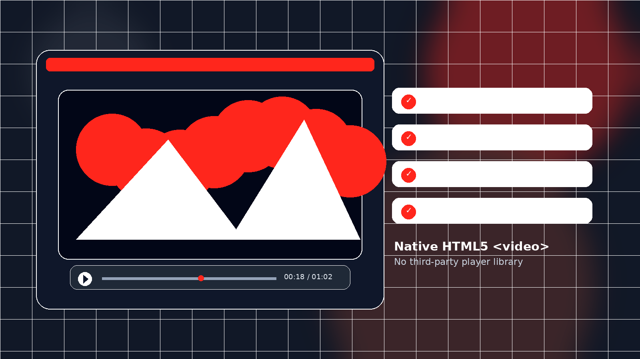
The video-player Block
DAM-sourced video playback for Edge Delivery Services
Author → build → publish → debug
HTML5 <video>
DAM references
Autoplay / Loop
Adobe Experience Manager — Internal technical walkthrough
Notes:
[Sources] User-provided source deck: Video-Player-Block-Build-Guide.pptx. Hero visual is a generated PNG created for this presentation.

Slide 2
Why use a native <video> element?
Keep the block small, predictable, and dependency-free.
1
Simple runtime
Render plain HTML5 <video>; no third-party player library or load-time dependency.
2
Author-friendly
Video + optional poster + a single Options multiselect for Autoplay, Loop, Muted, Hide controls.
3
Browser-aware
Autoplay forces Muted + playsInline so the authored option stays realistic across browsers.
4
Lightweight styling
The native element already handles playback controls, aspect ratio and responsiveness.
Notes:
[Sources] Source deck supports these points in “What It Does, and Why a Native <video> Element” and “Best Practices & Summary”.

Slide 3
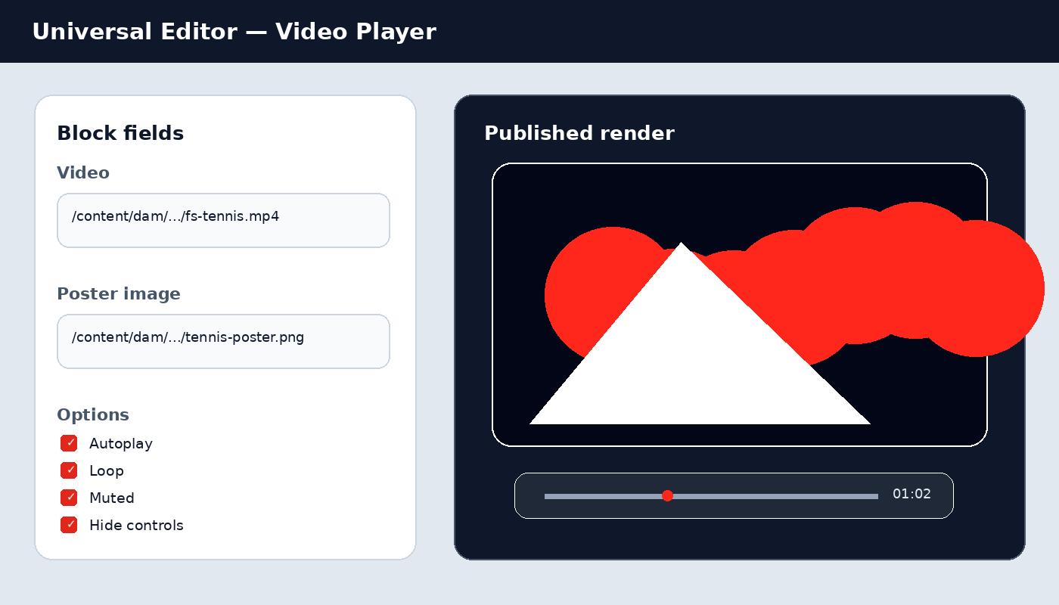
How authors use it in Universal Editor
A five-step authoring flow, with one publishing step that is easy to miss.
1
Add a Section and insert “Video Player”.
2
Pick the Video asset from DAM.
3
Optionally pick a Poster image.
4
Select Autoplay / Loop / Muted / Hide controls.
5
Preview, then publish BOTH the page and the video asset.
Most common miss: page published, video asset not published.
Notes:
[Sources] Source deck supports the exact five authoring steps and notes asset publication is the #1 cause of a video not appearing.

Slide 4
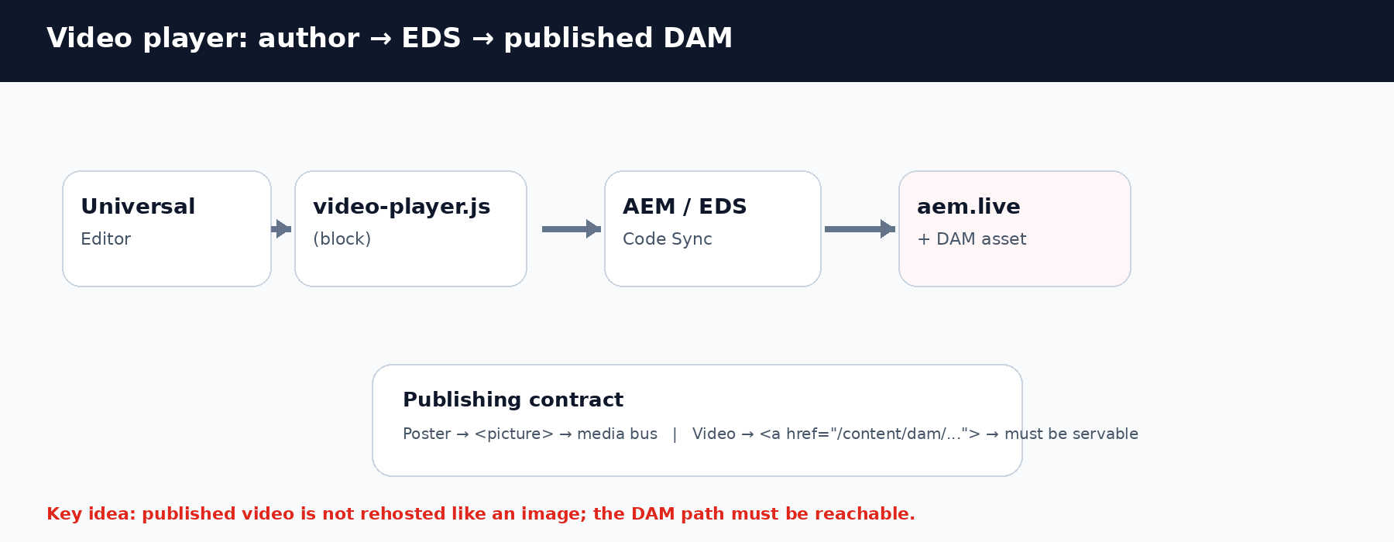
The markup contract matters
Image references and video references behave differently after publish.
Poster image → <picture> → media bus → site-hosted media URL
Video → <a href="/content/dam/..."> → DAM path must be directly servable
Notes:
[Sources] Source deck: markup contract section. The visual is a generated PNG based on that contract.

Slide 5
Step 1 — Content model
Three top-level fields keep the block small and align with the EDS classes convention.
video
poster
classes
reference
reference
multiselect
Required DAM video asset
Optional thumbnail
Autoplay / Loop / Muted / Hide controls
Model JSON (abridged)
{ "id": "video-player", "fields": [
{ "component": "reference", "name": "video", "required": true },
{ "component": "reference", "name": "poster" },
{ "component": "multiselect", "name": "classes", "options": ["autoplay","loop","muted","hide-controls"] }
] }
Design note: use one multiselect “Options” field instead of four boolean fields.
Notes:
[Sources] Source deck: Step 1 — Content Model and code excerpt.

Slide 6
Step 2 — Block JS: read fields, build <video>
Field order + block classes form the runtime contract.
1
Read video link
div:nth-child(1) → <a href>
1 const videoLink = fieldLink(block, 1); 2 const posterPicture = fieldPicture(block, 2); 3 4 const autoplay = block.classList.contains('autoplay'); 5 const muted = block.classList.contains('muted') || autoplay; 6 const controls = !block.classList.contains('hide-controls'); 7 8 const video = document.createElement('video'); 9 video.src = videoLink.href; 10 video.controls = controls; 11 video.muted = muted; 12 video.playsInline = true; 13 video.autoplay = autoplay; 14 if (posterPicture) video.poster = posterPicture.querySelector('img')?.src;
2
Read poster
div:nth-child(2) → <picture>
3
Read options
block.classList → classes
4
Apply browser-safe playback
Autoplay ⇒ muted + playsInline
Empty required field → render nothing while author completes the block.
Notes:
[Sources] Source deck: Step 3 — Block JS and code excerpt.

Slide 7
Steps 3–4 — Style + register
Minimal CSS, then make the block selectable in Sections.
CSS
REGISTER
Minimal styling is intentional
1. _video-player.json is auto-discovered
1 .video-player video { 2 display: block; 3 width: 100%; 4 height: auto; 5 background: #000; 6 }
2. Add "video-player" to the section filter
3. Run npm run build:json
A one-character component-id typo can silently hide the block from the picker.
Native controls, responsive sizing, and a black loading background do most of the work.
Build output: component-models / definition / filters
Notes:
[Sources] Source deck: Steps 4–5 — Styling and Registering the Block.

Slide 8
Publishing is part of the feature
A video block can be correct in the editor and still fail on the published page.
1
paths.json
Include the DAM path so EDS may serve it.
2
Cloud Configuration
Assign the site configuration to the DAM folder.
3
Publish the asset
The binary itself must be published — page publish is not enough.
4
Republish the page
Regenerate the published block markup after the asset is reachable.
5
Large files
Use the MP4 processing profile when the asset needs a compliant rendition.
Important distinction: an image reference is auto-rehosted by the media bus; a video reference is not.
Notes:
[Sources] Source deck: Publishing Tips — Cloud Configuration & DAM Assets.

Slide 9
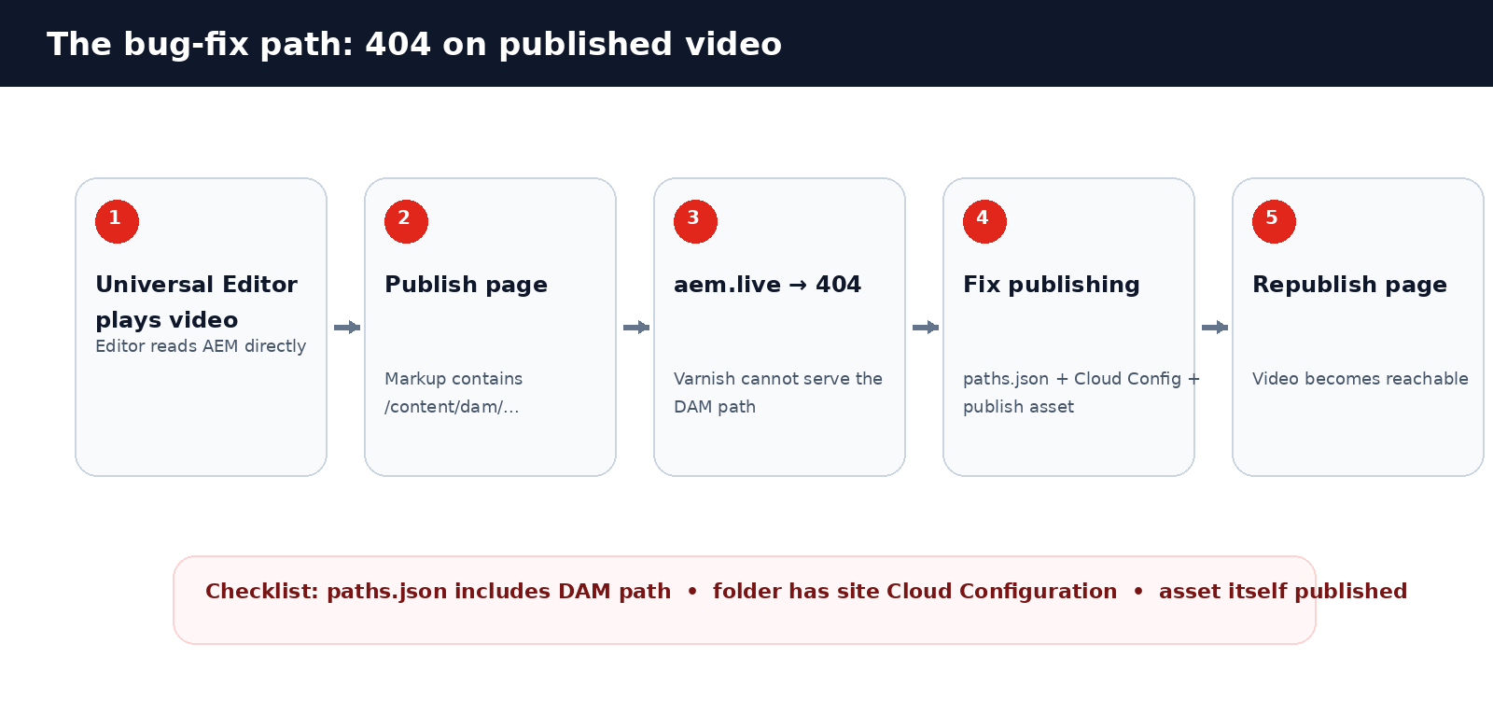
Bug-fix tip: why the video works in UE but 404s on publish
Treat this as a publishing-pipeline problem first, not a block-code bug.
Notes:
[Sources] Source deck: Issues Hit Along the Way — Varnish 404 / publishing pipeline diagnosis. The visual is a generated PNG based on the source content.

Slide 10
Bug-fix tips: use the symptom to choose the layer
A fast diagnostic path for internal teams.
Symptom
Likely root cause
Fix
Block missing from picker
Section filter / wrong component id
Fix models/_section.json → build:json
Video blank after publish
DAM path not servable
Check paths.json + Cloud Config + asset publish
Varnish 404 / Error 54113
Video reference is not auto-rehosted
Make /content/dam/... directly reachable
Large video fails to serve
Missing compliant rendition
Apply edge-delivery-services-mp4 processing profile
Private DAM video still 404
Technical account lacks read access
Verify Cloud Manager technical account permissions
Notes:
[Sources] Source deck: Issues Hit Along the Way table.

Slide 11
Best practices to carry into other EDS blocks
The same patterns recur across video-player, ai-image, and product-variant work.
Model
Keep fields small. Use block-options classes for booleans.
Runtime
Read reference fields by position and classes via classList.
Browser
Autoplay ⇒ muted + playsInline.
Publish
Page publication and asset publication are separate actions.
Register
A component-id mismatch can hide a block silently.
Debug
Start from the published URL / serving layer before rewriting block code.
Takeaway: a small native block is easy; the publishing contract is where most real-world bugs surface.
Notes:
[Sources] Source deck: Best Practices & Summary.

