Slide 1

Software Libre, economía local y su realización política
Erik Albers
Free Software Foundation Europe
(Fundación de Software Libre de Europa)
mail: eal@fsfe.org / shortnews: @3albers

Slide 2
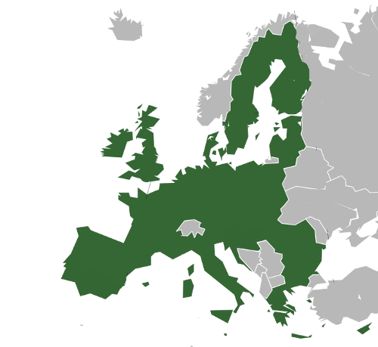
Help individuals & organisations
Legal advice
Lobbying, Public Awareness
Education, Administration

Slide 3

Free Software
Use
Study
Share
Improve

Slide 4

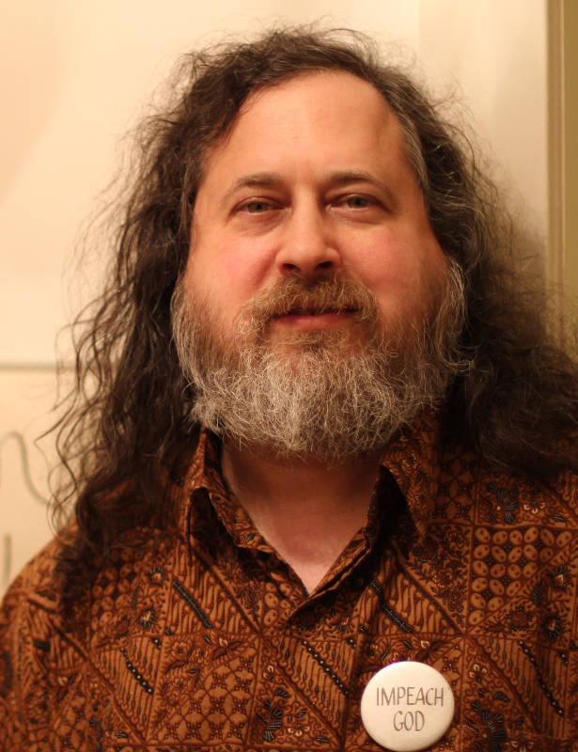
Richard Stallman, Massachusetts Institute of Technology (MIT)

Slide 5
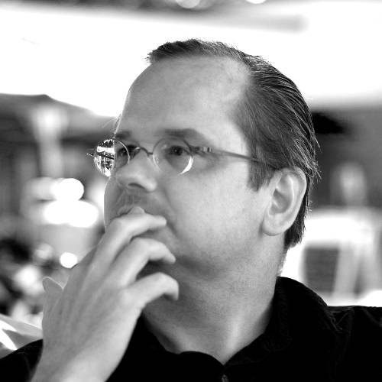
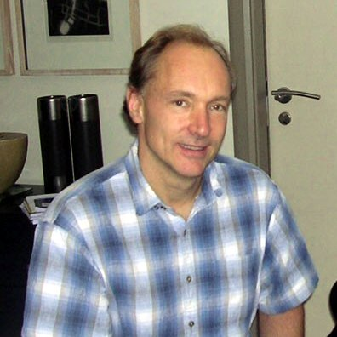
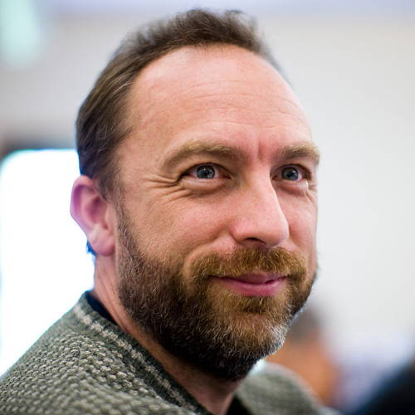
Free Software as background for free culture
Lawrence Lessig
Creative Commons
Tim Berners-Lee
Open Web
Jimmy Wales
Wikipedia

Slide 6
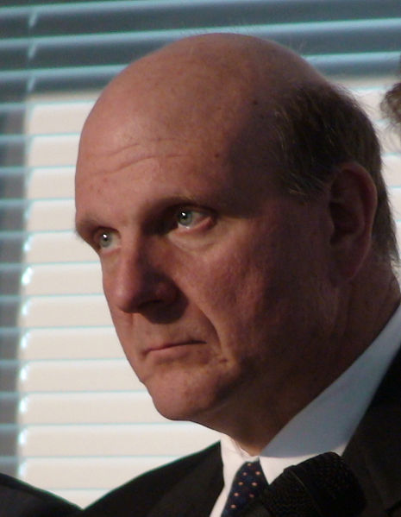
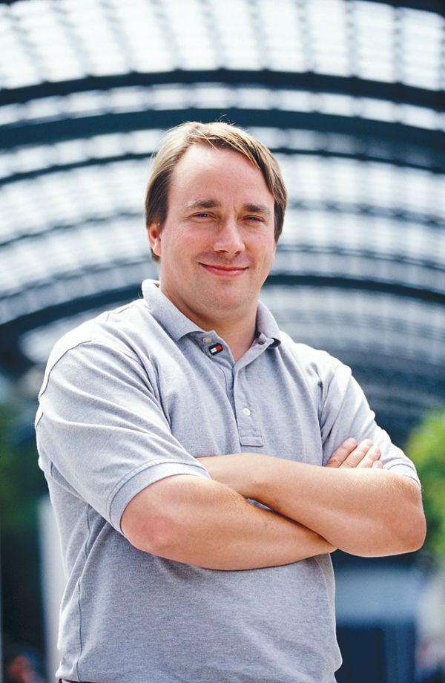
Free Software and economy
“Making Linux GPL'd
was definitely the best
thing I ever did”
“The GPL is a cancer”
vs
Steve Ballmer
Linus Torvald

Slide 7
Knowledge based economy I: closed sources
business fees
proprietary
services
Company
Keeping
Knowledge
Secret
maintenance
licensing
Highly centralised resource, maximising and centralising profits

Slide 8
Knowledge based economy II: free sources
users
volunteers
staff
Free
For
Everyone
3rd party investors
teachers / researchers
service and maintenance
centralized resource, free to fork, decentralized profits

Slide 9
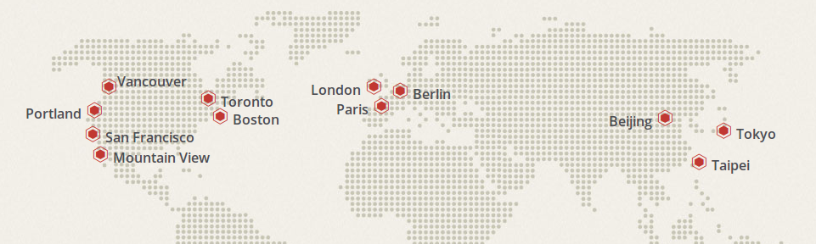
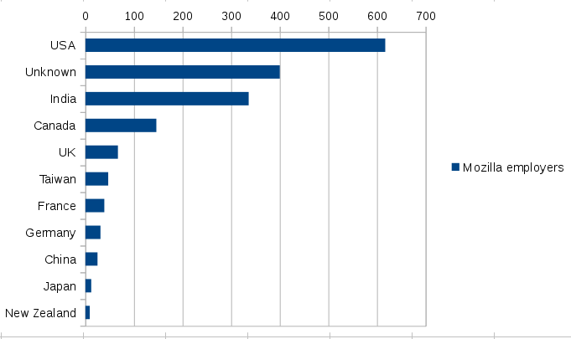
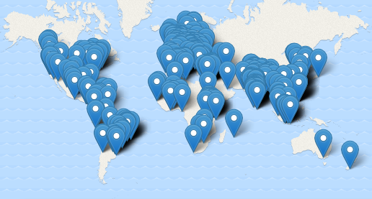
Example: Mozilla
Mozilla offices
Mozilla staff
Mozilla representatives

Slide 10
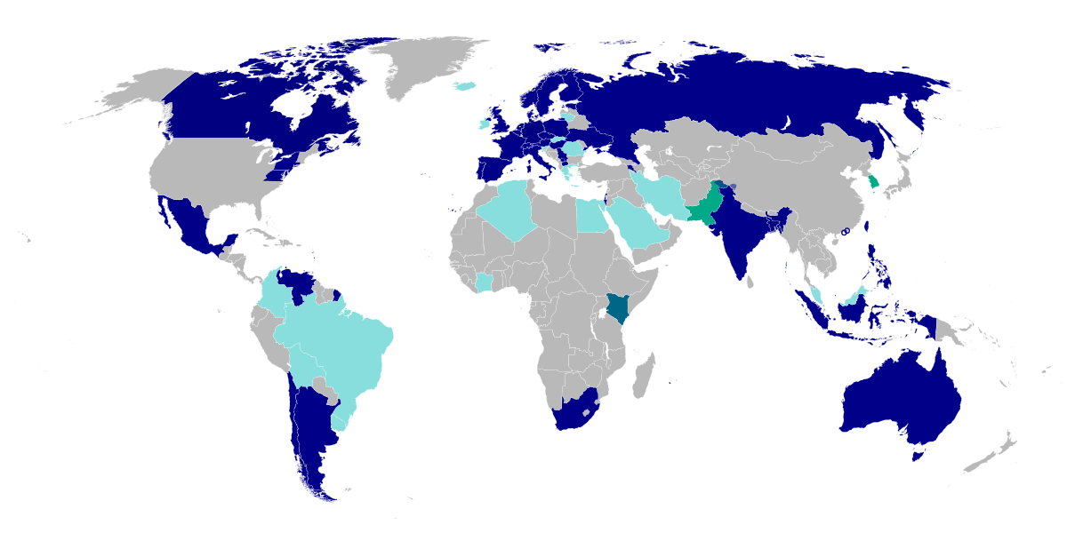
Example: Wikimedia
National chapters of Wikimedia:
Blue – existing / light blue: in progress

Slide 11
More?
Google summer of code
European funding
Funding by various organisations (Shuttleworth Foundation, Digitalcourage ...)

Slide 12
Knowledge based economy III: commons
3rd party business
3rd party services
Free
Software
3rd party maintenance
3rd party software on top of this software
free resources, decentralized economy

Slide 13
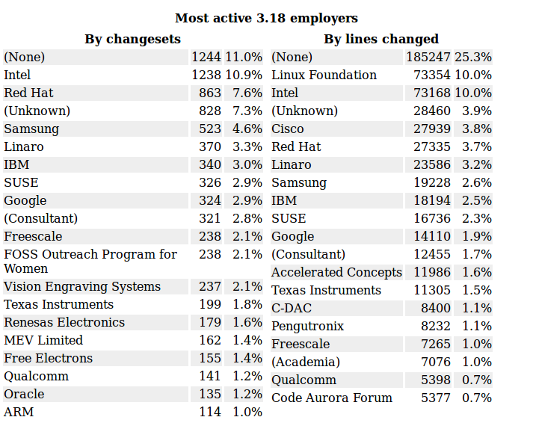
Linux Kernel 3.18 development statistics
Example: Linux Kernel
Source: http://lwn.net/Articles/620827/

Slide 14
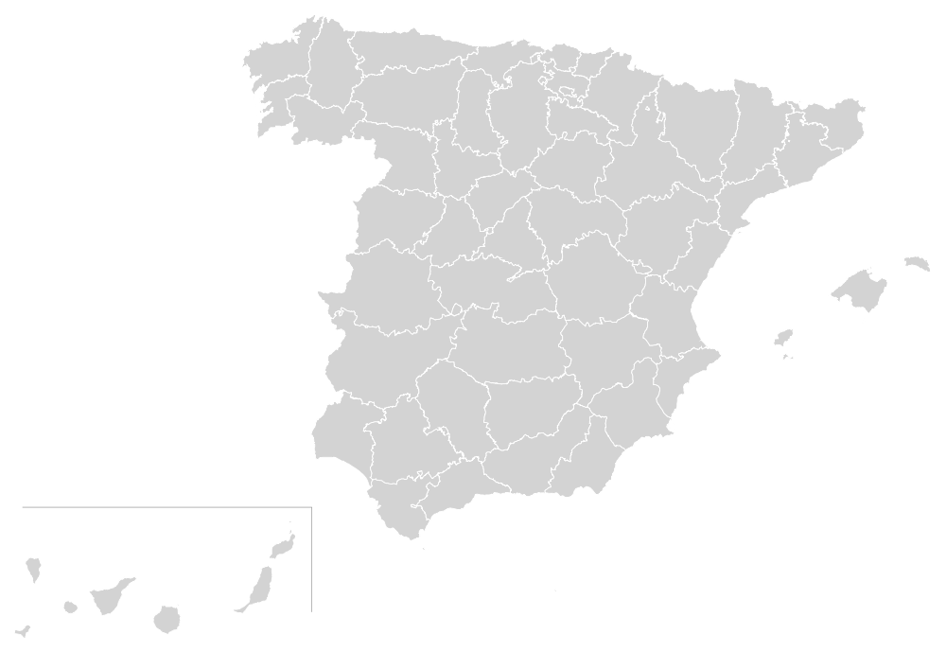
Key player: the state
Huge IT infrastructure
Public money
Autonomy
Spreads the word to the people

Slide 15
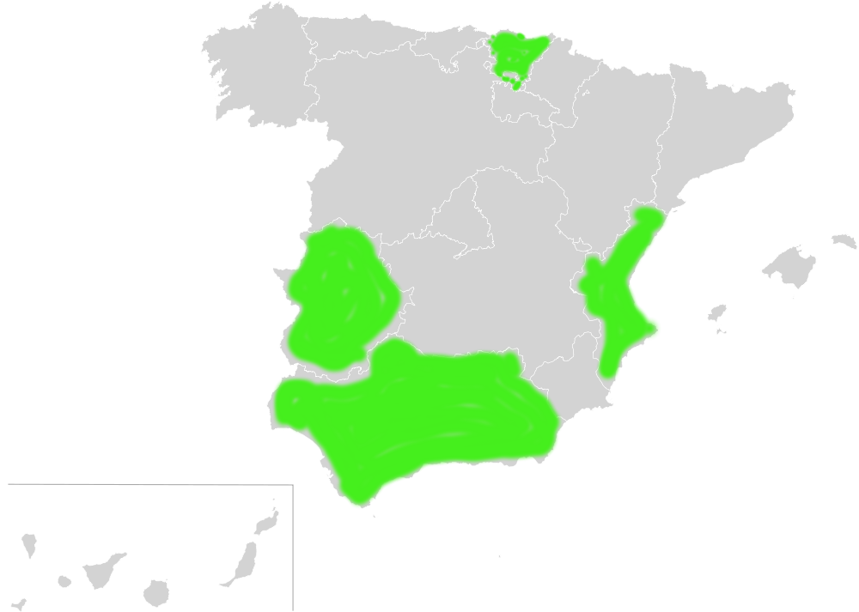
Sinadura - open source eID tool by Zylk
LinEx + Lingobex
(Health sector, School)
Lliurex
(School)
Guadalinex + Guadalinex EDU

Slide 16
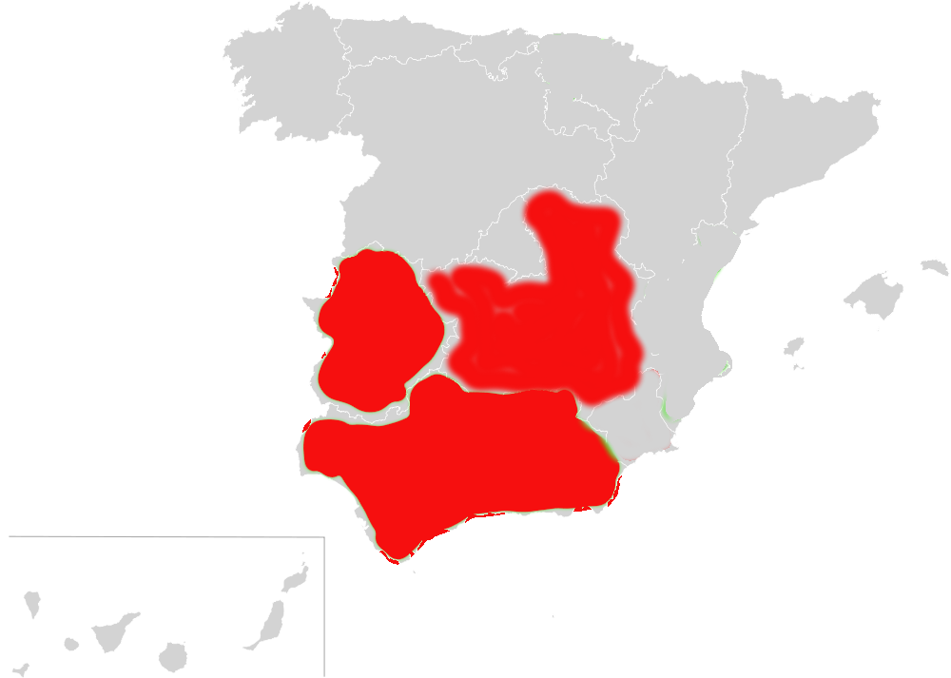
In administration, just 5% GNU/Linux
Stopped
MoLinux
in 2014
paid 12 million Euro license fine
to Microsoft in 2012

Slide 17
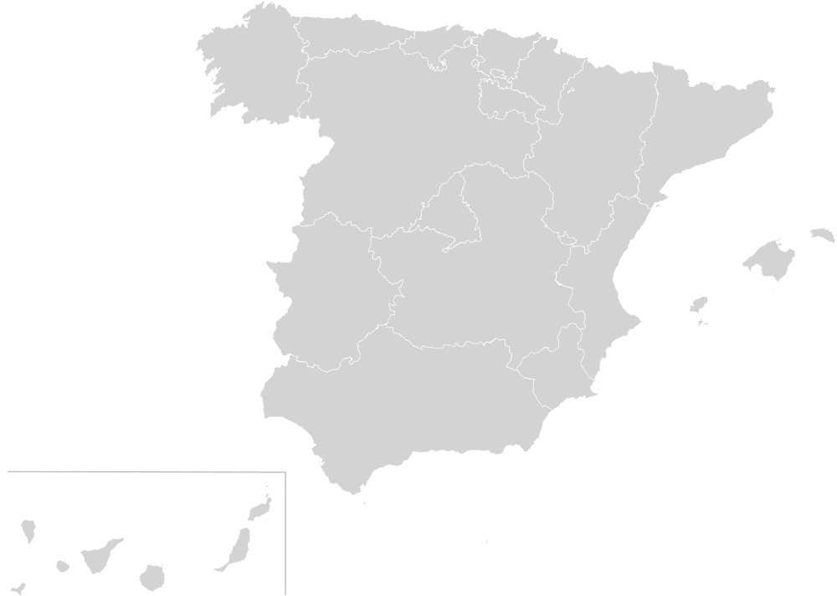
Spain on the big scale
  Server: FOSS installed is only 40%
  Desktop: FOSS installed is only 15%
December 2015: national elections

Slide 18
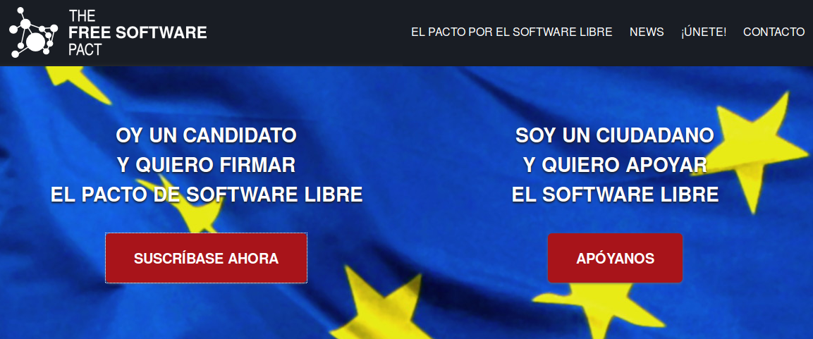

Let's make it a topic for the elections

Slide 19
Freesoftwarepact.eu
Y, por lo tanto, me comprometo a
AIlentar mediante medios institucionales a las administraciones públicas, instituciones públicas y entidades locales a desarrollar y utilizar preferentemente programas de software libre y los estándares abiertos;
Apoyar políticas activas en favor del Software Libre y oponerme a cualquier discriminación en su contra;
Defender los derechos de los autores y usuarios de software libre, principalmente, solicitando la modificación de cualquier disposición legal que menoscabe estos derechos y oponiéndome a cualquier proyecto o proposición orientado a tal fin.

Slide 20
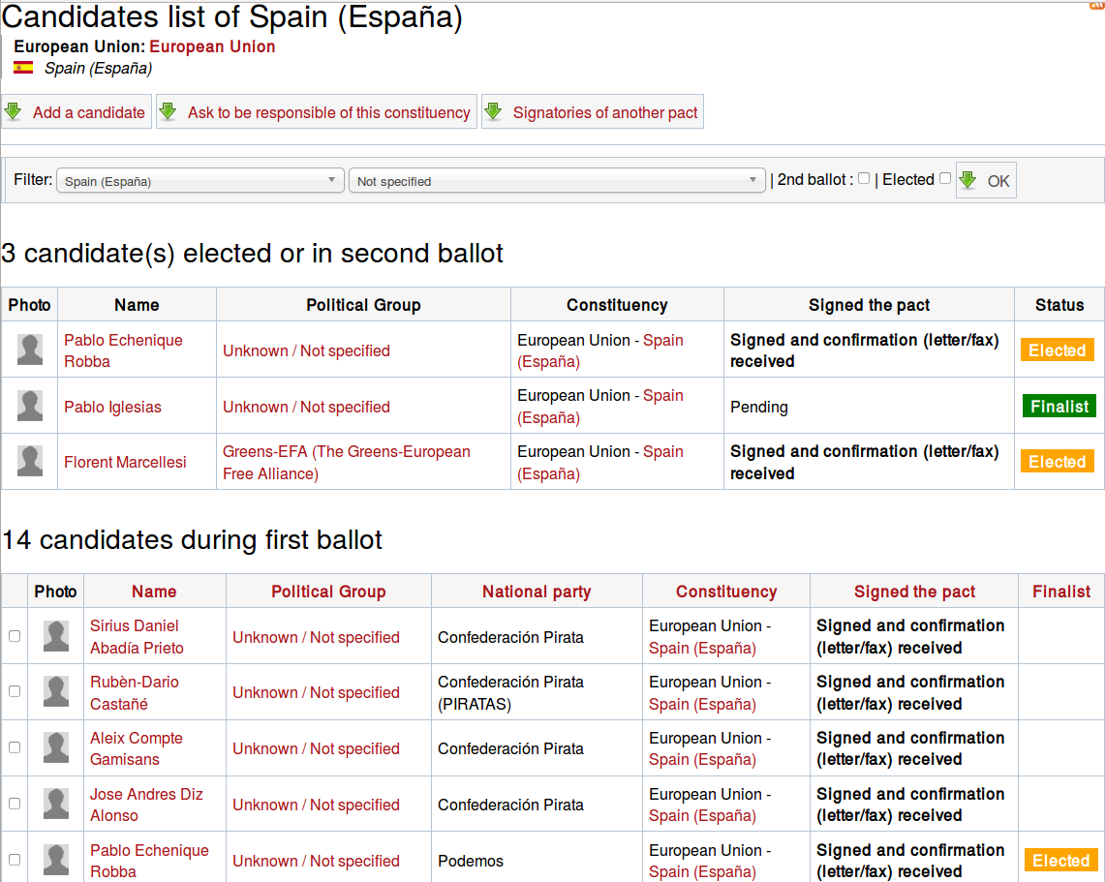
165 signatories

Slide 21
Pacto por el Software Libre 2015
Use, study, share and improve the text
Get help from the FSFE
Bring Free Software into politics: let them know & push the topic
Other options:
  Talk to the public
  Become member of a political party and influence their program
  Act inside your University

Slide 22
Whatever you do
We can support you (PR, knowledge, publicity ...)

Slide 23

A big Thank You to our members and donors for making this possible

Slide 24
Sources, attribution and usage rights
Images
Page 4, left, Richard Stallman: Sam Ogden / Science Photo Library
Page 4, right, Richard Stallman: CC-BY-SA by Blake Livingston
Page 5, Lawrence Lessig CC-BY 2.0 by Joi
Page 5, Tim Berners-Lee: CC-BY-SA 2.5 by Uldis Bojars
Page 5, Jimmy Wales: CC-BY 2.0 by Jo
Page 6, Steve Ballmer: CC-BY 2.0 by Luc Van Braekel
Page 6, Linus Torvald: CC-BY-SA 3.0 by Martin Streicher
Page 9: screenshots: mozilla.org, 2015-05-01
Page 10, wimikedia chapters: Cary Bass, CC0
Page 18 + 20, screenshots: freesoftwarepact.eu, 2015-05-01

Slide 25
Sources
Page 16
Castilla La-Mancha: http://www.eldiario.es/clm/Castilla-Mancha-abandona-MoLinux_0_255124825.html
Extremadura: https://joinup.ec.europa.eu/community/osor/news/extremadura-health-care-has-switched-open-source
Andalucia:
http://www.eldiario.es/clm/Castilla-Mancha-abandona-MoLinux_0_255124825.html
Page 17:
http://observatorio.cenatic.es/images/stories/indicadores/aapp/age/Indicadores_encuesta_ESFA-AGE_2011.ods

