Slide 1


Freedom Boxes:
Communication Emancipation

Slide 2

Good service?
Computing has moved away from the desktop
We used to use software – now we use 'services'
Many operating systems merely web portals
Applications have become site specific web browsers
Desktop environments now written in HTML
Thin clients = thinned freedoms
What? How? Where? Why? We don't know
Keep hoping that they will work tomorrow
Keep hoping that your trust is justified
Who's changing your drip?

Slide 3
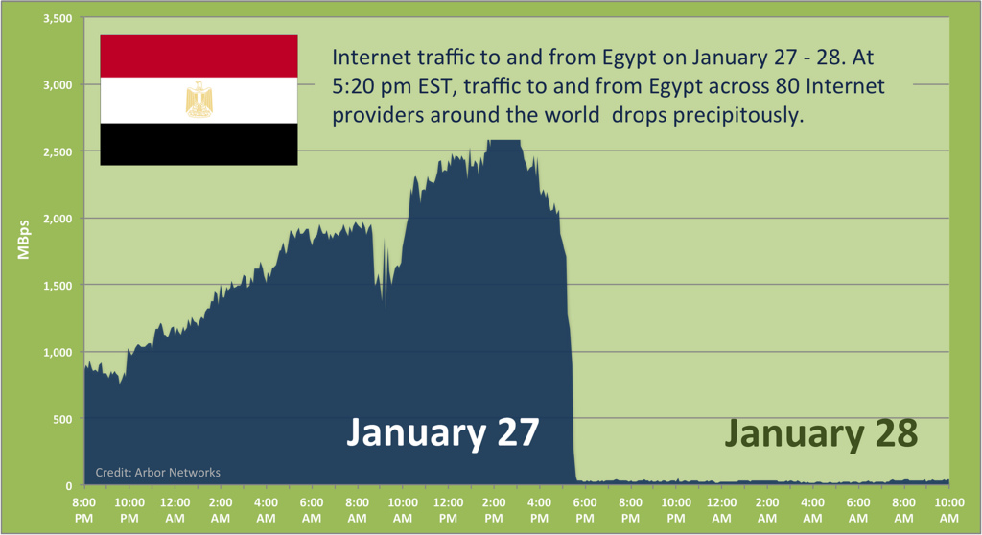
Unstable politics
“Egypt’s largest ISPs shut off their networks Thursday, making it impossible for traffic to get to websites hosted in Egypt or for Egyptians to use e-mail, Twitter or Facebook. The regime of President Hosni Mubarak also ordered the shut down of mobile phone networks, including one run by the U.K.-based Vodafone, all in an attempt to undermine the growing protests over Mubarak’s autocratic rule of the country.”

Slide 4



Unstable politics
“We are working with the police, the intelligence services and industry to look at whether it would be right to stop people communicating via these websites and services when we know they are plotting violence, disorder and criminality." - David Cameron, August 2011
“The security service MI5 and the electronic interception centre GCHQ have been asked by the government to join the hunt for people who organised last week's riots, the Guardian has learned. The agencies, the bulk of whose work normally involves catching terrorists inspired by al-Qaida, are helping the effort to catch people who used social messaging...”
“A US Senate committee has approved a wide-ranging cyber-security bill that some critics have suggested would give the US president the authority to shut down parts of the Internet during a cyber attack...the bill puts limits on the powers the president already has to cause "the closing of any facility or stations for wire communication" in a time of war”

Slide 5

Untrustworthy companies
Facebook provides:
User ID number
Email address
Date and Time of your account’s creation
The most recent logins (last 2-3 days)
Your phone number, if you registered it
Profile contact info
Mini-feed
Status update history
Shares
Notes
Wall posts
Friends list
Groups list
Future and past events
Videos
Photos
Private messages
IP address logs

Slide 6

Untrustworthy companies
Gmail:
lack of disclosed data retention and correlation policies
Google combines information contained in a person's e-mail messages with information from Internet searches.
Google has not confirmed how long such information is kept or how it can be used.
More than 30 privacy and civil liberties organizations have urged Google to suspend Gmail service until these issues are resolved.
Twitter
Collects personally identifiable information about its users and shares it with third parties.
Reserves the right to sell off information as an asset
Numerous security vulnerabilities: use SMS spoofing to post messages (2007), high profile accounts compromised by dictionary attacks (2009), users forced to follow hundreds malicious accounts without consent or knowledge (2010), prosecuted by Federal Trade Commission for these and other breaches
Subpoenaed by US Department of Justice to hand over all WikiLeaks related accounts data

Slide 7
Freedom in a box
Vision presented in 2006 German masters thesis for Media Design at the Bauhaus Universität Weimar
Outlined political and social implications
Placed peer-to-peer networking systems as central requirement
“a device that gives people the ability to communicate using free networks...and includes ease of operation and experimental non-hierarchical and stable structures...”
“the unifying vision of free of charge wireless networks...the democratization of communications media, the promotion of local social structures...license-free community radio, the transmission of local events, private goods exchanges and...a strengthening of local, civic and private community structures...”

Slide 8
The tripartite challenge
For decentralised citizen owned communications:
Hardware to provide 24hr availability
Networking to allow remote access to the hardware
Software to allow the user to interact with the hardware over the network
Dropbox:
Hardware = Amazon S3 datacentres (Ireland, California, Singapore)
Network = Traditional ISP based internet connection (via Sky, Virgin Media, TalkTalk etc.)
Software = proprietary Dropbox clients
FreedomBox
Hardware = Mini plug computer in your lounge
Network = Local mesh network / community run regional wifi
Software = eg. Owncloud

Slide 9
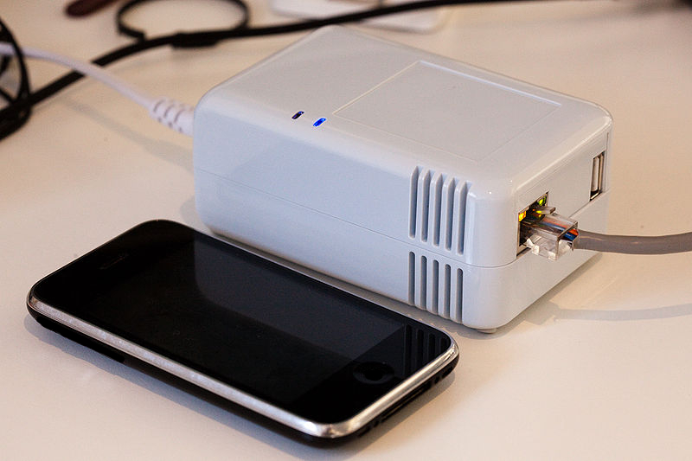
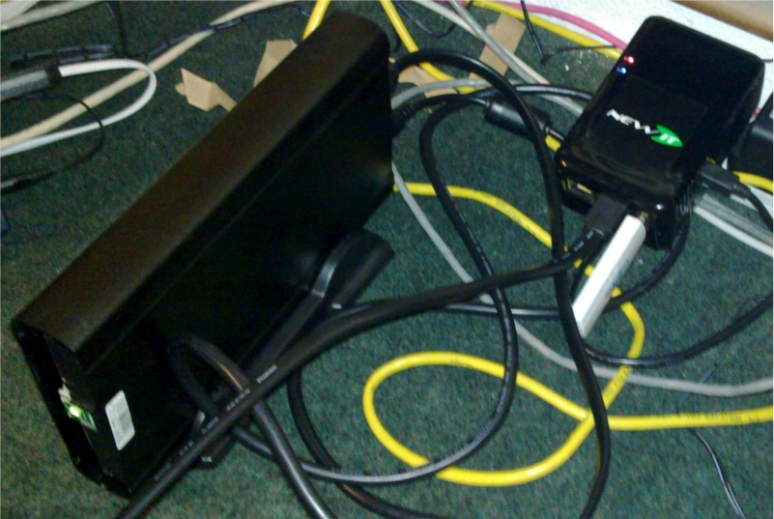
Freedom hardware
Cheap (~100 EUR)
Energy efficient
ARM based – runs Debian

Slide 10
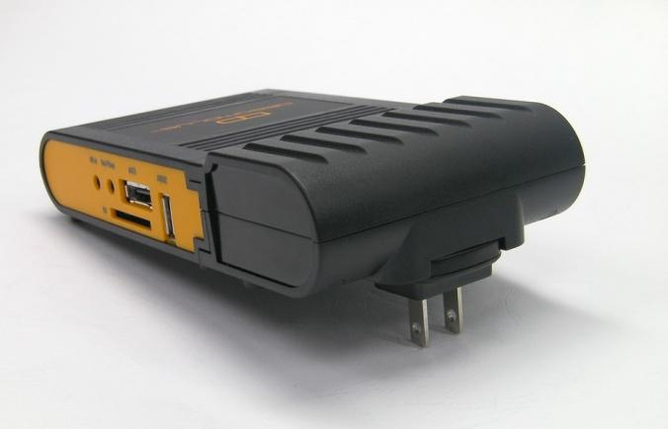
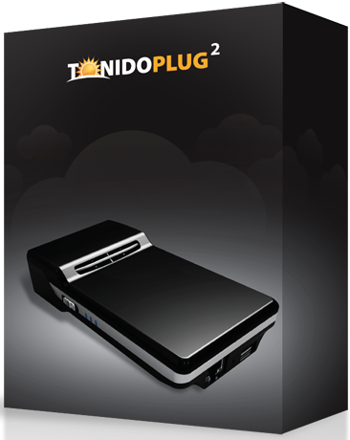
Freedom hardware
Dreamplug
Tonidoplug

Slide 11

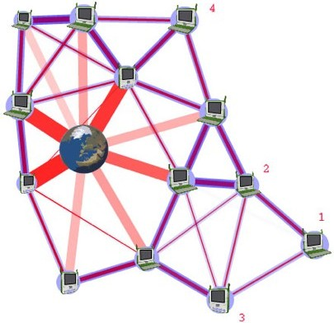
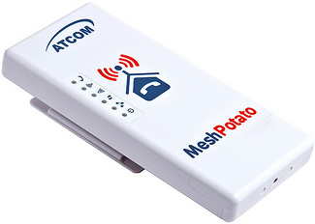
Freedom network
Emerging technologies
IEEE 802.11s – allows interconnecting devices to create a WLAN mesh network, which may be used for static topologies and ad-hoc networks.
Software / hardware currently unavailable for plug computing platforms

Slide 12
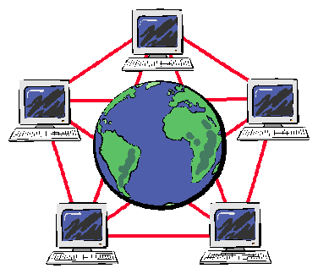
Freedom software
Wealth of Free Software available for hosting services:
  Appleseed
  Yacy
  Diaspora
  Kolab
  Status.net
  Horde
  XMPP
  Tahoe
  Yacy
  Ampache
  Seeks
  Sparkleshare
My Dad has never heard of httpd.conf, or even apache
Interface required to bring it all together
Owncloud? Webmin? The Freedombox Foundation?

Slide 13


Just a good idea?
Can I buy one?
Can I use it?
Can my grandma / nephew / chinchilla use it?
Is there demand for it?
Is there profit in it?
Am I even allowed to use it?
Can I run my own global search engine on it?
(research your ISP)

Slide 14
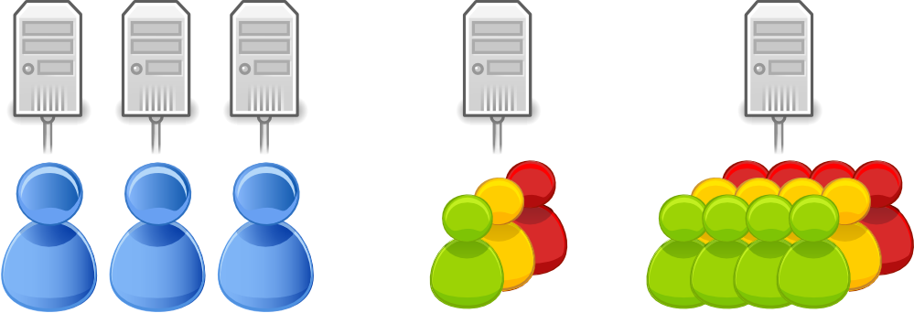
Delegating freedom
Users can delegate administration
FriPost in Sweden running similar cooperative
Business / trust models in development

Slide 15

Recovering control
The 'cloud' is great – so run your own
Get your web services from someone you trust – yourself
Always be your server's top priority
Protect your freedom of speech
Encrypt your data
Personalise your services
Run cutting edge software
Provide services for friends

