Slide 1
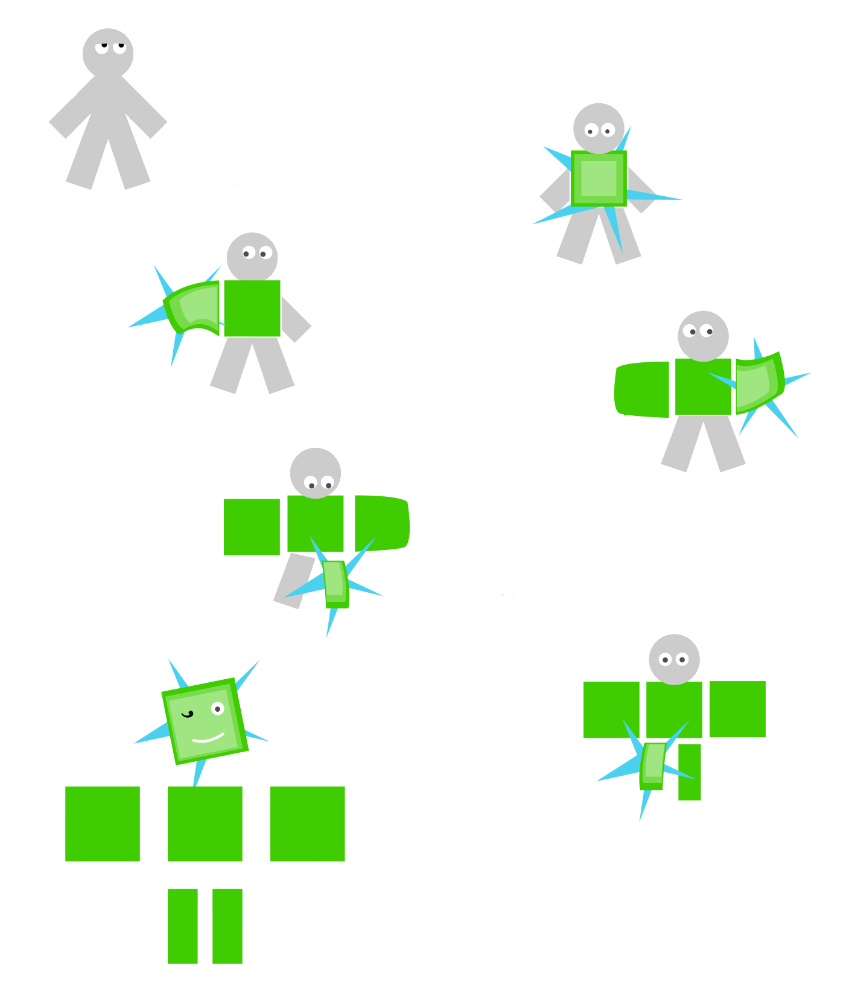
Why do we / I engage as a Fellow?
Notes:
Text text text

Slide 3
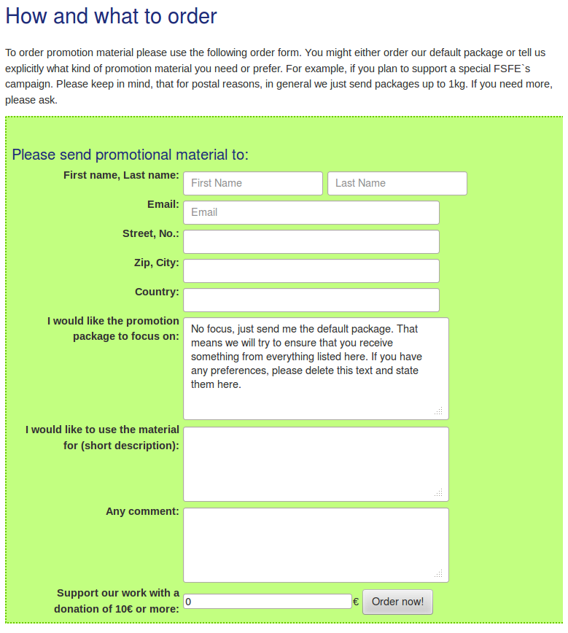
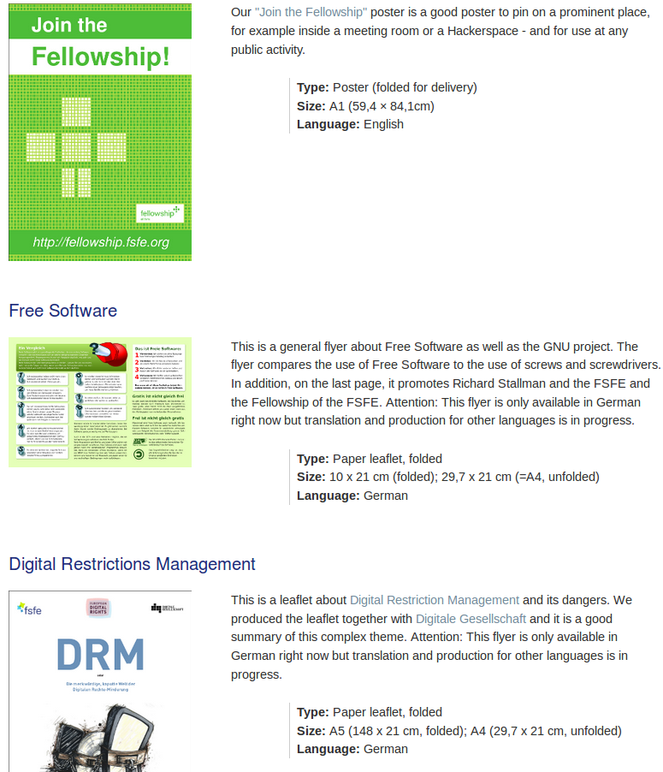
Spread the word with promotion material
https://fsfe.org/contribute/spreadtheword.en.html

Slide 4
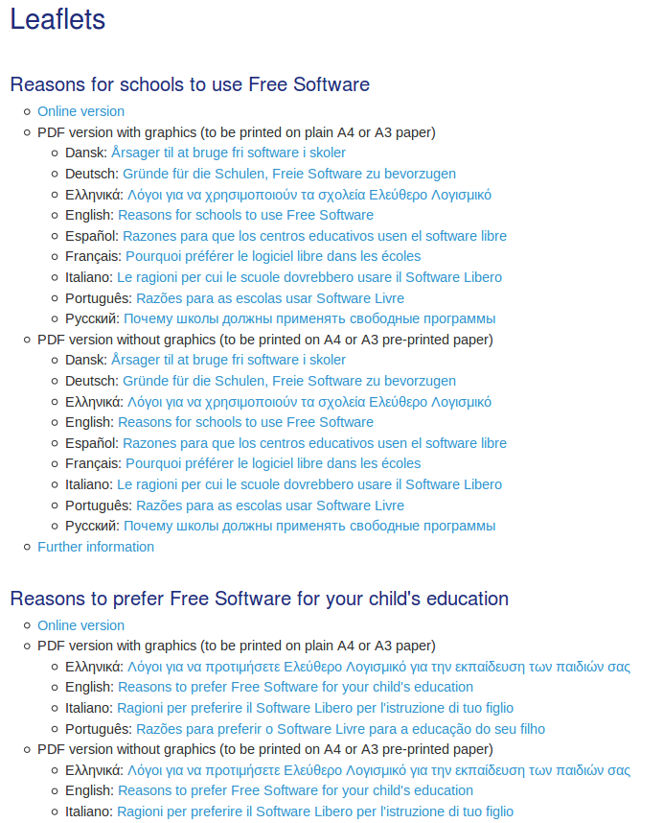
DIY: Create / Print your own leaflet
https://fsfe.org/about/printable/index.en.html

Slide 5
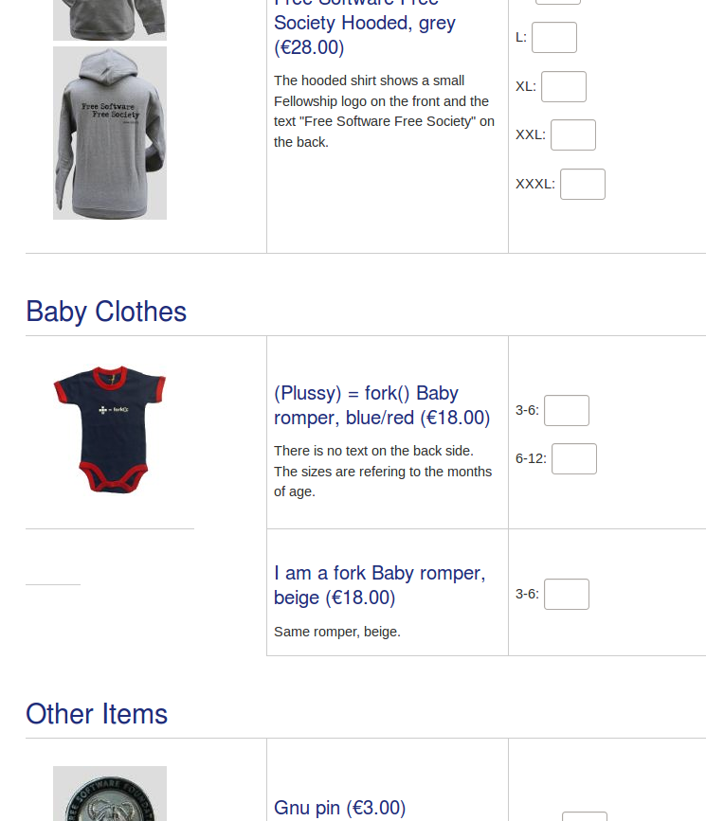
Spread / sell merchandise
https://fsfe.org/order/order.en.html

Slide 6
Cooperation and Communication
Let us establish ONE SINGLE list for communication among FS-coordinators
coordinators@lists.fsfe.org
- easy way of sharing knowledge and getting help
- good platform for collaboration
- good way of participation
- best way to multiply messages

Slide 7
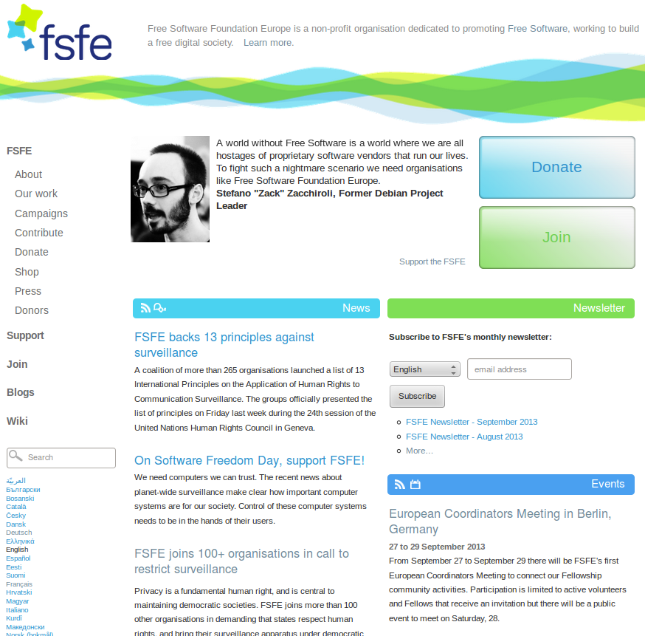
FSFE Event Announcements

Slide 8
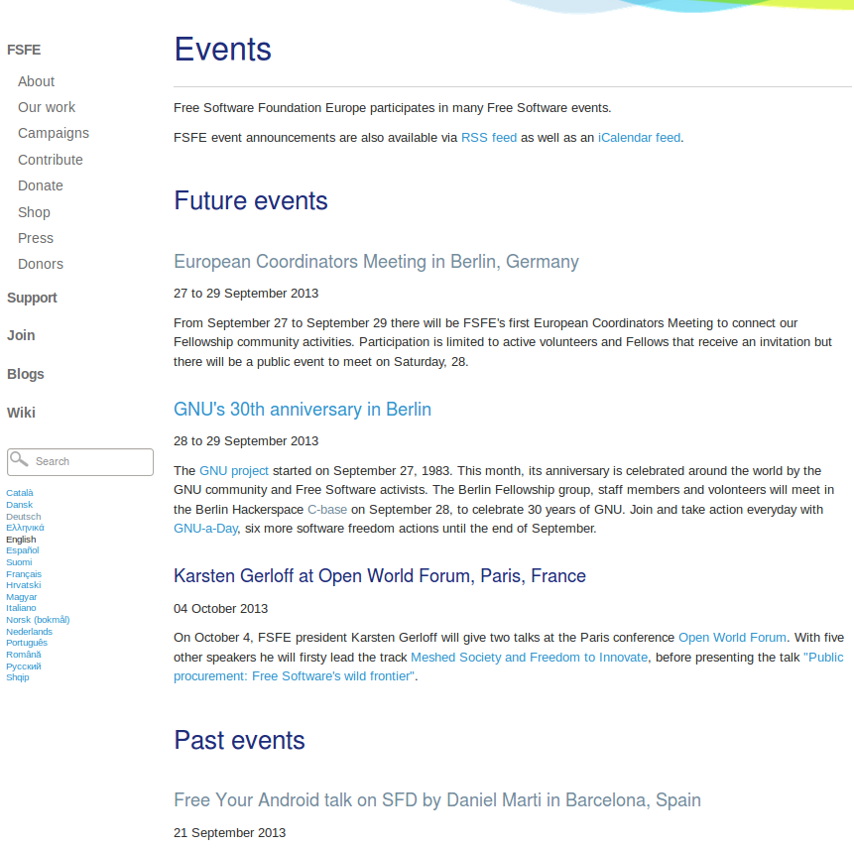
FSFE Event Announcements
public awareness (press and other people look on our page)
RSS feed and iCalender feed
you have something to link to if you spread the message in mailing lists or anywhere else

Slide 9
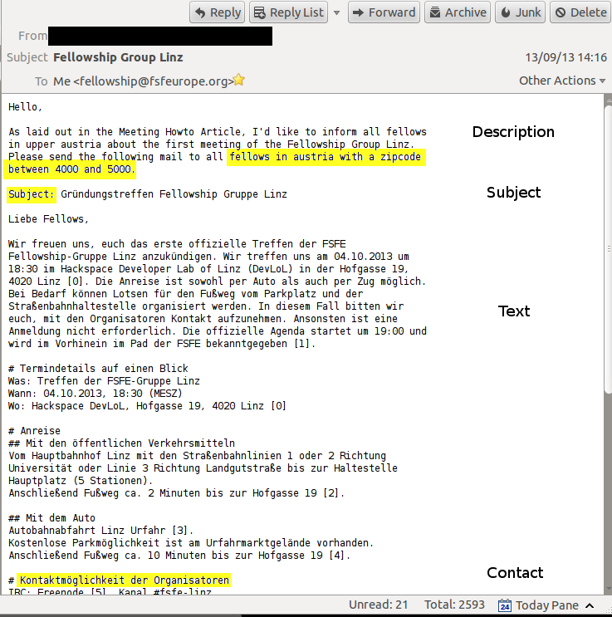
How to contact other Fellows?

Slide 10
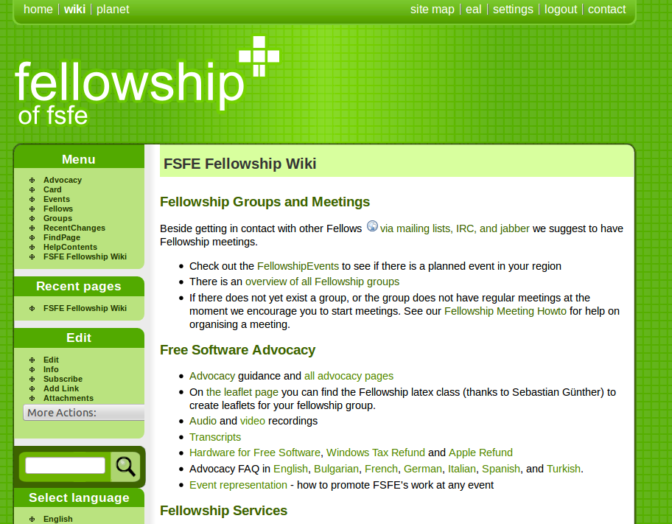
https://wiki.fsfe.org

Slide 11
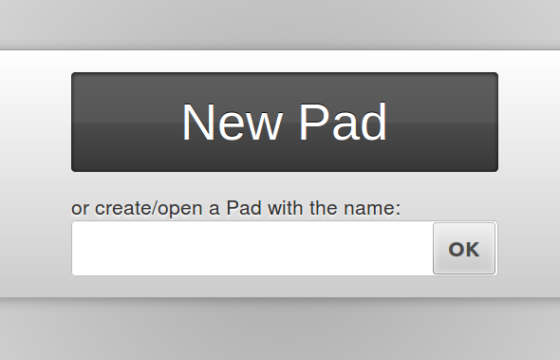
https://public.pad.fsfe.org/

Slide 12
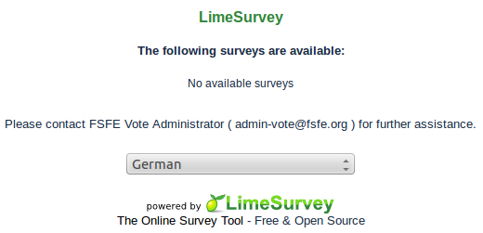
https://vote.fsfe.org

Slide 13
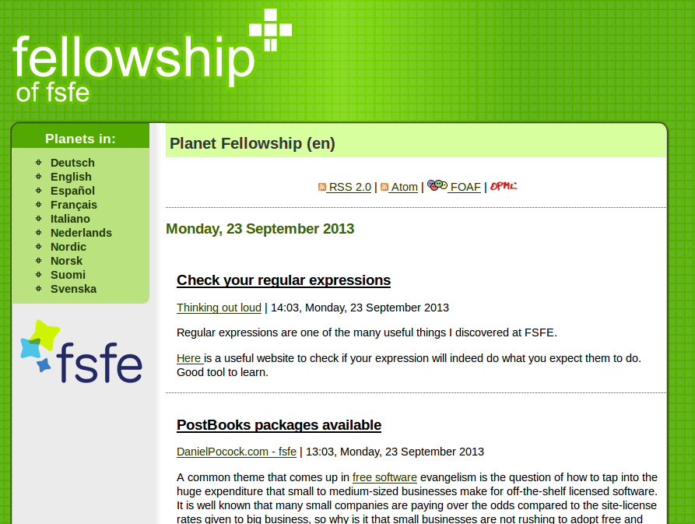
http://planet.fsfe.org/

Slide 14
The newsletter

Slide 15
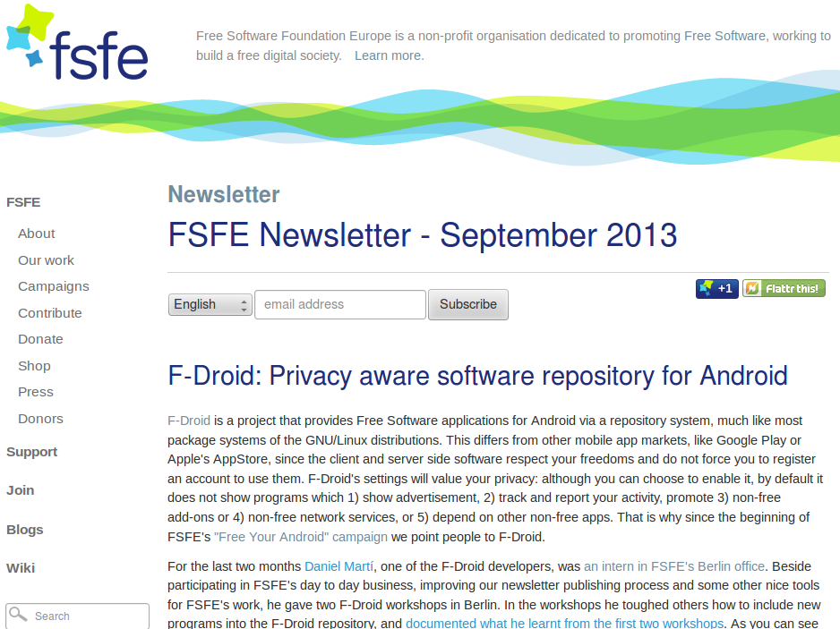
The newsletter
Different parts:
Content of FSFE
Something completely different
From the planet aggregation
“Get active”
Read it! Spread it!

Slide 16
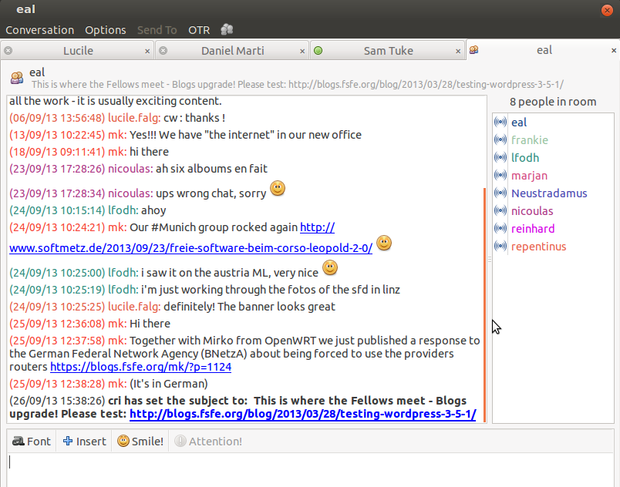
Room: fellowship
Server: conference.jabber.fsfe.org

Slide 17
To sum up:
There is plenty of infrastructure for you to use:
chatting, blogging, planet, wiki, events, lime survey, promotion delivery, etherpad, mail-forward to all fellows, coordinators-list for collaboration ...
Please do so!
And don't forget that you can contact us at every time.
We are here to help you!

Slide 18
Please never hesitate to contact us to ask for:
- advise (in organisation, press contact, public awareness...)
- funding of Fellowship activities (there are funds!)
- official statements of FSFE (signed by the president …)
- a good contact to an expert
- help on background information, wording of letters …
In general and once again: we are here to help you!

Slide 20
Sharing experience about Fellowship
What are the difficulties you see (for your group)?
what do you like the fellowship to be like?
What do you expect from the Fellowship or the FSFE?
How do you manage your groups?
How do you coordinate/collaborate/participate?
Do you have some useful tips of DO's and DON'Ts ?

Slide 22
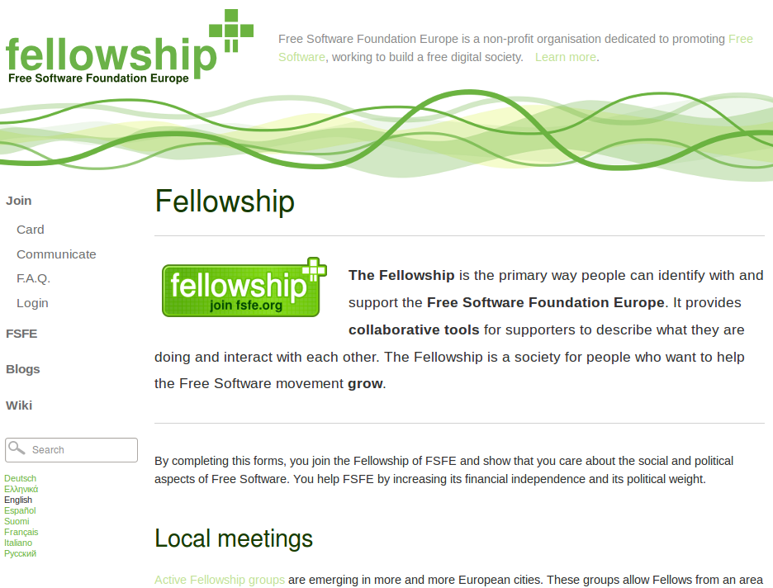
New Fellowship pages

Slide 23
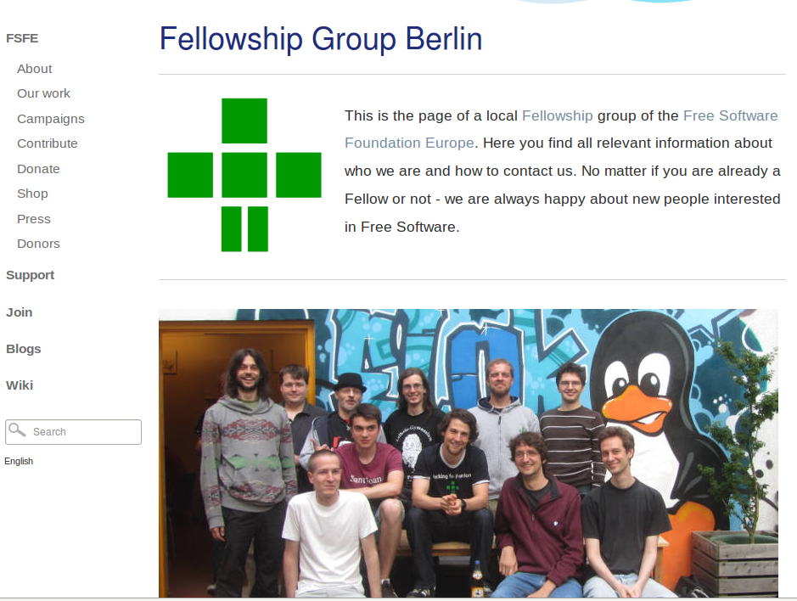
Fellowship group profiles
Notes:
Explain that every group should set up a profile
How this is good for internal as well as external perception
Explain what will happen here with events, latest blog post, interviews

Slide 24
City planet
Notes:
Explain that there will be a category by city, not only language
Explain that there will also be an rss feed implemented to show the blog entries on the group-profile-pages

Slide 25
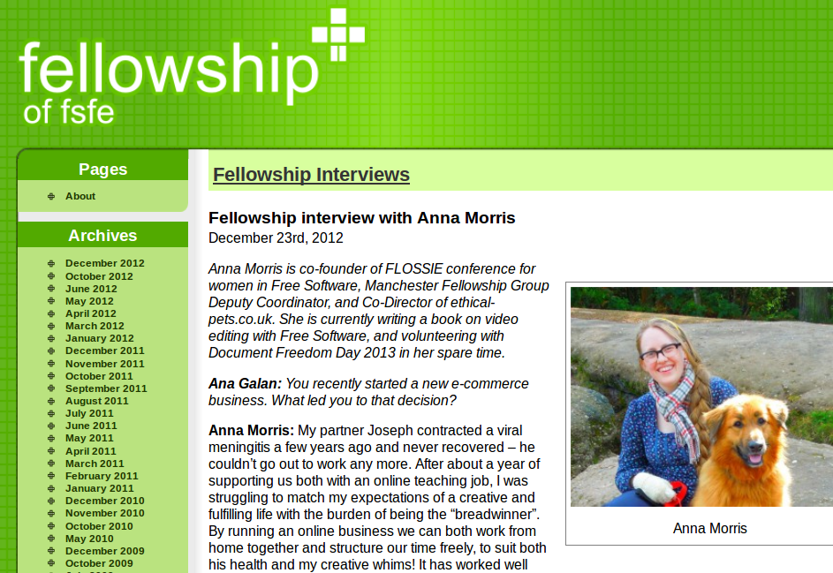
https://blogs.fsfe.org/fellowship-interviews/
Notes:
Explain the Fellowship interviews
That we would like to establish this again, every 2nd month
That Fellowshp interview will be available from the group pages

Slide 26
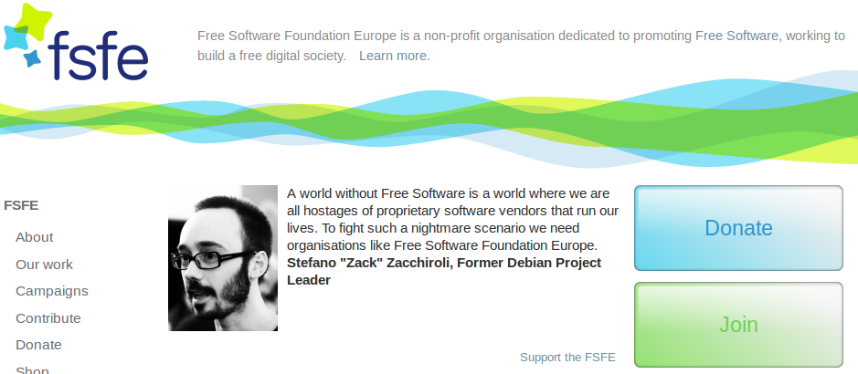

Fellowship quotes

Slide 28

FreeYourAndroid - Campaign
Set up a portal for information and cooperation
Spread software freedom on mobile devices – users,
developers, manufacturers
Spread Free Software on
mobilie devices - workshops
Notes:
Insert some slides from FYA
Explain the concept in short (google, root access, …)
Show picture from the workshop-page
Explain concept of the wokshops (organisation)
Then tell about the disadvantages of these workshops
Explain that we try another model: help by helping hands from outside, bring together people

Slide 29


Not every Android is same
Google Android
Free Android

Slide 30



Free Alternatives

Slide 31







F-Droid

Slide 32
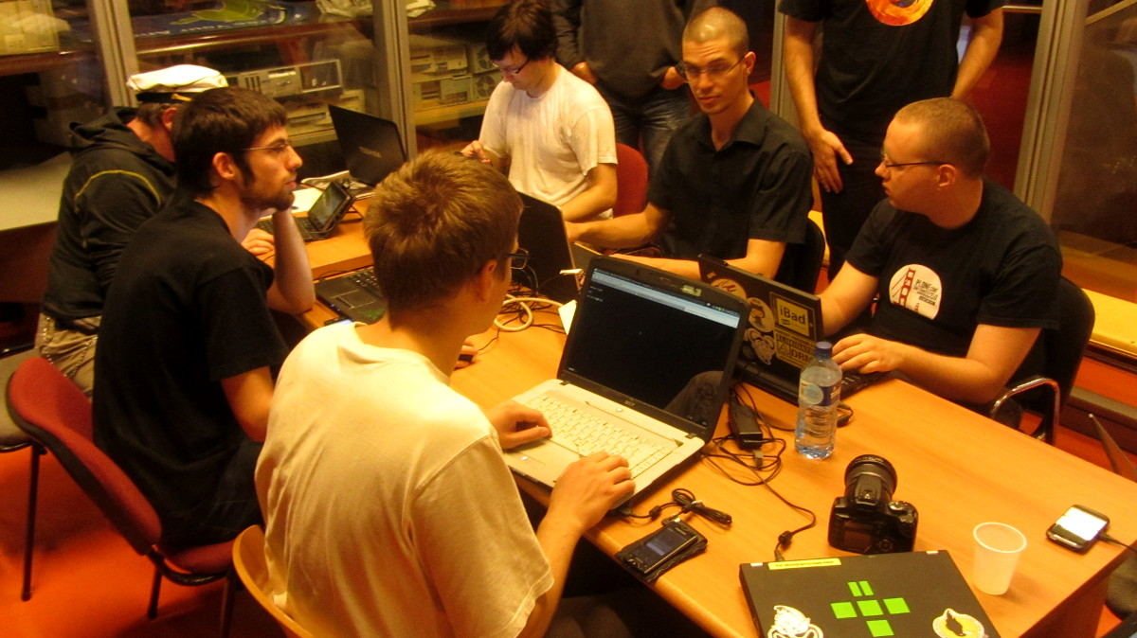
Phone Liberation Workshops

Slide 34

Fellowship project:
European Free Software Summer School

Slide 35
Fellowship project:
European Free Software Summer School
Prerequisites
young people from at least 2 countries
every participating country needs a “promoter”, that means we need a collaborating organisation in these countries
To be accepted, our topics should be around “participation, society, digital rights [...]”
one topic must be cultural exchange/experience

Slide 36
Fellowship project:
European Free Software Summer School
Pros:
Funding by the EU: 70% of travel costs + day rates
deepen contact with partner organisation
getting media attention
Getting funding once, it is easy to get it every year.
Cons:
applying for & organising cost a lot of work-time
no full-funding from EU, that means FSFE (and partner organisations) have to cover the rest of the costs

Slide 38
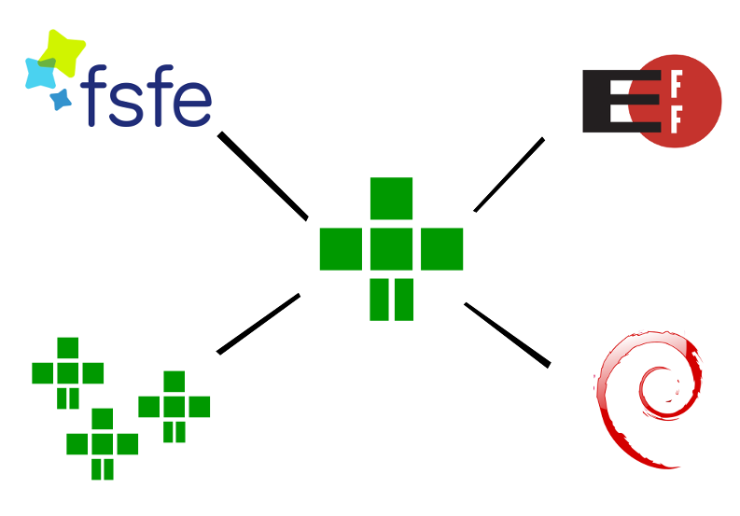
Discussion: How to better connect?

Slide 39
2014
The most important goals to achieve for the next year for your Fellowship group?
what did I learn what will I tell / spread to my FS group at home??
what do I like to achive with my Fellowship group?
what else do I need to achieve this?
[ … ]

Slide 41
Time for Feedback

