Slide 1

AN OVERVIEW ON HEALTH CHECK PATTERNS

Slide 2
AN OVERVIEW ON HEALTH CHECK PATTERNS

Slide 3



FAIL!

Slide 4
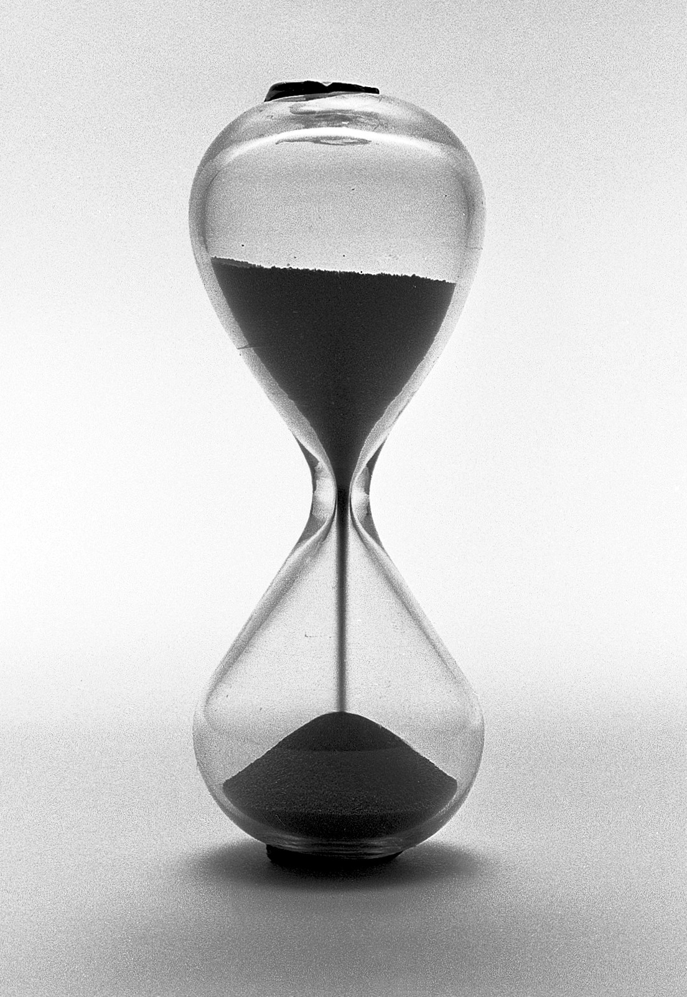
1
1
reliability
0.5
0.5
0
0
time

