Slide 1
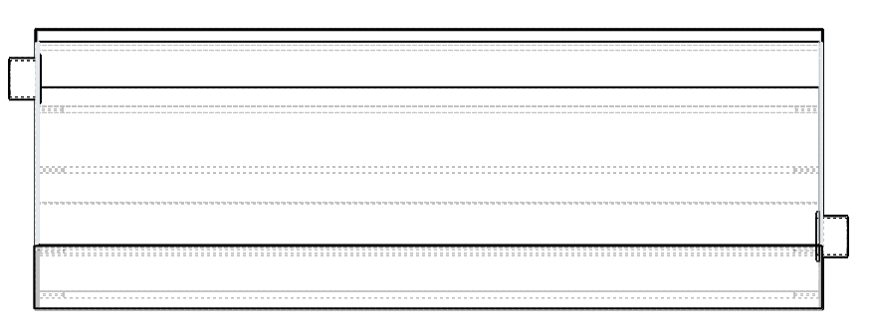
Measurements:
Air flow rate
Air flow temperature
Air flow relative humidity
FRONT VIEW
FAN
OUTLET
INLET
Measurements:
Air flow temperature
Air flow relative humidity
Pressure meter
ΔP = P_{outlet} - P_{inlet}

Slide 2
Material and Instruments for 1 collector
Component | Dimension |  | Instrument | Quantity | Range
Reflector Sheet | 1.32m x 1.25m |  | Air Flow Meter | 1 | 0 - 20 m/s or 0 - 120 ft³/min
Tempered, Low-e Glass | 270mm x 1246mm x 4 mm |  | Fan/Blower | 1 | 10 W
Wool | 1.32m x 1.25m x 5cm |  | Pressure Meter | 1 | 0 - 100 Pa or 0 - 10 mmHg
Aluminium Sheet | 1.5m x 1.3m x 1.5mm |  | Humidity Meter | 2 | 0 - 100% RH
2 Pipe Connection w/ flange | 10 cm long; 2.5 in of inner diameter |  | Thermocouple | 14 | 0 - 200 ºC
Type of experiments w/ control system:
1. Set-point of air flow rate;
2. Set-point of outlet air temperature by manipulating air flow;
3. Set-point of energy delivered by manipulating air flow.

Slide 4
l
Absorber
surface
Absorber
hole
d_{H}

Slide 5
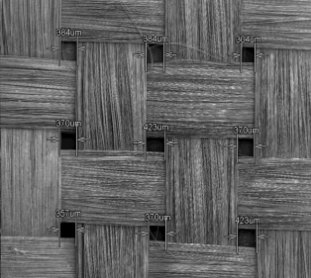
Absorber
hole
l
φ_{h}
Absorber surface

Slide 6
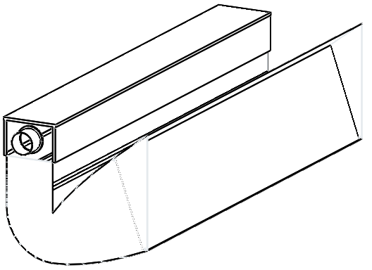
y-axis (vertical)
Solar ray
xz plane (top view)
xy plane (cross section view)
z-axis
y-axis (vertical)
Solar ray
α_{s}
z-axis
Solar ray
γ_{s}
γ_{s}
α_{s}
x-axis (south)
x-axis (south)
x-axis (south)
y-axis
z-axis
x-axis

Slide 7
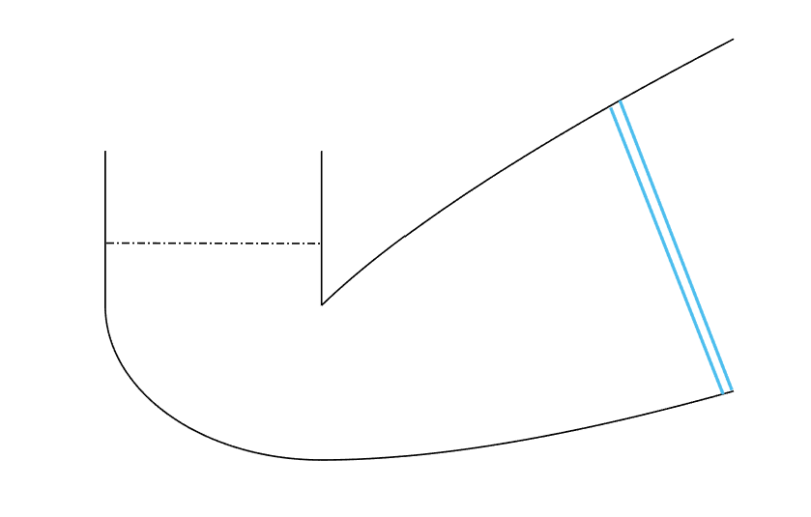
SOLAR
RADIATION
USEFUL
HEAT
CONVECTION
LOSS
Absorber
RADIATION
LOSS
SOLAR
RADIATION
CONVECTION
LOSS
Glazing
RADIATION
LOSS

Slide 8
RADIAÇÃO
SOLAR
CALOR
ÚTIL
PERDAS
CONVECTIVAS
Absorvedor
PERDAS
RADIATIVAS
RADIAÇÃO
SOLAR
ABSORVIDA
PERDAS
CONVECTIVAS
Vidro
PERDAS
RADIATIVAS

Slide 9
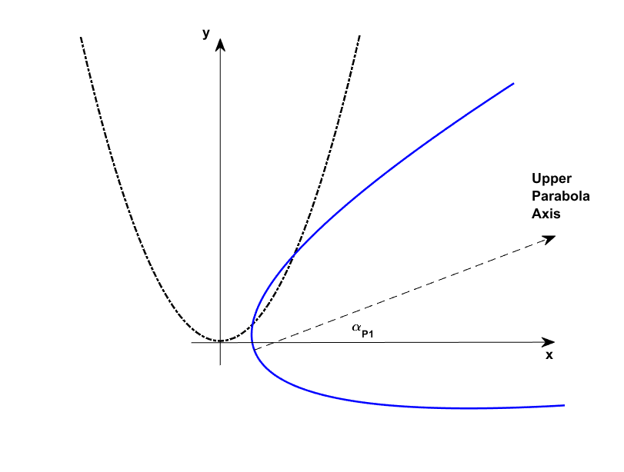

Slide 10
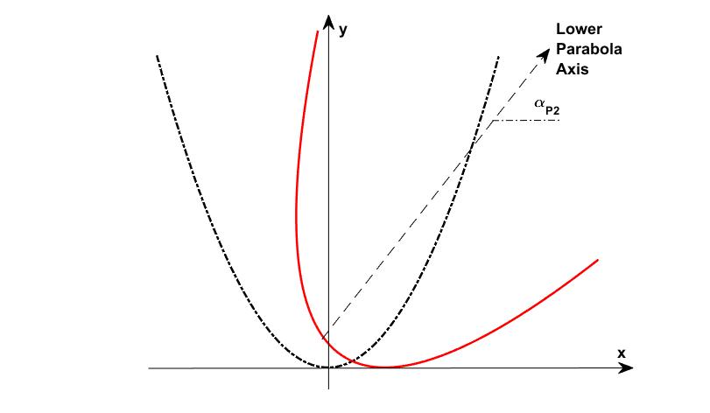

Slide 11
(a)
(b)

Slide 12
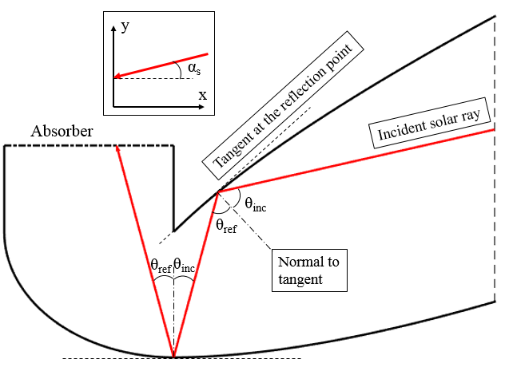
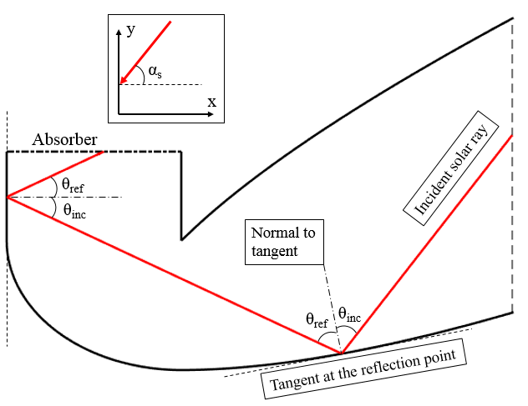

Slide 13
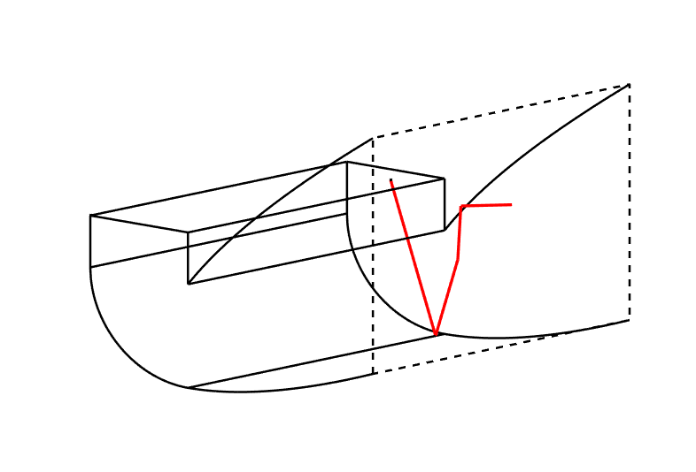
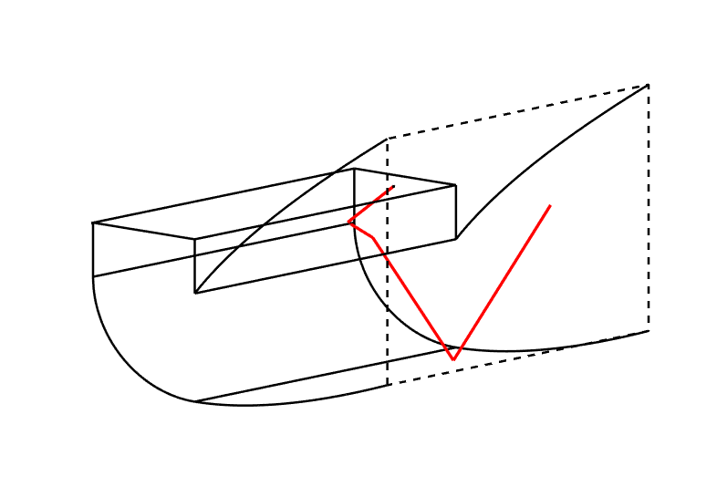
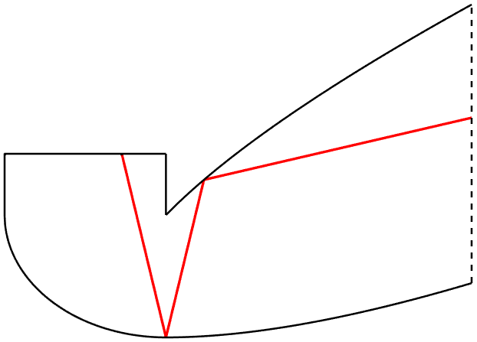
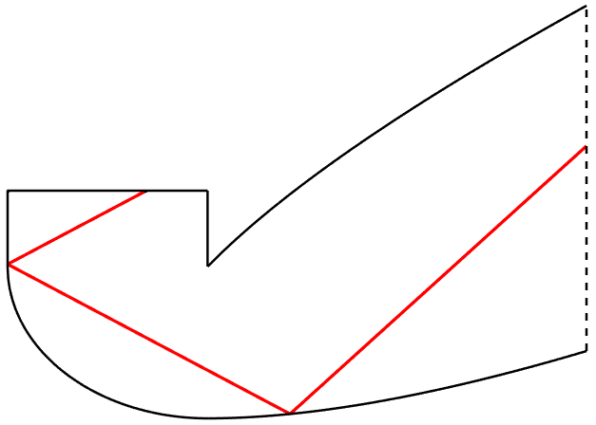
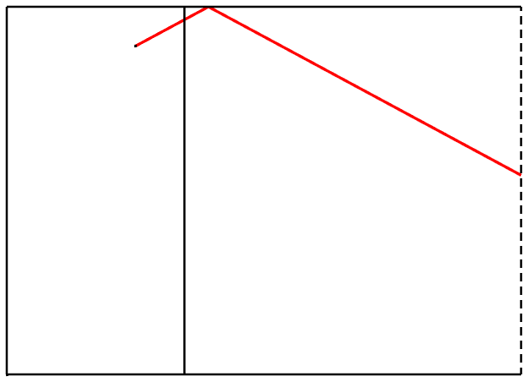
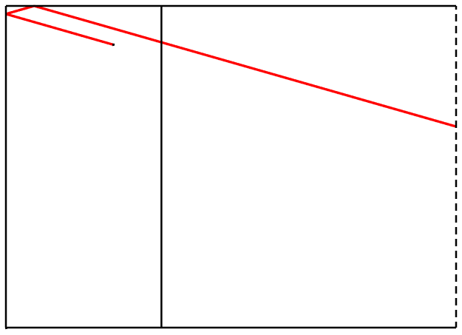
(a)
(d)
(b)
(e)
(c)
(f)

Slide 14
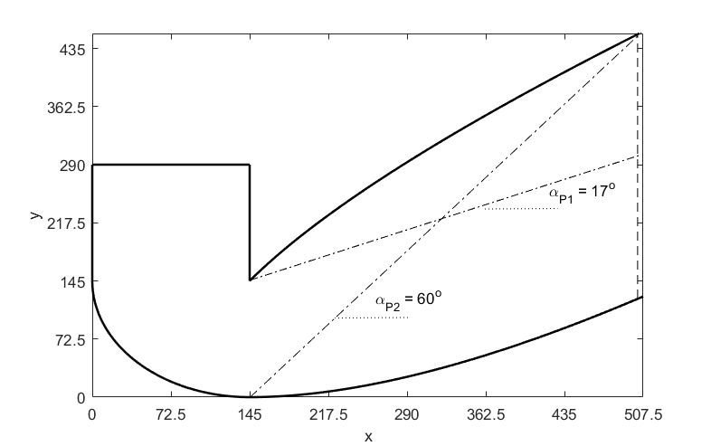

Slide 15
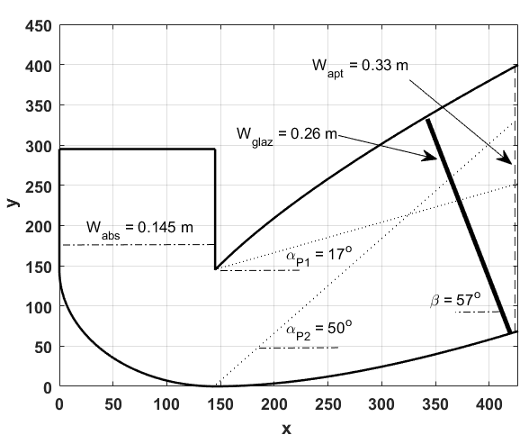

Slide 16
POWERSUPPLY
FAN
PROTOTYPE
OUTLET
INLET

Slide 17
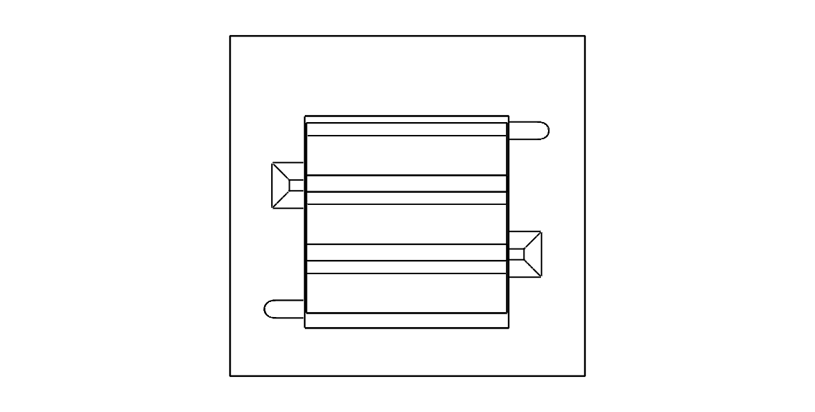
outlet
IACPC 3
IACPC 2
IACPC 1
inlet

Slide 18
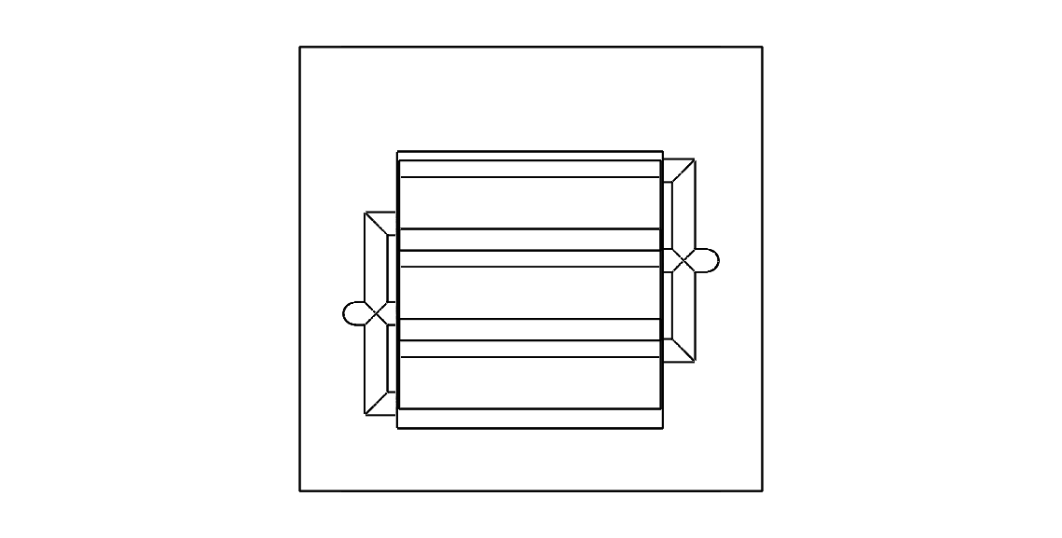
IACPC 3
IACPC 2
outlet
inlet
IACPC 1

Slide 19
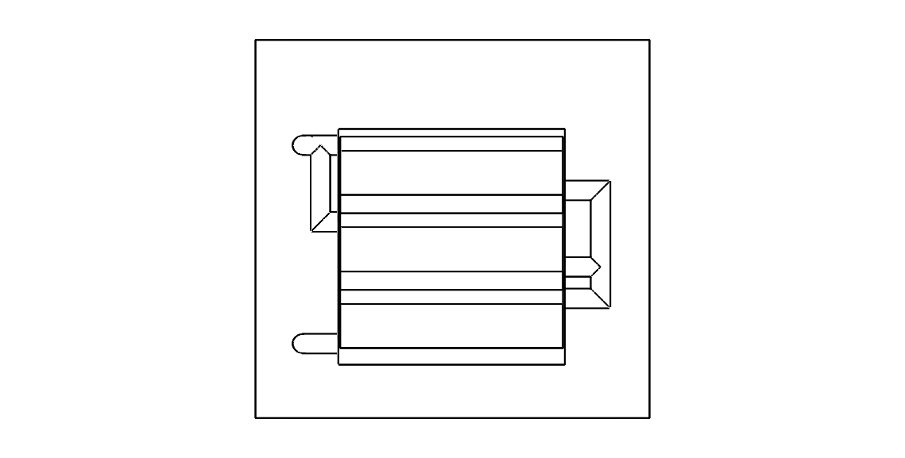
outlet
IACPC 3
IACPC 2
IACPC 1
inlet

Slide 20
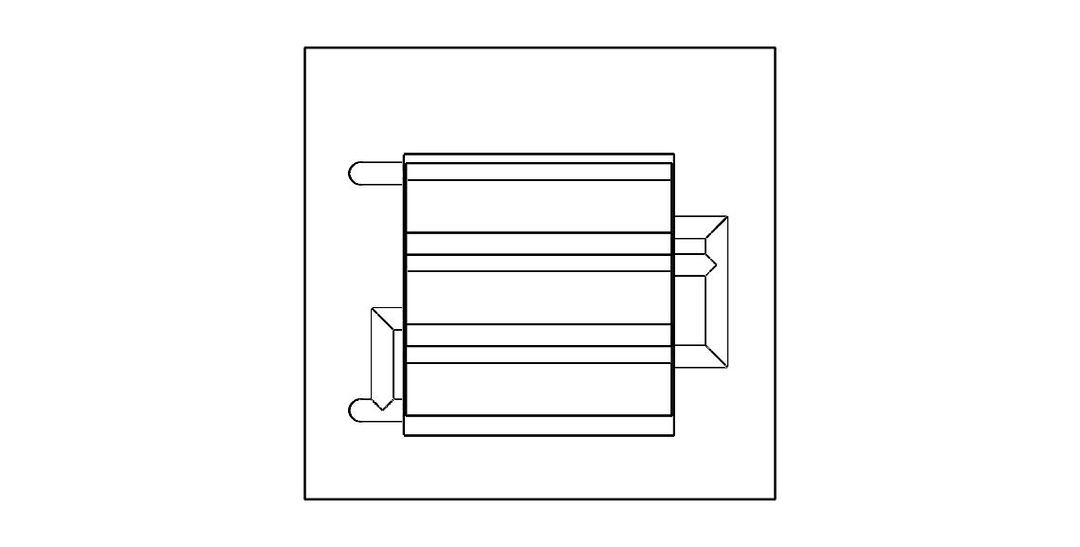
outlet
IACPC 3
IACPC 2
IACPC 1
inlet

Slide 21
Main heater (gas burner)
Barley dryer
Auxiliary system (solar collector(s))

