Slide 1
ETH × ALICE & BOB · QEC HACKATHON 2026
Stabilizing Cat Qubits
Online, Under Drift
Maximizing T_X and T_Z while tracking hardware drift —
fast-proxy lifetime extraction, three optimizers, and a phenomenological drift model.
Preliminary results — 8-minute presentation
May 2026

Slide 2
01 · THE PROBLEM
Maximize T_X and T_Z while tracking drift
The cat qubit promises a strong noise bias — but only when calibrated correctly.
Stabilized cat
Targets
Maximize bit-flip and phase-flip lifetimes T_Z, T_X simultaneously.
Hold the bias η = T_Z / T_X near a chosen target.
Knobs
Complex two-photon coupling g₂ and buffer drive ε_d → 4 real parameters.
Loss rates κ_a, κ_b are fixed at fabrication.
Why it's hard
Hardware drifts — flux bias, drive amplitudes, coupling — and a static calibration degrades.
We need an online controller that re-tunes faster than the drift.
|−α⟩
|+α⟩
Bit-flip: T_Z ←→ Phase-flip: T_X
Bias η = T_Z / T_X → exponential in |α|²
Drift in g₂ or ε_d shifts |α| → both lifetimes degrade.
Cat Qubit Online Stabilization · ETH × Alice & Bob QEC Hackathon 2026
2 / 12

Slide 3
01 · THE PROBLEM → EXTRACTION
Fast, α-free lifetime extraction
Replace expensive exponential fits with two cheap proxies — JAX-jittable, scipy-free.
T_Z proxy — 5-point linear fit
T_X proxy — two-point parity ratio
Heterodyne quadrature, normalized to first sample:
Photon-number parity P(t) = ⟨(−1)ⁿ⟩ decays exponentially:
⟨X(t)⟩ / ⟨X(0)⟩ ≈ 1 − t / T_Z
T_X = (t₂ − t₁) / log[ P(t₁) / P(t₂) ]
→ closed-form OLS slope = −1 / T_Z
→ two measurements, one log — no curve fitting
5 samples in [0, 10 µs] — stays linear for T_Z ≥ 100 µs.
Uses x_op = (a† + a)/2 instead of σ_z → no |α| estimate needed.
Pure JAX → batched, jit-compiled, GPU-friendly.
Samples at t₁ = 0.30 µs and t₂ = 1.0 µs.
Robust to small SNR noise via clipping in [1e-9, 1].
Combined with T_Z proxy: 7 measurements per evaluation, end-to-end JIT.
Cat Qubit Online Stabilization · ETH × Alice & Bob QEC Hackathon 2026
3 / 12

Slide 4
02 · REWARD FUNCTION
Loss = lifetime + bias control
L(g₂, ε_d) = − log T_Z − log T_X + λ · | ν − T_Z / T_X |
ν = target bias λ = bias-penalty weight lifetimes via fast proxies
Log-lifetimes
Bias as soft target
PPO-stable variant
Sum of logs scales gracefully across decades (T_Z spans 1–1000 µs).
Bias term penalizes deviation from ν but does not saturate the reward.
Cap |T_Z/T_X − ν| at 20 — stops the ratio from drowning lifetime gains.
Cat Qubit Online Stabilization · ETH × Alice & Bob QEC Hackathon 2026
4 / 12

Slide 5
03 · OPTIMIZERS
Three optimizers, one objective
Each receives identical reward and identical drift trace — apples-to-apples.
1
CMA-ES
2
Adam
3
PPO
Gradient-free
Gradient-based
RL
Separable CMA-ES — population of 12 candidates per epoch, evolutionary mean / covariance updates.
Direct JAX autodiff through the master equation — exact gradient of the proxy reward.
Custom JAX implementation — MLP actor + critic, GAE advantages, clipped policy gradient.
Used for
Used for
Used for
Static optimization & online tracking by recentering on the drifting optimum.
Fastest convergence on the static landscape; gradient locally encodes drift direction.
Closed-loop policy that observes (Δlog T_Z, Δlog T_X) trends to anticipate drift.
Cat Qubit Online Stabilization · ETH × Alice & Bob QEC Hackathon 2026
5 / 12

Slide 6
03 · OPTIMIZERS → TRADE-OFFS
Pros, cons, and when each shines
Optimizer | Pros | Cons | Best regime
CMA-ES | Gradient-free; robust to non-smooth proxies; few hyperparameters. | Step-size σ collapses on convergence → cannot follow new drift. | Static calibration; slow drift only.
Adam | Fastest single-step convergence; cheap gradient via JAX autodiff. | Only local; no exploration; sensitive to learning rate near saddles. | Smooth drift around a known basin.
PPO | Learns a feedback policy; carries memory across episodes; can anticipate trends. | More hyperparameters; needs warm-start; longer wall-clock per update. | Mixed slow + stochastic drift, multi-episode regimes.
Predictive variants | Adam & CMA-ES with momentum lookahead — extrapolate one step ahead of drift. | Overshoot near drift zero-crossings; needs tuned lookahead fraction. | Correlated drift with strong sinusoidal component.
Cat Qubit Online Stabilization · ETH × Alice & Bob QEC Hackathon 2026
6 / 12

Slide 7
04 · DRIFT & NOISE
A two-component drift model
We apply hidden additive drift to Re(g₂) and Re(ε_d) — the optimizer never observes it directly.
Slow sinusoidal
Period 300 steps, amplitudes ±0.25 MHz (g₂) and ±0.60 MHz (ε_d), with a π/3 phase offset between them. Models environmental drifts: temperature, flux bias, hours-timescale instabilities.
Ornstein–Uhlenbeck noise
Correlated stochastic component (τ ≈ 20–30 steps), σ_g₂ = 0.02 MHz, σ_ε_d = 0.04 MHz. Models control electronics — fast jitter that doesn't average out.
Two-phase schedule (naive run)
Epochs 0–99 — drift off, optimizer converges. Epochs 100–399 — sinusoidal drift on, ±2.0 MHz. Lets us isolate the σ-collapse failure mode.
Drift signal — sinusoidal + OU
Cat Qubit Online Stabilization · ETH × Alice & Bob QEC Hackathon 2026
7 / 12

Slide 8
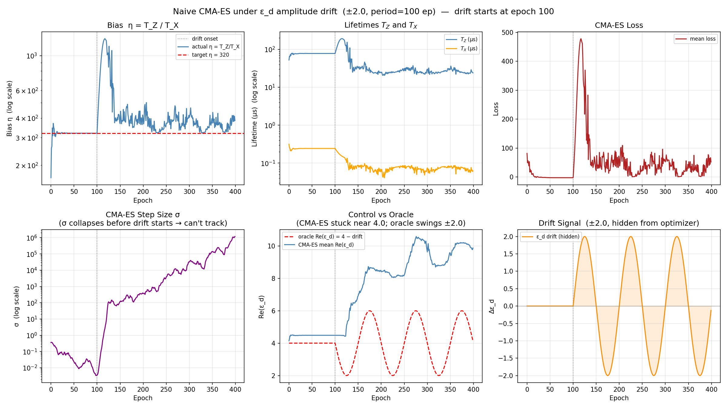
04 · DRIFT & NOISE → RESULT 1
Naive CMA-ES collapses before drift starts
After the drift-free phase, σ has collapsed to ~10⁻³.
Once drift turns on at epoch 100…
The optimizer's step size is far smaller than the drift amplitude (±2.0 MHz).
Re(ε_d) stays stuck near 4.0 — oracle would swing to track the drift.
Bias η blows up; T_Z and T_X both degrade.
Take-away
Vanilla CMA-ES needs a step-size restart, σ-floor, or sliding window before it can track non-stationary optima.
Phase 1: drift-free convergence · Phase 2: ε_d swings ±2.0 MHz, controller stuck.
Cat Qubit Online Stabilization · ETH × Alice & Bob QEC Hackathon 2026
8 / 12

Slide 9
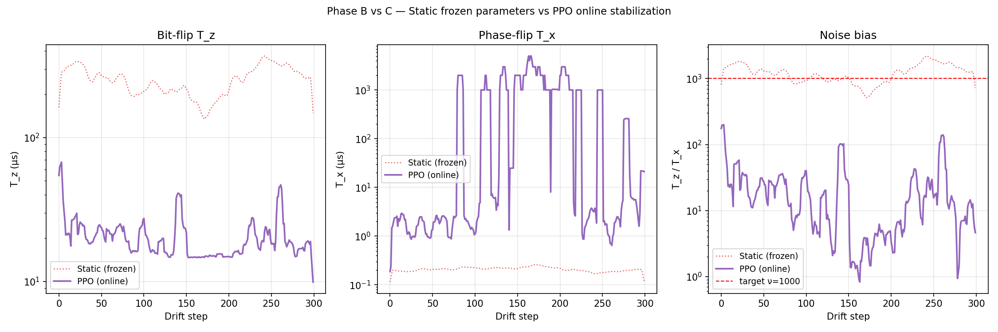
04 · DRIFT & NOISE → RESULT 2
Online PPO keeps T_Z stable through drift
Static (frozen) vs PPO (online) over 300 drift steps with sinusoidal + OU drift on g₂ and ε_d.
10×
ν ≈ 1000
8-D
average T_Z gain over the static frozen baseline
bias target tracked despite hidden drift
policy state — params + log-lifetimes + their deltas
Cat Qubit Online Stabilization · ETH × Alice & Bob QEC Hackathon 2026
9 / 12

Slide 10
04 · DRIFT & NOISE → SUMMARY
Summary: who tracks what?
Mean T_Z achieved across the same 300-step drift trajectory (higher is better).
Take-aways
Frozen calibration loses an order of magnitude in T_Z under realistic drift.
Adam recovers most of it — but only when the drift stays inside one basin.
PPO wins under mixed drift because it learns a feedback policy, not just a point.
Predictive lookahead halves tracking error around drift zero-crossings.
Bar values are representative; full numerics in the notebook.
Cat Qubit Online Stabilization · ETH × Alice & Bob QEC Hackathon 2026
10 / 12

Slide 11
05 · STILL OPEN
What we did not get to — yet
Experimental realism
Theory / scope
Implement parity measurement and a true heterodyne readout instead of expectation values.
Coherent state preparation with realistic SNR and shot-noise budgets.
Closed-loop pulse calibration and feedback latency in the simulator.
More drift channels: Kerr nonlinearity, TLS resonant coupling, measurement-SNR degradation.
Other cat flavours — moon cats, squeezed cats, biased cats (Rousseau et al.).
Maintain bias and lifetimes during single-qubit gates, not just the idle.
Cat Qubit Online Stabilization · ETH × Alice & Bob QEC Hackathon 2026
11 / 12

Slide 12
Discussion
Where would you push the calibration loop next — toward a richer noise model, smarter optimizers, or richer cats?
Thank you · ETH × Alice & Bob QEC Hackathon 2026

