Slide 1
Chapter 2 – Introduction to Python Programming
Outline
2.1 Introduction
2.2 First Program in Python: Printing a Line of Text
2.3 Modifying our First Python Program
2.3.1 Displaying a Single Line of Text with
Multiple Statements
2.3.2 Displaying Multiple Lines of Text with
a Single Statement
2.4 Another Python Program: Adding Integers
2.5 Memory Concepts
2.6 Arithmetic
2.7 String Formatting
2.8 Decision Making: Equality and Relational Operators
2.9 Indentation
2.10 Thinking About Objects: Introduction to Object Technology

Slide 2
2.1 Introduction
Introduction to Python programming
Introduction to programming techniques
  Structured programming
  Object-oriented programming

Slide 3
2.2 First Program in Python: Printing a Line of Text
Python
  The # symbol
    Used to denote a single line comment
  The print function
    Used to send a stream of text to be output to the user
Executing
  Saving as a file
    Type code into a .py file and save it
    To run it type python fileName.py
  Executing code
    Type python in the command line
    Runs the python interpreter

Slide 4
Fig02_01.py
Program Output
1 # Fig. 2.1: fig02_01.py
2 # Printing a line of text in Python.
3
4 print "Welcome to Python!"
This is a comment
Prints out the line of text
Welcome to Python!

Slide 5
2.2 First Program in Python: Printing a Line of Text
Python 2.2b2 (#26, Nov 16 2001, 11:44:11) [MSC 32 bit (Intel)] on win32
Type "help", "copyright", "credits" or "license" for more information­.
>>> print "Welcome to Python!"
Welcome to Python!
>>> ^Z
Fig. 2.2 Interactive mode. (Python interpreter software Copyright ©2001 Python
Software Foundation.)

Slide 6
2.3 Modifying our First Python Program
Text outputs
  How to display the text on one line through multiple statements, 2.3.1
  How to display the text on several lines with only one code statement, 2.3.2

Slide 7
2.3.1 Displaying a Single Line of Text with Multiple Statements
Printing Lines of Text
  Python displays each print function on a new line
  The comma can be used to tell the compiler to make a space rather than a white line

Slide 8
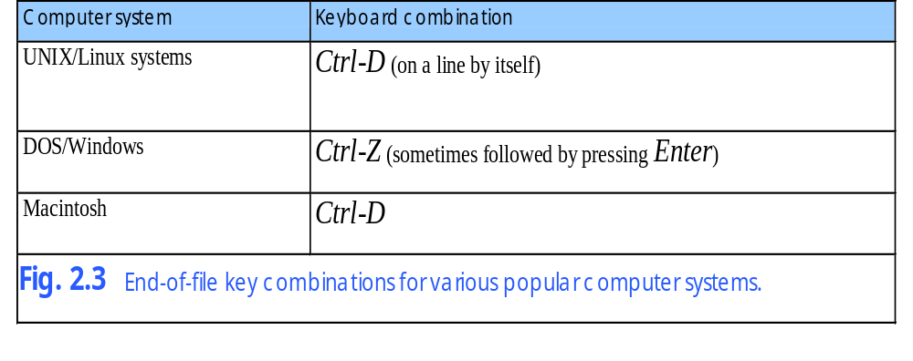
2.3.1 Displaying a Single Line of Text with Multiple Statements

Slide 9
Fig02_04.py
Program Output
1 # Fig. 2.4: fig02_04.py
2 # Printing a line with multiple statements.
3
4 print "Welcome",
5 print "to Python!"
The comma tells the compiler to insert a space rather than go to the next line
Welcome to Python!

Slide 10
2.3.2 Displaying Multiple Lines of Text with a Single Statement
Escape characters
  Used to perform a different task that normally intended
  \n – insert a new line
  \" – insert double quotes
  \' – insert a single quote
  \\ – inserts a backslash
  More are listed in Fig. 2.6

Slide 11
Fig02_05.py
Program Output
1 # Fig. 2.5: fig02_05.py
2 # Printing multiple lines with a single statement.
3
4 print "Welcome\nto\n\nPython!"
The \n is used to make the text appear on the next line
Welcome
To
Python!

Slide 12
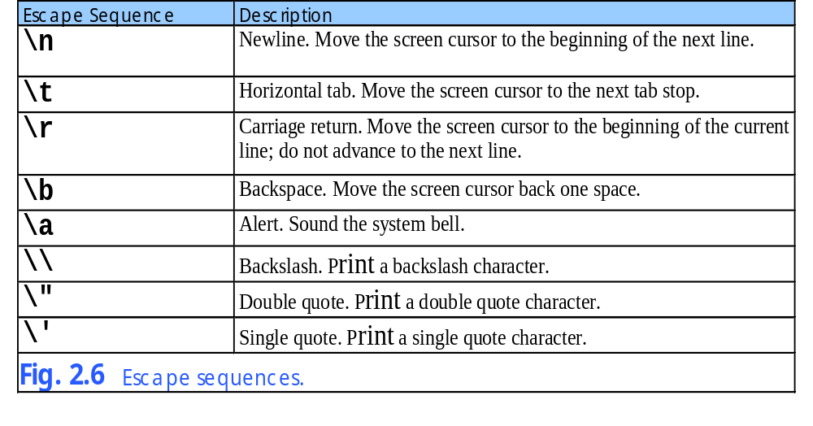
2.3.2 Displaying Multiple Lines of Text with a Single Statement

Slide 13
2.4 Another Program: Adding Integers
Functions
  The raw_input function
    Used to retrieve data from the user
  The int function
    Used to convert strings to integers

Slide 14
Fig02_07.py
Program Output
1 # Fig. 2.7: fig02_07.py
2 # Simple addition program.
3
4 # prompt user for input
5 integer1 = raw_input( "Enter first integer:\n" ) # read string
6 integer1 = int( integer1 ) # convert string to integer
7
8 integer2 = raw_input( "Enter second integer:\n" ) # read string
9 integer2 = int( integer2 ) # convert string to integer
10
11 sum = integer1 + integer2 # compute and assign sum
12
13 print "Sum is", sum # print sum
Prompts the user to enter and integer value
Converts the string value into an integer value
Adds up and then prints out the sum of the two numbers
Enter first integer:
45
Enter second integer:
72
Sum is 117

Slide 15
2.4 Another Program: Adding Integers
Python 2.2b2 (#26, Nov 16 2001, 11:44:11) [MSC 32 bit (Intel)] on win32
Type "help", "copyright", "credits" or "license" for more information.
>>> value1 = raw_input( "Enter an integer: " )
Enter an integer: 2
>>> value2 = raw_input( "Enter an integer: " )
Enter an integer: 4
>>> print value1 + value2
24
Fig. 2.8 Adding values from raw_input (incorrectly) without converting to integers (the result should be 6).

Slide 16
2.5 Memory Concepts
Objects
  Every object has a type, size, value, and location
    Stored in computers memory
    Type and location cannot be changed
  When a variable is made the name is binded to the value
  Values are not modified as a computer performs the calculation

Slide 17
2.5 Memory Concepts
integer1
"45"
Fig. 2.9 Memory location showing value of a variable and the name bound to the value.
"45"
integer1
45
Fig. 2.10 Memory location showing the name and value of a variable.

Slide 18
2.5 Memory Concepts
integer1
45
integer2
72
Fig. 2.11 Memory locations after values for two variables have been input.
integer1
45
integer2
72
sum
117
Fig. 2.12 Memory locations after a calculation.

Slide 19
Fig02_13.py
Program Output
1 # Fig. 2.13: fig02_13.py
2 # Displaying an object’s location, type and value.
3
4 # prompt the user for input
5 integer1 = raw_input( "Enter first integer:\n" ) # read a string
6 print "integer1: ", id( integer1 ), type( integer1 ), integer1
7 integer1 = int( integer1 ) # convert the string to an integer
8 print "integer1: ", id( integer1 ), type( integer1 ), integer1
9
10 integer2 = raw_input( "Enter second integer:\n" ) # read a string
11 print "integer2: ", id( integer2 ), type( integer2 ), integer2
12 integer2 = int( integer2 ) # convert the string to an integer
13 print "integer2: ", id( integer2 ), type( integer2 ), integer2
14
15 sum = integer1 + integer2 # assignment of sum
16 print "sum: ", id( sum ), type( sum ), sum
Prints the id, type and value before and after the variable is converted into an integer
Notice in the output that after the conversion the value is the same but the type and id have changed
Enter first integer:
5
integer1: 7956744 <type 'str'> 5
integer1: 7637688 <type 'int'> 5
Enter second integer:
27
integer2: 7776368 <type 'str'> 27
integer2: 7637352 <type 'int'> 27
sum: 7637436 <type 'int'> 32

Slide 20
2.6 Arithmetic
Symbols
  * = multiply
  / = divide
  % = modulus
  ** = exponential
  // = floor division
    Only available in Python 2.2
    Must use from __future__ import division
Order
  Operators are done in order of parenthesis, exponents, multiple and divide (left to right), and lastly add and subtract (left to right)

Slide 21
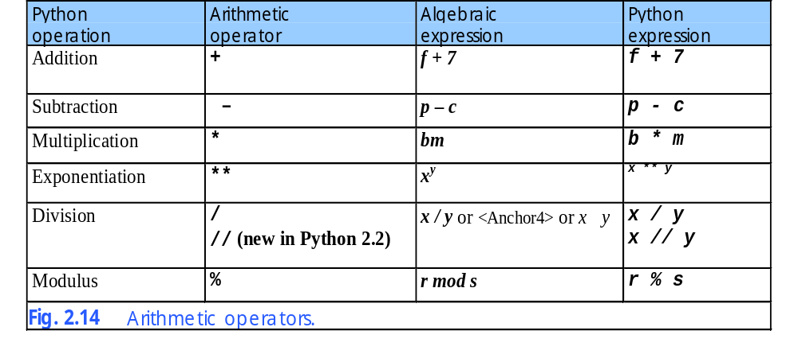
2.6 Arithmetic

Slide 22
2.6 Arithmetic
Python 2.2b2 (#26, Nov 16 2001, 11:44:11) [MSC 32 bit (Intel)] on win32
Type "help", "copyright", "credits" or "license" for more information.
>>> 3 / 4 # floor division (default behavior)
0
>>> 3.0 / 4.0 # true division (floating-point operands)
0.75
>>> 3 // 4 # floor division (only behavior)
0
>>> 3.0 // 4.0 # floating-point floor division
0.0
>>> from __future__ import division
>>> 3 / 4 # true division (new behavior)
0.75
>>> 3.0 / 4.0 # true division (same as before)
0.75
Fig. 2.15 Difference in behavior of the / operator.

Slide 23
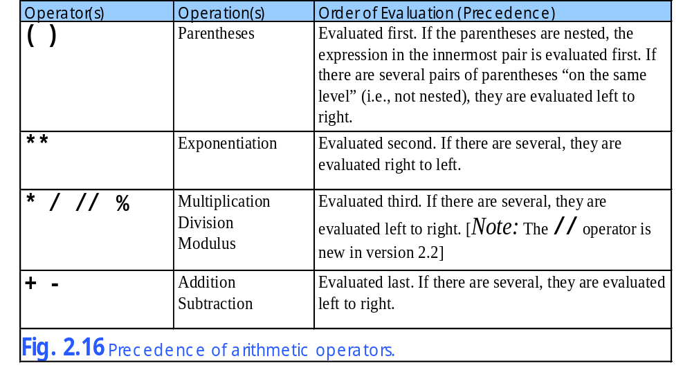
2.6 Arithmetic

Slide 24
2.6 Arithmetic
Step 1.
y = 2 * 5 ** 2 + 3 * 5 + 7
5 ** 2 = 25
Exponentiation
Step 2.
y = 2 * 25 + 3 * 5 + 7
2 * 25 = 50
Leftmost multiplication
Step 3.
y = 50 + 3 * 5 + 7
3 * 5 = 15
Multiplication before addition
Step 4.
y = 50 + 15 + 7
50 + 15 = 65
Leftmost addition
Step 5.
y = 65 + 7 is 72
Last edition
Step 6.
y = 72
Python assigns 72 to y
Fig. 2.17 Order in which a second-degree polynomial is evaluated.

Slide 25
2.7 String Formatting
Strings
  Unlike other languages strings are a built in data type
    Allows for easy string manipulation
  Double quote strings
    Single quotes need not be escaped
  Single quote strings
    Double quotes need not be escaped
  Triple quoted strings
    Do not need any escape sequence
    Used for large blocks of text

Slide 26
Fig02_18
Program Output
Strings in single quotes need not have double quotes escaped
1 # Fig. 2.18: fig02_18.py
2 # Creating strings and using quote characters in strings.
3
4 print "This is a string with \"double quotes.\""
5 print 'This is another string with "double quotes."'
6 print 'This is a string with \'single quotes.\''
7 print "This is another string with 'single quotes.'"
8 print """This string has "double quotes" and 'single quotes'.
9 You can even do multiple lines."""
10 print '''This string also has "double" and 'single' quotes.'''
Strings with double quotes need not escape single quotes
This is a string with "double quotes."
This is another string with "double quotes."
This is a string with 'single quotes.'
This is another string with 'single quotes.'
This string has "double quotes" and 'single quotes'.
You can even do multiple lines.
This string also has "double" and 'single' quotes.
Strings in triple quotes do not have to escape anything and can span many lines

Slide 27
Fig02_19.py
1 # Fig. 2.19: fig02_19.py
2 # String formatting.
3
4 integerValue = 4237
5 print "Integer ", integerValue
6 print "Decimal integer %d" % integerValue
7 print "Hexadecimal integer %x\n" % integerValue
8
9 floatValue = 123456.789
10 print "Float", floatValue
11 print "Default float %f" % floatValue
12 print "Default exponential %e\n" % floatValue
13
14 print "Right justify integer (%8d)" % integerValue
15 print "Left justify integer (%-8d)\n" % integerValue
16
17 stringValue = "String formatting"
18 print "Force eight digits in integer %.8d" % integerValue
19 print "Five digits after decimal in float %.5f" % floatValue
20 print "Fifteen and five characters allowed in string:"
21 print "(%.15s) (%.5s)" % ( stringValue, stringValue )
The %e is used to format the string to scientific notation number
Formats the string to contain exactly a specified amount of letters
Formats the string to only allow so many characters

Slide 28
Fig02_19.py
Program Output
Integer 4237
Decimal integer 4237
Hexadecimal integer 108d
Float 123456.789
Default float 123456.789000
Default exponential 1.234568e+005
Right justify integer ( 4237)
Left justify \integer (4237 )
Force eight digits in integer 00004237
Five digits after decimal in float 123456.78900
Fifteen and five characters allowed in string:
(String formatti) (Strin)

Slide 29
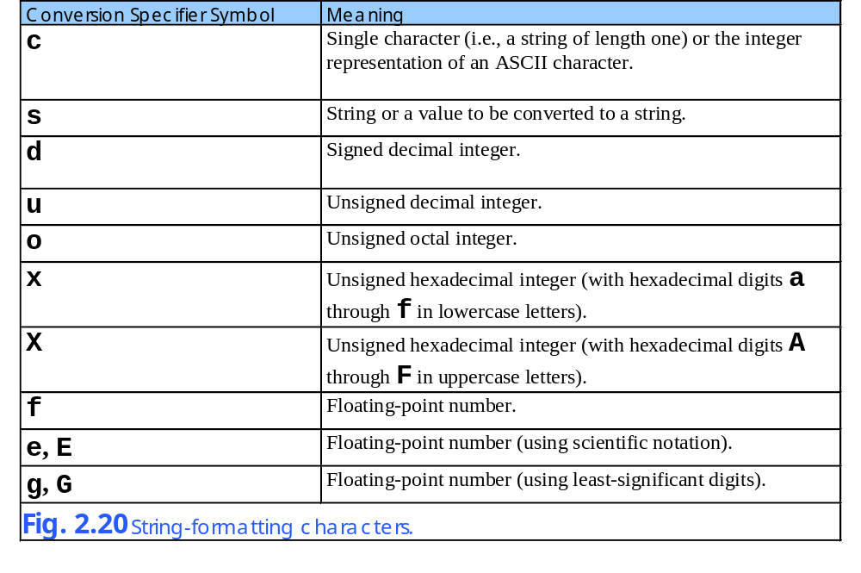
2.7 String Formatting

Slide 30
2.8 Decision Making: Equality and Relational Operators
The if structure
  Can be formed with equality and relational operators
    <, >, ==, …

Slide 31
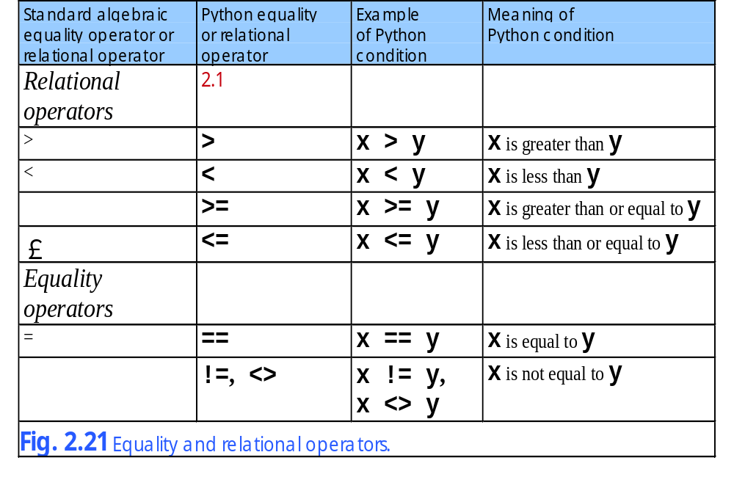
2.8 Decision Making: Equality and Relational Operators

Slide 32
Fig02_22.py
1 # Fig. 2.22: fig02_22.py
2 # Compare integers using if structures, relational operators
3 # and equality operators.
4
5 print "Enter two integers, and I will tell you"
6 print "the relationships they satisfy."
7
8 # read first string and convert to integer
9 number1 = raw_input( "Please enter first integer: " )
10 number1 = int( number1 )
11
12 # read second string and convert to integer
13 number2 = raw_input( "Please enter second integer: " )
14 number2 = int( number2 )
15
16 if number1 == number2:
17 print "%d is equal to %d" % ( number1, number2 )
18
19 if number1 != number2:
20 print "%d is not equal to %d" % ( number1, number2 )
21
22 if number1 < number2:
23 print "%d is less than %d" % ( number1, number2 )
24
25 if number1 > number2:
26 print "%d is greater than %d" % ( number1, number2 )
27
28 if number1 <= number2:
29 print "%d is less than or equal to %d" % ( number1, number2 )
30
31 if number1 >= number2:
32 print "%d is greater than or equal to %d" % ( number1, number2 )
Gets two values from the user and converts them to strings
Checks each of the rational operators or the numbers using if statements

Slide 33
Fig02_22.py
Program Output
Enter two integers, and I will tell you
the relationships they satisfy.
Please enter first integer: 37
Please enter second integer: 42
37 is not equal to 42
37 is less than 42
37 is less than or equal to 42
Enter two integers, and I will tell you
the relationships they satisfy.
Please enter first integer: 7
Please enter second integer: 7
7 is equal to 7
7 is less than or equal to 7
7 is greater than or equal to 7
Enter two integers, and I will tell you
the relationships they satisfy.
Please enter first integer: 54
Please enter second integer: 17
54 is not equal to 17
54 is greater than 17
54 is greater than or equal to 17

Slide 34
2.8 Decision Making: Equality and Relational Operators
Python 2.2b2 (#26, Nov 16 2001, 11:44:11) [MSC 32 bit (Intel)] on win32
Type "help", "copyright", "credits" or "license" for more information.
>>> print 1 +
File "<string>", line 1
print 1 +
^
SyntaxError: invalid syntax
>>> print 1 + \
... 2
3
>>>

Slide 35
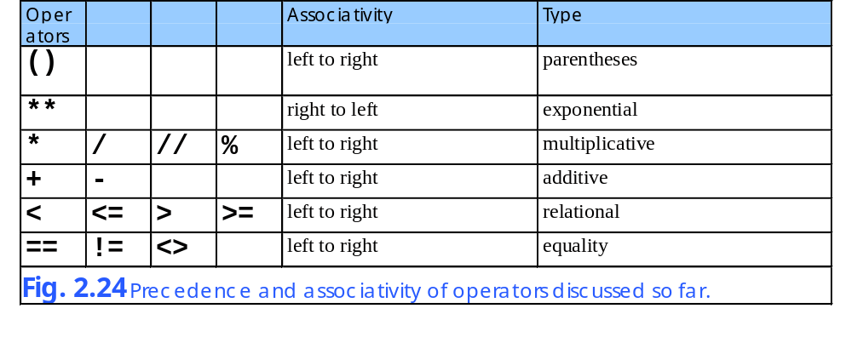
2.8 Decision Making: Equality and Relational Operators

Slide 36
2.9 Indentation
Indenting
  Used to delimit code
  Python uses no end of statement character
  Therefore a new line of code is determined by return space
  Indenting is the same way
    Python does not use {} to enclose a multi-line statement
    The indentation must be exactly the same same
  There is no exact rule for the number of spaces but they are generally in groups of three

Slide 37
Fig02_25.py
1 # Fig. 2.25: fig02_25.py
2 # Using if statements, relational operators and equality
3 # operators to show improper indentation.
4
5 print "Enter two integers, and I will tell you"
6 print "the relationships they satisfy."
7
8 # read first string and convert to integer
9 number1 = raw_input( "Please enter first integer: " )
10 number1 = int( number1 )
11
12 # read second string and convert to integer
13 number2 = raw_input( "Please enter second integer: " )
14 number2 = int( number2 )
15
16 if number1 == number2:
17 print "%d is equal to %d" % ( number1, number2 )
18
19 # improper indentation causes this if statement to execute only
20 # when the above if statement executes
21 if number1 != number2:
22 print "%d is not equal to %d" % ( number1, number2 )
23
24 if number1 < number2:
25 print "%d is less than %d" % ( number1, number2 )
26
27 if number1 > number2:
28 print "%d is greater than %d" % ( number1, number2 )
29
30 if number1 <= number2:
31 print "%d is less than or equal to %d" % ( number1, number2 )
32
33 if number1 >= number2:
34 print "%d is greater than or equal to %d" % ( number1, number2 )
Since this if statement is indented it is considered part of the other if statement

Slide 38
Fig02_25.py
Program Output
Enter two integers, and I will tell you
the relationships they satisfy.
Please enter first integer: 1
Please enter second integer: 2
1 is less than 2
1 is less than or equal to 2

Slide 39
2.10 Thinking about Objects: Introduction to Object Technology
Objects
  Everything in the real world is made of objects
  Each object has attributes
    Shape, size, color, weight
  Each object has behaviors
    Roll, bounce, inflate, deflate
Object Oriented Programming (OOP)
  Modes real world objects with programming counterparts
  Information hiding
    Know how to communicate with one another
    Don’t know the specifics of other objects
  Encapsulate, to prevent code repetition

