Slide 1
Chapter 3 – Control Structures
Outline
3.1 Introduction
3.2 Algorithms
3.3 Pseudocode
3.4 Control Structures
3.5 if Selection Structure
3.6 if/else and if/elif/else Selection Structures
3.7 while Repetition Structure
3.8 Formulating Algorithms:
Case Study 1 (Counter-Controlled Repetition)
3.9 Formulating Algorithms with Top-Down, Stepwise Refinement: Case Study 2 (Sentinel-Controlled Repetition)
3.10 Formulating Algorithms with Top-Down, Stepwise Refinement: Case Study 3 (Nested Control Structures)
3.11 Augmented Assignment Symbols
3.12 Essentials of Counter-Controlled Repetition

Slide 2
Chapter 3 – Control Structures
Outline
3.14 Using the for Repetition Structure
3.15 break and continue Statements
3.16 Logical Operators
3.17 Structured-Programming Summary

Slide 3
3.1 Introduction
Pre-programming
  Have a through understanding of the problem
  Have a carefully planned approach to the solution
When writing the program
  Understand the types of building blocks available
  Use proven program-construction principles

Slide 4
3.2 Algorithms
Algorithm
  A procedure for solving a problem in terms of:
    Action to be executed
    Order in which these actions will take place
  Any programming problems can be solved in that way

Slide 5
3.3 Pseudocode
Pseudocode
  An artificial and inform computer language
  Contains descriptions of executable statements
  Similar to English
  Not an actual programming language
    If done properly allows for easy conversion to Python or any other computer language

Slide 6
3.4 Control Structure
Sequential order
  Statements are executed in the order they are written
Transfer of control
  A program executes a statement other than the following one
  Do using control structures
  The goto statement
    Allows a program to go to a wide range of areas in the code
    Structured programming was broken with the use of goto
    Any code can be written without a goto statement
Flowcharts
  Used to map the path a program would take using any combination of control structures
    Rectangle represents an action
    Diamond represents a decision

Slide 7
3.4 Control Structure (II)
3 control structures
  Sequential structure
    Built into Python
  Selection structure
    The if statement
    The if/else statement
    The if/elif/else statement
  Repetition structure
    The while repetition structure
    The for repetition structure

Slide 8
3.4 Control Structure
add grade to total
total = total + grade;
add 1 to counter
counter = counter + 1;
Fig. 3.1 Sequence structure flowchart.

Slide 9
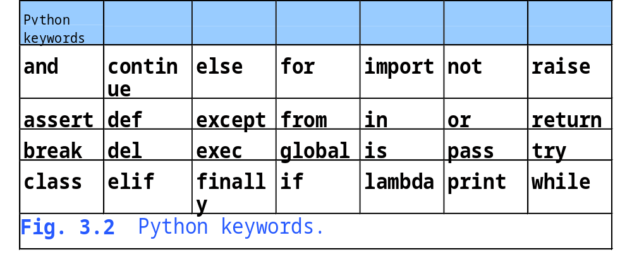
3.4 Control Structure

Slide 10
3.5 if Selection Structure
The if statement
  It is a single entry, single exit structure
  Allows a program to perform an action only if a statement is true
  Otherwise the action is skipped

Slide 11
3.5 if Selection Structure
true
Grade >= 60
print “Passed”
false
Fig. 3.3 if single-selection structure flowchart.

Slide 12
3.6 if/else and if/elif/else Selection Structures
The if/else statement
  Double selection statement
  Allows the programmer to perform an action when a condition is true
  An alternate action is preformed when the action is false
The if/elif/else statement
  Multiple selection statement
  This is used in place of nested if/else statements
  The final else statement is optional
    It is used as a default action should all other statements be false

Slide 13
3.6 if/else and if/elif/else Selection Structures (II)
Two types of errors can occur
  Syntax error
    Error in code
    Will be caught by the interpreter
  Logic error
    Nonfatal logic error
      Does not end the program but will yield incorrect results
    Fetal logic error
      Causes the program to fail and terminate prematurely

Slide 14
3.6 if/else and if/elif/else Selection Structures
false
true
Grade >= 60
print “Failed”
print “Passed”
Fig. 3.4 if/else double-selection structure flowchart.

Slide 15
3.6 if/else and if/elif/else Selection Structures
if statement
condition a
true
case a action(s)
false
first elif statement
true
condition b
case b action(s)
false
.
.
.
last elif statement
true
condition z
case z action(s)
false
else statement
default action(s)
Fig. 3.5 if/elif/else multiple-selection structure.

Slide 16
3.6 if/else and if/elif/else Selection Structures
Python 2.2b2 (#26, Nov 16 2001, 11:44:11) [MSC 32 bit (Intel)] on win32
Type "help", "copyright", "credits" or "license" for more information.
>>> value1 = raw_input( "Enter a number: " )
Enter a number: 3
>>> value2 = raw_input( "Enter a number: " )
Enter a number: 0
>>> print value1 +
File "<stdin>", line 1
print value1 +
^
SyntaxError: invalid syntax
>>> print value1 + value2
30
>>> print int( value1 ) / int( value2 )
Traceback (most recent call last):
File "<stdin>", line 1, in ?
ZeroDivisionError: integer division or modulo by zero
Fig. 3.6 Syntax and logic errors.

Slide 17
3.7 while Repetition Structure
Repetition Structures
  Allow a program to repeat an action while a statement is true
Using while Repetition
  The action is contained within the body of the loop
    Can be one or more than one action
  Condition should evaluate to false at some point
    Creates a infinite loop and program hangs

Slide 18
3.7 while Repetition Structure
Python 2.2b2 (#26, Nov 16 2001, 11:44:11) [MSC 32 bit (Intel)] on win32
Type "help", "copyright", "credits" or "license" for more information.
>>> if 1 < 2:
... pass
...
Fig. 3.7 Keyword pass.

Slide 19
3.7 while Repetition Structure
true
Product <= 1000
Product = 2 * product
false
Fig. 3.8 while repetition structure flowchart.

Slide 20
3.8 Formulating Algorithms: Case Study 1 (Counter Controlled Repetition)
Counter controlled repetition
  Called definite repetition
    The number of loops is known before the loop starts
  Uses a counter to limit the number of times a loop repeats
  Counter must be incremented or decremented in the loop

Slide 21
3.8 Formulating Algorithms: Case Study 1 (Counter Controlled Repetition)
Set total to zero
Set grade counter to one
While grade counter is less than or equal to ten
Input the next grade
Add the grade into the total
Add one to the grade counter
Set the class average to the total divided by ten
Print the class average
Fig. 3.9 Pseudocode algorithm that uses counter-controlled repetition to
solve the class-average problem.

Slide 22
Fig03_10.py
Program Output
1 # Fig. 3.10: fig03_10.py
2 # Class average program with counter-controlled repetition.
3
4 # initialization phase
5 total = 0 # sum of grades
6 gradeCounter = 1 # number of grades entered
7
8 # processing phase
9 while gradeCounter <= 10: # loop 10 times
10 grade = raw_input( "Enter grade: " ) # get one grade
11 grade = int( grade ) # convert string to an integer
12 total = total + grade
13 gradeCounter = gradeCounter + 1
14
15 # termination phase
16 average = total / 10 # integer division
17 print "Class average is", average
The total and counter, set to zero and one respectively
A loop the continues as long as the counter does not go past 10
Adds one to the counter to eventually break the loop
Divides the total by the 10 to get the class average
Enter grade: 98
Enter grade: 76
Enter grade: 71
Enter grade: 87
Enter grade: 83
Enter grade: 90
Enter grade: 57
Enter grade: 79
Enter grade: 82
Enter grade: 94
Class average is 81

Slide 23
3.9 Formulating Algorithms with Top-Down, Stepwise Refinement: Case Study 2 (Sentinel-Controlled Repetition)
Sentinel Value
  A dummy value, one that the program checks for in order to break out of the loop
  Sentinel values should be values that would not normally be entered in by the user
  Known as indefinite repetition
    The total number of loops is unknown

Slide 24
3.9 Formulating Algorithms with Top-Down, Stepwise Refinement: Case Study 2 (Sentinel-Controlled Repetition)
Python 2.2b2 (#26, Nov 16 2001, 11:44:11) [MSC 32 bit (Intel)] on win32
Type "help", "copyright", "credits" or "license" for more information.
>>> gradeCounter = 1
>>> while gradeCounter <= 10:
... gradeCounter = gradeCounter + 1
...
>>> print gradeCounter
11
Fig. 3.11 Counter value used after termination of counter-controlled loop.

Slide 25
3.9 Formulating Algorithms with Top-Down, Stepwise Refinement: Case Study 2 (Sentinel-Controlled Repetition)
Initialize total to zero
Initialize counter to zero
Input the first grade (possibly the sentinel)
While the user has not as yet entered the sentinel
Add this grade into the running total
Add one to the grade counter
Input the next grade (possibly the sentinel)
If the counter is not equal to zero
Set the average to the total divided by the counter
Print the average
else
Print “No grades were entered”
Fig. 3.12 Pseudocode algorithm that uses sentinel-controlled repetition
to solve the class-average problem.

Slide 26
Fig03_13.py
1 # Fig. 3.13: fig03_13.py
2 # Class average program with sentinel-controlled repetition.
3
4 # initialization phase
5 total = 0 # sum of grades
6 gradeCounter = 0 # number of grades entered
7
8 # processing phase
9 grade = raw_input( "Enter grade, -1 to end: " ) # get one grade
10 grade = int( grade ) # convert string to an integer
11
12 while grade != -1:
13 total = total + grade
14 gradeCounter = gradeCounter + 1
15 grade = raw_input( "Enter grade, -1 to end: " )
16 grade = int( grade )
17
18 # termination phase
19 if gradeCounter != 0:
20 average = float( total ) / gradeCounter
21 print "Class average is", average
22 else:
23 print "No grades were entered"
The –1 acts as the dummy value, it is used to stop the program from looping
Again a counter is used so that the program knows the total number to students
Finds the average by dividing total by the gradeCounter

Slide 27
Fig03_13.py
Program Output
Enter grade, -1 to end: 75
Enter grade, -1 to end: 94
Enter grade, -1 to end: 97
Enter grade, -1 to end: 88
Enter grade, -1 to end: 70
Enter grade, -1 to end: 64
Enter grade, -1 to end: 83
Enter grade, -1 to end: 89
Enter grade, -1 to end: -1
Class average is 82.5

Slide 28
3.10 Formulating Algorithms with Top-Down, Stepwise Refinement: Case Study 3 (Nested Control Structures)
Nesting
  Inserting one control structure into another
    A loop inside of a loop
    An if statement inside of a loop

Slide 29
3.10 Formulating Algorithms with Top-Down, Stepwise Refinement: Case Study 3 (Nested Control Structures)
Initialize passes to zero
Initialize failures to zero
Initialize student counter to one
While student counter is less than or equal to ten
Input the next exam result
If the student passed
Add one to passes
else
Add one to failures
Add one to student counter
Print the number of passes
Print the number of failures
If more than eight students passed
Print “Raise tuition”
Fig. 3.14 Pseudocode for examination-results problem.

Slide 30
Fig03_15.py
1 # Fig. 3.15: fig03_15.py
2 # Analysis of examination results.
3
4 # initialize variables
5 passes = 0 # number of passes
6 failures = 0 # number of failures
7 studentCounter = 1 # student counter
8
9 # process 10 students; counter-controlled loop
10 while studentCounter <= 10:
11 result = raw_input( "Enter result (1=pass,2=fail): " )
12 result = int( result ) # one exam result
13
14 if result == 1:
15 passes = passes + 1
16 else:
17 failures = failures + 1
18
19 studentCounter = studentCounter + 1
20
21 # termination phase
22 print "Passed", passes
23 print "Failed", failures
24
25 if passes > 8:
26 print "Raise tuition"
Creates a loop that will break once the counter is passed 10
This if/else statement is nested within the while loop
Adds one to either the passes or failures counter

Slide 31
Fig03_15.py
Program Output
Enter result (1=pass,2=fail): 1
Enter result (1=pass,2=fail): 1
Enter result (1=pass,2=fail): 1
Enter result (1=pass,2=fail): 1
Enter result (1=pass,2=fail): 2
Enter result (1=pass,2=fail): 1
Enter result (1=pass,2=fail): 1
Enter result (1=pass,2=fail): 1
Enter result (1=pass,2=fail): 1
Enter result (1=pass,2=fail): 1
Passed 9
Failed 1
Raise tuition

Slide 32
Fig03_15.py
Program Output
Enter result (1=pass,2=fail): 1
Enter result (1=pass,2=fail): 2
Enter result (1=pass,2=fail): 2
Enter result (1=pass,2=fail): 1
Enter result (1=pass,2=fail): 1
Enter result (1=pass,2=fail): 1
Enter result (1=pass,2=fail): 2
Enter result (1=pass,2=fail): 1
Enter result (1=pass,2=fail): 1
Enter result (1=pass,2=fail): 2
Passed 6
Failed 4

Slide 33
3.11 Augmented Assignment Symbols
Augmented addition assignment symbols
  x = x +5 is the same as x += 5
  y = y + 1 is the same as y += 1 and y++
Other math signs
  The same rule applies to any other mathematical symbol
    *, **, /, %

Slide 34
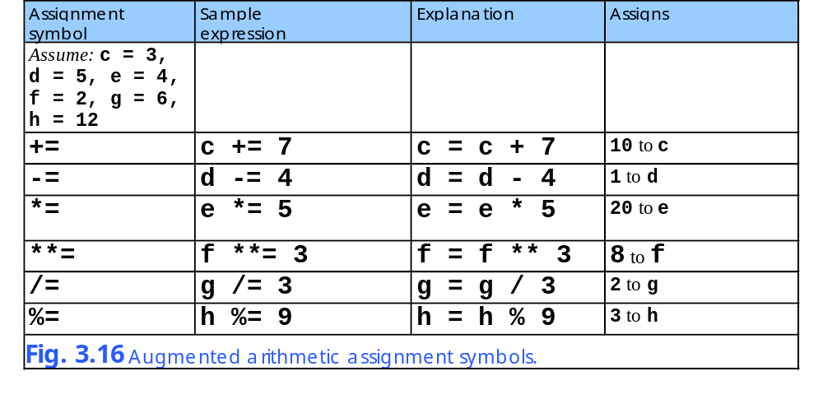
3.11 Augmented Assignment Symbols

Slide 35
3.12 Essentials of Counter-Controlled Repetition
Essentials
  The counter
    A named variable to control the loop
  Initial value
    That which the counter starts at
  Increment
    Modifying the counter to make the loop eventually terminate
  Condition
    The test that the counter must pass in order to continue looping

Slide 36
Fig03_17.py
Program Output
1 # Fig. 3.17: fig03_17.py
2 # Counter-controlled repetition.
3
4 counter = 0
5
6 while counter < 10:
7 print counter
8 counter += 1
The counter with an initial value of zero
The conditional that if the counter is above 10 the loop breaks
The incrementing of the counter
0
1
2
3
4
5
6
7
8
9

Slide 37
3.13 for Repetition Structure
The for loop
  Function range is used to create a list of values
      range ( integer )
        Values go from 0 u to given integer
      range ( integer, integer )
        Values go from first up to second integer
      range ( integer, integer, integer )
        Values go from first up to second integer but increases in intervals of the third integer
  The loop will execute as many times as the the value passed
  for counter in range ( value )

Slide 38
Fig03_18.py
Program Output
1 # Fig. 3.18: fig03_18.py
2 # Counter-controlled repetition with the
3 # for structure and range function.
4
5 for counter in range( 10 ):
6 print counter
Makes the counter go from zero to nine
0
1
2
3
4
5
6
7
8
9

Slide 39
3.13 for Repetition Structure
Python 2.2b2 (#26, Nov 16 2001, 11:44:11) [MSC 32 bit (Intel)] on win32
Type "help", "copyright", "credits" or "license" for more information.
>>> range( 10 )
[0, 1, 2, 3, 4, 5, 6, 7, 8, 9]
Fig. 3.19 Function range.
Python 2.2b2 (#26, Nov 16 2001, 11:44:11) [MSC 32 bit (Intel)] on win32
Type "help", "copyright", "credits" or "license" for more information.
>>> range( 10, 0, -1 )
[10, 9, 8, 7, 6, 5, 4, 3, 2, 1]
Fig. 3.20 Function range with a third value.

Slide 40
3.14 Using the for Repetition Structure
Techniques
  If the third value passed is negative then the loop will count backwards through the provided numbers
  Avoid putting useless need code in a loop
    If possible evaluate beforehand

Slide 41
3.14 Using the for Repetition Structure
Establish initial value of control variable
x = first item in y
Determine if final value of control variable has been processed
true
x = next item in y
more items to process
print x
Body of loop (this may be many statements)
false
Update the control variable (Python does this automatically)
Fig. 3.21 for repetition structure flowchart.

Slide 42
Fig03_22.py
Program Output
1 # Fig. 3.22: fig03_22.py
2 # Summation with for.
3
4 sum = 0
5
6 for number in range( 2, 101, 2 ):
7 sum += number
8
9 print "Sum is", sum
Loops from 2 to 101 in increments of 2
A sum of all the even numbers from 2 to 100
Sum is 2550

Slide 43
Fig02_23.py
Program Output
1 # Fig. 3.23: fig03_23.py
2 # Calculating compound interest.
3
4 principal = 1000.0 # starting principal
5 rate = .05 # interest rate
6
7 print "Year %21s" % "Amount on deposit"
8
9 for year in range( 1, 11 ):
10 amount = principal * ( 1.0 + rate ) ** year
11 print "%4d%21.2f" % ( year, amount )
Starts the loop at 1 and goes to 10
1.0 + rate is the same no matter what, therefore it should have been calculated outside of the loop
Year Amount on deposit
1 1050.00
2 1102.50
3 1157.63
4 1215.51
5 1276.28
6 1340.10
7 1407.10
8 1477.46
9 1551.33
10 1628.89

Slide 44
3.15 break and continue Statements
The break statement
  Used to make a loop stop looping
  The loop is exited and no more loop code is executed
The continue statement
  Used to continue the looping process
  All following actions in the loop are not executed
    But the loop will continue to run

Slide 45
Fig03_24.py
Program Output
1 # Fig. 3.24: fig03_24.py
2 # Using the break statement in a for structure.
3
4 for x in range( 1, 11 ):
5
6 if x == 5:
7 break
8
9 print x,
10
11 print "\nBroke out of loop at x =", x
The loop will go from 1 to 10
When x equals 5 the loop breaks. Only up to 4 will be displayed
Shows that the counter does not get to 10 like it normally would have
1 2 3 4
Broke out of loop at x = 5

Slide 46
Fig03_25.py
1 # Fig. 3.25: fig03_25.py
2 # Using the break statement to avoid repeating code
3 # in the class-average program.
4
5 # initialization phase
6 total = 0 # sum of grades
7 gradeCounter = 0 # number of grades entered
8
9 while 1:
10 grade = raw_input( "Enter grade, -1 to end: " )
11 grade = int( grade )
12
13 # exit loop if user inputs -1
14 if grade == -1:
15 break
16
17 total += grade
18 gradeCounter += 1
19
20 # termination phase
21 if gradeCounter != 0:
22 average = float( total ) / gradeCounter
23 print "Class average is", average
24 else:
25 print "No grades were entered"
This loop will continue no matter what
If the user enters –1 then the loop ends
Keeps a count and a sum of all the grades
Finds the average by dividing total by the counter

Slide 47
Fig03_25.py
Program Output
Enter grade, -1 to end: 75
Enter grade, -1 to end: 94
Enter grade, -1 to end: 97
Enter grade, -1 to end: 88
Enter grade, -1 to end: 70
Enter grade, -1 to end: 64
Enter grade, -1 to end: 83
Enter grade, -1 to end: 89
Enter grade, -1 to end: -1
Class average is 82.5

Slide 48
Fig03_26.py
Program Output
1 # Fig. 3.26: fig03_26.py
2 # Using the continue statement in a for/in structure.
3
4 for x in range( 1, 11 ):
5
6 if x == 5:
7 continue
8
9 print x,
10
11 print "\nUsed continue to skip printing the value 5"
The loop will continue if the value equals 5
The value 5 will never be output but all the others will
1 2 3 4 6 7 8 9 10
Used continue to skip printing the value 5

Slide 49
3.16 Logical Operators
Operators
  and
    Evaluates to true if both expressions are true
  or
    Evaluates to true if at least one expression is true
  not
    Returns true if the expression is false
    Not required in any program

Slide 50
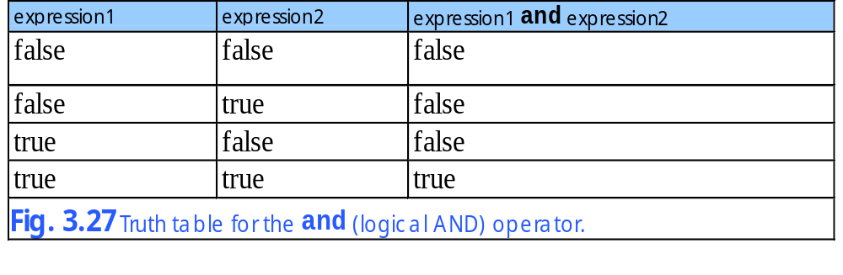
3.16 Logical Operators

Slide 51
3.16 Logical Operators
Python 2.2b2 (#26, Nov 16 2001, 11:44:11) [MSC 32 bit (Intel)] on win32
Type "help", "copyright", "credits" or "license" for more information.
>>> if 0:
... print "0 is true"
... else:
... print "0 is false"
...
0 is false
>>> if 1:
... print "non-zero is true"
...
non-zero is true
>>> if -1:
... print "non-zero is true"
...
non-zero is true
>>> print 2 < 3
1
>>> print 0 and 1
0
>>> print 1 and 3
3
Fig. 3.28 Truth values.

Slide 52
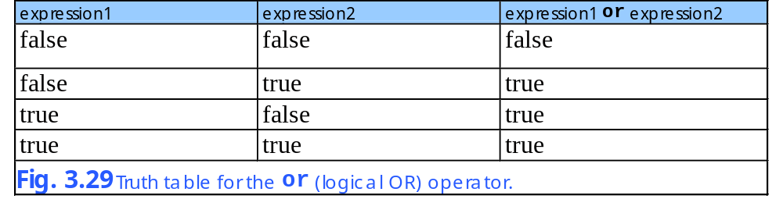
3.16 Logical Operators

Slide 53
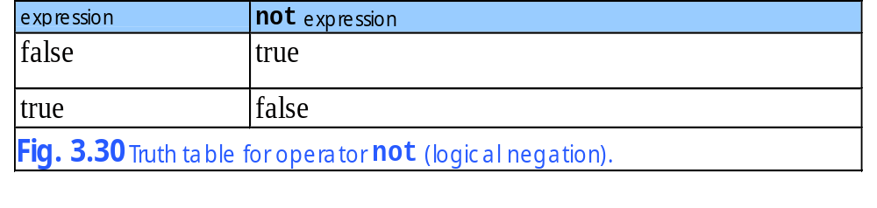
3.16 Logical Operators

Slide 54
3.17 Structured-Programming Summary
Structured-Programming
  Code is neat and readable
  Contains several ways to solve a problem
    Sequential
    Selection
      The if, if/else and if/elsif/else statements
    Repetition
      The while and for loops

Slide 55
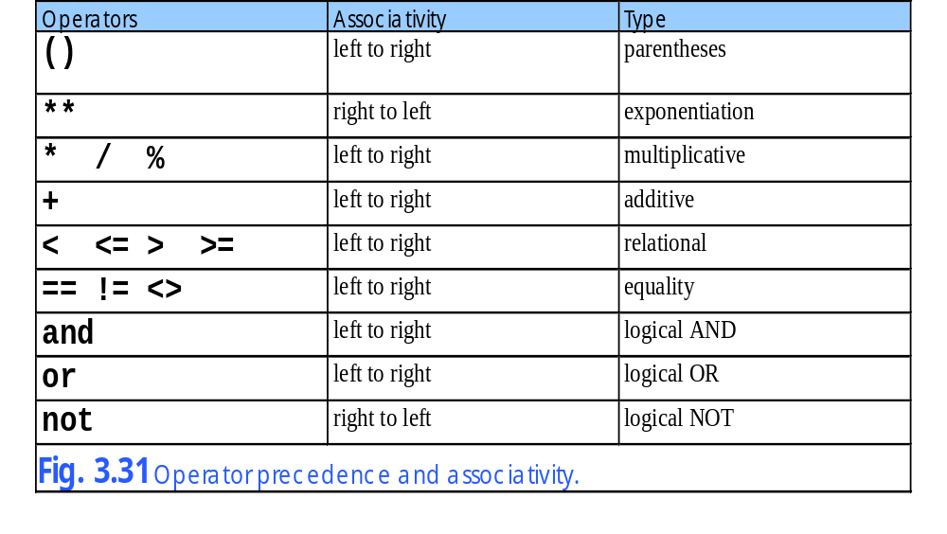
3.17 Structured-Programming Summary

Slide 56
3.17 Structured-Programming Summary
Sequence
.
.
Fig. 3.32 Single-entry/single-exit sequence, selection and repetition structures (part 1).

Slide 57
3.17 Structured-Programming Summary
if/elsif/else (multiple selections)
if/else structure (double selection)
T
F
T
F
T
F
.
.
if structure (single selection)
T
T
F
F
break
Fig. 3.32 Single-entry/single-exit sequence, selection and repetition structures (part 2).

Slide 58
3.17 Structured-Programming Summary
Repetition
while structure
for structure
T
F
T
F
Fig. 3.32 Single-entry/single-exit sequence, selection and repetition structures (part 3).

Slide 59
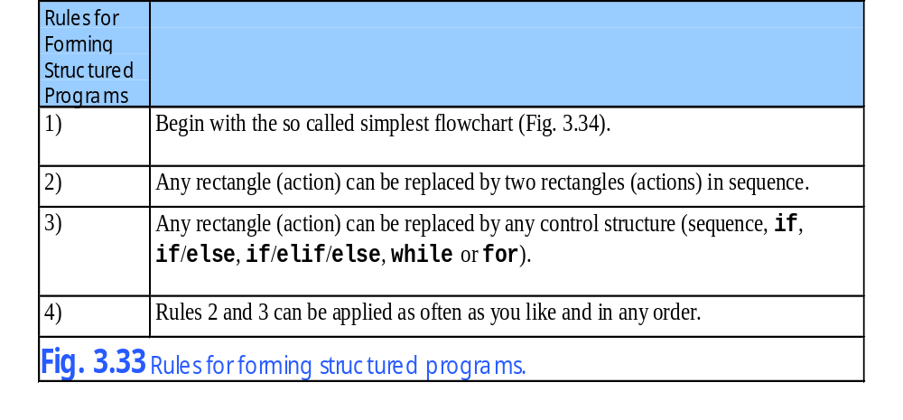
3.17 Structured-Programming Summary

Slide 60
3.17 Structured-Programming Summary
Fig. 3.34 Simplest flowchart.

Slide 61
3.17 Structured-Programming Summary
Rule 2
Rule 2
Rule 2
.
.
.
Fig. 3.35 Applying (repeatedly) rule 2 of Fig. 3.33 to the simplest flowchart.

Slide 62
3.17 Structured-Programming Summary
Rule 3
Rule 3
Fig. 3.36 Applying rule 3 of Fig. 3.35 to the simplest flowchart.

Slide 63
3.17 Structured-Programming Summary
Stacked building blocks
Nested building blocks
Overlapping building blocks (illegal in structured programs)
Fig. 3.37 Stacked, nested and overlapped building blocks.

Slide 64
3.17 Structured-Programming Summary
Fig. 3.38 Unstructured flowchart.

