Slide 1
Chapter 4 – Control Structures
Outline
4.1 Introduction
4.2 Program Components in Python
4.3 Functions
4.4 Module math Functions
4.5 Function Definitions
4.6 Random-Number Generation
4.7 Example: A Game of Chance
4.8 Scope Rules
4.9 Keyword import and Namespaces
4.9.1 Importing one or more modules
4.9.2 Importing identifiers from a module
4.9.3 Binding names for modules and module identifiers
4.10 Recursion
4.11 Example Using Recursion: The Fibonacci Series
4.12 Recursion vs. Iteration
4.13 Default Arguments
4.14 Keyword Arguments

Slide 2
4.1 Introduction
Maintenance
  The best way to maintain a large program is to break it down into smaller more manageable pieces
    These pieces are called components

Slide 3
4.2 Program Components in Python
Components
  Consist of functions, classes, modules and packages
  In most cases programs are a combination of programmer defined functions and classes with predefined ones
Programmer defined functions
  Programs the perform specific tasks and execute at various points in the program
Modules
  Used to perform common tasks
  Help to eliminate code rewriting
  The standard library
    A collection of modules provided with the python language

Slide 4
4.2 Program Components in Python (II)
Functions
  Invoked by a function call
    Specifies the function name and its arguments
  Arguments
    Additional information the function needs to compete its task
  The return task
    Information that the function returns to the source that invoked it for use elsewhere in the program

Slide 5
4.2 Program Components in Python
boss
worker1
worker2
worker3
worker4
worker5
Fig. 4.1 Hierarchical boss-function/worker-function relationship.

Slide 6
4.3 Functions
Functions
  Allow a programmer to modularize a program
  Variables created in a function are local to that function
  Parameters
    Also local variables
    Provide a means for one function to communicate with another
Purpose
  Functions support the divide and conquer strategy
  Help enhance software reusability
  Acts as building blocks for the program
  Avoids code repetition

Slide 7
4.4 Module math Functions
Module
  Contains function definitions and other elements
    All of which are related in some way
  Calling a function
    functionName ( argument1, argument2 )
  The import keyword is used to include a module
  Invoking functions from a module
    Use the module name followed by the dot operator (.)
    moduleName.functionName( argument )

Slide 8
4.4 Module math Functions
Python 2.2b2 (#26, Nov 16 2001, 11:44:11) [MSC 32 bit (Intel)] on win32
Type "help", "copyright", "credits" or "license" for more information.
>>> import math
>>> print math.sqrt( 900 )
30.0
>>> print math.sqrt( -900 )
Traceback (most recent call last):
File "<stdin>", line 1, in ?
ValueError: math domain error
Fig. 4.2 Function sqrt of module math.

Slide 9
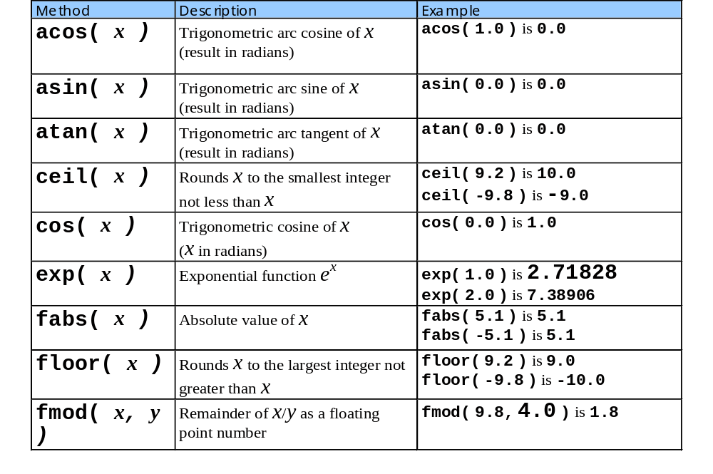
4.4 Module math Functions

Slide 10
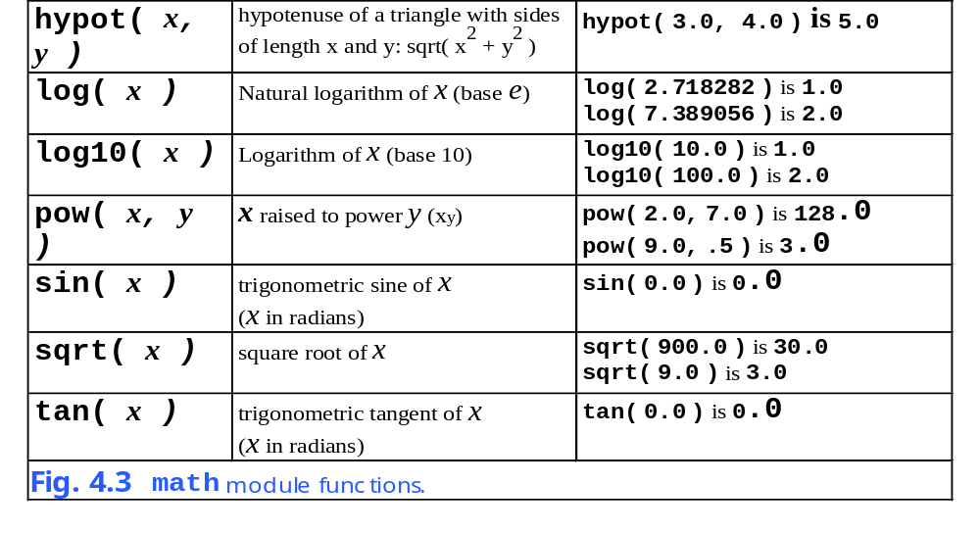
4.4 Module math Functions

Slide 11
4.5 Function Definitions
Definitions
  Functions must be defined before they are used
  def functionName ( paramList ):
    functionName is a valid identifier
    paramList is a comma separated list of parameters received
    The actions of the functions then follows
      They should all be indented appropriately
      The actions are also called the block or the function body

Slide 12
Fig04_04.py
Program Output
1 # Fig. 4.4: fig04_04.py
2 # Creating and using a programmer-defined function.
3
4 # function definition
5 def square( y ):
6 return y * y
7
8 for x in range( 1, 11 ):
9 print square( x ),
10
11 print
This is a function definition, the function is called square and is passed the value y
The function returns the passed value multiplied by itself
This calls the square function and passes it the value x
1 4 9 16 25 36 49 64 81 100

Slide 13
Fig04_05.py
1 # Fig. 4.5: fig04_05.py
2 # Finding the maximum of three integers.
3
4 def maximumValue( x, y, z ):
5 maximum = x
6
7 if y > maximum:
8 maximum = y
9
10 if z > maximum:
11 maximum = z
12
13 return maximum
14
15 a = int( raw_input( "Enter first integer: " ) )
16 b = int( raw_input( "Enter second integer: " ) )
17 c = int( raw_input( "Enter third integer: " ) )
18
19 # function call
20 print "Maximum integer is:", maximumValue( a, b, c )
21 print # print new line
22
23 d = float( raw_input( "Enter first float: " ) )
24 e = float( raw_input( "Enter second float: " ) )
25 f = float( raw_input( "Enter third float: " ) )
26 print "Maximum float is: ", maximumValue( d, e, f )
27 print
28
29 g = raw_input( "Enter first string: " )
30 h = raw_input( "Enter second string: " )
31 i = raw_input( "Enter third string: " )
32 print "Maximum string is: ", maximumValue( g, h, i )
This is a function that receives tree values
The function determines the greater of three numbers and returns it
Gets three integers, passes them to the maximumValue function, and displays the results to the user
The same process is performed on float and string variables to show the diversity of the function

Slide 14
Fig04_05.py
Program Output
Enter first integer: 27
Enter second integer: 12
Enter third integer: 36
Maximum integer is: 36
Enter first float: 12.3
Enter second float: 45.6
Enter third float: 9.03
Maximum float is: 45.6
Enter first string: hello
Enter second string: programming
Enter third string: goodbye
Maximum string is: programming

Slide 15
4.6 Random-Number Generation
The random module
  Used to generate a random number for the programmer
  Function randrange
    Generates a number from the first argument up to, but not including, the second argument
    Each number in the range has the same likelihood of being selected by the function

Slide 16
Fig04_06.py
Program Output
1 # Fig. 4.6: fig04_06.py
2 # Random integers produced by randrange.
3
4 import random
5
6 for i in range( 1, 21 ): # simulates 20 die rolls
7 print "%10d" % ( random.randrange( 1, 7 ) ),
8
9 if i % 5 == 0: # print newline every 5 rolls
10 print
The random module is imported
The randrange function is called passing the values 1 and 7
As shown by the output the number range is really from 1 to 6 not 7
5 3 3 3 2
3 2 3 3 4
2 3 6 5 4
6 2 4 1 2

Slide 17
Fig04_07.py
1 # Fig. 4.7: fig04_07.py
2 # Roll a six-sided die 6000 times.
3
4 import random
5
6 frequency1 = 0
7 frequency2 = 0
8 frequency3 = 0
9 frequency4 = 0
10 frequency5 = 0
11 frequency6 = 0
12
13 for roll in range( 1, 6001 ): # 6000 die rolls
14 face = random.randrange( 1, 7 )
15
16 if face == 1: # frequency counted
17 frequency1 += 1
18 elif face == 2:
19 frequency2 += 1
20 elif face == 3:
21 frequency3 += 1
22 elif face == 4:
23 frequency4 += 1
24 elif face == 5:
25 frequency5 += 1
26 elif face == 6:
27 frequency6 += 1
28 else: # simple error handling
29 print "should never get here!"
30
Creates a loop that executes 6000 times
Again the randrange function is called with values 1 and 7 passed to it
This nested if is used to keep track of the occurrence of each number generated
This else statement should never be used by the program but is there for good programming purposes

Slide 18
Fig04_07.py
Program Output
31 print "Face %13s" % "Frequency"
32 print " 1 %13d" % frequency1
33 print " 2 %13d" % frequency2
34 print " 3 %13d" % frequency3
35 print " 4 %13d" % frequency4
36 print " 5 %13d" % frequency5
37 print " 6 %13d" % frequency6
Displays the total amount of times each number was returned
Face Frequency
1 946
2 1003
3 1035
4 1012
5 987
6 1017

Slide 19
4.7 Example: A Game of Chance

Slide 20
Fig04_08.py
1 # Fig. 4.8: fig04_08.py
2 # Craps.
3
4 import random
5
6 def rollDice():
7 die1 = random.randrange( 1, 7 )
8 die2 = random.randrange( 1, 7 )
9 workSum = die1 + die2
10 print "Player rolled %d + %d = %d" % ( die1, die2, workSum )
11
12 return workSum
13
14 sum = rollDice() # first dice roll
15
16 if sum == 7 or sum == 11: # win on first roll
17 gameStatus = "WON"
18 elif sum == 2 or sum == 3 or sum == 12: # lose on first roll
19 gameStatus = "LOST"
20 else: # remember point
21 gameStatus = "CONTINUE"
22 myPoint = sum
23 print "Point is", myPoint
24
25 while gameStatus == "CONTINUE": # keep rolling
26 sum = rollDice()
27
28 if sum == myPoint: # win by making point
29 gameStatus = "WON"
30 elif sum == 7: # lose by rolling 7:
31 gameStatus = "LOST"
32
The start of the rollDice function
Prints out the value of each random number along with their sum, which is also returned
An if statement that determines the next step in the game based on what the player rolled
The while statement will loop until the player has wither lost or won the game

Slide 21
Fig04_08.py
Program Output
33 if gameStatus == "WON":
34 print "Player wins"
35 else:
36 print "Player loses"
Determines whether or not the player won
Player rolled 2 + 5 = 7
Player wins
Player rolled 1 + 2 = 3
Player loses
Player rolled 1 + 5 = 6
Point is 6
Player rolled 1 + 6 = 7
Player loses
Player rolled 5 + 4 = 9
Point is 9
Player rolled 4 + 4 = 8
Player rolled 2 + 3 = 5
Player rolled 5 + 4 = 9
Player wins

Slide 22
4.8 Scope Rules
Rules for value retrieval
  Based on namespace and scope
  Namespaces store information about an identifier and a value to which it is bound
  Three types
    Local, global, and built-in
    They are also checked by Python in the order listed above
Local namespace
  Contains values that were created in a block
  Each function has a unique local namespace

Slide 23
4.8 Scope Rules
Global namespace
  Stores the names of date, functions and classes defined within the file or module
  Each module contain a __name__
    It holds the name of the module
  The global keyword
    Used to automatically search the global namespace
Built-in namespace
  Not usually modified by programmers
  Contains functions such as raw_input, int, and range
  The built-in namespace is included when the interpreter starts

Slide 24
4.8 Scope Rules
Python 2.2b2 (#26, Nov 16 2001, 11:44:11) [MSC 32 bit (Intel)] on win32
Type "help", "copyright", "credits" or "license" for more information.
>>> dir()
['__builtins__', '__doc__', '__name__']
>>> print __name__
__main__
>>> print __builtins__
<module '__builtin__' (built-in)>
>>> x = 3 # bind new identifier to global namespace
>>> dir()
['__builtins__', '__doc__', '__name__', 'x']
Fig. 4.9 Function dir.

Slide 25
Fig04_10.py
1 # Fig. 4.10: fig04_10.py
2 # Scoping example.
3
4 x = 1 # global variable
5
6 # alters the local variable x, shadows the global variable
7 def a():
8 x = 25
9
10 print "\nlocal x in a is", x, "after entering a"
11 x += 1
12 print "local x in a is", x, "before exiting a"
13
14 # alters the global variable x
15 def b():
16 global x
17
18 print "\nglobal x is", x, "on entering b"
19 x *= 10
20 print "global x is", x, "on exiting b"
21
22 print "global x is", x
23
24 x = 7
25 print "global x is", x
26
27 a()
28 b()
29 a()
30 b()
31
32 print "\nglobal x is", x
This is a global variable and can be used by any function in the program
Has its own value of x therefore the global value is hidden
Function b uses and modifies the value of the global x
Changes the value of x to 7

Slide 26
Fig04_10.py
Program Output
global x is 1
global x is 7
local x in a is 25 after entering a
local x in a is 26 before exiting a
global x is 7 on entering b
global x is 70 on exiting b
local x in a is 25 after entering a
local x in a is 26 before exiting a
global x is 70 on entering b
global x is 700 on exiting b
global x is 700

Slide 27
4.9 Keyword import and Namespaces
Importing
  Affects a programs namespace

Slide 28
4.9.1 Importing One or More Modules
Importing
  Use the keyword import followed by the desired module
    Several imports may be made over several lines
    One import can exist with several coma separated modules
  Inserts the imported module into the programs namespace

Slide 29
4.9.1 Importing One or More Modules
Python 2.2b2 (#26, Nov 16 2001, 11:44:11) [MSC 32 bit (Intel)] on win32
Type "help", "copyright", "credits" or "license" for more information.
>>> import math
>>> dir()
['__builtins__', '__doc__', '__name__', 'math']
>>> print math
<module 'math' (built-in)>
>>> dir( math )
['__doc__', '__name__', 'acos', 'asin', 'atan', 'atan2', 'ceil', 'cos', 'cosh','e', 'exp', 'fabs', 'floor', 'fmod', 'frexp', 'hypot', 'ldexp', 'log', 'log10','modf', 'pi', 'pow', 'sin', 'sinh', 'sqrt', 'tan', 'tanh']
>>> math.sqrt( 9.0 )
3.0
Fig. 4.11 Importing a module.

Slide 30
4.9.1 Importing One or More Modules
Python 2.2b2 (#26, Nov 16 2001, 11:44:11) [MSC 32 bit (Intel)] on win32
Type "help", "copyright", "credits" or "license" for more information.
>>> import math, random
>>> dir()
['__builtins__', '__doc__', '__name__', 'math', 'random']
Fig. 4.12 Importing more than one module.

Slide 31
4.9.2 Importing Identifiers as a Module
The from/import statement
  Allows a programmer to import only a specific part of a module
  Take identifiers from a module and insert them directly into the current programs name space

Slide 32
4.9.2 Importing Identifiers as a Module
Python 2.2b2 (#26, Nov 16 2001, 11:44:11) [MSC 32 bit (Intel)] on win32
Type "help", "copyright", "credits" or "license" for more information.
>>> from math import sqrt
>>> dir()
['__builtins__', '__doc__', '__name__', 'sqrt']
>>> sqrt( 9.0 )
3.0
>>> from math import sin, cos, tan
>>> dir()
['__builtins__', '__doc__', '__name__', 'cos', 'sin', 'sqrt', 'tan']
Fig. 4.13 Importing an identifier from a module.

Slide 33
4.9.2 Importing Identifiers as a Module
Python 2.2b2 (#26, Nov 16 2001, 11:44:11) [MSC 32 bit (Intel)] on win32
Type "help", "copyright", "credits" or "license" for more information.
>>> from math import *
>>> dir()
['__builtins__', '__doc__', '__name__', 'acos', 'asin', 'atan', 'atan2', 'ceil', 'cos', 'cosh', 'e', 'exp', 'fabs', 'floor', 'fmod', 'frexp', 'hypot', 'ldexp','log', 'log10', 'modf', 'pi', 'pow', 'sin', 'sinh', 'sqrt', 'tan', 'tanh']
Fig. 4.14 Importing all identifiers from a module.

Slide 34
4.9.3 Binding Names of Modules as Module Identifiers
The import/as statement
  Creates a reference that is used to call the module
    Allows a module to be used with a different name
    Prevents conflict in the program

Slide 35
4.9.3 Binding Names of Modules as Module Identifiers
Python 2.2b2 (#26, Nov 16 2001, 11:44:11) [MSC 32 bit (Intel)] on win32
Type "help", "copyright", "credits" or "license" for more information.
>>> import random as randomModule
>>> dir()
['__builtins__', '__doc__', '__name__', 'randomModule']
>>> randomModule.randrange( 1, 7 )
1
>>> from math import sqrt as squareRoot
>>> dir()
['__builtins__', '__doc__', '__name__', 'randomModule', 'squareRoot']
>>> squareRoot( 9.0 )
3.0
Fig. 4.15 Specifying names for imported elements.

Slide 36
4.10 Recursion
Recursive functions
  A function that has a call to itself
    Either directly or indirectly
  The function only knows how to solve the base case
    The base case is the simplest form of the problem
  If the function does not get the base case it breaks the problem up
    The problem is split into a solvable and non-solvable pieces
  These pieces are then passed to the function again to either be solved or broken up more
  Original call to the function remains open
    Closes only when all sub calls are finished

Slide 37
4.10 Recursion
Final value = 120
5!
5!
5! = 5 * 24 = 120 is returned
5 * 4!
5 * 4!
4! = 4 * 6 = 24 is returned
4 * 3!
4 * 3!
3! = 3 * 2 = 6 is returned
3 * 2!
3 * 2!
2! = 2 * 1 = 2 is returned
2 * 1!
2 * 1!
1 returned
1
1
(a) Procession of recursive calls.
(b) Values returned from each recursive call.
Fig. 4.16 Recursive evaluation of 5!.

Slide 38
Fig04_17.py
Program Output
1 # Fig. 4.17: fig04_17.py
2 # Recursive factorial function.
3
4 # Recursive definition of function factorial
5 def factorial( number ):
6
7 if number <= 1: # base case
8 return 1
9 else:
10 return number * factorial( number - 1 ) # recursive call
11
12 for i in range( 11 ):
13 print "%2d! = %d" % ( i, factorial( i ) )
The factorial function receives one number as an argument
If the number is less than or equal to 1 then return 1
Else a recursive call is made to the factorial function passing the number minus 1
0! = 1
1! = 1
2! = 2
3! = 6
4! = 24
5! = 120
6! = 720
7! = 5040
8! = 40320
9! = 362880
10! = 3628800

Slide 39
4.11 Example Using Recursion: The Fibonacci Series
The Fibonacci series
  Each number is composed of the sum of the two previous numbers
    Fibonacci( n ) = Fibonacci( n – 1 ) + Fibonacci( n – 2 )
    Fibonacci( 1 ) = 1 and Fibonacci( 0 ) = 0
  Converges to 1.618
    Also known as the golden ratio
    Aesthetically pleasing in nature

Slide 40
Fig04_18.py
Program Output
1 # Fig. 4.18: fig04_18.py
2 # Recursive fibonacci function.
3
4 def fibonacci( n ):
5
6 if n < 0:
7 print "Cannot find the fibonacci of a negative number."
8
9 if n == 0 or n == 1: # base case
10 return n
11 else:
12
13 # two recursive calls
14 return fibonacci( n - 1 ) + fibonacci( n - 2 )
15
16 number = int( raw_input( "Enter an integer: " ) )
17 result = fibonacci( number )
18 print "Fibonacci(%d) = %d" % ( number, result )
If n is either 0 or 1 then return that value
If the value is neither zero or one then two recursive calls are made
Enter an integer: 0
Fibonacci(0) = 0
Enter an integer: 1
Fibonacci(1) = 1
Enter an integer: 2
Fibonacci(2) = 1

Slide 41
Fig04_18.py
Program Output
Enter an integer: 3
Fibonacci(3) = 2
Enter an integer: 4
Fibonacci(4) = 3
Enter an integer: 6
Fibonacci(6) = 8
Enter an integer: 10
Fibonacci(10) = 55
Enter an integer: 20
Fibonacci(20) = 6765

Slide 42
4.11 Example Using Recursion: The Fibonacci Series
Fibonacci( 3 )
return
Fibonacci( 2 )
+
Fibonacci( 1 )
return
Fibonacci( 1 )
+
Fibonacci( 0 )
return 1
return 1
return 0
Fig. 4.19 Recursive call to function fibonacci.

Slide 43
4.12 Recursion vs. Iteration
Iteration
  The use of loops to create repetition
  Loops infinitely if condition never evaluates to false
Recursion
  The use of function calls to create repetition
  Loops infinitely if condition never breaks down to base case
  Repeatedly invokes the mechanism and function
    This can eat up processor time
    Uses lots of memory as well
      Copies of the function’s variables are made

Slide 44
4.13 Default Arguments
Function arguments
  Functions may commonly receive a particular value type
  When this is true a default argument can be set
    Must appear to the right of any other arguments
    When omitted all value to the right must also be omitted
  A default value can also be set
    If passes a value then the default value is overridden

Slide 45
Fig04_20.py
Program Output
1 # Fig. 4.20: fig04_20.py
2 # Using default arguments.
3
4 # function definition with default arguments
5 def boxVolume( length = 1, width = 1, height = 1 ):
6 return length * width * height
7
8 print "The default box volume is:", boxVolume()
9 print "\nThe volume of a box with length 10,"
10 print "width 1 and height 1 is:", boxVolume( 10 )
11 print "\nThe volume of a box with length 10,"
12 print "width 5 and height 1 is:", boxVolume( 10, 5 )
13 print "\nThe volume of a box with length 10,"
14 print "width 5 and height 2 is:", boxVolume( 10, 5, 2 )
Sets the three values, defaulted to 1
When this is called the default values will be used
The 10 will replace the left most 1 and the other default values will be used
Here two values are sent meaning only height will use its default value
In this case no default values were used
The default box volume is: 1
The volume of a box with length 10,
width 1 and height 1 is: 10
The volume of a box with length 10,
width 5 and height 1 is: 50
The volume of a box with length 10,
width 5 and height 2 is: 100

Slide 46
4.14 Keyword Arguments
Keyword arguments
  Just as a programmer specifies default arguments keyword arguments can be specified as well
  Allows parameter to be passed in any order so long as they are explicitly stated
  Will set the values that were not passed to the default

Slide 47
Fig04_21.py
Program Output
1 # Fig. 4.21: fig04_21.py
2 # Keyword arguments example.
3
4 def generateWebsite( name, url = "www.deitel.com",
5 Flash = "no", CGI = "yes" ):
6 print "Generating site requested by", name, "using url", url
7
8 if Flash == "yes":
9 print "Flash is enabled"
10
11 if CGI == "yes":
12 print "CGI scripts are enabled"
13 print # prints a new line
14
15 generateWebsite( "Deitel" )
16
17 generateWebsite( "Deitel", Flash = "yes",
18 url = "www.deitel.com/new" )
19
20 generateWebsite( CGI = "no", name = "Prentice Hall" )
The definition of this function specifies keywords, some of which have default values as well
Sets Deitel as the first value and uses the defaults for all the others
In order the variables are given new values and CGI uses the default
The values need not be entered in order
Generating site requested by Deitel using url www.deitel.com
CGI scripts are enabled
Generating site requested by Deitel using url www.deitel.com/new
Flash is enabled
CGI scripts are enabled
Generating site requested by Prentice Hall using url www.deitel.com

Slide 48
4.14 Keyword Arguments
Python 2.2b2 (#26, Nov 16 2001, 11:44:11) [MSC 32 bit (Intel)] on win32
Type "help", "copyright", "credits" or "license" for more information.
>>> def test( name, number1 = "one", number2 = "two" ):
... pass
...
>>> test( number1 = "two", "Name" )
SyntaxError: non-keyword arg after keyword arg
>>> test( number1 = "three" )
Traceback (most recent call last):
File "<stdin>", line 1, in ?
TypeError: test() takes at least 1 non-keyword argument (0 given)
Fig. 4.22 Errors with keyword arguments.

