Slide 1
Chapter 5 – Lists, Tuples and Dictionaries
Outline
5.1 Introduction
5.2 Sequences
5.3 Creating Sequences
5.4 Using Lists and Tuples
5.4.1 Using Lists
5.4.2 Using Tuples
5.4.3 Sequence Unpacking
5.4.4 Sequence Slicing
5.5 Dictionaries
5.6 List and Dictionary Methods
5.7 References and Reference Parameters
5.8 Passing Lists to Functions
5.9 Sorting and Searching Lists
5.10 Multiple-Subscripted Sequences

Slide 2
5.1 Introduction
Data structures
  Structures that hold and organize information
Sequences
  Also know as arrays in other languages
  Store related data types
  3 types
    Strings
    Lists
    Tuples
Mappings
  In most languages called hashes or associative arrays
  Dictionaries are the only python mapping container

Slide 3
5.2 Sequences
Sequence
  Series of items that are often related
  Strings are sequences in Python
  A sequence is returned by the range function
  Elements
    The individual items in each sequence
      Referred to by subscripts
    The first is always zero
    Obtain one by using sequenceName[ subscript ]
    Can also be referred to negatively
      -1 would be the last element of the sequence

Slide 4
5.2 Sequences
c[ 0 ]
-45
c[ -12 ]
c[ 1 ]
6
c[ -11 ]
Name sequence (c)
c[ 2 ]
0
c[ -10 ]
c[ 3 ]
72
c[ -9 ]
c[ 4 ]
1543
c[ -8]
c[ 5 ]
-89
c[- 7 ]
c[ 6 ]
0
c[ -6 ]
c[ 7 ]
62
c[ -5 ]
c[ 8]
-3
c[ -4 ]
Position number of the element within sequence c
c[ 9 ]
1
c[- 3 ]
c[ 10 ]
6453
c[ -2 ]
c[ 11 ]
-78
c[ -1 ]
Fig. 5.1 Sequence with elements and indices.

Slide 5
5.3 Creating Sequences
Creations
  Strings
    Use quotes
    string1 = ""
  Lists
    Use brackets
    Separate multiple items with a comma
    list1 = []
  Tuples
    Use parenthesis
    Separate multiple items with a comma
    tuple = ()
    singleton = 1, - this is a one element tuple or a singleton

Slide 6
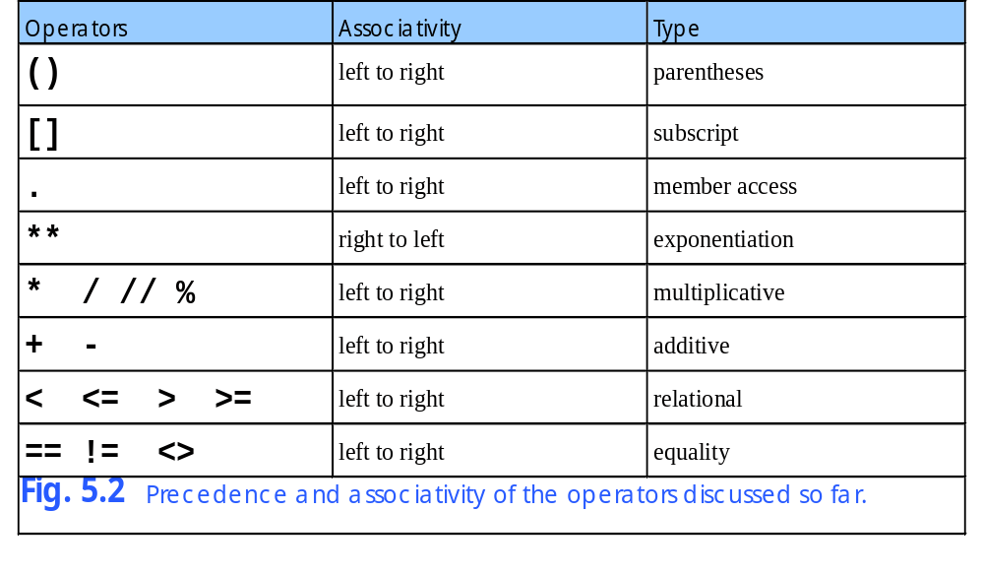
5.3 Creating Sequences

Slide 7
5.4 Using Lists and Tuples
Differences
  Tuples and lists can both contain the same data
  For practical purposes though each is used to hold different types of items

Slide 8
5.4.1 Using Lists
Lists
  Not restricted to values of the same type
    Programmers use lists to hold data that is of the same type
  The length is not usually predetermined and can vary throughout the program
  Accessing elements out of range
    Python exits and an out of range error is displayed

Slide 9
Fig05_03.py
1 # Fig. 5.3: fig05_03.py
2 # Creating, accessing and changing a list.
3
4 aList = [] # create empty list
5
6 # add values to list
7 for number in range( 1, 11 ):
8 aList += [ number ]
9
10 print "The value of aList is:", aList
11
12 # access list values by iteration
13 print "\nAccessing values by iteration:"
14
15 for item in aList:
16 print item,
17
18 print
19
20 # access list values by index
21 print "\nAccessing values by index:"
22 print "Subscript Value"
23
24 for i in range( len( aList ) ):
25 print "%9d %7d" % ( i, aList[ i ] )
26
27 # modify list
28 print "\nModifying a list value..."
29 print "Value of aList before modification:", aList
30 aList[ 0 ] = -100
31 aList[ -3 ] = 19
32 print "Value of aList after modification:", aList
Adds the values 1 to 10 to the list
Prints the list, both all at once and one at a time
Prints the list in comparison to its subscripts
Sets the value of the first item to -100
Sets the value of the 8th item to 19

Slide 10
Fig05_03.py
Program Output
The value of aList is: [1, 2, 3, 4, 5, 6, 7, 8, 9, 10]
Accessing values by iteration:
1 2 3 4 5 6 7 8 9 10
Accessing values by index:
Subscript Value
0 1
1 2
2 3
3 4
4 5
5 6
6 7
7 8
8 9
9 10
Modifying a list value...
Value of aList before modification: [1, 2, 3, 4, 5, 6, 7, 8, 9, 10]
Value of aList after modification: [-100, 2, 3, 4, 5, 6, 7, 19, 9, 10]

Slide 11
5.4.1 Using Lists
Python 2.2b2 (#26, Nov 16 2001, 11:44:11) [MSC 32 bit (Intel)] on win32
Type "help", "copyright", "credits" or "license" for more information.
>>> aList = [ 1 ]
>>> print aList[ 13 ]
Traceback (most recent call last):
File "<stdin>", line 1, in ?
IndexError: list index out of range
Fig. 5.4 Out-of-range error.

Slide 12
Fig05_05.py
1 # Fig. 5.5: fig05_05.py
2 # Creating a histogram from a list of values.
3
4 values = [] # a list of values
5
6 # input 10 values from user
7 print "Enter 10 integers:"
8
9 for i in range( 10 ):
10 newValue = int( raw_input( "Enter integer %d: " % ( i + 1 ) ) )
11 values += [ newValue ]
12
13 # create histogram
14 print "\nCreating a histogram from values:"
15 print "%s %10s %10s" % ( "Element", "Value", "Histogram" )
16
17 for i in range( len( values ) ):
18 print "%7d %10d %s" % ( i, values[ i ], "*" * values[ i ] )
Prompts the user for 10 integers
Outputs as many *’s as the number entered into the list by the user

Slide 13
Fig05_05.py
Program Output
Enter 10 integers:
Enter integer 1: 19
Enter integer 2: 3
Enter integer 3: 15
Enter integer 4: 7
Enter integer 5: 11
Enter integer 6: 9
Enter integer 7: 13
Enter integer 8: 5
Enter integer 9: 17
Enter integer 10: 1
Creating a histogram from values:
Element Value Histogram
0 19 *******************
1 3 ***
2 15 ***************
3 7 *******
4 11 ***********
5 9 *********
6 13 *************
7 5 *****
8 17 *****************
9 1 *

Slide 14
5.4.2 Using Tuples
Tuples
  Used to contain data that is related but not necessarily of the same type
    Each data item represents a unique piece of the overall portion
      In this case tuples are usually not not iterated though
      The needed data is accessed before hand
    A person’s name, age and birth date
    Again this is not required but is a general rule

Slide 15
Fig05_06.py
Program Output
1 # Fig. 5.6: fig05_06.py
2 # Creating and accessing tuples.
3
4 # retrieve hour, minute and second from user
5 hour = int( raw_input( "Enter hour: " ) )
6 minute = int( raw_input( "Enter minute: " ) )
7 second = int( raw_input( "Enter second: " ) )
8
9 currentTime = hour, minute, second # create tuple
10
11 print "The value of currentTime is:", currentTime
12
13 # access tuple
14 print "The number of seconds since midnight is", \
15 ( currentTime[ 0 ] * 3600 + currentTime[ 1 ] * 60 +
16 currentTime[ 2 ] )
Creates a tuple that holds the time entered by the user
Out puts the entire tuple
Tuples are accessed using brackets
Converts the time to seconds
Enter hour: 9
Enter minute: 16
Enter second: 1
The value of currentTime is: (9, 16, 1)
The number of seconds since midnight is 33361

Slide 16
5.4.3 Sequence Unpacking
Unpacking
  A useful shortcut for to assign values to multiple variables in one statement

Slide 17
Fig05_07.py
1 # Fig. 5.7: fig05_07.py
2 # Unpacking sequences.
3
4 # create sequences
5 aString = "abc"
6 aList = [ 1, 2, 3 ]
7 aTuple = "a", "A", 1
8
9 # unpack sequences to variables
10 print "Unpacking string..."
11 first, second, third = aString
12 print "String values:", first, second, third
13
14 print "\nUnpacking list..."
15 first, second, third = aList
16 print "List values:", first, second, third
17
18 print "\nUnpacking tuple..."
19 first, second, third = aTuple
20 print "Tuple values:", first, second, third
21
22 # swapping two values
23 x = 3
24 y = 4
25
26 print "\nBefore swapping: x = %d, y = %d" % ( x, y )
27 x, y = y, x # swap variables
28 print "After swapping: x = %d, y = %d" % ( x, y )
Creates a sting a list and a tuple
Unpacks the string into characters
Unpacks the list into elements
Unpacks the tuple into elements
The technique can also be used to swap two items

Slide 18
Fig05_07.py
Program Output
Unpacking string...
String values: a b c
Unpacking list...
List values: 1 2 3
Unpacking tuple...
Tuple values: a A 1
Before swapping: x = 3, y = 4
After swapping: x = 4, y = 3

Slide 19
5.4.4 Sequence Slicing
Slicing
  Allows a programmer to access a portion of a string or element at once
  theSequence [ start:end ]
  Returns the portion of the sequence from the starting position up to the ending position

Slide 20
Fig05_08.py
1 # Fig. 5.8: fig05_08.py
2 # Slicing sequences.
3
4 # create sequences
5 sliceString = "abcdefghij"
6 sliceTuple = ( 1, 2, 3, 4, 5, 6, 7, 8, 9, 10 )
7 sliceList = [ "I", "II", "III", "IV", "V",
8 "VI", "VII", "VIII", "IX", "X" ]
9
10 # print strings
11 print "sliceString: ", sliceString
12 print "sliceTuple: ", sliceTuple
13 print "sliceList: ", sliceList
14 print
15
16 # get slices
17 start = int( raw_input( "Enter start: " ) )
18 end = int( raw_input( "Enter end: " ) )
19
20 # print slices
21 print "\nsliceString[", start, ":", end, "] = ", \
22 sliceString[ start:end ]
23
24 print "sliceTuple[", start, ":", end, "] = ", \
25 sliceTuple[ start:end ]
26
27 print "sliceList[", start, ":", end, "] = ", \
28 sliceList[ start:end ]
Creates a string a list and a tuple
Gets a start and end point from the user
Returns only the data from the start point up to the end point

Slide 21
Fig05_08.py
Program Output
sliceString: abcdefghij
sliceTuple: (1, 2, 3, 4, 5, 6, 7, 8, 9, 10)
sliceList: ['I', 'II', 'III', 'IV', 'V', 'VI', 'VII', 'VIII',
'IX', 'X']
Enter start: 3
Enter end: 3
sliceString[ 3 : 3 ] =
sliceTuple[ 3 : 3 ] = ()
sliceList[ 3 : 3 ] = []
sliceString: abcdefghij
sliceTuple: (1, 2, 3, 4, 5, 6, 7, 8, 9, 10)
sliceList: ['I', 'II', 'III', 'IV', 'V', 'VI', 'VII', 'VIII',
'IX', 'X']
Enter start: -4
Enter end: -1
sliceString[ -4 : -1 ] = ghi
sliceTuple[ -4 : -1 ] = (7, 8, 9)
sliceList[ -4 : -1 ] = ['VII', 'VIII', 'IX']

Slide 22
Fig05_08.py
Program Output
sliceString: abcdefghij
sliceTuple: (1, 2, 3, 4, 5, 6, 7, 8, 9, 10)
sliceList: ['I', 'II', 'III', 'IV', 'V', 'VI', 'VII', 'VIII',
'IX', 'X']
Enter start: 0
Enter end: 10
sliceString[ 0 : 10 ] = abcdefghij
sliceTuple[ 0 : 10 ] = (1, 2, 3, 4, 5, 6, 7, 8, 9, 10)
sliceList[ 0 : 10 ] = ['I', 'II', 'III', 'IV', 'V', 'VI', 'VII',
'VIII', 'IX', 'X']

Slide 23
5.5 Dictionaries
Dictionaries
  Mapping constructs consisting of key-value pairs
    Referred to as hashes in other languages
  Unordered collection of references
  Each value is referenced though key in the pair
  Curley braces ({}) are used to create a dictionary
  When entering values
    Use { key1:value1, … }
  Keys must be immutable values such as strings, numbers and tuples
  Values can be of any Python data type

Slide 24
Fig05_09.py
1 # Fig. 5.09: fig05_09.py
2 # Creating, accessing and modifying a dictionary.
3
4 # create and print an empty dictionary
5 emptyDictionary = {}
6 print "The value of emptyDictionary is:", emptyDictionary
7
8 # create and print a dictionary with initial values
9 grades = { "John": 87, "Steve": 76, "Laura": 92, "Edwin": 89 }
10 print "\nAll grades:", grades
11
12 # access and modify an existing dictionary
13 print "\nSteve's current grade:", grades[ "Steve" ]
14 grades[ "Steve" ] = 90
15 print "Steve's new grade:", grades[ "Steve" ]
16
17 # add to an existing dictionary
18 grades[ "Michael" ] = 93
19 print "\nDictionary grades after modification:"
20 print grades
21
22 # delete entry from dictionary
23 del grades[ "John" ]
24 print "\nDictionary grades after deletion:"
25 print grades
Creates an empty dictionary
Creates a grades dictionary using names as the key and their grade as the value
Alters and displays the new grade for Steve
Adds a new name to the grades dictionary
Removes the name john from the dictionary with the del keyword

Slide 25
Fig05_09.py
Program Output
The value of emptyDictionary is: {}
All grades: {'Edwin': 89, 'John': 87, 'Steve': 76, 'Laura': 92}
Steve's current grade: 76
Steve's new grade: 90
Dictionary grades after modification:
{'Edwin': 89, 'Michael': 93, 'John': 87, 'Steve': 90, 'Laura': 92}
Dictionary grades after deletion:
{'Edwin': 89, 'Michael': 93, 'Steve': 90, 'Laura': 92}

Slide 26
5.6 List and Dictionary Methods
Method
  A function that performs the behaviors of an object
List methods
  append - add values on to the end of a list
  A list of methods is provided in Fig. 5.12
Dictionary methods
  Allows manipulation of the items just as in a list
  A list of methods is provided in Fig. 5.14

Slide 27
Fig05_10.py
Program Output
1 # Fig. 5.10: fig05_10.py
2 # Appending items to a list.
3
4 playList = [] # list of favorite plays
5
6 print "Enter your 5 favorite Shakespearean plays.\n"
7
8 for i in range( 5 ):
9 playName = raw_input( "Play %d: " % ( i + 1 ) )
10 playList.append( playName )
11
12 print "\nSubscript Value"
13
14 for i in range( len( playList ) ):
15 print "%9d %-25s" % ( i + 1, playList[ i ] )
Has the user enter 5 plays
Appends the items onto the list using the append method
Displays the items for the user
Enter your 5 favorite Shakespearean plays.
Play 1: Richard III
Play 2: Henry V
Play 3: Twelfth Night
Play 4: Hamlet
Play 5: King Lear
Subscript Value
1 Richard III
2 Henry V
3 Twelfth Night
4 Hamlet
5 King Lear

Slide 28
Fig05_11.py
Program Output
1 # Fig. 5.11: fig05_11.py
2 # Student poll program.
3
4 responses = [ 1, 2, 6, 4, 8, 5, 9, 7, 8, 10,
5 1, 6, 3, 8, 6, 10, 3, 8, 2, 7,
6 6, 5, 7, 6, 8, 6, 7, 5, 6, 6,
7 5, 6, 7, 5, 6, 4, 8, 6, 8, 10 ]
8
9 print "Rating Frequency"
10
11 for i in range( 1, 11 ):
12 print "%6d %13d" % ( i, responses.count( i ) )
Creates a list of 40 numbers from 1 through 10
Uses the count method to tally up the total of each number in the lint
Rating Frequency
1 2
2 2
3 2
4 2
5 5
6 11
7 5
8 7
9 1
10 3

Slide 29
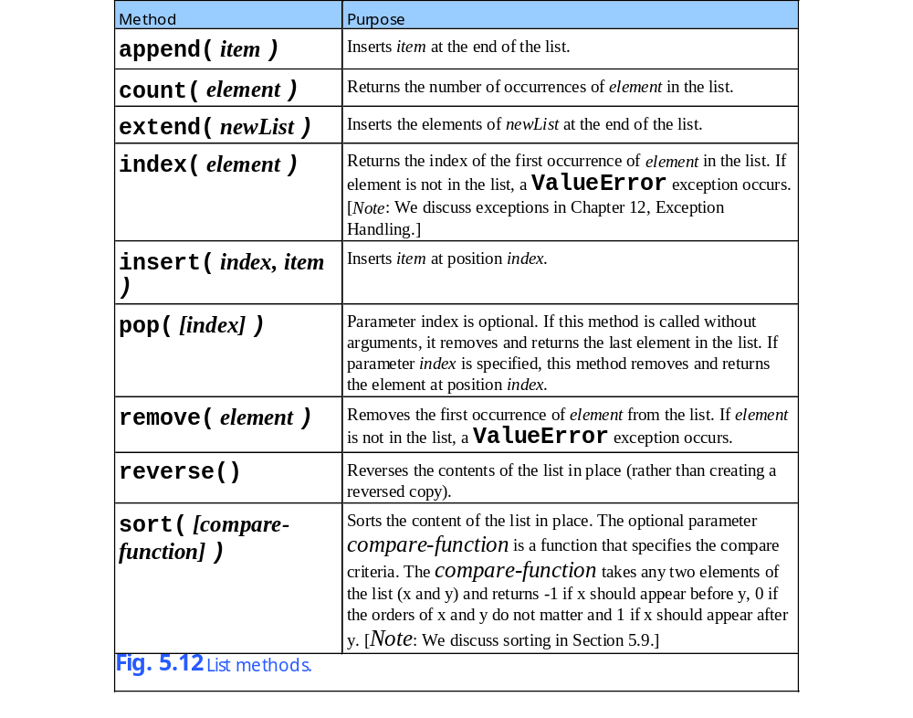
5.6 List and Dictionary Methods

Slide 30
Fig05_13.py
1 # Fig. 5.13: fig05_13.py
2 # Dictionary methods.
3
4 monthsDictionary = { 1 : "January", 2 : "February", 3 : "March",
5 4 : "April", 5 : "May", 6 : "June", 7 : "July",
6 8 : "August", 9 : "September", 10 : "October",
7 11 : "November", 12 : "December" }
8
9 print "The dictionary items are:"
10 print monthsDictionary.items()
11
12 print "\nThe dictionary keys are:"
13 print monthsDictionary.keys()
14
15 print "\nThe dictionary values are:"
16 print monthsDictionary.values()
17
18 print "\nUsing a for loop to get dictionary items:"
19
20 for key in monthsDictionary.keys():
21 print "monthsDictionary[", key, "] =", monthsDictionary[ key ]
Creates a dictionary with the month number as the key and the month name as the value
Prints out all the items, both key and value, in the dictionary
Prints out all the keys in the dictionary
Prints out just the values in the dictionary
Loops though using the keys to display all the items in the dictionary

Slide 31
Fig05_13.py
Program Output
The dictionary items are:
[(1, 'January'), (2, 'February'), (3, 'March'), (4, 'April'), (5, 'May'), (6, 'June'), (7, 'July'), (8, 'August'), (9, 'September'), (10, 'October'), (11, 'November'), (12, 'December')]
The dictionary keys are:
[1, 2, 3, 4, 5, 6, 7, 8, 9, 10, 11, 12]
The dictionary values are:
['January', 'February', 'March', 'April', 'May', 'June', 'July', 'August', 'September', 'October', 'November', 'December']
Using a for loop to get dictionary items:
monthsDictionary[ 1 ] = January
monthsDictionary[ 2 ] = February
monthsDictionary[ 3 ] = March
monthsDictionary[ 4 ] = April
monthsDictionary[ 5 ] = May
monthsDictionary[ 6 ] = June
monthsDictionary[ 7 ] = July
monthsDictionary[ 8 ] = August
monthsDictionary[ 9 ] = September
monthsDictionary[ 10 ] = October
monthsDictionary[ 11 ] = November
monthsDictionary[ 12 ] = December

Slide 32
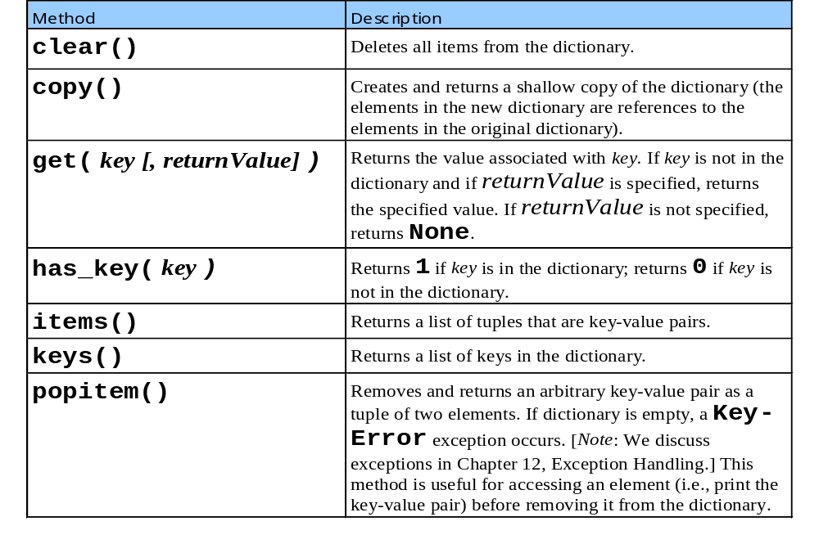
5.6 List and Dictionary Methods

Slide 33
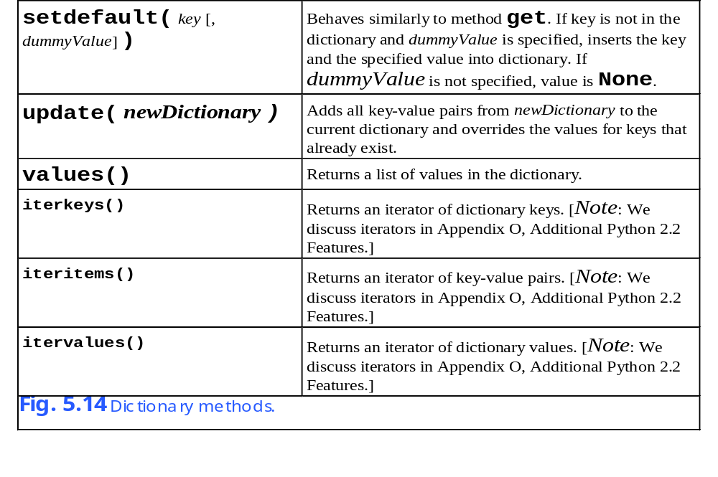
5.6 List and Dictionary Methods

Slide 34
5.6 List and Dictionary Methods
Python 2.2b2 (#26, Nov 16 2001, 11:44:11) [MSC 32 bit (Intel)] on win32
Type "help", "copyright", "credits" or "license" for more information.
>>> dictionary = { "listKey" : [ 1, 2, 3 ] }
>>> shallowCopy = dictionary.copy() # make a shallow copy
>>> dictionary[ "listKey" ].append( 4 )
>>> print dictionary
{'listKey': [1, 2, 3, 4]}
>>> print shallowCopy
{'listKey': [1, 2, 3, 4]}
>>> from copy import deepcopy
>>> deepCopy = deepcopy( dictionary ) # make a deep copy
>>> dictionary[ "listKey" ].append( 5 )
>>> print dictionary
{'listKey': [1, 2, 3, 4, 5]}
>>> print shallowCopy
{'listKey': [1, 2, 3, 4, 5]}
>>> print deepCopy
{'listKey': [1, 2, 3, 4]}
Fig. 5.15 Difference between a shallow copy and a deep copy.

Slide 35
5.7 References and Reference Parameters
Pass-by-value
  Copies the value and passes the copy
Pass-by-reference
  Allows a function to access the caller data and to modify it
  Can increase performance
    Prevents the copying of large data
  Can weaken security
    Allows direct access to the data
Pass by object reference
  Only thing allowed in Python
  Combination of pass-by-value and pass-by-reference
  Can modify mutable objects and not immutable objects

Slide 36
5.8 Passing Lists to Functions
Passing a list
  The same applies for other mutable objects in Python
  To pass a list pass it without its brackets
  This allows the entire list to be changed
  Item in the list that are immutable (numbers or strings) cannot be changed by the function when passed individually

Slide 37
Fig05_16.py
1 # Fig. 5.16: fig05_16.py
2 # Passing lists and individual list elements to functions.
3
4 def modifyList( aList ):
5
6 for i in range( len( aList ) ):
7 aList[ i ] *= 2
8
9 def modifyElement( element ):
10 element *= 2
11
12 aList = [ 1, 2, 3, 4, 5 ]
13
14 print "Effects of passing entire list:"
15 print "The values of the original list are:"
16
17 for item in aList:
18 print item,
19
20 modifyList( aList )
21
22 print "\n\nThe values of the modified list are:"
23
24 for item in aList:
25 print item,
26
27 print "\n\nEffects of passing list element:"
28 print "aList[ 3 ] before modifyElement:", aList[ 3 ]
29 modifyElement( aList[ 3 ] )
30 print "aList[ 3 ] after modifyElement:", aList[ 3 ]
31
32 print "\nEffects of passing slices of list:"
33 print "aList[ 2:4 ] before modifyList:", aList[ 2:4 ]
34 modifyList( aList[ 2:4 ] )
35 print "aList[ 2:4 ] after modifyList:", aList[ 2:4 ]
Both the modifyList and modifyElement functions take the given object and multiply them by 2
Passes the entire list, the changes in the function will affect the list
Passes on element, it will not permanently be modified in the list
Passes a slice of the list, the changes made are only temporary

Slide 38
Fig05_16.py
Program Output
Effects of passing entire list:
The values of the original list are:
1 2 3 4 5
The values of the modified list are:
2 4 6 8 10
Effects of passing list element:
aList[ 3 ] before modifyElement: 8
aList[ 3 ] after modifyElement: 8
Effects of passing slices of list:
aList[ 2:4 ] before modifyList: [6, 8]
aList[ 2:4 ] after modifyList: [6, 8]

Slide 39
5.9 Sorting and Searching Lists
Sorting a list
  Use the sort method
Searching a list
  Use the index method

Slide 40
Fig05_17.py
Program Output
1 # Fig. 5.17: fig05_17.py
2 # Sorting a list.
3
4 aList = [ 2, 6, 4, 8, 10, 12, 89, 68, 45, 37 ]
5
6 print "Data items in original order"
7
8 for item in aList:
9 print item,
10
11 aList.sort()
12
13 print "\n\nData items after sorting"
14
15 for item in aList:
16 print item,
17
18 print
Displays the unorganized list
The sort method is used to order the numbers in ascending order
Displays the sorted list
Data items in original order
2 6 4 8 10 12 89 68 45 37
Data items after sorting
2 4 6 8 10 12 37 45 68 89

Slide 41
Fig05_18.py
Program Output
1 # Fig. 5.18: fig05_18.py
2 # Searching a list for an integer.
3
4 # Create a list of even integers 0 to 198
5 aList = range( 0, 199, 2 )
6
7 searchKey = int( raw_input( "Enter integer search key: " ) )
8
9 if searchKey in aList:
10 print "Found at index:", aList.index( searchKey )
11 else:
12 print "Value not found"
Creates a list containing the even numbers from 0 to 200
The index method is used to find an item in the list and return the index of that item
Enter integer search key: 36
Found at index: 18
Enter integer search key: 37
Value not found

Slide 42
5.10 Multiple-Scripted Sequences
Multiple-scripted sequences
  Sequences that contain elements that are sequences
  Common use is a table
    By convention it is organized by row and column
  Python does not support multiple scripted arrays directly
    Can make a sequence containing sequences which contains sequences…
    This would give the effect of a multiple-scripted sequence

Slide 43
5.10 Multiple-Scripted Sequences
Column 0
Column 1
Column 2
Column 3
Row 0
a[0, 0]
a[0, 1]
a[0, 2]
a[0, 3]
Row 1
a[1, 0]
a[1, 1]
a[1, 2]
a[1, 3]
Row 2
a[2, 0]
a
[2,
1]
a[2, 2]
a[2, 3]
Column index (or subscript)
Row index (or subscript)
Array name
Fig. 5.19 Double-subscripted sequence with three rows and four columns.

Slide 44
Fig05_20.py
Program Output
1 # Fig. 5.20: fig05_20.py
2 # Making tables using lists of lists and tuples of tuples.
3
4 table1 = [ [ 1, 2, 3 ], [ 4, 5, 6 ] ]
5 table2 = ( ( 1, 2 ), ( 3, ), ( 4, 5, 6 ) )
6
7 print "Values in table1 by row are"
8
9 for row in table1:
10
11 for item in row:
12 print item,
13
14 print
15
16 print "\nValues in table2 by row are"
17
18 for row in table2:
19
20 for item in row:
21 print item,
22
23 print
This list has two rows
This tuple has three rows
A nested for loop is needed to display all of the items in the list
Values in table1 by row are
1 2 3
4 5 6
Values in table2 by row are
1 2
3
4 5 6

Slide 45
Fig05_21.py
1 # Fig. 5.21: fig05_21.py
2 # Double-subscripted list example.
3
4
5 def printGrades( grades ):
6 students = len( grades ) # number of students
7 exams = len( grades[ 0 ] ) # number of exams
8
9 # print table headers
10 print "The list is:"
11 print " ",
12
13 for i in range( exams ):
14 print "[%d]" % i,
15
16 print
17
18 # print scores, by row
19 for i in range( students ):
20 print "grades[%d] " % i,
21
22 for j in range( exams ):
23 print grades[ i ][ j ], "",
24
25 print
26
27
28 def minimum( grades ):
29 lowScore = 100
30
31 for studentExams in grades: # loop over students
32
33 for score in studentExams: # loop over scores
34
This function is used to print the grades in the proper format
Again a nested for loop is used to display all of the data
Finds the minimum of all the grades

Slide 46
Fig05_21.py
35 if score < lowScore:
36 lowScore = score
37
38 return lowScore
39
40
41 def maximum( grades ):
42 highScore = 0
43
44 for studentExams in grades: # loop over students
45
46 for score in studentExams: # loop over scores
47
48 if score > highScore:
49 highScore = score
50
51 return highScore
52
53
54 def average( setOfGrades ):
55 total = 0.0
56
57 for grade in setOfGrades: # loop over student’s scores
58 total += grade
59
60 return total / len( setOfGrades )
61
62
63 # main program
64 grades = [ [ 77, 68, 86, 73 ],
65 [ 96, 87, 89, 81 ],
66 [ 70, 90, 86, 81 ] ]
67
68 printGrades( grades )
Returns the maximum grade in the list
This function finds and returns the average of the grades on the list
Creates the list of grades for manipulation

Slide 47
Fig05_21.py
Program Output
69 print "\n\nLowest grade:", minimum( grades )
70 print "Highest grade:", maximum( grades )
71 print "\n"
72
73 # print average for each student
74 for i in range( len( grades ) ):
75 print "Average for student", i, "is", average( grades[ i ] )
A call to each function to display the results
The list is:
[0] [1] [2] [3]
grades[0] 77 68 86 73
grades[1] 96 87 89 81
grades[2] 70 90 86 81
Lowest grade: 68
Highest grade: 96
Average for student 0 is 76.0
Average for student 1 is 88.25
Average for student 2 is 81.75

