Slide 1
Chapter 8 – Customizing Classes
Outline
8.1 Introduction
8.2 Customizing String Representation: Method __str__
8.3 Customizing Attribute Access
8.4 Operator Overloading
8.5 Restrictions on Operator Overloading
8.6 Overloading Unary Operators
8.7 Overloading Binary Operators
8.8 Overloading Built-in Functions
8.9 Converting Between Types
8.10 Case Study: A Rational Class
8.11 Overloading Sequence Operations
8.12 Case Study: A SingleList Class
8.13 Overloading Mapping Operations
8.14 Case Study: A SimpleDictionary Class

Slide 2
8.1 Introduction
Class Customization
  Provide clients with simple notation for manipulating objects
  Special methods
    Called by Python when a client performs a certain operation on an object
  Operator overloading
    Enable Python’s operators to work with objects
    For example, the + operator is overloaded to work with numeric values as well as perform string concatenation

Slide 3
8.2 Customizing String Representation: Method __str__
Special Methods
  __str__
    Allows object to be output with print statement
    Method is called by Python when print statement occurs
      Example: print objectOfClass
    String returned by method is output displayed to user

Slide 4
PhoneNumber.py
1 # Fig. 8.1: PhoneNumber.py
2 # Representation of phone number in USA format: (xxx) xxx-xxxx.
3
4 class PhoneNumber:
5 """Simple class to represent phone number in USA format"""
6
7 def __init__( self, number ):
8 """Accepts string in form (xxx) xxx-xxxx"""
9
10 self.areaCode = number[ 1:4 ] # 3-digit area code
11 self.exchange = number[ 6:9 ] # 3-digit exchange
12 self.line = number[ 10:14 ] # 4-digit line
13
14 def __str__( self ):
15 """Informal string representation"""
16
17 return "(%s) %s-%s" % \
18 ( self.areaCode, self.exchange, self.line )
19
20 def test():
21
22 # obtain phone number from user
23 newNumber = raw_input(
24 "Enter phone number in the form (123) 456-7890:\n" )
25
26 phone = PhoneNumber( newNumber ) # create PhoneNumber object
27 print "The phone number is:",
28 print phone # invokes phone.__str__()
29
30 if __name__ == "__main__":
31 test()
__str__ constructs and returns a string that represents the PhoneNumber object
print statement invokes the __str__ method and prints a string representation of phone
test() is called if PhoneNumber.py is executed as a stand-alone program
Enter phone number in the form (123) 456-7890:
(800) 555-1234
The phone number is: (800) 555-1234

Slide 5
8.3 Customizing Attribute Access
Special Methods
  Can control how the dot access operator behaves on objects of a class
  Accessing an attribute with the dot operator causes methods to execute
    __setattr__
      Called by Python every time a program makes an assignment to an object’s attribute through the dot operator
    __getattr__
      Called by Python if an attribute is accessed as a right-hand value by the dot operator
      Executes only if attribute is not found in the object’s __dict__

Slide 6
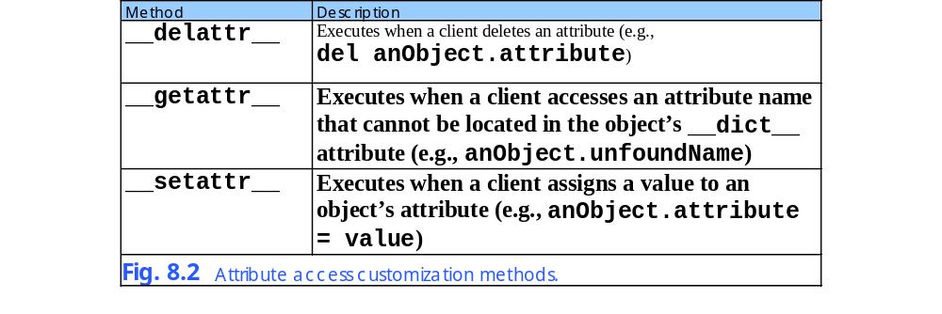

Slide 7
TimeAccess.py
1 # Fig: 8.3: TimeAccess.py
2 # Class Time with customized attribute access.
3
4 class Time:
5 """Class Time with customized attribute access"""
6
7 def __init__( self, hour = 0, minute = 0, second = 0 ):
8 """Time constructor initializes each data member to zero"""
9
10 # each statement invokes __setattr__
11 self.hour = hour
12 self.minute = minute
13 self.second = second
14
15 def __setattr__( self, name, value ):
16 """Assigns a value to an attribute"""
17
18 if name == "hour":
19
20 if 0 <= value < 24:
21 self.__dict__[ "_hour" ] = value
22 else:
23 raise ValueError, "Invalid hour value: %d" % value
24
25 elif name == "minute" or name == "second":
26
27 if 0 <= value < 60:
28 self.__dict__[ "_" + name ] = value
29 else:
30 raise ValueError, "Invalid %s value: %d" % \
31 ( name, value )
32
33 else:
34 self.__dict__[ name ] = value
35
Each assignment in the constructor invokes the __setattr__ method
Object reference argument
Name of attribute to change
New value for attribute
Test to determine which attribute is going to be modified
Perform checking to make sure new value is valid
Assign new value using the class’s __dict__ to avoid causing an infinite recursion by using the dot operator

Slide 8
TimeAccess.py
36 def __getattr__( self, name ):
37 """Performs lookup for unrecognized attribute name"""
38
39 if name == "hour":
40 return self._hour
41 elif name == "minute":
42 return self._minute
43 elif name == "second":
44 return self._second
45 else:
46 raise AttributeError, name
47
48 def __str__( self ):
49 """Returns Time object string in military format"""
50
51 # attribute access does not call __getattr__
52 return "%.2d:%.2d:%.2d" % \
53 ( self._hour, self._minute, self._second )
__getattr__ tests for attribute being accessed and returns appropriate value

Slide 9
Interactive Session
(Fig. 8.3)
Python 2.2b2 (#26, Nov 16 2001, 11:44:11) [MSC 32 bit (Intel)] on win32
Type "help", "copyright", "credits" or "license" for more information.
>>>
>>> from TimeAccess import Time
>>> time1 = Time( 4, 27, 19 )
>>> print time1
04:27:19
>>> print time1.hour, time1.minute, time1.second
4 27 19
>>> time1.hour = 16
>>> print time1
16:27:19
>>> time1.second = 90
Traceback (most recent call last):
File "<stdin>", line 1, in ?
File "TimeAccess.py", line 30, in __setattr__
raise ValueError, "Invalid %s value: %d" % \
ValueError: Invalid second value: 90
Attempt to change second to 90 results in an error

Slide 10
8.4 Operator Overloading
Operators
  Provide concise notation for manipulation of built-in types
  Overloading
    Allows operators to work with programmer-defined types
    Done by defining a special method that corresponds to a certain operator
      For example, __add__ overloads the + operator

Slide 11
8.5 Restrictions on Operator Overloading
Restrictions
  Precedence of operators cannot be changed
    Parenthesis may be used to force order of evaluation
  “Arity” of operators may not be changed
    Number of operands an operator takes
  Meaning of how an operator works on built-in types may not be changed
  Overloading mathematical operators automatically overloads the corresponding augmented assignment statement
    Overloading the + operator causes += to be overloaded as well

Slide 12
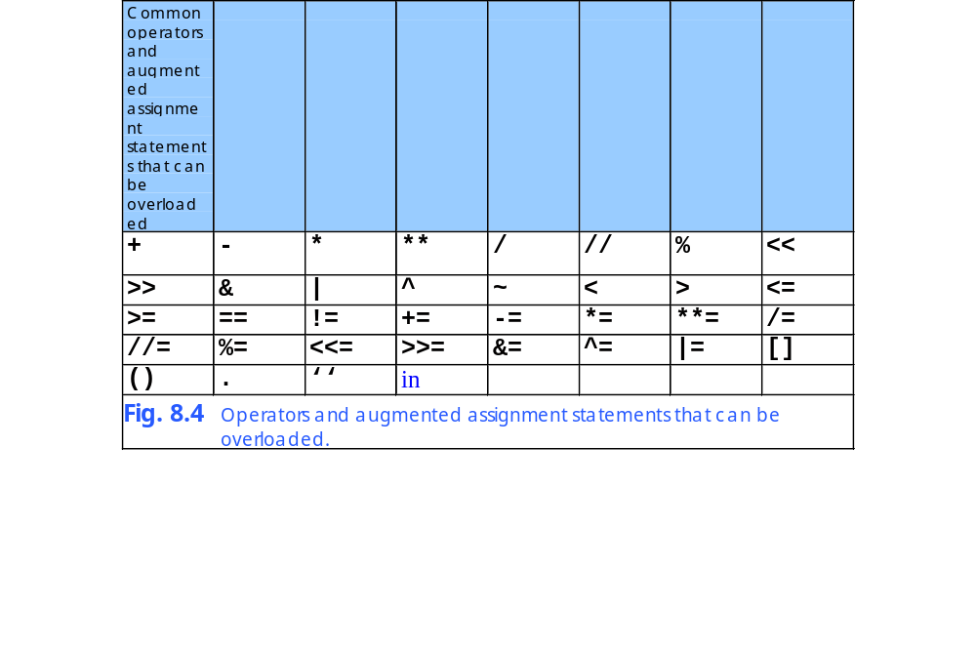

Slide 13
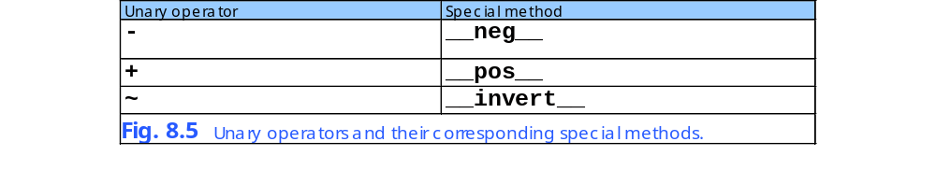
8.6 Overloading Unary Operators
Unary Operators
  Overloaded with special method definition
    Only argument is object reference (self)

Slide 14
8.7 Overloading Binary Operators
Binary operators
  Overloaded by method with two arguments
    self and other

Slide 15
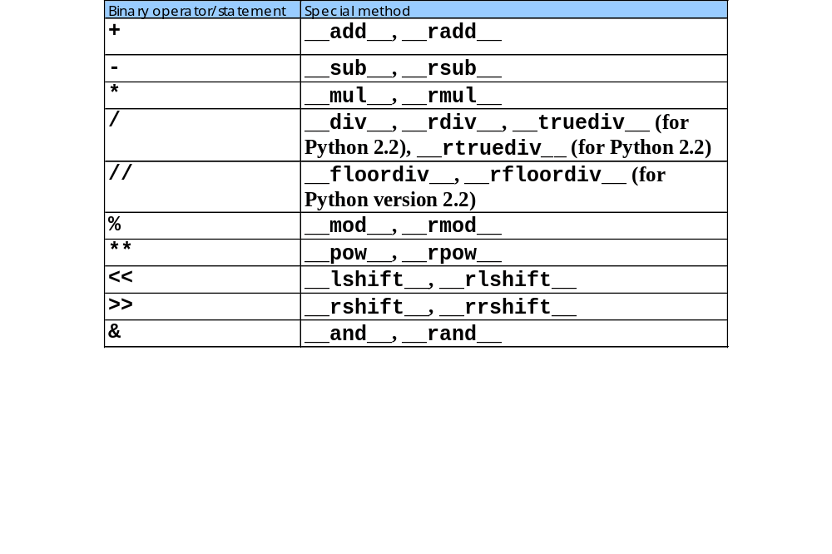

Slide 16
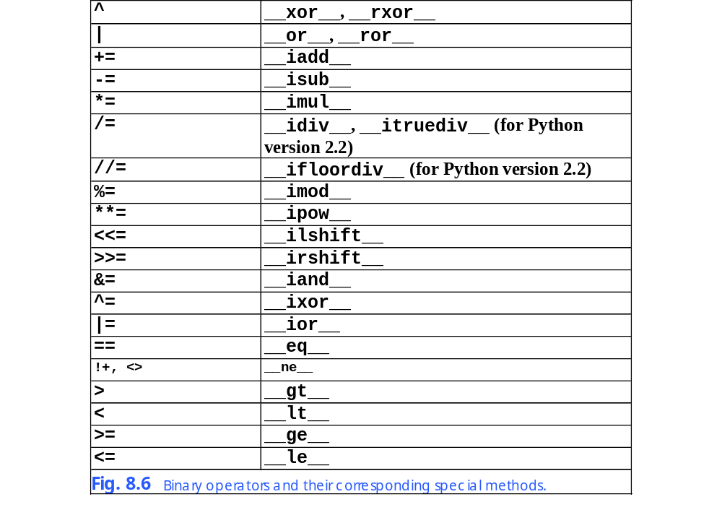

Slide 17
8.8 Overloading Built-in Functions
Built-in Functions
  Overloading
    Special methods execute when certain built-in functions are performed on an object of a class
      For example, __abs__ may be defined to execute when a program calls the abs() function

Slide 18
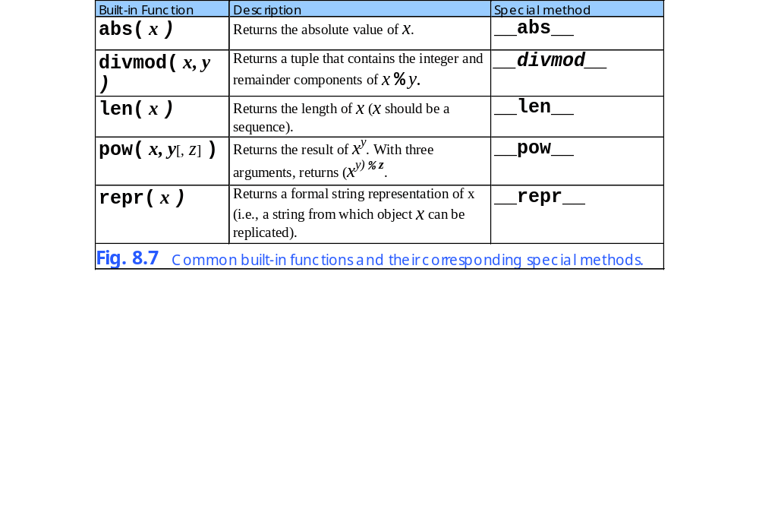

Slide 19
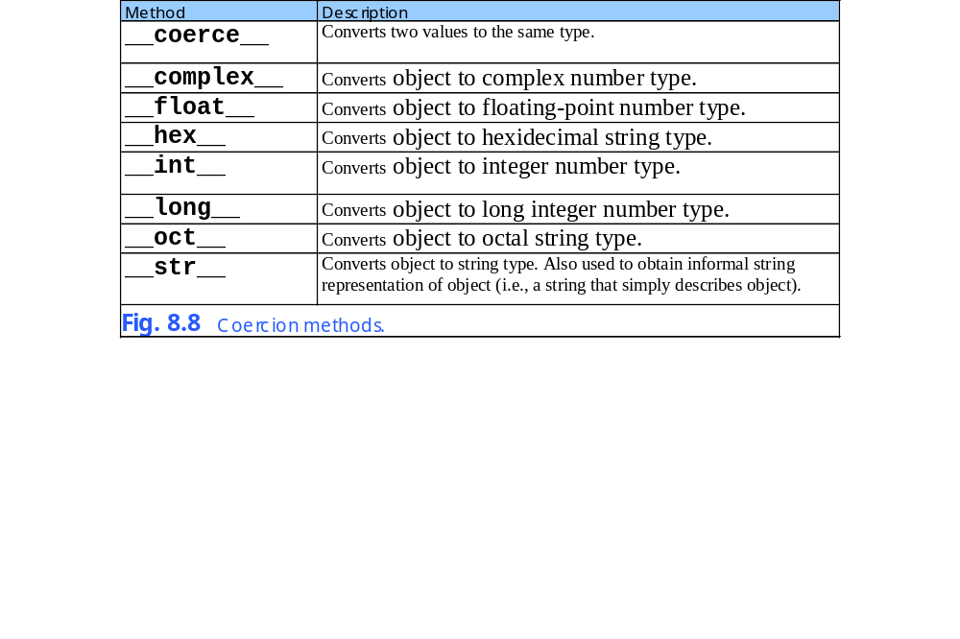

Slide 20
RationalNumber.py
1 # Fig. 8.9: RationalNumber.py
2 # Definition of class Rational.
3
4 def gcd( x, y ):
5 """Computes greatest common divisor of two values"""
6
7 while y:
8 z = x
9 x = y
10 y = z % y
11
12 return x
13
14 class Rational:
15 """Representation of rational number"""
16
17 def __init__( self, top = 1, bottom = 1 ):
18 """Initializes Rational instance"""
19
20 # do not allow 0 denominator
21 if bottom == 0:
22 raise ZeroDivisionError, "Cannot have 0 denominator"
23
24 # assign attribute values
25 self.numerator = abs( top )
26 self.denominator = abs( bottom )
27 self.sign = ( top * bottom ) / ( self.numerator *
28 self.denominator )
29
30 self.simplify() # Rational represented in reduced form
31
32 # class interface method
33 def simplify( self ):
34 """Simplifies a Rational number"""
35

Slide 21
RationalNumber.py
36 common = gcd( self.numerator, self.denominator )
37 self.numerator /= common
38 self.denominator /= common
39
40 # overloaded unary operator
41 def __neg__( self ):
42 """Overloaded negation operator"""
43
44 return Rational( -self.sign * self.numerator,
45 self.denominator )
46
47 # overloaded binary arithmetic operators
48 def __add__( self, other ):
49 """Overloaded addition operator"""
50
51 return Rational(
52 self.sign * self.numerator * other.denominator +
53 other.sign * other.numerator * self.denominator,
54 self.denominator * other.denominator )
55
56 def __sub__( self, other ):
57 """Overloaded subtraction operator"""
58
59 return self + ( -other )
60
61 def __mul__( self, other ):
62 """Overloaded multiplication operator"""
63
64 return Rational( self.numerator * other.numerator,
65 self.sign * self.denominator *
66 other.sign * other.denominator )
67
68 def __div__( self, other ):
69 """Overloaded / division operator."""
70

Slide 22
RationalNumber.py
71 return Rational( self.numerator * other.denominator,
72 self.sign * self.denominator *
73 other.sign * other.numerator )
74
75 def __truediv__( self, other ):
76 """Overloaded / division operator. (For use with Python
77 versions (>= 2.2) that contain the // operator)"""
78
79 return self.__div__( other )
80
81 # overloaded binary comparison operators
82 def __eq__( self, other ):
83 """Overloaded equality operator"""
84
85 return ( self - other ).numerator == 0
86
87 def __lt__( self, other ):
88 """Overloaded less-than operator"""
89
90 return ( self - other ).sign < 0
91
92 def __gt__( self, other ):
93 """Overloaded greater-than operator"""
94
95 return ( self - other ).sign > 0
96
97 def __le__( self, other ):
98 """Overloaded less-than or equal-to operator"""
99
100 return ( self < other ) or ( self == other )
101
102 def __ge__( self, other ):
103 """Overloaded greater-than or equal-to operator"""
104
105 return ( self > other ) or ( self == other )

Slide 23
RationalNumber.py
106
107 def __ne__( self, other ):
108 """Overloaded inequality operator"""
109
110 return not ( self == other )
111
112 # overloaded built-in functions
113 def __abs__( self ):
114 """Overloaded built-in function abs"""
115
116 return Rational( self.numerator, self.denominator )
117
118 def __str__( self ):
119 """String representation"""
120
121 # determine sign display
122 if self.sign == -1:
123 signString = "-"
124 else:
125 signString = ""
126
127 if self.numerator == 0:
128 return "0"
129 elif self.denominator == 1:
130 return "%s%d" % ( signString, self.numerator )
131 else:
132 return "%s%d/%d" % \
133 ( signString, self.numerator, self.denominator )
134
135 # overloaded coercion capability
136 def __int__( self ):
137 """Overloaded integer representation"""
138
139 return self.sign * divmod( self.numerator,
140 self.denominator )[ 0 ]

Slide 24
RationalNumber.py
141
142 def __float__( self ):
143 """Overloaded floating-point representation"""
144
145 return self.sign * float( self.numerator ) / self.denominator
146
147 def __coerce__( self, other ):
148 """Overloaded coercion. Can only coerce int to Rational"""
149
150 if type( other ) == type( 1 ):
151 return ( self, Rational( other ) )
152 else:
153 return None

Slide 25
Fig08_10.py
1 # Fig. 8.10: fig08_10.py
2 # Driver for class Rational.
3
4 from RationalNumber import Rational
5
6 # create objects of class Rational
7 rational1 = Rational() # 1/1
8 rational2 = Rational( 10, 30 ) # 10/30 (reduces to 1/3)
9 rational3 = Rational( -7, 14 ) # -7/14 (reduces to -1/2)
10
11 # print objects of class Rational
12 print "rational1:", rational1
13 print "rational2:", rational2
14 print "rational3:", rational3
15 print
16
17 # test mathematical operators
18 print rational1, "/", rational2, "=", rational1 / rational2
19 print rational3, "-", rational2, "=", rational3 - rational2
20 print rational2, "*", rational3, "-", rational1, "=", \
21 rational2 * rational3 - rational1
22
23 # overloading + implicitly overloads +=
24 rational1 += rational2 * rational3
25 print "\nrational1 after adding rational2 * rational3:", rational1
26 print
27
28 # test comparison operators
29 print rational1, "<=", rational2, ":", rational1 <= rational2
30 print rational1, ">", rational3, ":", rational1 > rational3
31 print
32
33 # test built-in function abs
34 print "The absolute value of", rational3, "is:", abs( rational3 )
35 print

Slide 26
Fig08_10.py
36
37 # test coercion
38 print rational2, "as an integer is:", int( rational2 )
39 print rational2, "as a float is:", float( rational2 )
40 print rational2, "+ 1 =", rational2 + 1
rational1: 1
rational2: 1/3
rational3: -1/2
1 / 1/3 = 3
-1/2 - 1/3 = -5/6
1/3 * -1/2 - 1 = -7/6
rational1 after adding rational2 * rational3: 5/6
5/6 <= 1/3 : 0
5/6 > -1/2 : 1
The absolute value of -1/2 is: 1/2
1/3 as an integer is: 0
1/3 as a float is: 0.333333333333
1/3 + 1 = 4/3

Slide 27
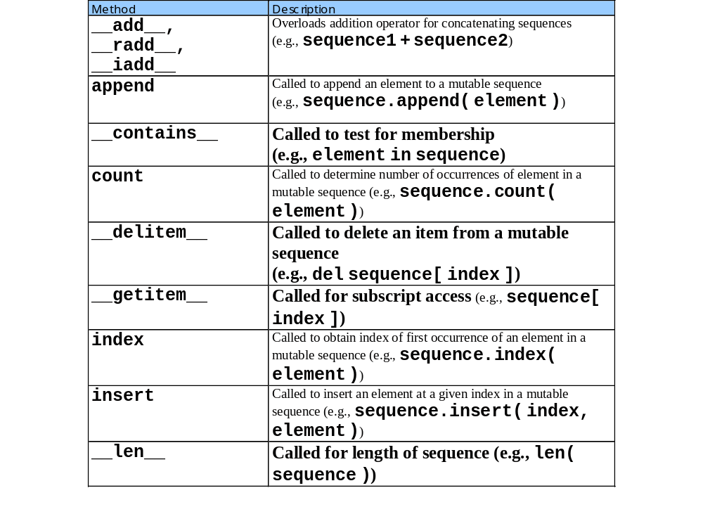

Slide 28
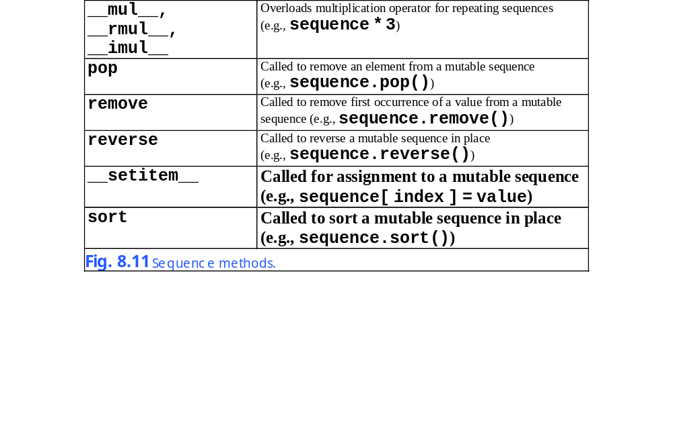

Slide 29
NewList.py
1 # Fig. 8.12: NewList.py
2 # Simple class SingleList.
3
4 class SingleList:
5
6 def __init__( self, initialList = None ):
7 """Initializes SingleList instance"""
8
9 self.__list = [] # internal list, contains no duplicates
10
11 # process list passed to __init__, if necessary
12 if initialList:
13
14 for value in initialList:
15
16 if value not in self.__list:
17 self.__list.append( value ) # add original value
18
19 # string representation method
20 def __str__( self ):
21 """Overloaded string representation"""
22
23 tempString = ""
24 i = 0
25
26 # build output string
27 for i in range( len( self ) ):
28 tempString += "%12d" % self.__list[ i ]
29
30 if ( i + 1 ) % 4 == 0: # 4 numbers per row of output
31 tempString += "\n"
32
33 if i % 4 != 0: # add newline, if necessary
34 tempString += "\n"
35

Slide 30
NewList.py
36 return tempString
37
38 # overloaded sequence methods
39 def __len__( self ):
40 """Overloaded length of the list"""
41
42 return len( self.__list )
43
44 def __getitem__( self, index ):
45 """Overloaded sequence element access"""
46
47 return self.__list[ index ]
48
49 def __setitem__( self, index, value ):
50 """Overloaded sequence element assignment"""
51
52 if value in self.__list:
53 raise ValueError, \
54 "List already contains value %s" % str( value )
55
56 self.__list[ index ] = value
57
58 # overloaded equality operators
59 def __eq__( self, other ):
60 """Overloaded == operator"""
61
62 if len( self ) != len( other ):
63 return 0 # lists of different sizes
64
65 for i in range( 0, len( self ) ):
66
67 if self.__list[ i ] != other.__list[ i ]:
68 return 0 # lists are not equal
69
70 return 1 # lists are equal

Slide 31
NewList.py
71
72 def __ne__( self, other ):
73 """Overloaded != and <> operators"""
74
75 return not ( self == other )

Slide 32
Fig08_13.py
1 # Fig. 8.13: fig08_13.py
2 # Driver for simple class SingleList.
3
4 from NewList import SingleList
5
6 def getIntegers():
7 size = int( raw_input( "List size: " ) )
8
9 returnList = [] # the list to return
10
11 for i in range( size ):
12 returnList.append(
13 int( raw_input( "Integer %d: " % ( i + 1 ) ) ) )
14
15 return returnList
16
17 # input and create integers1 and integers2
18 print "Creating integers1..."
19 integers1 = SingleList( getIntegers() )
20
21 print "Creating integers2..."
22 integers2 = SingleList( getIntegers() )
23
24 # print integers1 size and contents
25 print "\nSize of list integers1 is", len( integers1 )
26 print "List:\n", integers1
27
28 # print integers2 size and contents
29 print "\nSize of list integers2 is", len( integers2 )
30 print "List:\n", integers2
31
32 # use overloaded comparison operator
33 print "Evaluating: integers1 != integers2"
34

Slide 33
Fig08_13.py
35 if integers1 != integers2:
36 print "They are not equal"
37
38 print "\nEvaluating: integers1 == integers2"
39
40 if integers1 == integers2:
41 print "They are equal"
42
43 print "integers1[ 0 ] is", integers1[ 0 ]
44 print "Assigning 0 to integers1[ 0 ]"
45 integers1[ 0 ] = 0
46 print "integers1:\n", integers1
Creating integers1...
List size: 8
Integer 1: 1
Integer 2: 2
Integer 3: 3
Integer 4: 4
Integer 5: 5
Integer 6: 6
Integer 7: 7
Integer 8: 8
Creating integers2...
List size: 10
Integer 1: 9
Integer 2: 10
Integer 3: 11
Integer 4: 12
Integer 5: 13
Integer 6: 14
Integer 7: 15
Integer 8: 16
Integer 9: 17
Integer 10: 18

Slide 34
Fig08_13.py
Size of list integers1 is 8
List:
1 2 3 4
5 6 7 8
Size of list integers2 is 10
List:
9 10 11 12
13 14 15 16
17 18
Evaluating: integers1 != integers2
They are not equal
Evaluating: integers1 == integers2
integers1[ 0 ] is 1
Assigning 0 to integers1[ 0 ]
integers1:
0 2 3 4
5 6 7 8

Slide 35
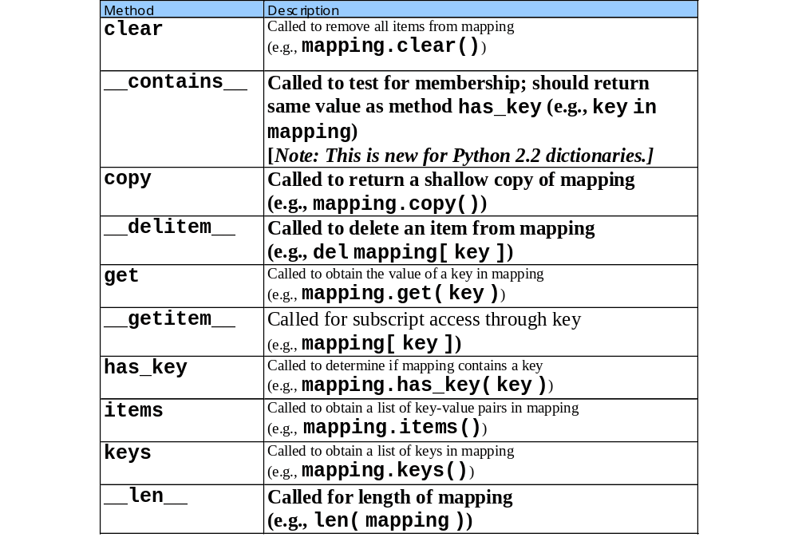

Slide 36
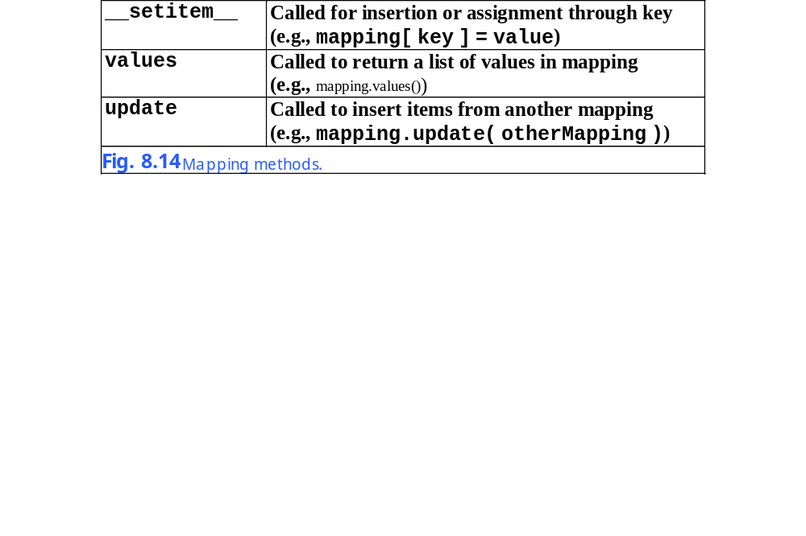

Slide 37
NewDictionary.py
1 # Fig. 8.15: NewDictionary.py
2 # Definition of class SimpleDictionary.
3
4 class SimpleDictionary:
5 """Class to make an instance behave like a dictionary"""
6
7 # mapping special methods
8 def __getitem__( self, key ):
9 """Overloaded key-value access"""
10
11 return self.__dict__[ key ]
12
13 def __setitem__( self, key, value ):
14 """Overloaded key-value assignment/creation"""
15
16 self.__dict__[ key ] = value
17
18 def __delitem__( self, key ):
19 """Overloaded key-value deletion"""
20
21 del self.__dict__[ key ]
22
23 def __str__( self ):
24 """Overloaded string representation"""
25
26 return str( self.__dict__ )
27
28 # common mapping methods
29 def keys( self ):
30 """Returns list of keys in dictionary"""
31
32 return self.__dict__.keys()
33

Slide 38
NewDictionary.py
34 def values( self ):
35 """Returns list of values in dictionary"""
36
37 return self.__dict__.values()
38
39 def items( self ):
40 """Returns list of items in dictionary"""
41
42 return self.__dict__.items()

Slide 39
Fig08_16.py
1 # Fig. 8.16: fig08_16.py
2 # Driver for class SimpleDictionary.
3
4 from NewDictionary import SimpleDictionary
5
6 # create and print SimpleDictionary object
7 simple = SimpleDictionary()
8 print "The empty dictionary:", simple
9
10 # add values to simple (invokes simple.__setitem__)
11 simple[ 1 ] = "one"
12 simple[ 2 ] = "two"
13 simple[ 3 ] = "three"
14 print "The dictionary after adding values:", simple
15
16 del simple[ 1 ] # remove a value
17 print "The dictionary after removing a value:", simple
18
19 # use mapping methods
20 print "Dictionary keys:", simple.keys()
21 print "Dictionary values:", simple.values()
22 print "Dictionary items:", simple.items()
The empty dictionary: {}
The dictionary after adding values: {1: 'one', 2: 'two', 3: 'three'}
The dictionary after removing a value: {2: 'two', 3: 'three'}
Dictionary keys: [2, 3]
Dictionary values: ['two', 'three']
Dictionary items: [(2, 'two'), (3, 'three')]

