Slide 1
Chapter 9 – Customizing Classes
Outline
9.1 Introduction
9.2 Inheritance: Base Classes and Derived Classes
9.3 Creating Base Classes and Derived Classes
9.4 Overriding Base-Class Methods in a Derived Class
9.5 Software Engineering with Inheritance
9.6 Composition vs. Inheritance
9.7 “Uses A” and “Knows A” Relationships
9.8 Case Study: Point, Circle, Cylinder
9.9 Abstract Base Classes and Concrete Classes
9.10 Case Study: Inheriting Interface and Implementation
9.11 Polymorphism
9.12 Classes and Python 2.2
9.12.1 Static Methods
9.12.2 Inheriting from Built-in Types
9.12.3 __getattribute__ Method
9.12.4 __slots__ Class Attribute
9.12.5 Properties

Slide 2
9.1 Introduction
Definitions
  Inheritance
  Base class
  Derived class
  Multiple inheritance
  Polymorphism
  Abstraction
  “is-a” relationship
  “has-a” relationship

Slide 3
9.2 Inheritance: Base Classes and Derived Classes
Base class
  Called superclass in other programming languages
  Other classes inherit its methods and attributes
Derived class
  Called subclass in other programming languages
  Inherits from a base class
  Generally overrides some base class methods and adds features
Examples of inheritance hierarchies

Slide 4
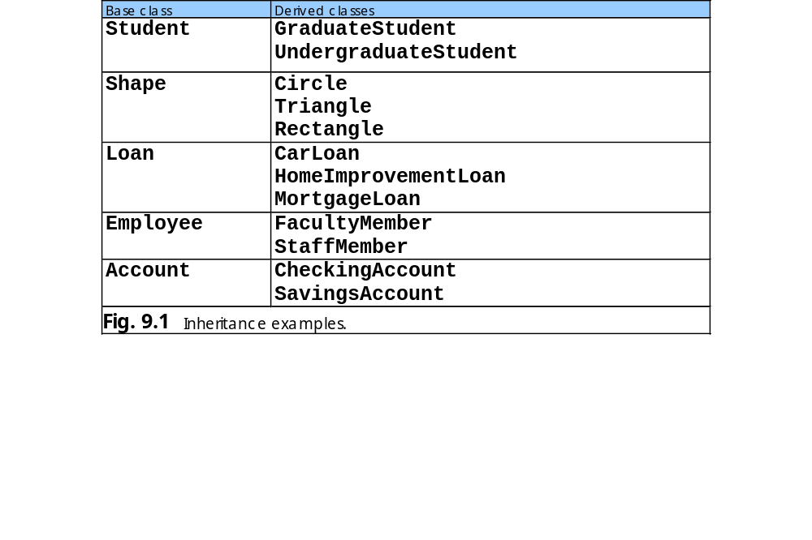
9.2 Inheritance: Base Classes and Derived Classes

Slide 5
9.2 Inheritance: Base Classes and Derived Classes
CommunityMember
Employee
Student
Alumnus (single inheritance)
Faculty
Staff (single inheritance)
Administrator
Teacher (single inheritance)
AdministratorTeacher (multiple inheritance)

Slide 6
9.2 Inheritance: Base Classes and Derived Classes
Shape
TwoDimensionalShape
ThreeDimensionalShape
Circle
Square
Triangle
Sphere
Cube
Tetrahedron

Slide 7
9.3 Creating Base Classes and Derived Classes
Function issubclass : determine whether class derived from another
Function isinstance : determine whether a value is an object of a particular class or a subclass of that class
Structural inheritance : Point and Circle classes example

Slide 8
fig09_04.py
1 # Fig 9.4: fig09_04.py
2 # Derived class inheriting from a base class.
3
4 import math
5
6 class Point:
7 """Class that represents geometric point"""
8
9 def __init__( self, xValue = 0, yValue = 0 ):
10 """Point constructor takes x and y coordinates"""
11
12 self.x = xValue
13 self.y = yValue
14
15 class Circle( Point ):
16 """Class that represents a circle"""
17
18 def __init__( self, x = 0, y = 0, radiusValue = 0.0 ):
19 """Circle constructor takes x and y coordinates of center
20 point and radius"""
21
22 Point.__init__( self, x, y ) # call base-class constructor
23 self.radius = float( radiusValue )
24
25 def area( self ):
26 """Computes area of a Circle"""
27
28 return math.pi * self.radius ** 2
29
30 # main program
31
32 # examine classes Point and Circle
33 print "Point bases:", Point.__bases__
34 print "Circle bases:", Circle.__bases__
35
Base class Point
Derived class Circle inherits from base class Point
Unbound method call to base-class constructor
Derived class adds new attribute
Derived class adds new method
Tuple containing a class’s base classes (if any)

Slide 9
fig09_04.py
36 # demonstrate class relationships with built-in function issubclass
37 print "\nCircle is a subclass of Point:", \
38 issubclass( Circle, Point )
39 print "Point is a subclass of Circle:", issubclass( Point, Circle )
40
41 point = Point( 30, 50 ) # create Point object
42 circle = Circle( 120, 89, 2.7 ) # create Circle object
43
44 # demonstrate object relationship with built-in function isinstance
45 print "\ncircle is a Point object:", isinstance( circle, Point )
46 print "point is a Circle object:", isinstance( point, Circle )
47
48 # print Point and Circle objects
49 print "\npoint members:\n\t", point.__dict__
50 print "circle members:\n\t", circle.__dict__
51
52 print "\nArea of circle:", circle.area()
Return 1 if first argument is a subclass of second argument
Return 1 if first argument is an object or an
instance of second argument
Contains an object’s attributes and their
values as key-value pairs
Point bases: ()
Circle bases: (<class __main__.Point at 0x00767250>,)
Circle is a subclass of Point: 1
Point is a subclass of Circle: 0
circle is a Point object: 1
point is a Circle object: 0
point members:
{'y': 50, 'x': 30}
circle members:
{'y': 89, 'x': 120, 'radius': 2.7000000000000002}
Area of circle: 22.9022104447

Slide 10
9.4 Overriding Base-Class Methods in a Derived Class
Override a base-class method by supplying a new version with the same name

Slide 11
fig09_05.py
1 # Fig. 9.5: fig09_05.py
2 # Overriding base-class methods.
3
4 class Employee:
5 """Class to represent an employee"""
6
7 def __init__( self, first, last ):
8 """Employee constructor takes first and last name"""
9
10 self.firstName = first
11 self.lastName = last
12
13 def __str__( self ):
14 """String representation of an Employee"""
15
16 return "%s %s" % ( self.firstName, self.lastName )
17
18 class HourlyWorker( Employee ):
19 """Class to represent an employee paid by hour"""
20
21 def __init__( self, first, last, initHours, initWage ):
22 """Constructor for HourlyWorker, takes first and last name,
23 initial number of hours and initial wage"""
24
25 Employee.__init__( self, first, last )
26 self.hours = float( initHours )
27 self.wage = float( initWage )
28
29 def getPay( self ):
30 """Calculates HourlyWorker's weekly pay"""
31
32 return self.hours * self.wage
33
34 def __str__( self ):
35 """String representation of HourlyWorker"""
Derived class overrides base-class method __str__
Overridden method __str__

Slide 12
fig09_05.py
36
37 print "HourlyWorker.__str__ is executing"""
38
39 return "%s is an hourly worker with pay of $%.2f" % \
40 ( Employee.__str__( self ), self.getPay() )
41
42 # main program
43 hourly = HourlyWorker( "Bob", "Smith", 40.0, 10.00 )
44
45 # invoke __str__ method several ways
46 print "Calling __str__ several ways..."
47 print hourly # invoke __str__ implicitly
48 print hourly.__str__() # invoke __str__ explicitly
49 print HourlyWorker.__str__( hourly ) # explicit, unbound call
Explicitly call base-class overridden method
Calling __str__ several ways...
HourlyWorker.__str__ is executing
Bob Smith is an hourly worker with pay of $400.00
HourlyWorker.__str__ is executing
Bob Smith is an hourly worker with pay of $400.00
HourlyWorker.__str__ is executing
Bob Smith is an hourly worker with pay of $400.00

Slide 13
9.5 Software Engineering with Inheritance
Software reuse with object-oriented programming improves software development process
Base class
  Specifies commonality
  Integrity preserved by inheritance

Slide 14
9.6 Composition vs. Inheritance
Is-a relationship supported by inheritance
Has-a relationship supported by composition
Has-a relationship where a class may have references to other classes as members
Both encourage software reuse

Slide 15
9.7 “Uses A” and “Knows A” Relationship
Use an object by calling one of its methods through a reference
One object is aware of another object if it contains a reference to that object
“Knows A” relationship referred to as an association

Slide 16
9.8 Case Study: Point, Circle, Cylinder
Structural-inheritance hierarchy of point, circle and cylinder
Class Circle derived from base class Point
Class Cylinder derived from class Circle

Slide 17
PointModule.py
1 # Fig 9.6: PointModule.py
2 # Definition and test function for class Point.
3
4 class Point:
5 """Class that represents a geometric point"""
6
7 def __init__( self, xValue = 0, yValue = 0 ):
8 """Point constructor takes x and y coordinates"""
9
10 self.x = xValue
11 self.y = yValue
12
13 def __str__( self ):
14 """String representation of a Point"""
15
16 return "( %d, %d )" % ( self.x, self.y )
17
18 # main program
19 def main():
20 point = Point( 72, 115 ) # create object of class Point
21
22 # print point attributes
23 print "X coordinate is:", point.x
24 print "Y coordinate is:", point.y
25
26 # change point attributes and output new location
27 point.x = 10
28 point.y = 10
29
30 print "The new location of point is:", point
31
32 if __name__ == "__main__":
33 main()
Base class Point

Slide 18
PointModule.py
X coordinate is: 72
Y coordinate is: 115
The new location of point is: ( 10, 10 )

Slide 19
CircleModule.py
1 # Fig. 9.7: CircleModule.py
2 # Definition and test function for class Circle.
3
4 import math
5 from PointModule import Point
6
7 class Circle( Point ):
8 """Class that represents a circle"""
9
10 def __init__( self, x = 0, y = 0, radiusValue = 0.0 ):
11 """Circle constructor takes center point and radius"""
12
13 Point.__init__( self, x, y ) # call base-class constructor
14 self.radius = float( radiusValue )
15
16 def area( self ):
17 """Computes area of a Circle"""
18
19 return math.pi * self.radius ** 2
20
21 def __str__( self ):
22 """String representation of a Circle"""
23
24 # call base-class __str__ method
25 return "Center = %s Radius = %f" % \
26 ( Point.__str__( self ), self.radius )
27
28 # main program
29 def main():
30 circle = Circle( 37, 43, 2.5 ) # create Circle object
31
32 # print circle attributes
33 print "X coordinate is:", circle.x
34 print "Y coordinate is:", circle.y
35 print "Radius is:", circle.radius
Import class Point from PointModule.py
Inherit from class Point
Overridden method

Slide 20
CircleModule.py
36
37 # change circle attributes and print new values
38 circle.radius = 4.25
39 circle.x = 2
40 circle.y = 2
41
42 print "\nThe new location and radius of circle are:", circle
43 print "The area of circle is: %.2f" % circle.area()
44
45 print "\ncircle printed as a Point is:", Point.__str__( circle )
46
47 if __name__ == "__main__":
48 main()
X coordinate is: 37
Y coordinate is: 43
Radius is: 2.5
The new location and radius of circle are: Center = ( 2, 2 ) Radius = 4.250000
The area of circle is: 56.75
circle printed as a Point is: ( 2, 2 )

Slide 21
CylinderModule.py
1 # Fig. 9.8: CylinderModule.py
2 # Definition and test function for class Cylinder.
3
4 import math
5 from PointModule import Point
6 from CircleModule import Circle
7
8 class Cylinder( Circle ):
9 """Class that represents a cylinder"""
10
11 def __init__( self, x, y, radius, height ):
12 """Constructor for Cylinder takes x, y, height and radius"""
13
14 Circle.__init__( self, x, y, radius )
15 self.height = float( height )
16
17 def area( self ):
18 """Calculates (surface) area of a Cylinder"""
19
20 return 2 * Circle.area( self ) + \
21 2 * math.pi * self.radius * self.height
22
23 def volume( self ):
24 """Calculates volume of a Cylinder"""
25
26 return Circle.area( self ) * height
27
28 def __str__( self ):
29 """String representation of a Cylinder"""
30
31 return "%s; Height = %f" % \
32 ( Circle.__str__( self ), self.height )
33
34 # main program
35 def main():
Class Point used in main program
Import class Circle from CircleModule.py
Class Cylinder inherits from class Circle
Unbound method call to Circle constructor
Override Circle method area

Slide 22
CylinderModule.py
36
37 # create object of class Cylinder
38 cylinder = Cylinder( 12, 23, 2.5, 5.7 )
39
40 # print Cylinder attributes
41 print "X coordinate is:", cylinder.x
42 print "Y coordinate is:", cylinder.y
43 print "Radius is:", cylinder.radius
44 print "Height is:", cylinder.height
45
46 # change Cylinder attributes
47 cylinder.height = 10
48 cylinder.radius = 4.25
49 cylinder.x, cylinder.y = 2, 2
50 print "\nThe new points, radius and height of cylinder are:", \
51 cylinder
52
53 print "\nThe area of cylinder is: %.2f" % cylinder.area()
54
55 # display the Cylinder as a Point
56 print "\ncylinder printed as a Point is:", \
57 Point.__str__( cylinder )
58
59 # display the Cylinder as a Circle
60 print "\ncylinder printed as a Circle is:", \
61 Circle.__str__( cylinder )
62
63 if __name__ == "__main__":
64 main()
Treat Cylinder object as Point
Treat Cylinder object as Circle

Slide 23
CylinderModule.py
coordinate is: 12
Y coordinate is: 23
Radius is: 2.5
Height is: 5.7
The new points, radius and height of cylinder are: Center = ( 2, 2 ) Radius = 4.250000; Height = 10.000000
The area of cylinder is: 380.53
cylinder printed as a Point is: ( 2, 2 )
cylinder printed as a Circle is: Center = ( 2, 2 ) Radius = 4.250000

Slide 24
9.9 Abstract Classes and Concrete Classes
Abstract class
  Objects never instantiated
  Intended as a base class in an inheritance hierarchy
Concrete class : class from which an object can be created
Example : Concrete class Square derived from abstract base class Shape

Slide 25
9.10 Case Study: Inheriting Interface and Implementation
Abstract base class Employee defines an interface
Derived concrete classes Boss, CommissionWorker, PieceWorker, HourlyWorker

Slide 26
fig09_09.py
1 # Fig 9.9: fig09_09.py
2 # Creating a class hierarchy with an abstract base class.
3
4 class Employee:
5 """Abstract base class Employee"""
6
7 def __init__( self, first, last ):
8 """Employee constructor, takes first name and last name.
9 NOTE: Cannot create object of class Employee."""
10
11 if self.__class__ == Employee:
12 raise NotImplementedError, \
13 "Cannot create object of class Employee"
14
15 self.firstName = first
16 self.lastName = last
17
18 def __str__( self ):
19 """String representation of Employee"""
20
21 return "%s %s" % ( self.firstName, self.lastName )
22
23 def _checkPositive( self, value ):
24 """Utility method to ensure a value is positive"""
25
26 if value < 0:
27 raise ValueError, \
28 "Attribute value (%s) must be positive" % value
29 else:
30 return value
31
32 def earnings( self ):
33 """Abstract method; derived classes must override"""
34
35 raise NotImplementedError, "Cannot call abstract method"
Return an error if program attempts to create Employee object
Utility method used by derived classes
Method earnings not implemented for generic Employee object

Slide 27
fig09_09.py
36
37 class Boss( Employee ):
38 """Boss class, inherits from Employee"""
39
40 def __init__( self, first, last, salary ):
41 """Boss constructor, takes first and last names and salary"""
42
43 Employee.__init__( self, first, last )
44 self.weeklySalary = self._checkPositive( float( salary ) )
45
46 def earnings( self ):
47 """Compute the Boss's pay"""
48
49 return self.weeklySalary
50
51 def __str__( self ):
52 """String representation of Boss"""
53
54 return "%17s: %s" % ( "Boss", Employee.__str__( self ) )
55
56 class CommissionWorker( Employee ):
57 """CommissionWorker class, inherits from Employee"""
58
59 def __init__( self, first, last, salary, commission, quantity ):
60 """CommissionWorker constructor, takes first and last names,
61 salary, commission and quantity"""
62
63 Employee.__init__( self, first, last )
64 self.salary = self._checkPositive( float( salary ) )
65 self.commission = self._checkPositive( float( commission ) )
66 self.quantity = self._checkPositive( quantity )
67
68 def earnings( self ):
69 """Compute the CommissionWorker's pay"""
70
Class Boss derived from abstract base class Employee
Call utility method to ensure salary is positive
Implement method earnings
Call Employee __str__ method to get name

Slide 28
fig09_09.py
71 return self.salary + self.commission * self.quantity
72
73 def __str__( self ):
74 """String representation of CommissionWorker"""
75
76 return "%17s: %s" % ( "Commission Worker",
77 Employee.__str__( self ) )
78
79 class PieceWorker( Employee ):
80 """PieceWorker class, inherits from Employee"""
81
82 def __init__( self, first, last, wage, quantity ):
83 """PieceWorker constructor, takes first and last names, wage
84 per piece and quantity"""
85
86 Employee.__init__( self, first, last )
87 self.wagePerPiece = self._checkPositive( float( wage ) )
88 self.quantity = self._checkPositive( quantity )
89
90 def earnings( self ):
91 """Compute PieceWorker's pay"""
92
93 return self.quantity * self.wagePerPiece
94
95 def __str__( self ):
96 """String representation of PieceWorker"""
97
98 return "%17s: %s" % ( "Piece Worker",
99 Employee.__str__( self) )
100
101 class HourlyWorker( Employee ):
102 """HourlyWorker class, inherits from Employee"""
103

Slide 29
fig09_09.py
104 def __init__( self, first, last, wage, hours ):
105 """HourlyWorker constructor, takes first and last names,
106 wage per hour and hours worked"""
107
108 Employee.__init__( self, first, last )
109 self.wage = self._checkPositive( float( wage ) )
110 self.hours = self._checkPositive( float( hours ) )
111
112 def earnings( self ):
113 """Compute HourlyWorker's pay"""
114
115 if self.hours <= 40:
116 return self.wage * self.hours
117 else:
118 return 40 * self.wage + ( self.hours - 40 ) *\
119 self.wage * 1.5
120
121 def __str__( self ):
122 """String representation of HourlyWorker"""
123
124 return "%17s: %s" % ( "Hourly Worker",
125 Employee.__str__( self ) )
126
127 # main program
128
129 # create list of Employees
130 employees = [ Boss( "John", "Smith", 800.00 ),
131 CommissionWorker( "Sue", "Jones", 200.0, 3.0, 150 ),
132 PieceWorker( "Bob", "Lewis", 2.5, 200 ),
133 HourlyWorker( "Karen", "Price", 13.75, 40 ) ]
134
135 # print Employee and compute earnings
136 for employee in employees:
137 print "%s earned $%.2f" % ( employee, employee.earnings() )

Slide 30
fig09_09.py
Boss: John Smith earned $800.00
Commission Worker: Sue Jones earned $650.00
Piece Worker: Bob Lewis earned $500.00
Hourly Worker: Karen Price earned $550.00

Slide 31
9.11 Polymorphism
Polymorphism : ability of objects of different classes related by inheritance to respond differently same messages
Python language inherently polymorphic because of dynamically typing
Dynamically typed : Python determines at runtime whether an object defines a method or contains an attribute

Slide 32
9.12 Classes and Python 2.2
Removes the differences between classes and types
Can distinguish between “classic” classes (presented earlier in chapter) and “new” classes
Type object defines new classes
Classes that inherit from object exhibit behaviors of a new class

Slide 33
9.12.1 Static Methods
All classes can define static methods
Static methods can be called even if no object of the class exists
Typically utility methods that do not require objects
Designate a method as static by passing its name to built-in function staticmethod and binding a name to the value returned from the function call
Static methods do not receive references to objects

Slide 34
EmployeeStatic.py
1 # Fig. 9.10: EmployeeStatic.py
2 # Class Employee with a static method.
3
4 class Employee:
5 """Employee class with static method isCrowded"""
6
7 numberOfEmployees = 0 # number of Employees created
8 maxEmployees = 10 # maximum number of comfortable employees
9
10 def isCrowded():
11 """Static method returns true if the employees are crowded"""
12
13 return Employee.numberOfEmployees > Employee.maxEmployees
14
15 # create static method
16 isCrowded = staticmethod( isCrowded )
17
18 def __init__( self, firstName, lastName ):
19 """Employee constructor, takes first name and last name"""
20
21 self.first = firstName
22 self.last = lastName
23 Employee.numberOfEmployees += 1
24
25 def __del__( self ):
26 """Employee destructor"""
27
28 Employee.numberOfEmployees -= 1
29
30 def __str__( self ):
31 """String representation of Employee"""
32
33 return "%s %s" % ( self.first, self.last )
34
Static method does not specify self as its first argument
Set isCrowded as a static method

Slide 35
EmployeeStatic.py
35 # main program
36 def main():
37 answers = [ "No", "Yes" ] # responses to isCrowded
38
39 employeeList = [] # list of objects of class Employee
40
41 # call static method using class
42 print "Employees are crowded?",
43 print answers[ Employee.isCrowded() ]
44
45 print "\nCreating 11 objects of class Employee..."
46
47 # create 11 objects of class Employee
48 for i in range( 11 ):
49 employeeList.append( Employee( "John", "Doe" + str( i ) ) )
50
51 # call static method using object
52 print "Employees are crowded?",
53 print answers[ employeeList[ i ].isCrowded() ]
54
55 print "\nRemoving one employee..."
56 del employeeList[ 0 ]
57
58 print "Employees are crowded?", answers[ Employee.isCrowded() ]
59
60 if __name__ == "__main__":
61 main()
Call static method using class name
Call static method using class object

Slide 36
EmployeeStatic.py
Employees are crowded? No
Creating 11 objects of class Employee...
Employees are crowded? No
Employees are crowded? No
Employees are crowded? No
Employees are crowded? No
Employees are crowded? No
Employees are crowded? No
Employees are crowded? No
Employees are crowded? No
Employees are crowded? No
Employees are crowded? No
Employees are crowded? Yes
Removing one employee...
Employees are crowded? No

Slide 37
9.12.2 Inheriting from Built-in Types
Type-class unification allows creation of a derived class that inherits from a Python built-in type
__builtin__ namespace has reference to each type
All built-in types (except object) inherit from object

Slide 38
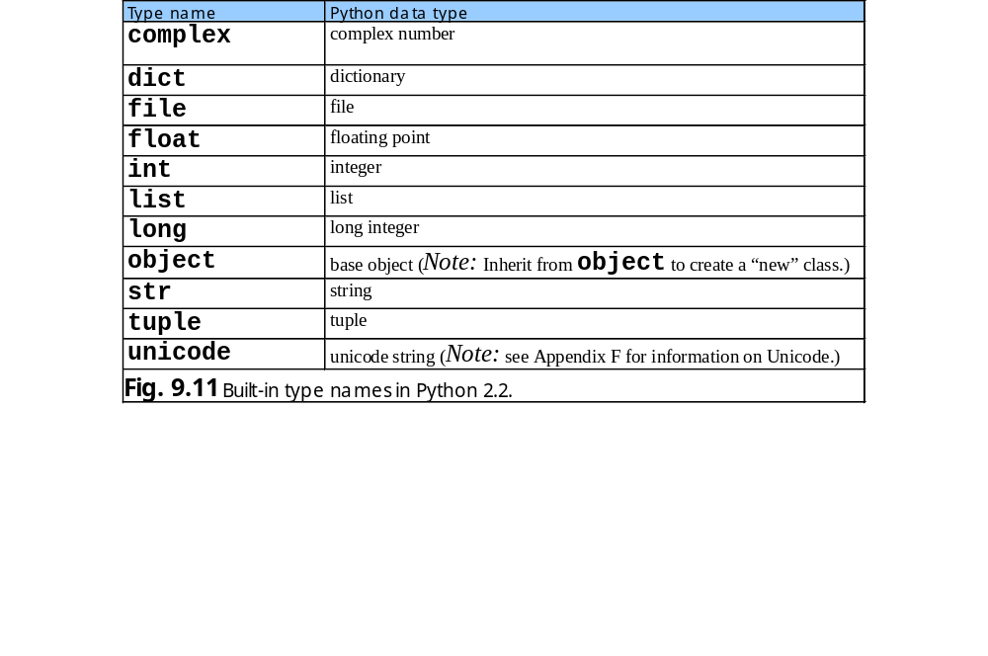
9.12.2 Inheriting from Built-in Types

Slide 39
NewList.py
1 # Fig 9.12: NewList.py
2 # Definition for class SingleList,
3
4 class SingleList( list ):
5
6 # constructor
7 def __init__( self, initialList = None ):
8 """SingleList constructor, takes initial list value.
9 New SingleList object contains only unique values"""
10
11 list.__init__( self )
12
13 if initialList:
14 self.merge( initialList )
15
16 # utility method
17 def _raiseIfNotUnique( self, value ):
18 """Utility method to raise an exception if value
19 is in list"""
20
21 if value in self:
22 raise ValueError, \
23 "List already contains value %s" % value
24
25 # overloaded sequence operation
26 def __setitem__( self, subscript, value ):
27 """Sets value of particular index. Raises exception if list
28 already contains value"""
29
30 # terminate method on non-unique value
31 self._raiseIfNotUnique( value )
32
33 return list.__setitem__( self, subscript, value )
34
Inherits from built-in base class list
SingleList object is a list so no list attribute in this implementation
Call base-class constructor to initialize list
Combines new list with initial list, removing any duplicate values
Raises exception if value not unique
Executes when a client assigns a value to a particular index

Slide 40
NewList.py
35 # overloaded mathematical operators
36 def __add__( self, other ):
37 """Overloaded addition operator, returns new SingleList"""
38
39 return SingleList( list.__add__( self, other ) )
40
41 def __radd__( self, otherList ):
42 """Overloaded right addition"""
43
44 return SingleList( list.__add__( other, self ) )
45
46 def __iadd__( self, other ):
47 """Overloaded augmented assignment. Raises exception if list
48 already contains any of the values in otherList"""
49
50 for value in other:
51 self.append( value )
52
53 return self
54
55 def __mul__( self, value ):
56 """Overloaded multiplication operator. Cannot use
57 multiplication on SingleLists"""
58
59 raise ValueError, "Cannot repeat values in SingleList"
60
61 # __rmul__ and __imul__ have same behavior as __mul__
62 __rmul__ = __imul__ = __mul__
63
64 # overridden list methods
65 def insert( self, subscript, value ):
66 """Inserts value at specified subscript. Raises exception if
67 list already contains value"""
68
Overloaded addition operators merge two lists
Repeated sequences not allowed so multiplication generates an error
Overrides list method insert

Slide 41
NewList.py
69 # terminate method on non-unique value
70 self._raiseIfNotUnique( value )
71
72 return list.insert( self, subscript, value )
73
74 def append( self, value ):
75 """Appends value to end of list. Raises exception if list
76 already contains value"""
77
78 # terminate method on non-unique value
79 self._raiseIfNotUnique( value )
80
81 return list.append( self, value )
82
83 def extend( self, other ):
84 """Adds to list the values from another list. Raises
85 exception if list already contains value"""
86
87 for value in other:
88 self.append( value )
89
90 # new SingleList method
91 def merge( self, other ):
92 """Merges list with unique values from other list"""
93
94 # add unique values from other
95 for value in other:
96
97 if value not in self:
98 list.append( self, value )
Ensure that no duplicate values added
Override list append method
Call list method append only on unique values

Slide 42
fig09_13.py
1 # Fig. 9.13: fig09_13.py
2 # Program that uses SingleList
3
4 from NewList import SingleList
5
6 duplicates = [ 1, 2, 2, 3, 4, 3, 6, 9 ]
7 print "List with duplicates is:", duplicates
8
9 single = SingleList( duplicates ) # create SingleList object
10 print "SingleList, created from duplicates, is:", single
11 print "The length of the list is:", len( single )
12
13 # search for values in list
14 print "\nThe value 2 appears %d times in list" % single.count( 2 )
15 print "The value 5 appears %d times in list" % single.count( 5 )
16 print "The index of 9 in the list is:", single.index( 9 )
17
18 if 4 in single:
19 print "The value 4 was found in list"
20
21 # add values to list
22 single.append( 10 )
23 single += [ 20 ]
24 single.insert( 3, "hello" )
25 single.extend( [ -1, -2, -3 ] )
26 single.merge( [ "hello", 2, 100 ] )
27 print "\nThe list, after adding elements is:", single
28
29 # remove values from list
30 popValue = single.pop()
31 print "\nRemoved", popValue, "from list:", single
32 single.append( popValue )
33 print "Added", popValue, "back to end of list:", single
34
Driver uses SingleList-specific functionality and functionality inherited
from base-class list
Demonstrates using an inherited method
Demonstrates using an overridden method

Slide 43
fig09_13.py
35 # slice list
36 print "\nThe value of single[ 1:4 ] is:", single[ 1:4 ]
List with duplicates is: [1, 2, 2, 3, 4, 3, 6, 9]
SingleList, created from duplicates, is: [1, 2, 3, 4, 6, 9]
The length of the list is: 6
The value 2 appears 1 times in list
The value 5 appears 0 times in list
The index of 9 in the list is: 5
The value 4 was found in list
The list, after adding elements is: [1, 2, 3, 'hello', 4, 6, 9, 10, 20, -1, -2, -3, 100]
Removed 100 from list: [1, 2, 3, 'hello', 4, 6, 9, 10, 20, -1, -2, -3]
Added 100 back to end of list: [1, 2, 3, 'hello', 4, 6, 9, 10, 20, -1, -2, -3, 100]
The value of single[ 1:4 ] is: [2, 3, 'hello']

Slide 44
9.12.2 Inheriting from Built-in Types
Python 2.2b2 (#26, Nov 16 2001, 11:44:11) [MSC 32 bit (Intel)] on win32
Type "help", "copyright", "credits" or "license" for more information.
>>>
>>> from NewList import SingleList
>>> single = SingleList( [ 1, 2, 3 ] )
>>>
>>> single.append( 1 )
Traceback (most recent call last):
File "<stdin>", line 1, in ?
File "NewList.py", line 79, in append
self._raiseIfNotUnique( value )
File "NewList.py", line 22, in _raiseIfNotUnique
raise ValueError, \
ValueError: List already contains value 1
>>>
>>> single += [ 2 ]
Traceback (most recent call last):
File "<stdin>", line 1, in ?
File "NewList.py", line 51, in __iadd__
self.append( value )
File "NewList.py", line 79, in append
self._raiseIfNotUnique( value )
File "NewList.py", line 22, in _raiseIfNotUnique
raise ValueError, \
ValueError: List already contains value 2
>>>

Slide 45
9.12.2 Inheriting from Built-in Types
>>> single.insert( 0, 1 )
Traceback (most recent call last):
File "<stdin>", line 1, in ?
File "NewList.py", line 70, in insert
self._raiseIfNotUnique( value )
File "NewList.py", line 22, in _raiseIfNotUnique
raise ValueError, \
ValueError: List already contains value 1
>>>
>>> single.extend( [ 3, 4 ] )
Traceback (most recent call last):
File "<stdin>", line 1, in ?
File "NewList.py", line 88, in extend
self.append( value )
File "NewList.py", line 79, in append
self._raiseIfNotUnique( value )
File "NewList.py", line 22, in _raiseIfNotUnique
raise ValueError, \
ValueError: List already contains value 3
Fig. 9.14 Class SingleList—inserting non-unique values.

Slide 46
9.12.3 __getattribute__ Method
Can be defined by classes that inherit from base-class object
Executes for every attribute access

Slide 47
fig09_15.py
1 # Fig. 9.15: fig09_15.py
2 # Class that defines method __getattribute__
3
4 class DemonstrateAccess( object ):
5 """Class to demonstrate when method __getattribute__ executes"""
6
7 def __init__( self ):
8 """DemonstrateAccess constructor, initializes attribute
9 value"""
10
11 self.value = 1
12
13 def __getattribute__( self, name ):
14 """Executes for every attribute access"""
15
16 print "__getattribute__ executing..."
17 print "\tClient attempt to access attribute:", name
18
19 return object.__getattribute__( self, name )
20
21 def __getattr__( self, name ):
22 """Executes when client access attribute not in __dict__"""
23
24 print "__getattr__ executing..."
25 print "\tClient attempt to access non-existent attribute:",\
26 name
27
28 raise AttributeError, "Object has no attribute %s" \
29 % name
Executes when the client accesses an object’s attribute with the dot operator
Call base-class method to return value of accessed attribute
Executes when client accesses an attribute not in object’s __dict__
Preserve default behavior by raising exception when client accesses nonexistent attribute

Slide 48
fig09_15.py
Python 2.2b2 (#26, Nov 16 2001, 11:44:11) [MSC 32 bit (Intel)] on win32
Type "help", "copyright", "credits" or "license" for more information.
>>>
>>> from fig09_15 import DemonstrateAccess
>>> access = DemonstrateAccess()
>>>
>>> access.value
__getattribute__ executing...
Client attempt to access attribute: value
1
>>>
>>> access.novalue
__getattribute__ executing...
Client attempt to access attribute: novalue
__getattr__ executing...
Client attempt to access non-existent attribute: novalue
Traceback (most recent call last):
File "<stdin>", line 1, in ?
File "fig09_15.py", line 28, in __getattr__
raise AttributeError, "Object has no attribute %s" \
AttributeError: Object has no attribute novalue

Slide 49
9.12.4 __slots__ Class Attribute
Python’s dynamism allows executing applications to change
Can add attributes to an instantiated object’s namespace
New classes can define __slots__ attribute listing the only allowed attributes for a class

Slide 50
Slots.py
1 # Fig. 9.16: Slots.py
2 # Simple class with slots
3
4 class PointWithoutSlots:
5 """Programs can add attributes to objects of this class"""
6
7 def __init__( self, xValue = 0.0, yValue = 0.0 ):
8 """Constructor for PointWithoutSlots, initializes x- and
9 y-coordinates"""
10
11 self.x = float( xValue )
12 self.y = float( yValue )
13
14 class PointWithSlots( object ):
15 """Programs cannot add attributes to objects of this class"""
16
17 # PointWithSlots objects can contain only attributes x and y
18 __slots__ = [ "x", "y" ]
19
20 def __init__( self, xValue = 0.0, yValue = 0.0 ):
21 """Constructor for PointWithoutSlots, initializes x- and
22 y-coordinates"""
23
24 self.x = float( xValue )
25 self.y = float( yValue )
26
27 # main program
28 def main():
29 noSlots = PointWithoutSlots()
30 slots = PointWithSlots()
31
32 for point in [ noSlots, slots ]:
33 print "\nProcessing an object of class", point.__class__
34
Can add attributes to this class
List of class attribute names
Create object with no __slots__ attribute
Instantiate object with __slots__ attribute

Slide 51
Slots.py
35 print "The current value of point.x is:", point.x
36 newValue = float( raw_input( "Enter new x coordinate: " ) )
37 print "Attempting to set new x-coordinate value..."
38
39 # Logic error: create new attribute called X, instead of
40 # changing the value of attribute X
41 point.X = newValue
42
43 # output unchanged attribute x
44 print "The new value of point.x is:", point.x
45
46 if __name__ == "__main__":
47 main()
Attempt to add an attribute to each object
Processing an object of class __main__.PointWithoutSlots
The current value of point.x is: 0.0
Enter new x coordinate: 1.0
Attempting to set new x-coordinate value...
The new value of point.x is: 0.0
Processing an object of class <class '__main__.PointWithSlots'>
The current value of point.x is: 0.0
Enter new x coordinate: 1.0
Attempting to set new x-coordinate value...
Traceback (most recent call last):
File "Slots.py", line 47, in ?
main()
File "Slots.py", line 41, in main
point.X = newValue
AttributeError: 'PointWithSlots' object has no attribute 'X'
Object with __slots__ attribute raises exception when client attempts to add attribute

Slide 52
9.12.5 Properties
Created by specifying four components – a get method, a set method, a delete method and a descriptive docstring
Created using built-in function property
Can define separate get, set and delete methods for each attribute

Slide 53
TimeProperty.py
1 # Fig. 9.17: TimeProperty.py
2 # Class Time with properties
3
4 class Time( object ):
5 """Class Time with hour, minute and second properties"""
6
7 def __init__( self, hourValue, minuteValue, secondValue ):
8 """Time constructor, takes hour, minute and second"""
9
10 self.__hour = hourValue
11 self.__minute = minuteValue
12 self.__second = secondValue
13
14 def __str__( self ):
15 """String representation of an object of class Time"""
16
17 return "%.2d:%.2d:%.2d" % \
18 ( self.__hour, self.__minute, self.__second )
19
20 def deleteValue( self ):
21 """Delete method for Time properties"""
22
23 raise TypeError, "Cannot delete attribute"
24
25 def setHour( self, value ):
26 """Set method for hour attribute"""
27
28 if 0 <= value < 24:
29 self.__hour = value
30 else:
31 raise ValueError, \
32 "hour (%d) must be in range 0-23, inclusive" % value
33
34 def getHour( self ):
35 """Get method for hour attribute"""
Class contains hour, minute and second properties
Create private attributes __hour, __minute and __second
Delete method does not allow attribute deletion
Set method for hour attribute ensures value in 0-23, inclusive
Get method for hour attribute

Slide 54
TimeProperty.py
36
37 return self.__hour
38
39 # create hour property
40 hour = property( getHour, setHour, deleteValue, "hour" )
41
42 def setMinute( self, value ):
43 """Set method for minute attribute"""
44
45 if 0 <= value < 60:
46 self.__minute = value
47 else:
48 raise ValueError, \
49 "minute (%d) must be in range 0-59, inclusive" % value
50
51 def getMinute( self ):
52 """Get method for minute attribute"""
53
54 return self.__minute
55
56 # create minute property
57 minute = property( getMinute, setMinute, deleteValue, "minute" )
58
59 def setSecond( self, value ):
60 """Set method for second attribute"""
61
62 if 0 <= value < 60:
63 self.__second = value
64 else:
65 raise ValueError, \
66 "second (%d) must be in range 0-59, inclusive" % value
67
68 def getSecond( self ):
69 """Get method for second attribute"""
70
Create hour property with get method, set method, delete method and docstring
Set method for minute attribute ensures value in 0-59, inclusive
Get method for minute attribute
Call property function to create minute property
Set method for second attribute ensures value in 0-59, inclusive
Get method for second attribute

Slide 55
TimeProperty.py
71 return self.__second
72
73 # create second property
74 second = property( getSecond, setSecond, deleteValue, "second" )
Create second property
Python 2.2b2 (#26, Nov 16 2001, 11:44:11) [MSC 32 bit (Intel)] on win32
Type "help", "copyright", "credits" or "license" for more information.
>>>
>>> from TimeProperty import Time
>>>
>>> time1 = Time( 5, 27, 19 )
>>> print time1
05:27:19
>>> print time1.hour, time1.minute, time1.second
5 27 19
>>>
>>> time1.hour, time1.minute, time1.second = 16, 1, 59
>>> print time1
16:01:59
>>>
>>> time1.hour = 25
Traceback (most recent call last):
File "<stdin>", line 1, in ?
File "TimeProperty.py", line 31, in setHour
raise ValueError, \
ValueError: hour (25) must be in range 0-23, inclusive
>>>
>>> time1.minute = -3
Traceback (most recent call last):
File "<stdin>", line 1, in ?
File "TimeProperty.py", line 48, in setMinute
raise ValueError, \
ValueError: minute (-3) must be in range 0-59, inclusive
>>>

Slide 56
TimeProperty.py
>>> time1.second = 99
Traceback (most recent call last):
File "<stdin>", line 1, in ?
File "TimeProperty.py", line 65, in setSecond
raise ValueError, \
ValueError: second (99) must be in range 0-59, inclusive

