Slide 1
Chapter 10 – Graphical User Interface Components: Part 1
Outline
10.1 Introduction
10.2 Tkinter Overview
10.3 Simple Tkinter Example: Label Component
10.4 Event Handling Model
10.5 Entry Component
10.6 Button Component
10.7 Checkbutton and Radiobutton Components
10.8 Mouse Event Handling
10.9 Keyboard Event Handling
10.10 Layout Managers
10.10.1 Pack
10.10.2 Grid
10.10.3 Place
10.11 Card Shuffling and Dealing Simulation
10.12 Internet and World Wide Web Resources

Slide 2
10.1 Introduction
Graphical user interface (GUI) enables user interaction via mouse or keyboard with program
GUIs built from components called widgets

Slide 3
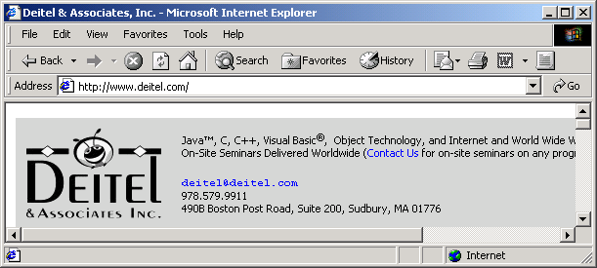
10.1 Introduction
Menu bar
Button
Label
Menu
Text field
Fig. 10.1 GUI components in an Internet Explorer window.

Slide 4
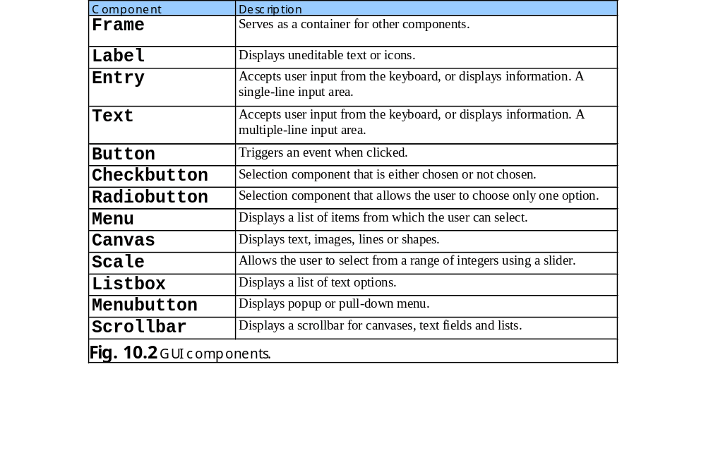
10.1 Introduction

Slide 5
10.2 Tkinter Overview
Python’s standard GUI package – Tkinter module
Tkinter library provides object-oriented interface to Tk GUI toolkit
Each GUI component class inherits from class Widget
GUI consists of top-level (or parent) component that can contain children components
Class Frame serves as a top-level component

Slide 6
10.2 Tkinter Overview
Frame
Widget
Label
Entry
Text
Button
Checkbutton
Radiobutton
Menu
Canvas
Scale
Listbox
Key
Scrollbar
Subclass name
Class name
Menubutton
Fig. 10.3 Widget subclasses.

Slide 7
10.3 Simple Tkinter Example: Label Component
Labels
  Display text or images
  Provide instructions and other information
  Created by Tkinter class Label

Slide 8
fig10_04.py
1 # Fig. 10.4: fig10_04.py
2 # Label demonstration.
3
4 from Tkinter import *
5
6 class LabelDemo( Frame ):
7 """Demonstrate Labels"""
8
9 def __init__( self ):
10 """Create three Labels and pack them"""
11
12 Frame.__init__( self ) # initializes Frame object
13
14 # frame fills all available space
15 self.pack( expand = YES, fill = BOTH )
16 self.master.title( "Labels" )
17
18 self.Label1 = Label( self, text = "Label with text" )
19
20 # resize frame to accommodate Label
21 self.Label1.pack()
22
23 self.Label2 = Label( self,
24 text = "Labels with text and a bitmap" )
25
26 # insert Label against left side of frame
27 self.Label2.pack( side = LEFT )
28
29 # using default bitmap image as label
30 self.Label3 = Label( self, bitmap = "warning" )
31 self.Label3.pack( side = LEFT )
32
33 def main():
34 LabelDemo().mainloop() # starts event loop
35
Allows program to access definitions without the module name
Parent container inherits from Frame
Base-class constructor initializes top-level component
Method pack and its keyword arguments specifies how and where to place components
Attribute master references component’s parent
Sets title of GUI
Create Label component to display specified text
Place Label1 with method pack’s default settings
Places Label2 against frame’s left side
Display warning bitmap image on label
Start GUI program

Slide 9


fig10_04.py
36 if __name__ == "__main__":
37 main()

Slide 10
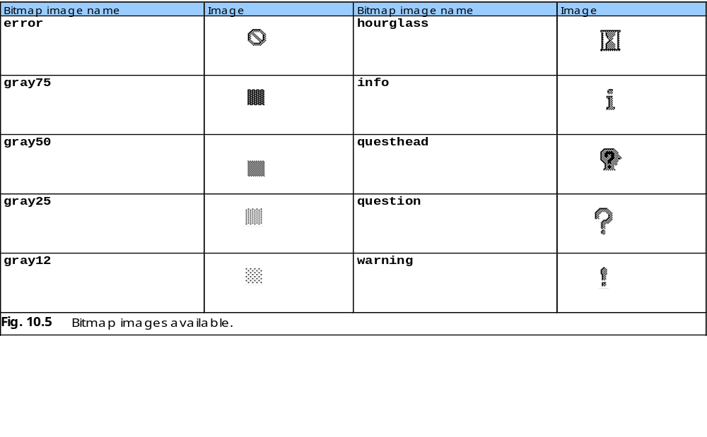
10.3 Simple Tkinter Example: Label Component

Slide 11
10.4 Event Handling Model
GUI components generate events due to user interaction
Asynchronous event-driven programs
Programs bind event to graphical component and implement event handler (or callback) to process GUI event

Slide 12
10.5 Entry Component
Text fields
  Areas in which users can enter text or programmers can display a line of text
  Created by Entry class
<Return> event occurs when user presses Enter key inside Entry component

Slide 13
fig10_06.py
1 # Fig. 10.6: fig10_06.py
2 # Entry components and event binding demonstration.
3
4 from Tkinter import *
5 from tkMessageBox import *
6
7 class EntryDemo( Frame ):
8 """Demonstrate Entrys and Event binding"""
9
10 def __init__( self ):
11 """Create, pack and bind events to four Entrys"""
12
13 Frame.__init__( self )
14 self.pack( expand = YES, fill = BOTH )
15 self.master.title( "Testing Entry Components" )
16 self.master.geometry( "325x100" ) # width x length
17
18 self.frame1 = Frame( self )
19 self.frame1.pack( pady = 5 )
20
21 self.text1 = Entry( self.frame1, name = "text1" )
22
23 # bind the Entry component to event
24 self.text1.bind( "<Return>", self.showContents )
25 self.text1.pack( side = LEFT, padx = 5 )
26
27 self.text2 = Entry( self.frame1, name = "text2" )
28
29 # insert text into Entry component text2
30 self.text2.insert( INSERT, "Enter text here" )
31 self.text2.bind( "<Return>", self.showContents )
32 self.text2.pack( side = LEFT, padx = 5 )
33
34 self.frame2 = Frame( self )
35 self.frame2.pack( pady = 5 )
Contains functions that display dialogs
Configures length and width of top-level component in pixels
Create Frame component as container for two Entry components
Specifies 5 pixels of vertical space between frame1 and other components
Create Entry component and set its name
Associate Entry component text1 with Enter key event
Specify event handler as second argument
Specifies 5 pixels of horizontal space between text1 and other components
Display text in Entry component
Create frame2 as container for next 2 Entry components

Slide 14
fig10_06.py
36
37 self.text3 = Entry( self.frame2, name = "text3" )
38 self.text3.insert( INSERT, "Uneditable text field" )
39
40 # prohibit user from altering text in Entry component text3
41 self.text3.config( state = DISABLED )
42 self.text3.bind( "<Return>", self.showContents )
43 self.text3.pack( side = LEFT, padx = 5 )
44
45 # text in Entry component text4 appears as *
46 self.text4 = Entry( self.frame2, name = "text4",
47 show = "*" )
48 self.text4.insert( INSERT, "Hidden text" )
49 self.text4.bind( "<Return>", self.showContents )
50 self.text4.pack( side = LEFT, padx = 5 )
51
52 def showContents( self, event ):
53 """Display the contents of the Entry"""
54
55 # acquire name of Entry component that generated event
56 theName = event.widget.winfo_name()
57
58 # acquire contents of Entry component that generated event
59 theContents = event.widget.get()
60 showinfo( "Message", theName + ": " + theContents )
61
62 def main():
63 EntryDemo().mainloop()
64
65 if name__ == "__main__":
66 main()
Method config sets Entry component text3’s state to DISABLED
Display asterisks rather than text in Entry component text4
Event handler displays Entry component’s name and entered text
Returns name of component associated with event
Display dialog box
Returns contents of component
Invoke GUI’s event loop

Slide 15
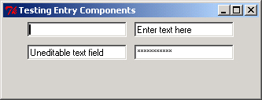
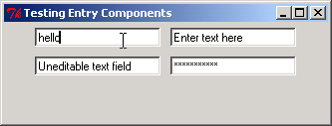
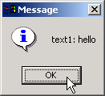
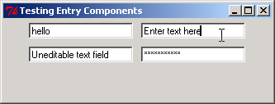
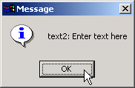
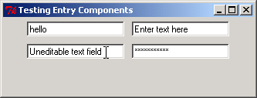
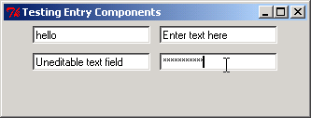
fig10_06.py

Slide 16
10.6 Button components
Buttons
  Generates events when selected
  Facilitate selection of actions
  Created with class Button
  Displays text or image called button label
  Each should have unique label

Slide 17
fig10_07.py
1 # Fig. 10.7: fig10_07.py
2 # Button demonstration.
3
4 from Tkinter import *
5 from tkMessageBox import *
6
7 class PlainAndFancy( Frame ):
8 """Create one plain and one fancy button"""
9
10 def __init__( self ):
11 """Create two buttons, pack them and bind events"""
12
13 Frame.__init__( self )
14 self.pack( expand = YES, fill = BOTH )
15 self.master.title( "Buttons" )
16
17 # create button with text
18 self.plainButton = Button( self, text = "Plain Button",
19 command = self.pressedPlain )
20 self.plainButton.bind( "<Enter>", self.rolloverEnter )
21 self.plainButton.bind( "<Leave>", self.rolloverLeave )
22 self.plainButton.pack( side = LEFT, padx = 5, pady = 5 )
23
24 # create button with image
25 self.myImage = PhotoImage( file = "logotiny.gif" )
26 self.fancyButton = Button( self, image = self.myImage,
27 command = self.pressedFancy )
28 self.fancyButton.bind( "<Enter>", self.rolloverEnter )
29 self.fancyButton.bind( "<Leave>", self.rolloverLeave )
30 self.fancyButton.pack( side = LEFT, padx = 5, pady = 5 )
31
32 def pressedPlain( self ):
33 showinfo( "Message", "You pressed: Plain Button" )
34
Create Button component displaying specified text label
Associate button with event handler
Mouse cursor rolling over button associated with callback
Mouse leaving button associated with callback
Button components display PhotoImage objects
Button displays object indicated by image option

Slide 18


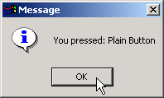



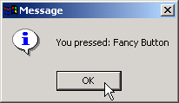
fig10_07.py
35 def pressedFancy( self ):
36 showinfo( "Message", "You pressed: Fancy Button" )
37
38 def rolloverEnter( self, event ):
39 event.widget.config( relief = GROOVE )
40
41 def rolloverLeave( self, event ):
42 event.widget.config( relief = RAISED )
43
44 def main():
45 PlainAndFancy().mainloop()
46
47 if __name__ == "__main__":
48 main()
Changes appearance of button when mouse cursor rolls over it
Button’s relief specifies how it appears in relation to other components
Sets Button component’s relief to GROOVE
Changes appearance of button when mouse cursor leaves it
Sets Button component’s relief to RAISED

Slide 19
10.7 Checkbutton and Radiobutton Components
Checkbox
  Small white square
  Either blank or contains a checkmark
  Descriptive text referred to as checkbox label
  Any number of boxes selected at a time
  Created by class Checkbutton
Radio button
  Mutually excusive options – only one radio button selected at a time
  Created by class Radiobutton
Both have on/off or true/false values and two states – selected and not selected (deselected)

Slide 20
fig10_08.py
1 # Fig. 10.8: fig10_08.py
2 # Checkbuttons demonstration.
3
4 from Tkinter import *
5
6 class CheckFont( Frame ):
7 """An area of text with Checkbutton controlled font"""
8
9 def __init__( self ):
10 """Create an Entry and two Checkbuttons"""
11
12 Frame.__init__( self )
13 self.pack( expand = YES, fill = BOTH )
14 self.master.title( "Checkbutton Demo" )
15
16 self.frame1 = Frame( self )
17 self.frame1.pack()
18
19 self.text = Entry( self.frame1, width = 40,
20 font = "Arial 10" )
21 self.text.insert( INSERT, "Watch the font style change" )
22 self.text.pack( padx = 5, pady = 5 )
23
24 self.frame2 = Frame( self )
25 self.frame2.pack()
26
27 # create boolean variable
28 self.boldOn = BooleanVar()
29
30 # create "Bold" checkbutton
31 self.checkBold = Checkbutton( self.frame2, text = "Bold",
32 variable = self.boldOn, command = self.changeFont )
33 self.checkBold.pack( side = LEFT, padx = 5, pady = 5 )
34
Attribute font specifies style of text in Entry component
Subclass of Tkinter class Variable
Container object for integer with value 0 (false) or 1 (true)
Create Checkbutton with label specified by text value
variable requires an object of Tkinter Variable or its subclasses
BooleanVar boldOn stores state of Checkbutton checkBold
Binds selection of Checkbutton to callback

Slide 21

fig10_08.py
Create another BooleanVar object for the second Checkbutton
35 # create boolean variable
36 self.italicOn = BooleanVar()
37
38 # create "Italic" checkbutton
39 self.checkItalic = Checkbutton( self.frame2,
40 text = "Italic", variable = self.italicOn,
41 command = self.changeFont )
42 self.checkItalic.pack( side = LEFT, padx = 5, pady = 5 )
43
44 def changeFont( self ):
45 """Change the font based on selected Checkbuttons"""
46
47 desiredFont = "Arial 10"
48
49 if self.boldOn.get():
50 desiredFont += " bold"
51
52 if self.italicOn.get():
53 desiredFont += " italic"
54
55 self.text.config( font = desiredFont )
56
57 def main():
58 CheckFont().mainloop()
59
60 if __name__ == "__main__":
61 main()
Returns value of specified Variable object
Set font of Entry component text to style specified by checkbox states

Slide 22



fig10_08.py

Slide 23
fig10_09.py
1 # Fig. 10.9: fig10_09.py
2 # Radiobuttons demonstration.
3
4 from Tkinter import *
5
6 class RadioFont( Frame ):
7 """An area of text with Radiobutton controlled font"""
8
9 def __init__( self ):
10 """Create an Entry and four Radiobuttons"""
11
12 Frame.__init__( self )
13 self.pack( expand = YES, fill = BOTH )
14 self.master.title( "Radiobutton Demo" )
15
16 self.frame1 = Frame( self )
17 self.frame1.pack()
18
19 self.text = Entry( self.frame1, width = 40,
20 font = "Arial 10" )
21 self.text.insert( INSERT, "Watch the font style change" )
22 self.text.pack( padx = 5, pady = 5 )
23
24 self.frame2 = Frame( self )
25 self.frame2.pack()
26
27 fontSelections = [ "Plain", "Bold", "Italic",
28 "Bold/Italic" ]
29 self.chosenFont = StringVar()
30
31 # initial selection
32 self.chosenFont.set( fontSelections[ 0 ] )
33
Subclass of Variable that stores strings
A group of Radiobuttons modifies the same variable
Set StringVar chosenFont to default style Plain

Slide 24

fig10_09.py
34 # create group of Radiobutton components with same variable
35 for style in fontSelections:
36 aButton = Radiobutton( self.frame2, text = style,
37 variable = self.chosenFont, value = style,
38 command = self.changeFont )
39 aButton.pack( side = LEFT, padx = 5, pady = 5 )
40
41 def changeFont( self ):
42 """Change the font based on selected Radiobutton"""
43
44 desiredFont = "Arial 10"
45
46 if self.chosenFont.get() == "Bold":
47 desiredFont += " bold"
48 elif self.chosenFont.get() == "Italic":
49 desiredFont += " italic"
50 elif self.chosenFont.get() == "Bold/Italic":
51 desiredFont += " bold italic"
52
53 self.text.config( font = desiredFont )
54
55 def main():
56 RadioFont().mainloop()
57
58 if __name__ == "__main__":
59 main()
Create Radiobutton with label specified by text value
Each Radiobutton in a group has same variable value
Option value specifies Radiobutton’s name
Returns value of specified Variable object

Slide 25



fig10_09.py

Slide 26
10.8 Mouse Event Handling
Events that occur as a result of user interaction with a mouse
Tkinter events described by strings following pattern <modifier-type-detail>
  type specifies kind of event (e.g. Button and Return)
  Specific mouse button is example of a detail
  Prefix Double is example of a modifier

Slide 27
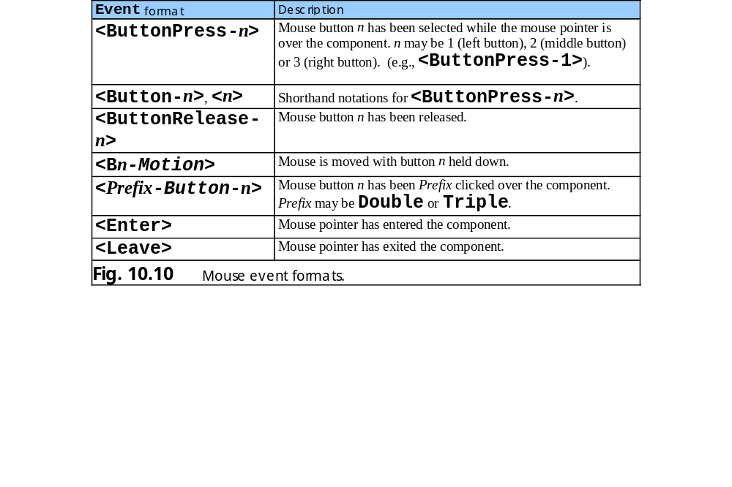
10.8 Mouse Event Handling

Slide 28
fig10_11.py
1 # Fig. 10.11: fig10_11.py
2 # Mouse events example.
3
4 from Tkinter import *
5
6 class MouseLocation( Frame ):
7 """Demonstrate binding mouse events"""
8
9 def __init__( self ):
10 """Create a Label, pack it and bind mouse events"""
11
12 Frame.__init__( self )
13 self.pack( expand = YES, fill = BOTH )
14 self.master.title( "Demonstrating Mouse Events" )
15 self.master.geometry( "275x100" )
16
17 self.mousePosition = StringVar() # displays mouse position
18 self.mousePosition.set( "Mouse outside window" )
19 self.positionLabel = Label( self,
20 textvariable = self.mousePosition )
21 self.positionLabel.pack( side = BOTTOM )
22
23 # bind mouse events to window
24 self.bind( "<Button-1>", self.buttonPressed )
25 self.bind( "<ButtonRelease-1>", self.buttonReleased )
26 self.bind( "<Enter>", self.enteredWindow )
27 self.bind( "<Leave>", self.exitedWindow )
28 self.bind( "<B1-Motion>", self.mouseDragged )
29
30 def buttonPressed( self, event ):
31 """Display coordinates of button press"""
32
33 self.mousePosition.set( "Pressed at [ " + str( event.x ) +
34 ", " + str( event.y ) + " ]" )
35
Text displayed in component associated with StringVar object
Associate clicking first mouse button with callback buttonPressed
Associate releasing first mouse button with callback buttonReleased
Associate mouse cursor entering window with callback enteredWindow
Associate mouse cursor leaving window with callback exitedWindow
Associate holding first button and dragging mouse with mouseDragged
Convert x-coordinate of mouse click to string

Slide 29
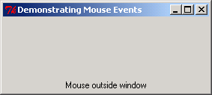
fig10_11.py
36 def buttonReleased( self, event ):
37 """Display coordinates of button release"""
38
39 self.mousePosition.set( "Released at [ " + str( event.x ) +
40 ", " + str( event.y ) + " ]" )
41
42 def enteredWindow( self, event ):
43 """Display message that mouse has entered window"""
44
45 self.mousePosition.set( "Mouse in window" )
46
47 def exitedWindow( self, event ):
48 """Display message that mouse has left window"""
49
50 self.mousePosition.set( "Mouse outside window" )
51
52 def mouseDragged( self, event ):
53 """Display coordinates of mouse being moved"""
54
55 self.mousePosition.set( "Dragged at [ " + str( event.x ) +
56 ", " + str( event.y ) + " ]" )
57
58 def main():
59 MouseLocation().mainloop()
60
61 if __name__ == "__main__":
62 main()
Changes the text displayed by the Label

Slide 30
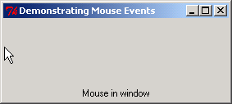
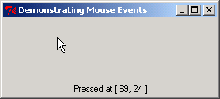
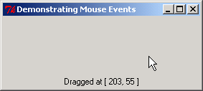
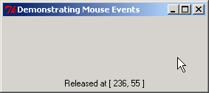
fig10_11.py

Slide 31
fig10_12.py
1 # Fig. 10.12: fig10_12.py
2 # Mouse button differentiation.
3
4 from Tkinter import *
5
6 class MouseDetails( Frame ):
7 """Demonstrate mouse events for different buttons"""
8
9 def __init__( self ):
10 """Create a Label, pack it and bind mouse events"""
11
12 Frame.__init__( self )
13 self.pack( expand = YES, fill = BOTH )
14 self.master.title( "Mouse clicks and buttons" )
15 self.master.geometry( "350x150" )
16
17 # create mousePosition variable
18 self.mousePosition = StringVar()
19 positionLabel = Label( self,
20 textvariable = self.mousePosition )
21 self.mousePosition.set( "Mouse not clicked" )
22 positionLabel.pack( side = BOTTOM )
23
24 # bind event handler to events for each mouse button
25 self.bind( "<Button-1>", self.leftClick )
26 self.bind( "<Button-2>", self.centerClick )
27 self.bind( "<Button-3>", self.rightClick )
28
29 def leftClick( self, event ):
30 """Display coordinates and indicate left button clicked"""
31
32 self.showPosition( event.x, event.y )
33 self.master.title( "Clicked with left mouse button" )
34
Associate first (left) mouse button with callback leftClick
Associate second (middle) mouse button with callback centerClick
Associate third (right) mouse button with callback rightClick

Slide 32
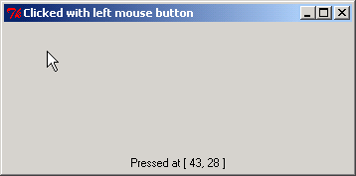
fig10_12.py
35 def centerClick( self, event ):
36 """Display coordinates and indicate center button used"""
37
38 self.showPosition( event.x, event.y )
39 self.master.title( "Clicked with center mouse button" )
40
41 def rightClick( self, event ):
42 """Display coordinates and indicate right button clicked"""
43
44 self.showPosition( event.x, event.y )
45 self.master.title( "Clicked with right mouse button" )
46
47 def showPosition( self, x, y ):
48 """Display coordinates of button press"""
49
50 self.mousePosition.set( "Pressed at [ " + str( x ) + ", " +
51 str( y ) + " ]" )
52
53 def main():
54 MouseDetails().mainloop()
55
56 if __name__ == "__main__":
57 main()

Slide 33
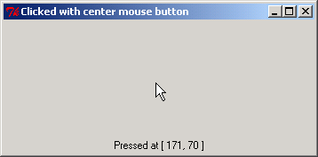
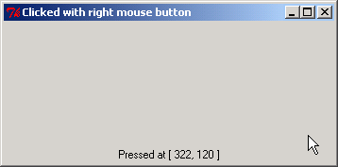
fig10_12.py

Slide 34
10.9 Keyboard Event Handling
Keyboard events generated when users press and release keys

Slide 35
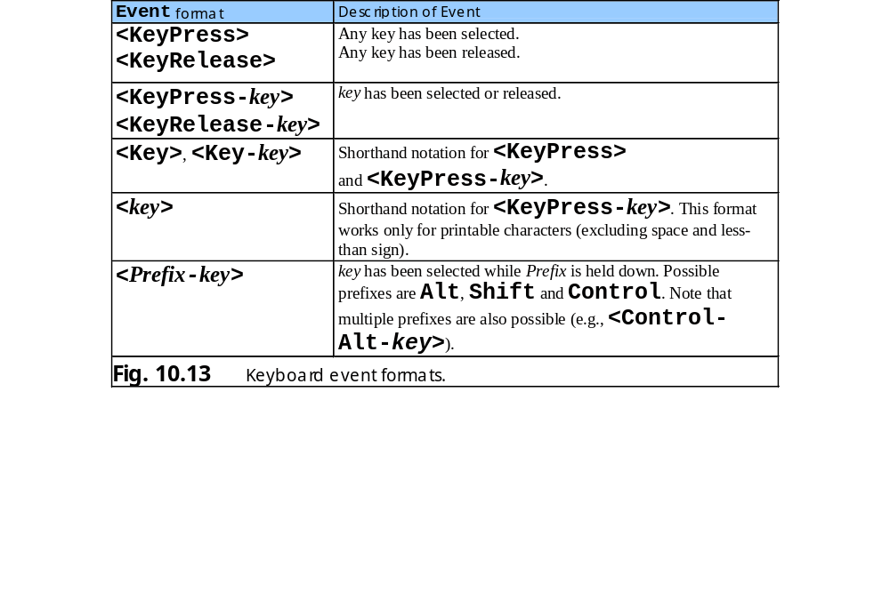
10.9 Keyboard Event Handling

Slide 36
fig10_14.py
1 # Fig. 10.14: fig10_14.py
2 # Binding keys to keyboard events.
3
4 from Tkinter import *
5
6 class KeyDemo( Frame ):
7 """Demonstrate keystroke events"""
8
9 def __init__( self ):
10 """Create two Labels and bind keystroke events"""
11
12 Frame.__init__( self )
13 self.pack( expand = YES, fill = BOTH )
14 self.master.title( "Demonstrating Keystroke Events" )
15 self.master.geometry( "350x100" )
16
17 self.message1 = StringVar()
18 self.line1 = Label( self, textvariable = self.message1 )
19 self.message1.set( "Type any key or shift" )
20 self.line1.pack()
21
22 self.message2 = StringVar()
23 self.line2 = Label( self, textvariable = self.message2 )
24 self.message2.set( "" )
25 self.line2.pack()
26
27 # binding any key
28 self.master.bind( "<KeyPress>", self.keyPressed )
29 self.master.bind( "<KeyRelease>", self.keyReleased )
30
31 # binding specific key
32 self.master.bind( "<KeyPress-Shift_L>", self.shiftPressed )
33 self.master.bind( "<KeyRelease-Shift_L>",
34 self.shiftReleased )
35
Pressing any key calls event handler keyPressed
Releasing any key calls event handler keyReleased
Pressing left shift key calls event handler shiftPressed
Releasing left shift key calls event handler shiftReleased

Slide 37
fig10_14.py
36 def keyPressed( self, event ):
37 """Display the name of the pressed key"""
38
39 self.message1.set( "Key pressed: " + event.char )
40 self.message2.set( "This key is not left shift" )
41
42 def keyReleased( self, event ):
43 """Display the name of the released key"""
44
45 self.message1.set( "Key released: " + event.char )
46 self.message2.set( "This key is not left shift" )
47
48 def shiftPressed( self, event ):
49 """Display a message that left shift was pressed"""
50
51 self.message1.set( "Shift pressed" )
52 self.message2.set( "This key is left shift" )
53
54 def shiftReleased( self, event ):
55 """Display a message that left shift was released"""
56
57 self.message1.set( "Shift released" )
58 self.message2.set( "This key is left shift" )
59
60 def main():
61 KeyDemo().mainloop()
62
63 if __name__ == "__main__":
64 main()
Obtain name of the key

Slide 38
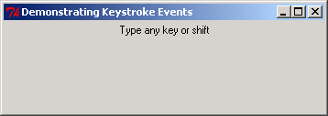
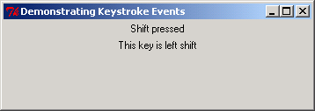
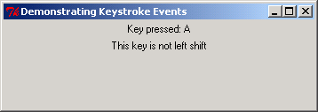
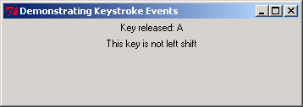
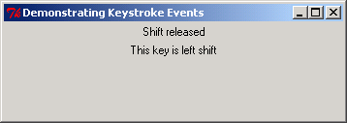
fig10_14.py

Slide 39
10.10 Layout Managers
Arrange placement of GUI components
Provide layout capabilities
Process most of design
Tkinter offers Pack, Grid and Place classes

Slide 40
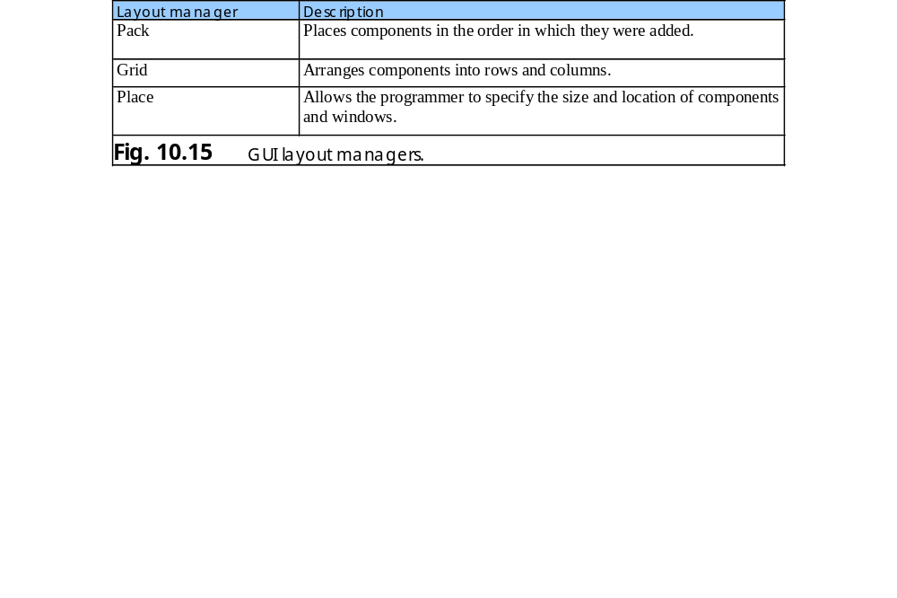
10.10 Layout Managers

Slide 41
10.10.1 Pack
Pack layout manager places GUI components in a container from top to bottom in program order, by default
Option side indicates side of container against which component is placed
Option expand determines whether the component fills any extra space in the container
Option fill allots amount of space the components should occupy in the container
Options padx and pady inserts horizontal and vertical padding around a component, respectively

Slide 42
fig10_16.py
1 # Fig. 10.16: fig10_16.py
2 # Pack layout manager demonstration.
3
4 from Tkinter import *
5
6 class PackDemo( Frame ):
7 """Demonstrate some options of Pack"""
8
9 def __init__( self ):
10 """Create four Buttons with different pack options"""
11
12 Frame.__init__( self )
13 self.master.title( "Packing Demo" )
14 self.master.geometry( "400x150" )
15 self.pack( expand = YES, fill = BOTH )
16
17 self.button1 = Button( self, text = "Add Button",
18 command = self.addButton )
19
20 # Button component placed against top of window
21 self.button1.pack( side = TOP )
22
23 self.button2 = Button( self,
24 text = "expand = NO, fill = BOTH" )
25
26 # Button component placed against bottom of window
27 # fills all available vertical and horizontal space
28 self.button2.pack( side = BOTTOM, fill = BOTH )
29
30 self.button3 = Button( self,
31 text = "expand = YES, fill = X" )
32
33 # Button component placed against left side of window
34 # fills all available horizontal space
35 self.button3.pack( side = LEFT, expand = YES, fill = X )
Places component against top of window
Places component against bottom of window filling all available space
Places component against window’s left side
Component fills any extra space
Component fills all available horizontal space

Slide 43
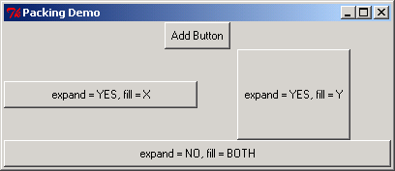
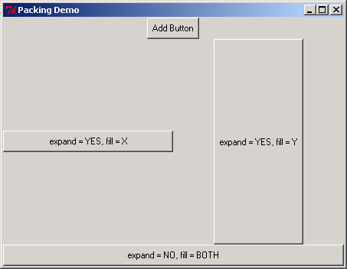
fig10_16.py
36
37 self.button4 = Button( self,
38 text = "expand = YES, fill = Y" )
39
40 # Button component placed against right side of window
41 # fills all available vertical space
42 self.button4.pack( side = RIGHT, expand = YES, fill = Y )
43
44 def addButton( self ):
45 """Create and pack a new Button"""
46
47 Button( self, text = "New Button" ).pack( pady = 5 )
48
49 def main():
50 PackDemo().mainloop()
51
52 if __name__ == "__main__":
53 main()
Component fills all available horizontal space
Places component against window’s right side
5 pixels of horizontal space between components

Slide 44
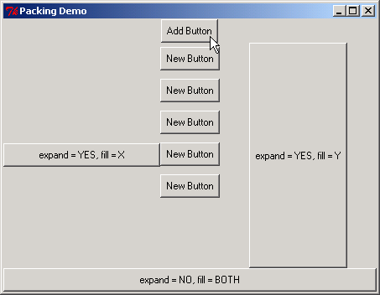
fig10_16.py

Slide 45
10.10.2 Grid
Grid layout manager divides container into a grid of rows and columns
Components added at specified row and column indices
Row and column numbers begin at 0
Option sticky specifies the component’s alignment and whether the component stretches to fill the cell – W, E, N, S, NW, NE, SW, SE and any combinations concatenated with +
Options padx and pady inserts horizontal and vertical padding around a component, respectively

Slide 46
10.10.2 Grid
Options ipadx and ipady inserts horizontal and vertical padding inside a component
Option weight indicates relative weight of growth for a row or a column when a window is resized

Slide 47
fig10_17.py
1 # Fig. 10.17: fig10_17.py
2 # Grid layout manager demonstration.
3
4 from Tkinter import *
5
6 class GridDemo( Frame ):
7 """Demonstrate the Grid geometry manager"""
8
9 def __init__( self ):
10 """Create and grid several components into the frame"""
11
12 Frame.__init__( self )
13 self.master.title( "Grid Demo" )
14
15 # main frame fills entire container, expands if necessary
16 self.master.rowconfigure( 0, weight = 1 )
17 self.master.columnconfigure( 0, weight = 1 )
18 self.grid( sticky = W+E+N+S )
19
20 self.text1 = Text( self, width = 15, height = 5 )
21
22 # text component spans three rows and all available space
23 self.text1.grid( rowspan = 3, sticky = W+E+N+S )
24 self.text1.insert( INSERT, "Text1" )
25
26 # place button component in first row, second column
27 self.button1 = Button( self, text = "Button 1",
28 width = 25 )
29 self.button1.grid( row = 0, column = 1, columnspan = 2,
30 sticky = W+E+N+S )
31
32 # place button component in second row, second column
33 self.button2 = Button( self, text = "Button 2" )
34 self.button2.grid( row = 1, column = 1, sticky = W+E+N+S )
35
Top-level component expands at same rate as window
Top-level component fills entire container
Component spans 3 rows and fills available space
Place component at specified row and column
Component spans 2 columns

Slide 48
fig10_17.py
36 # configure button component to fill all it allocated space
37 self.button3 = Button( self, text = "Button 3" )
38 self.button3.grid( row = 1, column = 2, sticky = W+E+N+S )
39
40 # span two columns starting in second column of first row
41 self.button4 = Button( self, text = "Button 4" )
42 self.button4.grid( row = 2, column = 1, columnspan = 2,
43 sticky = W+E+N+S )
44
45 # place text field in fourth row to span two columns
46 self.entry = Entry( self )
47 self.entry.grid( row = 3, columnspan = 2,
48 sticky = W+E+N+S )
49 self.entry.insert( INSERT, "Entry" )
50
51 # fill all available space in fourth row, third column
52 self.text2 = Text( self, width = 2, height = 2 )
53 self.text2.grid( row = 3, column = 2, sticky = W+E+N+S )
54 self.text2.insert( INSERT, "Text2" )
55
56 # make second row/column expand
57 self.rowconfigure( 1, weight = 1 )
58 self.columnconfigure( 1, weight = 1 )
59
60 def main():
61 GridDemo().mainloop()
62
63 if __name__ == "__main__":
64 main()
Changes row options
Changes column options

Slide 49
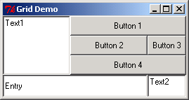
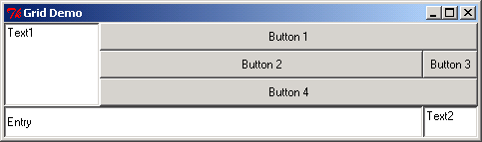
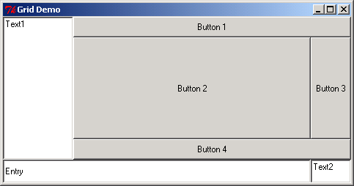
fig10_17.py

Slide 50
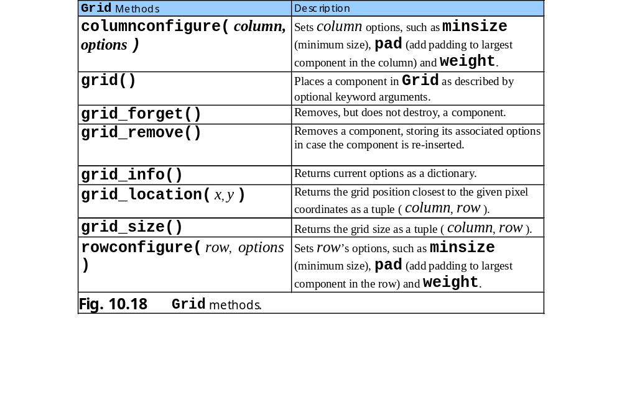
10.10.2 Grid

Slide 51
10.10.3 Place
Place layout manager sets the position and size of a GUI component absolutely or relatively to the position and size of another component
Referenced component specified with option in_
More complicated than other layout managers

Slide 52
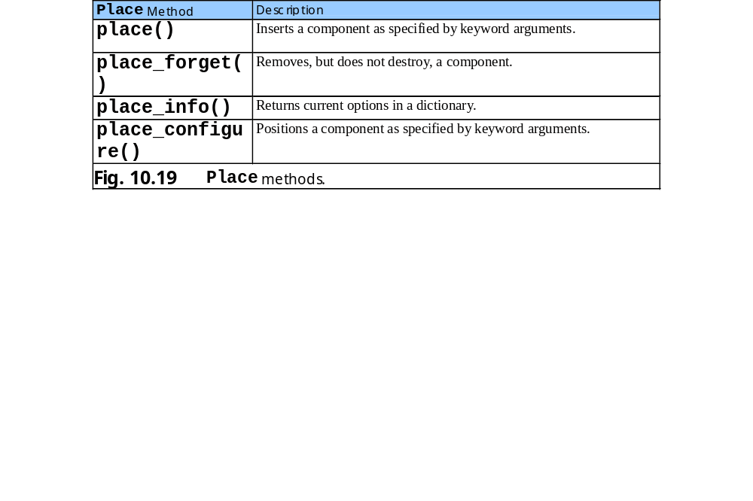
10.10.3 Place

Slide 53
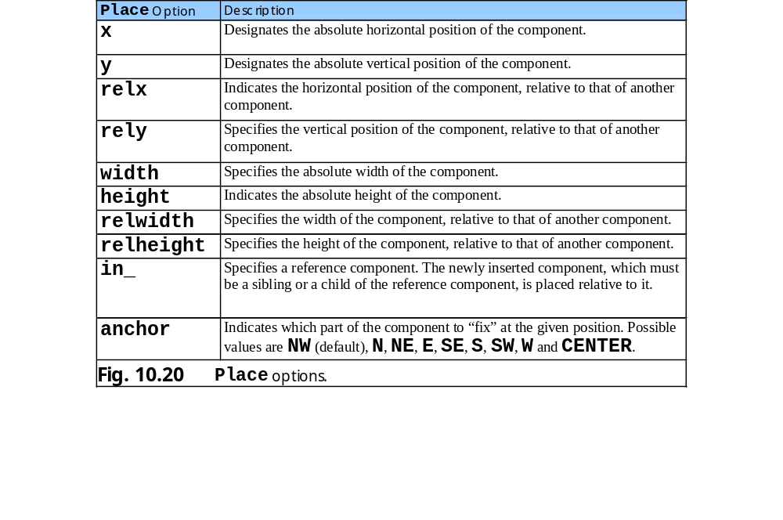
10.10.3 Place

Slide 54
10.11 Card Shuffling and Dealing Simulation
Creates GUI with Button and Label components
Event handlers associated with button events
Uses random number generation

Slide 55
fig10_21.py
1 # Fig. 10.21: fig10_21.py
2 # Card shuffling and dealing program
3
4 import random
5 from Tkinter import *
6
7 class Card:
8 """Class that represents one playing card"""
9
10 # class attributes faces and suits contain strings
11 # that correspond to card face and suit values
12 faces = [ "Ace", "Deuce", "Three", "Four", "Five",
13 "Six", "Seven", "Eight", "Nine", "Ten",
14 "Jack", "Queen", "King" ]
15 suits = [ "Hearts", "Diamonds", "Clubs", "Spades" ]
16
17 def __init__( self, face, suit ):
18 """Card constructor, takes face and suit as strings"""
19
20 self.face = face
21 self.suit = suit
22
23 def __str__( self ):
24 """String representation of a card"""
25
26 return "%s of %s" % ( self.face, self.suit )
27
28 class Deck( Frame ):
29 """Class to represent a GUI card deck shuffler"""
30
31 def __init__( self ):
32 """Deck constructor"""
33
34 Frame.__init__( self )
35 self.master.title( "Card Dealing Program" )
Represents Card with face and suit attributes
Class Deck creates GUI card deck shuffler

Slide 56
fig10_21.py
36
37 self.deck = [] # list of card objects
38 self.currentCard = 0 # index of current card
39
40 # create deck
41 for i in range( 52 ):
42 self.deck.append( Card( Card.faces[ i % 13 ],
43 Card.suits[ i / 13 ] ) )
44
45 # create buttons
46 self.dealButton = Button( self, text = "Deal Card",
47 width = 10, command = self.dealCard )
48 self.dealButton.grid( row = 0, column = 0 )
49
50 self.shuffleButton = Button( self, text = "Shuffle cards",
51 width = 10, command = self.shuffle )
52 self.shuffleButton.grid( row = 0, column = 1 )
53
54 # create labels
55 self.message1 = Label( self, height = 2,
56 text = "Welcome to Card Dealer!" )
57 self.message1.grid( row = 1, columnspan = 2 )
58
59 self.message2 = Label( self, height = 2,
60 text = "Deal card or shuffle deck" )
61 self.message2.grid( row = 2, columnspan = 2 )
62
63 self.shuffle()
64 self.grid()
65
66 def shuffle( self ):
67 """Shuffle the deck"""
68
69 self.currentCard = 0
70
Create dealButton and associate it with callback dealCard
Create shuffleButton and associate it with callback shuffle
Create Label component and set height option
Event handler shuffle rearranges the order of the 52 Card objects

Slide 57
fig10_21.py
71 for i in range( len( self.deck ) ):
72 j = random.randint( 0, 51 )
73
74 # swap the cards
75 self.deck[ i ], self.deck[ j ] = \
76 self.deck[ j ], self.deck[ i ]
77
78 self.message1.config( text = "DECK IS SHUFFLED" )
79 self.message2.config( text = "" )
80 self.dealButton.config( state = NORMAL )
81
82 def dealCard( self ):
83 """Deal one card from the deck"""
84
85 # display the card, if it exists
86 if self.currentCard < len( self.deck ):
87 self.message1.config(
88 text = self.deck[ self.currentCard ] )
89 self.message2.config(
90 text = "Card #: %d" % self.currentCard )
91 else:
92 self.message1.config( text = "NO MORE CARDS TO DEAL" )
93 self.message2.config( text =
94 "Shuffle cards to continue" )
95 self.dealButton.config( state = DISABLED )
96
97 self.currentCard += 1 # increment card for next turn
98
99 def main():
100 Deck().mainloop()
101
102 if __name__ == "__main__":
103 main()
Set Label component’s text
Alter state value of Button component
Event handler dealCard displays Card object

Slide 58
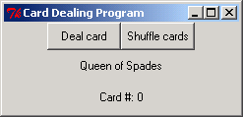
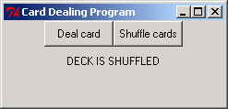
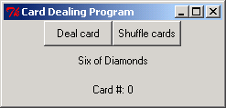
fig10_21.py

