Slide 1
Chapter 11 – Graphical User Interface Components: Part 2
Outline
11.1 Introduction
11.2 Overview of Pmw
11.3 ScrolledListbox Component
11.4 ScrolledText Component
11.5 MenuBar Component
11.6 Popup Menus
11.7 Canvas Component
11.8 Scale Component
11.9 Other GUI Toolkits

Slide 2
11.1 Introduction
More advanced components and more complex GUIs
Python megawidgets (Pmw) toolkit provides high-level GUI components developed from smaller Tkinter components
Introduce more Tkinter classes

Slide 3
11.2 Overview of Pmw
Each Pmw component combines Tkinter components to create a useful, more complex component
Each subcomponent can be configured independently
Pmw option names have the form subcomponent_option
Method configure alters Pmw options

Slide 4
11.3 ScrolledListbox Component
List box
  Sometimes called a drop-down list
  Provides a list of items from which a user can select
  Implemented by Tkinter class Listbox
  Scrolling through a list can be accomplished with a Tkinter Scrollbar
Pmw ScrolledListbox megawidget combines Tkinter classes Listbox and Scrollbar

Slide 5
fig11_01.py
1 # Fig. 11.1: fig11_01.py
2 # ScrolledListBox used to select image.
3
4 from Tkinter import *
5 import Pmw
6
7 class ImageSelection( Frame ):
8 """List of available images and an area to display them"""
9
10 def __init__( self, images ):
11 """Create list of PhotoImages and Label to display them"""
12
13 Frame.__init__( self )
14 Pmw.initialise()
15 self.pack( expand = YES, fill = BOTH )
16 self.master.title( "Select an image" )
17
18 self.photos = []
19
20 # add PhotoImage objects to list photos
21 for item in images:
22 self.photos.append( PhotoImage( file = item ) )
23
24 # create scrolled list box with vertical scrollbar
25 self.listBox = Pmw.ScrolledListBox( self, items = images,
26 listbox_height = 3, vscrollmode = "static",
27 selectioncommand = self.switchImage )
28 self.listBox.pack( side = LEFT, expand = YES, fill = BOTH,
29 padx = 5, pady = 5 )
30
31 self.display = Label( self, image = self.photos[ 0 ] )
32 self.display.pack( padx = 5, pady = 5 )
33
34 def switchImage( self ):
35 """Change image in Label to current selection"""
Import Pmw module
Initialize Pmw
Create ScrolledListBox component
Assign list to option items
Default number of list items to display
Scrollbar always present
Set callback for list selection event

Slide 6


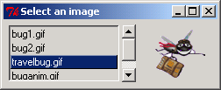

fig11_01.py
36
37 # get tuple containing index of selected list item
38 chosenPicture = self.listBox.curselection()
39
40 # configure label to display selected image
41 if chosenPicture:
42 choice = int( chosenPicture[ 0 ] )
43 self.display.config( image = self.photos[ choice ] )
44
45 def main():
46 images = [ "bug1.gif", "bug2.gif",
47 "travelbug.gif", "buganim.gif" ]
48 ImageSelection( images ).mainloop()
49
50 if __name__ == "__main__":
51 main()
Return tuple containing index of selected item

Slide 7
11.4 ScrolledText Component
Pmw ScrolledText component combines Tkinter Text and Scrollbar components
Sometimes an external event (i.e., an event generated by a different GUI component) indicates when to process the text in a ScrolledText component

Slide 8
fig11_02.py
1 # Fig. 11.2: fig11_02.py
2 # Copying selected text from one text area to another.
3
4 from Tkinter import *
5 import Pmw
6
7 class CopyTextWindow( Frame ):
8 """Demonstrate ScrolledTexts"""
9
10 def __init__( self ):
11 """Create two ScrolledTexts and a Button"""
12
13 Frame.__init__( self )
14 Pmw.initialise()
15 self.pack( expand = YES, fill = BOTH )
16 self.master.title( "ScrolledText Demo" )
17
18 # create scrolled text box with word wrap enabled
19 self.text1 = Pmw.ScrolledText( self,
20 text_width = 25, text_height = 12, text_wrap = WORD,
21 hscrollmode = "static", vscrollmode = "static" )
22 self.text1.pack( side = LEFT, expand = YES, fill = BOTH,
23 padx = 5, pady = 5 )
24
25 self.copyButton = Button( self, text = "Copy >>>",
26 command = self.copyText )
27 self.copyButton.pack( side = LEFT, padx = 5, pady = 5 )
28
29 # create uneditable scrolled text box
30 self.text2 = Pmw.ScrolledText( self, text_state = DISABLED,
31 text_width = 25, text_height = 12, text_wrap = WORD,
32 hscrollmode = "static", vscrollmode = "static" )
33 self.text2.pack( side = LEFT, expand = YES, fill = BOTH,
34 padx = 5, pady = 5 )
35
Create Pmw ScrolledText component
Set number of columns
Set number of rows
Enable word wrap
Vertical scrollbar always present
Horizontal scrollbar always present
Create uneditable ScrolledText component

Slide 9
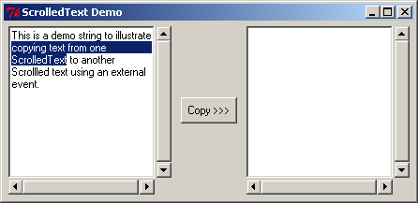
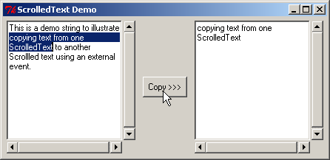
fig11_02.py
36 def copyText( self ):
37 """Set the text in the second ScrolledText"""
38
39 self.text2.settext( self.text1.get( SEL_FIRST, SEL_LAST ) )
40
41 def main():
42 CopyTextWindow().mainloop()
43
44 if __name__ == "__main__":
45 main()
Retrieve text from ScrolledText component text1
Arguments specify range of text to retrieve
Display text1’s selected text in ScrolledText component text2

Slide 10
11.5 MenuBar Component
Menus
  Contain lists of actions
  Simply the appearance of GUIs
Pmw MenuBar contains methods necessary to manage a menu bar, a container for menus
Menu item – GUI component inside a menu that performs an action when selected by a user
  command menu item – initiates an action
  checkbutton menu item – toggled on or off
  radiobutton menu item – a group presents mutually exclusive options

Slide 11
11.5 Menubar Component
  separator menu item – horizontal line groups related menu items
  cascade menu item – submenu (or cascade menu) provides more menu items from which users can select
Balloons (also called tool-tips) display descriptions of menus and menu items

Slide 12
fig11_03.py
1 # Fig. 11.3: fig11_03.py
2 # MenuBars with Balloons demonstration.
3
4 from Tkinter import *
5 import Pmw
6 import sys
7
8 class MenuBarDemo( Frame ):
9 """Create window with a MenuBar"""
10
11 def __init__( self ):
12 """Create a MenuBar with items and a Canvas with text"""
13
14 Frame.__init__( self )
15 Pmw.initialise()
16 self.pack( expand = YES, fill = BOTH )
17 self.master.title( "MenuBar Demo" )
18 self.master.geometry( "500x200" )
19
20 self.myBalloon = Pmw.Balloon( self )
21 self.choices = Pmw.MenuBar( self,
22 balloon = self.myBalloon )
23 self.choices.pack( fill = X )
24
25 # create File menu and items
26 self.choices.addmenu( "File", "Exit" )
27 self.choices.addmenuitem( "File", "command",
28 command = self.closeDemo, label = "Exit" )
29
30 # create Format menu and items
31 self.choices.addmenu( "Format", "Change font/color" )
32 self.choices.addcascademenu( "Format", "Color" )
33 self.choices.addmenuitem( "Format", "separator" )
34 self.choices.addcascademenu( "Format", "Font" )
35
Create a Pmw Balloon component
Create Pmw MenuBar component
Specify Balloon component attached to MenuBar
Second argument specifies text of balloon
Add menu File to Pmw MenuBar choices
Add command menu item to File menu
Associate menu item with event handler
Set name of menu item
Add submenu Color to menu Format
Add separator menu item to menu Format

Slide 13
fig11_03.py
36 # add items to Format/Color menu
37 colors = [ "Black", "Blue", "Red", "Green" ]
38 self.selectedColor = StringVar()
39 self.selectedColor.set( colors[ 0 ] )
40
41 for item in colors:
42 self.choices.addmenuitem( "Color", "radiobutton",
43 label = item, command = self.changeColor,
44 variable = self.selectedColor )
45
46 # add items to Format/Font menu
47 fonts = [ "Times", "Courier", "Helvetica" ]
48 self.selectedFont = StringVar()
49 self.selectedFont.set( fonts [ 0 ] )
50
51 for item in fonts:
52 self.choices.addmenuitem( "Font", "radiobutton",
53 label = item, command = self.changeFont,
54 variable = self.selectedFont )
55
56 # add a horizontal separator in Font menu
57 self.choices.addmenuitem( "Font", "separator" )
58
59 # associate checkbutton menu item with BooleanVar object
60 self.boldOn = BooleanVar()
61 self.choices.addmenuitem( "Font", "checkbutton",
62 label = "Bold", command = self.changeFont,
63 variable = self.boldOn )
64
65 # associate checkbutton menu item with BooleanVar object
66 self.italicOn = BooleanVar()
67 self.choices.addmenuitem( "Font", "checkbutton",
68 label = "Italic", command = self.changeFont,
69 variable = self.italicOn )
70
Create radiobutton menu items
Associate grouped radiobutton menu items with same callback
Associate grouped radiobutton menu items with same variable
Create checkbutton menu item

Slide 14
fig11_03.py
Create a Tkinter Canvas component with a white background
71 # create Canvas with text
72 self.display = Canvas( self, bg = "white" )
73 self.display.pack( expand = YES, fill = BOTH )
74
75 self.sampleText = self.display.create_text( 250, 100,
76 text = "Sample Text", font = "Times 48" )
77
78 def changeColor( self ):
79 """Change the color of the text on the Canvas"""
80
81 self.display.itemconfig( self.sampleText,
82 fill = self.selectedColor.get() )
83
84 def changeFont( self ):
85 """Change the font of the text on the Canvas"""
86
87 # get selected font and attach size
88 newFont = self.selectedFont.get() + " 48"
89
90 # determine which checkbutton menu items selected
91 if self.boldOn.get():
92 newFont += " bold"
93
94 if self.italicOn.get():
95 newFont += " italic"
96
97 # configure sample text to be displayed in selected style
98 self.display.itemconfig( self.sampleText, font = newFont )
99
100 def closeDemo( self ):
101 """Exit the program"""
102
103 sys.exit()
104
Display Canvas text item
Method itemconfig configures Canvas items
Set fill color of Canvas item
Terminate the program

Slide 15
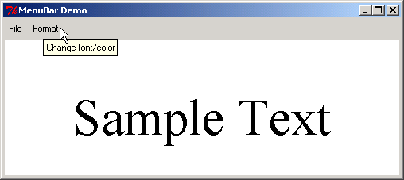
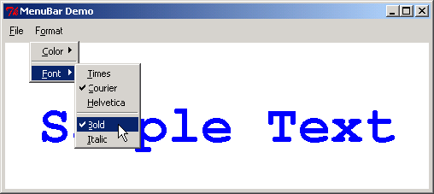
fig11_03.py
105 def main():
106 MenuBarDemo().mainloop()
107
108 if __name__ == "__main__":
109 main()

Slide 16
11.6 Popup Menus
Context-sensitive popup menus created with Tkinter class Menu
Provide options specific to the component for which generated the popup trigger event

Slide 17
fig11_04.py
1 # Fig. 11.4: fig11_04.py
2 # Popup menu demonstration.
3
4 from Tkinter import *
5
6 class PopupMenuDemo( Frame ):
7 """Demonstrate popup menus"""
8
9 def __init__( self ):
10 """Create a Menu but do not add it to the Frame"""
11
12 Frame.__init__( self )
13 self.pack( expand = YES, fill = BOTH )
14 self.master.title( "Popup Menu Demo" )
15 self.master.geometry( "300x200" )
16
17 # create and pack frame with initial white background
18 self.frame1 = Frame( self, bg = "white" )
19 self.frame1.pack( expand = YES, fill = BOTH )
20
21 # create menu without packing it
22 self.menu = Menu( self.frame1, tearoff = 0 )
23
24 colors = [ "White", "Blue", "Yellow", "Red" ]
25 self.selectedColor = StringVar()
26 self.selectedColor.set( colors[ 0 ] )
27
28 for item in colors:
29 self.menu.add_radiobutton( label = item,
30 variable = self.selectedColor,
31 command = self.changeBackgroundColor )
32
33 # popup menu on right-mouse click
34 self.frame1.bind( "<Button-3>", self.popUpMenu )
35
Create Tkinter Menu component
Remove default first entry, a dashed separator item
Add radiobutton menu item to Tkinter Menu component
Associate right-mouse click event with callback popupMenu

Slide 18
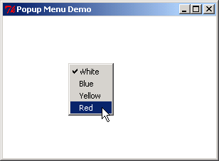
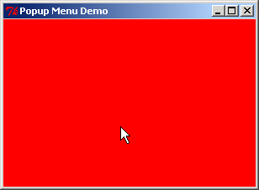
fig11_04.py
36 def popUpMenu( self, event ):
37 """Add the Menu to the Frame"""
38
39 self.menu.post( event.x_root, event.y_root )
40
41 def changeBackgroundColor( self ):
42 """Change the Frame background color"""
43
44 self.frame1.config( bg = self.selectedColor.get() )
45
46 def main():
47 PopupMenuDemo().mainloop()
48
49 if __name__ == "__main__":
50 main()
Display Menu component at given coordinates
Set Frame component’s background color

Slide 19
11.7 Canvas Component
Tkinter component Canvas displays text, images, lines and shapes
Blank by default
Program creates canvas items to display items on a Canvas
New items drawn on existing items unless otherwise specified

Slide 20
fig11_05.py
1 # Fig. 11.5: fig11_05.py
2 # Canvas paint program.
3
4 from Tkinter import *
5
6 class PaintBox( Frame ):
7 """Demonstrate drawing on a Canvas"""
8
9 def __init__( self ):
10 """Create Canvas and bind paint method to mouse dragging"""
11
12 Frame.__init__( self )
13 self.pack( expand = YES, fill = BOTH )
14 self.master.title( "A simple paint program" )
15 self.master.geometry( "300x150" )
16
17 self.message = Label( self,
18 text = "Drag the mouse to draw" )
19 self.message.pack( side = BOTTOM )
20
21 # create Canvas component
22 self.myCanvas = Canvas( self )
23 self.myCanvas.pack( expand = YES, fill = BOTH )
24
25 # bind mouse dragging event to Canvas
26 self.myCanvas.bind( "<B1-Motion>", self.paint )
27
28 def paint( self, event ):
29 """Create an oval of radius 4 around the mouse position"""
30
31 x1, y1 = ( event.x - 4 ), ( event.y - 4 )
32 x2, y2 = ( event.x + 4 ), ( event.y + 4 )
33 self.myCanvas.create_oval( x1, y1, x2, y2, fill = "black" )
34
Create Tkinter Canvas component
Bind mouse dragging event to Canvas component
Retrieve x- and y- coordinates of mouse position
Create oval Canvas item

Slide 21
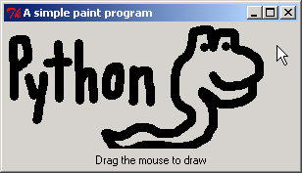
fig11_05.py
35 def main():
36 PaintBox().mainloop()
37
38 if __name__ == "__main__":
39 main()

Slide 22
11.8 Scale Component
Tkinter component Scale enables user to select from a range of integer values
Has numeric values and a slider
Horizontal orientation: minimum value at extreme left and maximum value at extreme right
Vertical orientation: minimum value at extreme top and maximum value at extreme bottom

Slide 23

11.8 Scale Component
Numeric value
slider

Slide 24
fig11_07.py
1 # Fig. 11.7: fig11_07.py
2 # Scale used to control the size of a circle.
3
4 from Tkinter import *
5
6 class ScaleDemo( Frame ):
7 """Demonstrate Canvas and Scale"""
8
9 def __init__( self ):
10 """Create Canvas with a circle controlled by a Scale"""
11
12 Frame.__init__( self )
13 self.pack( expand = YES, fill = BOTH )
14 self.master.title( "Scale Demo" )
15 self.master.geometry( "220x270" )
16
17 # create Scale
18 self.control = Scale( self, from_ = 0, to = 200,
19 orient = HORIZONTAL, command = self.updateCircle )
20 self.control.pack( side = BOTTOM, fill = X )
21 self.control.set( 10 )
22
23 # create Canvas and draw circle
24 self.display = Canvas( self, bg = "white" )
25 self.display.pack( expand = YES, fill = BOTH )
26
27 def updateCircle( self, scaleValue ):
28 """Delete the circle, determine new size, draw again"""
29
30 end = int( scaleValue ) + 10
31 self.display.delete( "circle" )
32 self.display.create_oval( 10, 10, end, end,
33 fill = "red", tags = "circle" )
34
35 def main():
Create Tkinter Scale component
Specify Scale’s maximum value
Specify Scale’s minimum value
Set initial Scale value
Delete previously drawn Canvas item
Create oval Canvas item
Option tags sets Canvas item’s name

Slide 25
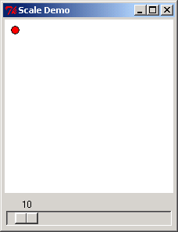
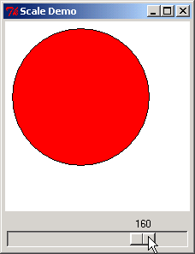
fig11_07.py
36 ScaleDemo().mainloop()
37
38 if __name__ == "__main__":
39 main()

Slide 26
11.9 Other GUI Toolkits
PyGTK provides object-oriented interface for the Gimp Toolkit component set
wxPython extension module enables access to wxWindows, a GUI C++ library
PyOpenGL interface to OpenGL

