Slide 1
Chapter 12 – Exception Handling
Outline
12.1 Introduction
12.2 Raising an Exception
12.3 Exception-Handling Overview
12.4 Example: DivideByZeroError
12.5 Python Exception Hierarchy
12.6 finally Clause
12.7 Exception Objects and Tracebacks
12.8 Programmer-Defined Exception Classes

Slide 2
12.1 Introduction
Exception: indication of an infrequent “special event” during program execution
Exception handling enables programmers to create applications that can resolve exceptions
Python creates traceback objects when it encounters exceptions

Slide 3
12.2 Raising an Exception
raise statement indicates an exception occurred
Simplest form of throwing (or raising) an exception is keyword raise, followed by exception name and possibly arguments that initialize the exception object

Slide 4
12.3 Exception-Handling Overview
Exception handling
  improves program clarity and modifiability by removing error-handling code from the “main line” of the program’s execution
  Improves a program’s fault tolerance
Programmers decide which exceptions to handle
Raised (or thrown) exception may be caught (detected) and processed by an exception handler
try statement encloses code that potentially cause exceptions

Slide 5
12.3 Exception-Handling Overview
try statement encloses code that potentially cause exceptions
try statement may specify zero or more except clauses
except clause specifies zero or more exception class names that represent exception type(s) that the clause can handle
Python uses termination model of exception handling in which the try suite that raises an exception expires immediately

Slide 6
12.4 Example: DivideByZeroError
Example handles ValueError and ZeroDivisionError

Slide 7
fig12_01.py
1 # Fig. 12.1: fig12_01.py
2 # Simple exception handling example.
3
4 number1 = raw_input( "Enter numerator: " )
5 number2 = raw_input( "Enter denominator: " )
6
7 # attempt to convert and divide values
8 try:
9 number1 = float( number1 )
10 number2 = float( number2 )
11 result = number1 / number2
12
13 # float raises a ValueError exception
14 except ValueError:
15 print "You must enter two numbers"
16
17 # division by zero raises a ZeroDivisionError exception
18 except ZeroDivisionError:
19 print "Attempted to divide by zero"
20
21 # else clause's suite executes if try suite raises no exceptions
22 else:
23 print "%.3f / %.3f = %.3f" % ( number1, number2, result )
Code in try suite may raise exceptions
User might raise ValueError by entering value that cannot be converted to float
Division by zero raises ZeroDivisionError exception
Catches ValueError exception raised by float
Catches ZeroDivisionError exception
Executes only if try suite did not raise any exceptions
Enter numerator: 100
Enter denominator: 7
100.000 / 7.000 = 14.286

Slide 8
fig12_01.py
Enter numerator: 100
Enter denominator: hello
You must enter two numbers
Enter numerator: 100
Enter denominator: 0
Attempted to divide by zero

Slide 9
12.5 Python Exception Hierarchy
Exceptions inherit from base class Exception
Exceptions defined in module exceptions
Exception names already in built-in namespace
Four primary classes
  SystemExit: terminates program execution when uncaught
  StopIteration: raised when for loop reaches end of its sequence
  Warning: indicates certain elements of Python may change in the future
  StandardError: base class for all Python error exceptions (e.g., ValueError and ZeroDivisionError)

Slide 10
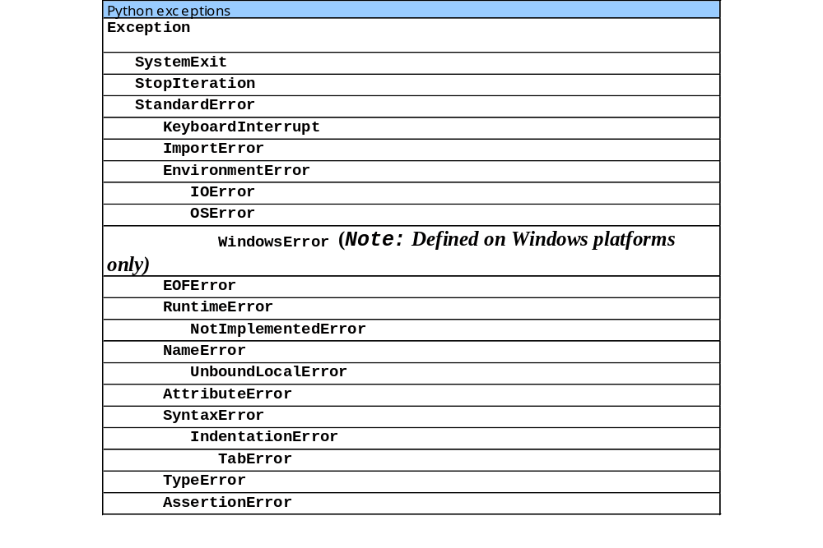
12.5 Python Exception Hierarchy

Slide 11
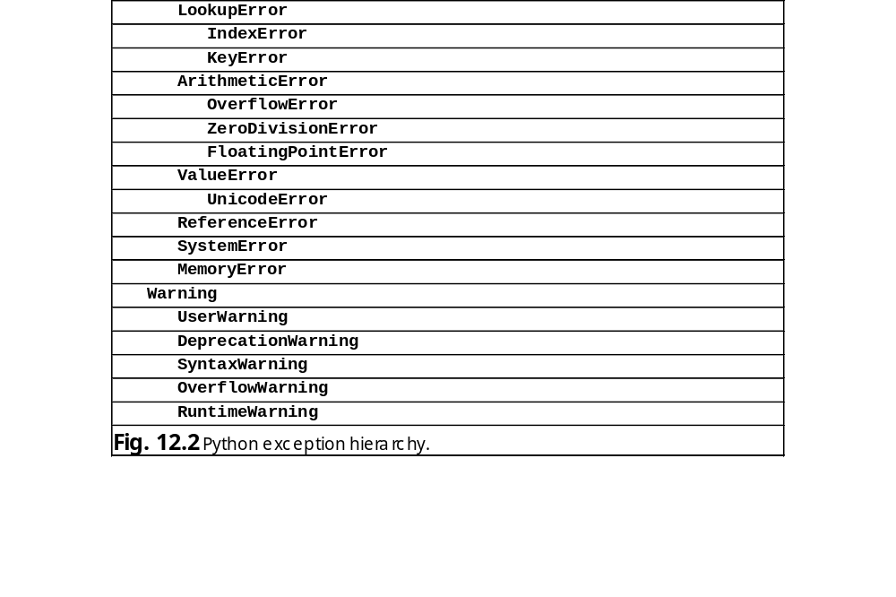
12.5 Python Exception Hierarchy

Slide 12
12.6 finally Clause
Guaranteed to execute if program control enters the corresponding try suite, regardless of whether it executes successfully or an exception occurs
Ideal location for resource-deallocation code

Slide 13
fig12_03.py
1 # Fig. 12.3: fig12_03.py
2 # Using finally clauses.
3
4 def doNotRaiseException():
5
6 # try block does not raise any exceptions
7 try:
8 print "In doNotRaiseException"
9
10 # finally executes because corresponding try executed
11 finally:
12 print "Finally executed in doNotRaiseException"
13
14 print "End of doNotRaiseException"
15
16 def raiseExceptionDoNotCatch():
17
18 # raise exception, but do not catch it
19 try:
20 print "In raiseExceptionDoNotCatch"
21 raise Exception
22
23 # finally executes because corresponding try executed
24 finally:
25 print "Finally executed in raiseExceptionDoNotCatch"
26
27 print "Will never reach this point"
28
29 # main program
30
31 # Case 1: No exceptions occur in called function.
32 print "Calling doNotRaiseException"
33 doNotRaiseException()
34
try suite does not raise any exceptions
Executes after corresponding try suite
Raise exception
Code after finally suite not executed
Called function does not raise any exceptions

Slide 14
fig12_03.py
35 # Case 2: Exception occurs, but is not handled in called function,
36 # because no except clauses exist in raiseExceptionDoNotCatch
37 print "\nCalling raiseExceptionDoNotCatch"
38
39 # call raiseExceptionDoNotCatch
40 try:
41 raiseExceptionDoNotCatch()
42
43 # catch exception from raiseExceptionDoNotCatch
44 except Exception:
45 print "Caught exception from raiseExceptionDoNotCatch " + \
46 "in main program."
Called function raises an exception
Catch exception raised by function
Calling doNotRaiseException
In doNotRaiseException
Finally executed in doNotRaiseException
End of doNotRaiseException
Calling raiseExceptionDoNotCatch
In raiseExceptionDoNotCatch
Finally executed in raiseExceptionDoNotCatch
Caught exception from raiseExceptionDoNotCatch in main program.

Slide 15
12.7 Exception Objects and Tracebacks
arguments from a raise statement in the exception object’s args attribute
traceback objects contain information about function call stack from the time the exception occurred
Inserts function name at beginning of function call stack
Stack unwinding: process of searching for an appropriate exception handler

Slide 16
fig12_04.py
1 # Fig. 12.4: fig12_04.py
2 # Demonstrating exception arguments and stack unwinding.
3
4 import traceback
5
6 def function1():
7 function2()
8
9 def function2():
10 function3()
11
12 def function3():
13
14 # raise exception, catch exception, reraise exception
15 try:
16 raise Exception, "An exception has occurred"
17 except Exception:
18 print "Caught exception in function3. Reraising....\n"
19 raise # reraises most recent exception
20
21 # call function1, any Exception it generates will be
22 # caught by the except clause that follows
23 try:
24 function1()
25
26 # output exception arguments, string representation of exception,
27 # and the traceback
28 except Exception, exception:
29 print "Exception caught in main program."
30 print "\nException arguments:", exception.args
31 print "\nException message:", exception
32 print "\nTraceback:"
33 traceback.print_exc()
Contains functions to manipulate traceback objects created during stack unwinding
Main program becomes first time on stack
Third item added to stack
Fourth item added to stack
function3 raises and catches an exception
Reraise most recent expression
function1 becomes second item on the stack
Catches any exceptions raised by function1
Contains Exception object’s arguments
Exception message
Prints traceback

Slide 17
fig12_04.py
Caught exception in function3. Reraising....
Exception caught in main program.
Exception arguments: ('An exception has occurred',)
Exception message: An exception has occurred
Traceback:
Traceback (most recent call last):
File "fig12_04.py", line 24, in ?
function1()
File "fig12_04.py", line 7, in function1
function2()
File "fig12_04.py", line 10, in function2
function3()
File "fig12_04.py", line 16, in function3
raise Exception, "An exception has occurred"
Exception: An exception has occurred

Slide 18
12.8 Programmer-Defined Exception Classes
Should derive directly or indirectly from class Exception
Programmers may wish to create exception types more specific to the problems that occur in their programs

Slide 19
fig12_05.py
1 # Fig. 12.5: fig12_05.py
2 # Demonstrating a programmer-defined exception class.
3
4 import math
5
6 class NegativeNumberError( ArithmeticError ):
7 """Attempted improper operation on negative number."""
8 pass
9
10 def squareRoot( number ):
11 """Computes square root of number. Raises NegativeNumberError
12 if number is less than 0."""
13
14 if number < 0:
15 raise NegativeNumberError, \
16 "Square root of negative number not permitted"
17
18 return math.sqrt( number )
19
20 while 1:
21
22 # get user-entered number and compute square root
23 try:
24 userValue = float( raw_input( "\nPlease enter a number: " ) )
25 print squareRoot( userValue )
26
27 # float raises ValueError if input is not numerical
28 except ValueError:
29 print "The entered value is not a number"
30
31 # squareRoot raises NegativeNumberError if number is negative
32 except NegativeNumberError, exception:
33 print exception
34
Programmer-defined exception class
Derived from exception class ArithmeticError
Attempt to perform illegal operation on negative number
Print exception before returning control to beginning of while loop

Slide 20
fig12_05.py
35 # successful execution: terminate while loop
36 else:
37 break
Executes after successful termination of try suite
Please enter a number: hello
The entered value is not a number
Please enter a number: -900
Square root of negative number not permitted
Please enter a number: 12.345
3.51354521815

