Slide 1
Chapter 13 – String Manipulation and Regular Expressions
Outline
13.1 Introduction
13.2 Fundamentals of Characters and Strings
13.3 String Presentation
13.4 Searching Strings
13.5 Joining and Splitting Strings
13.6 Regular Expressions
13.7 Compiling Regular Expressions and Manipulating Regular Expression Objects
13.8 Regular Expression Repetition and Placement Characters
13.9 Classes and Special Sequences
13.10 Regular Expression String-Manipulation Functions
13.11 Grouping
13.12 Internet and World Wide Web Resources

Slide 2
13.1 Introduction
Presentation of Python’s string and character processing capabilities
Demonstrates powerful text-processing capabilities of regular expressions with module re

Slide 3
13.2 Fundamentals of Characters and Strings
Characters: fundamental building blocks of Python programs
Function ord returns a character’s integer ordinal value
Python supports strings as a built-in type

Slide 4
13.2 Fundamentals of Characters and Strings
Python 2.2b2 (#26, Nov 16 2001, 11:44:11) [MSC 32 bit (Intel)] on win32
Type "help", "copyright", "credits" or "license" for more information.
>>> ord( "z" )
122
>>> ord( "\n" )
10
Fig. 13.1 Integer ordinal value of a character.

Slide 5
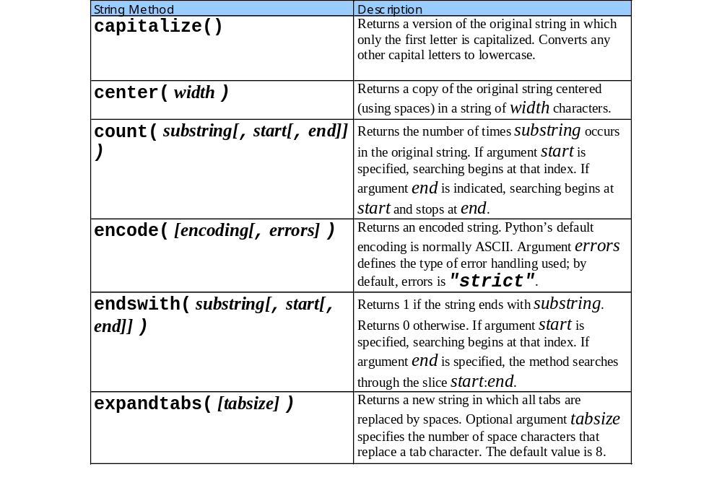
13.2 Fundamentals of Characters and Strings

Slide 6
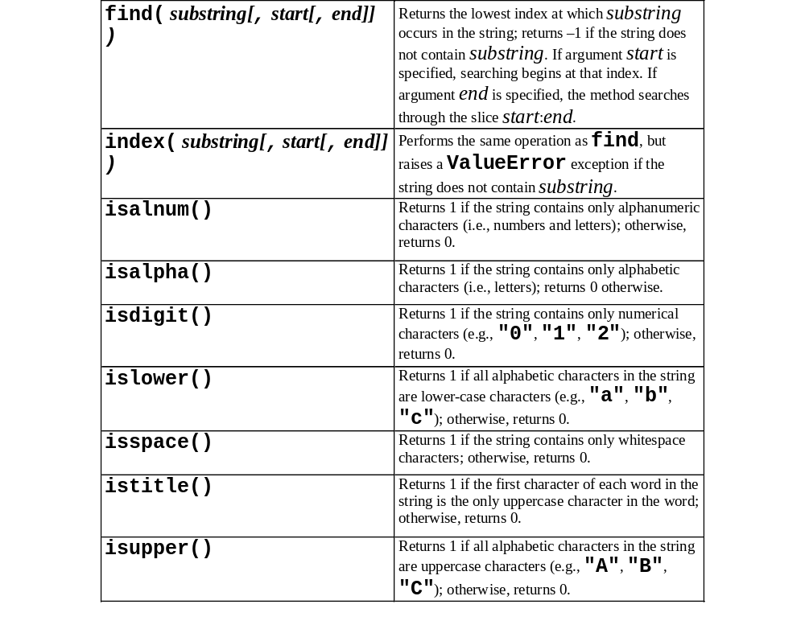
13.2 Fundamentals of Characters and Strings

Slide 7
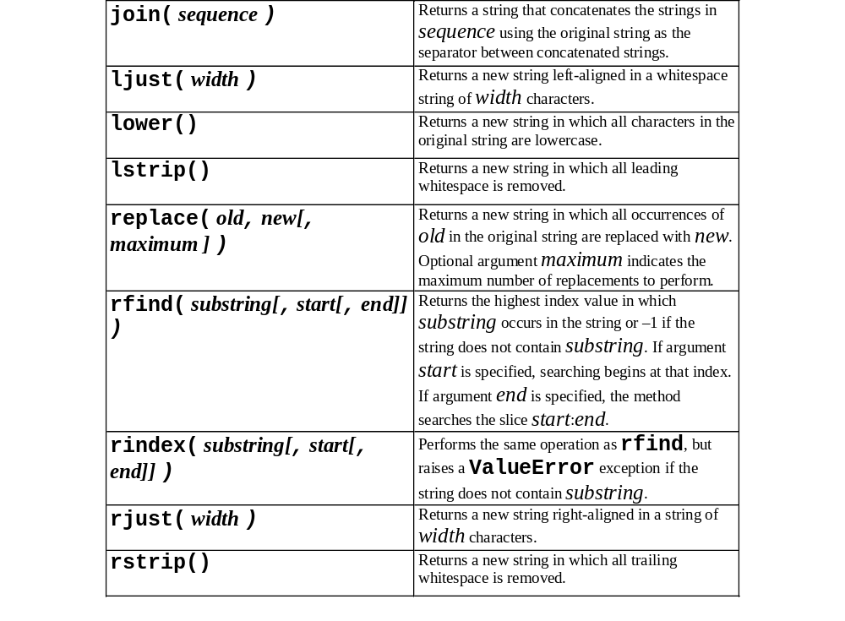
13.2 Fundamentals of Characters and Strings

Slide 8
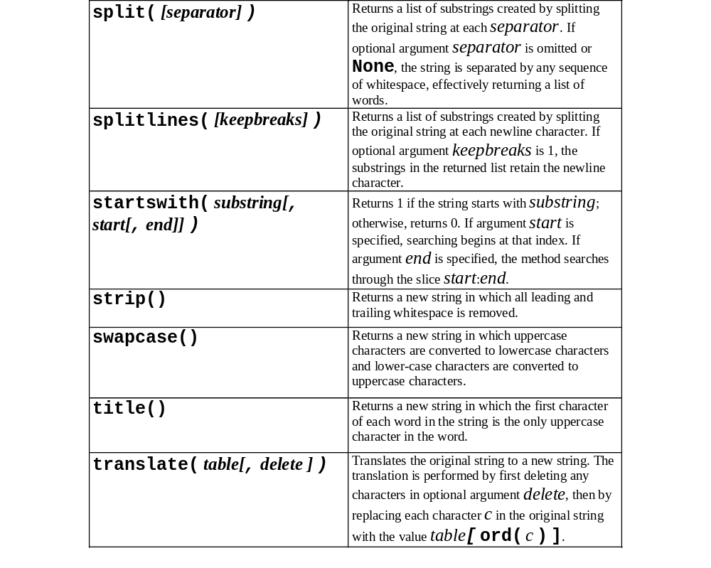
13.2 Fundamentals of Characters and Strings

Slide 9
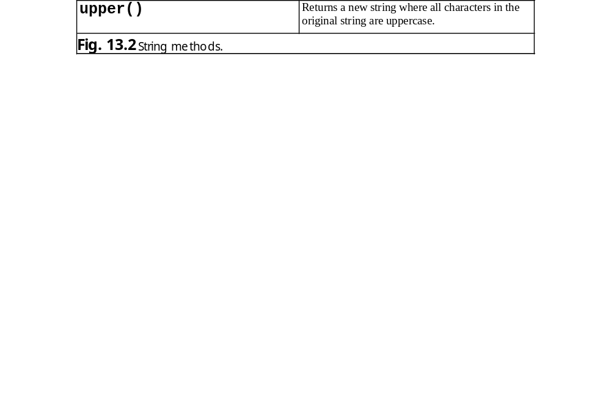
13.2 Fundamentals of Characters and Strings

Slide 10
13.3 String Presentation
Formatting enables users to read and understand string data (e.g., program instructions)

Slide 11
fig13_03.py
1 # Fig. 13.3: fig13_03.py
2 # Simple output formatting example.
3
4 string1 = "Now I am here."
5
6 print string1.center( 50 )
7 print string1.rjust( 50 )
8 print string1.ljust( 50 )
Centers calling string in a new string of 50 characters
Right-aligns calling string in new string of 50 characters
Left-aligns calling string in new string of 50 characters
Now I am here.
Now I am here.
Now I am here.

Slide 12
fig13_04.py
1 # Fig. 13.4: fig13_04.py
2 # Stripping whitespace from a string.
3
4 string1 = "\t \n This is a test string. \t\t \n"
5
6 print 'Original string: "%s"\n' % string1
7 print 'Using strip: "%s"\n' % string1.strip()
8 print 'Using left strip: "%s"\n' % string1.lstrip()
9 print "Using right strip: \"%s\"\n" % string1.rstrip()
Removes all leading and trailing whitespace from string
Removes all leading whitespace from strings
Removes all trailing whitespace from string
Original string: "
This is a test string.
"
Using strip: "This is a test string."
Using left strip: "This is a test string.
"
Using right strip: "
This is a test string."

Slide 13
13.4 Searching Strings
Method find, index, rfind and rindex search for substrings in a calling string
Methods startswith and endswith return 1 if a calling string begins with or ends with a given string, respectively
Method count returns number of occurrences of a substring in a calling string
Method replace substitutes its second argument for its first argument in a calling string

Slide 14
fig13_05.py
1 # Fig. 13.5: fig13_05.py
2 # Searching strings for a substring.
3
4 # counting the occurrences of a substring
5 string1 = "Test1, test2, test3, test4, Test5, test6"
6
7 print '"test" occurs %d times in \n\t%s' % \
8 ( string1.count( "test" ), string1 )
9 print '"test" occurs %d times after 18th character in \n\t%s' % \
10 ( string1.count( "test", 18, len( string1 ) ), string1 )
11 print
12
13 # finding a substring in a string
14 string2 = "Odd or even"
15
16 print '"%s" contains "or" starting at index %d' % \
17 ( string2, string2.find( "or" ) )
18
19 # find index of "even"
20 try:
21 print '"even" index is', string2.index( "even" )
22 except ValueError:
23 print '"even" does not occur in "%s"' % string2
24
25 if string2.startswith( "Odd" ):
26 print '"%s" starts with "Odd"' % string2
27
28 if string2.endswith( "even" ):
29 print '"%s" ends with "even"\n' % string2
30
31 # searching from end of string
32 print 'Index from end of "test" in "%s" is %d' \
33 % ( string1, string1.rfind( "test" ) )
34 print
35
Returns number of times given substring appears in calling string
Returns number of times substring appears in slice of calling string
Returns lowest index at which substring occurs in calling string
Returns lowest index at which substring occurs
Unlike find, index raises ValueError if substring not found
Returns 1 if calling string begins with substring
Returns 1 if calling string ends with substring
Returns highest index at which substring occurs

Slide 15
fig13_05.py
36 # find rindex of "Test"
37 try:
38 print 'First occurrence of "Test" from end at index', \
39 string1.rindex( "Test" )
40 except ValueError:
41 print '"Test" does not occur in "%s"' % string1
42
43 print
44
45 # replacing a substring
46 string3 = "One, one, one, one, one, one"
47
48 print "Original:", string3
49 print 'Replaced "one" with "two":', \
50 string3.replace( "one", "two" )
51 print "Replaced 3 maximum:", string3.replace( "one", "two", 3 )
Return highest index at which substring is found
Unlike rfind, rindex raises ValueError if substring not found
Replace all occurrences of first argument with second argument
Replace 3 occurrences of first argument with second argument
"test" occurs 4 times in
Test1, test2, test3, test4, Test5, test6
"test" occurs 2 times after 18th character in
Test1, test2, test3, test4, Test5, test6
"Odd or even" contains "or" starting at index 4
"even" index is 7
"Odd or even" starts with "Odd"
"Odd or even" ends with "even"
Index from end of "test" in "Test1, test2, test3, test4, Test5, test6" is 35
First occurrence of "Test" from end at index 28
Original: One, one, one, one, one, one
Replaced "one" with "two": One, two, two, two, two, two
Replaced 3 maximum: One, two, two, two, one, one

Slide 16
13.5 Splitting and Joining Strings
Tokenization breaks statements into individual components (or tokens)
Delimiters, typically whitespace characters, separate tokens

Slide 17
fig13_06.py
1 # Fig. 13.6: fig13_06.py
2 # Token splitting and delimiter joining.
3
4 # splitting strings
5 string1 = "A, B, C, D, E, F"
6
7 print "String is:", string1
8 print "Split string by spaces:", string1.split()
9 print "Split string by commas:", string1.split( "," )
10 print "Split string by commas, max 2:", string1.split( ",", 2 )
11 print
12
13 # joining strings
14 list1 = [ "A", "B", "C", "D", "E", "F" ]
15 string2 = "___"
16
17 print "List is:", list1
18 print 'Joining with "%s": %s' \
19 % ( string2, string2.join ( list1 ) )
20 print 'Joining with "-.-":', "-.-".join( list1 )
Splits calling string by whitespace characters
Splits calling string by specified character
Return list of tokens split by 2 comma delimiters
Combines list with calling string as a delimiter to create new string
Combines list with calling quoted string as delimiter to create new string
String is: A, B, C, D, E, F
Split string by spaces: ['A,', 'B,', 'C,', 'D,', 'E,', 'F']
Split string by commas: ['A', ' B', ' C', ' D', ' E', ' F']
Split string by commas, max 2: ['A', ' B', ' C, D, E, F']
List is: ['A', 'B', 'C', 'D', 'E', 'F']
Joining with "___": A___B___C___D___E___F
Joining with "-.-": A-.-B-.-C-.-D-.-E-.-F

Slide 18
13.6 Regular Expressions
Provide more efficient and powerful alternative to string search methods
Text pattern that a program uses to find substrings that match patterns
Processing capabilities provided by module re

Slide 19
fig13_07.py
1 # Fig. 13.7: fig13_07.py
2 # Simple regular-expression example.
3
4 import re
5
6 # list of strings to search and expressions used to search
7 testStrings = [ "Hello World", "Hello world!", "hello world" ]
8 expressions = [ "hello", "Hello", "world!" ]
9
10 # search every expression in every string
11 for string in testStrings:
12
13 for expression in expressions:
14
15 if re.search( expression, string ):
16 print expression, "found in string", string
17 else:
18 print expression, "not found in string", string
19
20 print
Module re provides regular expression processing capabilities
List of regular expressions
Returns an object containing substring matching the regular expression
Returns None if substring not found
hello not found in string Hello World
Hello found in string Hello World
world! not found in string Hello World
hello not found in string Hello world!
Hello found in string Hello world!
world! found in string Hello world!
hello found in string hello world
Hello not found in string hello world
world! not found in string hello world

Slide 20
13.7 Compiling Regular Expressions and Manipulating Regular Expression Objects
Compiled regular expressions represented by SRE_Pattern object, which provides all functionality available in module re
If a program uses a regular expression several times, the compiled version may be more efficient
Methods re.search and re.match return an SRE_Match object

Slide 21
fig13_08.py
1 # Fig. 13.08: fig13_08.py
2 # Compiled regular-expression and match objects.
3
4 import re
5
6 testString = "Hello world"
7 formatString = "%-35s: %s" # string for formatting the output
8
9 # create regular expression and compiled expression
10 expression = "Hello"
11 compiledExpression = re.compile( expression )
12
13 # print expression and compiled expression
14 print formatString % ( "The expression", expression )
15 print formatString % ( "The compiled expression",
16 compiledExpression )
17
18 # search using re.search and compiled expression's search method
19 print formatString % ( "Non-compiled search",
20 re.search( expression, testString ) )
21 print formatString % ( "Compiled search",
22 compiledExpression.search( testString ) )
23
24 # print results of searching
25 print formatString % ( "search SRE_Match contains",
26 re.search( expression, testString ).group() )
27 print formatString % ( "compiled search SRE_Match contains",
28 compiledExpression.search( testString ).group() )
Method compile takes a regular expression as an argument
Method compile returns an SRE_Pattern object
Compiled regular expression’s search method
SRE_Match object’s method group returns matching substring
The expression : Hello
The compiled expression : <SRE_Pattern object at 0x00B60A20>
Non-compiled search : <SRE_Match object at 0x00D0F9B8>
Compiled search : <SRE_Match object at 0x00D0F9B8>
search SRE_Match contains : Hello
compiled search SRE_Match contains : Hello

Slide 22
13.8 Regular Expression Repetition and Placement Characters
Patterns built using combination of metacharacters and escape sequences
Metacharacter: regular-expression syntax element that repeats, groups, places or classifies one or more characters
  ?: matches zero or one occurrences of the expression it follows
  +: matches one or more occurrences of the expression it follows
  *: matches zero or more occurrences of the expression it follows

Slide 23
13.8 Regular Expression Repetition and Placement Characters
  ^: indicates placement at the beginning of the string
  $: indicates placement at the end of the string

Slide 24
fig13_09.py
1 # Fig. 13.9: fig13_09.py
2 # Repetition patterns, matching vs searching.
3
4 import re
5
6 testStrings = [ "Heo", "Helo", "Hellllo" ]
7 expressions = [ "Hel?o", "Hel+o", "Hel*o" ]
8
9 # match every expression with every string
10 for expression in expressions:
11
12 for string in testStrings:
13
14 if re.match( expression, string ):
15 print expression, "matches", string
16 else:
17 print expression, "does not match", string
18
19 print
20
21 # demonstrate the difference between matching and searching
22 expression1 = "elo" # plain string
23 expression2 = "^elo" # "elo" at beginning of string
24 expression3 = "elo$" # "elo" at end of string
25
26 # match expression1 with testStrings[ 1 ]
27 if re.match( expression1, testStrings[ 1 ] ):
28 print expression1, "matches", testStrings[ 1 ]
29
30 # search for expression1 in testStrings[ 1 ]
31 if re.search( expression1, testStrings[ 1 ] ):
32 print expression1, "found in", testStrings[ 1 ]
33
? matches 0 or 1 occurrences of l
* Returns zero or more occurrences of l
+ matches 1 or more occurrences of l
Returns SRE_Match object only if beginning of string matches regular expression
Pattern occurs at beginning of string
Pattern occurs at end of string

Slide 25
fig13_09.py
34 # search for expression2 in testStrings[ 1 ]
35 if re.search( expression2, testStrings[ 1 ] ):
36 print expression2, "found in", testStrings[ 1 ]
37
38 # search for expression3 in testStrings[ 1 ]
39 if re.search( expression3, testStrings[ 1 ] ):
40 print expression3, "found in", testStrings[ 1 ]
Hel?o matches Heo
Hel?o matches Helo
Hel?o does not match Hellllo
Hel+o does not match Heo
Hel+o matches Helo
Hel+o matches Hellllo
Hel*o matches Heo
Hel*o matches Helo
Hel*o matches Hellllo
elo found in Helo
elo$ found in Helo

Slide 26
13.9 Classes and Special Sequences
Regular-expression building blocks
Character class: specifies a group of characters to match in a string
  Denoted by []
  Metacharacter ^ at beginning negates character class
Special sequence: shortcut for a common character class

Slide 27
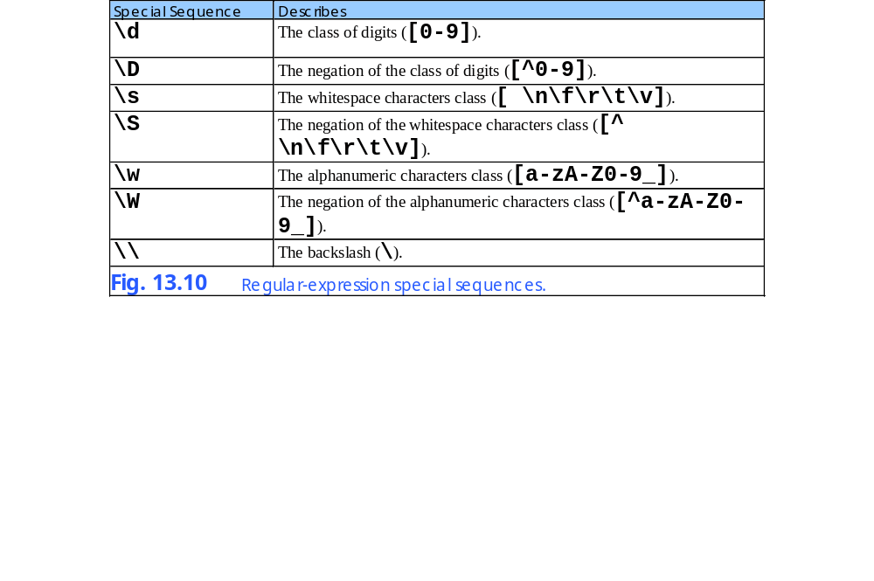
13.9 Classes and Special Sequences

Slide 28
fig13_11.py
1 # Fig. 13.11: fig13_11.py
2 # Program that demonstrates classes and special sequences.
3
4 import re
5
6 # specifying character classes with [ ]
7 testStrings = [ "2x+5y","7y-3z" ]
8 expressions = [ r"2x\+5y|7y-3z",
9 r"[0-9][a-zA-Z0-9_].[0-9][yz]",
10 r"\d\w-\d\w" ]
11
12 # match every expression with every string
13 for expression in expressions:
14
15 for testString in testStrings:
16
17 if re.match( expression, testString ):
18 print expression, "matches", testString
19
20 # specifying character classes with special sequences
21 testString1 = "800-123-4567"
22 testString2 = "617-123-4567"
23 testString3 = "email: \t joe_doe@deitel.com"
24
25 expression1 = r"^\d{3}-\d{3}-\d{4}$"
26 expression2 = r"\w+:\s+\w+@\w+\.(com|org|net)"
27
28 # matching with character classes
29 if re.match( expression1, testString1 ):
30 print expression1, "matches", testString1
31
32 if re.match( expression1, testString2 ):
33 print expression1, "matches", testString2
34
Raw string preceded by letter r
Character class of digits
Alphanumeric character class
\d represents character class of digits
\w represents alphanumeric character class
Bracket metacharacters specifies number or range of repetitions
Match 1 or more alphanumeric characters

Slide 29
fig13_11.py
35 if re.match( expression2, testString3 ):
36 print expression2, "matches", testString3
2x\+5y|7y-3z matches 2x+5y
2x\+5y|7y-3z matches 7y-3z
[0-9][a-zA-Z0-9_].[0-9][yz] matches 2x+5y
[0-9][a-zA-Z0-9_].[0-9][yz] matches 7y-3z
\d\w-\d\w matches 7y-3z
^\d{3}-\d{3}-\d{4}$ matches 800-123-4567
^\d{3}-\d{3}-\d{4}$ matches 617-123-4567
\w+:\s+\w+@\w+\.(com|org|net) matches email: joe_doe@deitel.com

Slide 30
13.9 Classes and Special Sequences
Python 2.2b2 (#26, Nov 16 2001, 11:44:11) [MSC 32 bit (Intel)] on win32
Type "copyright", "credits" or "license" for more information.
>>> import re
>>> print re.match( "2x+5y", "2x+5y" )
None
>>> print re.match( "2x+5y", "2x5y" )
<SRE_Match object at 0x00932268>
>>> print re.match( "2x+5y", "2xx5y" )
<SRE_Match object at 0x00949A88>
Fig. 13.12 \ metacharacter in regular expressions.

Slide 31
13.10 Regular Expression String-Manipulation Functions
Module re provides pattern-based, string-manipulation capabilities, such as substituting a substring in a string and splitting a string with a delimiter

Slide 32
fig13_13.py
1 # Fig. 13.13: fig13_13.py
2 # Regular-expression string manipulation.
3
4 import re
5
6 testString1 = "This sentence ends in 5 stars *****"
7 testString2 = "1,2,3,4,5,6,7"
8 testString3 = "1+2x*3-y"
9 formatString = "%-34s: %s" # string to format output
10
11 print formatString % ( "Original string", testString1 )
12
13 # regular expression substitution
14 testString1 = re.sub( r"\*", r"^", testString1 )
15 print formatString % ( "^ substituted for *", testString1 )
16
17 testString1 = re.sub( r"stars", "carets", testString1 )
18 print formatString % ( '"carets" substituted for "stars"',
19 testString1 )
20
21 print formatString % ( 'Every word replaced by "word"',
22 re.sub( r"\w+", "word", testString1 ) )
23
24 print formatString % ( 'Replace first 3 digits by "digit"',
25 re.sub( r"\d", "digit", testString2, 3 ) )
26
27 # regular expression splitting
28 print formatString % ( "Splitting " + testString2,
29 re.split( r",", testString2 ) )
30
31 print formatString % ( "Splitting " + testString3,
32 re.split( r"[+\-*/%]", testString3 ) )
sub replaces ^ with * in testString1
Special character * is escaped with backslash
sub’s optional fourth argument specifies a maximum number (3) of replacements
split tokenizes string by specified delimiter (,)
Passes split a character class of delimiters
Only – and ^ need to be escaped in a character class

Slide 33
fig13_13.py
Original string : This sentence ends in 5 stars *****
^ substituted for * : This sentence ends in 5 stars ^^^^^
"carets" substituted for "stars" : This sentence ends in 5 carets ^^^^^
Every word replaced by "word" : word word word word word word ^^^^^
Replace first 3 digits by "digit" : digit,digit,digit,4,5,6,7
Splitting 1,2,3,4,5,6,7 : ['1', '2', '3', '4', '5', '6', '7']
Splitting 1+2x*3-y : ['1', '2x', '3', 'y']

Slide 34
13.11 Grouping
Regular expression may specify groups of substrings to match in a string
Program extracts information from matching groups
Metacharacters ( and ) denote a group
Greedy operators (+ and *) attempt to match as many characters as possible even if this is not the desired behavior

Slide 35
fig13_14.py
1 # Fig. 13.14: fig13_14.py
2 # Program that demonstrates grouping and greedy operations.
3
4 import re
5
6 formatString1 = "%-22s: %s" # string to format output
7
8 # string that contains fields and expression to extract fields
9 testString1 = \
10 "Albert Antstein, phone: 123-4567, e-mail: albert@bug2bug.com"
11 expression1 = \
12 r"(\w+ \w+), phone: (\d{3}-\d{4}), e-mail: (\w+@\w+\.\w{3})"
13
14 print formatString1 % ( "Extract all user data",
15 re.match( expression1, testString1 ).groups() )
16 print formatString1 % ( "Extract user e-mail",
17 re.match( expression1, testString1 ).group( 3 ) )
18 print
19
20 # greedy operations and grouping
21 formatString2 = "%-38s: %s" # string to format output
22
23 # strings and patterns to find base directory in a path
24 pathString = "/books/2001/python" # file path string
25
26 expression2 = "(/.+)/" # greedy operator expression
27 print formatString1 % ( "Greedy error",
28 re.match( expression2, pathString ).group( 1 ) )
29
30 expression3 = "(/.+?)/" # non-greedy operator expression
31 print formatString1 % ( "No error, base only",
32 re.match( expression3, pathString ).group( 1 ) )
Regular expression expression1 describes 3 groups
groups returns list of substrings which match specified groups in expression1
group returns substring matching regular expressions in specified group
Greedy operation expression
Greedy operator expression matches too many characters
? alters greedy behavior of +

Slide 36
fig13_14.py
Extract all user data : ('Albert Antstein', '123-4567', 'albert@
bug2bug.com')
Extract user e-mail : albert@bug2bug.com
Greedy error : /books/2001
No error, base only : /books

