Slide 1
Chapter 14 – File Processing and Serialization
Outline
14.1 Introduction
14.2 Data Hierarchy
14.3 Files and Streams
14.4 Creating a Sequential-Access File
14.5 Reading Data from a Sequential-Access File
14.6 Updating Sequential-Access Files
14.7 Random-Access Files
14.8 Simulating a Random-Access File: The shelve Module
14.9 Writing Data to a shelve File
14.10 Retrieving Data from a shelve File
14.11 Example: A Transaction-Processing Program
14.12 Object Serialization

Slide 2
14.1 Introduction
Files provide long-term retention of large amounts of data
Persistent data maintained in files
Files stored on secondary storage devices, such as magnetic disks, optical disks and tapes

Slide 3
14.2 Data Hierarchy
Data items processed by computers form data hierarchy in which data items become larger, more complex in structure in progression from bits to bytes to characters to fields, etc.
Smallest computer-supported data item bit (short for “binary digit”) either 0 or 1
1 byte = 8 bits
Preferable to program with characters (digits, letters and special symbols)
Fields composed of characters (or bytes)
Record (typically, tuple, dictionary or instance) composed of several fields

Slide 4
14.2 Data Hierarchy
File: group of related records
Record key distinguishes individual records

Slide 5
14.2 Data Hierarchy
Sally
Black
Tom
Blue
Judy
Green
File
Iris
Orange
Randy
Red
Judy
Green
Record
J u d y Field
01001010 Byte (ASCII character J)
1 Bit
Fig. 14.1 Data hierarchy.

Slide 6
14.3 Files and Streams
Python views files as sequential streams of bytes
Each file ends with an end-of-file marker or a specific byte number recorded in system-maintained administrative data structure
Opening a file creates an object associated with a stream
Three file streams created when Python program executes – sys.stdin (standard input stream), sys.stdout (standard output stream) and sys.stderr (standard error stream)

Slide 7
14.3 File and Streams
0
1
2
3
4
5
6
7
8
9
...
n-1
...
end-of-file marker
Fig. 14.2 Python’s view of a file of n bytes.

Slide 8
14.4 Creating a Sequential-Access File
Python imposes no file structure

Slide 9
fig14_03.py
1 # Fig. 14.3: fig14_03.py
2 # Opening and writing to a file.
3
4 import sys
5
6 # open file
7 try:
8 file = open( "clients.dat", "w" ) # open file in write mode
9 except IOError, message: # file open failed
10 print >> sys.stderr, "File could not be opened:", message
11 sys.exit( 1 )
12
13 print "Enter the account, name and balance."
14 print "Enter end-of-file to end input."
15
16 while 1:
17
18 try:
19 accountLine = raw_input( "? " ) # get account entry
20 except EOFError:
21 break # user entered EOF
22 else:
23 print >> file, accountLine # write entry to file
24
25 file.close()
Open “clients.dat” in write mode
Function open raises IOError exception if error encountered
Redirect error message to sys.stderr
Terminating program with argument 1 indicates error
EOFError generated when user enters EOF character
Write user input to file
Close file
Enter the account, name and balance.
Enter end-of-file to end input.
? 100 Jones 24.98
? 200 Doe 345.67
? 300 White 0.00
? 400 Stone -42.16
? 500 Rich 224.62
? ^Z

Slide 10
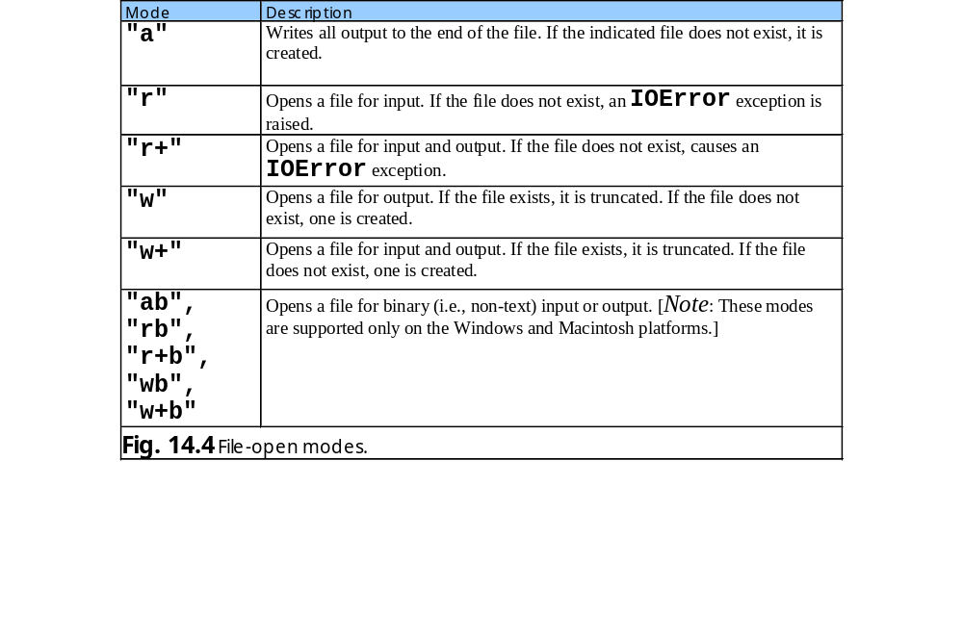
14.4 Creating a Sequential-Access File

Slide 11
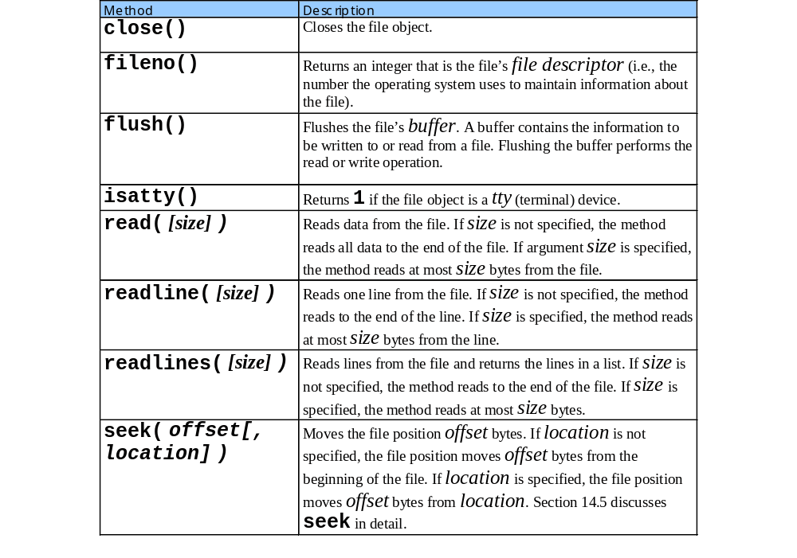
14.4 Creating a Sequential-Access File

Slide 12
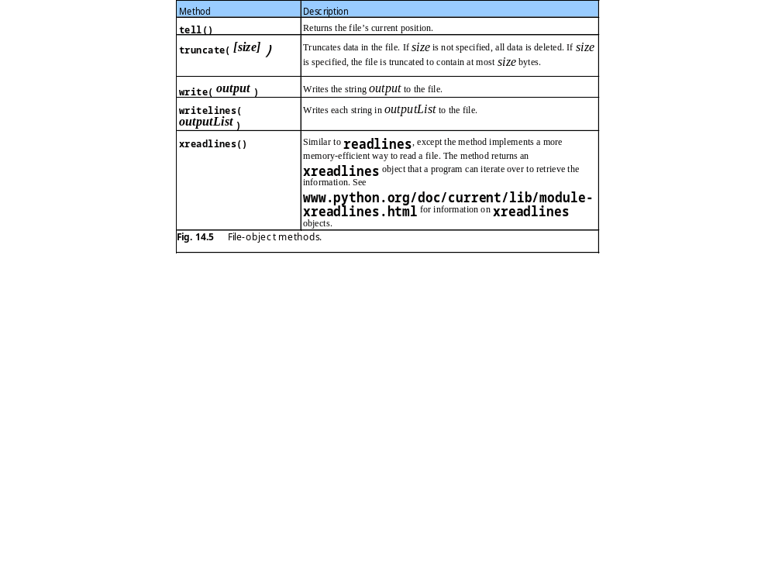
14.4 Creating a Sequential-Access File

Slide 13
14.5 Reading Data from a Sequential-Access File
Data in files can be retrieved for processing

Slide 14
fig14_06.py
1 # Fig. 14.6: fig14_06.py
2 # Reading and printing a file.
3
4 import sys
5
6 # open file
7 try:
8 file = open( "clients.dat", "r" )
9 except IOError:
10 print >> sys.stderr, "File could not be opened"
11 sys.exit( 1 )
12
13 records = file.readlines() # retrieve list of lines in file
14
15 print "Account".ljust( 10 ),
16 print "Name".ljust( 10 ),
17 print "Balance".rjust( 10 )
18
19 for record in records: # format each line
20 fields = record.split()
21 print fields[ 0 ].ljust( 10 ),
22 print fields[ 1 ].ljust( 10 ),
23 print fields[ 2 ].rjust( 10 )
24
25 file.close()
Create list of file lines
Format information in each line for output
Account Name Balance
100 Jones 24.98
200 Doe 345.67
300 White 0.00
400 Stone -42.16
500 Rich 224.62

Slide 15
fig14_07.py
1 # Fig. 14.7: fig14_07.py
2 # Credit inquiry program.
3
4 import sys
5
6 # retrieve one user command
7 def getRequest():
8
9 while 1:
10 request = int( raw_input( "\n? " ) )
11
12 if 1 <= request <= 4:
13 break
14
15 return request
16
17 # determine if balance should be displayed, based on type
18 def shouldDisplay( accountType, balance ):
19
20 if accountType == 2 and balance < 0: # credit balance
21 return 1
22
23 elif accountType == 3 and balance > 0: # debit balance
24 return 1
25
26 elif accountType == 1 and balance == 0: # zero balance
27 return 1
28
29 else: return 0
30
31 # print formatted balance data
32 def outputLine( account, name, balance ):
33

Slide 16
fig14_07.py
34 print account.ljust( 10 ),
35 print name.ljust( 10 ),
36 print balance.rjust( 10 )
37
38 # open file
39 try:
40 file = open( "clients.dat", "r" )
41 except IOError:
42 print >> sys.stderr, "File could not be opened"
43 sys.exit( 1 )
44
45 print "Enter request"
46 print "1 - List accounts with zero balances"
47 print "2 - List accounts with credit balances"
48 print "3 - List accounts with debit balances"
49 print "4 - End of run"
50
51 # process user request(s)
52 while 1:
53
54 request = getRequest() # get user request
55
56 if request == 1: # zero balances
57 print "\nAccounts with zero balances:"
58 elif request == 2: # credit balances
59 print "\nAccounts with credit balances:"
60 elif request == 3: # debit balances
61 print "\nAccounts with debit balances:"
62 elif request == 4: # exit loop
63 break
64 else: # getRequest should never let program reach here
65 print "\nInvalid request."
66
67 currentRecord = file.readline() # get first record
Open “clients.dat” in read mode
Retrieve file’s first line

Slide 17
fig14_07.py
68
69 # process each line
70 while ( currentRecord != "" ):
71 account, name, balance = currentRecord.split()
72 balance = float( balance )
73
74 if shouldDisplay( request, balance ):
75 outputLine( account, name, str( balance ) )
76
77 currentRecord = file.readline() # get next record
78
79 file.seek( 0, 0 ) # move to beginning of file
80
81 print "\nEnd of run."
82 file.close() # close file
Method seek receives two arguments - byte offset and optional location
Move file pointer to beginning of file
Enter request
1 - List accounts with zero balances
2 - List accounts with credit balances
3 - List accounts with debit balances
4 - End of run
? 1
Accounts with zero balances:
300 White 0.0
? 2
Accounts with credit balances:
400 Stone -42.16
? 3

Slide 18
fig14_07.py
Accounts with debit balances:
100 Jones 24.98
200 Doe 345.67
500 Rich 224.62
? 4
End of run.

Slide 19
14.6 Updating Sequential-Access Files
Sequential-access file data cannot be modified without risk of destroying other data

Slide 20
14.7 Random-Access Files
Make instant-access files possible because individual records can be accessed directly and quickly

Slide 21
14.7 Random-Access Files
0
100
200
300
400
500
byte offsets
100 bytes
100 bytes
100 bytes
100 bytes
100 bytes
100 bytes
Fig. 14.8 Structure of a random-access file.

Slide 22
14.8 Simulating a Random-Access File: The shelve Module
Python provides shelve module to simulate behavior of random-access files
shelve files has dictionary interface to a file

Slide 23
14.9 Writing Data to a shelve File
Resembles writing to a regular file
Records stored by key value

Slide 24
fig14_09.py
1 # Fig. 14.9: fig14_09.py
2 # Writing to shelve file.
3
4 import sys
5 import shelve
6
7 # open shelve file
8 try:
9 outCredit = shelve.open( "credit.dat" )
10 except IOError:
11 print >> sys.stderr, "File could not be opened"
12 sys.exit( 1 )
13
14 print "Enter account number (1 to 100, 0 to end input)"
15
16 # get account information
17 while 1:
18
19 # get account information
20 accountNumber = int( raw_input(
21 "\nEnter account number\n? " ) )
22
23 if 0 < accountNumber <= 100:
24
25 print "Enter lastname, firstname, balance"
26 currentData = raw_input( "? " )
27
28 outCredit[ str( accountNumber ) ] = currentData.split()
29
30 elif accountNumber == 0:
31 break
32
33 outCredit.close() # close shelve file
shelve file functions
Resembles open function for regular files
Dictionary interface for file information
String record keys
Close shelve file

Slide 25
fig14_09.pv
Enter account number (1 to 100, 0 to end input)
? 37
Enter lastname, firstname, balance
? Barker Doug 0.00
Enter account number
? 29
Enter lastname, firstname, balance
? Brown Nancy -24.54
Enter account number
? 96
Enter lastname, firstname, balance
? Stone Sam 34.98
Enter account number
? 88
Enter lastname, firstname, balance
? Smith Dave 258.34
Enter account number
? 33
Enter lastname, firstname, balance
? Dunn Stacey 314.33
Enter account number
? 0

Slide 26
14.10 Retrieving Data from a shelve File
Retrieve records from shelve file using dictionary interface

Slide 27
fig14_10.py
1 # Fig. 14.10: fig14_10.py
2 # Reading shelve file.
3
4 import sys
5 import shelve
6
7 # print formatted credit data
8 def outputLine( account, aList ):
9
10 print account.ljust( 10 ),
11 print aList[ 0 ].ljust( 10 ),
12 print aList[ 1 ].ljust( 10 ),
13 print aList[ 2 ].rjust( 10 )
14
15 # open shelve file
16 try:
17 creditFile = shelve.open( "credit.dat" )
18 except IOError:
19 print >> sys.stderr, "File could not be opened"
20 sys.exit( 1 )
21
22 print "Account".ljust( 10 ),
23 print "Last Name".ljust( 10 ),
24 print "First Name".ljust( 10 ),
25 print "Balance".rjust( 10 )
26
27 # display each account
28 for accountNumber in creditFile.keys():
29 outputLine( accountNumber, creditFile[ accountNumber ] )
30
31 creditFile.close() # close shelve file
Iterate over shelve file’s keys
Display each key-value pair (record)

Slide 28
fig14_10.py
Account Last Name First Name Balance
37 Barker Doug 0.00
88 Smith Dave 258.34
33 Dunn Stacey 314.33
29 Brown Nancy -24.54
96 Stone Sam 34.98

Slide 29
14.11 Example: A Transaction-Processing Program
Example substantial transaction-processing program uses shelve file to achieve “instant-access” processing

Slide 30
fig14_11.py
1 # Fig. 14.11: fig14_11.py
2 # Reads shelve file, updates data
3 # already written to file, creates data
4 # to be placed in file and deletes data
5 # already in file.
6
7 import sys
8 import shelve
9
10 # prompt for input menu choice
11 def enterChoice():
12
13 print "\nEnter your choice"
14 print "1 - store a formatted text file of accounts"
15 print " called \"print.txt\" for printing"
16 print "2 - update an account"
17 print "3 - add a new account"
18 print "4 - delete an account"
19 print "5 - end program"
20
21 while 1:
22 menuChoice = int( raw_input( "? " ) )
23
24 if not 1 <= menuChoice <= 5:
25 print >> sys.stderr, "Incorrect choice"
26
27 else:
28 break
29
30 return menuChoice
31
32 # create formatted text file for printing
33 def textFile( readFromFile ):
34
Create formatted text file of records suitable for printing

Slide 31
fig14_11.py
35 # open text file
36 try:
37 outputFile = open( "print.txt", "w" )
38 except IOError:
39 print >> sys.stderr, "File could not be opened."
40 sys.exit( 1 )
41
42 print >> outputFile, "Account".ljust( 10 ),
43 print >> outputFile, "Last Name".ljust( 10 ),
44 print >> outputFile, "First Name".ljust( 10 ),
45 print >> outputFile, "Balance".rjust( 10 )
46
47 # print shelve values to text file
48 for key in readFromFile.keys():
49 print >> outputFile, key.ljust( 10 ),
50 print >> outputFile, readFromFile[ key ][ 0 ].ljust( 10 ),
51 print >> outputFile, readFromFile[ key ][ 1 ].ljust( 10 ),
52 print >> outputFile, readFromFile[ key ][ 2 ].rjust( 10 )
53
54 outputFile.close()
55
56 # update account balance
57 def updateRecord( updateFile ):
58
59 account = getAccount( "Enter account to update" )
60
61 if updateFile.has_key( account ):
62 outputLine( account, updateFile[ account ] ) # get record
63
64 transaction = raw_input(
65 "\nEnter charge (+) or payment (-): " )
66
Print shelve file data to text file
Update record
Test whether record exists with dictionary method has_key

Slide 32
fig14_11.py
67 # create temporary record to alter data
68 tempRecord = updateFile[ account ]
69 tempBalance = float( tempRecord[ 2 ] )
70 tempBalance += float( transaction )
71 tempBalance = "%.2f" % tempBalance
72 tempRecord[ 2 ] = tempBalance
73
74 # update record in shelve
75 del updateFile[ account ] # remove old record first
76 updateFile[ account ] = tempRecord
77 outputLine( account, updateFile[ account ] )
78 else:
79 print >> sys.stderr, "Account #", account, \
80 "does not exist."
81
82 # create and insert new record
83 def newRecord( insertInFile ):
84
85 account = getAccount( "Enter new account number" )
86
87 if not insertInFile.has_key( account ):
88 print "Enter lastname, firstname, balance"
89 currentData = raw_input( "? " )
90 insertInFile[ account ] = currentData.split()
91 else:
92 print >> sys.stderr, "Account #", account, "exists."
93
94 # delete existing record
95 def deleteRecord( deleteFromFile ):
96
97 account = getAccount( "Enter account to delete" )
98
Delete record using dictionary method del
Create and insert new record
Delete existing record

Slide 33
fig14_11.py
99 if deleteFromFile.has_key( account ):
100 del deleteFromFile[ account ]
101 print "Account #", account, "deleted."
102 else:
103 print >> sys.stderr, "Account #", account, \
104 "does not exist."
105
106 # output line of client information
107 def outputLine( account, record ):
108
109 print account.ljust( 10 ),
110 print record[ 0 ].ljust( 10 ),
111 print record[ 1 ].ljust( 10 ),
112 print record[ 2 ].rjust( 10 )
113
114 # get account number from keyboard
115 def getAccount( prompt ):
116
117 while 1:
118 account = raw_input( prompt + " (1 - 100): " )
119
120 if 1 <= int( account ) <= 100:
121 break
122
123 return account
124
125 # list of functions that correspond to user options
126 options = [ textFile, updateRecord, newRecord, deleteRecord ]
127

Slide 34
fig14_11.py
129 # open shelve file
130 try:
131 creditFile = shelve.open( "credit.dat" )
132 except IOError:
133 print >> sys.stderr, "File could not be opened."
134 sys.exit( 1 )
135
136 # process user commands
137 while 1:
138
139 choice = enterChoice() # get user menu choice
140
141 if choice == 5:
142 break
143
144 options[ choice - 1 ]( creditFile ) # invoke option function
145
146 creditFile.close() # close shelve file
Account Last Name First Name Balance
37 Barker Doug 0.00
88 Smith Dave 258.54
33 Dunn Stacey 314.33
29 Brown Nancy -24.54
96 Stone Sam 34.98

Slide 35
Enter account to update (1 - 100): 37
37 Barker Doug 0.00
Enter charge (+) or payment (-): +87.99
37 Barker Doug 87.99
Enter new account number (1 - 100): 22
Enter lastname, firstname, balance
? Johnston Sarah 247.45
Enter account to delete (1 - 100): 29
Account # 29 deleted.

Slide 36
14.12 Object Serialization
Serialization (pickling, flattening or marshalling) converts complex object types to sets of bytes for storage or transmission over a network
Module cPickle written in C executes faster than Python module pickle

Slide 37
fig14_12.py
1 # Fig. 14.12: fig14_12.py
2 # Opening and writing pickled object to file.
3
4 import sys, cPickle
5
6 # open file
7 try:
8 file = open( "users.dat", "w" ) # open file in write mode
9 except IOError, message: # file open failed
10 print >> sys.stderr, "File could not be opened:", message
11 sys.exit( 1 )
12
13 print "Enter the user name, name and date of birth."
14 print "Enter end-of-file to end input."
15
16 inputList = []
17
18 while 1:
19
20 try:
21 accountLine = raw_input( "? " ) # get user entry
22 except EOFError:
23 break # user-entered EOF
24 else:
25 inputList.append( accountLine.split() ) # append entry
26
27 cPickle.dump( inputList, file ) # write pickled object to file
28
29 file.close()
Import module cPickle to access pickling methods
Method cPickle.dump takes two arguments – object to pickle and file pointer
Pickles list to file “users.dat”

Slide 38
fig14_12.py
Enter the user name, name and date of birth.
Enter end-of-file to end input.
? mike Michael 4/3/60
? joe Joseph 12/5/71
? amy Amelia 7/10/80
? jan Janice 8/18/74
? ^Z

Slide 39
fig14_13.py
1 # Fig. 14.13: fig14_13.py
2 # Reading and printing pickled object in a file.
3
4 import sys, cPickle
5
6 # open file
7 try:
8 file = open( "users.dat", "r" )
9 except IOError:
10 print >> sys.stderr, "File could not be opened"
11 sys.exit( 1 )
12
13 records = cPickle.load( file ) # retrieve list of lines in file
14 file.close()
15
16 print "Username".ljust( 15 ),
17 print "Name".ljust( 10 ),
18 print "Date of birth".rjust( 20 )
19
20 for record in records: # format each line
21 print record[ 0 ].ljust( 15 ),
22 print record[ 1 ].ljust( 10 ),
23 print record[ 2 ].rjust( 20 )
Method cPickle.load unpickles data in file
Username Name Date of birth
mike Michael 4/3/60
joe Joseph 12/5/71
amy Amelia 7/10/80
jan Janice 8/18/74

