Slide 1
Chapter 15 – Extensible Markup Language (XML)
Outline
15.1 Introduction
15.2 XML Documents
15.3 XML Namespaces
15.4 Document Object Model (DOM)
15.5 Simple API for XML (SAX)
15.6 Document Type Definitions (DTDs), Schemas and Validation
15.6.1 Document Type Definition Documents
15.6.2 W3C XML Schema Documents
15.7 XML Vocabularies
15.7.1 MathML™
15.7.2 Chemical Markup Language (CML)
15.7.3 Other XML Vocabularies
15.8 Extensible Stylesheet Language (XSL)
15.9 Internet and World Wide Web Resources

Slide 2
15.1 Introduction
XML developed by World Wide Consortium’s (W3C’s) XML Working Group (1996)
XML portable, widely supported, open technology for describing data
XML quickly becoming standard for data exchange between applications

Slide 3
15.2 XML Documents
XML marks up data using tags, which are names enclosed in angle brackets (<>)
Elements: individual units of markup (i.e., everything included between a start tag and its corresponding end tag)
Root element contains all other document elements
Nested elements form hierarchies
XML documents end with .xml extension

Slide 4
article.xml
1 <?xml version = "1.0"?>
2
3 <!-- Fig. 15.1: article.xml -->
4 <!-- Article structured with XML. -->
5
6 <article>
7
8 <title>Simple XML</title>
9
10 <date>December 21, 2001</date>
11
12 <author>
13 <firstName>John</firstName>
14 <lastName>Doe</lastName>
15 </author>
16
17 <summary>XML is pretty easy.</summary>
18
19 <content>In this chapter, we present a wide variety of examples
20 that use XML.
21 </content>
22
23 </article>
XML comments delimited by <!– and -->
Optional XML declaration includes version information parameter
Root element contains all other document elements
End tag has format </start tag name>

Slide 5
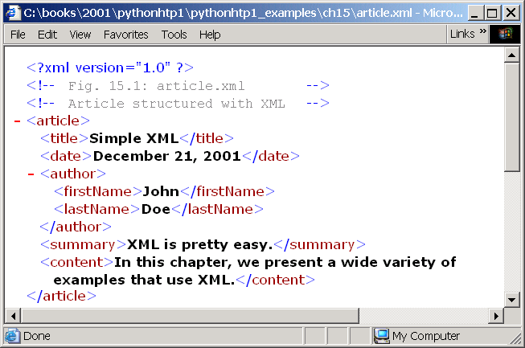
15.2 XML Documents
Minus sign

Slide 6
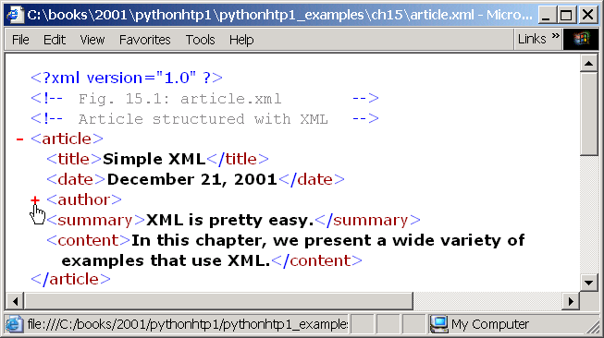
15.2 XML Documents
Plus sign
Fig. 15.2 article.xml displayed by Internet Explorer.

Slide 7
letter.xml
1 <?xml version = "1.0"?>
2
3 <!-- Fig. 15.3: letter.xml -->
4 <!-- Business letter formatted with XML. -->
5
6 <letter>
7 <contact type = "from">
8 <name>Jane Doe</name>
9 <address1>Box 12345</address1>
10 <address2>15 Any Ave.</address2>
11 <city>Othertown</city>
12 <state>Otherstate</state>
13 <zip>67890</zip>
14 <phone>555-4321</phone>
15 <flag gender = "F" />
16 </contact>
17
18 <contact type = "to">
19 <name>John Doe</name>
20 <address1>123 Main St.</address1>
21 <address2></address2>
22 <city>Anytown</city>
23 <state>Anystate</state>
24 <zip>12345</zip>
25 <phone>555-1234</phone>
26 <flag gender = "M" />
27 </contact>
28
29 <salutation>Dear Sir:</salutation>
30
Root element letter
Child element contact
Attribute (name-value pair)
Empty elements do not contain character data

Slide 8
letter.xml
31 <paragraph>It is our privilege to inform you about our new
32 database managed with <technology>XML</technology>. This
33 new system allows you to reduce the load on
34 your inventory list server by having the client machine
35 perform the work of sorting and filtering the data.
36 </paragraph>
37
38 <paragraph>Please visit our Web site for availability
39 and pricing.
40 </paragraph>
41
42 <closing>Sincerely</closing>
43
44 <signature>Ms. Doe</signature>
45 </letter>

Slide 9
15.3 XML Namespaces
Provided for unique identification of XML elements
Namespace prefixes identify namespace to which an element belongs

Slide 10
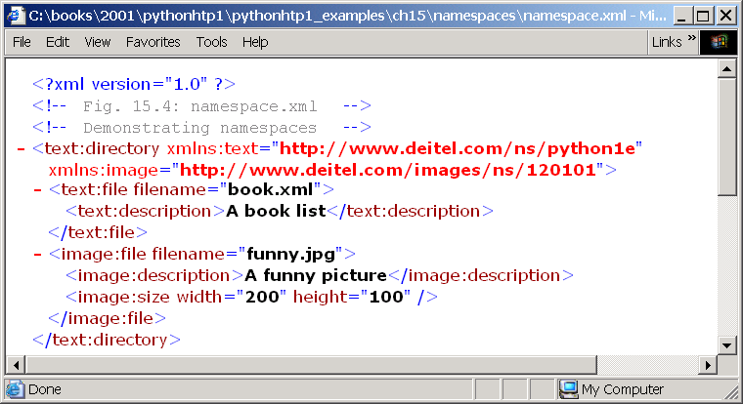
namespace.xml
1 <?xml version = "1.0"?>
2
3 <!-- Fig. 15.4: namespace.xml -->
4 <!-- Demonstrating namespaces. -->
5
6 <text:directory xmlns:text = "http://www.deitel.com/ns/python1e"
7 xmlns:image = "http://www.deitel.com/images/ns/120101">
8
9 <text:file filename = "book.xml">
10 <text:description>A book list</text:description>
11 </text:file>
12
13 <image:file filename = "funny.jpg">
14 <image:description>A funny picture</image:description>
15 <image:size width = "200" height = "100" />
16 </image:file>
17
18 </text:directory>
Attribute xmlns creates namespace prefix
Namespace prefix bound to an URI
Uses prefix text to describe element file

Slide 11
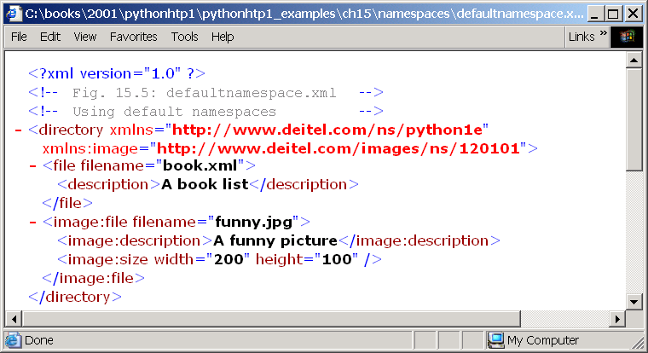
defaultnamespace.xml
1 <?xml version = "1.0"?>
2
3 <!-- Fig. 15.5: defaultnamespace.xml -->
4 <!-- Using default namespaces. -->
5
6 <directory xmlns = "http://www.deitel.com/ns/python1e"
7 xmlns:image = "http://www.deitel.com/images/ns/120101">
8
9 <file filename = "book.xml">
10 <description>A book list</description>
11 </file>
12
13 <image:file filename = "funny.jpg">
14 <image:description>A funny picture</image:description>
15 <image:size width = "200" height = "100" />
16 </image:file>
17
18 </directory>
Creates default namespace by binding URI to attribute xmlns without prefix
Element without prefix defined in default namespace

Slide 12
15.4 Document Object Model (DOM)
DOM parser retrieves data from XML document
Hierarchical tree structure called a DOM tree
Each component of an XML document represented as a tree node
Parent nodes contain child nodes
Sibling nodes have same parent
Single root (or document) node contains all other document nodes

Slide 13
15.4 Document Object Model (DOM)
article
title
date
author
firstName
summary
lastName
contents
Fig. 15.6 Tree structure for article.xml.

Slide 14
15.5 Simple API for XML (SAX)
Event-based model for parsing XML documents
SAX-based parsers generate notifications called events as the parser processes documents
SAX-based parsers invoke listener methods when parser encounters markup

Slide 15
15.6 Document Type Definitions (DTDs), Schemas and Validation
DTDs and Schemas specify structure of XML documents
Validating parsers (or validators) read DTD or Schema and check XML document’s structure against it for conformity (or validity)
Valid XML documents considered well-formed (i.e., syntactically correct)

Slide 16
15.6.1 Document Type Definition Documents
Means for verifying XML documents’ validity
Use EBNF (Extended Backus-Naur Form) grammar to describe XML document content
Optional but recommended to ensure document conformity

Slide 17
letter.dtd
1 <!-- Fig. 15.7: letter.dtd -->
2 <!-- DTD document for letter.xml. -->
3
4 <!ELEMENT letter ( contact+, salutation, paragraph+,
5 closing, signature )>
6
7 <!ELEMENT contact ( name, address1, address2, city, state,
8 zip, phone, flag )>
9 <!ATTLIST contact type CDATA #IMPLIED>
10
11 <!ELEMENT name ( #PCDATA )>
12 <!ELEMENT address1 ( #PCDATA )>
13 <!ELEMENT address2 ( #PCDATA )>
14 <!ELEMENT city ( #PCDATA )>
15 <!ELEMENT state ( #PCDATA )>
16 <!ELEMENT zip ( #PCDATA )>
17 <!ELEMENT phone ( #PCDATA )>
18 <!ELEMENT flag EMPTY>
19 <!ATTLIST flag gender (M | F) "M">
20
21 <!ELEMENT salutation ( #PCDATA )>
22 <!ELEMENT closing ( #PCDATA )>
23 <!ELEMENT paragraph ( #PCDATA )>
24 <!ELEMENT signature ( #PCDATA )>
ELEMENT element type declaration defines rules for element letter
Plus sign (+) occurrence indicator specifies element occurs one or more times
ATTLIST element type declaration defines attribute
Keyword #IMPLIED signifies optional attribute
CDATA indicates value passed to application, not processed by parser
Flag #PCDATA specifies element stores parsed character data
Keyword EMPTY specifies element cannot contain character data

Slide 18
letter2.xml
1 <?xml version = "1.0"?>
2
3 <!-- Fig. 15.8: letter2.xml -->
4 <!-- Business letter formatted with XML. -->
5
6 <!DOCTYPE letter SYSTEM "letter.dtd">
7
8 <letter>
9 <contact type = "from">
10 <name>Jane Doe</name>
11 <address1>Box 12345</address1>
12 <address2>15 Any Ave.</address2>
13 <city>Othertown</city>
14 <state>Otherstate</state>
15 <zip>67890</zip>
16 <phone>555-4321</phone>
17 <flag gender = "F" />
18 </contact>
19
20 <contact type = "to">
21 <name>John Doe</name>
22 <address1>123 Main St.</address1>
23 <address2></address2>
24 <city>Anytown</city>
25 <state>Anystate</state>
26 <zip>12345</zip>
27 <phone>555-1234</phone>
28 <flag gender = "M" />
29 </contact>
30
31 <salutation>Dear Sir:</salutation>
32
DTD applied to specified root element letter
Keyword SYSTEM denotes external DTD
Specifies DTD’s name and location

Slide 19
letter2.xml
33 <paragraph>It is our privilege to inform you about our new
34 database managed with XML. This new system
35 allows you to reduce the load on your inventory list
36 server by having the client machine perform the work of
37 sorting and filtering the data.
38 </paragraph>
39
40 <paragraph>Please visit our Web site for availability
41 and pricing.
42 </paragraph>
43 <closing>Sincerely</closing>
44 <signature>Ms. Doe</signature>
45 </letter>

Slide 20
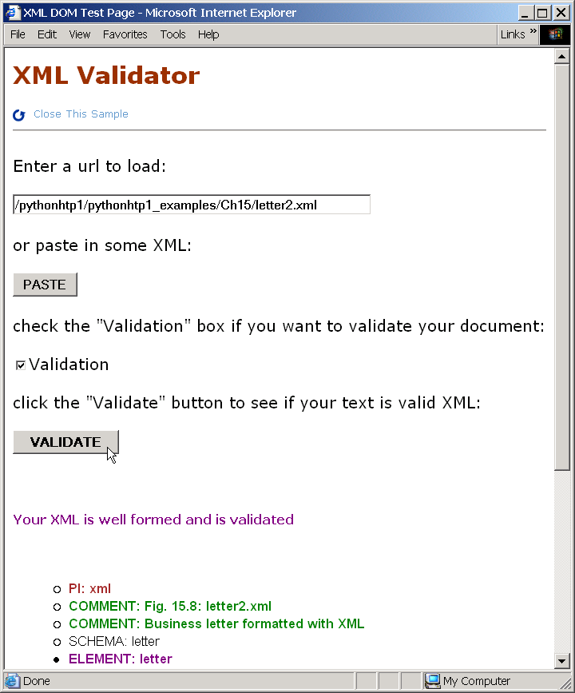
15.6.1 Document Type Definition Documents
Fig. 15.9 XML Validator validating an XML document against a DTD.

Slide 21
15.6.2 W3C XML Schema Documents
W3C XML Schema: W3C Recommendation (i.e., stable release suitable for industry use)
Schemas: XML documents that can be manipulated programmatically
Schemas require validating parsers and likely will replace DTDs as primary means of describing XML document structure
Schema valid: XML documents that conform to a schema
Schemas typically use .xsd file extension

Slide 22
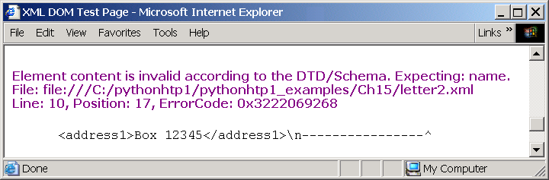
15.6.2 W3C XML Schema Documents
Fig. 15.10 XML Validator displaying an error message.

Slide 23
book.xml
1 <?xml version = "1.0"?>
2
3 <!-- Fig. 15.11: book.xml -->
4 <!-- Document that conforms to a W3C XML Schema. -->
5
6 <deitel:books xmlns:deitel = "http://www.deitel.com/booklist">
7 <book>
8 <title>e-Business and e-Commerce How to Program</title>
9 </book>
10 <book>
11 <title>Python How to Program</title>
12 </book>
13 </deitel:books>
C:\Program Files\XSV>xsv /pythonhtp1_examples/ch15/Schema/book.xml /pythonhtp1_examples/ch15/Schema/book.xsd
<?xml version='1.0'?>
<xsv docElt='{http://www.deitel.com/booklist}books'
instanceAssessed='true' instanceErrors='0' rootType='{http://www.deitel.com/booklist}:BooksType' schemaDocs='/pythonhtp1_examples/ch15/Schema/book.xsd' schemaErrors='0' target='file:/pythonhtp1_examples/ch15/Schema/book.xml' validation='strict' version='XSV 1.203.2.37/1.106.2.19 of 2001/11/29 11:00:00'xmlns='http://www.w3.org/2000/05/xsv'>
<schemaDocAttempt URI='file:/pythonhtp1_examples/ch15/Schema/book.xsd' outcome='success' source='command line'/>
</xsv>

Slide 24
book.xsd
1 <?xml version = "1.0"?>
2
3 <!-- Fig. 15.12: book.xsd -->
4 <!-- Simple W3C XML Schema document. -->
5
6 <xsd:schema xmlns:xsd = "http://www.w3.org/2001/XMLSchema"
7 xmlns:deitel = "http://www.deitel.com/booklist"
8 targetNamespace = "http://www.deitel.com/booklist">
9
10 <xsd:element name = "books" type = "deitel:BooksType" />
11
12 <xsd:complexType name = "BooksType">
13 <xsd:sequence>
14 <xsd:element name = "book" type = "deitel:BookType"
15 minOccurs = "1" maxOccurs = "unbounded" />
16 </xsd:sequence>
17 </xsd:complexType>
18
19 <xsd:complexType name = "BookType">
20 <xsd:sequence>
21 <xsd:element name = "title" type = "xsd:string" />
22 </xsd:sequence>
23 </xsd:complexType>
24
25 </xsd:schema>
Schemas often use namespace prefix xsd
W3C XML Schema’s namespace URI
Binds URI to namespace deitel
Specifies targetNamespace, namespace for Schema-defined elements and attributes
element defines an element
Specifies element’s and data type
complexType defines element types with attributes or child elements
Set minimum and maximum times an element can appear
Elements with simple types prohibited from containing child elements or attributes

Slide 25
15.6.2 W3C XML Schema Documents
C:\PROGRA~1\XSV>xsv /pythonhtp1/pythonhtp1_examples/Ch15/Schema/book.xml /pythonhtp1/pythonhtp1_examples/Ch15/Schema/book.xsd
<?xml version='1.0'?>
<xsv docElt='{http://www.deitel.com/booklist}books' instanceAssessed='true' instanceErrors='1' rootType='{http://www.deitel.com/booklist}:BooksType' schemaDocs='/pythonhtp1/pythonhtp1_examples/Ch15/Schema/book.xsd' schemaErrors='0' target='file:/pythonhtp1/pythonhtp1_examples/Ch15/Schema/book.xml' validation='strict' version='XSV 1.203.2.37/1.106.2.19 of 2001/11/29 11:00:00' xmlns='http://www.w3.org/2000/05/xsv'>
<schemaDocAttempt URI='file:/pythonhtp1/pythonhtp1_examples/Ch15/Schema/book.xsd' outcome='success' source='command line'/>
<invalid char='4' code='cvc-complex-type.1.2.4' line='8' resource='file:/pythonhtp1/pythonhtp1_examples/Ch15/Schema/book.xml'>content of book is not allowed to end here (1), expecting ['{None}:title']:
<fsm>
<node id='1'>
<edge dest='2' label='{None}:title'/>
</node>
<node final='true' id='2'/>
</fsm></invalid>
</xsv>
Fig. 15.13 XML document that does not conform to a W3C XML Schema.

Slide 26
15.7 XML Vocabularies
XML allows document authors to create their own tags to describe data precisely
Some XML vocabularies: MathML™ (Mathematical Markup Language), Scalable Vector Graphics (SVG), Wireless Markup Language (WML), Extensible Business Reporting Language (XBRL), Extensible User Interface Language (XUL), W3C XML Schema, Extensible StyleSheet Language (XSL) and VoiceXML™

Slide 27
15.7.1 MathML™
Developed by W3C for describing mathematical notations and expressions
W3C’s Amaya™ browser/editor can parse and render MathML

Slide 28
mathhml1.htm
1 <?xml version="1.0"?>
2
3 <!DOCTYPE html PUBLIC "-//W3C//DTD XHTML 1.0 Transitional//EN"
4 "http://www.w3.org/TR/xhtml1/DTD/xhtml1-transitional.dtd">
5
6 <!-- Fig. 15.14: mathml1.html -->
7 <!-- Simple MathML. -->
8
9 <html xmlns = "http://www.w3.org/1999/xhtml">
10
11 <head><title>Simple MathML Example</title></head>
12
13 <body>
14
15 <math xmlns = "http://www.w3.org/1998/Math/MathML">
16
17 <mrow>
18 <mn>2</mn>
19 <mo>+</mo>
20 <mn>3</mn>
21 <mo>=</mo>
22 <mn>5</mn>
23 </mrow>
24
25 </math>
26
27 </body>
28 </html>
Embeds MathML content into XHMTL document with math element
Default namespace
Container element for expressions that contain more than one element
mn element marks up a number
mo element marks up an operator

Slide 29
mathml2.html
1 <?xml version="1.0"?>
2
3 <!DOCTYPE html PUBLIC "-//W3C//DTD XHTML 1.0 Transitional//EN"
4 "http://www.w3.org/TR/xhtml1/DTD/xhtml1-transitional.dtd">
5
6 <!-- Fig. 15.15: mathml2.html -->
7 <!-- Simple MathML. -->
8
9 <html xmlns = "http://www.w3.org/1999/xhtml">
10
11 <head><title>Algebraic MathML Example</title></head>
12
13 <body>
14
15 <math xmlns = "http://www.w3.org/1998/Math/MathML">
16 <mrow>
17
18 <mrow>
19 <mn>3</mn>
20 <mo>&InvisibleTimes;</mo>
21
22 <msup>
23 <mi>x</mi>
24 <mn>2</mn>
25 </msup>
26
27 </mrow>
28
29 <mo>+</mo>
30 <mi>x</mi>
31 <mo>-</mo>
32
Entity reference indicates multiplication operation without symbol
Represents a superscript
Marks up base
Marks up superscript (i.e, exponent)

Slide 30
mathml2.html
33 <mfrac>
34 <mn>2</mn>
35 <mi>x</mi>
36 </mfrac>
37
38 <mo>=</mo>
39 <mn>0</mn>
40
41 </mrow>
42 </math>
43
44 </body>
45 </html>
Used to display a fraction

Slide 31
mathml3.html
1 <?xml version="1.0"?>
2
3 <!DOCTYPE html PUBLIC "-//W3C//DTD XHTML 1.0 Transitional//EN"
4 "http://www.w3.org/TR/xhtml1/DTD/xhtml1-transitional.dtd">
5
6 <!-- Fig. 15.16: mathml3.html -->
7 <!-- Calculus example using MathML. -->
8
9 <html xmlns = "http://www.w3.org/1999/xhtml">
10
11 <head><title>Calculus MathML Example</title></head>
12
13 <body>
14
15 <math xmlns = "http://www.w3.org/1998/Math/MathML">
16 <mrow>
17 <msubsup>
18
19 <mo>&Integral;</mo>
20 <mn>0</mn>
21
22 <mrow>
23 <mn>1</mn>
24 <mo>-</mo>
25 <mi>y</mi>
26 </mrow>
27
28 </msubsup>
29
30 <msqrt>
31 <mrow>
32
33 <mn>4</mn>
34 <mo>&InvisibleTimes;</mo>
35
Specifies superscript and subscript
Represents integral symbol
Represents square root expression

Slide 32
mathml3.html
36 <msup>
37 <mi>x</mi>
38 <mn>2</mn>
39 </msup>
40
41 <mo>+</mo>
42 <mi>y</mi>
43
44 </mrow>
45 </msqrt>
46
47 <mo>&delta;</mo>
48 <mi>x</mi>
49 </mrow>
50 </math>
51 </body>
52 </html>
Entity reference for delta symbol

Slide 33
15.7.2 Chemical Markup Language (CML)
XML vocabulary for representing molecular and chemical information
Jumbo™ browser for editing and viewing CML

Slide 34
ammonia.xml
1 <?jumbo:namespace ns = "http://www.xml-cml.org"
2 prefix = "C" java = "jumbo.cmlxml.*Node" ?>
3
4 <!-- Fig. 15.17: ammonia.xml -->
5 <!-- Structure of ammonia. -->
6
7 <C:molecule id = "Ammonia">
8
9 <C:atomArray builtin = "elsym">
10 N H H H
11 </C:atomArray>
12
13 <C:atomArray builtin = "x2" type = "float">
14 1.5 0.0 1.5 3.0
15 </C:atomArray>
16
17 <C:atomArray builtin = "y2" type = "float">
18 1.5 1.5 0.0 1.5
19 </C:atomArray>
20
21 <C:bondArray builtin = "atid1">
22 1 1 1
23 </C:bondArray>
24
25 <C:bondArray builtin = "atid2">
26 2 3 4
27 </C:bondArray>
28
29 <C:bondArray builtin = "order" type = "integer">
30 1 1 1
31 </C:bondArray>
32
33 </C:molecule>
Processing instruction contains application-specific information
Defines ammonia molecule
Specifies molecule’s atoms
Specifies x-coordinates of each atom
Specifies y-coordinates of each atom
Defines bonds between atoms

Slide 35
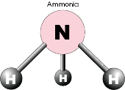
ammonia.xml

Slide 36
15.7.3 Other XML Vocabularies
Hundreds of XML vocabularies derive from XML

Slide 37
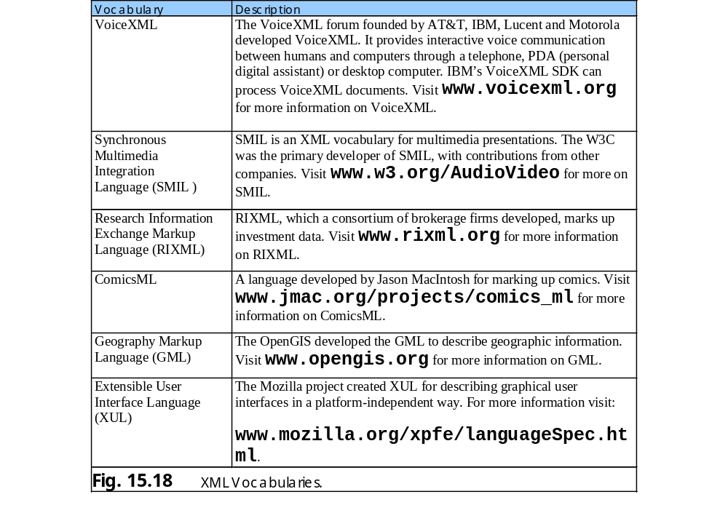
15.7.3 Other XML Vocabularies

Slide 38
15.8 Extensible Stylesheet Language (XSL)
XML vocabulary for formatting XML data
XSL Transformations (XSLT) creates formatted text-based documents from XML documents
XSLT processor (e.g., Microsoft’s msxml, Apache Software Foundation’s Xalan 2 and Python package 4XSLT) performs transformations

Slide 39
sorting.xml
1 <?xml version = "1.0"?>
2
3 <!-- Fig. 15.19: sorting.xml -->
4 <!-- XML document containing book information. -->
5
6 <?xml:stylesheet type = "text/xsl" href = "sorting.xsl"?>
7
8 <book isbn = "999-99999-9-X">
9 <title>Mary&apos;s XML Primer</title>
10
11 <author>
12 <firstName>Mary</firstName>
13 <lastName>White</lastName>
14 </author>
15
16 <chapters>
17 <frontMatter>
18 <preface pages = "2" />
19 <contents pages = "5" />
20 <illustrations pages = "4" />
21 </frontMatter>
22
23 <chapter number = "3" pages = "44">
24 Advanced XML</chapter>
25 <chapter number = "2" pages = "35">
26 Intermediate XML</chapter>
27 <appendix number = "B" pages = "26">
28 Parsers and Tools</appendix>
29 <appendix number = "A" pages = "7">
30 Entities</appendix>
31 <chapter number = "1" pages = "28">
32 XML Fundamentals</chapter>
33 </chapters>
34
Specifies location of XSLT document to apply (IE specific processing instruction)

Slide 40
sorting.xml
35 <media type = "CD" />
36 </book>

Slide 41
sorting.xsl
1 <?xml version = "1.0"?>
2
3 <!-- Fig. 15.20: sorting.xsl -->
4 <!-- Transformation of book information into XHTML. -->
5
6 <xsl:stylesheet version = "1.0"
7 xmlns:xsl = "http://www.w3.org/1999/XSL/Transform">
8
9 <!-- write XML declaration and DOCTYPE DTD information -->
10 <xsl:output method = "xml" omit-xml-declaration = "no"
11 doctype-system =
12 "http://www.w3.org/TR/xhtml1/DTD/xhtml1-strict.dtd"
13 doctype-public = "-//W3C//DTD XHTML 1.0 Strict//EN"/>
14
15 <!-- match document root -->
16 <xsl:template match = "/">
17 <html xmlns = "http://www.w3.org/1999/xhtml">
18 <xsl:apply-templates />
19 </html>
20 </xsl:template>
21
22 <!-- match book -->
23 <xsl:template match = "book">
24 <head>
25 <title>ISBN <xsl:value-of select = "@isbn" /> -
26 <xsl:value-of select = "title" /></title>
27 </head>
28
29 <body>
30 <h1 style = "color: blue">
31 <xsl:value-of select = "title"/></h1>
32
33 <h2 style = "color: blue">by <xsl:value-of
34 select = "author/lastName" />,
35 <xsl:value-of select = "author/firstName" /></h2>
Present because XSTL document is an XML document
xsl:stylesheet root element
Namespace prefix xsl defined and bound to W3C’s XSLT URI
Write DTD to result tree
Indicates XML output to result tree
Template matches source tree’s document root
Create XHTML document’s title
Create header that contains author’s name

Slide 42
sorting.xsl
36
37 <table style =
38 "border-style: groove; background-color: wheat">
39
40 <xsl:for-each select = "chapters/frontMatter/*">
41 <tr>
42 <td style = "text-align: right">
43 <xsl:value-of select = "name()" />
44 </td>
45
46 <td>
47 ( <xsl:value-of select = "@pages" /> pages )
48 </td>
49 </tr>
50 </xsl:for-each>
51
52 <xsl:for-each select = "chapters/chapter">
53 <xsl:sort select = "@number" data-type = "number"
54 order = "ascending" />
55 <tr>
56 <td style = "text-align: right">
57 Chapter <xsl:value-of select = "@number" />
58 </td>
59
60 <td>
61 ( <xsl:value-of select = "@pages" /> pages )
62 </td>
63 </tr>
64 </xsl:for-each>
65
66 <xsl:for-each select = "chapters/appendix">
67 <xsl:sort select = "@number" data-type = "text"
68 order = "ascending" />
69 <tr>
70 <td style = "text-align: right">
Selects each child element (indicated by *) of element frontMatter
Node-set function name retrieves current node’s element name
Sort in ascending order

Slide 43
sorting.xsl
71 Appendix <xsl:value-of select = "@number" />
72 </td>
73
74 <td>
75 ( <xsl:value-of select = "@pages" /> pages )
76 </td>
77 </tr>
78 </xsl:for-each>
79 </table>
80
81 <p style = "color: blue">Pages:
82 <xsl:variable name = "pagecount"
83 select = "sum(chapters//*/@pages)" />
84 <xsl:value-of select = "$pagecount" />
85 <br />Media Type:
86 <xsl:value-of select = "media/@type" /></p>
87 </body>
88 </xsl:template>
89
90 </xsl:stylesheet>
XSLT variable stores book’s page count

Slide 44
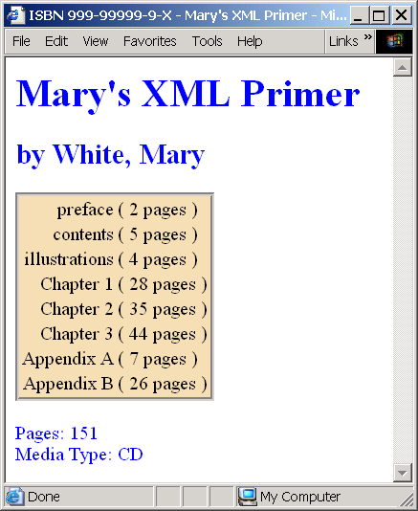
sorting.xsl

Slide 45
Fig. 15.21 XHTML generated when sorting.xsl is applied by msxml to sorting.xml.
1 <?xml version="1.0" encoding="UTF-8"?>
2 <!DOCTYPE html PUBLIC "-//W3C//DTD XHTML 1.0 Strict//EN"
3 "http://www.w3.org/TR/xhtml1/DTD/xhtml1-strict.dtd">
4
5 <html xmlns="http://www.w3.org/1999/xhtml">
6
7 <head>
8 <title>ISBN 999-99999-9-X - Mary's XML Primer</title>
9 </head>
10
11 <body>
12 <h1 style="color: blue">Mary's XML Primer</h1>
13 <h2 style="color: blue">by White, Mary</h2>
14 <table style="border-style: groove; background-color: wheat">
15
16 <tr>
17 <td style="text-align: right">preface</td>
18 <td>( 2 pages )</td>
19 </tr>
20
21 <tr>
22 <td style="text-align: right">contents</td>
23 <td>( 5 pages )</td>
24 </tr>
25
26 <tr>
27 <td style="text-align: right">illustrations</td>
28 <td>( 4 pages )</td>
29 </tr>
30
31 <tr>
32 <td style="text-align: right">Chapter 1</td>
33 <td>( 28 pages )</td>
34 </tr>
35
Value encoding indicates type of character encoding

Slide 46
Fig. 15.21 XHTML generated when sorting.xsl is applied by msxml to sorting.xml.
36 <tr>
37 <td style="text-align: right">Chapter 2</td>
38 <td>( 35 pages )</td>
39 </tr>
40
41 <tr>
42 <td style="text-align: right">Chapter 3</td>
43 <td>( 44 pages )</td>
44 </tr>
45
46 <tr>
47 <td style="text-align: right">Appendix A</td>
48 <td>( 7 pages )</td>
49 </tr>
50
51 <tr>
52 <td style="text-align: right">Appendix B</td>
53 <td>( 26 pages )</td>
54 </tr>
55
56 </table>
57
58 <p style="color: blue">Pages: 11<br />Media Type: CD</p>
59
60 </body>
61 </html>

