Slide 1
Chapter 16 – Python XML Processing
Outline
16.1 Introduction
16.2 Generating XML Content Dynamically
16.3 XML Processing Packages
16.4 Document Object Model (DOM)
16.5 Parsing XML with xml.sax
16.6 Case Study: Message Forums with Python and XML
16.6.1 Displaying the Forums
16.6.2 Adding Forums and Messages
16.6.3 Alterations for Browsers without XML and XSLT Support

Slide 2
16.1 Introduction
XML support provided through Python packages, including 4DOM and xml.sax

Slide 3
16.2 Generating XML Content Dynamically
Generating XML dynamically similar to generating XHTML
Python scripts can use print statements or XSLT to output XML

Slide 4
names.txt
1 O'Black, John
2 Green, Sue
3 Red, Bob
4 Blue, Mary
5 White, Mike
6 Brown, Jane
7 Gray, Bill
Fig. 16.1 Text file names.txt used in Fig. 16.2.

Slide 5
fig16_02.py
1 #!c:\Python\python.exe
2 # Fig. 16.2: fig16_02.py
3 # Marking up a text file's data as XML.
4
5 import sys
6
7 print "Content-type: text/xml\n"
8
9 # write XML declaration and processing instruction
10 print """<?xml version = "1.0"?>
11 <?xml:stylesheet type = "text/xsl"
12 href = "../XML/contact_list.xsl"?>"""
13
14 # open data file
15 try:
16 file = open( "names.txt", "r" )
17 except IOError:
18 sys.exit( "Error opening file" )
19
20 print "<contacts>" # write root element
21
22 # list of tuples: ( special character, entity reference )
23 replaceList = [ ( "&", "&amp;" ),
24 ( "<", "&lt;" ),
25 ( ">", "&gt;" ),
26 ( '"', "&quot;" ),
27 ( "'", "&apos;" ) ]
28
29 # replace special characters with entity references
30 for currentLine in file.readlines():
31
32 for oldValue, newValue in replaceList:
33 currentLine = currentLine.replace( oldValue, newValue )
34
Print HTTP header setting MIME type to text/xml
Print XML declaration
Print processing instruction referencing stylesheet
Open text file if it exists
Print root element
List of special characters and their entity references
Replace special characters with entity references

Slide 6
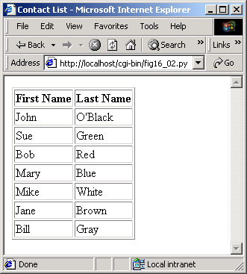
fig16_02.py
Extract first and last name
35 # extract lastname and firstname
36 last, first = currentLine.split( ", " )
37 first = first.strip() # remove carriage return
38
39 # write contact element
40 print """ <contact>"
41 <LastName>%s</LastName>
42 <FirstName>%s</FirstName>
43 </contact>""" % ( last, first )
44
45 file.close()
46
47 print "</contacts>"
Remove carriage return
Print contact element
Print root’s closing tag

Slide 7
contact_list.xsl
Formats contact list as XHTML table
1 <?xml version = "1.0"?>
2 <!-- Fig. 16.3: contact_list.xsl -->
3 <!-- Formats a contact list -->
4
5 <xsl:stylesheet version = "1.0"
6 xmlns:xsl = "http://www.w3.org/1999/XSL/Transform">
7
8 <!-- match document root -->
9 <xsl:template match = "/">
10
11 <html xmlns = "http://www.w3.org/1999/xhtml">
12
13 <head>
14 <title>Contact List</title>
15 </head>
16
17 <body>
18 <table border = "1">
19
20 <thead>
21 <tr>
22 <th>First Name</th>
23 <th>Last Name</th>
24 </tr>
25 </thead>
26
27 <!-- process each contact element -->
28 <xsl:for-each select = "contacts/contact">
29 <tr>
30 <td>
31 <xsl:value-of select = "FirstName" />
32 </td>
33 <td>
34 <xsl:value-of select = "LastName" />

Slide 8
contact_list.xsl
35 </td>
36 </tr>
37 </xsl:for-each>
38
39 </table>
40
41 </body>
42
43 </html>
44
45 </xsl:template>
46
47 </xsl:stylesheet>

Slide 9
16.3 XML Processing Packages
Third-party package 4DOM, included with package PyXML, complies with W3C’s DOM Recommendation
xml.sax, included with Python, contains classes and functions for SAX-based parsing
4XSLT, located in package 4Suite, contains an XSLT processor for transforming XML documents into other text-based formats

Slide 10
16.4 Document Object Model (DOM)
Python can use the DOM API to manipulate XML documents programmatically

Slide 11
fig16_04.py
1 # Fig. 16.4: fig16_04.py
2 # Using 4DOM to traverse an XML Document.
3
4 import sys
5 from xml.dom.ext import StripXml
6 from xml.dom.ext.reader import PyExpat
7 from xml.parsers.expat import ExpatError
8
9 # open XML file
10 try:
11 file = open( "article2.xml" )
12 except IOError:
13 sys.exit( "Error opening file" )
14
15 # parse contents of XML file
16 try:
17 reader = PyExpat.Reader() # create Reader instance
18 document = reader.fromStream( file ) # parse XML document
19 file.close()
20 except ExpatError:
21 sys.exit( "Error processing XML file" )
22
23 # get root element
24 rootElement = StripXml( document.documentElement )
25 print "Here is the root element of the document: %s" % \
26 rootElement.nodeName
27
28 # traverse all child nodes of root element
29 print "The following are its child elements:"
30
31 for node in rootElement.childNodes:
32 print node.nodeName
33
Open XML document in read mode
Instantiate PyExpat Reader object, a DOM-based parser
Reference to the DOM tree, a Document object
Parse XML document and load data into memory
End program if ExpatError exception raised
Remove insignificant whitespace
documentElement attribute refers to root node
Attribute nodeName refers to element’s name
List of a node’s children

Slide 12
fig16_04.py
First child of node
34 # get first child node of root element
35 child = rootElement.firstChild
36 print "\nThe first child of root element is:", child.nodeName
37 print "whose next sibling is:",
38
39 # get next sibling of first child
40 sibling = child.nextSibling
41 print sibling.nodeName
42 print 'Value of "%s" is:' % sibling.nodeName,
43
44 value = sibling.firstChild
45
46 # print text value of sibling
47 print value.nodeValue
48 print "Parent node of %s is: %s" % \
49 ( sibling.nodeName, sibling.parentNode.nodeName )
50
51 reader.releaseNode( document ) # remove DOM tree from memory
Next sibling of node
Text value of node
Remove specified DOM tree from memory
Here is the root element of the document: article
The following are its child elements:
title
date
author
summary
content
The first child of root element is: title
whose next sibling is: date
Value of "date" is: December 19, 2001
Parent node of date is: article

Slide 13
article2.xml
1 <?xml version = "1.0"?>
2
3 <!-- Fig. 16.5: article2.xml -->
4 <!-- Article formatted with XML -->
5
6 <article>
7
8 <title>Simple XML</title>
9
10 <date>December 19, 2001</date>
11
12 <author>
13 <firstName>Jane</firstName>
14 <lastName>Doe</lastName>
15 </author>
16
17 <summary>XML is easy.</summary>
18
19 <content>Once you have mastered XHTML, XML is learned
20 easily. Remember that XML is not for displaying
21 information but for managing information.
22 </content>
23
24 </article>
XML document used by fig16_04.py

Slide 14
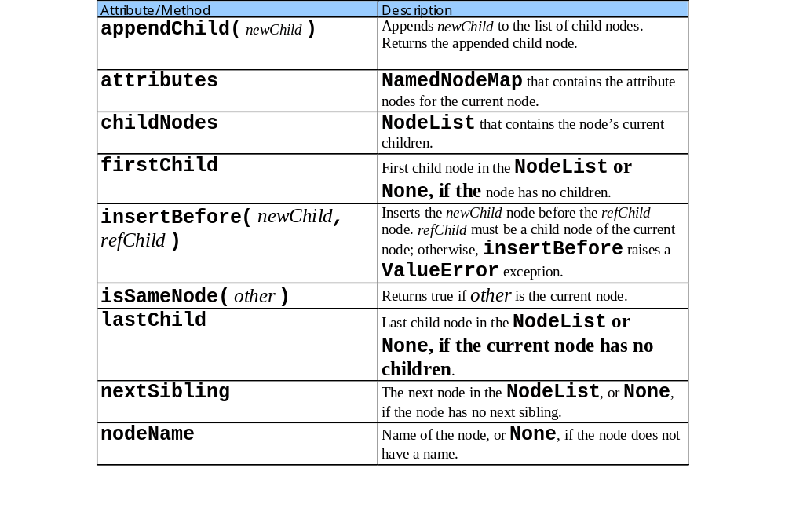
16.4 Document Object Model (DOM)

Slide 15
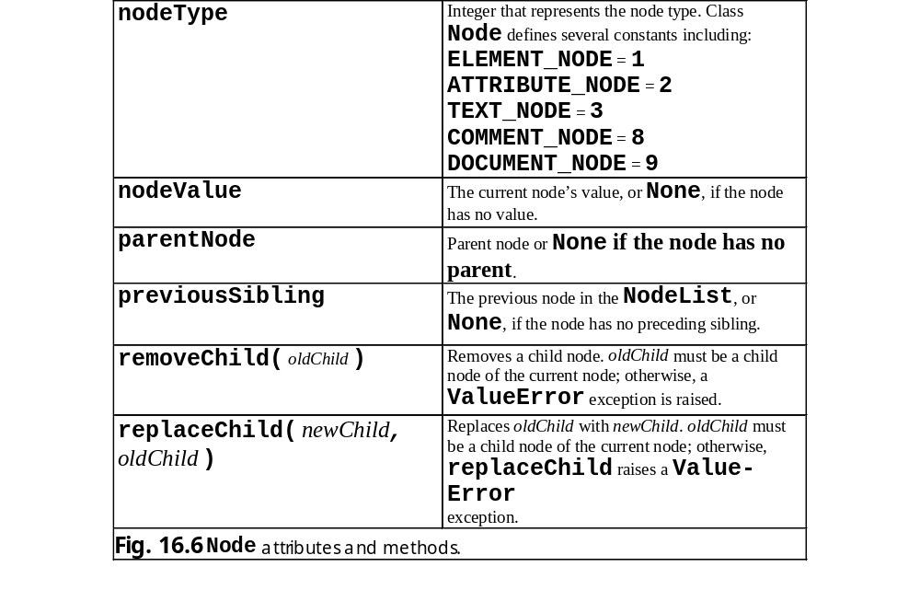
16.4 Document Object Model (DOM)

Slide 16
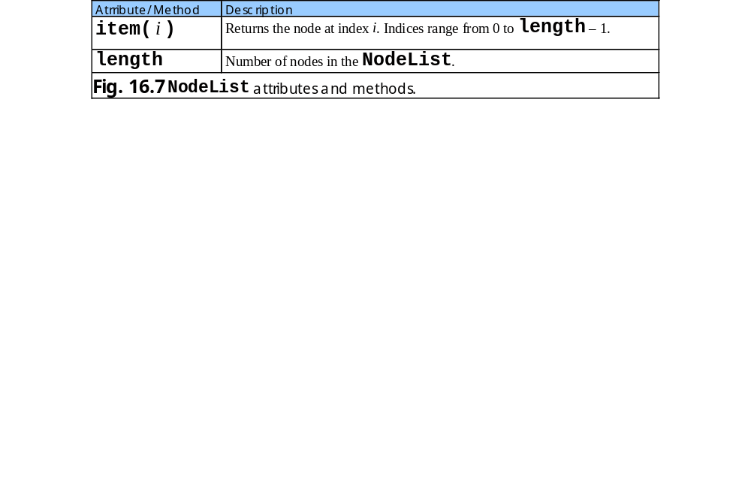
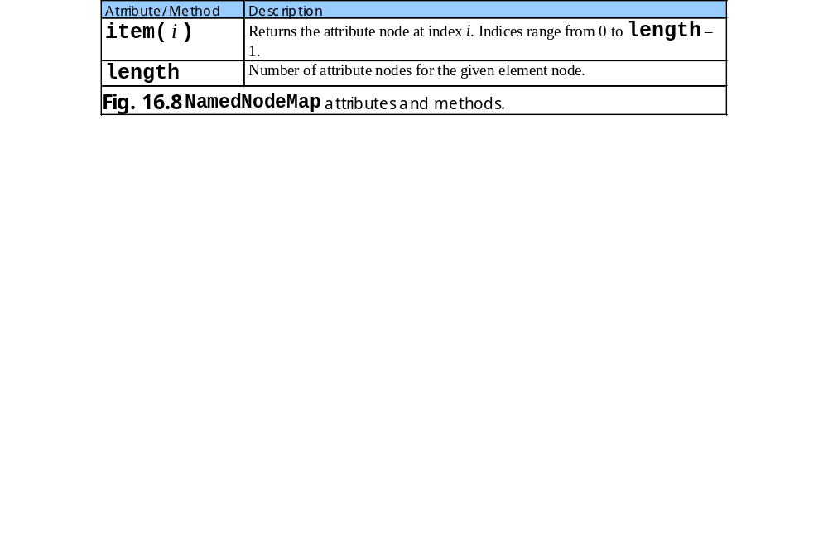
16.4 Document Object Model (DOM)

Slide 17
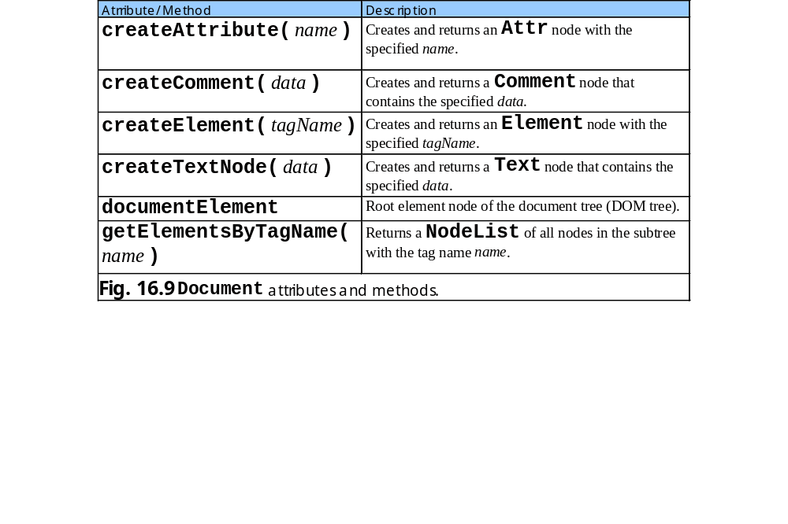
16.4 Document Object Model (DOM)

Slide 18
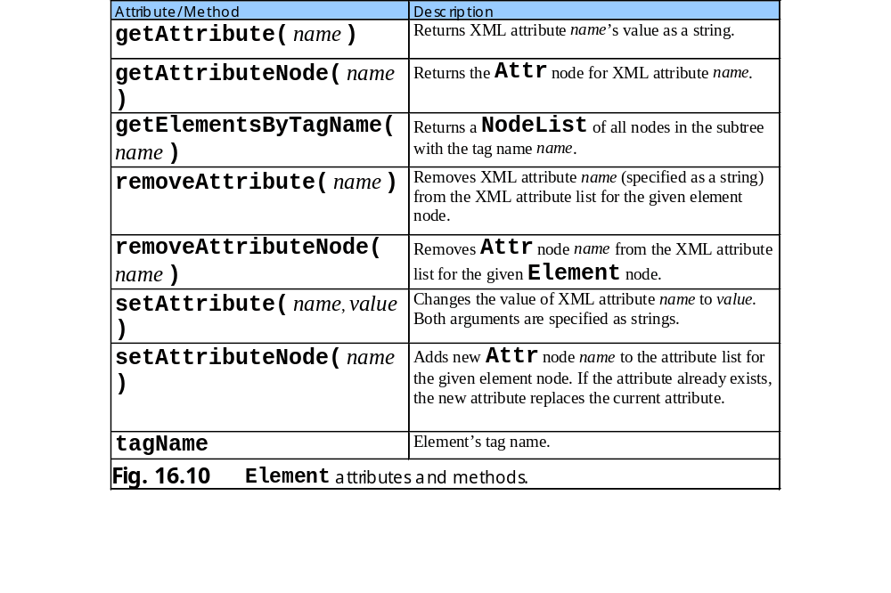
16.4 Document Object Model (DOM)

Slide 19
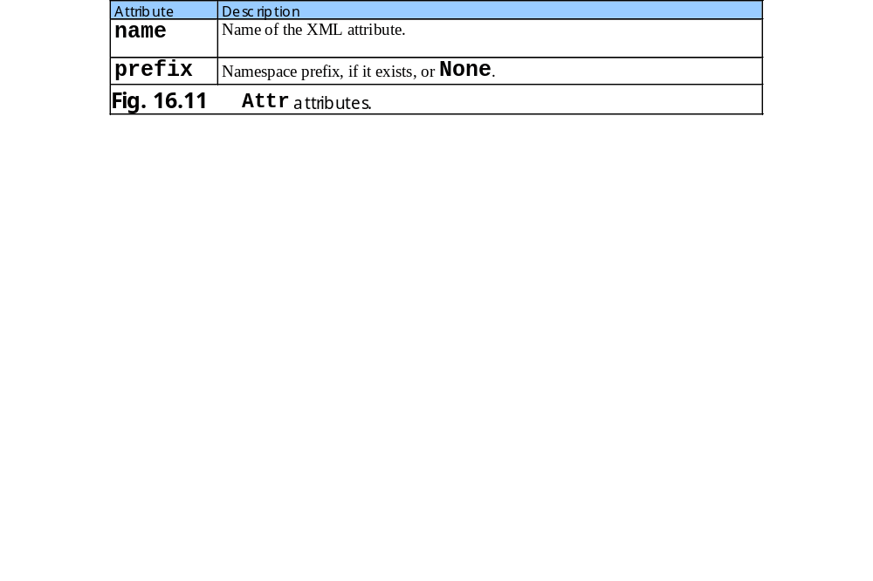
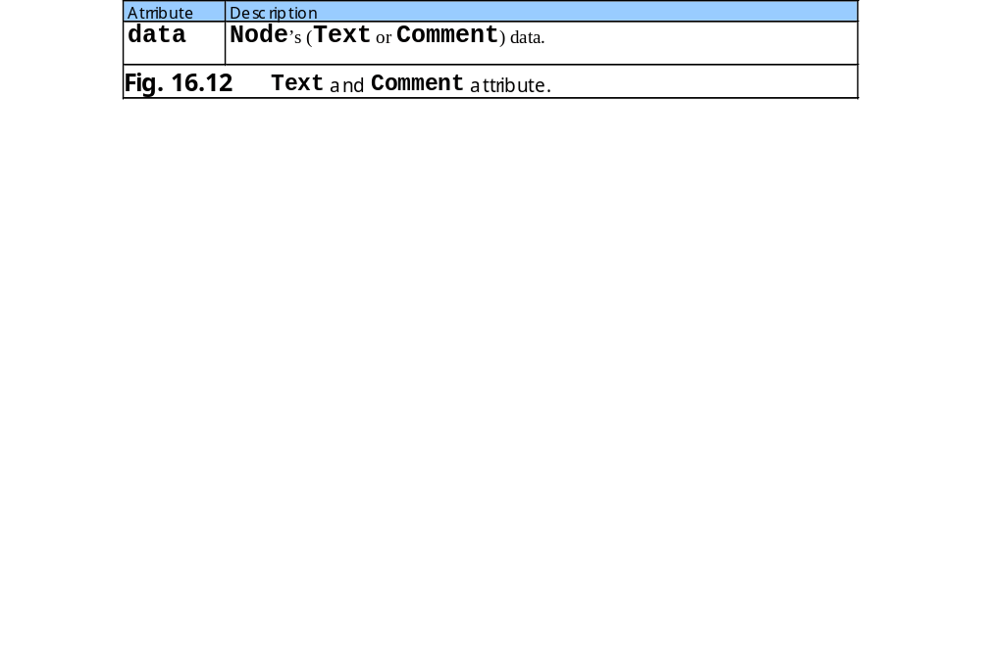
16.4 Document Object Model (DOM)

Slide 20
fig16_13.py
1 # Fig. 16.13: fig16_13.py
2 # Using 4DOM to manipulate an XML Document.
3
4 import sys
5 from xml.dom.ext.reader import PyExpat
6 from xml.dom.ext import PrettyPrint
7
8 def printInstructions():
9 print """\nEnter 'a' to add a contact.
10 Enter 'l' to list contacts.xml.
11 Enter 'i' for instructions.
12 Enter 'q' to quit."""
13
14 def printList( document ):
15 print "Your contact list is:"
16
17 # iterate over NodeList of contact elements
18 for contact in document.getElementsByTagName( "contact" ):
19 first = contact.getElementsByTagName( "FirstName" )[ 0 ]
20
21 # get first node’s value
22 firstText = first.firstChild.nodeValue
23
24 # get NodeList for nodes that contain tag name "LastName"
25 last = contact.getElementsByTagName( "LastName" )[ 0 ]
26 lastText = last.firstChild.nodeValue
27
28 print firstText, lastText
29
30 def addContact( document ):
31 root = document.documentElement # get root element node
32
33 name = raw_input(
34 "Enter the name of the person you wish to add: " )
35
Print contact list to standard output
Return NodeList containing all Element nodes with tag name contact
Each contact element contains only one FirstName element
Get first’s firstChild’s nodeValue
Print text values for FirstName and LastName elements
Add new contact element
Get root element node of DOM tree

Slide 21
fig16_13.py
36 first, last = name.split()
37
38 # create first name element node
39 firstNode = document.createElement( "FirstName" )
40 firstNodeText = document.createTextNode( first )
41 firstNode.appendChild( firstNodeText )
42
43 # create last name element node
44 lastNode = document.createElement( "LastName" )
45 lastNodeText = document.createTextNode( last )
46 lastNode.appendChild( lastNodeText )
47
48 # create contact node, append first name and last name nodes
49 contactNode = document.createElement( "contact" )
50 contactNode.appendChild( firstNode )
51 contactNode.appendChild( lastNode )
52
53 root.appendChild( contactNode ) # add contact node
54
55 # open contacts file
56 try:
57 file = open( "contacts.xml", "r+" )
58 except IOError:
59 sys.exit( "Error opening file" )
60
61 # create DOM parser and parse XML document
62 reader = PyExpat.Reader()
63 document = reader.fromStream( file )
64
65 printList( document )
66 printInstructions()
67 character = "l"
68
69 while character != "q":
70 character = raw_input( "\n? " )
Create element named FirstName
Create text node
Append text node to new Element node
Create new contact Element node
Append FirstName and LastName nodes to contact node
Open XML document for reading and writing
Call function printList to print contact list

Slide 22
fig16_13.py
71
72 if character == "a":
73 addContact( document )
74 elif character == "l":
75 printList( document )
76 elif character == "i":
77 printInstructions()
78 elif character != "q":
79 print "Invalid command!"
80
81 file.seek( 0, 0 ) # position to beginning of file
82 file.truncate() # remove data from file
83 PrettyPrint( document, file ) # print DOM contents to file
84 file.close() # close XML file
85 reader.releaseNode( document ) # free memory
Delete file contents
Writes XML DOM tree’s data to specified output stream (file)
Uses indentation and carriage returns to enhance readability
Your contact list is:
John Black
Sue Green
Enter 'a' to add a contact.
Enter 'l' to list contacts.xml.
Enter 'i' for instructions.
Enter 'q' to quit.
? a
Enter the name of the person you wish to add: Michael Red
? l
Your contact list is:
John Black
Sue Green
Michael Red
? q

Slide 23
Fig. 16.14 Contact list output by fig16_13.py
1 <?xml version="1.0" encoding="UTF-8"?>
2 <!DOCTYPE contacts>
3 <contacts>
4 <contact>
5 <LastName>Black</LastName>
6 <FirstName>John</FirstName>
7 </contact>
8 <contact>
9 <LastName>Green</LastName>
10 <FirstName>Sue</FirstName>
11 </contact>
12 <contact>
13 <FirstName>Michael</FirstName>
14 <LastName>Red</LastName>
15 </contact>
16 </contacts>

Slide 24
16.5 Parsing XML with xml.sax
SAX-based parser reads input to identify XML markup
Parser calls event handlers as it encounters markup

Slide 25
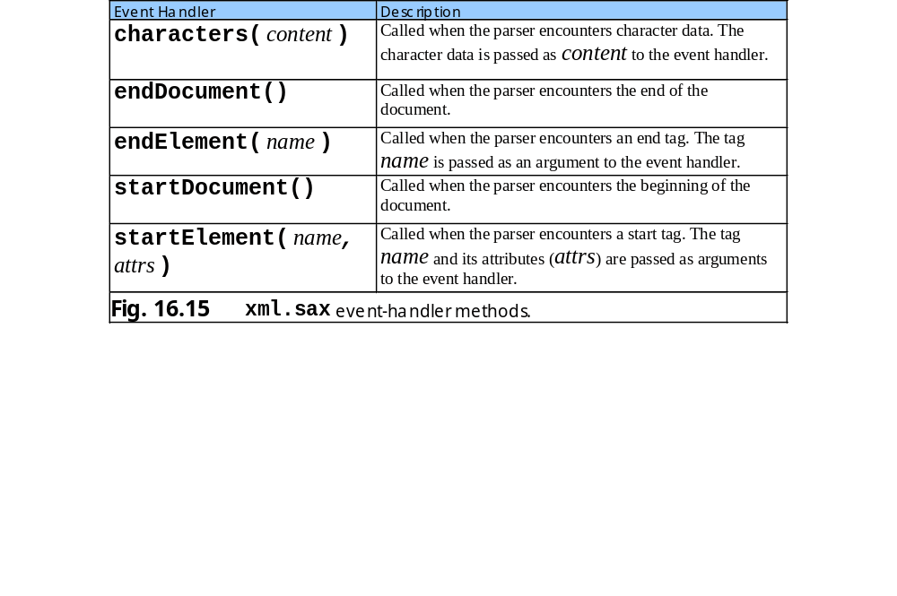
16.5 Parsing XML with xml.sax

Slide 26
fig16_16.py
1 # Fig. 16.16: fig16_16.py
2 # Demonstrating SAX-based parsing.
3
4 from xml.sax import parse, SAXParseException, ContentHandler
5
6 class TagInfoHandler( ContentHandler ):
7 """Custom xml.sax.ContentHandler"""
8
9 def __init__( self, tagName ):
10 """Initialize ContentHandler and set tag to search for"""
11
12 ContentHandler.__init__( self )
13 self.tagName = tagName
14 self.depth = 0 # spaces to indent to show structure
15
16 # override startElement handler
17 def startElement( self, name, attributes ):
18 """An Element has started"""
19
20 # check if this is tag name for which we are searching
21 if name == self.tagName:
22 print "\n%s<%s> started" % ( " " * self.depth, name )
23
24 self.depth += 3
25
26 print "%sAttributes:" % ( " " * self.depth )
27
28 # check if element has attributes
29 for attribute in attributes.getNames():
30 print "%s%s = %s" % ( " " * self.depth, attribute,
31 attributes.getValue( attribute ) )
32
33 # override endElement handler
34 def endElement( self, name ):
35 """An Element has ended"""
Class TagInfoHandler derived from xml.sax.ContentHandler
Call base class constructor
Override startElement handler
Called each time parser encounters a start tag
List of element’s attributes
Returns value of given attribute
Overridden endElement handler called each time parser encounters an end tag

Slide 27
fig16_16.py
36
37 if name == self.tagName:
38 self.depth -= 3
39 print "%s</%s> ended\n" % ( " " * self.depth, name )
40
41 def main():
42 file = raw_input( "Enter a file to parse: " )
43 tagName = raw_input( "Enter tag to search for: " )
44
45 try:
46 parse( file, TagInfoHandler( tagName ) )
47
48 # handle exception if unable to open file
49 except IOError, message:
50 print "Error reading file:", message
51
52 # handle exception parsing file
53 except SAXParseException, message:
54 print "Error parsing file:", message
55
56 if __name__ == "__main__":
57 main()
Prompt user to enter XML document to parse
xml.sax function parse creates a SAX parser object
First argument is Python file object or filename
Second argument is object of ContentHandler class
Function parse raises SAXParseException if it encounters an error

Slide 28
fig16_16.py
Enter a file to parse: boxes.xml
Enter tag to search for: box
<box> started
Attributes:
size = big
<box> started
Attributes:
size = medium
</box> ended
<box> started
Attributes:
type = small
<box> started
Attributes:
type = tiny
</box> ended
</box> ended
</box> ended

Slide 29
boxes.xml
1 <?xml version = "1.0"?>
2
3 <!-- Fig. 16.17: boxes.xml -->
4 <!-- XML document used in Fig. 16.16 -->
5
6 <boxlist>
7
8 <box size = "big">
9 This is the big box.
10
11 <box size = "medium">
12 Medium sized box
13 <item>Some stuff</item>
14 <thing>More stuff</thing>
15 </box>
16
17 <parcel />
18 <box type = "small">
19 smaller stuff
20 <box type = "tiny">tiny stuff</box>
21 </box>
22
23 </box>
24
25 </boxlist>
XML document used by fig16_16.py

Slide 30
16.6 Case Study: Message Forums with Python and XML
Demonstrate using XML and several XML-related technologies to create a message, a “virtual” bulletin board where users discuss various topics

Slide 31
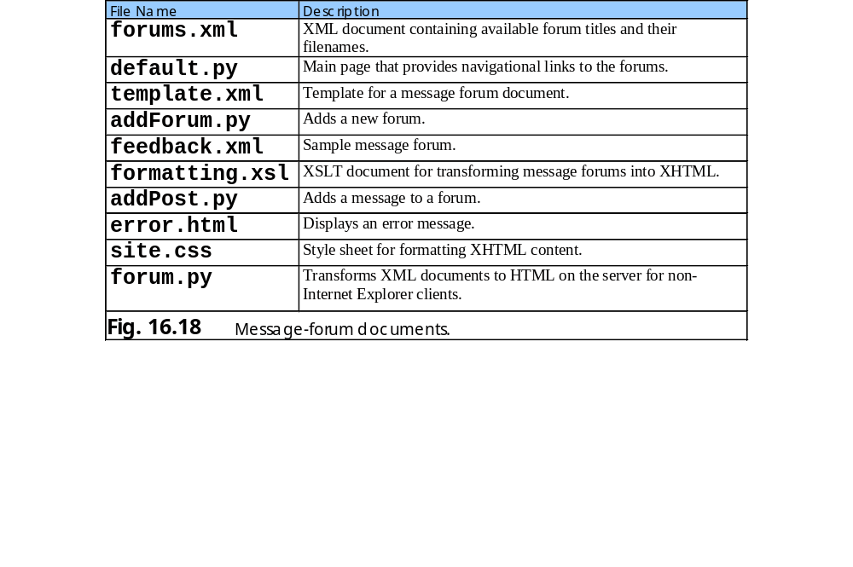
16.6 Case Study: Message Forums with Python and XML

Slide 32
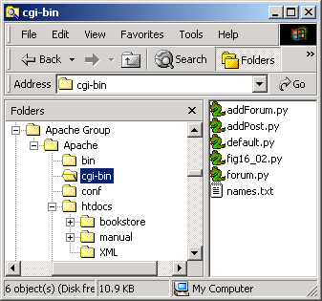
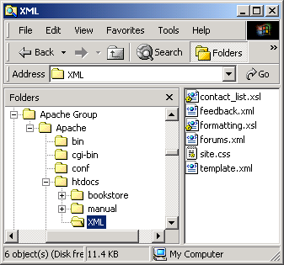
16.6 Case Study: Message Forums with Python and XML

Slide 33
16.6 Case Study: Message Forums with Python and XML
default.py
forums.xml
addForum.py
feedback.xml
formatting.xsl
addPost.py

Slide 34
feedback.xml
1 <?xml version = "1.0"?>
2
3 <!-- Fig. 16.21: feedback.xml -->
4 <!-- XML document representing a forum -->
5
6 <?xml:stylesheet type = "text/xsl" href = "../XML/formatting.xsl"?>
7
8 <forum file = "feedback.xml">
9 <name>Feedback</name>
10
11 <message timestamp = "Wed Jun 27 12:53:22 2001">
12 <user>Jessica</user>
13 <title>Nice forums!</title>
14 <text>These forums are great! Well done, all.</text>
15 </message>
16
17 </forum>
Sample forum
References style sheet formatting.xsl
Element name specifies forum’s name
Root element forum contains attribute file which specifies the document’s filename
Element message contains timestamp, user, title and text elements

Slide 35
forums.xml
1 <?xml version = "1.0"?>
2
3 <!-- Fig. 16.22: forums.xml -->
4 <!-- XML document containing all forums -->
5
6 <?xml:stylesheet type = "text/xsl" href = "formatting.xsl"?>
7
8 <forums>
9
10 <forum filename = "feedback.xml">
11 <name>Feedback</name>
12 </forum>
13
14 </forums>
Contains filename and title for each message forum
Root element forums contains one or more forum child elements

Slide 36
default.py
Generates initial greeting page
1 #!c:\Python\python.exe
2 # Fig. 16.23: default.py
3 # Default page for message forums.
4
5 import os
6 import sys
7 from xml.dom.ext.reader import PyExpat
8
9 def printHeader( title, style ):
10 print """Content-type: text/html
11
12 <?xml version = "1.0" encoding = "UTF-8"?>
13 <!DOCTYPE html PUBLIC
14 "-//W3C//DTD XHTML 1.0 Strict//EN"
15 "DTD/xhtml1-strict.dtd">
16 <html xmlns = "http://www.w3.org/1999/xhtml">
17
18 <head>
19 <title>%s</title>
20 <link rel = "stylesheet" href = "%s" type = "text/css" />
21 </head>
22
23 <body>""" % ( title, style )
24
25 # open XML document that contains the forum names and locations
26 try:
27 XMLFile = open( "../htdocs/XML/forums.xml" )
28 except IOError:
29 print "Location: /error.html\n"
30 sys.exit()
31
32 # parse XML document containing forum information
33 reader = PyExpat.Reader()
34 document = reader.fromStream( XMLFile )
35 XMLFile.close()
Generated XHTML header link to CSS that formats page
Open forums.xml which contains forum names and locations
Parse XML document that contains forum information

Slide 37
default.py
36
37 # write XHTML to browser
38 printHeader( "Deitel Message Forums", "/XML/site.css" )
39 print """<h1>Deitel Message Forums</h1>
40 <p style="font-weight:bold">Available Forums</p>
41 <ul>"""
42
43 # determine client-browser type
44 if os.environ[ "HTTP_USER_AGENT" ].find( "MSIE" ) != -1:
45 prefix = "../XML/" # Internet Explorer
46 else:
47 prefix = "forum.py?file="
48
49 # add links for each forum
50 for forum in document.getElementsByTagName( "forum" ):
51
52 # create link to forum
53 link = prefix + forum.attributes.item( 0 ).value
54
55 # get element nodes containing tag name "name"
56 name = forum.getElementsByTagName( "name" )[ 0 ]
57
58 # get Text node's value
59 nameText = name.childNodes[ 0 ].nodeValue
60 print '<li><a href = "%s">%s</a></li>' % ( link, nameText )
61
62 print """</ul>
63 <p style="font-weight:bold">Forum Management</p>
64 <ul>
65 <li><a href = "addForum.py">Add a Forum</a></li>
66 <li>Delete a Forum</li>
67 <li>Modify a Forum</li>
68 </ul>
69 </body>
70
Prefix of forum hyperlinks depends on Web browser
Retrieve all Element nodes with tag name forum
Link to addForum.py

Slide 38
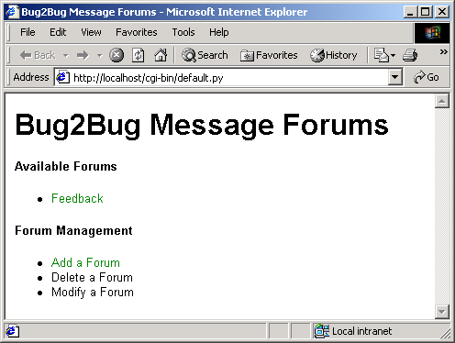
default.py
71 </html>"""
72
73 reader.releaseNode( document )

Slide 39
addForum.py
1 #!c:\Python\python.exe
2 # Fig. 16.24: addForum.py
3 # Adds a forum to the list
4
5 import re
6 import sys
7 import cgi
8
9 # 4DOM packages
10 from xml.dom.ext.reader import PyExpat
11 from xml.dom.ext import PrettyPrint
12
13 def printHeader( title, style ):
14 print """Content-type: text/html
15
16 <?xml version = "1.0" encoding = "UTF-8"?>
17 <!DOCTYPE html PUBLIC
18 "-//W3C//DTD XHTML 1.0 Strict//EN"
19 "DTD/xhtml1-strict.dtd">
20 <html xmlns = "http://www.w3.org/1999/xhtml">
21
22 <head>
23 <title>%s</title>
24 <link rel = "stylesheet" href = "%s" type = "text/css" />
25 </head>
26
27 <body>""" % ( title, style )
28
29 form = cgi.FieldStorage()
30
31 # if user enters data in form fields
32 if form.has_key( "name" ) and form.has_key( "filename" ):
33 newFile = form[ "filename" ].value
34
Retrieve form data

Slide 40
addForum.py
Ensures that filename contains only alphanumeric characters and ends with .xml
35 # determine whether file has xml extension
36 if not re.match( "\w+\.xml$", newFile ):
37 print "Location: /error.html\n"
38 sys.exit()
39 else:
40
41 # create forum files from xml files
42 try:
43 newForumFile = open( "../htdocs/XML/" + newFile, "w" )
44 forumsFile = open( "../htdocs/XML/forums.xml", "r+" )
45 templateFile = open( "../htdocs/XML/template.xml" )
46 except IOError:
47 print "Location: /error.html\n"
48 sys.exit()
49
50 # parse forums document
51 reader = PyExpat.Reader()
52 document = reader.fromStream( forumsFile )
53
54 # add new forum element
55 forum = document.createElement( "forum" )
56 forum.setAttribute( "filename", newFile )
57
58 name = document.createElement( "name" )
59 nameText = document.createTextNode( form[ "name" ].value )
60 name.appendChild( nameText )
61 forum.appendChild( name )
62
63 # obtain root element of forum
64 documentNode = document.documentElement
65 firstForum = documentNode.getElementsByTagName(
66 "forum" )[ 0 ]
67 documentNode.insertBefore( forum, firstForum )
68
Redirect user to error.html if filename unacceptable
Open new forum file
Open forums.xml for reading and writing
Open template.xml which provides forum’s markup
Create new forum element with filename attribute
Create name element with text node
Obtain root element
Get first forum element
Insert new forum element at beginning so that most recent forums appear first

Slide 41
addForum.py
69 # write updated XML to disk
70 forumsFile.seek( 0, 0 )
71 forumsFile.truncate()
72 PrettyPrint( document, forumsFile )
73 forumsFile.close()
74
75 # create document for new forum from template file
76 document = reader.fromStream( templateFile )
77 forum = document.documentElement
78 forum.setAttribute( "file", newFile )
79
80 # create name element
81 name = document.createElement( "name" )
82 nameText = document.createTextNode( form[ "name" ].value )
83 name.appendChild( nameText )
84 forum.appendChild( name )
85
86 # write generated XML to new forum file
87 PrettyPrint( document, newForumFile )
88 newForumFile.close()
89 templateFile.close()
90 reader.releaseNode( document )
91
92 print "Location: default.py\n"
93 else:
94 printHeader( "Add a forum", "/XML/site.css" )
95 print """<form action = "addForum.py" method="post">
96 Forum Name<br />
97 <input type = "text" name = "name" size = "40" /><br />
98 Forum File Name<br />
99 <input type = "text" name = "filename" size = "40" /><br />
100 <input type = "submit" name = "submit" value = "Submit" />
101 <input type = "reset" value = "Reset" />
102 </form>
103
Write updated XML to disk
Create document for new forum file from template file
Write generated XML to new forum file
Redirect user to default.py
Output a form that prompts user for forum name and filename

Slide 42
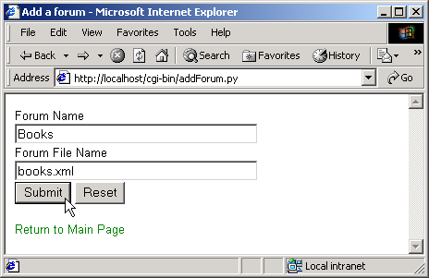
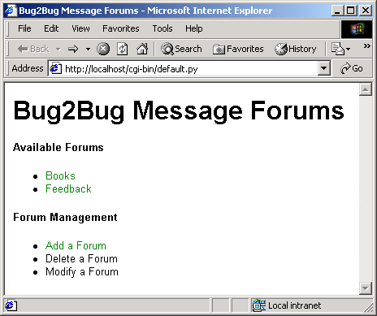
addForum.py
104 <a href = "/cgi-bin/default.py">Return to Main Page</a>
105 </body>
106
107 </html>"""

Slide 43
template.xml
Template for forum file
1 <?xml version = "1.0"?>
2
3 <!-- Fig. 16.25: template.xml -->
4 <!-- Empty forum file -->
5
6 <?xml:stylesheet type = "text/xsl" href = "../XML/formatting.xsl"?>
7 <forum>
8 </forum>

Slide 44
addPost.py
Adds message to forum
1 #!c:\Python\python.exe
2 # Fig. 16.26: addPost.py
3 # Adds a message to a forum.
4
5 import re
6 import os
7 import sys
8 import cgi
9 import time
10
11 # 4DOM packages
12 from xml.dom.ext.reader import PyExpat
13 from xml.dom.ext import PrettyPrint
14
15 def printHeader( title, style ):
16 print """Content-type: text/html
17
18 <?xml version = "1.0" encoding = "UTF-8"?>
19 <!DOCTYPE html PUBLIC
20 "-//W3C//DTD XHTML 1.0 Strict//EN"
21 "DTD/xhtml1-strict.dtd">
22 <html xmlns = "http://www.w3.org/1999/xhtml">
23
24 <head>
25 <title>%s</title>
26 <link rel = "stylesheet" href = "%s" type = "text/css" />
27 </head>
28
29 <body>""" % ( title, style )
30
31 # identify client browser
32 if os.environ[ "HTTP_USER_AGENT" ].find( "MSIE" ) != -1:
33 prefix = "../XML/" # Internet Explorer
34 else:
35 prefix = "forum.py?file="

Slide 45
addPost.py
Obtain form data
36
37 form = cgi.FieldStorage()
38
39 # user has submitted message to post
40 if form.has_key( "submit" ):
41 filename = form[ "file" ].value
42
43 # add message to forum
44 if not re.match( "\w+\.xml$", filename ):
45 print "Location: /error.html\n"
46 sys.exit()
47
48 try:
49 forumFile = open( "../htdocs/XML/" + filename, "r+" )
50 except IOError:
51 print "Location: /error.html\n"
52 sys.exit()
53
54 # parse forum document
55 reader = PyExpat.Reader()
56 document = reader.fromStream( forumFile )
57 documentNode = document.documentElement
58
59 # create message element
60 message = document.createElement( "message" )
61 message.setAttribute( "timestamp", time.ctime( time.time() ))
62
63 # add elements to message
64 messageElements = [ "user", "title", "text" ]
65
66 for item in messageElements:
67
68 if not form.has_key( item ):
69 text = "( Field left blank )"
70 else:
Process form if user has submitted message
Redirect user to error.html if filename incorrect
Open new forum file
Parse forum document
Create new message element with timestamp attribute
Insert default text for any blank fields

Slide 46
addPost.py
71 text = form[ item ].value
72
73 # create nodes
74 element = document.createElement( item )
75 elementText = document.createTextNode( text )
76 element.appendChild( elementText )
77 message.appendChild( element )
78
79 # append new message to forum and update document on disk
80 documentNode.appendChild( message )
81 forumFile.seek( 0, 0 )
82 forumFile.truncate()
83 PrettyPrint( document, forumFile )
84 forumFile.close()
85 reader.releaseNode( document )
86
87 print "Location: %s\n" % ( prefix + form[ "file" ].value )
88
89 # create form to obtain new message
90 elif form.has_key( "file" ):
91 printHeader( "Add a posting", "/XML/site.css" )
92 print """\n<form action = "addPost.py" method="post">
93 User<br />
94 <input type = "text" name = "user" size = "40" /><br />
95 Message Title<br />
96 <input type = "text" name = "title" size = "40" /><br />
97 Message Text<br />
98 <textarea name = "text" cols = "40" rows = "5"></textarea><br />
99 <input type = "hidden" name = "file" value = "%s" />
100 <input type = "submit" name = "submit" value = "Submit" />
101 <input type = "reset" value = "Reset" />
102 </form>
103
104 <a href = "%s">Return to Forum</a>
105 </body>
Append message to forum
Update document on disk
Redirect user to updated forum
Print form to obtain message
Pass filename as hidden input

Slide 47
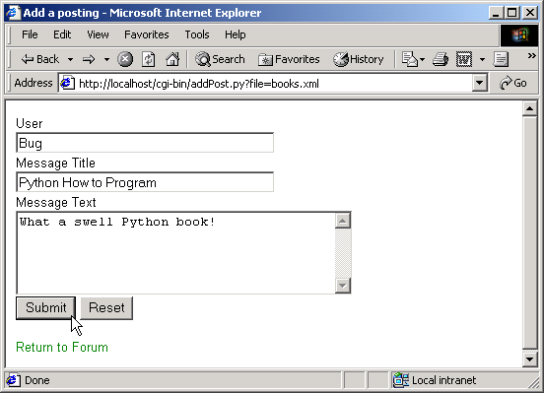
addPost.py
106
107 </html>""" % ( form[ "file" ].value,
108 prefix + form[ "file" ].value )
109 else:
110 print "Location: /error.html\n"

Slide 48
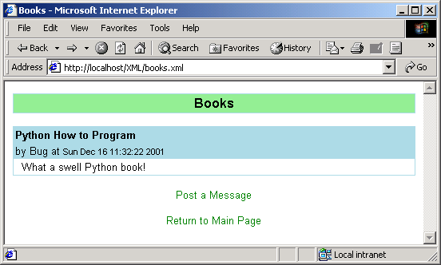
addPost.py

Slide 49
formatting.xsl
Style sheet that transforms XML data into XHTML
1 <?xml version = "1.0"?>
2
3 <!-- Fig. 16.27: formatting.xsl -->
4 <!-- Style sheet for forum files -->
5
6 <xsl:stylesheet version = "1.0"
7 xmlns:xsl = "http://www.w3.org/1999/XSL/Transform">
8
9 <!-- match document root -->
10 <xsl:template match = "/">
11 <html xmlns = "http://www.w3.org/1999/xhtml">
12
13 <!-- apply templates for all elements -->
14 <xsl:apply-templates select = "*" />
15 </html>
16 </xsl:template>
17
18 <!-- match forum elements -->
19 <xsl:template match = "forum">
20 <head>
21 <title><xsl:value-of select = "name" /></title>
22 <link rel = "stylesheet" type = "text/css"
23 href = "../XML/site.css" />
24 </head>
25
26 <body>
27 <table width = "100%" cellspacing = "0"
28 cellpadding = "2">
29 <tr>
30 <td class = "forumTitle">
31 <xsl:value-of select = "name" />
32 </td>
33 </tr>
34 </table>
35

Slide 50
formatting.xsl
36 <!-- apply templates for message elements -->
37 <br />
38 <xsl:apply-templates select = "message" />
39 <br />
40
41 <div style = "text-align: center">
42 <a>
43
44 <!-- add href attribute to "a" element -->
45 <xsl:attribute name = "href">../cgi-bin/addPost.py?file=<xsl:value-of select = "@file" />
46 </xsl:attribute>
47 Post a Message
48 </a>
49 <br /><br />
50 <a href = "../cgi-bin/default.py">Return to Main Page</a>
51 </div>
52
53 </body>
54 </xsl:template>
55
56 <!-- match message elements -->
57 <xsl:template match = "message">
58 <table width = "100%" cellspacing = "0"
59 cellpadding = "2">
60 <tr>
61 <td class = "msgTitle">
62 <xsl:value-of select = "title" />
63 </td>
64 </tr>
65
66 <tr>
67 <td class = "msgInfo">
68 by

Slide 51
formatting.xsl
69 <xsl:value-of select = "user" />
70 at
71 <span class = "date">
72 <xsl:value-of select = "@timestamp" />
73 </span>
74 </td>
75 </tr>
76
77 <tr>
78 <td class = "msgText">
79 <xsl:value-of select = "text" />
80 </td>
81 </tr>
82
83 </table>
84 </xsl:template>
85
86 </xsl:stylesheet>

Slide 52
forum.py
1 #!c:\Python\python.exe
2 # Fig. 16.28: forum.py
3 # Display forum postings for non-Internet Explorer browsers.
4
5 import re
6 import cgi
7 import sys
8 from xml.xslt import Processor
9
10 form = cgi.FieldStorage()
11
12 # form to display has been specified
13 if form.has_key( "file" ):
14
15 # determine whether file is xml
16 if not re.match( "\w+\.xml$", form[ "file" ].value ):
17 print "Location: /error.html\n"
18 sys.exit()
19
20 try:
21 style = open( "../htdocs/XML/formatting.xsl" )
22 XMLFile = open( "../htdocs/XML/" + form[ "file" ].value )
23 except IOError:
24 print "Location: /error.html\n"
25 sys.exit()
26
27 # create XSLT processor instance
28 processor = Processor.Processor()
29
30 # specify style sheet
31 processor.appendStylesheetStream( style )
32
Open stylesheet
Open forum file
Instantiate a 4SXLT Processor object
Specifies appropriate style sheet to apply

Slide 53
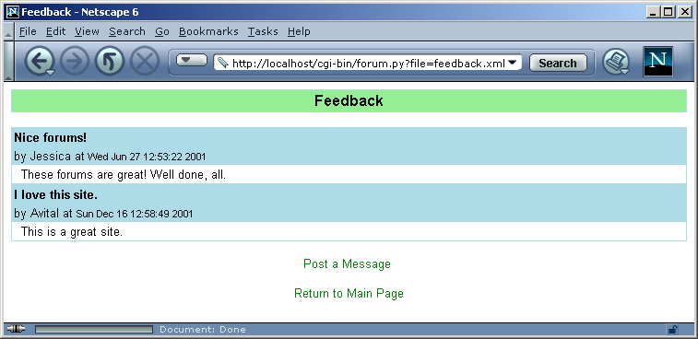
forum.py
Apply style sheet to file referenced by specified file object
33 # apply style sheet to XML document
34 results = processor.runStream( XMLFile )
35 style.close()
36 XMLFile.close()
37 print "Content-type: text/html\n"
38 print results
39 else:
40 print "Location: /error.html\n"
Transformed XML sent to client as HTML

