Slide 1
Chapter 17 – Customizing Classes
Outline
17.1 Introduction
17.2 Relational Database Model
17.3 Relational Database Overview: Books Database
17.4 Structured Query Language (SQL)
17.4.1 Basic SELECT Query
17.4.2 WHERE Clause
17.4.3 ORDER BY Clause
17.4.4 Merging Data from Multiple Tables: INNER JOIN
17.4.5 Joining Data from Tables Authors, AuthorISBN, Titles and Publishers
17.4.6 INSERT Statement
17.4.7 UPDATE Statement
17.4.8 DELETE Statement
17.5 Python DB-API Specification
17.6 Case Study: A SimpleDictionary Class
17.7 Querying the Books Database
17.8 Reading, Inserting and Updating a Database

Slide 2
17.1 Introduction
Database: integrated collection of data
Database management system (DBMS): provides mechanisms for storing and organizing data in a manner consistent with the database’s format
Relational databases: store data in tables and define relationships between the tables
Examples of popular relational database systems includes Microsoft SQL Server, Oracle, Sybase, DB2, Informix and MySQL

Slide 3
17.2 Relational Database Model
Relational database model: logical representation of data that allows relationships among data to be considered without concern for the data’s physical structure
Relational database composed of tables
Row called record
Column called field
Primary key is a field that contains unique data

Slide 4
17.2 Relational Database Model
Number
Name
Department
Salary
Location
23603
Jones
413
1100
New Jersey
24568
Kerwin
413
2000
New Jersey
Record/Row
34589
Larson
642
1800
Los Angeles
35761
Myers
611
1400
Orlando
47132
Neumann
413
9000
New Jersey
78321
Stephens
611
8500
Orlando
Primary key
Field/Column

Slide 5
17.2 Relational Database Model
Department
Location
413
New Jersey
611
Orlando
642
Los Angeles
Fig. 17.2 Result set formed by selecting Department and Location data from the Employee table.

Slide 6
17.3 Relational Database Overview: Books Database
Books database has four tables: Authors, Publishers, AuthorISBN and Titles
Authors table has three fields: author’s unique ID number, first name and last name
Publishers table has two fields: publisher’s unique ID and name
AuthorISBN table has two fields: authors’ ID numbers and corresponding ISBN numbers
Titles has seven fields: ISBN number, title, edition number, copyright year, publisher’s ID number, book price and filename of cover image

Slide 7
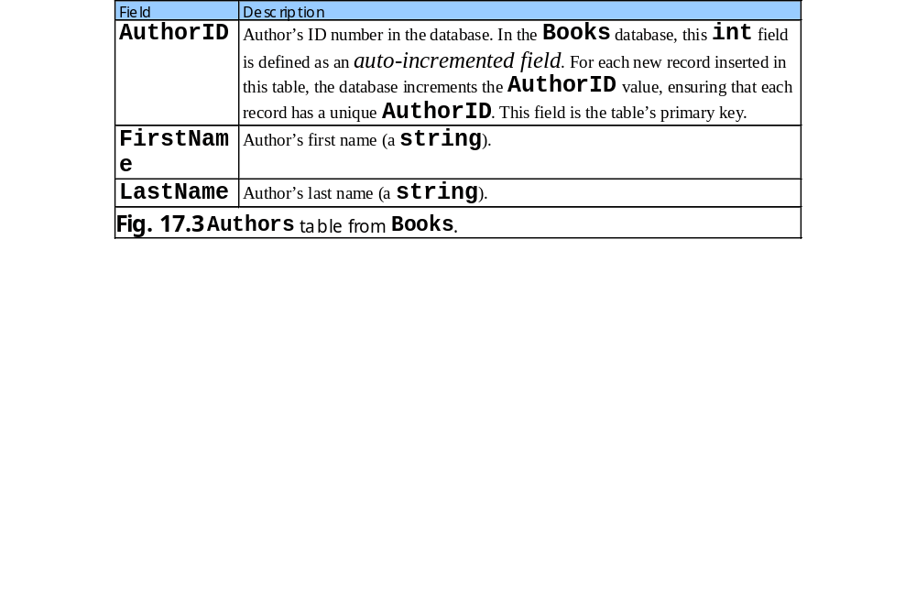
17.3 Relational Database Overview: Books Database

Slide 8
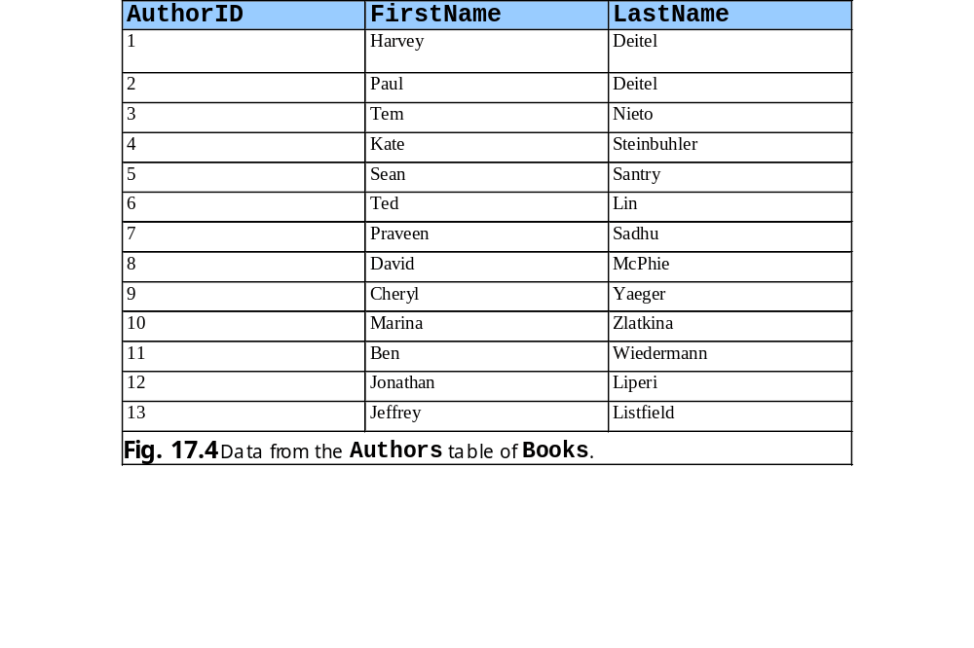
17.3 Relational Database Overview: Books Database

Slide 9
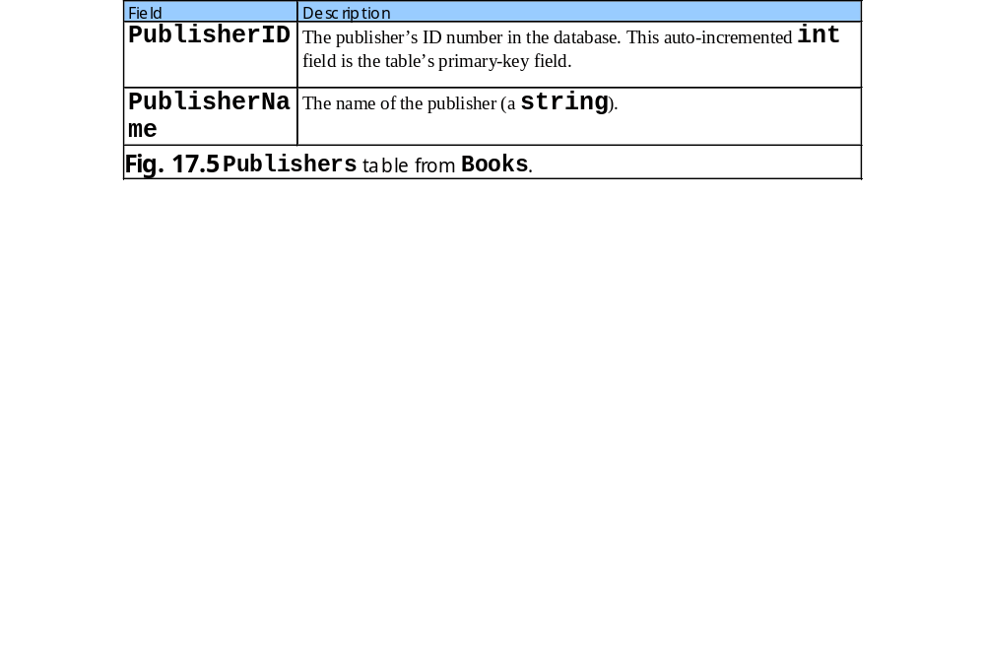
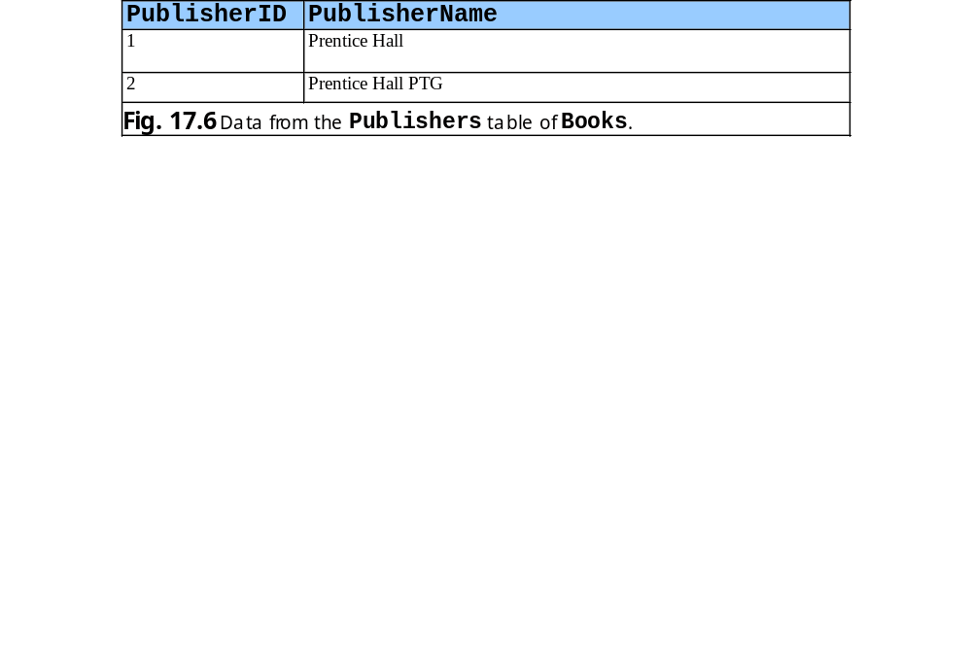
17.3 Relational Database Overview: Books Database

Slide 10
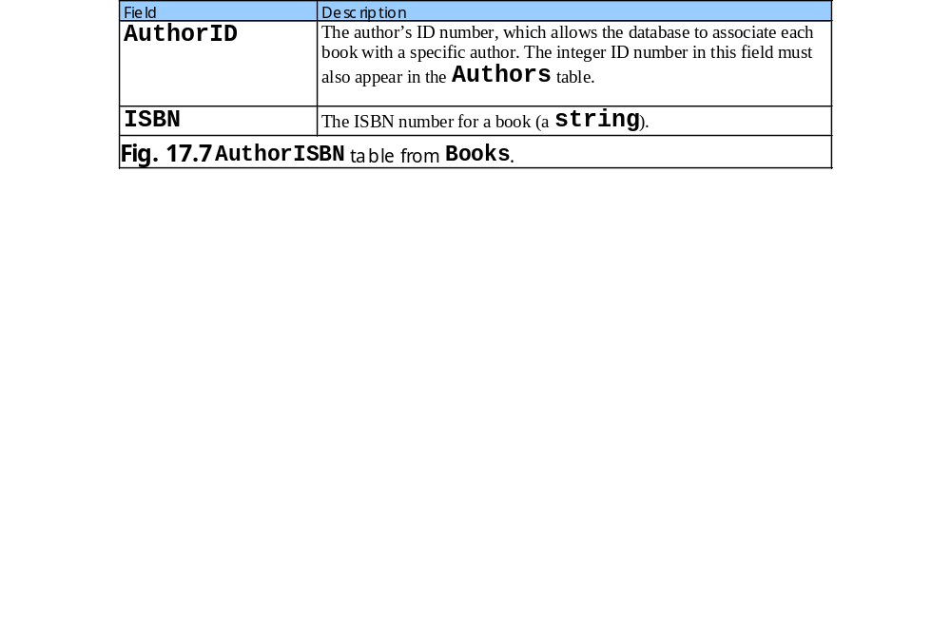
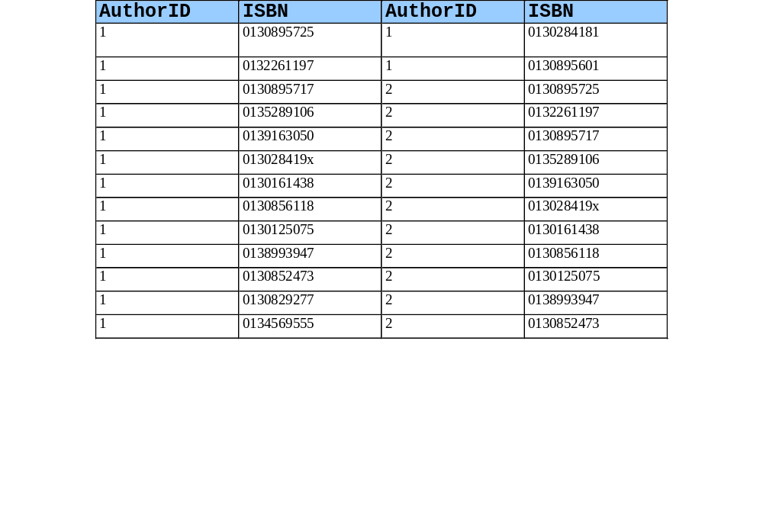
17.3 Relational Database Overview: Books Database

Slide 11
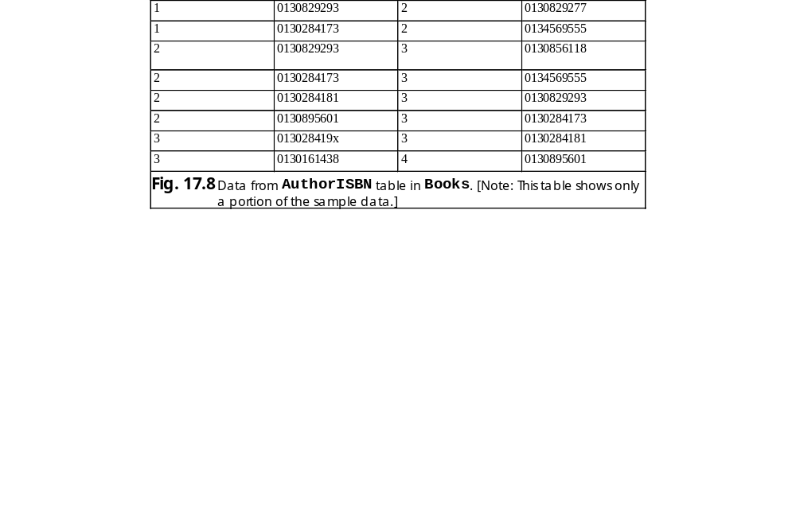
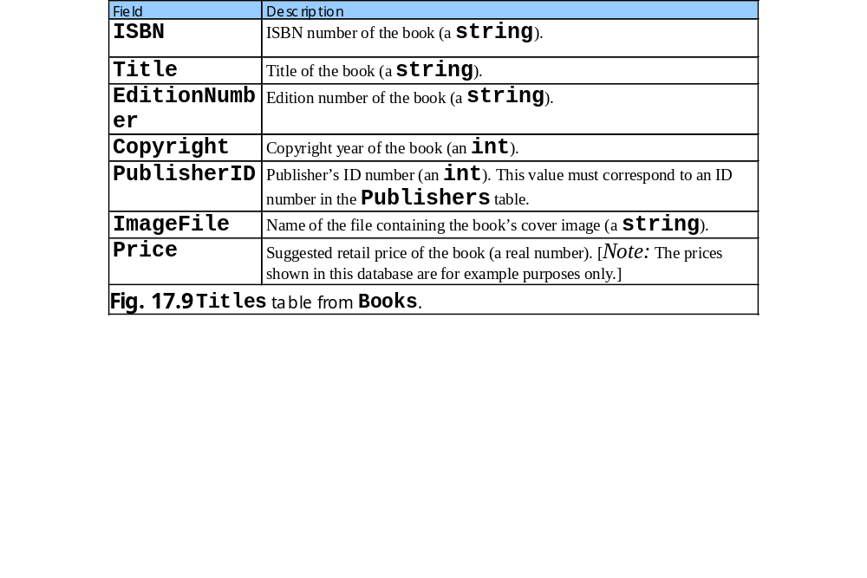
17.3 Relational Database Overview: Books Database

Slide 12
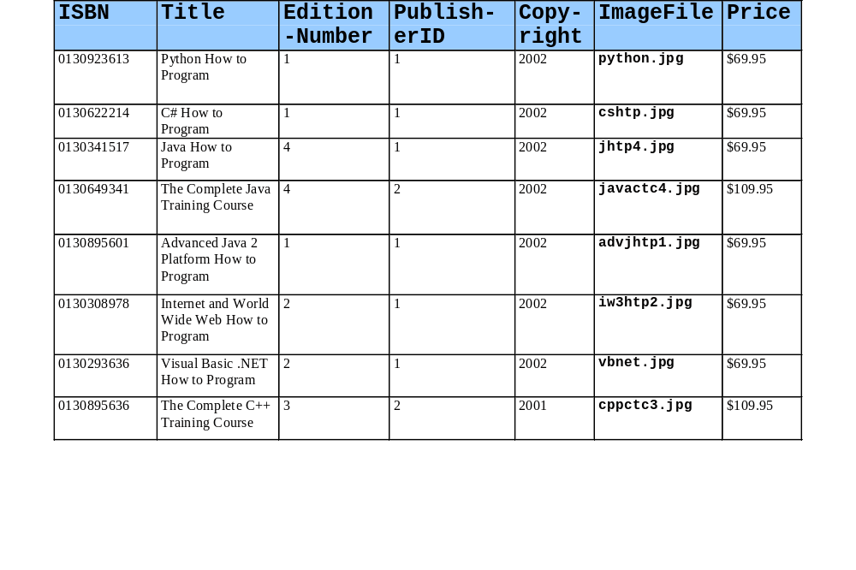
17.3 Relational Database Overview: Books Database

Slide 13
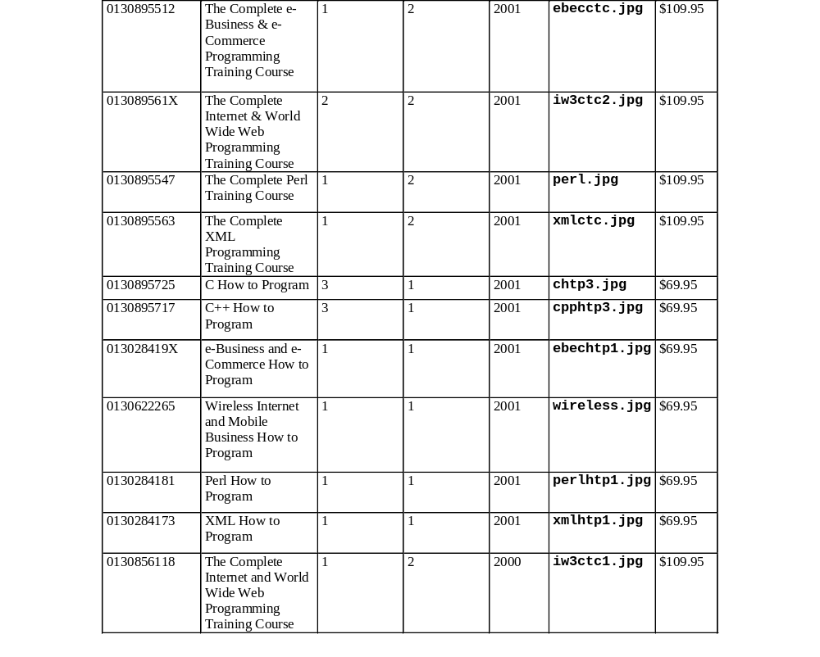
17.3 Relational Database Overview: Books Database

Slide 14
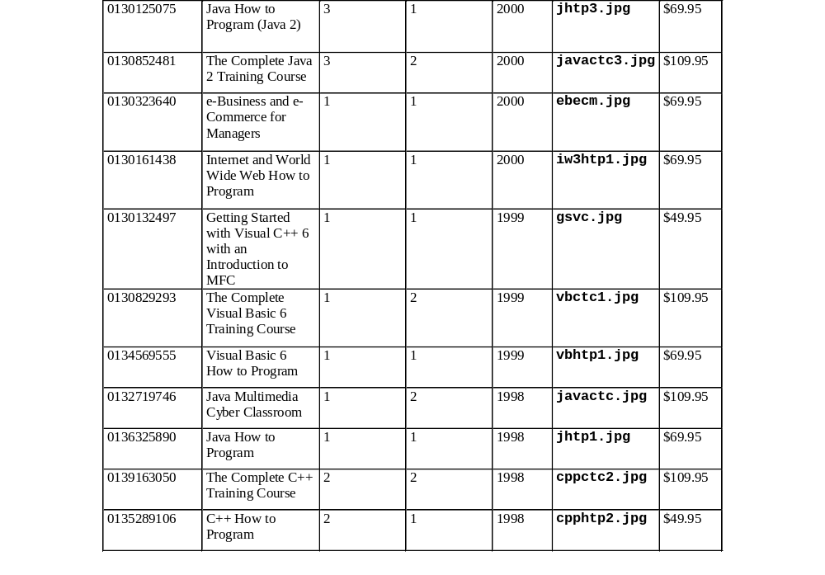
17.3 Relational Database Overview: Books Database

Slide 15
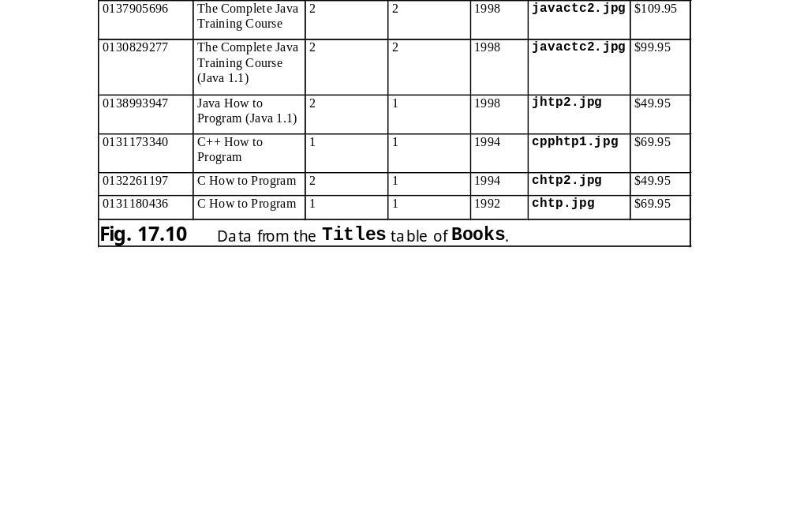
17.3 Relational Database Overview: Books Database

Slide 16
17.3 Relational Database Overview: Books Database
Authors
1
•
AuthorISBN
1
Titles
AuthorID
AuthorID
•
ISBN
FirstName
ISBN
Title
LastName
EditionNumber
•
Copyright
Publishers
1
PublisherID
PublisherID
ImageFile
PublisherName
Price
Fig. 17.11 Table relationships in Books.

Slide 17
17.4 Structured Query Language (SQL)
Used almost universally with relational database systems to perform queries (i.e., to request information that satisfies given criteria) and to manipulate data

Slide 18
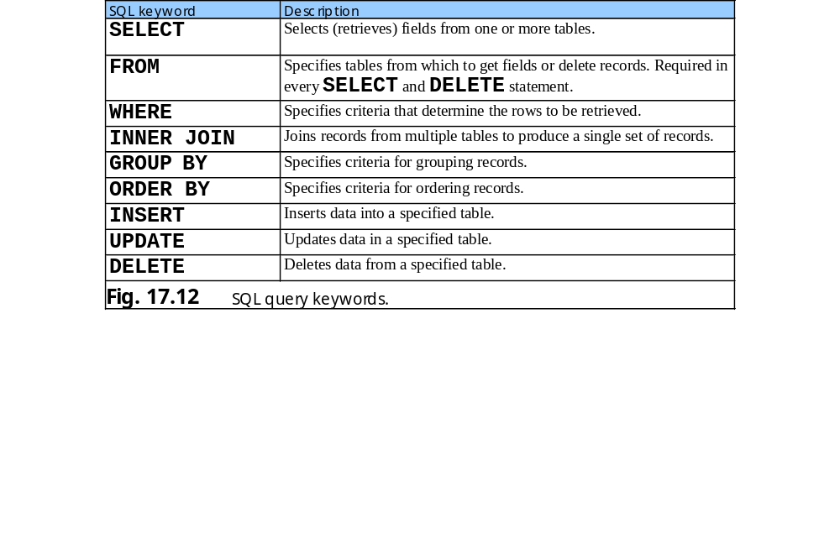
17.4 Structured Query Language (SQL)

Slide 19
17.4.1 Basic SELECT Query
SELECT queries select information from one or more database tables
Basic format: SELECT * FROM tableName

Slide 20
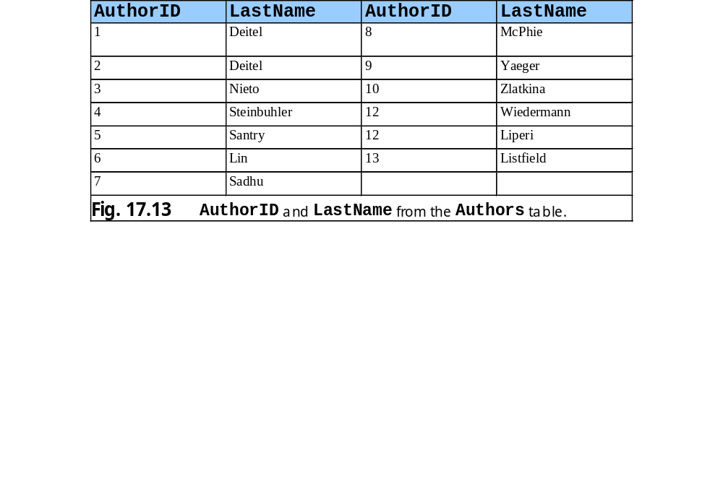
17.4.1 Basic SELECT Query

Slide 21
17.4.2 WHERE Clause
Users can search a database for records that satisfy selection criteria
Optional WHERE clause in a SELECT query specifies selection criteria for the query
Simplest format: SELECT fieldName FROM tableName WHERE criteria
WHERE clause condition can contain operators <, >, <=, >=, =, <> and LIKE (used for pattern matching with wildcard characters like % and _)

Slide 22
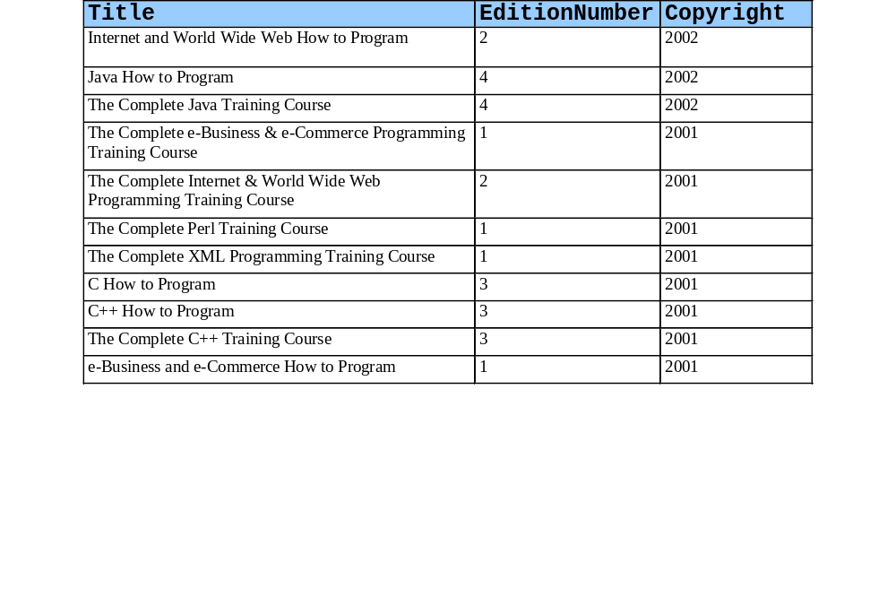
17.4.2 WHERE Clause

Slide 23
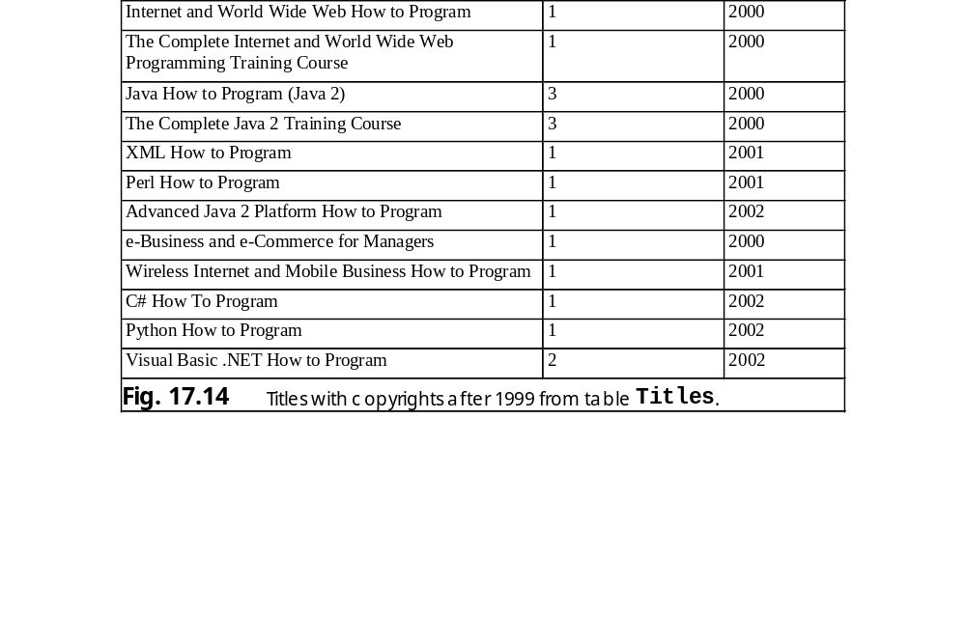
17.4.2 WHERE Clause

Slide 24
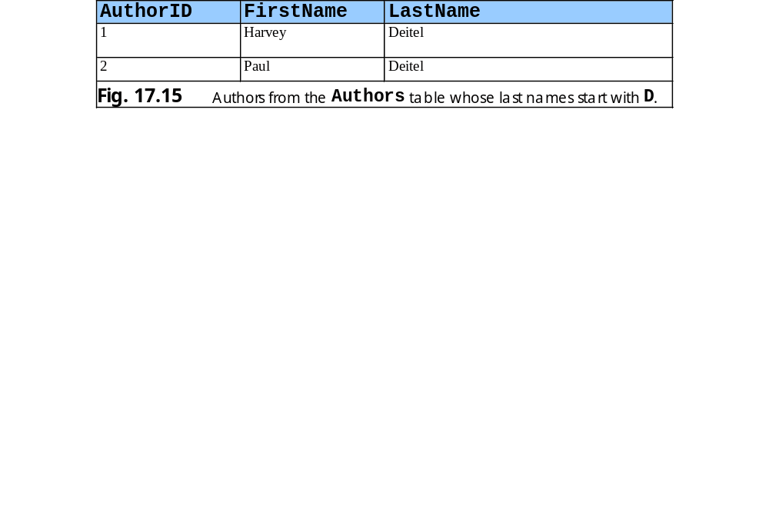
17.4.2 WHERE Clause

Slide 25
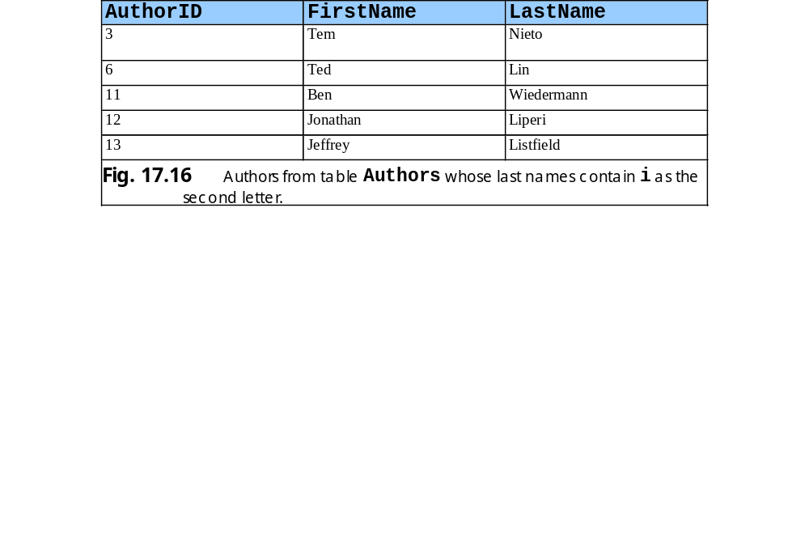
17.4.2 WHERE Clause

Slide 26
17.4.3 ORDER BY Clause
Option ORDER BY clause can arrange query results in ascending or descending order
To specify ascending order: ORDER BY field ASC
To specify descending order: ORDER BY field DESC

Slide 27
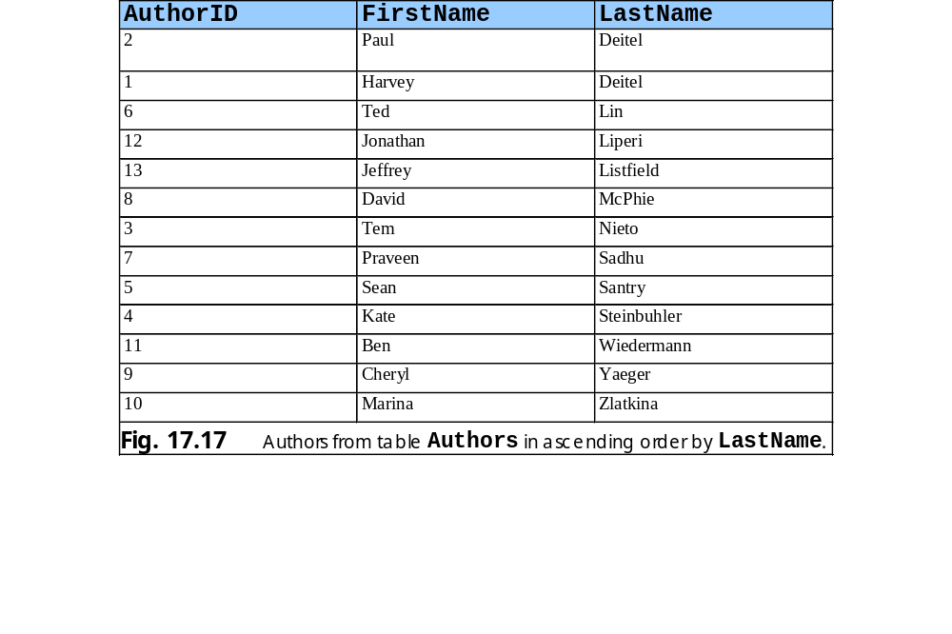
17.4.3 ORDER BY Clause

Slide 28
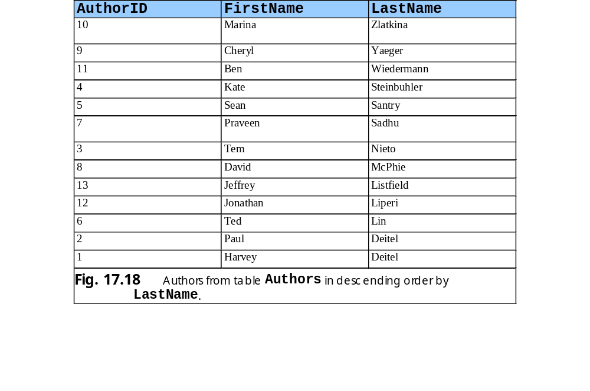
17.4.3 ORDER BY Clause

Slide 29
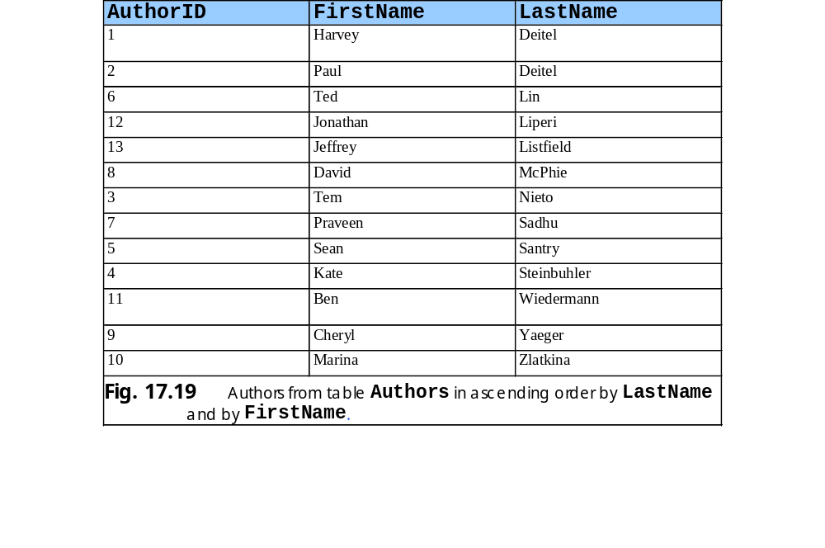
17.4.3 ORDER BY Clause

Slide 30
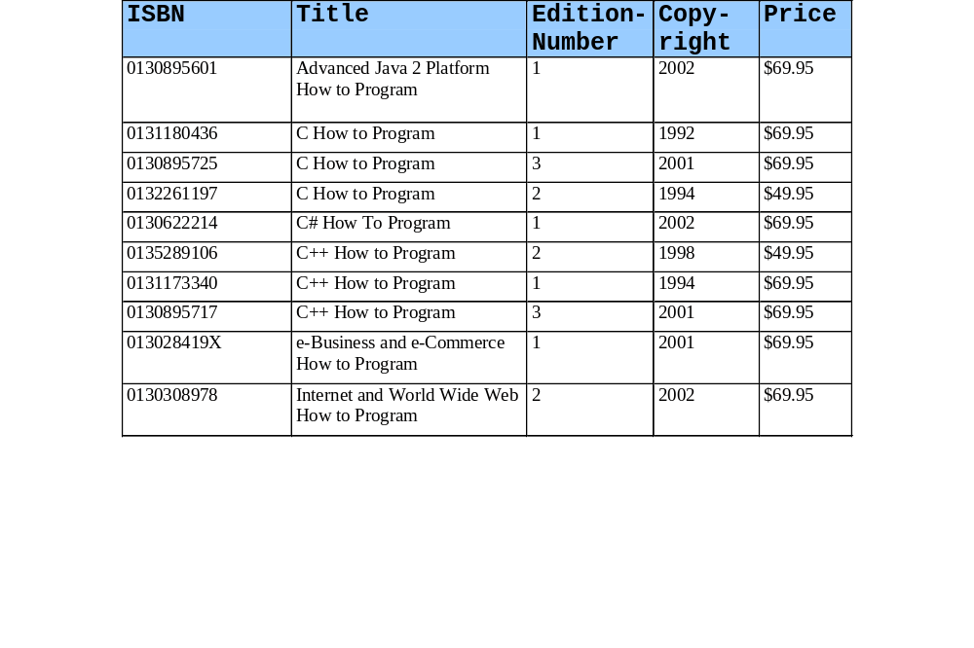
17.4.3 ORDER BY Clause

Slide 31
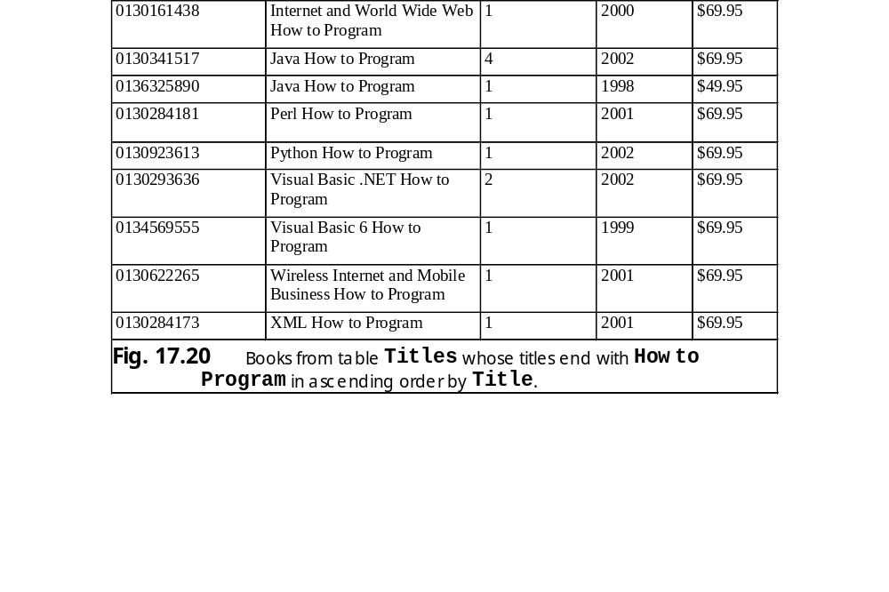
17.4.3 ORDER BY Clause

Slide 32
17.4.4 Merging Data from Multiple Tables: INNER JOIN
Merging data from multiple tables into a single set of data is referred to as joining the tables
INNER JOIN operation in SELECT query accomplishes joining
ON part of an INNER JOIN clause specifies the fields from each each table that are compared to determine which records are joined

Slide 33
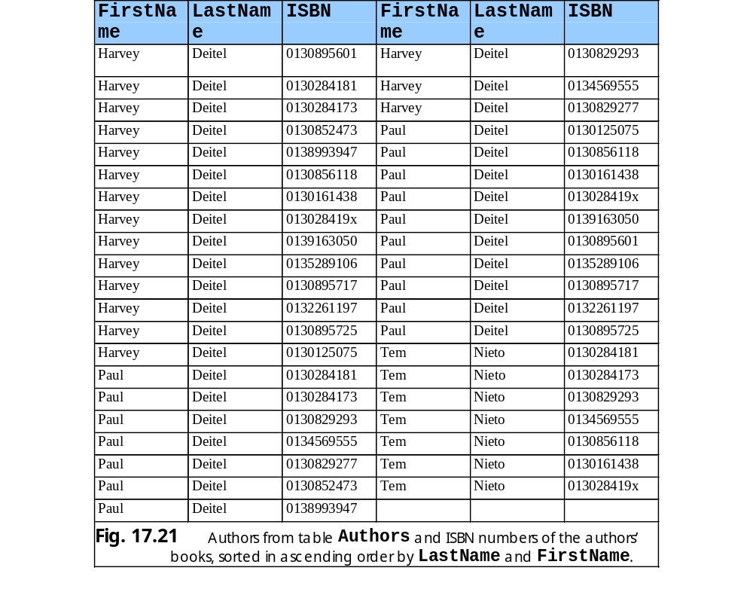
17.4.4 Merging Data from Multiple Tables: INNER JOIN

Slide 34
17.4.5 Joining Data from Tables Authors, AuthorISBN, Titles and Publishers
Books database predefined query (TitleAuthor) selects as its results the title, ISBN number, author’s first name, author’s last name, copyright year and publisher’s name for each book in the database
Query depicted in Fig. 17.22
Figure 17.23 contains portion of the query results

Slide 35
Fig. 17.22 TitleAuthor query of Books database
1 SELECT Titles.Title, Titles.ISBN, Authors.FirstName,
2 Authors.LastName, Titles.Copyright,
3 Publishers.PublisherName
4 FROM
5 ( Publishers INNER JOIN Titles
6 ON Publishers.PublisherID = Titles.PublisherID )
7 INNER JOIN
8 ( Authors INNER JOIN AuthorISBN
9 ON Authors.AuthorID = AuthorISBN.AuthorID )
10 ON Titles.ISBN = AuthorISBN.ISBN
11 ORDER BY Titles.Title

Slide 36
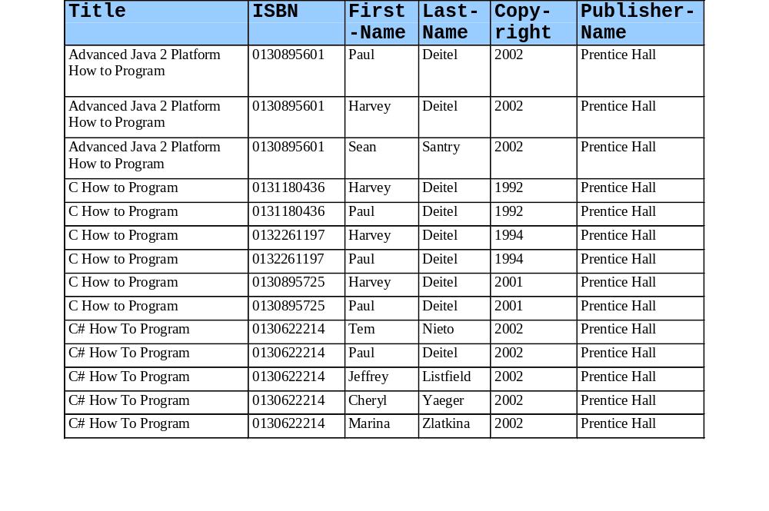
17.4.5 Joining Data from Tables Authors, AuthorISBN, Titles and Publishers

Slide 37
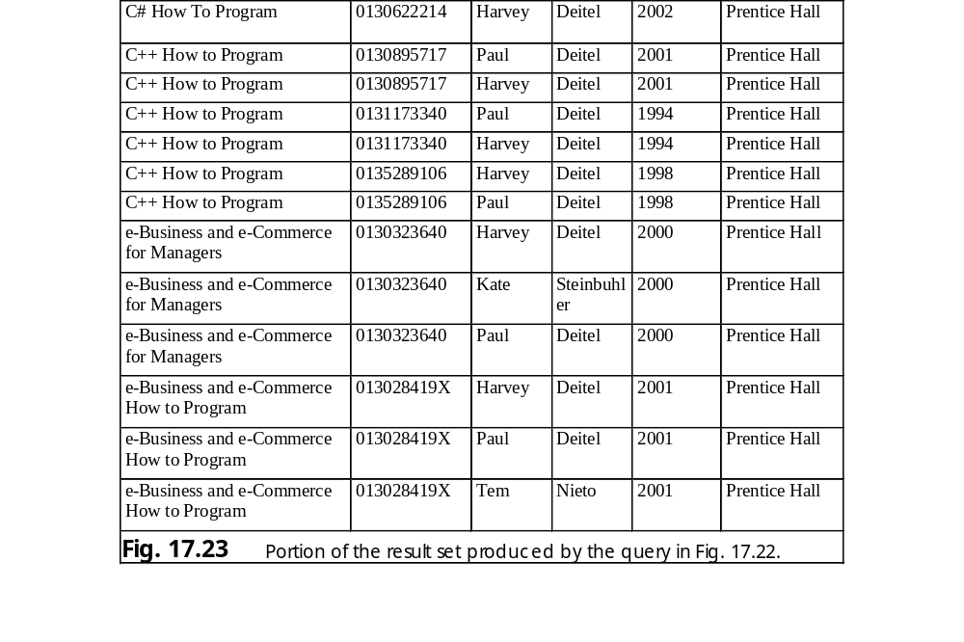
17.4.5 Joining Data from Tables Authors, AuthorISBN, Titles and Publishers

Slide 38
17.4.6 INSERT statement
INSERT statement inserts new record in the table
Simplest form: INSERT INTO tableName ( fieldName1, . . ., fieldNameN ) VALUES ( value1, . . ., valueN )

Slide 39
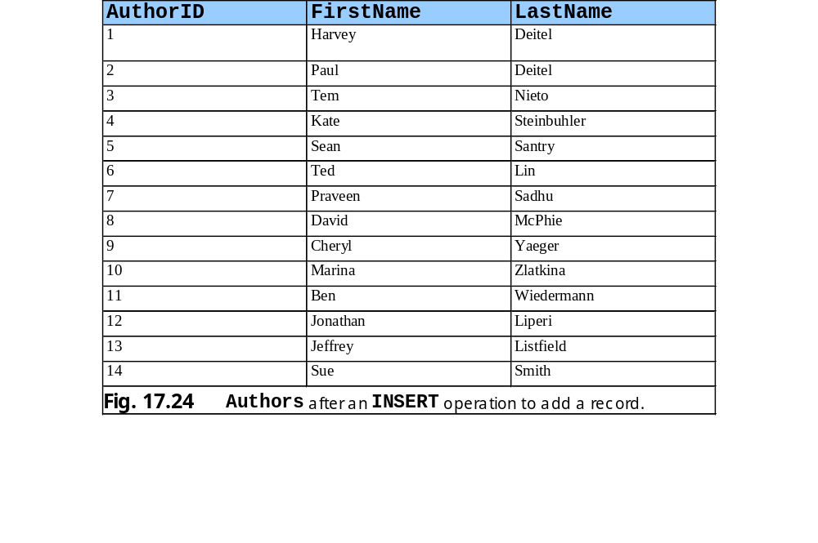
17.4.6 INSERT statement

Slide 40
17.4.7 UPDATE Statement
UPDATE statement modifies table data
Simplest form: UPDATE tableName SET fieldName = value WHERE criteria

Slide 41
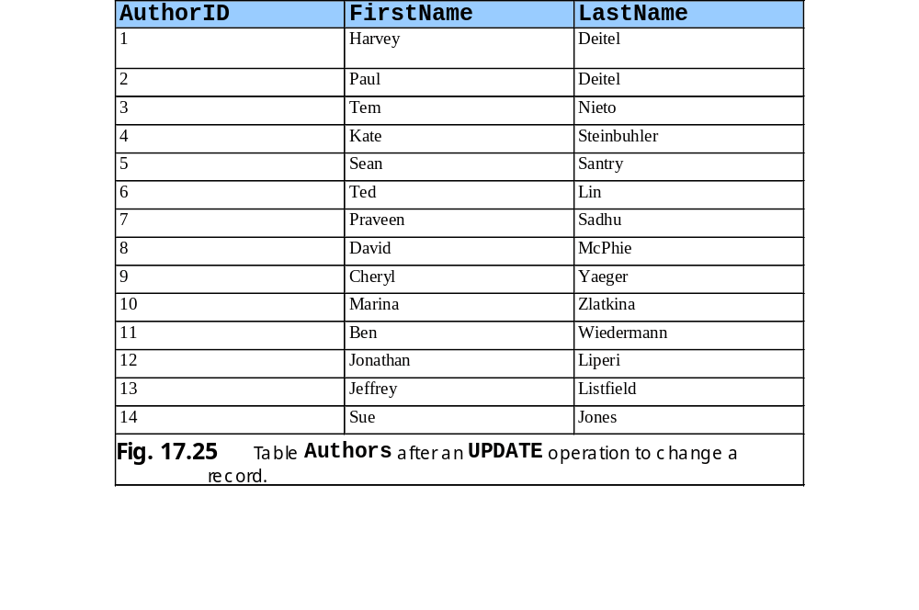
17.4.7 UPDATE Statement

Slide 42
17.4.8 DELETE Statement
DELETE statement removes table data
Simplest form: DELETE FROM tableName WHERE criteria

Slide 43
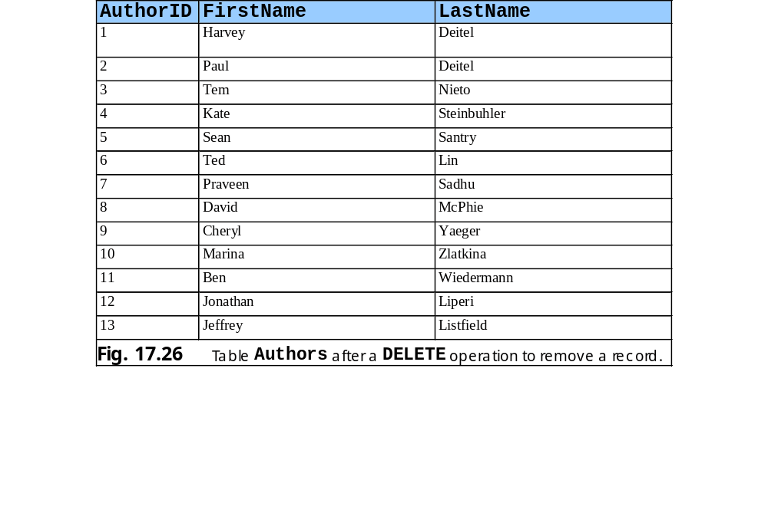
17.4.8 DELETE Statement

Slide 44
17.5 Python DB-API Specification
Python Database Application Programming Interface (DB-API): document that specifies common object and method names for manipulating any database
Describes a Connection object that accesses the database
Cursor object, created by Connection object, manipulates and retrieves data
Three methods for fetching rows of a query result set – fetchone, fetchmany and fetchall

Slide 45
17.6 Database Query Example
Presents a CGI program that performs a simple query on the Books database and displays result set in an XHTML table

Slide 46
fig17_27.py
1 #!c:\python\python.exe
2 # Fig. 17.27: fig17_27.py
3 # Displays contents of the Authors table,
4 # ordered by a specified field.
5
6 import MySQLdb
7 import cgi
8 import sys
9
10 def printHeader( title ):
11 print """Content-type: text/html
12
13 <?xml version = "1.0" encoding = "UTF-8"?>
14 <!DOCTYPE html PUBLIC
15 "-//W3C//DTD XHTML 1.0 Transitional//EN"
16 "DTD/xhtml1-transitional.dtd">
17 <html xmlns = "http://www.w3.org/1999/xhtml"
18 xml:lang = "en" lang = "en">
19 <head><title>%s</title></head>
20
21 <body>""" % title
22
23 # obtain user query specifications
24 form = cgi.FieldStorage()
25
26 # get "sortBy" value
27 if form.has_key( "sortBy" ):
28 sortBy = form[ "sortBy" ].value
29 else:
30 sortBy = "firstName"
31
32 # get "sortOrder" value
33 if form.has_key( "sortOrder" ):
34 sortOrder = form[ "sortOrder" ].value
35 else:
Contains classes and functions for manipulating MySQL databases
Obtain form data
Get “sort by” value for ORDER BY
Get sorting order for ORDER BY

Slide 47
fig17_27.py
36 sortOrder = "ASC"
37
38 printHeader( "Authors table from Books" )
39
40 # connect to database and retrieve a cursor
41 try:
42 connection = MySQLdb.connect( db = "Books" )
43
44 # error connecting to database
45 except MySQLdb.OperationalError, error:
46 print "Error:", error
47 sys.exit( 1 )
48
49 # retrieve cursor
50 else:
51 cursor = connection.cursor()
52
53 # query all records from Authors table
54 cursor.execute( "SELECT * FROM Authors ORDER BY %s %s" %
55 ( sortBy, sortOrder ) )
56
57 allFields = cursor.description # get field names
58 allRecords = cursor.fetchall() # get records
59
60 # close cursor and connection
61 cursor.close()
62 connection.close()
63
64 # output results in a table
65 print """\n<table border = "1" cellpadding = "3" >
66 <tr bgcolor = "silver" >"""
67
68 # create table header
69 for field in allFields:
70 print "<td>%s</td>" % field[ 0 ]
Create Connection object to manage connection
Specify database as value of keyword db
MySQLdb.connect failure raises MySQLdb.OperationalError exception
Create Cursor object
Execute query against database
Attribute description contains information about fields
Obtain all records
Close Cursor object
Close Connection object
Output results in table

Slide 48
fig17_27.py
71
72 print "</tr>"
73
74 # display each record as a row
75 for author in allRecords:
76 print "<tr>"
77
78 for item in author:
79 print "<td>%s</td>" % item
80
81 print "</tr>"
82
83 print "</table>"
84
85 # obtain sorting method from user
86 print """
87 \n<form method = "post" action = "/cgi-bin/fig17_27.py">
88 Sort By:<br />"""
89
90 # display sorting options
91 for field in allFields:
92 print """<input type = "radio" name = "sortBy"
93 value = "%s" />""" % field[ 0 ]
94 print field[ 0 ]
95 print "<br />"
96
97 print """<br />\nSort Order:<br />
98 <input type = "radio" name = "sortOrder"
99 value = "ASC" checked = "checked" />
100 Ascending
101 <input type = "radio" name = "sortOrder"
102 value = "DESC" />
103 Descending
104 <br /><br />\n<input type = "submit" value = "SORT" />
105 </form>\n\n</body>\n</html>"""
Display each record as a table row
Print form to obtain sorting information from user

Slide 49
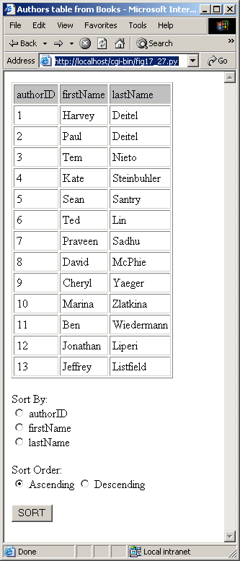
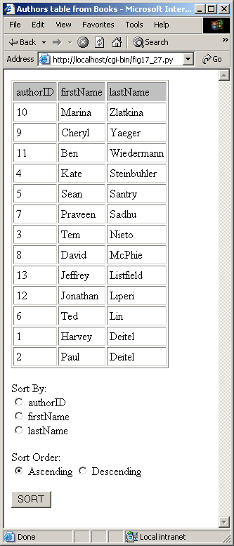
fig17_27.py

Slide 50
17.7 Querying the Books Database
Creates GUI interface for user to enter a query
Introduces Pmw components ScrolledFrame and PanedWidget

Slide 51
fig17_28.py
1 # Fig. 17.28: fig17_28.py
2 # Displays results returned by a
3 # query on Books database.
4
5 import MySQLdb
6 from Tkinter import *
7 from tkMessageBox import *
8 import Pmw
9
10 class QueryWindow( Frame ):
11 """GUI Database Query Frame"""
12
13 def __init__( self ):
14 """QueryWindow Constructor"""
15
16 Frame.__init__( self )
17 Pmw.initialise()
18 self.pack( expand = YES, fill = BOTH )
19 self.master.title( \
20 "Enter Query, Click Submit to See Results." )
21 self.master.geometry( "525x525" )
22
23 # scrolled text pane for query string
24 self.query = Pmw.ScrolledText( self, text_height = 8 )
25 self.query.pack( fill = X )
26
27 # button to submit query
28 self.submit = Button( self, text = "Submit query",
29 command = self.submitQuery )
30 self.submit.pack( fill = X )
31
GUI allows user to enter query

Slide 52
fig17_28.py
Create Pmw ScrolledFrame component to display query results
32 # frame to display query results
33 self.frame = Pmw.ScrolledFrame( self,
34 hscrollmode = "static", vscrollmode = "static" )
35 self.frame.pack( expand = YES, fill = BOTH )
36
37 self.panes = Pmw.PanedWidget( self.frame.interior(),
38 orient = "horizontal" )
39 self.panes.pack( expand = YES, fill = BOTH )
40
41 def submitQuery( self ):
42 """Execute user-entered query against database"""
43
44 # open connection, retrieve cursor and execute query
45 try:
46 connection = MySQLdb.connect( db = "Books" )
47 cursor = connection.cursor()
48 cursor.execute( self.query.get() )
49 except MySQLdb.OperationalError, message:
50 errorMessage = "Error %d:\n%s" % \
51 ( message[ 0 ], message[ 1 ] )
52 showerror( "Error", errorMessage )
53 return
54 else: # obtain user-requested information
55 data = cursor.fetchall()
56 fields = cursor.description # metadata from query
57 cursor.close()
58 connection.close()
59
60 # clear results of last query
61 self.panes.destroy()
62 self.panes = Pmw.PanedWidget( self.frame.interior(),
63 orient = "horizontal" )
64 self.panes.pack( expand = YES, fill = BOTH )
65
Create Pmw PanedWidget
Execute user-entered query
Clear results of last query with method destroy

Slide 53
fig17_28.py
Create pane and label for each result
66 # create pane and label for each field
67 for item in fields:
68 self.panes.add( item[ 0 ] )
69 label = Label( self.panes.pane( item[ 0 ] ),
70 text = item[ 0 ], relief = RAISED )
71 label.pack( fill = X )
72
73 # enter results into panes, using labels
74 for entry in data:
75
76 for i in range( len( entry ) ):
77 label = Label( self.panes.pane( fields[ i ][ 0 ] ),
78 text = str( entry[ i ] ), anchor = W,
79 relief = GROOVE, bg = "white" )
80 label.pack( fill = X )
81
82 self.panes.setnaturalsize()
83
84 def main():
85 QueryWindow().mainloop()
86
87 if __name__ == "__main__":
88 main()
Uses labels to enter results into panes
Set size of each pane to be large enough to view largest label

Slide 54
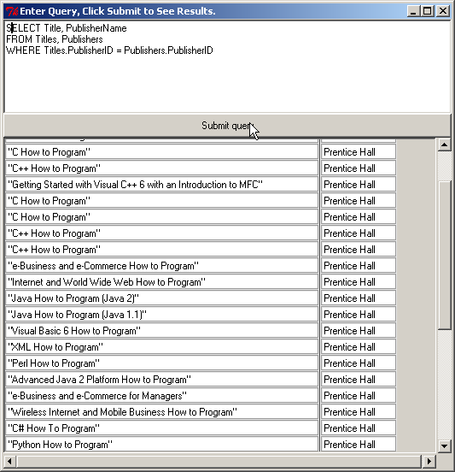
fig17_28.py

Slide 55
17.8 Reading, Inserting and Updating a Database
Example manipulates a MySQL AddressBook database that contains one table (addresses) with 11 columns-ID, FirstName, LastName, Address, City, StateOrProvince, PostalCode, Country, EmailAddress, HomePhone and FaxNumber

Slide 56
fig17_29.py
1 # Fig. 17.29: fig17_29.py
2 # Inserts into, updates and searches a database
3
4 import MySQLdb
5 from Tkinter import *
6 from tkMessageBox import *
7 import Pmw
8
9 class AddressBook( Frame ):
10 """GUI Database Address Book Frame"""
11
12 def __init__( self ):
13 """Address Book constructor"""
14
15 Frame.__init__( self )
16 Pmw.initialise()
17 self.pack( expand = YES, fill = BOTH )
18 self.master.title( "Address Book Database Application" )
19
20 # buttons to execute commands
21 self.buttons = Pmw.ButtonBox( self, padx = 0 )
22 self.buttons.grid( columnspan = 2 )
23 self.buttons.add( "Find", command = self.findAddress )
24 self.buttons.add( "Add", command = self.addAddress )
25 self.buttons.add( "Update", command = self.updateAddress )
26 self.buttons.add( "Clear", command = self.clearContents )
27 self.buttons.add( "Help", command = self.help, width = 14 )
28 self.buttons.alignbuttons()
29
30
31 # list of fields in an address record
32 fields = [ "ID", "First name", "Last name",
33 "Address", "City", "State Province", "Postal Code",
34 "Country", "Email Address", "Home phone", "Fax Number" ]
35
Create Pmw ButtonBox for application commands
List of fields in an address record

Slide 57
fig17_29.py
36 # dictionary with Entry components for values, keyed by
37 # corresponding addresses table field names
38 self.entries = {}
39
40 self.IDEntry = StringVar() # current address id text
41 self.IDEntry.set( "" )
42
43 # create entries for each field
44 for i in range( len( fields ) ):
45 label = Label( self, text = fields[ i ] + ":" )
46 label.grid( row = i + 1, column = 0 )
47 entry = Entry( self, name = fields[ i ].lower(),
48 font = "Courier 12" )
49 entry.grid( row = i + 1 , column = 1,
50 sticky = W+E+N+S, padx = 5 )
51
52 # user cannot type in ID field
53 if fields[ i ] == "ID":
54 entry.config( state = DISABLED,
55 textvariable = self.IDEntry, bg = "gray" )
56
57 # add entry field to dictionary
58 key = fields[ i ].replace( " ", "_" )
59 key = key.upper()
60 self.entries[ key ] = entry
61
62 def addAddress( self ):
63 """Add address record to database"""
64
65 if self.entries[ "LAST_NAME" ].get() != "" and \
66 self.entries[ "FIRST_NAME"].get() != "":
67
Dictionary for fields and corresponding values
Create Entry component for each field
User cannot type in ID field
Add entry field to dictionary
Add address record to database

Slide 58
fig17_29.py
Create INSERT query command
68 # create INSERT query command
69 query = """INSERT INTO addresses (
70 FIRST_NAME, LAST_NAME, ADDRESS, CITY,
71 STATE_PROVINCE, POSTAL_CODE, COUNTRY,
72 EMAIL_ADDRESS, HOME_PHONE, FAX_NUMBER
73 ) VALUES (""" + \
74 "'%s', " * 10 % \
75 ( self.entries[ "FIRST_NAME" ].get(),
76 self.entries[ "LAST_NAME" ].get(),
77 self.entries[ "ADDRESS" ].get(),
78 self.entries[ "CITY" ].get(),
79 self.entries[ "STATE_PROVINCE" ].get(),
80 self.entries[ "POSTAL_CODE" ].get(),
81 self.entries[ "COUNTRY" ].get(),
82 self.entries[ "EMAIL_ADDRESS" ].get(),
83 self.entries[ "HOME_PHONE" ].get(),
84 self.entries[ "FAX_NUMBER" ].get() )
85 query = query[ :-2 ] + ")"
86
87 # open connection, retrieve cursor and execute query
88 try:
89 connection = MySQLdb.connect( db = "AddressBook" )
90 cursor = connection.cursor()
91 cursor.execute( query )
92 except MySQLdb.OperationalError, message:
93 errorMessage = "Error %d:\n%s" % \
94 ( message[ 0 ], message[ 1 ] )
95 showerror( "Error", errorMessage )
96 else:
97 cursor.close()
98 connection.close()
99 self.clearContents()
100

Slide 59
fig17_29.py
101 else: # user has not filled out first/last name fields
102 showwarning( "Missing fields", "Please enter name" )
103
104 def findAddress( self ):
105 """Query database for address record and display results"""
106
107 if self.entries[ "LAST_NAME" ].get() != "":
108
109 # create SELECT query
110 query = "SELECT * FROM addresses " + \
111 "WHERE LAST_NAME = ’" + \
112 self.entries[ "LAST_NAME" ].get() + "'"
113
114 # open connection, retrieve cursor and execute query
115 try:
116 connection = MySQLdb.connect( db = "AddressBook" )
117 cursor = connection.cursor()
118 cursor.execute( query )
119 except MySQLdb.OperationalError, message:
120 errorMessage = "Error %d:\n%s" % \
121 ( message[ 0 ], message[ 1 ] )
122 showerror( "Error", errorMessage )
123 self.clearContents()
124 else: # process results
125 results = cursor.fetchall()
126 fields = cursor.description
127
128 if not results: # no results for this person
129 showinfo( "Not found", "Nonexistent record" )
130 else: # display information in GUI
131 self.clearContents()
132
133 # display results
134 for i in range( len( fields ) ):
135
Query database for address record and display results
Create SELECT query with WHERE clause

Slide 60
fig17_29.py
136 if fields[ i ][ 0 ] == "ID":
137 self.IDEntry.set( str( results[ 0 ][ i ] ) )
138 else:
139 self.entries[ fields[ i ][ 0 ] ].insert(
140 INSERT, str( results[ 0 ][ i ] ) )
141
142 cursor.close()
143 connection.close()
144
145 else: # user did not enter last name
146 showwarning( "Missing fields", "Please enter last name" )
147
148 def updateAddress( self ):
149 """Update address record in database"""
150
151 if self.entries[ "ID" ].get():
152
153 # create UPDATE query command
154 entryItems= self.entries.items()
155 query = "UPDATE addresses SET"
156
157 for key, value in entryItems:
158
159 if key != "ID":
160 query += " %s='%s'," % ( key, value.get() )
161
162 query = query[ :-1 ] + " WHERE ID=" + self.IDEntry.get()
163
164 # open connection, retrieve cursor and execute query
165 try:
166 connection = MySQLdb.connect( db = "AddressBook" )
167 cursor = connection.cursor()
168 cursor.execute( query )
Update address record in database
Execute UPDATE query command

Slide 61
fig17_29.py
169 except MySQLdb.OperationalError, message:
170 errorMessage = "Error %d:\n%s" % \
171 ( message[ 0 ], message[ 1 ] )
172 showerror( "Error", errorMessage )
173 self.clearContents()
174 else:
175 showinfo( "database updated", "Database Updated." )
176 cursor.close()
177 connection.close()
178
179 else: # user has not specified ID
180 showwarning( "No ID specified", """
181 You may only update an existing record.
182 Use Find to locate the record,
183 then modify the information and press Update.""" )
184
185 def clearContents( self ):
186 """Clear GUI panel"""
187
188 for entry in self.entries.values():
189 entry.delete( 0, END )
190
191 self.IDEntry.set( "" )
192
193 def help( self ):
194 "Display help message to user"
195
196 showinfo( "Help", """Click Find to locate a record.
197 Click Add to insert a new record.
198 Click Update to update the information in a record.
199 Click Clear to empty the Entry fields.\n""" )
200
201 def main():
202 AddressBook().mainloop()
203
Clear GUI display
Display help dialog

Slide 62
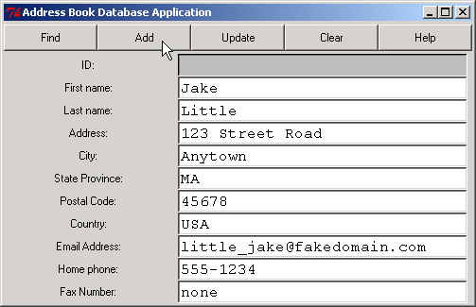
fig17_29.py
204 if __name__ == "__main__":
205 main()

