Slide 1
Chapter 20 – Networking
Outline
20.1 Introduction
20.2 Accessing URLs over HTTP
20.3 Establishing a Simple Server (Using Stream Sockets)
20.4 Establishing a Simple Client (Using Stream Sockets)
20.5 Client/Server Interaction with Stream Socket Connections
20.6 Connectionless Client/Server Interaction with Datagrams
20.7 Client/Server Tic-Tac-Toe Using a Multithreaded Server

Slide 2
20.1 Introduction
Client/server relationship
stream sockets provide connection-oriented using Transmission Control Protocol (TCP)
User Datagram Protocol (UDP) enables connectionless network communication with datagram sockets
Module socket contains the functions and class definitions that enable programs to communicate over a network

Slide 3
20.2 Accessing URLs over HTTP
HyperText Transfer Protocol (HTTP), which is crucial to data transmission on the Web, uses Uniform (or Universal) Resource Locators (URLs) to locate content on the Internet
URLs represent files, directories or complex tasks, such as database lookups and Internet searches

Slide 4
fig20_1.py
1 # Fig. 20.1: fig20_01.py
2 # Displays the contents of a file from a Web server in a browser.
3
4 from Tkinter import *
5 import Pmw
6 import urllib
7 import urlparse
8
9 class WebBrowser( Frame ):
10 """A simple Web browser"""
11
12 def __init__( self ):
13 """Create the Web browser GUI"""
14
15 Frame.__init__( self )
16 Pmw.initialise()
17 self.pack( expand = YES, fill = BOTH )
18 self.master.title( "Simple Web Browser" )
19 self.master.geometry( "400x300" )
20
21 self.address = Entry( self )
22 self.address.pack( fill = X, padx = 5, pady = 5 )
23 self.address.bind( "<Return>", self.getPage )
24
25 self.contents = Pmw.ScrolledText( self,
26 text_state = DISABLED )
27 self.contents.pack( expand = YES, fill = BOTH, padx = 5,
28 pady = 5 )
29
30 def getPage( self, event ):
31 """Parse URL, add addressing scheme and retrieve file"""
32
Provides methods for accessing data referred to by URLs
Provides functions to parse and manipulate URLs
Implements a simple Web browser
Entry component for user-entered URL
Web page displayed in Pmw ScrolledText component
Retrieves and displays specified Web page

Slide 5
fig20_1.py
Retrieve URL from Entry component
Takes a string as input and returns a six-element tuple
33 # parse the URL
34 myURL = event.widget.get()
35 components = urlparse.urlparse( myURL )
36 self.contents.text_state = NORMAL
37
38 # if addressing scheme not specified, use http
39 if components[ 0 ] == "":
40 myURL = "http://" + myURL
41
42 # connect and retrieve the file
43 try:
44 tempFile = urllib.urlopen( myURL )
45 self.contents.settext( tempFile.read() ) # show results
46 tempFile.close()
47 except IOError:
48 self.contents.settext( "Error finding file" )
49
50 self.contents.text_state = DISABLED
51
52 def main():
53 WebBrowser().mainloop()
54
55 if __name__ == "__main__":
56 main()
First element of tuple returned by urlparse.urlparse is addressing scheme
Append http:// to user-entered URL if necessary
Retrieve requested file
Display requested file
Generated if file could not be found

Slide 6
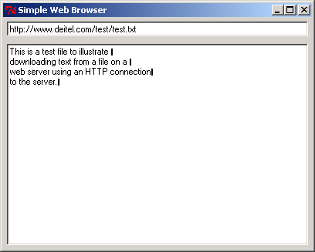
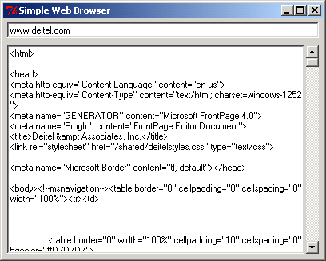
fig20_1.py

Slide 7
20.3 Establishing a Simple Server (Using Stream Sockets)
Step 1: Create a socket object with a call to the socket constructor: socket.socket( family, type )
  family (AF_INET or AF_UNIX) specifies how to interpret any addresses used by the socket
  type (SOCK_STREAM or SOCK_DGRAM) specifies stream sockets or datagram sockets, respectively
Step 2: Bind (assign) the socket object to a specified address: socket.bind( address )
  For AF_INET family sockets, address specifies the machine’s hostname or IP address and a port number for connections

Slide 8
20.3 Establishing a Simple Server (Using Stream Sockets)
Step 3: Prepare socket to receive connection requests: socket.listen( backlog )
  backlog specifies the maximum number of clients that can request connections to the server
Step 4: Wait for a client to request a connection: connection, address = socket.accept()
  socket object blocks indefinitely
  Server communicates with client using connection, a new socket object
  address corresponds to the client’s Internet address

Slide 9
20.3 Establishing a Simple Server (Using Stream Sockets)
Step 5: Processing phase in which server and client communicates using socket methods send and recv
Step 6: Transmission completes and server closes connection by invoking close method on the socket object

Slide 10
20.4 Establishing a Simple Client (Using Stream Sockets)
Step 1: Create a socket object
Step 2: Connect to the server using socket.connect( ( host, port ) ) where host represents server’s hostname or IP address and port is the port number to which the server process is bound
Step 3: Processing phase in which client and server communicate with methods send and recv
Step 4: Client closes connection by invoking close method on the socket object

Slide 11
20.5 Client/Server Interaction with Stream Socket Connections
Implementation of a simple client/server chat application using stream sockets

Slide 12
fig20_02.py
1 # Fig. 20.2: fig20_02.py
2 # Set up a server that will receive a connection
3 # from a client, send a string to the client,
4 # and close the connection.
5
6 import socket
7
8 HOST = "127.0.0.1"
9 PORT = 5000
10 counter = 0
11
12 # step 1: create socket
13 mySocket = socket.socket( socket.AF_INET, socket.SOCK_STREAM )
14
15 # step 2: bind the socket to address
16 try:
17 mySocket.bind( ( HOST, PORT ) )
18 except socket.error:
19 print "Call to bind failed"
20
21 while 1:
22
23 # step 3: wait for connection request
24 print "Waiting for connection"
25 mySocket.listen( 1 )
26
27 # step 4: establish connection for request
28 connection, address = mySocket.accept()
29 counter += 1
30 print "Connection", counter, "received from:", address[ 0 ]
31
32 # step 5: send and receive data via connection
33 connection.send( "SERVER>>> Connection successful" )
34 clientMessage = connection.recv( 1024 )
35
String “127.0.0.1” always refers to the local machine
Creates socket object mySocket to wait for connection requests
Bind mySocket to port 5000
Method bind failure generates socket.error exception
Specifies that only one client can request a connection
Establishes connection for a request
Send data via connection
Specify that server can receive at most 1024 bytes

Slide 13
fig20_02.py
36 while clientMessage != "CLIENT>>> TERMINATE":
37
38 if not clientMessage:
39 break
40
41 print clientMessage
42 serverMessage = raw_input( "SERVER>>> " )
43 connection.send( "SERVER>>> " + serverMessage )
44 clientMessage = connection.recv( 1024 )
45
46 # step 6: close connection
47 print "Connection terminated"
48 connection.close()
Terminate connection

Slide 14
fig20_03.py
1 # Fig. 20.3: fig20_03.py
2 # Set up a client that will read information sent
3 # from a server and display that information.
4
5 import socket
6
7 HOST = "127.0.0.1"
8 PORT = 5000
9
10 # step 1: create socket
11 print "Attempting connection"
12 mySocket = socket.socket( socket.AF_INET, socket.SOCK_STREAM )
13
14 # step 2: make connection request to server
15 try:
16 mySocket.connect( ( HOST, PORT ) )
17 except socket.error:
18 print "Call to connect failed"
19
20 print "Connected to Server"
21
22 # step 3: transmit data via connection
23 serverMessage = mySocket.recv( 1024 )
24
25 while serverMessage != "SERVER>>> TERMINATE":
26
27 if not serverMessage:
28 break
29
30 print serverMessage
31 clientMessage = raw_input( "CLIENT>>> " )
32 mySocket.send( "CLIENT>>> " + clientMessage )
33 serverMessage = mySocket.recv( 1024 )
34
Create a stream socket
Make a connection request to server
Accept message from server
Send message to server

Slide 15
fig20_03.py
Terminate connection
35 # step 4: close connection
36 print "Connection terminated"
37 mySocket.close()
Waiting for connection
Connection 1 received from: 127.0.0.1
Attempting connection
Connected to Server
SERVER>>> Connection successful
CLIENT>>> Hi to person at server
Waiting for connection
Connection 1 received from: 127.0.0.1
CLIENT>>> Hi to person at server
SERVER>>> Hi back to you--client!
Attempting connection
Connected to Server
SERVER>>> Connection successful
CLIENT>>> Hi to person at server
SERVER>>> Hi back to you--client!
CLIENT>>> TERMINATE
Waiting for connection
Connection 1 received from: 127.0.0.1
CLIENT>>> Hi to person at server
SERVER>>> Hi back to you--client!
Connection terminated
Waiting for connection

Slide 16
20.6 Connectionless Client/Server Interaction with Datagrams
Connectionless transmission uses datagrams (packets)
Connectionless transmission can result in lost, duplicated and lost packets

Slide 17
fig20_04.py
1 # Fig. 20.4: fig20_04.py
2 # Set up a server that will receive packets from a
3 # client and send packets to a client.
4
5 import socket
6
7 HOST = "127.0.0.1"
8 PORT = 5000
9
10 # step 1: create socket
11 mySocket = socket.socket( socket.AF_INET, socket.SOCK_DGRAM )
12
13 # step 2: bind socket
14 mySocket.bind( ( HOST, PORT ) )
15
16 while 1:
17
18 # step 3: receive packet
19 packet, address = mySocket.recvfrom( 1024 )
20
21 print "Packet received:"
22 print "From host:", address[ 0 ]
23 print "Host port:", address[ 1 ]
24 print "Length:", len( packet )
25 print "Containing:"
26 print "\t" + packet
27
28 # step 4: echo packet back to client
29 print "\nEcho data to client...",
30 mySocket.sendto( packet, address )
31 print "Packet sent\n"
32
33 mySocket.close()
Create a datagram socket object
Assign socket to specified host at port 5000
Method recvfrom blocks until message arrives
Returns received message and address of the socket sending the data
Method sendto specifies data to be sent and the address to which it is sent
Terminate connection

Slide 18
fig20_04.py
Packet received:
From host: 127.0.0.1
Host port: 1645
Length: 20
Containing:
first message packet
Echo data to client... Packet sent

Slide 19
fig20_05.py
1 # Fig. 20.5: fig20_05.py
2 # Set up a client that will send packets to a
3 # server and receive packets from a server.
4
5 import socket
6
7 HOST = "127.0.0.1"
8 PORT = 5000
9
10 # step 1: create socket
11 mySocket = socket.socket( socket.AF_INET, socket.SOCK_DGRAM )
12
13 while 1:
14
15 # step 2: send packet
16 packet = raw_input( "Packet>>>" )
17 print "\nSending packet containing:", packet
18 mySocket.sendto( packet, ( HOST, PORT ) )
19 print "Packet sent\n"
20
21 # step 3: receive packet back from server
22 packet, address = mySocket.recvfrom( 1024 )
23
24 print "Packet received:"
25 print "From host:", address[ 0 ]
26 print "Host port:", address[ 1 ]
27 print "Length:", len( packet )
28 print "Containing:"
29 print "\t" + packet + "\n"
30
31 mySocket.close()
Create datagram socket
Send packet to HOST at PORT
Receive packet from server
Terminate connection

Slide 20
fig20_05.py
Packet>>>first message packet
Sending packet containing: first message packet
Packet sent
Packet received:
From host: 127.0.0.1
Host port: 5000
Length: 20
Containing:
first message packet
Packet>>>

Slide 21
20.7 Client/Server Tic-Tac-Toe Using a Multithreaded Server
Tic-Tac-Toe game implemented with stream sockets and using client/server techniques
A TicTacToeServer class allows two TicTacToeClients to connect to the server and play the game

Slide 22
fig20_06.py
1 # Fig. 20.6: fig20_06.py
2 # Class TicTacToeServer maintains a game of Tic-Tac-Toe
3 # for two clients, each managed by a Player thread.
4
5 import socket
6 import threading
7
8 class Player( threading.Thread ):
9 """Thread to manage each Tic-Tac-Toe client individually"""
10
11 def __init__( self, connection, server, number ):
12 """Initialize thread and setup variables"""
13
14 threading.Thread.__init__( self )
15
16 # specify player's mark
17 if number == 0:
18 self.mark = "X"
19 else:
20 self.mark = "O"
21
22 self.connection = connection
23 self.server = server
24 self.number = number
25
26 def otherPlayerMoved( self, location ):
27 """Notify client of opponent’s last move"""
28
29 self.connection.send( "Opponent moved." )
30 self.connection.send( str( location ) )
31
32 def run( self ):
33 """Play the game"""
34
Thread to manage each Tic-Tac-Toe client individually
Specify each player’s mark
Send message to other client that opponent moved

Slide 23
fig20_06.py
Each client receives message indicating its mark (X or 0)
35 # send client message indicating its mark (X or O)
36 self.server.display( "Player %s connected." % self.mark )
37 self.connection.send( self.mark )
38
39 # wait for another player to arrive
40 if self.mark == "X":
41 self.connection.send( "Waiting for another player..." )
42 self.server.gameBeginEvent.wait()
43 self.connection.send(
44 "Other player connected. Your move." )
45 else:
46 self.server.gameBeginEvent.wait() # wait for server
47 self.connection.send( "Waiting for first move..." )
48
49 # play game until over
50 while not self.server.gameOver():
51
52 # get more location from client
53 location = self.connection.recv( 1 )
54
55 if not location:
56 break
57
58 # check for valid move
59 if self.server.validMove( int( location ), self.number ):
60 self.server.display( "loc: " + location )
61 self.connection.send( "Valid move." )
62 else:
63 self.connection.send( "Invalid move, try again." )
64
65 # close connection to client
66 self.connection.close()
67 self.server.display( "Game over." )
68 self.server.display( "Connection closed." )
69
Wait for second player to arrive
Continue game until game is over
Get selected location from client
Send message informing player whether selected move was valid
Terminate connection

Slide 24
fig20_06.py
70 class TicTacToeServer:
71 """Server that maintains a game of Tic-Tac-Toe for two clients"""
72
73 def __init__( self ):
74 """Initialize variables and setup server"""
75
76 HOST = ""
77 PORT = 5000
78
79 self.board = []
80 self.currentPlayer = 0
81 self.turnCondition = threading.Condition()
82 self.gameBeginEvent = threading.Event()
83
84 for i in range( 9 ):
85 self.board.append( None )
86
87 # setup server socket
88 self.server = socket.socket( socket.AF_INET,
89 socket.SOCK_STREAM )
90 self.server.bind( ( HOST, PORT ) )
91 self.display( "Server awaiting connections..." )
92
93 def execute( self ):
94 """Play the game--create and start both Player threads"""
95
96 self.players = []
97
98 # wait for and accept two client connections
99 for i in range( 2 ):
100 self.server.listen( 2 )
101 connection, address = self.server.accept()
102
Server that maintains Tic-Tac-Toe game for two clients
Condition variable controls which player moves
Event object controls whether game has begun
Create server stream socket
Bind server socket
Server socket prepares for two connection requests
Socket accepts a connection

Slide 25
fig20_06.py
103 # assign each client to a Player thread
104 self.players.append( Player( connection, self, i ) )
105 self.players[ -1 ].start()
106
107 self.server.close() # no more connections to wait for
108
109 # players are suspended until player O connects
110 # resume players now
111 self.gameBeginEvent.set()
112
113 def display( self, message ):
114 """Display a message on the server"""
115
116 print message
117
118 def validMove( self, location, player ):
119 """Determine if a move is valid--if so, make move"""
120
121 # only one move can be made at a time
122 self.turnCondition.acquire()
123
124 # while not current player, must wait for turn
125 while player != self.currentPlayer:
126 self.turnCondition.wait()
127
128 # make move if location is not occupied
129 if not self.isOccupied( location ):
130
131 # set move on board
132 if self.currentPlayer == 0:
133 self.board[ location ] = "X"
134 else:
135 self.board[ location ] = "O"
136
Terminate connection
Assign each client to a Player thread
Resume players
Make valid move
Acquire lock to ensure that only one move can be made at a given time
Player waits for turn
Make move if location is not occupied

Slide 26
fig20_06.py
Change current player
137 # change current player
138 self.currentPlayer = ( self.currentPlayer + 1 ) % 2
139 self.players[ self.currentPlayer ].otherPlayerMoved(
140 location )
141
142 # tell waiting player to continue
143 self.turnCondition.notify()
144 self.turnCondition.release()
145
146 # valid move
147 return 1
148
149 # invalid move
150 else:
151 self.turnCondition.notify()
152 self.turnCondition.release()
153 return 0
154
155 def isOccupied( self, location ):
156 """Determine if a space is occupied"""
157
158 return self.board[ location ] # an empty space is None
159
160 def gameOver( self ):
161 """Determine if the game is over"""
162
163 # place code here testing for a game winner
164 # left as an exercise for the reader
165 return 0
166
167 def main():
168 TicTacToeServer().execute()
169
170 if __name__ == "__main__":
171 main()
Tell waiting player to continue

Slide 27
fig20_06.py
Server awaiting connections...
Player X connected.
Player O connected.
loc: 0
loc: 4
loc: 3
loc: 1
loc: 7
loc: 5
loc: 2
loc: 8
loc: 6

Slide 28
fig20_07.py
1 # Fig. 20.7: fig20_07.py
2 # Client for Tic-Tac-Toe program.
3
4 import socket
5 import threading
6 from Tkinter import *
7 import Pmw
8
9 class TicTacToeClient( Frame, threading.Thread ):
10 """Client that plays a game of Tic-Tac-Toe"""
11
12 def __init__( self ):
13 """Create GUI and play game"""
14
15 threading.Thread.__init__( self )
16
17 # initialize GUI
18 Frame.__init__( self )
19 Pmw.initialise()
20 self.pack( expand = YES, fill = BOTH )
21 self.master.title( "Tic-Tac-Toe Client" )
22 self.master.geometry( "250x325" )
23
24 self.id = Label( self, anchor = W )
25 self.id.grid( columnspan = 3, sticky = W+E+N+S )
26
27 self.board = []
28
29 # create and add all buttons to the board
30 for i in range( 9 ):
31 newButton = Button( self, font = "Courier 20 bold",
32 height = 1, width = 1, relief = GROOVE,
33 name = str( i ) )
34 newButton.bind( "<Button-1>", self.sendClickedSquare )
35 self.board.append( newButton )
Client that plays Tic-Tac-Toe
Create GUI to play game
Create and add all buttons to the board
Associate each button with an event – left mouse button click

Slide 29
fig20_07.py
36
37 current = 0
38
39 # display buttons in 3x3 grid beginning with grid's row one
40 for i in range( 1, 4 ):
41
42 for j in range( 3 ):
43 self.board[ current ].grid( row = i, column = j,
44 sticky = W+E+N+S )
45 current += 1
46
47 # area for server messages
48 self.display = Pmw.ScrolledText( self, text_height = 10,
49 text_width = 35, vscrollmode = "static" )
50 self.display.grid( row = 4, columnspan = 3 )
51
52 self.start() # run thread
53
54 def run( self ):
55 """Control thread to allow continuous updated display"""
56
57 # setup connection to server
58 HOST = "127.0.0.1"
59 PORT = 5000
60 self.connection = socket.socket( socket.AF_INET,
61 socket.SOCK_STREAM )
62 self.connection.connect( ( HOST, PORT ) )
63
64 # first get player s mark ( X or O )
65 self.myMark = self.connection.recv( 1 )
66 self.id.config( text = 'You are player "%s"' % self.myMark )
67
68 self.myTurn = 0
69
Create client socket

Slide 30
fig20_07.py
70 # receive messages sent to client
71 while 1:
72 message = self.connection.recv( 34 )
73
74 if not message:
75 break
76
77 self.processMessage( message )
78
79 self.connection.close()
80 self.display.insert( END, "Game over.\n" )
81 self.display.insert( END, "Connection closed.\n" )
82 self.display.yview( END )
83
84 def processMessage( self, message ):
85 """Interpret server message to perform necessary actions"""
86
87 # valid move occurred
88 if message == "Valid move.":
89 self.display.insert( END, "Valid move, please wait.\n" )
90 self.display.yview( END )
91
92 # set mark
93 self.board[ self.currentSquare ].config(
94 text = self.myMark, bg = "white" )
95
96 # invalid move occurred
97 elif message == "Invalid move, try again.":
98 self.display.insert( END, message + "\n" )
99 self.display.yview( END )
100 self.myTurn = 1
101
102 # opponent moved
103 elif message == "Opponent moved.":
104
Receive messages sent to client
Terminate connection
Interpret server messages to perform necessary actions

Slide 31
fig20_07.py
105 # get move location
106 location = int( self.connection.recv( 1 ) )
107
108 # update board
109 if self.myMark == "X":
110 self.board[ location ].config( text = "O",
111 bg = "gray" )
112 else:
113 self.board[ location ].config( text = "X",
114 bg = "gray" )
115
116 self.display.insert( END, message + " Your turn.\n" )
117 self.display.yview( END )
118 self.myTurn = 1
119
120 # other player's turn
121 elif message == "Other player connected. Your move.":
122 self.display.insert( END, message + "\n" )
123 self.display.yview( END )
124 self.myTurn = 1
125
126 # simply display message
127 else:
128 self.display.insert( END, message + "\n" )
129 self.display.yview( END )
130
131 def sendClickedSquare( self, event ):
132 """Send attempted move to server"""
133
134 if self.myTurn:
135 name = event.widget.winfo_name()
136 self.currentSquare = int( name )
137
Send attempted move to server

Slide 32
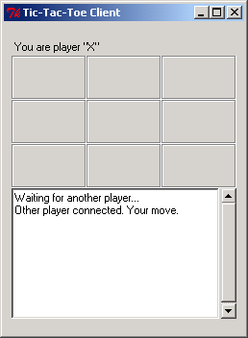
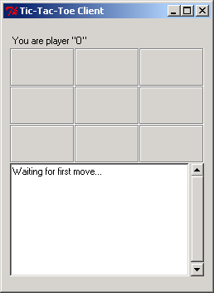
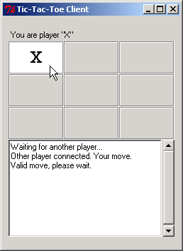
fig20_07.py
138 # send location to server
139 self.connection.send( name )
140 self.myTurn = 0
141
142 def main():
143 TicTacToeClient().mainloop()
144
145 if __name__ == "__main__":
146 main()
Send location of move to server

Slide 33
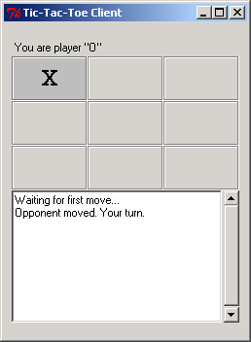
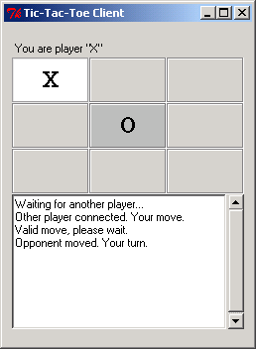
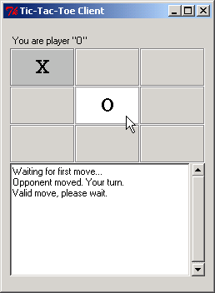
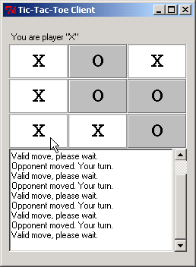
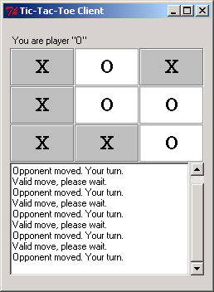
fig20_07.py

