Slide 1
Chapter 21 – Customizing Classes
Outline
21.1 Introduction
21.2 Ancient Ciphers to Modern Cryptosystems
21.3 Secret-Key Cryptography
21.4 Public-Key Cryptography
21.5 Cryptanalysis
21.6 Key-Agreement Protocols
21.7 Key Management
21.8 Digital Signatures
21.9 Public-Key Infrastructure, Certificates and Certificate Authorities
21.9.1 Smart Cards
21.10 Security Protocols
21.10.1 Secure Sockets Layer (SSL)
21.10.2 IPSec and Virtual Private Networks (VPN)
21.11 Authentication
21.11.1 Kerberos
21.11.2 Biometrics
21.11.3 Single Sign-On
21.11.4 Microsoft Passport

Slide 2
Chapter 21 – Customizing Classes
Outline
21.12 Security Attacks
21.12.1 Denial-of-Service (DoS) Attacks
21.12.2 Viruses and Worms
21.12.3 Software Exploitation, Web Defacing and Cybercrime
21.13 Running Restricted Python Code
21.13.1 Module rexec
21.13.2 Module Bastion
21.13.3 Restricted Web Browser
21.14 Network Security
21.14.1 Firewalls
21.14.2 Intrusion-Detection Systems
21.15 Steganography

Slide 3
21.1 Introduction
Modern computer security address problems and concerns of protecting electronic communications and maintaining network security
Four fundamentals requirements for a successful, secure transaction: privacy, integrity, authentication and nonrepudiation
Privacy issue: How do you ensure that information transmitted over the Internet has not been captured or passed on to a third party without your knowledge?

Slide 4
21.1 Introduction
Integrity issue: How do you ensure that information sent or received has not been compromised or altered?
Authentication issue: How do the sender and receiver of a message prove their identities to each other?
Nonrepudiation issue: How do you legally prove that a message was sent or received?

Slide 5
21.2 Ancient Ciphers to Modern Cryptosystems
Cryptography: transforms data using a cipher (or cryptosystem), which is a mathematical algorithm for encrypting messages
Key: alpha-numeric string input to a cipher
Substitution ciphers and transposition ciphers are the two main types of ciphers
Caesar Cipher: first prominent substitution cipher
Historical ciphers relied on restricted algorithms

Slide 6
21.2 Ancient Ciphers to Modern Cryptosystems
Modern cryptosystems are digital with algorithms based on individual bits or blocks rather than alphabet letters
Module rotor encrypts and decrypts messages
rotor: substitution cipher

Slide 7
fig21_01.py
1 # Fig. 21.01: fig21_01.py
2 # Demonstrating crypto system.
3
4 from Tkinter import *
5 import rotor
6 import string
7
8 class Crypto( Frame ):
9 """Demonstrate the cryptosystem"""
10
11 def __init__( self ):
12 """Create and grid several components into the frame"""
13
14 Frame.__init__( self )
15 self.grid( sticky = W+E+N+S )
16 self.master.title( "Python Encryption and Decryption" )
17 self.master.rowconfigure( 0, weight = 1 )
18 self.master.columnconfigure( 0, weight = 1 )
19
20 self.button1 = Button( self, text = "Encrypt",
21 width = 15, command = self.encrypt )
22
23 # specify position of Button component button1
24 self.button1.grid( row = 0, column = 1, sticky = W+E+N+S )
25
26 self.button2 = Button( self, text = "Decrypt",
27 width = 15, command = self.decrypt )
28 self.button2.grid( row = 0, column = 2, sticky = W+E+N+S )
29
30 self.text1 = Text( self, width = 30, height = 15 )
31
32 # text component spans three rows and all available space
33 self.text1.grid( row = 3, column = 1, columnspan = 2,
34 sticky = W+E+N+S )
35 self.text1.insert( INSERT, "Text" )
Create Encrypt button
Create Decrypt button
User enters message to encrypt in Text component

Slide 8
fig21_01.py
36
37 # makes second row/column expand
38 self.rowconfigure( 1, weight = 1 )
39 self.columnconfigure( 1, weight = 1 )
40
41 self.cipher = rotor.newrotor( "deitelkey", 12 )
42
43 def encrypt( self ):
44 """Encrypt a text"""
45
46 # get text from Text component
47 text = self.text1.get( 1.0, END )
48 text = string.strip( text )
49
50 # encrypt text
51 encryptedText = self.cipher.encrypt( text )
52 self.text1.delete( 1.0, END )
53
54 # display encrypted text
55 self.text1.insert( END, encryptedText )
56
57 def decrypt( self ):
58 """Decrypt a text"""
59
60 # get text from Text component
61 text = self.text1.get( 1.0, END )
62 text = string.strip( text )
63
64 # decrypt text
65 decryptedText = self.cipher.decrypt( text )
66 self.text1.delete( 1.0, END )
67
68 # display decrypted text
69 self.text1.insert( END, decryptedText )
70
Function newrotor accepts a key and a number of rotors
Use rotor object to encrypt message
Use rotor object to decrypt message

Slide 9
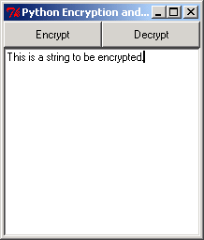
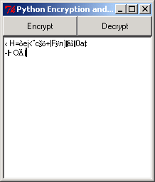
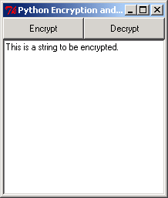
fig21_01.py
71 def main():
72 Crypto().mainloop()
73
74 if __name__ == "__main__":
75 main()

Slide 10
21.3 Secret-Key Cryptography
Also known as symmetric cryptography
Uses a single secret key to encrypt and decrypt as message
Users must have a way to securely communicate the key (e.g., key-distribution center (KDC))
Example: Data Encryption Standard (DES)

Slide 11
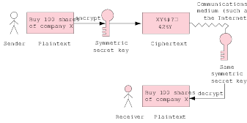
21.3 Secret-Key Cryptography
Fig. 21.2 Secret key used to encrypt and decrypt a message.

Slide 12
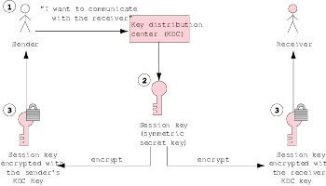
21.3 Secret-Key Cryptography
Fig. 21.3 Distributing a session key with a key-distribution center.

Slide 13
21.4 Public-Key Cryptography
Asymmetric
Uses two inversely related keys: public key and private key
Private key kept secret by owner while private key freely distributed
If public key encrypts message, only corresponding public key can decrypt it and vice versa
Public-key algorithm: computationally infeasible to calculate private key from public key

Slide 14
21.4 Public-Key Cryptography
Most commonly used public-key algorithm: RSA
Other example: Pretty Good Privacy (PGP)

Slide 15
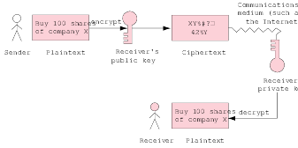
21.4 Public-Key Cryptography
Fig. 21.4 Encrypting and decrypting a message using public-key cryptography.

Slide 16
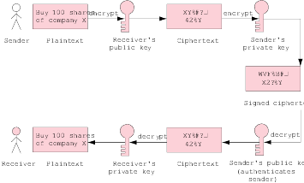
21.4 Public-Key Cryptography
Fig. 21.5 Authentication with a public-key algorithm.

Slide 17
21.5 Cryptanalysis
Cryptanalysis: trying to decipher ciphertext without knowledge of the decryption key
Commercial encryption systems constantly researched by cryptologists to ensure that systems are not vulnerable to cryptanalytic attack

Slide 18
21.6 Key-Agreement Protocols
Public-key algorithms allows two parties to agree on a key to be used for secret-key encryption
Key-agreement protocol: process by which two parties can exchange keys
Example of a key-agreement protocol: digital envelope

Slide 19
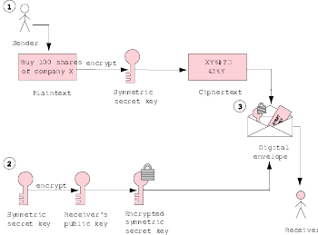
21.6 Key-Agreement Protocols
Fig. 21.6 Digital envelope creation.

Slide 20
21.7 Key Management
Maintaining secrecy of private keys crucial to keeping cryptographic systems secure
Key generation: process by which keys are created
Key-generation algorithms should be constructed to choose from a large enough subset of possible keys such that brute-force cracking is computationally infeasible

Slide 21
21.8 Digital Signatures
Digital signatures
  Electronic equivalent of written signatures
  Developed to be used in public-key cryptography to solve problems of authentication and integrity
  Authenticates sender’s identity and is difficult to forge
To create a digital signature run original plaintext message through a hash function, a mathematical calculation which produces a hash value for the message
Secure Hash Algorithm (SHA-1): current standard for hashing functions

Slide 22
21.8 Digital Signatures
Timestamping: binds a time and a date to a digital document and can help solve the problem of nonrepudiation
Digital Signature Algorithm (DSA): U.S. government’s digital-authentication standard

Slide 23
21.8 Digital Signatures
Python 2.2b2 (#26, Nov 16 2001, 11:44:11) [MSC 32 bit (Intel)] on win32
Type "help", "copyright", "credits" or "license" for more information.
>>> import sha
>>> m1 = sha.new( "Buy 100 shares of company X" )
>>> print m1.hexdigest()
d8a9b69f72650bd56d0c4700950dfd31960afdb5
>>> m2 = sha.new()
>>> m2.update( "Buy 100 shares " )
>>> print m2.hexdigest()
4269dec883d1a763250d701c881defd34171809a
>>> m2.update( "of company X" )
>>> print m2.hexdigest()
d8a9b69f72650bd56d0c4700950dfd31960afdb5
>>>
Fig. 21.7 SHA-1 hash in Python.

Slide 24
21.9 Public-Key Infrastructure, Certificates and Certificate Authorities
Public-Key Infrastructure (PKI): integrates public-key cryptography with digital certificates and certificate authorities to authenticate parties in a transaction
Digital certificate: digital document used to identify a user and issued by a certificate authority (CA), which is a trusted third party such as VeriSign
Issued digital certificates publicly available and held by CA in certificate repositories

Slide 25
21.9 Public-Key Infrastructure, Certificates and Certificate Authorities
Usually, each CA is part of a certificate authority hierarchy
  Hierarchy starts with the root certificate authority, the Internet Policy Registration Authority (IPRA) which signs certificates using the root key
  Root key signs certificates only for policy creation authorities
Cancelled and revoked certificates placed on certificate revocation list (CRL)

Slide 26
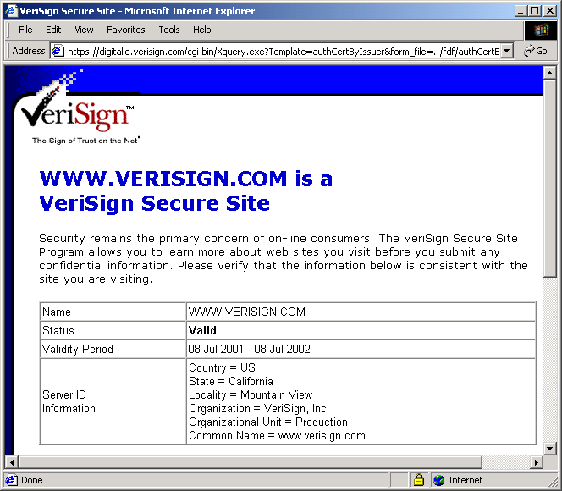
21.9 Public-Key Infrastructure, Certificates and Certificate Authorities

Slide 27
21.9.1 Smart Cards
Rapidly growing PKI application
Look like a credit card and serve many different functions, from authentication to data storage
Examples: memory cards and microprocessor cards
Have contact interfaces or contactless interfaces
Each used in combination with a personal identification number (PIN)

Slide 28
21.10 Security Protocols
Network security protocols establish secure connections for data transmission

Slide 29
21.10.1 Secure Sockets Layer (SSL)
Used by most e-businesses although SSL is designed to secure World Wide Web connections, rather than transactions
SSL protocol
  Nonproprietary protocol commonly used to secure communications between two computers on the Internet and the Web
  Built into many Web browsers, including Microsoft IE and Netscape Communicator
  Sockets secured by public-key cryptography in transactions using SSL
  Implements public-key cryptography using RSA and digital certificates

Slide 30
21.10.2 IPSec and Virtual Private Networks (VPN)
Organizations use the Internet’s infrastructure to create Virtual Private Networks (VPNs), linking multiple networks, wireless users and other remote users
VPN created by establishing a secure tunnel through which data passes between multiple networks over the Internet
IPSec: one of the technologies used to secure the tunnel thought which data passes, ensuring privacy and integrity

Slide 31
21.11 Authentication
Fundamental requirements for e-business and m-business security

Slide 32
21.11.1 Kerberos
Freely available, open-source protocol developed at MIT
Employs secret-key cryptography to authenticate users in a network and to maintain the integrity and privacy of network communications
Kerberos system handles authentication with a main system and a secondary Ticket-Granting Service (TGS)

Slide 33
21.11.2 Biometrics
Uses unique personal information (e.g., fingerprints, face scans) to identify a user
Eliminates need for easy-to-steal passwords
Biometric Application Programming Interface (BAPI) will be included in future versions of Windows
Two-factor authentication: uses two means to authenticate users (e.g. biometrics or smart card combined with a password)

Slide 34
21.11.3 Single Sign-On
Single sign-on systems allows user to logic once with a single password
Workstation logon scripts
  send user’s password to the application servers and user is authenticated for future access to those applications
  Do not provide security because user passwords stored on PC in plaintext
Authentication server scripts authenticates users with a central server which stores the passwords
Token-based authentication
  Nonreusable token issued to authenticated user
  Logon secured with single password or encryption

Slide 35
21.11.4 Microsoft® Passport
Incorporates authentication, online purchasing, single sign-on and several other technologies into one product that can be used over several different Internet sites
Passport users sign in only once and Passport provides authentication information to participating sites

Slide 36
21.12 Security Attacks
Security attacks, such as denial-of-service attacks (DoS), viruses and worms, have cost companies billions of dollars

Slide 37
21.12.1 Denial-of-Service (DoS) Attacks
Denial-of-service attacks causes a system to behave improperly
Typically, attack performed by flooding servers with data packets
In a distributed DoS attack, packet flooding comes from many separate computers

Slide 38
21.12.2 Viruses and Worms
Viruses: pieces of code that attach to or overwrite other programs to replicate themselves
Viruses can corrupt files or even wipe out a hard drive
Examples of viruses: transient, resident and logic bombs
Worm: similar to a virus, but does not need to be attached to another program to spread

Slide 39
21.12.3 Software Exploitation, Web Defacing and Cybercrime
Example of software exploitation: buffer overflow in which a program is overwhelmed by more data input than it has allocated space for
Web defacing: crackers illegally enter an organization’s Web site and change the contents
Cybercrime can have significant financial implications for organizations
Implementing security policy is key to protecting an organization’s data and network

Slide 40
21.13 Running Restricted Python Code
Downloaded code can misuse the local machine when executed
Running code in a restricted environment prevents damage
Restricted environment: virtual machine that provides access to only those resources that the program may need and prevents access to sensitive resources (e.g., hard drive, network)

Slide 41
21.13.1 Module rexec
Contains the Rexec class for executing Python code in a restricted environment
RExec objects support methods such as r_eval that execute code in a restricted environment
Code executing in this environment has limited access to standard module and built-in Python functions

Slide 42
21.13.2 Module Bastion
Restricts access to specific objects, rather than the entire environment
Bastion object controls access to the object which it wraps
Bastion must be executed in a restricted environment, such as RExec environment, to enhance a program’s security

Slide 43
21.13.3 Restricted Web Browser
Modified Web browser runs Python code in a restricted environment

Slide 44
fig21_09.py
1 # Fig. 21.9: fig21_09.py
2 # Displays the contents of a file on a Web server.
3
4 from Tkinter import *
5 import tkMessageBox
6 import Pmw
7 import urllib
8 import urlparse
9 import Bastion
10 import rexec
11
12 class WebBrowser( Frame ):
13 """A simple Web browser"""
14
15 def __init__( self ):
16 """Create the Web browser GUI"""
17
18 Frame.__init__( self )
19 Pmw.initialise()
20 self.pack( expand = YES, fill = BOTH )
21 self.master.title( "Simple Web Browser" )
22 self.master.geometry( "400x300" )
23
24 self.address = Entry( self )
25 self.address.pack( fill = X, padx = 5, pady = 5 )
26 self.address.bind( "<Return>", self.getPage )
27
28 self.contents = Pmw.ScrolledText( self,
29 text_state = DISABLED )
30 self.contents.pack( expand = YES, fill = BOTH, padx = 5,
31 pady = 5 )
32
Restricts access to objects
Contains RExec class for executing Python code in a secure environment

Slide 45
fig21_09.py
Create RExec object
33 # create restricted environment
34 self.restricted = rexec.RExec()
35 self.module = self.restricted.add_module( "__main__" )
36 self.environment = self.module.__dict__
37
38 # add browser to environment
39 self.environment[ "browser" ] = Bastion.Bastion( self )
40
41 def setColor( self, color ):
42 """Set browser’s background color"""
43
44 self.configure( background = color )
45
46 def _setColor( self, color ):
47 """Set browser’s background"""
48
49 self.configure( background = color )
50
51 def setText( self, text ):
52 """Set the text of the ScrolledText component"""
53
54 self.contents.settext( text )
55
56 def runCode( self, statement ):
57 """Run a Python statement in restricted environment"""
58
59 try:
60 self.restricted.r_exec( statement ) # execute in rexec
61 except AttributeError, name:
62 tkMessageBox.showerror( "Error",
63 "Restricted code tried to access forbidden " + \
64 "attribute:" + str( name ) )
65
66 def getPage( self, event ):
67 """Parse the URL and addressing scheme and retrieve file"""
Get environment’s __main__ module
__dict__ contains module-global bindings for the restricted environment
Adds browser to environment
Bastion object wraps Web browser component
Set foreground color of WebBrowser
Code may not access a Bastion-wrapped browser object’s _setColor method
Called when a request for a Python program is made
Execute code in restricted environment
Raise AttributeError if code tries to access forbidden attribute

Slide 46
fig21_09.py
68
69 # parse the URL
70 myURL = event.widget.get()
71 components = urlparse.urlparse( myURL )
72 self.contents.text_state = NORMAL
73
74 # if addressing scheme not specified, use http
75 if components[ 0 ] == "":
76 myURL = "http://" + myURL
77
78 # connect and retrieve the file
79 try:
80 tempFile = urllib.urlopen( myURL ).read()
81 except IOError:
82 self.contents.settext( "Error finding file" )
83 else:
84 tempFile = tempFile.replace( "\r\n", "\n" )
85
86 if myURL[ -3: ] == ".py":
87 self.runCode( tempFile )
88 else:
89 self.contents.settext( tempFile ) # show results
90
91 self.contents.text_state = DISABLED
92
93 def main():
94 WebBrowser().mainloop()
95
96 if __name__ == "__main__":
97 main()
Test requested page for .py extension

Slide 47
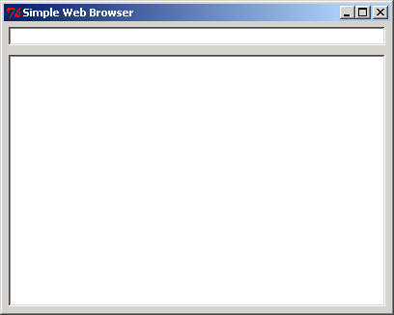
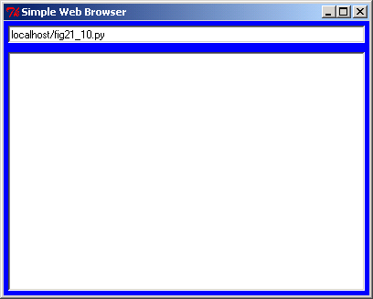
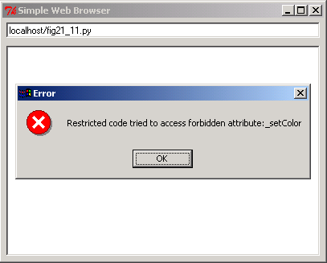
fig21_09.py

Slide 48
fig21_10.py
1 # Fig. 21.10: fig21_10.py
2 # Calls method setColor to set background color.
3
4 browser.setColor( "blue" )
Legal call to method setColor

Slide 49
fig21_11.py
1 # Fig. 21.11: fig21_11.py
2 # Method _setColor raises attribute error in restricted environment.
3
4 browser._setColor( "red" )
Call raises AttributeError exception in restricted environment

Slide 50
21.14 Network Security
Goal of network security is to allow authorized users access to information and services, while preventing unauthorized users from gaining access to the network
Trade-off between network security and network performance

Slide 51
21.14.1 Firewalls
Firewall protects a LAN from intruders outside the network
Each LAN can be connected to the Internet through a gateway, which usually includes a firewall
Two main types of firewalls: packet-filtering firewalls and application-level gateways
Air-gap technology is a network security solution which separates external and internal networks and complements the firewall

Slide 52
21.14.2 Intrusion-Detection Systems
Monitor networks and application log files to detect any intrusion and consequently halt the session and alert the system administrator
Host-based intrusion-detection systems monitor system and application log files
Network-based intrusion-detection software monitors network traffic for nay unusual patterns that may indicate DoS attacks or attempted entry by an unauthorized user

Slide 53
21.15 Steganography
Practice of hiding information within other information
Literally means “covered writing”
Increasingly popular application of steganography is digital watermarking for intellectual property protection

Slide 54
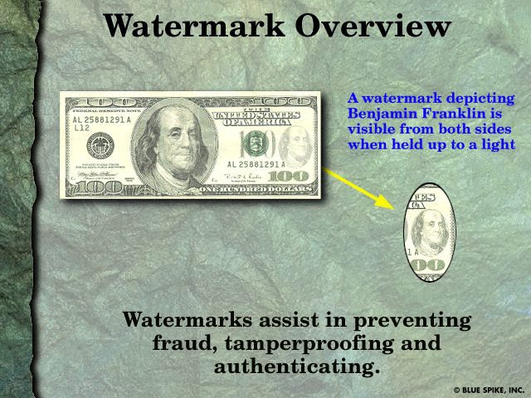
21.15 Steganography
Fig. 21.12 Conventional watermark example. (Courtesy of Blue Spike, Inc.)

Slide 55
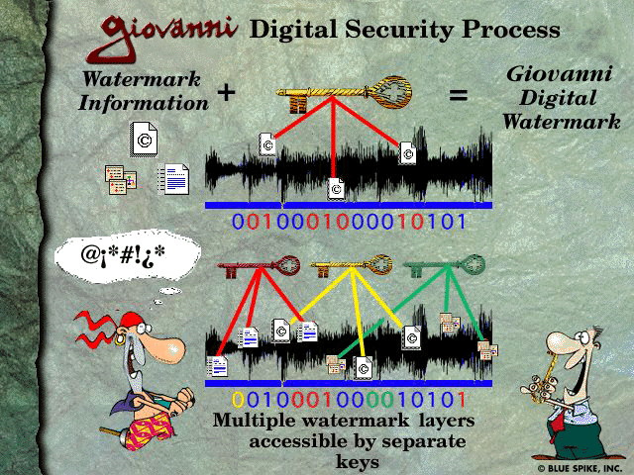
21.15 Steganography
Fig. 21.13 Steganography example: Blue Spike’s Giovanni digital watermarking process. (Courtesy of Blue Spike, Inc.)

