Slide 1
Chapter 23 – Case Study: Online Bookstore
Outline
23.1 Introduction
23.2 HTTP Sessions and Session-Tracking Technologies
23.3 Tracking Sessions in the Bookstore
23.4 Bookstore Architecture
23.5 Configuring the Bookstore
23.6 Entering the Bookstore
23.7 Obtaining the Book List from the Database
23.8 Viewing a Book’s Details
23.9 Adding an Item to the Shopping Cart
23.10 Viewing the Shopping Cart
23.11 Checking Out
23.12 Processing the Order
23.13 Error Handling
23.14 Handling Wireless Clients (XHTML Basic and WML)
23.14.1 Introduction to XHTML Basic
23.14.2 Introduction to WML
23.15 Internet and World Wide Web Resources

Slide 2
23.1 Introduction
We implement a bookstore Web application that integrates many technologies and serves as a capstone for our Python CGI presentation
Case study uses CGI, XML, XSL, XSLT, MySQL and the Python DB-API, XHTML and Cascading Style Sheets
Also illustrates Wireless Markup Language (WML) and XHTML Basic

Slide 3
23.2 HTTP Sessions and Session-Tracking Technologies
Web sites that provide custom Web pages and functionality tailored to clients can implement e-commerce applications
Session-tracking technology enables online bookstore case study’s server distinguishes one client from another to ensure proper shipping and payment

Slide 4
23.2 HTTP Sessions and Session-Tracking Technologies
Cookies
  Small text files sent by server (or Web site) as part of a response to a client request
  Web site can retrieve cookies, which contain user information, on subsequent visits
  Expiration depends on maximum age
  Not all browsers support cookies and some users disable cookies due to security and privacy concerns

Slide 5
23.2 HTTP Sessions and Session-Tracking Technologies
Embedding state information in each communication between client and server
  Used in bookstore case study
  First time a client connects to server, Web application assigns the user a unique sessionID which must be passed from page to page during the transaction

Slide 6
23.3 Tracking Sessions in the Bookstore
Class Session uses embedded state information to keep track of HTTP sessions
New Session object created when a user first enters the bookstore
Session data pickled and stored on the server

Slide 7
Session.py
1 # Fig. 23.1: Session.py
2 # Contains a Session class that keeps track of an http session
3 # by assigning a session ID and pickling session information.
4
5 import os
6 import sha
7 import cgi
8 import time
9 import urlparse
10 import urllib
11 import cPickle
12
13 def getClientType():
14 """Return client type and corresponding file extension"""
15
16 # search environment variables for identifying strings
17 if os.environ[ "HTTP_USER_AGENT" ].find( "MSIE" ) > -1 or \
18 os.environ[ "HTTP_USER_AGENT" ].find( "Netscape" ) > -1:
19
20 # MSIE and Netscape represent XHTML clients (.html)
21 return ( "xhtml", "html" )
22
23 elif os.environ[ "HTTP_ACCEPT" ].find(
24 "text/vnd.wap.wml" ) > -1:
25
26 # text/vnd.wap.wml represents WML clients (.wml)
27 return ( "wml", "wml" )
28
29 else:
30
31 # otherwise, assume XHTML Basic client (.html)
32 return ( "xhtml_basic", "html" )
33
34 def getContentType():
35 """Return the contents of the client’s contentType.txt file"""
Module sha used to generate a unique session ID
Return client type and corresponding file extension
Opens contentType.txt file in client type’s subdirectory and returns file contents

Slide 8
Session.py
36
37 # obtain contentType.txt located in client’s subfolder
38 try:
39 file = open( getClientType()[ 0 ] + "/contentType.txt" )
40 except:
41 raise SessionError( "Missing file: contentType.txt" )
42
43 contentType = file.read()
44 file.close()
45 return contentType
46
47 def redirect( URL ):
48 """Redirect the client to a relative URL"""
49
50 # use urljoin to append full path to relative URL
51 print "Location: %s\n" % \
52 urlparse.urljoin( "http://" + os.environ[ "HTTP_HOST" ] +
53 os.environ[ "REQUEST_URI" ], URL )
54
55 class SessionError( Exception ):
56 """User-defined exception for Session class"""
57
58 def __init__( self, error ):
59 """Set error message"""
60
61 # use quote_plus to replace spaces with ’+’
62 self.error = urllib.quote_plus( error )
63
64 def __str__( self ):
65 """Return error message"""
66
67 return self.error
68
69 class IDError( Exception ):
70 """User-defined exception for Session class"""
Redirect client to specified relative URL
User-defined Session class exception
User-defined exception class for ID errors

Slide 9
Session.py
71
72 pass
73
74 class Session:
75 """Session class keeps track of an HTTP session"""
76
77 def __init__( self, createNew = 0 ):
78 """Create a new session or load an existing session"""
79
80 # create new session
81 if createNew:
82 self.sessionID = self.generateID()
83 self.fileName = os.getcwd() + "/sessions/." + \
84 self.sessionID
85
86 # newly generated ID already exists
87 if self.sessionExists():
88 raise IDError
89
90 self.data = {} # dictionary is empty
91
92 # store ID, empty cart, content type and agent type
93 self.data[ "ID" ] = self.sessionID
94 self.data[ "cart" ] = {}
95 self.data[ "content type" ] = getContentType()
96 self.data[ "agent" ], self.data[ "extension" ] = \
97 getClientType()
98
99 # attempt to load previously created session
100 else:
101
102 # session ID is passed in query string
103 queryString = cgi.parse_qs( os.environ[ "QUERY_STRING" ] )
104
Default value of 0 indicates new session
Generate new session ID
Session filename, stored in subdirectory sessions, is a period followed by ID
Raise user-defined IDError exception if newly generated ID already exists
Dictionary stores session information
Store session ID
Store empty shopping cart
Store results of function getContentType
Store client type and corresponding file extension
Attempt to load previously created session

Slide 10
Session.py
105 # no ID has been supplied in query string
106 if not queryString.has_key( "ID" ):
107 raise SessionError( "No ID given" )
108
109 self.sessionID = queryString[ "ID" ][ 0 ]
110 self.fileName = os.getcwd() + "/sessions/." + \
111 self.sessionID
112
113 # supplied ID is invalid
114 if not self.sessionExists():
115 raise SessionError( "Nonexistent ID given" )
116
117 # load pickled session dictionary
118 self.loadSession()
119
120 def sessionExists( self ):
121 """Determine if the specified session file exists"""
122
123 return os.path.exists( self.fileName )
124
125 def loadSession( self ):
126 """Unpickle dictionary of existing session"""
127
128 if self.sessionExists():
129 sessionFile = open( self.fileName )
130 data = cPickle.load( sessionFile )
131 sessionFile.close()
132 self.data = data
133
134 def saveSession( self ):
135 """Pickle session dictionary to session file"""
136
137 sessionFile = open( self.fileName, "w" )
138 cPickle.dump( self.data, sessionFile )
139 sessionFile.close()
Determine if specified session file exists
Unpickle dictionary of existing session
Pickle session dictionary to session file

Slide 11
Session.py
140
141 def deleteSession( self ):
142 """Delete session file"""
143
144 os.remove( self.fileName )
145
146 def generateID( self ):
147 """Use sha to generate a unique ID"""
148
149 # generate ID using time, client address and port
150 randomString = str( time.time() ) + \
151 os.environ[ "REMOTE_ADDR" ] + os.environ[ "REMOTE_PORT" ]
152 ID = sha.new( randomString )
153 return ID.hexdigest()
Uses module sha to generate unique ID
Constructs string to pass to sha.new from time, client address and port

Slide 12
contentType.txt
1 Content-type: text/html
2
Example of browser-specific HTTP header

Slide 13
23.4 Bookstore Architecture
Case study implemented as a distributed, three-tier, Web-based application
User’s Web browser, which displays static or dynamic documents that enable user-server interaction, represents client (top) tier
Server (middle) tier consists of several scripts that act on client’s behalf (e.g., creating list of publications, adding items to the shopping cart)
Information (data or bottom) tier maintains application data (i.e. Books database)

Slide 14
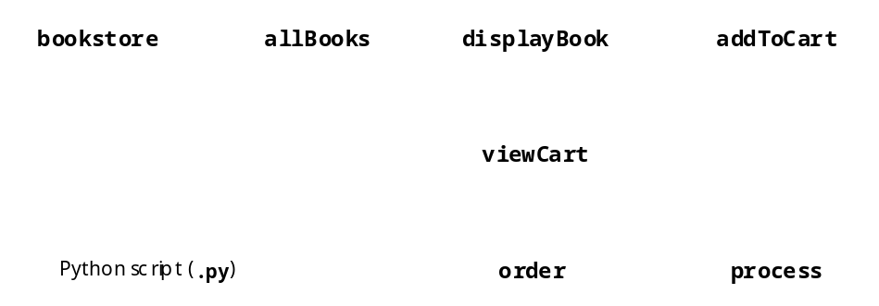
23.4 Bookstore Architecture
Fig. 23.3 Bookstore component interactions.

Slide 15
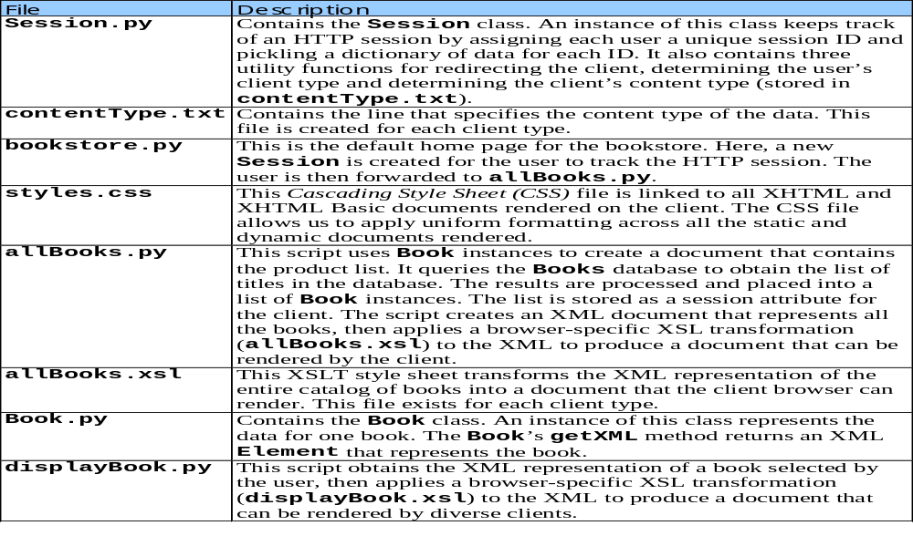
23.4 Bookstore Architecture
Fig. 23.4 (Part 1 of 2) Components for bookstore case study.

Slide 16
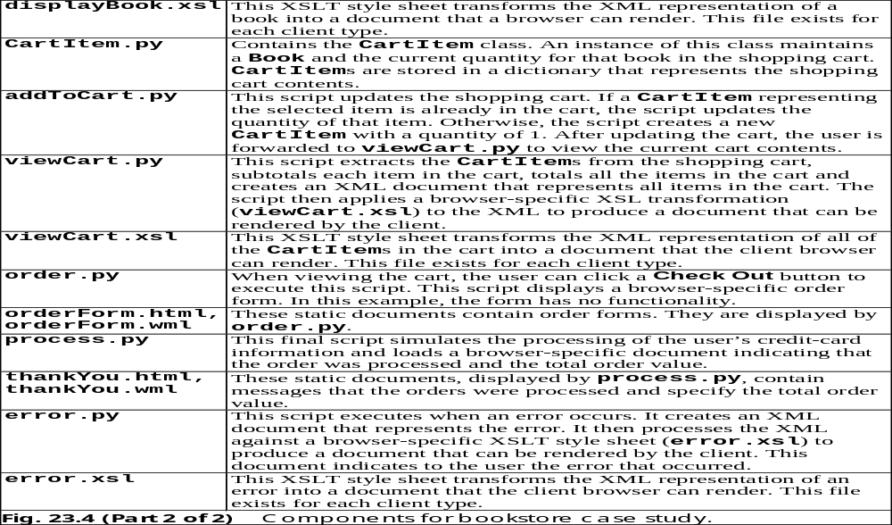
23.4 Bookstore Architecture

Slide 17
23.5 Configuring the Bookstore
Requires 4Suite, PyXML, MySQL and the Books database

Slide 18
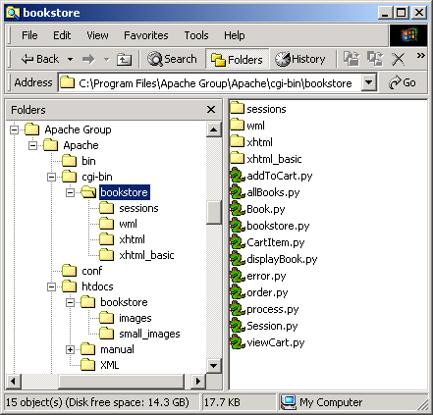
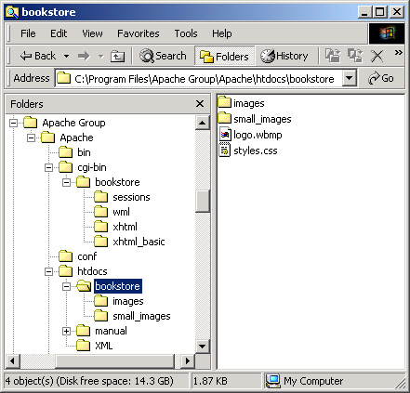
23.5 Configuring the Bookstore
Fig. 23.5 Apache directory structure for online bookstore.

Slide 19
23.6 Entering the Bookstore
bookstore.py is the bookstore’s default homepage, or welcome page

Slide 20
bookstore.py
1 #!c:\Python\python.exe
2 # Fig. 23.6: bookstore.py
3 # Create a new Session for client.
4
5 import sys
6 import time
7 import Session
8
9 session = None # Session not yet created
10
11 # attempt to create Session three times
12 for i in range( 3 ):
13
14 # create new Session
15 try:
16 session = Session.Session( 1 )
17
18 # ID already exists
19 except Session.IDError:
20 time.sleep( 0.1 ) # wait 0.1 seconds -- try again
21
22 # missing content type
23 except Session.SessionError, message:
24 Session.redirect( "error.py?message=%s" % message )
25 sys.exit()
26
27 else:
28 break # Session created successfully
29
30 # if successful, save Session and re-direct to allBooks.py
31 if session:
32 nextPage = "allBooks.py?ID=%s" % session.data[ "ID" ]
33 session.saveSession()
34 Session.redirect( nextPage )
Indicates Session not yet created
Attempt to create Session three times
Create new Session object
Handle Session.IDError exception
Wait 0.1 seconds before trying again to create Session
Direct user to error.py if Session.SessionError exception raised
Construct URL and append session ID
Save Session
Redirect user to allBooks.py

Slide 21
bookstore.py
35 else:
36 Session.redirect( "error.py?message=Unable+to+create+Session" )

Slide 22
23.7 Obtaining the Book List from the Database
Python script allBooks.py creates a document that contains the list of available books
Book object represents a single book’s information and defines XML format of that information

Slide 23
Book.py
1 # Fig. 23.7: Book.py
2 # Represents one book.
3
4 class Book:
5 """A Book instance contains the data for one book"""
6
7 def __init__( self ):
8 """Initialize Book data"""
9
10 self.isbn = None
11 self.title = None
12 self.price = None
13 self.imageFile = None
14 self.copyright = None
15 self.publisherID = None
16 self.editionNumber = None
17
18 def getXML( self, document ):
19 """Return an XML representation of the product"""
20
21 # create dictionary of Book information
22 data = { "isbn" : self.isbn,
23 "title" : self.title,
24 "price" : self.price,
25 "imageFile" : self.imageFile,
26 "copyright" : self.copyright,
27 "publisherID" : self.publisherID,
28 "editionNumber" : self.editionNumber }
29
30 # create product node
31 product = document.createElement( "product" )
32
Book object contains data for one book
Represents properties such as ISBN, title, edition number, etc.
Return an XML Element that represents the book
product element contains complete book information

Slide 24
Book.py
33 # add element for each Book attribute
34 for key in data.keys():
35
36 # create element, append as child of product
37 temp = document.createElement( key )
38 temp.appendChild( document.createTextNode(
39 str( data[ key ] ) ) )
40 product.appendChild( temp )
41
42 return product
Create element for each Book attribute
Specify text in the Element node
Append child node to product node

Slide 25
Fig. 23.8 product element
1 <product>
2 <isbn>0130895601</isbn>
3 <title>Advanced Java 2 Platform How to Program</title>
4 <price>69.95</price>
5 <imageFile>advjhtp1.jpg</imageFile>
6 <copyright>2002</copyright>
7 <publisherID>1</publisherID>
8 <editionNumber>1</editionNumber>
9 </product>

Slide 26
allBooks.py
1 #!c:\Python\python.exe
2 # Fig. 23.9: allBooks.py
3 # Retrieve all books from database and store in session.
4 # Display book list to client by retrieving XML and converting
5 # to required format using browser-specific XSLT stylesheet.
6
7 import sys
8 import Book
9 import urllib
10 import Session
11 import MySQLdb
12 from xml.xslt import Processor
13 from xml.dom.DOMImplementation import implementation
14
15 # load Session
16 try:
17 session = Session.Session()
18 except Session.SessionError, message: # invalid/no session ID
19 Session.redirect( "error.py?message=%s" % message )
20 sys.exit()
21
22 # setup mySQL statement
23 query = """SELECT ISBN, Title, EditionNumber,
24 Copyright, PublisherID, ImageFile, Price
25 FROM Titles ORDER BY Title"""
26
27 # attempt database connection and retrieve list of Books
28 try:
29
30 # connect to the database, retrieve a cursor and execute query
31 connection = MySQLdb.connect( db = "Books" )
32 cursor = connection.cursor()
33 cursor.execute( query )
34
Load the session
Invalid or no ID generates an error
Prepare MySQL statement to query Books database
Connect to database
Retrieve cursor
Execute query on database to retrieve book list

Slide 27
allBooks.py
35 # acquire results and close database connection
36 results = cursor.fetchall()
37 cursor.close()
38 connection.close()
39
40 # error occurred, redirect to error page
41 except MySQLdb.OperationalError, message:
42
43 # replace spaces with ’+’ for URL compatibility
44 message = urllib.quote_plus( str( message ) )
45 Session.redirect( "error.py?message=%s" % message )
46 sys.exit()
47
48 allBooks = []
49
50 # get row data
51 for row in results:
52
53 # create new Book and set attributes
54 book = Book.Book()
55 book.isbn = row[ 0 ]
56 book.title = row[ 1 ]
57 book.editionNumber = row[ 2 ]
58 book.copyright = row[ 3 ]
59 book.publisherID = row[ 4 ]
60 book.imageFile = row[ 5 ]
61 book.price = row[ 6 ]
62
63 allBooks.append( book ) # one more Book created
64
65 session.data[ "titles" ] = allBooks
66
Exception results in error.py displaying an error message
Create Book object for each book in the database
Append each Book object to allBooks list
Store list of Book objects in Session dictionary

Slide 28
allBooks.py
Create empty DOM Document
67 # generate XML
68 document = implementation.createDocument( None, None, None )
69 catalog = document.createElement( "catalog" )
70 document.appendChild( catalog )
71
72 # add all products to catalog
73 for book in allBooks:
74 catalog.appendChild( book.getXML( document ) )
75
76 # process XML against XSLT stylesheet
77 processor = Processor.Processor()
78 style = open( session.data[ "agent" ] + "/allBooks.xsl" )
79 processor.appendStylesheetString( style.read() % \
80 session.data[ "ID" ] )
81 results = processor.runNode( document )
82 style.close()
83
84 # save Session data and display processed XML
85 pageData = session.data[ "content type" ] + results
86 session.saveSession()
87 print pageData
Create empty catalog element
Append catalog element to Document object
Append each product element to catalog
Create Processor object
Open allBooks.xsl in client’s subdirectory
Specify stylesheet(s) that the Processor object can use
Apply stylesheet
Save Session data
Display processed XML

Slide 29
allBooks.xsl
1 <?xml version = "1.0"?>
2
3 <!-- Fig. 23.10: allBooks.xsl -->
4 <!-- XSLT style sheet that transforms XML generated by -->
5 <!-- books.py into XHTML. -->
6
7 <xsl:stylesheet version = "1.0"
8 xmlns:xsl = "http://www.w3.org/1999/XSL/Transform">
9
10 <xsl:output method = "xml" omit-xml-declaration = "no"
11 indent = "yes" doctype-system = "DTD/xhtml1-strict.dtd"
12 doctype-public = "-//W3C//DTD XHTML 1.0 Strict//EN"/>
13
14 <!-- template for catalog element -->
15 <xsl:template match = "catalog">
16
17 <html xmlns = "http://www.w3.org/1999/xhtml">
18
19 <head>
20 <title>Book List</title>
21 <link rel = "stylesheet" href = "/bookstore/styles.css"
22 type = "text/css" />
23 </head>
24
25 <body>
26
27 <p class = "bigFont">Available Books</p>
28 <p class = "bold">
29 Click a link to view book information</p>
30
31 <!-- match product elements to product template -->
32 <xsl:apply-templates select = "/catalog/product">
33
34 <!-- sort products by title -->
35 <xsl:sort select = "title" />
Transforms XML generated by books.py into XHTML
Define template for catalog elements
Specify linked style sheet styles.css
Match product elements to product template
Sort product elements by title

Slide 30
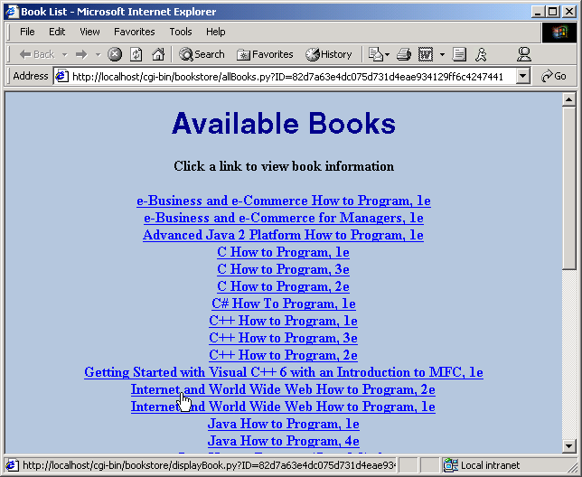
allBooks.xsl
36
37 </xsl:apply-templates>
38
39 </body>
40
41 </html>
42
43 </xsl:template>
44
45 <!-- template for building row of product information -->
46 <xsl:template match = "product">
47
48 <a href = "displayBook.py?ID=%s&amp;isbn={isbn}">
49 <strong><xsl:value-of select = "title" />, <xsl:value-of
50 select = "editionNumber" />e</strong>
51 </a><br />
52
53 </xsl:template>
54
55 </xsl:stylesheet>
Define xsl:template for product elements
Specify anchor tag with attribute href
References displayBook.py with query string

Slide 31
styles.css
1 body { text-align: center;
2 background-color: #boc4de }
3 .bold { font-weight: bold }
4 .bigFont { font-family: helvetica, arial, sans-serif;
5 font-weight: bold;
6 font-size: 2em;
7 color: #00008b }
8 .italic { font-style: italic }
9 .right { text-align: right }
10 table, th, td { border: 3px groove;
11 padding: 5px }
12 table { background-color: #6495ed;
13 margin-left: auto;
14 margin-right: auto }
Center text in body element
Set background color to steel blue
Apply bold font weight to text
Define class .bigFont with four CSS attributes
Applying .bigFont usually creates bold, Helvetica, dark blue, double sized font
Applies italic font
Right justifies text
All table elements have blue background color and predefined margins

Slide 32
23.8 Viewing a Book’s Details
Selecting a book in allBooks.py forward the user to displayBook.py
displayBook.py extracts ISBN from query string and determines which book the user selected
Program then obtains XML representation of the book and processes that representation against a browser-specific XSLT stylesheet (displayBook.xsl)
Processed XML sent to user

Slide 33
displayBook.py
1 #!c:\Python\python.exe
2 # Fig. 23.12: displayBook.py
3 # Retrieve one book’s XML representation, convert
4 # to required format using browser-specific XSLT
5 # stylesheet and display results.
6
7 import cgi
8 import sys
9 import Session
10 from xml.xslt import Processor
11 from xml.dom.DOMImplementation import implementation
12
13 form = cgi.FieldStorage()
14
15 # ISBN has not been specified
16 if not form.has_key( "isbn" ):
17 Session.redirect( "error.py?message=No+ISBN+given" )
18 sys.exit()
19
20 # load Session
21 try:
22 session = Session.Session()
23 except Session.SessionError, message: # invalid/no session ID
24 Session.redirect( "error.py?message=%s" % message )
25 sys.exit()
26
27 titles = session.data[ "titles" ] # get titles
28 session.data[ "bookToAdd" ] = None # book has not been found
29
30 # locate Book object for selected book
31 for book in titles:
32
33 if form[ "isbn" ].value == book.isbn:
34 session.data[ "bookToAdd" ] = book
35 break
Error generated if ISBN not specified in query string
Load session
Obtain list of Book objects
Indicates specified ISBN not found yet
Locate Book object for selected book

Slide 34
displayBook.py
Determine whether matching book exists
36
37 # book has been found
38 if session.data[ "bookToAdd" ] is not None:
39
40 # get XML from selected book
41 document = implementation.createDocument( None, None, None )
42 document.appendChild( session.data[ "bookToAdd" ].getXML(
43 document ) )
44
45 # process XML against XSLT style sheet
46 processor = Processor.Processor()
47 style = open( session.data[ "agent" ] + "/displayBook.xsl" )
48 processor.appendStylesheetString( style.read() % \
49 ( session.data[ "ID" ], session.data[ "ID" ] ) )
50 results = processor.runNode( document )
51 style.close()
52
53 # save Session data and display processed XML
54 pageData = session.data[ "content type" ] + results
55 session.saveSession()
56 print pageData
57 else:
58
59 # invalid ISBN has been specified
60 Session.redirect( "error.py?message=Nonexistent+ISBN" )
Create new XML Document
Process XML against XSLT style sheet displayBook.xsl
Save Session
Display processed XML

Slide 35
displayBook.xsl
1 <?xml version = "1.0"?>
2
3 <!-- Fig. 23.13: displayBook.xsl -->
4 <!-- XSLT style sheet that transforms XML generated by -->
5 <!-- displayBook.py into XHTML. -->
6
7 <xsl:stylesheet version = "1.0"
8 xmlns:xsl = "http://www.w3.org/1999/XSL/Transform">
9
10 <xsl:output method = "xml" omit-xml-declaration = "no"
11 indent = "yes" doctype-system = "DTD/xhtml1-strict.dtd"
12 doctype-public = "-//W3C//DTD XHTML 1.0 Strict//EN"/>
13
14 <!-- specify the root of the XML document -->
15 <!-- that references this style sheet -->
16 <xsl:template match = "product">
17
18 <html xmlns = "http://www.w3.org/1999/xhtml">
19
20 <head>
21
22 <!-- obtain book title from script to place in title -->
23 <title><xsl:value-of select = "title" /></title>
24
25 <link rel = "stylesheet" href = "/bookstore/styles.css"
26 type = "text/css" />
27 </head>
28
29 <body>
30
31 <p class = "bigFont"><xsl:value-of select = "title" /></p>
32
33 <table>
34 <tr>
35
Place book’s title in title element
Place book’s title in first paragraph of the body element

Slide 36
displayBook.xsl
Specify title for img element’s alt attribute
36 <!-- create table cell for product image -->
37 <td rowspan = "5"> <!-- cell spans 5 rows -->
38 <img src = "/bookstore/images/{imageFile}"
39 alt = "{title}" />
40 </td>
41
42 <!-- create table cells for price in row 1 -->
43 <td class = "bold">Price:</td>
44
45 <td><xsl:value-of select = "price" /></td>
46 </tr>
47
48 <tr>
49
50 <!-- create table cells for ISBN in row 2 -->
51 <td class = "bold">ISBN #:</td>
52
53 <td><xsl:value-of select = "isbn" /></td>
54 </tr>
55
56 <tr>
57
58 <!-- create table cells for edition in row 3 -->
59 <td class = "bold">Edition:</td>
60
61 <td><xsl:value-of select = "editionNumber" /></td>
62 </tr>
63
64 <tr>
65
66 <!-- create table cells for copyright in row 4 -->
67 <td class = "bold">Copyright:</td>
68
69 <td><xsl:value-of select = "copyright" /></td>
70 </tr>
Create table cells for price in first row
Create table cells for ISBN in second row
Create table cells for edition in third row
Create table cells for copyright in fourth row

Slide 37
displayBook.xsl
71
72 <tr>
73
74 <!-- create Add to Cart button in row 5 -->
75 <td>
76 <form method = "post"
77 action = "addToCart.py?ID=%s">
78 <p><input type = "submit"
79 value = "Add to Cart" /></p>
80 </form>
81 </td>
82
83 <!-- create View Cart button in row 5 -->
84 <td>
85 <form method = "post"
86 action = "viewCart.py?ID=%s">
87 <p><input type = "submit"
88 value = "View Cart" /></p>
89 </form>
90 </td>
91 </tr>
92 </table>
93
94 </body>
95
96 </html>
97
98 </xsl:template>
99
100 </xsl:stylesheet>
Create Add to Cart button
Use post form method to pass session ID to target file
Create View Cart

Slide 38
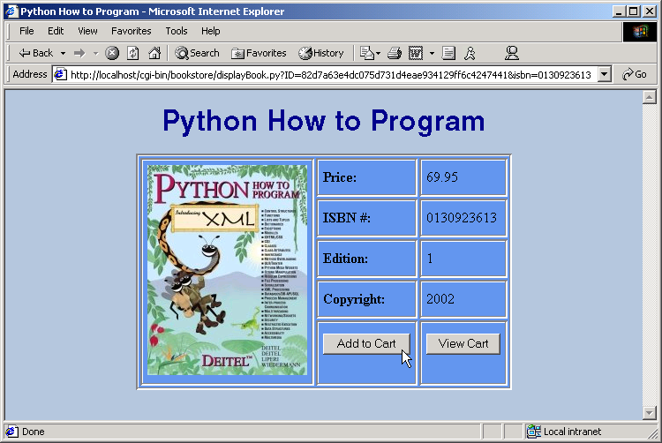

Slide 39
23.9 Adding an Item to the Shopping Cart
When user press Add to Cart button, addToCart.py updates the shopping cart
CartItem object stores a Book object and the quantity of that Book in the cart

Slide 40
CartItem.py
1 # Fig. 23.14: CartItem.py
2 # Maintains an item and a quantity.
3
4 class CartItem:
5 """Class that maintains an item and its quantity"""
6
7 def __init__( self, itemToAdd, number ):
8 """Initialize a CartItem"""
9
10 self.item = itemToAdd
11 self.quantity = number
Represents a shopping cart item
Reference to the shopping cart item (e.g., Book object)
Quantity of the particular object in the shopping cart

Slide 41
addToCart.py
1 #!c:\Python\python.exe
2 # Fig. 23.15: addToCart.py
3 # Create new/update CartItem for selected Book object
4
5 import sys
6 import Session
7 import CartItem
8
9 # load Session
10 try:
11 session = Session.Session()
12 except Session.SessionError, message: # invalid/no session ID
13 Session.redirect( "error.py?message=%s" % message )
14 sys.exit()
15
16 book = session.data[ "bookToAdd" ]
17 cart = session.data[ "cart" ]
18
19 # if book is already in cart, update quantity
20 if book.isbn in cart.keys():
21 cartItem = cart[ book.isbn ]
22 cartItem.quantity += 1
23
24 # otherwise, create and add a new CartItem to cart
25 else:
26 cart[ book.isbn ] = CartItem.CartItem( book, 1 )
27
28 # update cart attribute
29 session.data[ "cart" ] = cart
30
31 # save Session data and send user to viewCart.py
32 nextPage = "viewCart.py?ID=%s" % session.data[ "ID" ]
33 session.saveSession()
34 Session.redirect( nextPage )
Load Session
Obtain Book to add to shopping cart
Obtain dictionary representing shopping cart
Determine whether book is already in shopping cart
Update quantity if book already present
Create and add new CartItem object
Update Session’s cart dictionary entry
Save Session
Direct user to viewCart.py

Slide 42
23.10 Viewing the Shopping Cart
Program viewCart.py extracts the CartItems from the shopping cart and creates a document that allows the client to view the cart in tabular format

Slide 43
viewCart.py
1 #!c:\Python\python.exe
2 # Fig. 23.16: viewCart.py
3 # Generate XML representing cart, convert
4 # to required format using browser-specific XSLT
5 # style sheet and display results.
6
7 import sys
8 import Session
9 from xml.xslt import Processor
10 from xml.dom.DOMImplementation import implementation
11
12 # load Session
13 try:
14 session = Session.Session()
15 except Session.SessionError, message: # invalid/no session ID
16 Session.redirect( "error.py?message=%s" % message )
17 sys.exit()
18
19 cart = session.data[ "cart" ]
20 total = 0 # total for all ordered items
21
22 # generate XML representing cart object
23 document = implementation.createDocument( None, None, None )
24 cartNode = document.createElement( "cart" )
25 document.appendChild( cartNode )
26
27 # add XML representation for each cart item
28 for cartItem in cart.values():
29
30 # get book data, calculate subtotal and total
31 book = cartItem.item
32 quantity = cartItem.quantity
33 price = book.price
34 subtotal = quantity * price
35 total += subtotal
Load Session
Retrieve Session cart dictionary
Keep total of all ordered items
Create cart element
Get Book data
Calculate subtotal
Calculate total

Slide 44
viewCart.py
Create orderProduct element
36
37 # create an orderProduct element
38 orderProduct = document.createElement( "orderProduct" )
39
40 # create a product element and append to orderProduct
41 productNode = book.getXML( document )
42 orderProduct.appendChild( productNode )
43
44 # create a quantity element and append to orderProduct
45 quantityNode = document.createElement( "quantity" )
46 quantityNode.appendChild( document.createTextNode( "%d" %
47 quantity ) )
48 orderProduct.appendChild( quantityNode )
49
50 # create a subtotal element and append to orderProduct
51 subtotalNode = document.createElement( "subtotal" )
52 subtotalNode.appendChild( document.createTextNode( "%.2f" %
53 subtotal ) )
54 orderProduct.appendChild( subtotalNode )
55
56 # append orderProduct to cartNode
57 cartNode.appendChild( orderProduct )
58
59 # set the total attribute of cart element
60 cartNode.setAttribute( "total", "%.2f" % total )
61
62 # make current total a session attribute
63 session.data[ "total" ] = total
64
65 # process generated XML against XSLT style sheet
66 processor = Processor.Processor()
67 style = open( session.data[ "agent" ] + "/viewCart.xsl" )
68 processor.appendStylesheetString( style.read() % \
69 ( session.data[ "ID" ], session.data[ "ID" ] ) )
70 results = processor.runNode( document )
Create quantity element and append to orderProduct element
Create subtotal element and append to orderProduct element
Set total attribute of cart element
Make current total a Session attribute
Process generated XML against XSLT style sheet viewCart.xsl

Slide 45
viewCart.py
71 style.close()
72
73 # save Session data and display processed XML
74 pageData = session.data[ "content type" ] + results
75 session.saveSession()
76 print pageData
Save Session data
Display processed XML

Slide 46
viewCart.xsl
1 <?xml version = "1.0"?>
2
3 <!-- Fig. 23.17: viewCart.xsl -->
4 <!-- XSLT style sheet that transforms XML generated by -->
5 <!-- viewCart.py into XHTML. -->
6
7 <xsl:stylesheet version = "1.0"
8 xmlns:xsl = "http://www.w3.org/1999/XSL/Transform">
9
10 <xsl:output method = "xml" omit-xml-declaration = "no"
11 indent = "yes" doctype-system = "DTD/xhtml1-strict.dtd"
12 doctype-public = "-//W3C//DTD XHTML 1.0 Strict//EN"/>
13
14 <xsl:template match = "cart">
15
16 <html xmlns = "http://www.w3.org/1999/xhtml">
17
18 <head>
19 <title>Your Online Shopping Cart</title>
20 <link rel = "stylesheet" href = "/bookstore/styles.css"
21 type = "text/css" />
22 </head>
23
24 <body>
25
26 <p class = "bigFont">Shopping Cart</p>
27
28 <xsl:choose>
29 <xsl:when test = "@total = '0.00'">
30 <p class = "bold">
31 Your shopping cart is currently empty.</p>
32 </xsl:when>
33
XSLT style sheet transforms XML generated by viewCart.py into XHTML
xsl:template matches cart elements
Display message indicating cart is empty

Slide 47
viewCart.xsl
Create table for cart items
34 <xsl:otherwise> <!-- total != 0.00 -->
35 <table class = "cart">
36 <tr>
37 <th>Product</th>
38 <th>Quantity</th>
39 <th>Price</th>
40 <th>Total</th>
41 </tr>
42
43 <xsl:apply-templates select = "orderProduct">
44
45 <!-- sort orderProducts by product/title -->
46 <xsl:sort select = "product/title" />
47
48 </xsl:apply-templates>
49
50 <tr>
51 <td colspan = "4" class = "bold right">
52 Total: <xsl:value-of select = "@total" />
53 </td>
54 </tr>
55 </table>
56
57 </xsl:otherwise>
58 </xsl:choose>
59
60 <p class = "bold green">
61 <a href = "allBooks.py?ID=%s">Continue Shopping</a>
62 </p>
63
64 <form method = "post" action = "order.py?ID=%s">
65 <p><input type = "submit" value = "Check Out" /></p>
66 </form>
67
Insert all matches sorted by their product/title elements
Display total
Link to allBooks.py for further shopping
Check Out button that directs user to order.py

Slide 48
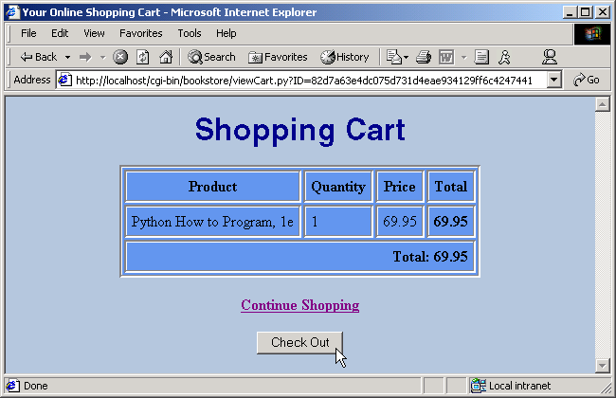
viewCart.xsl
68 </body>
69
70 </html>
71
72 </xsl:template>
73
74 <xsl:template match = "orderProduct">
75
76 <tr>
77 <td><xsl:value-of select = "product/title" />,
78 <xsl:value-of select = "product/editionNumber" />e</td>
79 <td><xsl:value-of select = "quantity" /></td>
80 <td class = "right"><xsl:value-of select =
81 "product/price" /></td>
82 <td class = "bold right"><xsl:value-of select =
83 "subtotal" /></td>
84 </tr>
85
86 </xsl:template>
87
88 </xsl:stylesheet>
Describes how to transform orderProduct elements
Insert information into table cells

Slide 49
23.11 Checking Out
Clicking Check Out button redirects user to order.py
order.py retrieves static page, orderForm, which varies with each client type and resides in a subdirectory named after the client type
Form orderForm requests users to enter names, addresses, phone number and credit-card information
After submitting form, client redirected to process.py to finalize the book order

Slide 50
order.py
1 #!c:\Python\python.exe
2 # Fig. 23.18: order.py
3 # Display order form to get information from customer
4
5 import sys
6 import Session
7
8 # load Session
9 try:
10 session = Session.Session()
11 except Session.SessionError, message: # invalid/no session ID
12 Session.redirect( "error.py?message=%s" % message )
13 sys.exit()
14
15 # display content type and orderForm for specific client-type
16 content = open( "%s/orderForm.%s" % ( session.data[ "agent" ],
17 session.data[ "extension" ] ) )
18 pageData = session.data[ "content type" ] + content.read() % \
19 session.data[ "ID" ]
20 content.close()
21
22 # save Session data and display order form
23 session.saveSession()
24 print pageData
Load Session
Error redirects user to error.py
Open browser-specific order form
Create string that contains client’s content type header and orderForm’s contents
Save Session data
Display order form

Slide 51
orderForm.html
1 <!-- Fig. 23.19: orderForm.html -->
2 <!-- Static XHTML to be displayed by order.py -->
3
4 <!DOCTYPE html PUBLIC "-//W3C//DTD XHTML 1.0 Strict//EN"
5 "DTD/xhtml1-strict.dtd">
6
7 <html xmlns = "http://www.w3.org/1999/xhtml">
8
9 <head>
10 <title>Order</title>
11 <link rel = "stylesheet" href = "/bookstore/styles.css"
12 type = "text/css" />
13 </head>
14
15 <body>
16
17 <p class = "bigFont">Shopping Cart Check Out</p>
18
19 <!-- form to input user information and credit card. -->
20 <!-- note: no need to input real data in this example. -->
21 <form method = "post" action = "process.py?ID=%s">
22 <p style = "font-weight: bold">
23 Please input the following information</p>
24
25 <table>
26 <tr>
27 <td class = "right bold">First name:</td>
28
29 <td>
30 <input type = "text" name = "firstname"
31 size = "25" />
32 </td>
33 </tr>
34 <tr>
35 <td class = "right bold">Last name:</td>
Order form displayed to XHTML clients

Slide 52
orderForm.html
36
37 <td>
38 <input type = "text" name = "lastname"
39 size = "25" />
40 </td>
41 </tr>
42 <tr>
43 <td class = "right bold">Street:</td>
44
45 <td>
46 <input type = "text" name = "street"
47 size = "25" />
48 </td>
49 </tr>
50 <tr>
51 <td class = "right bold">City:</td>
52
53 <td>
54 <input type = "text" name = "city"
55 size = "25" />
56 </td>
57 </tr>
58 <tr>
59 <td class = "right bold">State:</td>
60
61 <td>
62 <input type = "text" name = "state"
63 size = "2" />
64 </td>
65 </tr>
66 <tr>
67 <td class = "right bold">Zip code:</td>
68
69 <td>

Slide 53
orderForm.html
70 <input type = "text" name = "zipcode"
71 size = "10" />
72 </td>
73 </tr>
74 <tr>
75 <td class = "right bold">Phone #:</td>
76
77 <td>
78 <input type = "text" name = "phone"
79 size = "12" />
80 </td>
81 </tr>
82 <tr>
83 <td class = "right bold">Credit Card #:</td>
84
85 <td>
86 <input type = "text" name = "creditcard"
87 size = "25" />
88 </td>
89 </tr>
90 <tr>
91 <td class = "right bold">Expiration (mm/yyyy):</td>
92
93 <td>
94 <input type = "text" name = "expires"
95 size = "2" />
96
97 <input type = "text" name = "expires2"
98 size = "4" />
99 </td>
100 </tr>
101 </table>

Slide 54
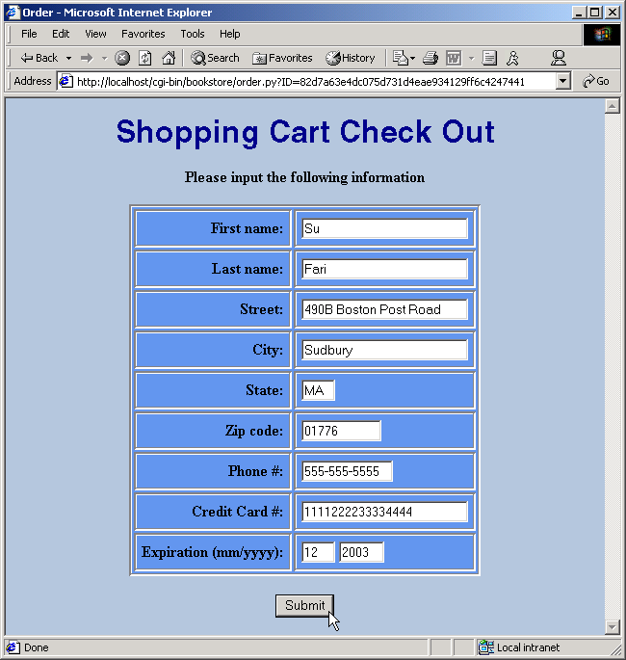
orderForm.html
102
103 <p><input type = "submit" value = "Submit" /></p>
104
105 </form>
106
107 </body>
108
109 </html>

Slide 55
23.12 Processing the Order
process.py simulates processing the user’s credit-card information and retrieves a browser-specific, static document called thankYou

Slide 56
process.py
1 #!c:\Python\python.exe
2 # Fig. 23.20: process.py
3 # Display thank you page to customer and delete session
4
5 import sys
6 import Session
7
8 # load session
9 try:
10 session = Session.Session()
11 except Session.SessionError, message: # invalid/no session ID
12 Session.redirect( "error.py?message=%s" % message )
13 sys.exit()
14
15 # display content type and thankYou for specific client-type
16 content = open( "%s/thankYou.%s" % ( session.data[ "agent" ],
17 session.data[ "extension" ] ) )
18 pageData = session.data[ "content type" ] + content.read() % \
19 session.data[ "total" ]
20 content.close()
21
22 # delete session and display thank you page
23 session.deleteSession()
24 print pageData
Delete Session object
Display thank you page

Slide 57
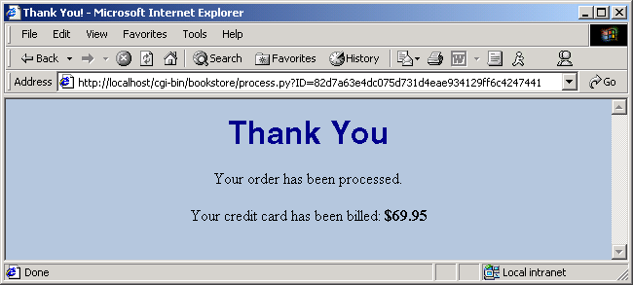
thankYou.html
1 <!-- Fig. 23.21: thankYou.html -->
2 <!-- Static XHTML to be displayed by process.py -->
3
4 <!DOCTYPE html PUBLIC "-//W3C//DTD XHTML 1.0 Strict//EN"
5 "DTD/xhtml1-strict.dtd">
6
7 <html xmlns = "http://www.w3.org/1999/xhtml">
8
9 <head>
10 <title>Thank You!</title>
11 <link rel = "stylesheet" href = "/bookstore/styles.css"
12 type = "text/css" />
13 </head>
14
15 <body>
16
17 <p class = "bigFont">Thank You</p>
18 <p>Your order has been processed.</p>
19 <p>Your credit card has been billed:
20 <span class = "bold">$%.2f</span>
21 </p>
22
23 </body>
24
25 </html>
Insert final dollar total

Slide 58
23.13 Error Handling
When an error occurs, application redirects user to error.py, which displays an error message

Slide 59
error.py
1 #!c:\Python\python.exe
2 # Fig. 23.22: error.py
3 # Generate XML error message and display to user
4 # using a browser-specific XSLT style sheet.
5
6 import cgi
7 import Session
8 from xml.xslt import Processor
9 from xml.dom.DOMImplementation import implementation
10
11 form = cgi.FieldStorage()
12
13 if form.has_key( "message" ):
14
15 # create DOM for error message
16 document = implementation.createDocument( None, None, None )
17 error = document.createElement( "error" )
18 message = document.createElement( "message" )
19 message.appendChild( document.createTextNode(
20 form[ "message" ].value ) )
21 error.appendChild( message )
22 document.appendChild( error )
23
24 # process against XSLT style sheet
25 processor = Processor.Processor()
26 style = open( Session.getClientType()[ 0 ] + "/error.xsl" )
27 processor.appendStylesheetStream( style )
28 results = processor.runNode( document )
29 style.close()
30
31 # display content type and processed XML
32 print Session.getContentType() + results
Create Document for error message
Create error element
Create message element
Append error message text to message element
Append message element to error element
Apply XSLT style sheet error.xsl
Display content type and processed XML

Slide 60
error.xsl
1 <?xml version = "1.0"?>
2
3 <!-- Fig. 23.23: error.xsl -->
4 <!-- XSLT style sheet that transforms XML generated by -->
5 <!-- error.py into XHTML. -->
6
7 <xsl:stylesheet version = "1.0"
8 xmlns:xsl = "http://www.w3.org/1999/XSL/Transform">
9
10 <xsl:output method = "xml" omit-xml-declaration = "no"
11 indent = "yes" doctype-system = "DTD/xhtml1-strict.dtd"
12 doctype-public = "-//W3C//DTD XHTML 1.0 Strict//EN"/>
13
14 <xsl:template match = "error">
15
16 <html xmlns = "http://www.w3.org/1999/xhtml">
17
18 <head>
19 <title>Error</title>
20 <link rel = "stylesheet" href = "/bookstore/styles.css"
21 type = "text/css" />
22 </head>
23
24 <body>
25
26 <p class = "bigFont">Error message:</p>
27 <p class = "bold">
28 <xsl:value-of select = "message" />
29 </p>
30
31 </body>
32
33 </html>
Describes how to transform error elements
Put error message in paragraph tags

Slide 61
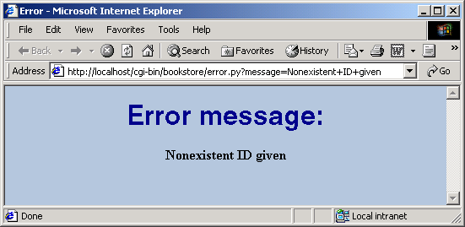
error.xsl
34
35 </xsl:template>
36
37 </xsl:stylesheet>

Slide 62
23.14 Handling Wireless Clients (XHTML Basic and WML)
Wireless clients (e.g., personal digital assistants (PDAs) and digital cell phones) support different markup languages from wireline (e.g., Internet Explorer)
Wireless Application Protocol (WAP): global standard for communication between wireless devices and the Internet supports both XHMTL Basic and WML, the two most widely supported wireless markup languages

Slide 63
23.14.1 Introduction to XHTML Basic
XHTML Basic
  World Wide Web Consortium’s initiative to provide a common markup language for wireless devices and other small devices with limited memory
  Derived from XML
  Excludes features of XHMTL (e.g., nested tables) that are ill-suited for wireless clients
  Documents have .html or .htm file extension

Slide 64
allBooks.xsl
XHTML Basic version of allBooks.xsl
1 <?xml version = "1.0"?>
2
3 <!-- Fig. 23.24: allBooks.xsl -->
4 <!-- XSLT style sheet that transforms XML generated by -->
5 <!-- books.py into XHTML Basic. -->
6
7 <xsl:stylesheet version = "1.0"
8 xmlns:xsl = "http://www.w3.org/1999/XSL/Transform">
9
10 <xsl:output method = "xml" omit-xml-declaration = "no"
11 indent = "yes" doctype-system =
12 "http://www.w3.org/TR/xhtml-basic/xhtml-basic10.dtd"
13 doctype-public = "-//W3C//DTD XHTML Basic 1.0//EN"/>
14
15 <!-- template for catalog element -->
16 <xsl:template match = "catalog">
17
18 <html xmlns = "http://www.w3.org/1999/xhtml">
19
20 <head>
21 <title>Book List</title>
22 <link rel = "stylesheet" href = "/bookstore/styles.css"
23 type = "text/css" />
24 </head>
25
26 <body>
27
28 <p class = "bigFont">Available Books</p>
29 <p class = "bold">
30 Click a link to view book information</p>
31
32 <!-- match product elements to product template -->
33 <xsl:apply-templates select = "/catalog/product">
34
Outputs required information for syntactically correct XHTML Basic documents
Template for catalog element
Insert any matches for the product template

Slide 65
allBooks.xsl
35 <!-- sort products by title -->
36 <xsl:sort select = "title" />
37
38 </xsl:apply-templates>
39
40 </body>
41
42 </html>
43
44 </xsl:template>
45
46 <!-- template for building row of Product information -->
47 <xsl:template match = "product">
48
49 <p><a href = "displayBook.py?ID=%s&amp;isbn={isbn}">
50 <strong><xsl:value-of select = "title" />, <xsl:value-of
51 select = "editionNumber" />e</strong>
52 </a></p>
53
54 </xsl:template>
55
56 </xsl:stylesheet>
Sort products by title
Defines xsl:template for product elements

Slide 66
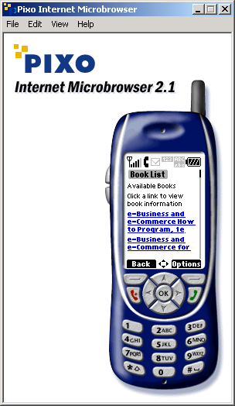

Slide 67
displayBook.xsl
1 <?xml version = "1.0"?>
2
3 <!-- Fig. 23.25: displayBook.xsl -->
4 <!-- XSLT style sheet that transforms XML generated by -->
5 <!-- displayBook.py into XHTML Basic. -->
6
7 <xsl:stylesheet version = "1.0"
8 xmlns:xsl = "http://www.w3.org/1999/XSL/Transform">
9
10 <xsl:output method = "xml" omit-xml-declaration = "no"
11 indent = "yes" doctype-system =
12 "http://www.w3.org/TR/xhtml-basic/xhtml-basic10.dtd"
13 doctype-public = "-//W3C//DTD XHTML Basic 1.0//EN"/>
14
15 <!-- specify the root of the XML document -->
16 <!-- that references this style sheet -->
17 <xsl:template match = "product">
18
19 <html xmlns = "http://www.w3.org/1999/xhtml">
20
21 <head>
22
23 <!-- obtain book title from script to place in title -->
24 <title><xsl:value-of select = "title" /></title>
25
26 <link rel = "stylesheet" href = "/bookstore/styles.css"
27 type = "text/css" />
28 </head>
29
30 <body>
31 <p class = "bigFont">
32 <xsl:value-of select = "title" /></p>
33
34 <img src = "/bookstore/small_images/{imageFile}"
35 alt = "{title}" />
Transforms XML generated by displayBook.py into XHTML Basic
Uses images stored in subdirectory small_images for XHTML Basic clients

Slide 68
displayBook.xsl
36
37 <!-- show price, ISBN, edition and copyright -->
38 <p class = "bold">Price:
39 <xsl:value-of select = "price" /></p>
40
41 <p class = "bold">ISBN:
42 <xsl:value-of select = "isbn" /></p>
43
44 <p class = "bold">Edition:
45 <xsl:value-of select = "editionNumber" /></p>
46
47 <p class = "bold">Copyright:
48 <xsl:value-of select = "copyright" /></p>
49
50 <!-- create Add to Cart button -->
51 <p>
52 <form method = "post" action = "addToCart.py?ID=%s">
53 <p><input type = "submit"
54 value = "Add to Cart" /></p>
55 </form>
56 </p>
57
58 <!-- create View Cart button -->
59 <p>
60 <form method = "post" action = "viewCart.py?ID=%s">
61 <p><input type = "submit"
62 value = "View Cart" /></p>
63 </form>
64 </p>
65
66 </body>
67
68 </html>

Slide 69
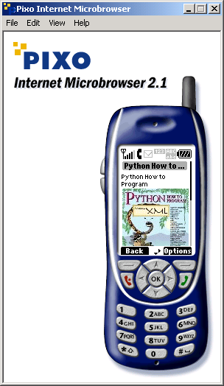
displayBook.xsl
69
70 </xsl:template>
71
72 </xsl:stylesheet>

Slide 70
viewCart.xsl
Transforms XML generated by viewCart.py into XHTML Basic
1 <?xml version = "1.0"?>
2
3 <!-- Fig. 23.26: viewCart.xsl -->
4 <!-- XSLT style sheet that transforms XML generated by -->
5 <!-- viewCart.py into XHTML Basic. -->
6
7 <xsl:stylesheet version = "1.0"
8 xmlns:xsl = "http://www.w3.org/1999/XSL/Transform">
9
10 <xsl:output method = "xml" omit-xml-declaration = "no"
11 indent = "yes" doctype-system =
12 "http://www.w3.org/TR/xhtml-basic/xhtml-basic10.dtd"
13 doctype-public = "-//W3C//DTD XHTML Basic 1.0//EN"/>
14
15 <xsl:template match = "cart">
16
17 <html xmlns = "http://www.w3.org/1999/xhtml">
18
19 <head>
20 <title>Shopping Cart</title>
21 <meta name = "PixoFriendly" content = "true" />
22 <link rel = "stylesheet" href = "/bookstore/styles.css"
23 type = "text/css" />
24 </head>
25
26 <body>
27
28 <p class = "bigFont">Shopping Cart</p>
29
30 <xsl:choose>
31 <xsl:when test = "@total = ’0.00’">
32 <p class = "bold">
33 Your shopping cart is currently empty.</p>
34 </xsl:when>
35
Specifies meta element with name “PixoFriendly” and content “true”
Allows tables to be used with the Pixo Microbrowser

Slide 71
viewCart.xsl
36 <xsl:otherwise> <!-- total != 0.00 -->
37
38 <table border = "true">
39 <xsl:apply-templates select = "orderProduct">
40
41 <!-- sort orderProducts by product/title -->
42 <xsl:sort select = "product/title" />
43
44 </xsl:apply-templates>
45 </table>
46
47 <p class = "bold right">Total: <xsl:value-of
48 select = "@total" /></p>
49
50 </xsl:otherwise>
51 </xsl:choose>
52
53 <p class = "bold green">
54 <a href = "allBooks.py?ID=%s">Continue Shopping</a>
55 </p>
56
57 <form method = "post" action = "order.py?ID=%s">
58 <p><input type = "submit" value = "Check Out" /></p>
59 </form>
60
61 </body>
62
63 </html>
64
65 </xsl:template>
66
67 <xsl:template match = "orderProduct">
68

Slide 72
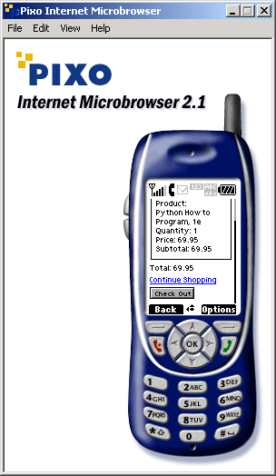
viewCart.xsl
69 <tr><td><ul>Product:<br />
70 <xsl:value-of select = "product/title" />,
71 <xsl:value-of select = "product/editionNumber" />e<br />
72 Quantity: <xsl:value-of select = "quantity" /><br />
73 Price: <xsl:value-of select = "product/price" /><br />
74 Subtotal: <xsl:value-of select = "subtotal" /><br />
75 </ul></td></tr>
76
77 </xsl:template>
78
79 </xsl:stylesheet>

Slide 73
orderForm.html
1 <!-- Fig. 23.27: orderForm.html -->
2 <!-- Static XHTML Basic to be displayed by order.py -->
3
4 <!DOCTYPE html PUBLIC "-//W3C//DTD XHTML Basic 1.0//EN"
5 "http://www.w3.org/TR/xhtml-basic/xhtml-basic10.dtd">
6
7 <html xmlns = "http://www.w3.org/1999/xhtml">
8
9 <head>
10 <title>Order</title>
11 <meta name = "PixoFriendly" content = "true" />
12 <link rel = "stylesheet" href = "/bookstore/styles.css"
13 type = "text/css" />
14 </head>
15
16 <body>
17
18 <p class = "bigFont">Shopping Cart Check Out</p>
19
20 <!-- form to input user information and credit card -->
21 <!-- note: no need to input real data in this example -->
22 <form method = "post" action = "process.py?ID=%s">
23 <p style = "font-weight: bold">
24 Input the following:</p>
25
26 <table border = "true">
27 <tr>
28 <td class = "right bold">First name:<br />
29 <input type = "text" name = "firstname"
30 size = "25" />
31 </td>
32 </tr>
33 <tr>
34 <td class = "right bold">Last name:<br />
Static XHTML Basic form to be displayed by order.py

Slide 74
orderForm.html
35 <input type = "text" name = "lastname"
36 size = "25" />
37 </td>
38 </tr>
39 <tr>
40 <td class = "right bold">Street:<br />
41 <input type = "text" name = "street"
42 size = "25" />
43 </td>
44 </tr>
45 <tr>
46 <td class = "right bold">City:<br />
47 <input type = "text" name = "city"
48 size = "25" />
49 </td>
50 </tr>
51 <tr>
52 <td class = "right bold">State:
53 <input type = "text" name = "state"
54 size = "2" />
55 </td>
56 </tr>
57 <tr>
58 <td class = "right bold">Zip code:
59 <input type = "text" name = "zipcode"
60 size = "10" />
61 </td>
62 </tr>
63 <tr>
64 <td class = "right bold">Phone #:
65 <input type = "text" name = "phone"
66 size = "12" />
67 </td>
68 </tr>
69 <tr>

Slide 75
orderForm.html
70 <td class = "right bold">Credit Card #:<br />
71 <input type = "text" name = "creditcard"
72 size = "25" />
73 </td>
74 </tr>
75 <tr>
76 <td class = "right bold">Expiration (mm/yyyy):
77 <br />
78 <input type = "text" name = "expires"
79 size = "2" />
80 <input type = "text" name = "expires2"
81 size = "4" />
82 </td>
83 </tr>
84 </table>
85
86 <p><input type = "submit" value = "Submit" /></p>
87
88 </form>
89
90 </body>
91
92 </html>

Slide 76
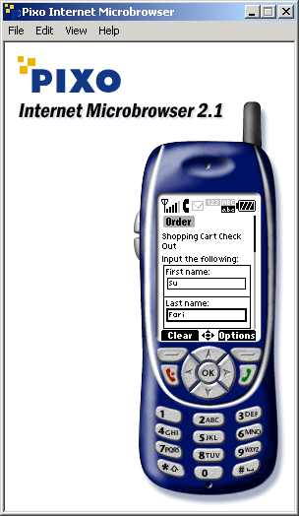

Slide 77
thankYou.html
1 <!-- Fig. 23.28: thankYou.html -->
2 <!-- Static XHTML Basic to be displayed by process.py -->
3
4 <!DOCTYPE html PUBLIC "-//W3C//DTD XHTML Basic 1.0//EN"
5 "http://www.w3.org/TR/xhtml-basic/xhtml-basic10.dtd">
6
7 <html xmlns = "http://www.w3.org/1999/xhtml">
8
9 <head>
10 <title>Thank You!</title>
11 <link rel = "stylesheet" href = "/bookstore/styles.css"
12 type = "text/css" />
13 </head>
14
15 <body>
16
17 <p class = "bigFont">Thank You</p>
18 <p>Your order has been processed.</p>
19 <p>Your credit card has been billed:
20 <span class = "bold">$%.2f</span>
21 </p>
22
23 </body>
24
25 </html>
Static XHTML Basic document displayed by process.py

Slide 78
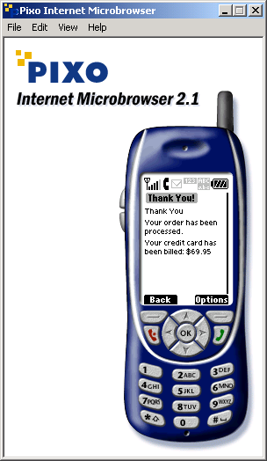

Slide 79
error.xsl
1 <?xml version = "1.0"?>
2
3 <!-- Fig. 23.29: error.xsl -->
4 <!-- XSLT style sheet that transforms XML generated by -->
5 <!-- error.py into XHTML Basic. -->
6
7 <xsl:stylesheet version = "1.0"
8 xmlns:xsl = "http://www.w3.org/1999/XSL/Transform">
9
10 <xsl:output method = "xml" omit-xml-declaration = "no"
11 indent = "yes" doctype-system =
12 "http://www.w3.org/TR/xhtml-basic/xhtml-basic10.dtd"
13 doctype-public = "-//W3C//DTD XHTML Basic 1.0//EN"/>
14
15 <xsl:template match = "error">
16
17 <html xmlns = "http://www.w3.org/1999/xhtml">
18
19 <head>
20 <title>Error</title>
21 <link rel = "stylesheet" href = "/bookstore/styles.css"
22 type = "text/css" />
23 </head>
24
25 <body>
26
27 <p class = "bigFont">Error message:</p>
28
29 <p class = "bold">
30 <xsl:value-of select = "message" />
31 </p>
32
33 </body>
34
35 </html>
Transforms XML generated by error.py into XHTML Basic

Slide 80
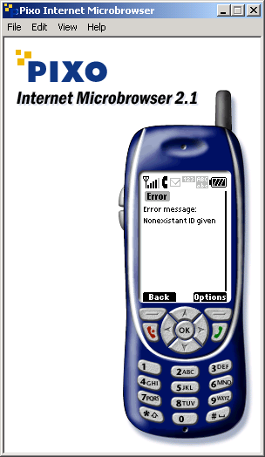
error.xsl
36
37 </xsl:template>
38
39 </xsl:stylesheet>

Slide 81
23.14.2 Introduction to WML
Wireless Markup Language (WML)
  Derived from XML
  Designed to accommodate limited memory capacities and small display screens of wireless devices
  Like XHTML Basic, identifies elements of a document so that a wireless device can render the document
Deck: WML document which contains one or more pages, called cards
Each card can contain both text content and navigational controls to facilitate user interaction
Navigation between cards is rapid because entire deck is stored on microbrowser

Slide 82
23.14.2 Introduction to WML
WML documents created with a text editor and given the .wml file extension

Slide 83
allBooks.xsl
1 <?xml version = "1.0"?>
2
3 <!-- Fig. 23.30: allBooks.xsl -->
4 <!-- XSLT style sheet that transforms XML generated by -->
5 <!-- books.py into WML. -->
6
7 <xsl:stylesheet version = "1.0"
8 xmlns:xsl = "http://www.w3.org/1999/XSL/Transform">
9
10 <xsl:output method = "xml" omit-xml-declaration = "no"
11 indent = "yes" doctype-system =
12 "http://www.wapforum.org/DTD/wml12.dtd"
13 doctype-public = "-//WAPFORUM//DTD WML 1.2//EN"/>
14
15 <!-- template for catalog element -->
16 <xsl:template match = "catalog">
17
18 <wml>
19
20 <head>
21 <meta forua = "true" http-equiv = "Cache-Control"
22 content = "max-age=0" />
23 </head>
24
25 <card title = "Book List">
26
27 <p>
28
29 <b>Available Books</b><br />
30 Click a link to view book information<br />
31
32 <!-- match product elements to product template -->
33 <xsl:apply-templates select = "/catalog/product">
34
Output required lines for a syntactically correct WML document
wml element referred to as a deck
Ensures that client does not cache current page
Each logical page marked up with card element
Attribute title describes the card
All text must be nested in <p> tags within <card> tags
Insert any matches of the product template into the document

Slide 84
allBooks.xsl
Sort matches by their title elements
35 <!-- sort products by title -->
36 <xsl:sort select = "title" />
37
38 </xsl:apply-templates>
39
40 </p>
41
42 </card>
43
44 </wml>
45
46 </xsl:template>
47
48 <!-- template for building row of Product information -->
49 <xsl:template match = "product">
50
51 <a href = "displayBook.py?ID=%s&amp;isbn={isbn}">
52 <xsl:value-of select = "title" />, <xsl:value-of
53 select = "editionNumber" />
54 </a><br />
55
56 </xsl:template>
57
58 </xsl:stylesheet>
Template for building row of product information

Slide 85
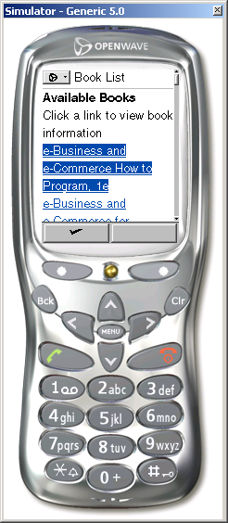

Slide 86
displayBook.xsl
1 <?xml version = "1.0"?>
2
3 <!-- Fig. 23.31: displayBook.xsl -->
4 <!-- XSLT style sheet that transforms XML generated by -->
5 <!-- displayBook.py into WML. -->
6
7 <xsl:stylesheet version = "1.0"
8 xmlns:xsl = "http://www.w3.org/1999/XSL/Transform">
9
10 <xsl:output method = "xml" omit-xml-declaration = "no"
11 indent = "yes" doctype-system =
12 "http://www.wapforum.org/DTD/wml12.dtd"
13 doctype-public = "-//WAPFORUM//DTD WML 1.2//EN"/>
14
15 <!-- specify the root of the XML document -->
16 <!-- that references this style sheet -->
17 <xsl:template match = "product">
18
19 <wml>
20
21 <head>
22 <meta forua = "true" http-equiv = "Cache-Control"
23 content = "max-age=0" />
24 </head>
25
26 <!-- obtain book title from script to place in title -->
27 <card title = "{title}">
28
29 <p>
30
31 <xsl:value-of select = "title" /><br />
32
33 <img src = "/bookstore/logo.wbmp" alt = "logo" />
34 <br />
35
Transforms XML generated by displayBook.py into WML
Place book’s title in card’s title attribute
Some microbrowser only support wireless bitmap (.wbmp) images

Slide 87
displayBook.xsl
36 <!-- show price, ISBN, edition and copyright -->
37 Price: <xsl:value-of select = "price" /><br />
38 ISBN: <xsl:value-of select = "isbn" /><br />
39 Edition: <xsl:value-of select = "editionNumber" />
40 <br />
41 Copyright: <xsl:value-of select = "copyright" /><br />
42 <br />
43
44 <!-- add links to shopping cart -->
45 <a href = "addToCart.py?ID=%s">Add to Cart</a><br />
46 <a href = "viewCart.py?ID=%s">View Cart</a><br />
47
48 </p>
49
50 </card>
51
52 </wml>
53
54 </xsl:template>
55
56 </xsl:stylesheet>
Create Add to Cart hyperlink
Create View Cart hyperlink

Slide 88
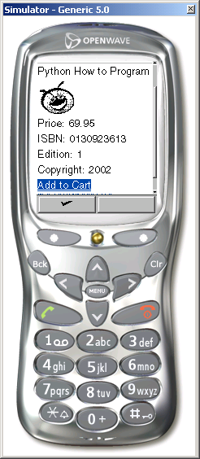

Slide 89
viewCart.xsl
Transform XML generated by viewCart.py into WML
1 <?xml version = "1.0"?>
2
3 <!-- Fig. 23.32: viewCart.xsl -->
4 <!-- XSLT style sheet that transforms XML generated by -->
5 <!-- viewCart.py into WML. -->
6
7 <xsl:stylesheet version = "1.0"
8 xmlns:xsl = "http://www.w3.org/1999/XSL/Transform">
9
10 <xsl:output method = "xml" omit-xml-declaration = "no"
11 indent = "yes" doctype-system =
12 "http://www.wapforum.org/DTD/wml12.dtd"
13 doctype-public = "-//WAPFORUM//DTD WML 1.2//EN"/>
14
15 <xsl:template match = "cart">
16
17 <wml>
18
19 <head>
20 <meta forua = "true" http-equiv = "Cache-Control"
21 content = "max-age=0" />
22 </head>
23
24 <card title = "Shopping Cart">
25
26 <p>
27
28 <b>Shopping Cart</b><br /><br />
29
30 <xsl:choose>
31 <xsl:when test = "@total = ’0.00’">
32 Your shopping cart is currently empty.<br />
33 <br />
34 </xsl:when>
35
Matches cart elements
Determine if shopping cart is empty

Slide 90
viewCart.xsl
36 <xsl:otherwise> <!-- total != 0.00 -->
37
38 <xsl:apply-templates select = "orderProduct">
39
40 <!-- sort orderProducts by title -->
41 <xsl:sort select = "product/title" />
42
43 </xsl:apply-templates>
44
45 <b>Total: <xsl:value-of
46 select = "@total" /></b><br />
47
48 </xsl:otherwise>
49 </xsl:choose>
50
51 <a href = "allBooks.py?ID=%s">Continue Shopping</a>
52 <br />
53 <a href = "order.py?ID=%s">Check Out</a>
54
55 </p>
56
57 </card>
58
59 </wml>
60
61 </xsl:template>
62
63 <xsl:template match = "orderProduct">
64
65 Product:<br />
66 <xsl:value-of select = "product/title" />,
67 <xsl:value-of select = "product/editionNumber" />e<br />
68 Quantity: <xsl:value-of select = "quantity" /><br />
69 Price: <xsl:value-of select = "product/price" /><br />
70 Subtotal: <xsl:value-of select = "subtotal" /><br />
Create Continue Shopping hyperlink
Create Check Out hyperlink

Slide 91
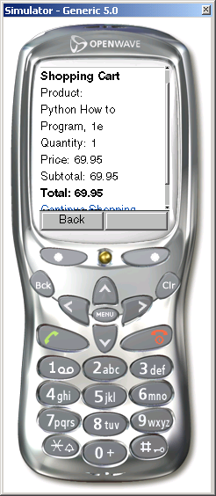
viewCart.xsl
71 <br />
72
73 </xsl:template>
74
75 </xsl:stylesheet>

Slide 92
orderForm.wml
1 <!-- Fig. 23.33: orderForm.wml -->
2 <!-- Static WML to be displayed by order.py -->
3
4 <!DOCTYPE wml PUBLIC "-//WAPFORUM//DTD WML 1.2//EN"
5 "http://www.wapforum.org/DTD/wml12.dtd">
6
7 <wml>
8
9 <head>
10 <meta forua = "true" http-equiv = "Cache-Control"
11 content = "max-age=0"/>
12 </head>
13
14 <card title = "Order">
15
16 <p>
17
18 <b>Shopping Cart Check Out</b><br /><br />
19
20 <!-- form to input user information and credit card -->
21 <!-- note: no need to input real data in this example -->
22 Input the following:<br />
23 First name: <input type = "text" name = "firstname" />
24 <br />
25 Last name: <input type = "text" name = "lastname" />
26 <br />
27 Street: <input type = "text" name = "street" /><br />
28 City: <input type = "text" name = "city" /><br />
29 State: <input type = "text" name = "state" /><br />
30 Zip code: <input type = "text" name = "zipcode" /><br />
31 Phone #: <input type = "text" name = "phone" /><br />
32 Credit Card #: <input type = "text"
33 name = "creditcard" /><br />
34 Expiration (mm): <input type = "text" name = "expires" />
Order form displayed by order.py to WML clients
input element creates a text field in which users can enter information

Slide 93
orderForm.wml
35 Expiration (yyyy): <input type = "text"
36 name = "expires2" /><br />
37
38 <do type = "accept" label = "Submit">
39
40 <go method = "post" href = "process.py?ID=%s">
41 <postfield name = "firstname"
42 value = "$(firstname)" />
43 <postfield name = "lastname"
44 value = "$(lastname)" />
45 <postfield name = "street" value = "$(street)" />
46 <postfield name = "city" value = "$(city)" />
47 <postfield name = "state" value = "$(state)" />
48 <postfield name = "zipcode" value = "$(zipcode)" />
49 <postfield name = "phone" value = "$(phone)" />
50 <postfield name = "creditcard"
51 value = "$(creditcard)" />
52 <postfield name = "expires"
53 value = "$(expires)" />
54 <postfield name = "expires2"
55 value = "$(expires2)" />
56 </go>
57
58 </do>
59
60 </p>
61
62 </card>
63
64 </wml>
do elements specify action of soft keys
type = “accept” corresponds to the left soft key
label attribute specifies text to display above soft key
Pressing the soft key performs the action of the go element
Links to process.py using post form method
Inserts data into go element using postfield elements
Attribute name specifies name that references the data
Attribute value specifies the actual data
Value of value attribute obtained from corresponding input

Slide 94
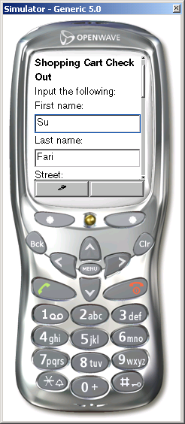

Slide 95
thankYou.wml
1 <!-- Fig. 23.34: thankYou.wml -->
2 <!-- Static WML to be displayed by process.py -->
3
4 <!DOCTYPE wml PUBLIC "-//WAPFORUM//DTD WML 1.2//EN"
5 "http://www.wapforum.org/DTD/wml12.dtd">
6
7 <wml>
8
9 <head>
10 <meta forua = "true" http-equiv = "Cache-Control"
11 content = "max-age=0" />
12 </head>
13
14 <card title = "Thank You!">
15
16 <p>
17
18 <b>Thank You</b><br /><br />
19 Your order has been processed.<br />
20 Your credit card has been billed: <b>%.2f</b>
21
22 </p>
23
24 </card>
25
26 </wml>
Document thankYou.wml displayed by process.py

Slide 96
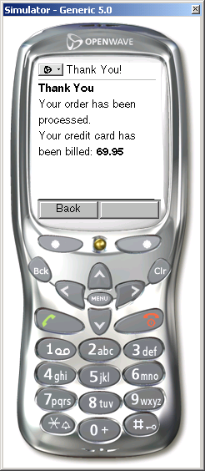

Slide 97
error.xsl
Transforms XML generated by error.py into WML
1 <?xml version = "1.0"?>
2
3 <!-- Fig. 23.35: error.xsl -->
4 <!-- XSLT style sheet that transforms XML generated by -->
5 <!-- error.py into WML. -->
6
7 <xsl:stylesheet version = "1.0"
8 xmlns:xsl = "http://www.w3.org/1999/XSL/Transform">
9
10 <xsl:output method = "xml" omit-xml-declaration = "no"
11 indent = "yes" doctype-system =
12 "http://www.wapforum.org/DTD/wml12.dtd"
13 doctype-public = "-//WAPFORUM//DTD WML 1.2//EN"/>
14
15 <xsl:template match = "error">
16
17 <wml>
18
19 <head>
20 <meta forua = "true" http-equiv = "Cache-Control"
21 content = "max-age=0" />
22 </head>
23
24 <card title = "Error">
25
26 <p>
27
28 <b>Error message:</b><br />
29 <xsl:value-of select = "message" />
30
31 </p>
32
33 </card>
34
35 </wml>
Insert value of message element into paragraph tags

Slide 98
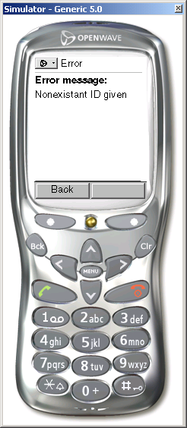
error.xsl
36
37 </xsl:template>
38
39 </xsl:stylesheet>

