Slide 1
Chapter 25 – Customizing Classes
Outline
25.1 Introduction
25.2 Python Servlets
25.3 Python Server Pages Overview
25.4 First Python Server Page Example
25.5 Implicit Objects
25.6 Scripting
25.6.1 Scripting Components
25.6.2 Scripting Example
25.7 Standard Actions
25.7.1 <psp:include> Action
25.7.2 <psp:insert> Action
25.8 <psp:method> Action
25.8.1 page Directive
25.8.2 include Directive
25.9 Case Study: Message Forums with Python and XML
25.9.1 Displaying the Forums
25.9.2 Adding Forums and Messages
25.9.3 Alterations for Browsers Without XML and XSLT Support

Slide 2
25.1 Introduction
Python Server Pages (PSP)
  Simplifies generation and delivery of dynamic Web content
  Enables Web-application programmers to create dynamic content by reusing predefined components and by interacting with components through server-side scripting
Webware WebKit package
  acts as a Python servlet engine that produces XHTML
  Application server that manages and executes Python servlets
Python servlets: Python objects that respond to client requests and execute in a Web server

Slide 3
25.2 Python Servlets
When a client sends a PSP request to the Web server, the Web server calls the servlet container, which is a process that manages servlet requests
Webware’s AppServer acts as the servlet container
WebKit’s ServletFactory (an abstract class that defines protocols used by applications to create servlets) creates a servlet instance to handle a client request

Slide 4
25.2 Python Servlets
Servlet’s life cycle
  Begins when the servlet container loads the servlet into memory
  Servlet container invokes the servlet’s awake method to initialize the servlet
  Servlet’s respond method receives and processes the request and sends a response to the client
  Servlet’s sleep method releases servlet resources
New transaction object is created and destroyed for each client request
Classes involved in a transaction include Application, Request, Response, Session and Servlet

Slide 5
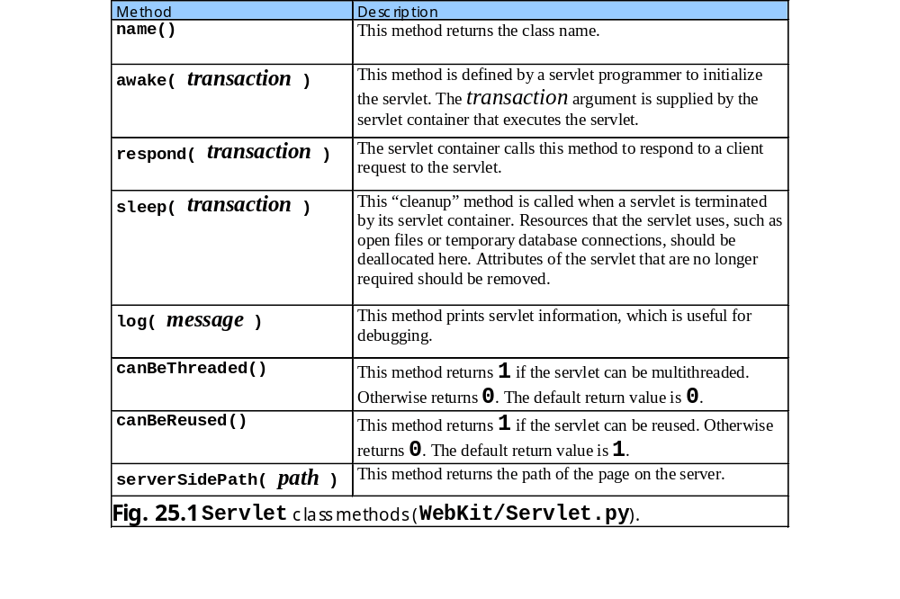
25.2 Python Servlets

Slide 6
25.3 Python Server Pages Overview
PSPs have three key components: directives, actions and scriptlets
PSPs normally include XHTML or HTML markup, known as fixed-template data
Generation-time errors: any errors during the compilation of the new servlet
Request-time errors: any errors that occur during request processing

Slide 7
25.4 First Python Server Page Example
Simple PSP example inserts the current data and time into a Web page

Slide 8
fig25_02.psp
1 <!DOCTYPE html PUBLIC "-//W3C//DTD XHTML 1.0 Strict//EN"
2 "http://www.w3.org/TR/xhtml1/DTD/xhtml1-strict.dtd">
3
4 <!-- Fig. 25.2: fig25_02.psp -->
5 <!-- Displays date and time every 60 seconds. -->
6
7 <%-- import time module --%>
8 <%@ page imports = "time" %>
9
10 <html xmlns = "http://www.w3.org/1999/xhtml">
11
12 <head>
13 <meta http-equiv = "refresh" content = "60" />
14
15 <title>A Simple PSP Example</title>
16
17 <style type = "text/css">
18 .big { font-family: helvetica, arial, sans-serif;
19 font-weight: bold;
20 font-size: 2em; }
21 </style>
22 </head>
23
24 <body>
25 <p class = "big">Simple PSP Example</p>
26
27 <table style = "border: 6px outset;">
28 <tr>
29 <td style = "background-color: black;">
30 <p class = "big" style = "color: cyan;">
31
32 <!-- PSP expression to insert date/time -->
33 <%= time.ctime() %>
34
page directive imports time module
meta element sets refresh interval of 60 seconds
PSP expressions delimited by <%= and %>
Calls function ctime to insert data and time

Slide 9
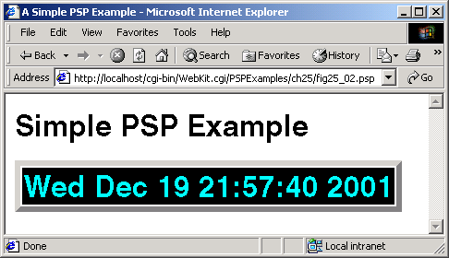
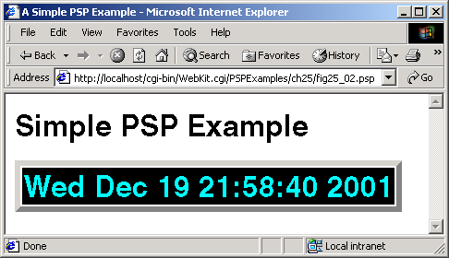
fig25_02.psp
35 </p>
36 </td>
37 </tr>
38 </table>
39 </body>
40
41 </html>

Slide 10
25.5 Implicit Objects
Provide programmers with access to many servlet capabilities in the context of a Python Server Page

Slide 11
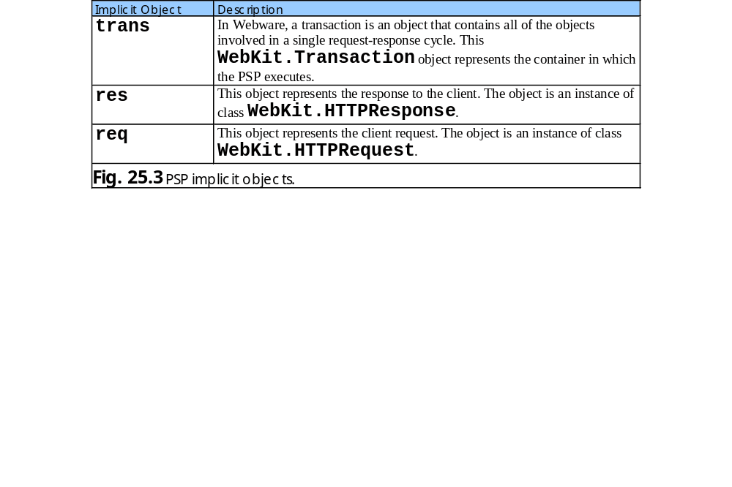
25.5 Implicit Objects

Slide 12
25.6 Scripting
PSP programmers can insert Python code and logic into PSPs through scripting

Slide 13
25.6.1 Scripting Components
Include scriptlets, comments and expressions
Scriptlets: blocks of code delimited by <% and %>
XHTML comments
  Delimited by <!-- and -->
  Can be placed through a PSP, but not inside scriptlets
PSP comments and Python comments are ignored and do not appear in response to a client
PSP expression
  Delimited by <%= and %>
  Contains a Python expression that is evaluated for a client request
  Container converts result to a string and then outputs the string as part of the response to the client

Slide 14
25.6.2 Scripting Example
Example demonstrates basic scripting capabilities by responding to get requests

Slide 15
fig25_04.psp
1 <!DOCTYPE html PUBLIC "-//W3C//DTD XHTML 1.0 Strict//EN"
2 "http://www.w3.org/TR/xhtml1/DTD/xhtml1-strict.dtd">
3
4 <!-- Fig. 25.4: fig25_04.psp -->
5 <!-- PSP that processes a "get" request containing data. -->
6
7 <%-- specify indent type --%>
8 <%@ page indentType = "braces" %>
9
10 <html xmlns = "http://www.w3.org/1999/xhtml">
11
12 <!-- head section of document -->
13 <head>
14 <title>Processing "get" requests with data</title>
15 </head>
16
17 <!-- body section of document -->
18 <body>
19
20 <%-- generate a form --%>
21 <% # begin scriptlet
22
23 if req.hasField( "firstName" ): {
24
25 %> <%-- end scriptlet to insert fixed template data --%>
26
27 <h1>
28 Hello <%= req.field( "firstName" ) %>, <br />
29 Welcome to Python Server Pages!
30 </h1>
31
32 <% # continue scriptlet
33
34 } # end if
35 else: {
Informs compiler that this PSP uses braces to signify suites and blocks of code in scriptlets
Begin scriptlet with <%
hasField of HTTPRequest object req determines whether PSP has parameter
End scriptlet to insert fixed template data
PSP expression outputs name entered in form

Slide 16
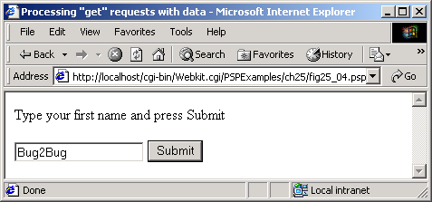
fig25_04.psp
36
37 %> <%-- end scriptlet to insert fixed template data --%>
38
39 <form action = "fig25_04.psp" method = "get">
40 <p>Type your first name and press Submit</p>
41
42 <p><input type = "text" name = "firstName" />
43 <input type = "submit" value = "Submit" />
44 </p>
45 </form>
46
47 <% # continue scriptlet
48
49 } # end else
50
51 %> <%-- end scriptlet --%>
52 </body>
53
54 </html> <!-- end XHTML document -->
Fixed-template data outputs a form

Slide 17
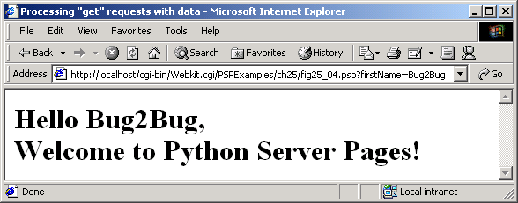
fig25_04.psp

Slide 18
25.7 Standard Actions
Provide PSP programmers with access to several of the most common tasks performed in a PSP
Delimited by <psp:action> and </psp:action> tags where action is the standard action name (i.e., include, insert or method)

Slide 19
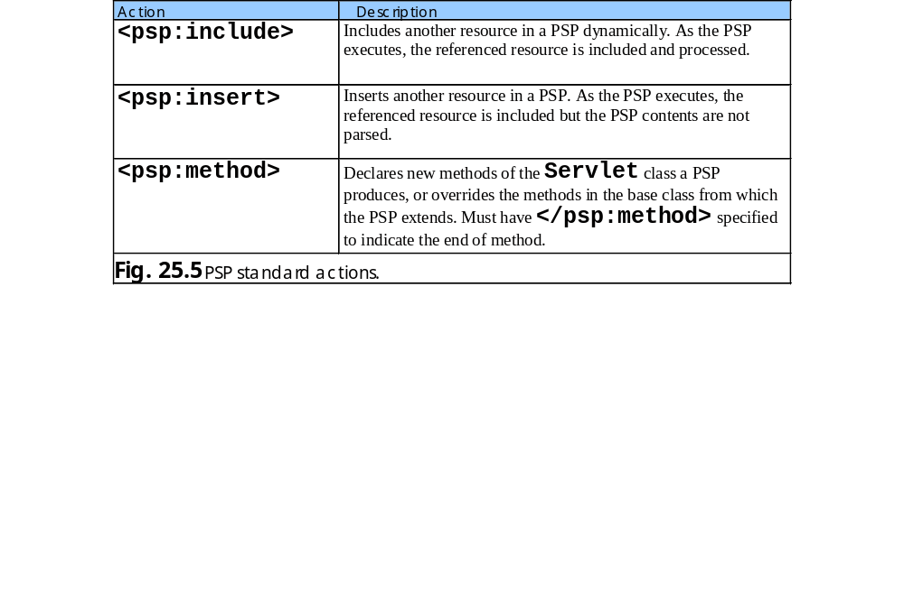
25.7 Standard Actions

Slide 20
25.7.1 <psp:include> Action
Enables PSP to reuse content from existing PSPs, XHTML documents, etc.
Subsequent requests to the PSP that contains the <psp:include> action reflect any changes made to the included resource

Slide 21
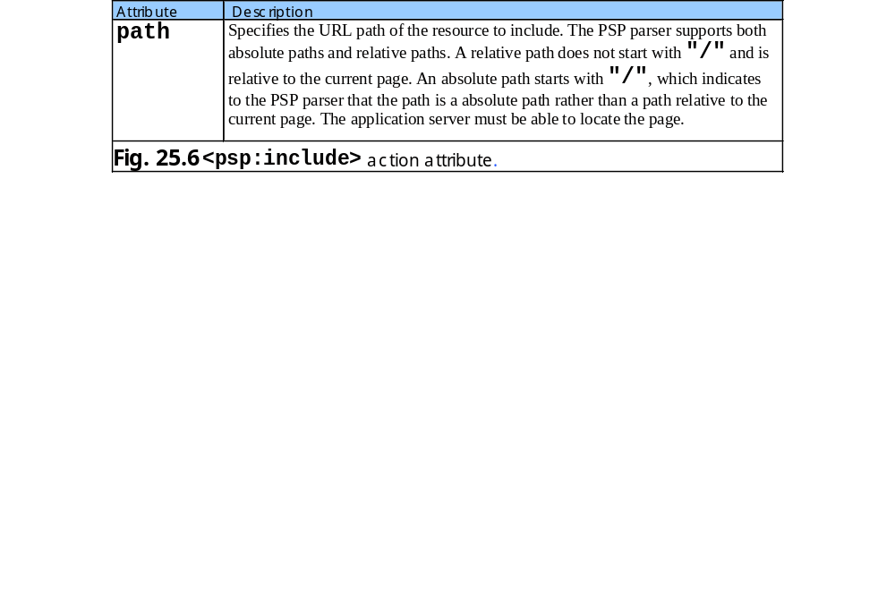
25.7.1 <psp:include> Action

Slide 22
banner.html
1 <!-- Fig. 25.7: banner.html -->
2 <!-- Banner to include in another document. -->
3
4 <div style = "width: 500px">
5 <p>
6 Java(TM), C, C++, Visual Basic(R),
7 Object Technology, and <br />Internet and
8 World Wide Web Programming Training&nbsp;<br />
9 On-Site Seminars Delivered Worldwide
10 </p>
11
12 <p>
13 <a href = "mailto:deitel@deitel.com">
14 deitel@deitel.com</a><br />
15
16 978.579.9911<br />
17 490B Boston Post Road, Suite 200,
18 Sudbury, MA 01776
19 </p>
20 </div>
Static XHMTL document

Slide 23
toc.html
1 <!-- Fig. 25.8: toc.html -->
2 <!-- Contents to include in another document. -->
3
4 <p><a href = "http://www.deitel.com/books/index.html">
5 Publications/BookStore
6 </a></p>
7
8 <p><a href = "http://www.deitel.com/whatsnew.html">
9 What's New
10 </a></p>
11
12 <p><a href = "http://www.deitel.com/books/downloads.html">
13 Downloads/Resources
14 </a></p>
15
16 <p><a href = "http://www.deitel.com/faq/index.html">
17 FAQ (Frequently Asked Questions)
18 </a></p>
19
20 <p><a href = "http://www.deitel.com/intro.html">
21 Who we are
22 </a></p>
23
24 <p><a href = "http://www.deitel.com/index.html">
25 Home Page
26 </a></p>
27
28 <p>Send questions or comments about this site to
29 <a href = "mailto:deitel@deitel.com">
30 deitel@deitel.com
31 </a><br />
32 Copyright 1995-2002 by Deitel &amp; Associates, Inc.
33 All Rights Reserved.
34 </p>
Static XHTML document

Slide 24
clock2.psp
1 <!-- Fig. 25.9: clock2.psp -->
2 <!-- Date and time to include in another document. -->
3
4 <%-- import time module --%>
5 <%@ page imports = "time"%>
6
7 <table>
8 <tr>
9 <td style = "background-color: black">
10 <p class = "big" style = "color: cyan; font-size: 3em;
11 font-weight: bold">
12
13 <%= time.ctime() %>
14 </p>
15 </td>
16 </tr>
17 </table>
PSP that generates data and time

Slide 25
include.psp
1 <!DOCTYPE html PUBLIC "-//W3C//DTD XHTML 1.0 Strict//EN"
2 "http://www.w3.org/TR/xhtml1/DTD/xhtml1-strict.dtd">
3
4 <!-- Fig. 25.10: include.psp -->
5 <!-- PSP that includes both static and dynamic content. -->
6
7 <html xmlns = "http://www.w3.org/1999/xhtml">
8
9 <head>
10 <title>Using psp:include</title>
11
12 <style type = "text/css">
13 body {
14 font-family: tahoma, helvetica, arial, sans-serif;
15 }
16
17 table, tr, td {
18 font-size: .9em;
19 border: 3px groove;
20 padding: 5px;
21 background-color: #dddddd;
22 }
23 </style>
24 </head>
25
26 <body>
27 <table>
28 <tr>
29 <td style = "width: 160px; text-align: center">
30 <img src = "images/logotiny.png"
31 width = "140" height = "93"
32 alt = "Deitel &amp; Associates, Inc. Logo" />
33 </td>
34
35 <td>
PSP includes both static and dynamic content

Slide 26
include.psp
Include contents of banner.html
banner.html spans two columns across top of table
36
37 <%-- include contents of banner.html here --%>
38 <psp:include path = "banner.html" >
39
40 </td>
41 </tr>
42
43 <tr>
44 <td style = "width: 160px">
45
46 <%-- include contents of toc.html here --%>
47 <psp:include path = "toc.html" >
48
49 </td>
50
51 <td style = "vertical-align: top">
52
53 <%-- include clock2.psp in this PSP --%>
54 <psp:include path = "clock2.psp" >
55
56 </td>
57 </tr>
58 </table>
59 </body>
60 </html>
Include contents of toc.html
toc.html is left column of second row
Include clock2.psp

Slide 27
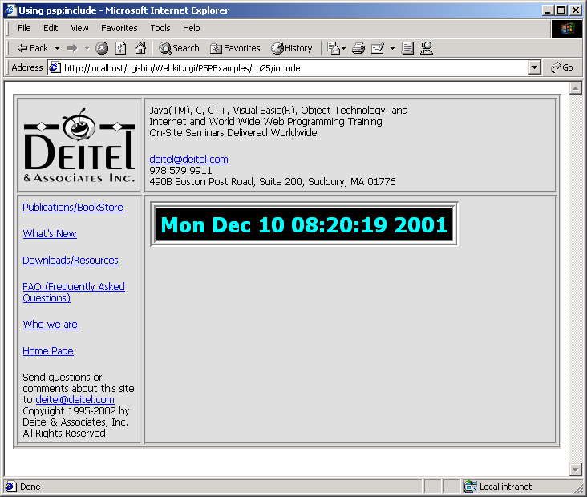
include.psp

Slide 28
25.7.2 <psp:insert> Action
Dynamically inserts a resource into a PSP
Instructs the PSP parser not to evaluate any scriptlets contained within the resource

Slide 29
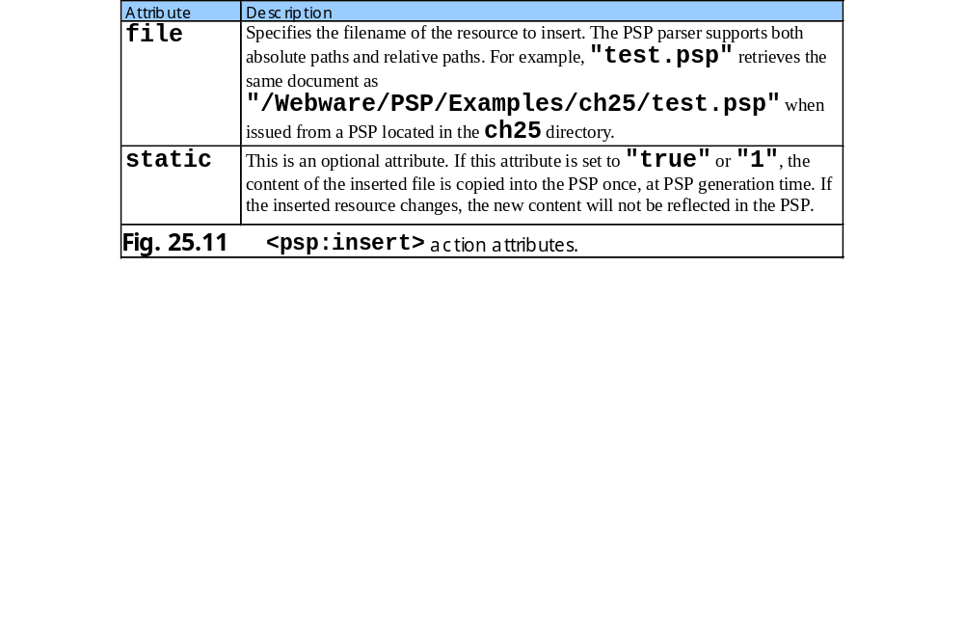
25.7.2 <psp:insert> Action

Slide 30
insert.psp
1 <!DOCTYPE html PUBLIC "-//W3C//DTD XHTML 1.0 Strict//EN"
2 "http://www.w3.org/TR/xhtml1/DTD/xhtml1-strict.dtd">
3
4 <!-- Fig. 25.12: insert.psp -->
5 <!-- Demonstrates the insert action. -->
6
7 <html xmlns = "http://www.w3.org/1999/xhtml">
8
9 <head>
10 <title>Using psp:insert</title>
11
12 <style type = "text/css">
13 body {
14 font-family: tahoma, helvetica, arial, sans-serif;
15 }
16
17 table, tr, td {
18 font-size: .9em;
19 border: 3px groove;
20 padding: 5px;
21 background-color: #dddddd;
22 }
23 </style>
24 </head>
25
26 <body>
27 <table>
28 <tr>
29 <td style = "width: 160px; text-align: center">
30 <img src = "images/logotiny.png"
31 width = "140" height = "93"
32 alt = "Deitel &amp; Associates, Inc. Logo" />
33 </td>
34
35 <td>

Slide 31
insert.psp
Include banner.html
36
37 <%-- include banner.html in this PSP --%>
38 <psp:insert file = "banner.html" static = "true" >
39
40 </td>
41 </tr>
42
43 <tr>
44 <td style = "width: 160px">
45
46 <%-- include toc.html in this PSP --%>
47 <psp:insert file = "toc.html" >
48
49 </td>
50
51 <td style = "vertical-align: top">
52
53 <%-- include clock2.psp in this PSP --%>
54 <psp:insert file = "clock2.psp" >
55
56 </td>
57 </tr>
58 </table>
59 </body>
60 </html>
Specifies that updates to banner.html will not be displayed
Include toc.html
Include clock2.psp

Slide 32
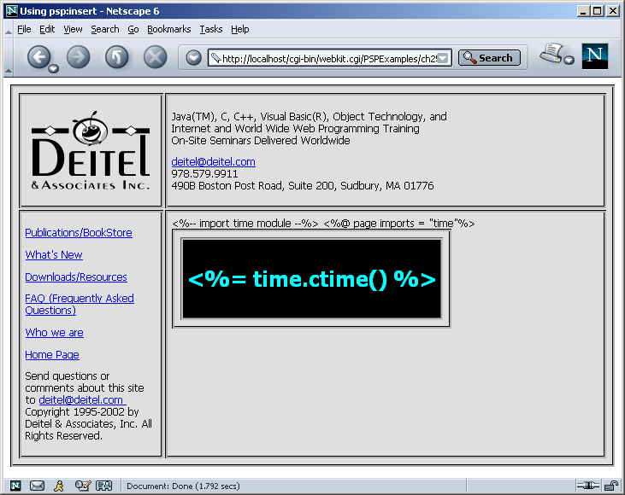
insert.psp

Slide 33
25.7.3 <psp:method> Action
Enables a PSP to override methods inherited from the servlet class and to declare new methods
Attribute name specifies method name
Attribute params specifies method’s parameter names
Code in a psp:method element is standard Python code
Neither raw XHTML nor scripts are allowed in psp:method elements

Slide 34
fig25_13.py
1 <!DOCTYPE html PUBLIC "-//W3C//DTD XHTML 1.0 Strict//EN"
2 "http://www.w3.org/TR/xhtml1/DTD/xhtml1-strict.dtd">
3
4 <!-- Fig. 25.13: fig25_13.html -->
5 <!-- Calculator form. -->
6
7 <html xmlns = "http://www.w3.org/1999/xhtml">
8
9 <head>
10 <title>Calculator Input Data</title>
11 </head>
12
13 <body>
14 <h1>Python Calculator</h1>
15
16 <form method = "post" action = "fig25_14.psp">
17 <table width = "100%" border = "3">
18 <tr>
19 <th>operand 1</th>
20 <th>Operator</th>
21 <th>operand 2</th>
22 </tr>
23 <tr>
24 <td><input type = "text" name = "operand1"/></td>
25 <td><select name = "operator">
26 <option value = "+">+
27 <option value = "-">-
28 <option value = "*">*
29 <option value = "/">/
30 <option value = "//">//
31 </select>
32 </td>
33 <td><input type = "text" name = "operand2"/></td>
34 </tr>
35 </table><br />
Form that prompts user to input two numbers and select a mathematical operation

Slide 35
fig25_13.py
36 <input type = "submit" value = "Submit">
37 </form>
38
39 </body>
40 </html>

Slide 36
fig25_14.py
1 <!DOCTYPE html PUBLIC "-//W3C//DTD XHTML 1.0 Strict//EN"
2 "http://www.w3.org/TR/xhtml1/DTD/xhtml1-strict.dtd">
3
4 <!-- Fig. 25.14: fig25_14.psp -->
5 <!-- PSP that processes a "get" request containing data. -->
6
7 <%-- specify indent type --%>
8 <%@ page indentType = "spaces" %>
9 <%@ page indentSpaces = "3" %>
10 <%@ page imports = "__future__:division" %>
11
12 <%-- define a psp method --%>
13 <psp:method name = "calculate"
14 params = "operand1, operator, operand2" >
15
16 if operator == "+": # addition operation
17 result = operand1 + operand2
18
19 elif operator == "-": # subtraction operation
20 result = operand1 - operand2
21
22 elif operator == "*": # multiplication operation
23 result = operand1 * operand2
24
25 elif operator == "/": # division operation
26 result = operand1 / operand2
27
28 elif operator == "//": # floor division
29 result = operand1 // operand2
30
31 else: # unrecognizable operator
32 result = None
33
34 return result
35
Spaces delimit blocks or suites of Python code
Sets number of indentation spaces to 3
Enables true division
Declares method calculate
Method takes three parameters
Return calculation result

Slide 37
fig25_14.py
36 </psp:method> <%-- end psp method declaration --%>
37
38
39 <html xmlns = "http://www.w3.org/1999/xhtml">
40
41 <!-- head section of document -->
42 <head>
43 <title>Calculator Result</title>
44 </head>
45
46 <!-- body section of document -->
47 <body>
48 <h1>Python Calculator Result</h1>
49
50 <%-- get client input --%>
51 <%
52 try:
53 operand1 = float( req.field( "operand1" ) )
54 operator = req.field( "operator", "+" )
55 operand2 = float( req.field( "operand2" ) )
56 noError = 1 $%>
57 <% except Exception:
58 res.write( "You did not enter a number." )
59 noError = 0 $%>
60
61 <%-- display expression --%>
62 <% if noError: %>
63 <br />
64 <%= operand1 %> <%= operator %> <%= operand2 %> =
65 <%= self.calculate( operand1, operator, operand2 ) %>
66 <% end %>
67 </body>
68
69 </html> <!-- end XHTML document -->
End psp method declaration
Second argument assigns default value
Indicates that following data belongs to code blocks started by %> tag
Catches Exception if user does not enter two operands
PSP expression invokes method calculate

Slide 38
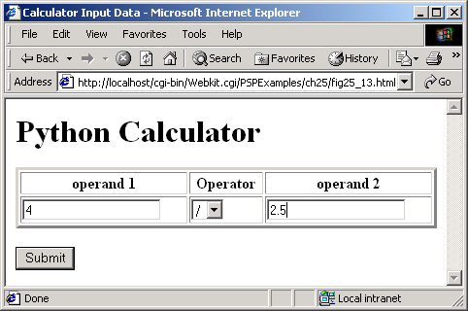
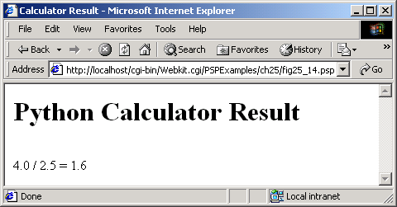
fig25_14.py

Slide 39
25.8 Directives
Instructions that enable programmers to specify page settings and content information to the PSP parser
Delimited by <%@ and %>
Processed at generation time
Do not produce any immediate output, because they are processed before the PSP accepts any requests

Slide 40
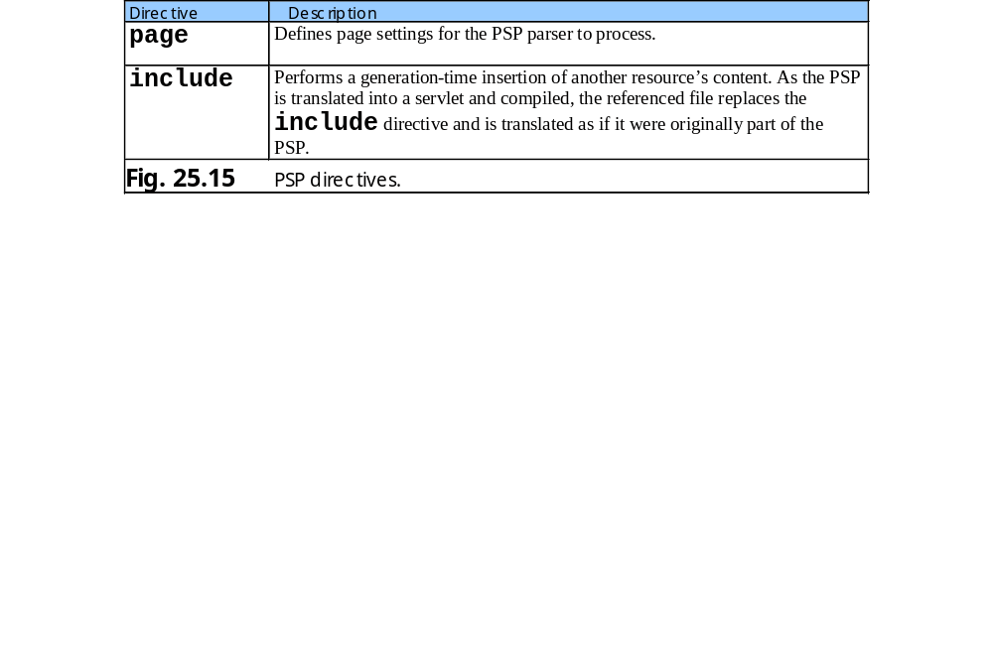
25.8 Directives

Slide 41
25.8.1 page Directive
Specifies global settings for the PSP
Can be only occurrence of each attribute with the exception of the imports attribute, which imports Python modules

Slide 42
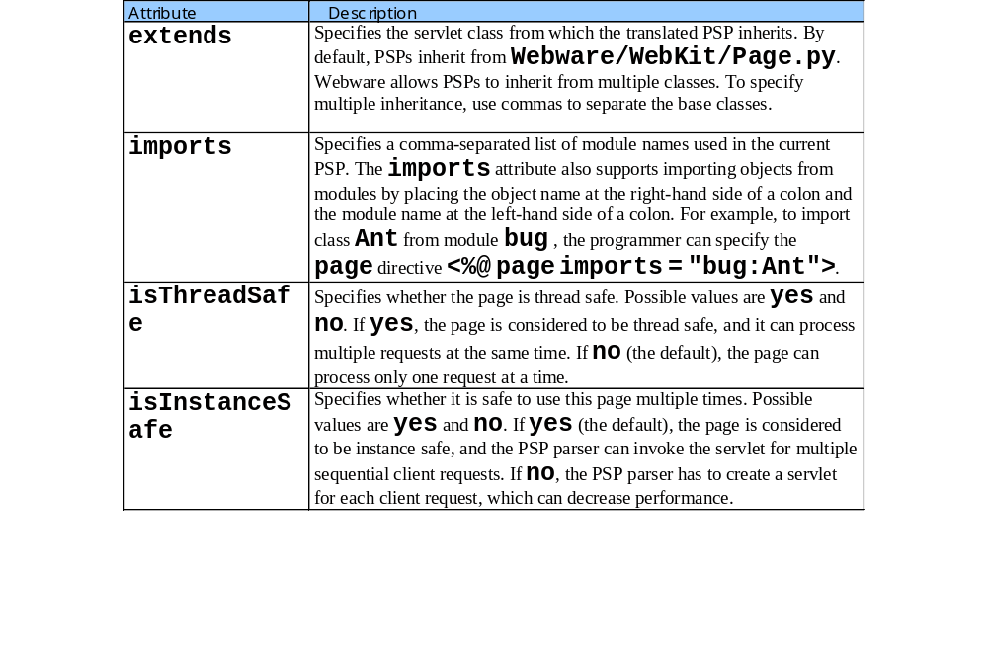
25.8.1 page Directive

Slide 43
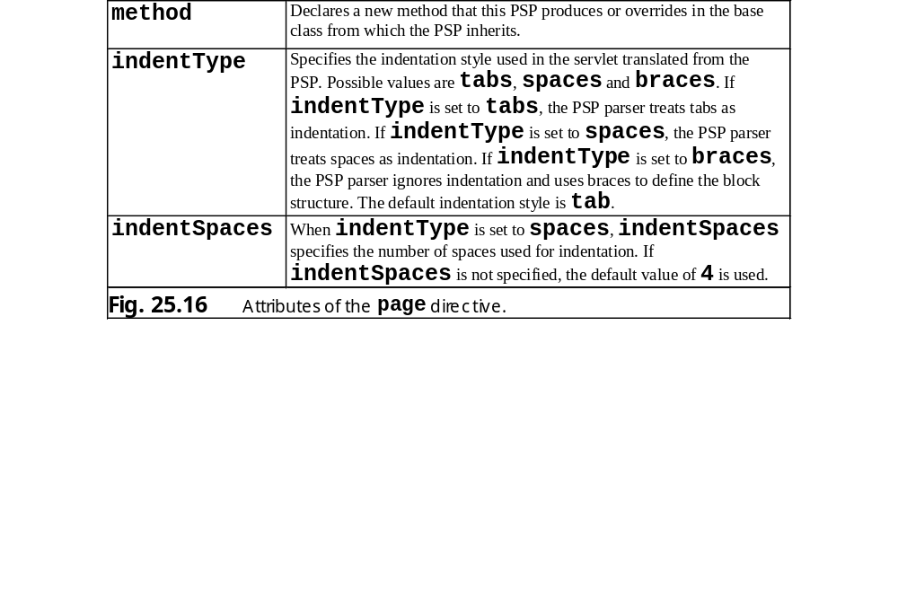
25.8.1 page Directive

Slide 44
fig25_17.py
1 # Fig. 25.17: fig25_17.py
2 # Subclass of the Page servlet.
3
4 from WebKit.Page import Page
5 from __future__ import division
6
7 class fig25_17( Page ):
8
9 def calculate( self, operand1, operator, operand2 ):
10 """Perform calculation"""
11
12 if operator == "+": # addition operation
13 result = operand1 + operand2
14 elif operator == "-": # subtraction operation
15 result = operand1 - operand2
16 elif operator == "*": # multiplication operation
17 result = operand1 * operand2
18 elif operator == "/": # division operation
19 result = operand1 / operand2
20 elif operator == "//": # floor division
21 result = operand1 // operand2
22 else: # unrecognizable operator
23 result = None
24 return result
Import Page servlet located in WebKit/Page.py
Class inherits from Page servlet
Performs calculation and returns result

Slide 45
fig25_18.py
1 <!DOCTYPE html PUBLIC "-//W3C//DTD XHTML 1.0 Strict//EN"
2 "http://www.w3.org/TR/xhtml1/DTD/xhtml1-strict.dtd">
3
4 <!-- Fig. 25.18: fig25_18.psp -->
5 <!-- PSP that extends a user-specified servlet. -->
6
7 <%-- specify indent type --%>
8 <%@ page indentType = "spaces" %>
9 <%@ page indentSpaces = "3" %>
10 <%@ page imports =
11 "PSP.Examples.ch25.fig25_17:fig25_17" %>
12 <%@ page extends = "fig25_17" %>
13
14 <html xmlns = "http://www.w3.org/1999/xhtml">
15
16 <!-- head section of document -->
17 <head>
18 <title>Calculator Result</title>
19 </head>
20
21 <!-- body section of document -->
22 <body>
23 <h1>Python Calculator Result</h1>
24
25 <%-- get client input --%>
26 <%
27 try:
28 operand1 = float( req.field( "operand1" ) )
29 operator = req.field( "operator", "+" )
30 operand2 = float( req.field( "operand2" ) )
31 noError = 1 $%>
32 <% except ValueError:
33 res.write( "You did not enter a number." )
34 noError = 0 $%>
35
Import the fig25_17 servlet
Indicates to PSP parser that the servlet produced is derived from fig25_17

Slide 46
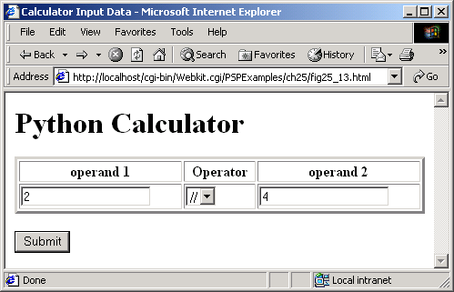
fig25_18.py
36 <%-- display expression --%>
37 <% if noError: %>
38 <br />
39 <%= operand1 %> <%= operator %> <%= operand2 %> =
40 <%= self.calculate( operand1, operator, operand2 ) %>
41 <% end %>
42 </body>
43
44 </html> <!-- end XHTML document -->

Slide 47

fig25_18.py

Slide 48
25.8.2 include Directive
Inserts contents of another PSP file as though the contents were in the file containing the directive
Changes to the included PSP file are not reflected in the PSP file with the directive
Attribute file specifies the URL of the page to include

Slide 49
fig25_19.py
1 <!DOCTYPE html PUBLIC "-//W3C//DTD XHTML 1.0 Strict//EN"
2 "http://www.w3.org/TR/xhtml1/DTD/xhtml1-strict.dtd">
3
4 <!-- Fig. 25.19: fig25_19.psp -->
5 <!-- Demonstrates the include directive -->
6
7 <html xmlns = "http://www.w3.org/1999/xhtml">
8
9 <head>
10 <title>Using the include directive</title>
11
12 <style type = "text/css">
13 body {
14 font-family: tahoma, helvetica, arial, sans-serif;
15 }
16
17 table, tr, td {
18 font-size: .9em;
19 border: 3px groove;
20 padding: 5px;
21 background-color: #dddddd;
22 }
23 </style>
24 </head>
25
26 <body>
27 <table>
28 <tr>
29 <td style = "width: 160px; text-align: center">
30 <img src = "images/logotiny.png"
31 width = "140" height = "93"
32 alt = "Deitel & Associates, Inc. Logo" />
33 </td>
34
35 <td>

Slide 50
fig25_19.py
Include banner.html
36
37 <%-- include banner.html in this PSP --%>
38 <%@ include file = "banner.html" %>
39
40 </td>
41 </tr>
42
43 <tr>
44 <td style = "width: 160px">
45
46 <%-- include toc.html in this PSP --%>
47 <%@ include file = "toc.html" %>
48
49 </td>
50
51 <td style = "vertical-align: top">
52
53 <%-- include clock2.psp in this PSP --%>
54 <%@ include file = "clock2.psp" %>
55
56 </td>
57 </tr>
58 </table>
59 </body>
60 </html>
Include toc.html
Include clock2.psp

Slide 51
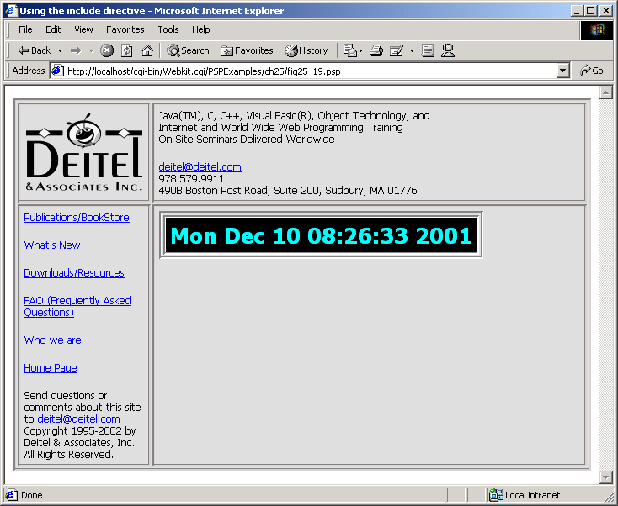
fig25_19.py

Slide 52
25.9 Case Study: Message Forums with Python and XML
Case study uses XML and several XML-related technologies to create a message forum
Message forum: “virtual” bulletin board where users discuss various topics

Slide 53
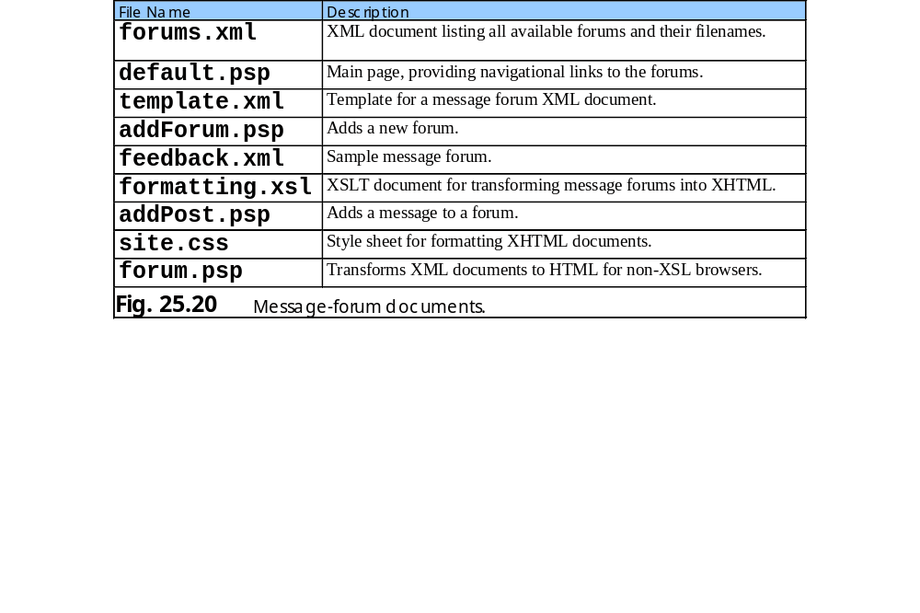
25.9 Case Study: Message Forums with Python and XML

Slide 54
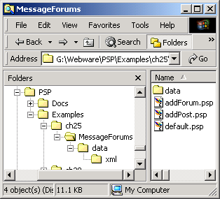
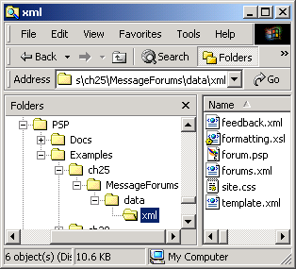
25.9 Case Study: Message Forums with Python and XML
Fig. 25.21 Directory structure of message forum.

Slide 55
25.9 Case Study: Message Forums with Python and XML
default.psp
forums.xml
addForum.psp
feedback.xml
formatting.xsl
addPost.psp
Fig. 25.22 Key interactions between message-forum documents.

Slide 56
25.9.1 Displaying the Forum
default.psp creates the message forum’s main XHTML page
Sample forum feedback.xml shows structure of a forum document

Slide 57
feedback.xml
Sample forum document
1 <?xml version = "1.0"?>
2
3 <!-- Fig. 25.23: feedback.xml -->
4 <!-- XML document representing a forum. -->
5
6 <?xml:stylesheet type = "text/xsl" href = "formatting.xsl"?>
7
8 <forum file = "feedback.xml">
9 <name>Feedback</name>
10
11 <message timestamp = "Wed Jun 27 12:53:22 2001">
12 <user>Jessica</user>
13 <title>Nice forums!</title>
14 <text>These forums are great! Well done, all.</text>
15 </message>
16
17 </forum>

Slide 58
forums.xml
Contains filename and title of every message forum
1 <?xml version = "1.0"?>
2
3 <!-- Fig. 25.24: forums.xml -->
4 <!-- XML document containing all forums. -->
5
6 <?xml:stylesheet type = "text/xsl" href = "formatting.xsl"?>
7
8 <forums>
9
10 <forum filename = "feedback.xml">
11 <name>Feedback</name>
12 </forum>
13
14 </forums>
Root element forums contains one or more forum child elements
Each forum element has attribute filename and child element name

Slide 59
default.psp
1 <?xml version = "1.0"?>
2 <!DOCTYPE html PUBLIC "-//W3C//DTD XHTML 1.0 Strict//EN"
3 "http://www.w3.org/TR/xhtml1/DTD/xhtml1-strict.dtd">
4
5 <!-- Fig. 25.25: default.psp -->
6 <!-- Default message forums. -->
7
8 <%-- import time module --%>
9 <%@ page imports = "os" %>
10 <%@ page imports = "xml.dom.ext.reader:PyExpat" %>
11 <%@ page indentType = "braces" %>
12
13 <html xmlns = "http://www.w3.org/1999/xhtml">
14
15 <head>
16 <title>Bug2Bug Message Forums</title>
17 <link rel = "stylesheet" href = "data/xml/site.css"
18 type = "text/css" />
19 </head>
20
21 <body>
22 <% # open forms.xml file
23 try: {
24 filePath = "PSP/Examples/ch25/MessageForums/"
25 XML = open( filePath + "data/xml/forums.xml" )
26 loadpage = 1
27 }
28 except IOError: {
29 res.write( "could not open file" )
30 loadpage = 0
31 }
32
Generates page that displays forum links and forum management options
PSP uses package 4DOM to parse XML
Link to CSS that formats the page

Slide 60
default.psp
33 # parse forums.xml and write XHTML markup
34 if loadpage: {
35 reader = PyExpat.Reader()
36 document = reader.fromStream( XML )
37 XML.close()
38
39 res.write( """<h1>Bug2Bug Message Forums</h1>
40 <p style="font-weight:bold">Available Forums</p>
41 <ul>""" )
42
43 # identify client browser type
44 if req.environ()['HTTP_USER_AGENT'].find( \
45 "MSIE" ) != -1: {
46 prefix = "data/xml/"
47 }
48 else: {
49 prefix = "data/xml/forum.psp?file="
50 }
51
52 # get available forums from forums.xml
53 for forum in document.getElementsByTagName( \
54 "forum" ): {
55 link = prefix + forum.attributes.item( 0 ).value
56 name = forum.getElementsByTagName( "name" )[ 0 ]
57 nameText = name.childNodes[ 0 ].nodeValue
58 res.write( '<li><a href = "%s">%s</a></li>' \
59 % ( link, nameText ) )
60 }
61
62 # add XHTML markup
63 res.write( """</ul>
64 <p style="font-weight:bold">Forum Management</p>
Create parser object
Load and parse forums.xml
Output XHTML
Returns a dictionary containing request’s environment variables
Retrieve all Element nodes that contain tag name forum

Slide 61
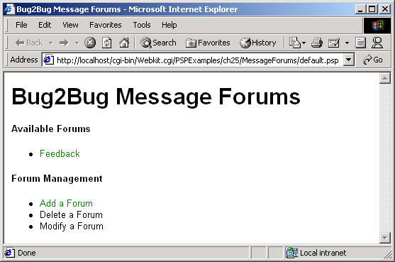
default.psp
Hyperlink to addForum.psp
65 <ul>
66 <li><a href = "addForum.psp">
67 Add a Forum</a></li>
68 <li>Delete a Forum</li>
69 <li>Modify a Forum</li>
70 </ul>""" )
71
72 reader.releaseNode( document )
73
74 } # end if
75
76 %> <!-- end script -->
77 </body>
78 </html>
Release Document object from memory

Slide 62
25.9.2 Adding Forums and Messages
addForum.psp adds forums
addPost.psp adds messages to a forum

Slide 63
addForum.psp
1 <?xml version = "1.0"?>
2 <!DOCTYPE html PUBLIC "-//W3C//DTD XHTML 1.0 Strict//EN"
3 "http://www.w3.org/TR/xhtml1/DTD/xhtml1-strict.dtd">
4
5 <!-- Fig. 25.26: addForum.psp -->
6 <!-- Adds a forum to the list of forums. -->
7
8 <%-- import modules and specify indent type --%>
9 <%@ page imports = "re" %>
10 <%@ page imports = "xml.dom.ext.reader:PyExpat" %>
11 <%@ page imports = "xml.dom.ext:PrettyPrint" %>
12 <%@ page indentType = "braces" %>
13
14 <html xmlns = "http://www.w3.org/1999/xhtml">
15
16 <head>
17 <title>Add a Forum</title>
18 <link rel = "stylesheet" href = "data/xml/site.css"
19 type = "text/css" />
20 </head>
21
22 <body>
23 <% # have form fields filled
24 if req.hasField( "name" ) and \
25 req.hasField( "filename" ): {
26 newFile = req.field( "filename" )
27
28 # filename must have suffix .xml
29 if not re.match( "\w+\.xml$", newFile ): {
30 res.write( """<h1>Error: File name should
31 end with ".xml".</h1>""" )
32 }
33 else: {
34
Test to see if required fields have been entered
Ensure that filename contains only alphanumeric characters and ends in .xml

Slide 64
addForum.psp
35 # open xml files
36 try: {
37 filePath = "PSP/Examples/ch25/MessageForums" \
38 + "/data/xml/"
39 newForumFile = open( filePath + newFile, "w" )
40 forumsFile = \
41 open( filePath + "forums.xml", "r+" )
42 templateFile = \
43 open( filePath + "template.xml" )
44 noError = 1
45 }
46 except IOError: {
47 res.write(
48 """<h1>Error: Cannot open files.</h1>""" )
49 noError = 0
50 }
51
52 # update old files and create new file
53 if noError: {
54
55 # parse old forums document
56 reader = PyExpat.Reader()
57 document = reader.fromStream( forumsFile )
58
59 # add new forum to DOM object
60 forum = document.createElement( "forum" )
61 forum.setAttribute( "filename", newFile )
62
63 name = document.createElement( "name" )
64 nameText = document.createTextNode(
65 req.field( "name" ) )
66 name.appendChild( nameText )
67 forum.appendChild( name )
68
69 documentNode = document.documentElement
Creates file for new forum
Open forum.xml for reading and writing
Open template.xml, which provides a forum’s markup
Create new forum element
Set new forum element’s filename attribute
Create forum element’s name child element

Slide 65
addForum.psp
70 firstForum = documentNode.getElementsByTagName(
71 "forum" )[ 0 ]
72 documentNode.insertBefore( forum, firstForum )
73
74 # write updated DOM object to forums document
75 forumsFile.seek( 0, 0 )
76 forumsFile.truncate()
77 PrettyPrint( document, forumsFile )
78 forumsFile.close()
79
80 # create document for new forum from
81 # template file
82 document = reader.fromStream( templateFile )
83 forum = document.documentElement
84 forum.setAttribute( "file", newFile )
85
86 name = document.createElement( "name" )
87 nameText = document.createTextNode(
88 req.field( "name" ) )
89 name.appendChild( nameText )
90 forum.appendChild( name )
91
92 # write created DOM object to new forum file
93 PrettyPrint( document, newForumFile )
94 newForumFile.close()
95 templateFile.close()
96 reader.releaseNode( document )
97
98 # forward to default page
99 trans.application().forward(
100 trans, 'default.psp' )
101
102 } # end if
103
104 } # end else
Insert new forum element so that it appears first
Write updated DOM object to truncated forums.xml
Load and parse template.xml
Write created DOM object to new forum file
Method forward directs user to default page

Slide 66
addForum.psp
105
106 } # end if
107
108 # create form
109 else: {
110 res.write( """
111 <form action = "addForum.psp" method="post">
112 Forum Name<br />
113 <input type = "text" name = "name"
114 size = "40" /><br />
115 Forum File Name<br />
116 <input type = "text" name = "filename"
117 size = "40" /><br />
118 <input type = "submit" name = "submit"
119 value = "Submit" />
120 <input type = "reset" value = "Reset" />
121 </form>
122
123 <a href = "default.psp">
124 Return to Main Page</a>""" )
125
126 } # end else
127
128 %> <!-- end script -->
129 </body>
130 </html>
Outputs the XHTML form

Slide 67
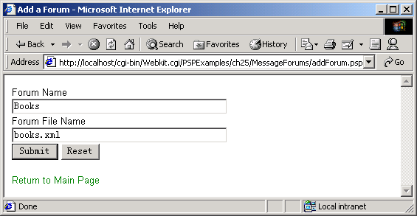
addForum.psp

Slide 68
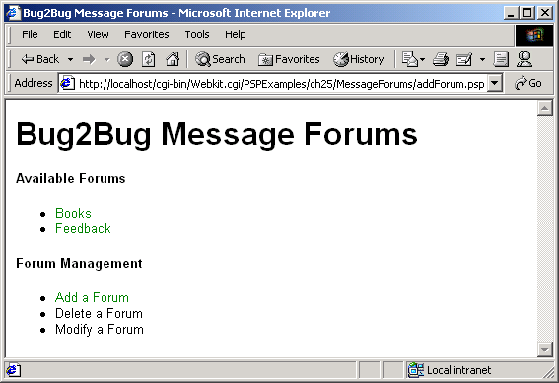
addForum.psp

Slide 69
template.xml
1 <?xml version = "1.0"?>
2
3 <!-- Fig. 25.27: template.xml -->
4 <!-- Empty forum file. -->
5
6 <?xml:stylesheet type = "text/xsl" href = "formatting.xsl"?>
7 <forum>
8 </forum>
Empty forum file

Slide 70
addPost.psp
1 <?xml version = "1.0"?>
2 <!DOCTYPE html PUBLIC "-//W3C//DTD XHTML 1.0 Strict//EN"
3 "http://www.w3.org/TR/xhtml1/DTD/xhtml1-strict.dtd">
4
5 <!-- Fig. 25.28: addPost.psp -->
6 <!-- Adds a message to a forum. -->
7
8 <%-- import modules and specify indent type --%>
9 <%@ page imports = "re, time" %>
10 <%@ page imports = "xml.dom.ext.reader:PyExpat" %>
11 <%@ page imports = "xml.dom.ext:PrettyPrint" %>
12 <%@ page indentType = "braces" %>
13
14 <html xmlns = "http://www.w3.org/1999/xhtml">
15
16 <head>
17 <title>Add a Posting</title>
18 <link rel = "stylesheet" href = "data/xml/site.css"
19 type = "text/css" />
20 </head>
21
22 <body>
23 <% # identify client browser type
24 if req.environ()['HTTP_USER_AGENT'].find( \
25 "MSIE" ) != -1: {
26 prefix = "data/xml/"
27 }
28 else: {
29 prefix = "data/xml/forum.psp?file="
30 }
31
32 # submit form
33 if req.hasField( "submit" ): {
34 filename = req.field( "file" )
35
Determine whether user has entered any information in the form

Slide 71
addPost.psp
Determine whether filename is correct
36 # filename must have suffix .xml
37 if not re.match( "\w+\.xml$", filename ): {
38 res.write( """<h1>Error:
39 File name should end with ".xml".</h1>""" )
40 }
41 else: {
42
43 # open forum xml file
44 try: {
45 forumFile = open( "PSP/Examples/ch25/" + \
46 "MessageForums/data/xml/" + filename, "r+" )
47 noError = 1
48 }
49 except IOError: {
50 res.write( """<h1>Error:
51 Cannot open files.</h1>""" )
52 noError = 0
53 }
54
55 # add message to forum xml file
56 if noError: {
57
58 # parse old forum document
59 reader = PyExpat.Reader()
60 document = reader.fromStream( forumFile )
61 documentNode = document.documentElement
62
63 # create new message element
64 message = document.createElement( "message" )
65 message.setAttribute(
66 "timestamp", time.ctime( time.time() ) )
67
68 # add elements to message
69 messageElements = [ "user", "title", "text" ]
70
Open forum’s XML file
Create new message element
Set message element’s timestamp attribute

Slide 72
addPost.psp
71 for item in messageElements: {
72
73 if not req.hasField( item ): {
74 text = "( Field left blank )"
75 }
76 else: {
77 text = req.field( item )
78 }
79
80 element = document.createElement( item )
81 elementText = document.createTextNode(
82 text )
83 element.appendChild( elementText )
84 message.appendChild( element )
85 }
86
87 # append new message to forum
88 documentNode.appendChild( message )
89 forumFile.seek( 0, 0 )
90 forumFile.truncate()
91 PrettyPrint( document, forumFile )
92 forumFile.close()
93 reader.releaseNode( document )
94
95 # forward to default page
96 trans.application().forward(
97 trans, 'default.psp' )
98
99 } # end if
100
101 } # end else
102
103 } # end if
104
Default text used if field left blank
Create user, title and text elements
Append each element as a child of message
Write updated XML to forum file
Forward to default page

Slide 73
addPost.psp
Output XHTML form
105 # create form
106 elif req.hasField( "file" ): {
107 res.write( """
108 <form action = "addPost.psp" method="post">
109 User<br />
110 <input type = "text" name = "user"
111 size = "40" /><br />
112 Message Title<br />
113 <input type = "text" name = "title"
114 size = "40" /><br />
115 Message Text<br />
116 <textarea name = "text" cols = "40"
117 rows = "5"></textarea><br />
118 <input type = "hidden" name = "file"
119 value = "%s" />
120 <input type = "submit" name = "submit"
121 value = "Submit" />
122 <input type = "reset" value = "Reset" />
123 </form>
124
125 <a href = "%s">Return to Forum</a>""" % \
126 ( req.field( "file" ), prefix + \
127 req.field( "file" ) ) )
128
129 } # end elif
130
131 else: {
132 res.write( """<h1>Error occured</h1>""" )
133 }
134
135 %> <!-- end script -->
136 </body>
137 </html>

Slide 74
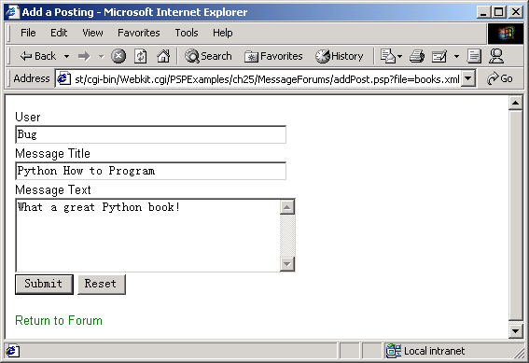
addPost.psp

Slide 75
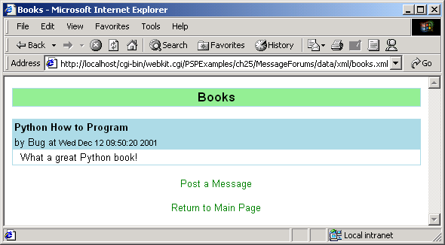
addPost.psp

Slide 76
25.9.3 Alterations for Browsers Without XML and XSLT Support
Support for XSLT currently available only for Internet Explorer 5 and higher

Slide 77
formatting.xsl
Style sheet used to transform XML forum files into XHTML
1 <?xml version = "1.0"?>
2
3 <!-- Fig. 25.29: formatting.xsl -->
4 <!-- Style sheet for forum files. -->
5
6 <xsl:stylesheet version = "1.0"
7 xmlns:xsl = "http://www.w3.org/1999/XSL/Transform">
8
9 <!-- match document root -->
10 <xsl:template match = "/">
11 <html xmlns = "http://www.w3.org/1999/xhtml">
12
13 <!-- apply for all elements -->
14 <xsl:apply-templates select = "*" />
15 </html>
16 </xsl:template>
17
18 <!-- match forum elements -->
19 <xsl:template match = "forum">
20 <head>
21 <title><xsl:value-of select = "name" /></title>
22 <link rel = "stylesheet" type = "text/css"
23 href = "site.css" />
24 </head>
25
26 <body>
27 <table width = "100%" cellspacing = "0"
28 cellpadding = "2">
29 <tr>
30 <td class = "forumTitle">
31 <xsl:value-of select = "name" />
32 </td>
33 </tr>
34 </table>
35

Slide 78
formatting.xsl
36 <!-- apply templates for message only -->
37 <br />
38 <xsl:apply-templates select = "message" />
39 <br />
40
41 <div style = "text-align: center">
42 <a>
43 <!-- href attribute for an element -->
44 <xsl:attribute name = "href">../../addPost.psp?file=<xsl:value-of select = "@file" />
45 </xsl:attribute>
46 Post a Message
47 </a>
48 <br /><br />
49 <a href = "../../default.psp">Return to Main Page</a>
50 </div>
51
52 </body>
53 </xsl:template>
54
55 <!-- match message elements -->
56 <xsl:template match = "message">
57 <table width = "100%" cellspacing = "0"
58 cellpadding = "2">
59 <tr>
60 <td class = "msgTitle">
61 <xsl:value-of select = "title" />
62 </td>
63 </tr>
64
65 <tr>
66 <td class = "msgInfo">
67 by
68 <xsl:value-of select = "user" />
69 at

Slide 79
formatting.xsl
70 <span class = "date">
71 <xsl:value-of select = "@timestamp" />
72 </span>
73 </td>
74 </tr>
75
76 <tr>
77 <td class = "msgText">
78 <xsl:value-of select = "text" />
79 </td>
80 </tr>
81
82 </table>
83 </xsl:template>
84
85 </xsl:stylesheet>

Slide 80
forum.psp
1 <?xml version = "1.0"?>
2 <!DOCTYPE html PUBLIC "-//W3C//DTD XHTML 1.0 Strict//EN"
3 "http://www.w3.org/TR/xhtml1/DTD/xhtml1-strict.dtd">
4
5 <!-- Fig. 25.30: forum.psp -->
6 <!-- Display forums for non-Internet Explorer browsers. -->
7
8 <%-- import modules and specify indent type --%>
9 <%@ page imports = "re" %>
10 <%@ page imports = "xml.xslt:Processor" %>
11 <%@ page indentType = "braces" %>
12
13 <html xmlns = "http://www.w3.org/1999/xhtml">
14
15 <head>
16 <title>Add a Forum</title>
17 </head>
18
19 <body>
20 <% # get xml filename
21 if req.hasField( "file" ): {
22 fileName = req.field( "file" )
23
24 # filename must have suffix .xml
25 if not re.match( "\w+\.xml$", fileName ): {
26 res.write( "<h1>Error:Invalid xml file</h1>" )
27 }
28 else: {
29
30 # open forum xml file and style sheet
31 try: {
32 filePath = "PSP/Examples/ch25/MessageForums" \
33 + "/data/xml/"
34 style = open( filePath + "formatting.xsl" )
35 XMLFile = open( filePath + fileName )
Displays forums for non-Internet Explorer browsers
Open style sheet
Opens forum XML file

Slide 81
forum.psp
36 noError = 1
37 }
38 except IOError: {
39 noError = 0
40 }
41
42 # translate xml to html
43 if noError: {
44 processor = Processor.Processor()
45 processor.appendStylesheetStream( style )
46 results = processor.runStream( XMLFile )
47 style.close()
48 XMLFile.close()
49 res.write( results )
50 }
51
52 } # end else
53
54 } # end if
55
56 else: {
57 res.write( "Error: No file supplied" )
58 }
59
60 %> <!-- end script -->
61 </body>
62 </html>
Apply style sheet to XML document

Slide 82
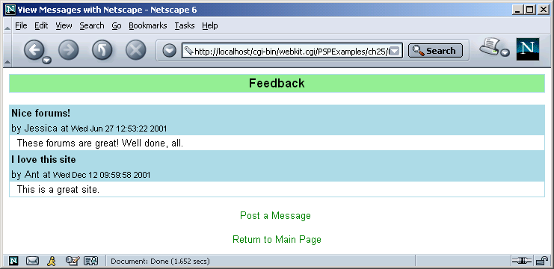
forum.psp

