Slide 1
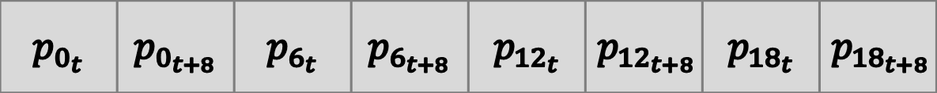
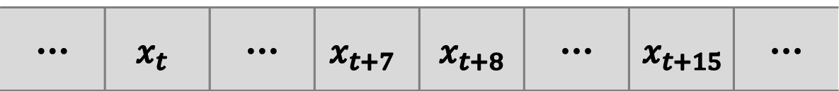




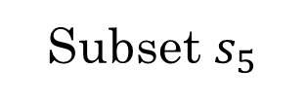

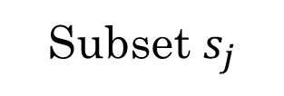

Video Dataset
Day $d_{i}$
Day $d_{i+1}$
Subset $s_{0}$
Subset $s_{j}$
Subset $s_{5}$
...
$$f_{0}$$
... | $$x_{t}$$ | ... | $$x_{t+7}$$ | $$x_{t+8}$$ | $$\text{...}$$ | $$x_{t+15}$$ | ...
$$p_{0_{t}}$$ | $$p_{0_{t+8}}$$ | $$p_{6_{t}}$$ | $$p_{6_{t+8}}$$ | $$p_{{12}_{t}}$$ | $$p_{{12}_{t+8}}$$ | $$p_{{18}_{t}}$$ | $$p_{{18}_{t+8}}$$
...
...
...
Batch
...
...
...
$$f_{6}$$
$$f_{12}$$
$$f_{18}$$
Fetch Batch
Batch Loader
Batch Loader
Batch Loader
Cache Batches
Cache Batches
Training Operator
Fetch Batches
Sync. Cache

