Slide 1
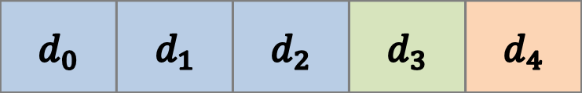

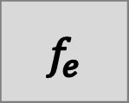

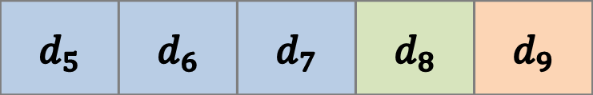
Capturing Period $p_{0}$
$$d_{0}$$ | $$d_{1}$$ | $$d_{2}$$ | $$d_{3}$$ | $$d_{4}$$
Training Data Set
$$f_{e}$$
Evaluation Data Set
$$d_{5}$$ | $$d_{6}$$ | $$d_{7}$$ | $$d_{8}$$ | $$d_{9}$$
Capturing Period $p_{1}$

