Slide 1

Autism Hackathon Use Case 3: Machine Learning
Presented by:
Noha Elprince, Olive Kingsley, Hanen Bondka, Anita Mohanani Rishi Bhatnagar, Dhruv Bhatnagar, Peter Shand, Halaa Menasy, Adam Pryce, and Ryan Carpenter
SME:
Richard M. Kubina and Nate Green

Slide 2

AGENDA
Problem Statement
Methodology
PCA
K-Means Cluster Model
Cluster Analysis
Insights
Next Steps

Slide 3
Problem Statements
Problem Statement #1 - Identify peer group for a patient to compare progress against and the most important features in the data
Problem Statement #2 - Determine whether progress is being made based on assessment

Slide 4
Methodology
Visualization of different patterns
Dataset
t-SNE
Cluster Model (K-Means, GMM)
Important cluster variables
PCA
Cluster profiling
Principal component analysis (PCA) is used to reduce the dimensionality. It finds a new set of dimensions such that all the dimensions ranked according to the variance of data along them.
t-SNE is used to reduce the dimensionality, data visualization and for outlier detection. It is used to map high dimensional data to 2 or 3 dimensions in order to visualize it.
Cluster Labelling
insights

Slide 5
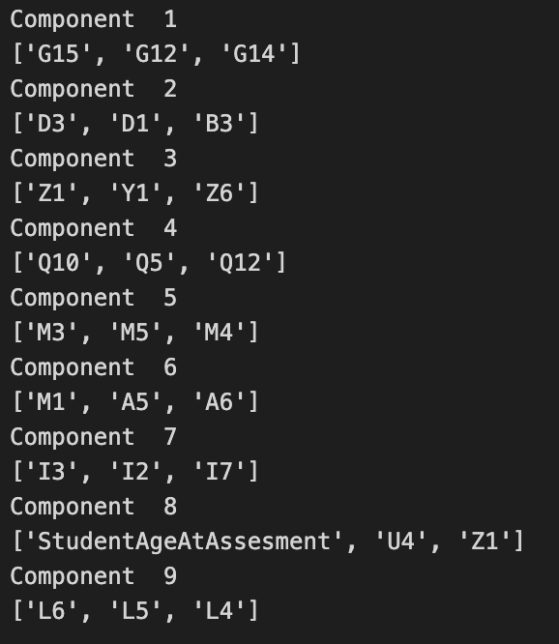
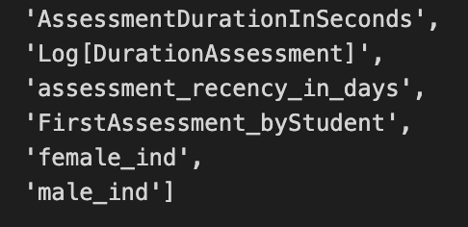
PCA
Feature selection was based on the most important features in the dataset with the highest variance sorted descending based on the absolute value PCA loadings
Total explained variance of those top features = 60%
Added features

Slide 6
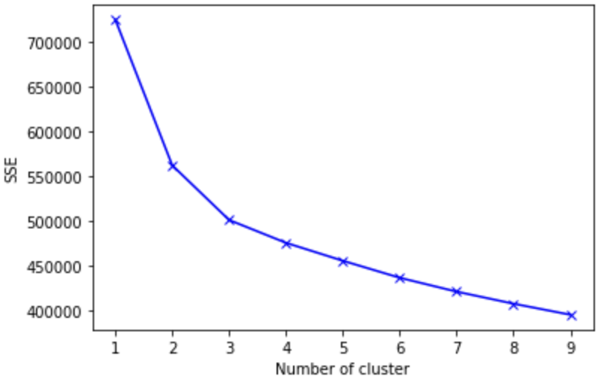
K-Means Cluster Model
Dataset dimensions are 23,354 rows and 32 columns
Quality issue appeared with the Assessment date, so we needed to drop the “assessment_receny_in_days” feature
Silhouette score for 3 clusters =0.15
Cluster label | counts
0 | 9932
1 | 6718
2 | 6704

Slide 7
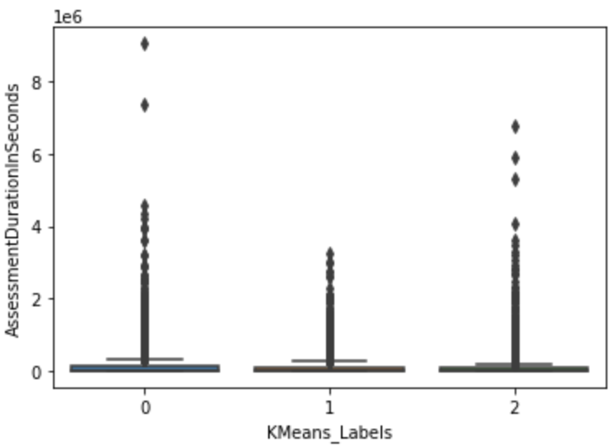
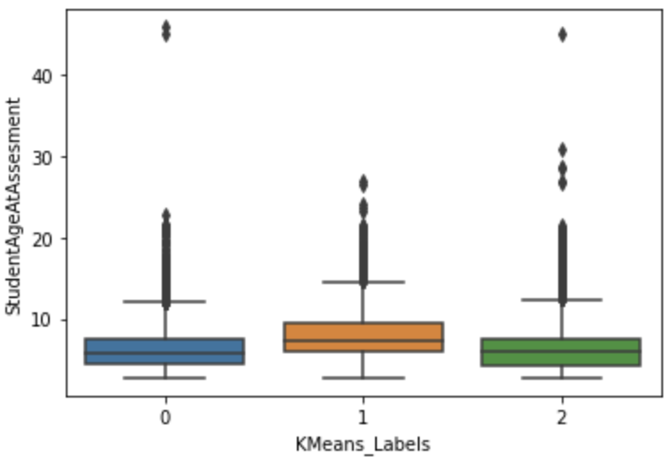
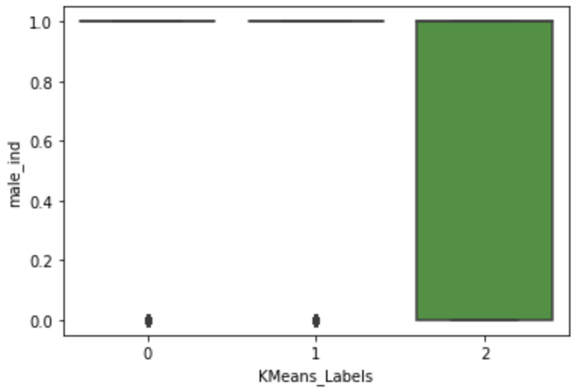
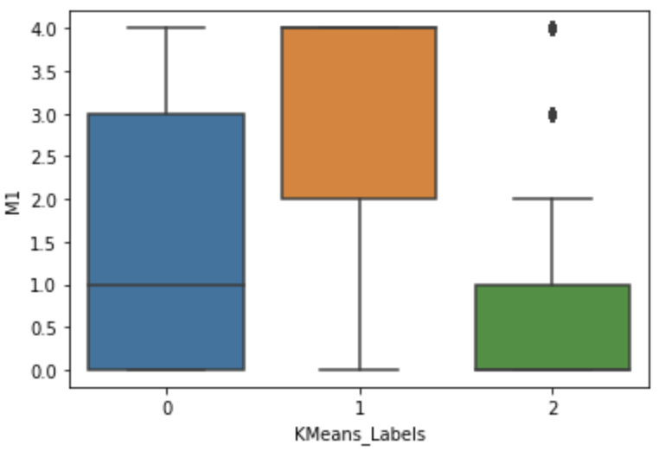
Cluster Analysis
Cluster 0 and 2 takes more time to complete the assessment
Older kids with Autism are in cluster 0 and 2 which takes more time to complete the task than cluster 1
Males mainly are concentrated in cluster 2
For assessment M1, cluster 1 median outperforms
other clusters in ratings, followed by cluster 0 then 2

Slide 8
Insights
Data curation
Data cleaning - e.g., future dated assessments, date of births, missing gender, etc.
Data compaction – from 544 skills to 25 behaviors – unweighted means, weighted means, bucketing
Data analysis
Lean metadata – age, gender are very broad dimensions to profile
Visualizing the data
https://jolly-desert-01b5c5610.3.azurestaticapps.net/

Slide 9
Next Steps
Depth vs breadth of data
Quality of data collection
Predictive model instead of only cluster analysis
More metadata
Data accuracy
Capture videos and overlap with video analysis

