Slide 1

FSI Hackathon for Autism 2026
USE CASE 4: AI AMBIENT GUARDIAN
Behavioral Twin
+ Intent Engine
S1
S2
AI
AI Ambient Guardian for Semi-Independent Living
Privacy-first AI for detecting risk, intent, and behavioral drift in real time
S3
“We detect intent—not just motion.”
Notes:
We’re presenting Use Case 4: the AI Ambient Guardian—a privacy-first ambient AI system for semi-independent living. The core innovation is that we don’t just detect motion—we understand intent. Our system combines edge vision, IoT sensors, and a behavioral reasoning layer to distinguish routine from emergency in real time, without constant human monitoring.

Slide 2
MEET OUR TEAM
PAVAN
KUMAR
CHARAN
TEJ
DEEP
GAUTAM
ZION
DU
NICHOLAS
ONEIL
Full Stack Developer
Full Stack Developer
Full Stack Developer
AI & Machine Learning
Microsoft Azure CSA
Cross-functional team spanning behavioral AI, edge computing, and Azure cloud architecture
Notes:
We’re a five-person global team. Each member maps to a key layer of the system—from edge AI and behavioral modeling to Azure infrastructure and full-stack development. This alignment let us design and build the full pipeline end-to-end within the hackathon timeline.

Slide 3
The Challenge: Safety Without Surveillance
What current systems miss
Constant human monitoring is intrusive and unsustainable
Traditional systems rely on reactive motion thresholds
High false positives create alert fatigue
Early warning signs are often missed
Residents lose independence when safety requires constant hovering
Current system
Our system
Motion detected
2:30 AM wake pattern
Unknown cause
Moved toward door
No context
No return behavior
Reactive only
Likely elopement risk
Current systems detect motion — but they don’t understand intent.
Notes:
Current safety systems rely on reactive motion thresholds. They trigger alerts without context, creating fatigue and missed warnings. The side-by-side comparison shows the gap: a traditional system sees motion and stops there. Ours traces the full behavioral sequence—wake pattern, door approach, no return—and classifies it as risk. The problem isn’t detection. It’s understanding.

Slide 4
Hackathon Requirements → Our Solution
Requirements
Our Implementation
Detect routine vs emergency behavior
Use Edge AI and sensor fusion
Identify high-risk events:
Falls
Wandering / elopement
Behavioral anomalies
Enable semi-independent living without constant monitoring
Behavioral Twin:
Learns individual routines
Establishes baseline behavior
Intent Engine:
Interprets deviations
Explains risk in context
Multimodal signal fusion:
Vision (privacy-safe events only)
IoT sensors
Real-time classification:
NORMAL
ELEVATED_RISK
EMERGENCY
ELOPEMENT_RISK
We directly solve the requirement: distinguishing routine vs emergency behavior in real time.
Notes:
This slide maps requirements directly to what we built. The Behavioral Twin handles routine learning. The Intent Engine handles deviation interpretation. Multimodal fusion covers the sensor requirement. And our four-level classification system handles real-time output. We don’t just meet the requirements—we go further with behavioral drift detection and explainability.

Slide 5
Ambient AI Guardian: How It Works
BT
IE
AM
Behavioral
Twin
Intent
Engine
Ambient
Monitoring
Learns individual routines
Establishes behavioral baselines
Interprets deviations with context
Explains risk to caregivers
Edge vision + IoT sensor fusion
Privacy-first by design
From detection → to understanding
Notes:
Our solution has three pillars. The Behavioral Twin learns each resident’s daily routines and tracks patterns over time—it defines what normal looks like. The Intent Engine goes beyond anomaly flagging—it interprets deviations and explains why something is a risk. Ambient Monitoring fuses vision and IoT data while keeping privacy at the core. Together, they move us from simple detection to genuine understanding.

Slide 6
End-to-End System Architecture
Edge Devices
Azure IoT Hub
Azure Stream Analytics
AI Layer
Dashboard
Vision
IoT Sensors
Ingestion
Sequence
Dwell time
Behavioral Twin
Intent Engine
Alerts
Narrative
Time-window analysis, zone transitions, and dwell-time computation
Privacy-safe vision produces structured behavioral events — no raw video leaves the edge
Real-time event routing via managed Azure messaging
Behavioral modeling + intent classification: NORMAL / ELEVATED_RISK / EMERGENCY / ELOPEMENT_RISK
Live caregiver dashboard with explainable narrative timeline
Azure-native pipeline: edge signals → streaming → behavioral AI → explainable caregiver action
Notes:
This is our Azure first-party pipeline, end to end. Edge devices run privacy-safe vision that produces structured events—not raw video. Azure IoT Hub handles real-time ingestion. Stream Analytics computes time windows, transitions, and dwell metrics. The AI layer runs the Behavioral Twin and Intent Engine for classification. Everything surfaces through a caregiver dashboard with alerts and an explainable narrative timeline.

Slide 7
Data Stream Access Control
Data Producers
Access Control Layer
Authorized Consumers
Vision Agent
Access Gateway
AI Services
AI (Decision Engine)
Policy Engine
Behavioral Twin Model
Caregiver Interface
Secure Topics / Streams
Intent Engine
Health Analytics
Alerting / Notification Systems
Access Model
Policy-based access control
Scoped data access per service
Event-level permissions
Privacy-preserving (no raw video exposure)
Only authorized services access the minimum required behavioral signals — never raw surveillance data
Notes:
This slide shows how we control data flow between system components. On the left, three data producers: the Vision Agent that generates behavioral events, our AI decision engine, and the Caregiver Interface. In the middle, the access control layer enforces policy-based permissions—each service only gets the specific behavioral signals it needs, nothing more. On the right, authorized consumers like the Behavioral Twin, Intent Engine, and alerting systems. The key point: no service ever touches raw video. Everything flows as structured events through scoped, permission-controlled streams. This is how we deliver privacy by architecture, not just by policy.

Slide 8
Vision Service: Structured Behavioral Events
Seeing Without Storing Video
Sample Behavioral Event Output
Runs edge-based vision models (YOLO for pose + movement detection)
Detects behavior, not identity
Tracks:
Movement patterns and entropy
Walking speed and gait
Zone crossings and boundary violations
Pose-based fall detection
Post-fall inactivity duration
Outputs structured behavioral events (no raw video stored or transmitted)
{
"event": "FALL_DETECTED",
"confidence": 0.91,
"camera_id": "bedroom_1",
"pose_confidence": 0.88,
"post_fall_inactivity_seconds": 45,
"timestamp": "2026-03-01T02:15:30Z"
}
Structured event — no pixels, no video frames, no PII. Just behavioral signals the AI layer needs.
Privacy-first: we publish signals, not surveillance footage.
Key: event type + confidence + context = actionable signal for the Intent Engine
All downstream AI operates on structured behavioral events, never raw video.
Notes:
This slide explains our edge vision pipeline. We run YOLO models directly on edge hardware—a Jetson Nano or equivalent—for real-time pose estimation and movement detection. The critical design choice: we never store or transmit raw video. Instead, the system publishes structured behavioral events like the JSON example shown here. A fall detection event includes the event type, confidence score, camera zone, pose confidence, and how long the person has been inactive after the fall. This is what the downstream AI layer actually needs—not pixels, not video frames, just actionable behavioral signals. It’s privacy-first by design: we see patterns, not people.
YOLO = YOU ONLY LOOK ONCE.
“YOLO is the model that lets us detect human posture and movement in real time. It looks at the entire scene once and produces structured behavioral signals instead of raw video, which is critical for both performance and privacy.”
A Jetson Nano is a small edge AI computer made by NVIDIA.
👉 Think of it as: a mini-computer with a built-in GPU designed to run AI models (like YOLO) locally.

Slide 9
Intent Engine: AI Reasoning and Decision Making
Making Sense of Behavioral Signals
AI Decision Output (VisionAgentOutput)
Combines multiple inputs:
Vision events (pose, movement, inactivity)
Behavioral Twin anomaly score
Context (time of day, location)
Optional health signals (heart rate, activity)
Uses an AI reasoning engine to interpret context
Distinguishes true risk from normal variation
Produces explainable outputs for caregivers
{
"severity": "HIGH_RISK",
"confidence": 0.87,
"event_type": "SUSPECTED_FALL",
"reasoning": "Person horizontal
for 45s post-movement spike.
Heart rate elevated.
No manual distress signal.
Behavioral deviation from
2AM routine.",
"recommended_action":
"voice_confirmation_then_escalate"
}
From signals → to meaning → to action
Every decision includes human-readable reasoning — no black-box outputs.
Severity + confidence + reasoning = explainable, actionable decisions
AI reasoning transforms anomalies into actionable, explainable decisions
Notes:
This is our key differentiator. Most systems stop at anomaly detection—they flag deviations but don’t explain them. We add an Intent Engine on top of the Behavioral Twin. It takes the anomaly signal, layers in context and reasoning, and produces an explainable classification. Four clear levels: Normal, Elevated Risk, Emergency, and Elopement Risk. Each comes with a reason, not just a score.

Slide 10
Live Risk Detection Scenarios
R
Routine
F
Fall
Normal transitions
Expected timing
Movement spike
No recovery
NORMAL
EMERGENCY
D
Drift
W
Wandering
Gradual change
Predictive early warning
Night activity
Exit risk
ELOPEMENT_RISK
ELEVATED_RISK
Drift is the differentiator: predicting decline before it becomes a crisis.
Notes:
Four scenarios that prove the system works. Routine activity is correctly classified as normal. A fall triggers emergency—movement spike followed by no recovery. Nighttime wandering escalates to elopement risk based on path and timing. And behavioral drift—this is the differentiator. We detect gradual changes over days and weeks, giving early warning before a crisis develops.

Slide 11
Caregiver Decision Support: Narrative + Explainable AI
Resident Status
GREEN
YELLOW
RED
Explainable AI
Alert triggered because:
•
Unusual time (2:30 AM)
•
Unexpected path toward exit
Bed
Bath
Hall
Door
•
No return movement
Narrative timeline: sequence of zones, states, and risk transitions over time
Possible fall detected in bathroom. No movement for 6 minutes. Caregiver notified with full context.
Notes:
This is the caregiver experience. On the left, a narrative timeline showing zone transitions and state changes with color-coded risk levels. On the right, the explainable AI output—not just an alert, but why it was triggered: unusual time, unexpected path, no return movement. Caregivers trust this because it shows its reasoning. It’s a decision support layer.

Slide 12
Impact: Why This Wins
Independence with safety and dignity
SL
SC
RD
Safer Living
Smarter Care
Respectful Design
Faster, targeted intervention
Fewer false alarms
Context-driven decisions
Reduced caregiver burden
No intrusive surveillance
Privacy-first, always
We see patterns — not people.
Notes:
Three outcomes that matter. Safer Living: faster intervention, more accurate escalation. Smarter Care: contextual decisions that cut alert fatigue. Respectful Design: no intrusive cameras, no constant monitoring—privacy by design. The bottom line: we see patterns, not people. This system delivers independence with dignity.

Slide 13

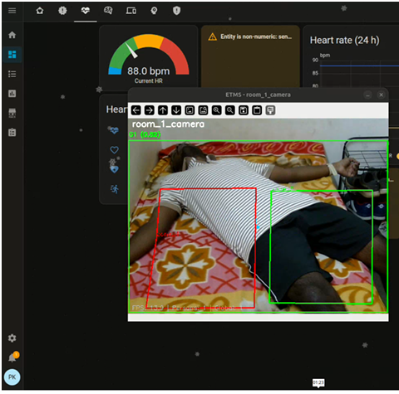
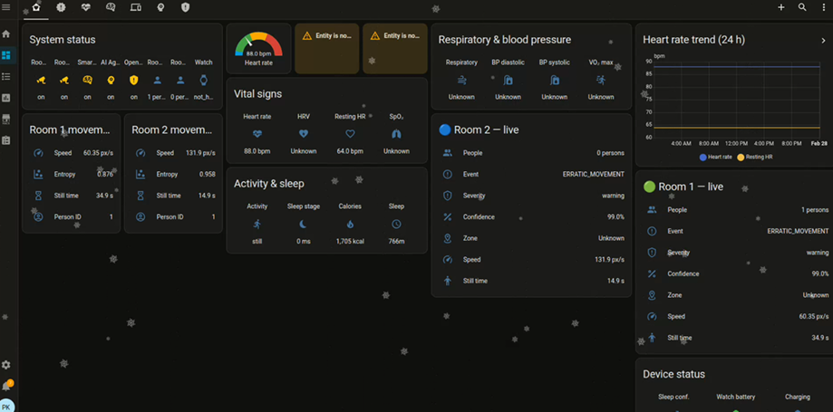
LIVE DEMO
What You’ll See
End-to-End System in Action
What Makes This Different
Edge vision detecting behavior (pose + motion)
Structured event generation (no raw video)
Behavioral Twin identifying deviations
Intent Engine reasoning about risk
Real-time classification:
NORMAL
ELEVATED_RISK
EMERGENCY
Alerting and caregiver notification
Privacy-first (no video streaming)
Context-aware decision making
Intent, not just anomaly detection
Behavioral drift detection
Explainable AI outputs
From perception → behavior → intent → action
Notes:
Pavan Kumar and Charan Tej, shared us a demo, it’s not just a single AI model. It is a distributed microservices architecture where each service has exactly one responsibility and communicates through a local, encrypted MQTT event bus. Think of it as 10 specialists in the same room, each focused on their domain, sharing information through a structured protocol.
(403) Autism Hackathon - YouTube

