Slide 1
Artificial eloquence: computer-generated haiku
DD2380 Class Project
Vanya Avramova, Rémi Domingues, Ahmed Kachkach, Johan Wikström

Slide 2
What is haiku?
Short form of traditional Japanese poetry, originating in the 17th century
Values simplicity and brevity
Traditional Japanese haiku follow strict rules:
Structure: syllables constraint
Cutting ("kireji"): juxtaposition of ideas
Seasonal theme ("kigo")

Slide 3
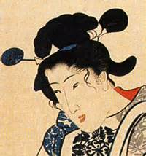
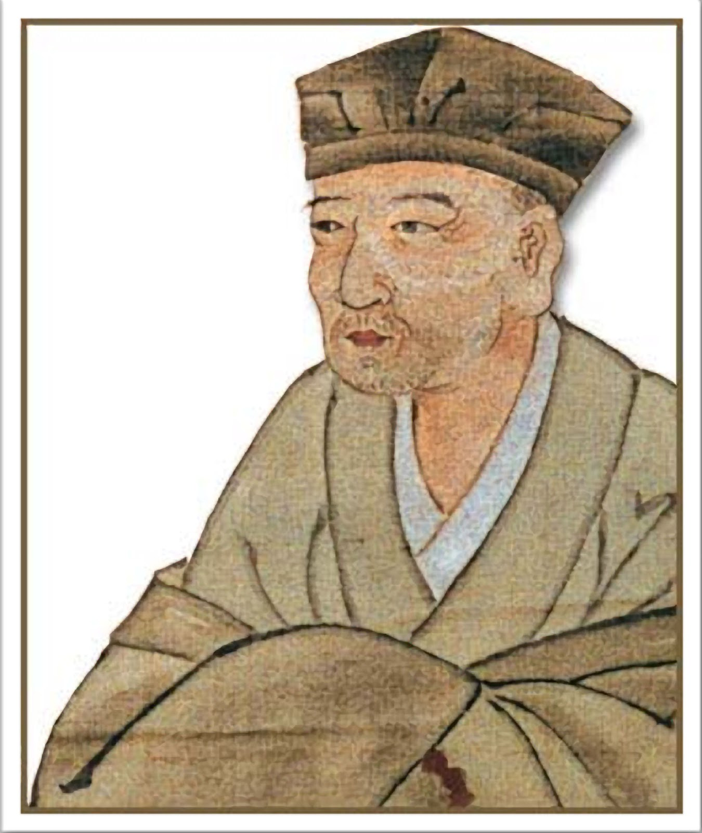
Matsuo Basho (1644 – 1694):
an ancient pond
a frog jumps in
the splash of water
Fukuda Chiyo-ni (1703-1775):
a dandelion
now and then interrupting
the butterfly's dream

Slide 4
Modern haiku
Popular and written in many languages
Unlikely to follow the syllables constraint
Free subject
Main point: juxtaposition of ideas

Slide 5
Background: Computer generated poetry
Multistage process with grammatical and semantic constraints
Creative choices of words
By nature, poems vary in structure and word choice
Netzer et al. - WAN (Word Association Norms) vs WordNet

Slide 6
Our method: preprocessing
Scraping haiku from the web
Extract common grammatical structures
('NN', 'VBG', 'NN') , 48
POS-tag the haiku corpus
Extract common stop words
('the', 'a', 'an')
Compute Markov Chains
Prepositions
('run', 'on'): 0.35, ('jump', 'in'): 0.21

Slide 7
Our method: generation
Seed words
(winter, snow)
Use WAN/WordNet
(NN,VB,JJ,RB)
For each POS tag in the haiku
Use Markov Chains
Apply pluralization, conjugate verbs & avoid repeating words
(IN)
other
Use random stop word

Slide 8
Result Samples
Cat life spouses— A hug Through every kindness
The atomic snows —
Had solidifications
Songbirds formed
An excessive desire— Fornicate wives Under theology exegeses
Over some winter—
Metropolis died
This life time
Big brontosaurus—
Keep
At the movie
No study understanding— Worlds Of no mathematics

Slide 9
THE experiment
100 generated haiku: 50 from WAN, 50 from WordNet, random seed words
15 haiku selected by the team: 5 from WAN, 5 from WordNet, 5 from humans
Poll:
Rating
Grammatical correctness
Coherent meaning
Was the haiku generated by a human or a machine?

Slide 10
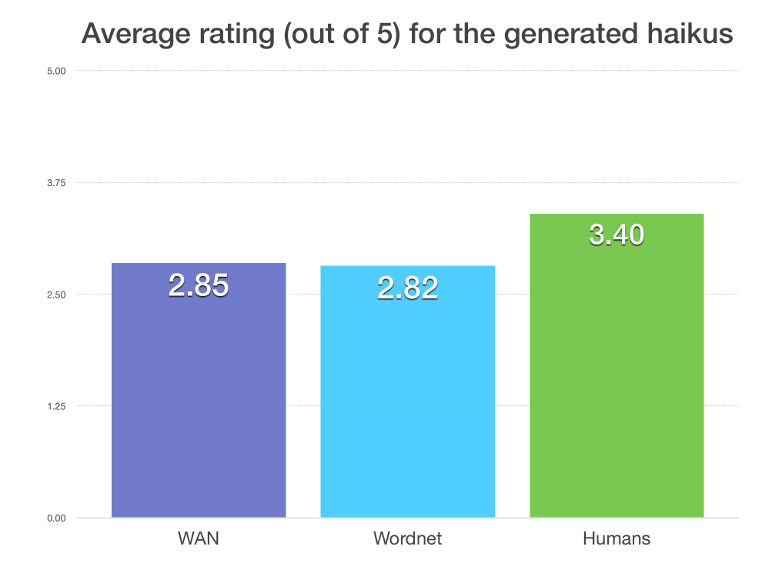
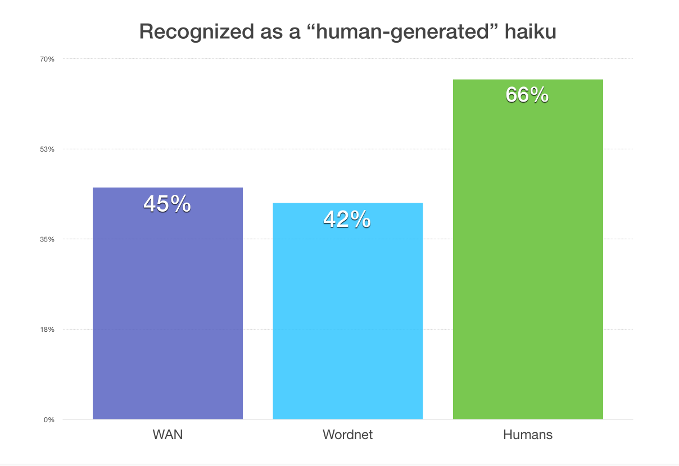
Results

Slide 11
conclusion
More than 40% of the haiku in the poll were perceived as human generated
WAN and WordNet:
Similar rating and perception
Different style
WAN: emotional similarity between words
WordNet: formal language based on dictionary meaning

Slide 12
QUESTIONS?... COMMENTS?...

