Slide 1
Lecture 6: Structural equation modelling 2: Path analysis
Notes:
SEM is best viewed as an broad-based modelling framework with a number of core, common features:
• a focus on both latent and observed random variables
• a capacity to include multiple endogenous variables
• a primary focus on linear relationships (though non-linear is possible. . . e.g., item response models)
• common estimation methods (either ML or WLS)
• an emphasis on the global fit of models to restrictive hypotheses
• use of path diagrams for model specification and interpretation
The traditional types of model specifications in SEM are: - path analysis - confirmatory factor analysis
(better referred to as restricted factor analysis)

Slide 2
SEM
x1
x2
Correlation
x1
y
Regression
x1
y
Multiple regression
x2
Notes:
Conventional Analyses in SEM
But the following statistical techniques can also be undertaken in SEM (not always as straightforwardly as in,
e.g., SPSS).
• correlational analysis
• multiple linear regression
• t tests (independent and dependent)
• ANOVA (of various forms)
• exploratory factor analysis (better referred to as unrestricted factor analysis)

Slide 3
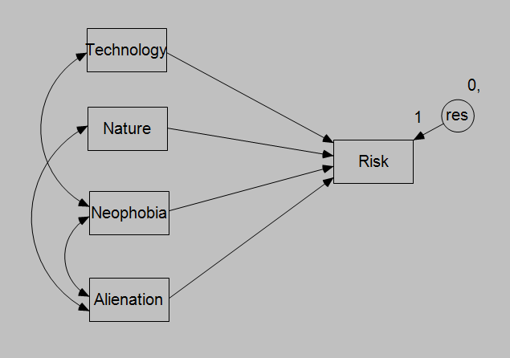
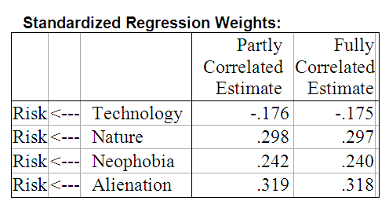
This model is ‘over-identified’ and thus can be tested for significance.

Slide 4
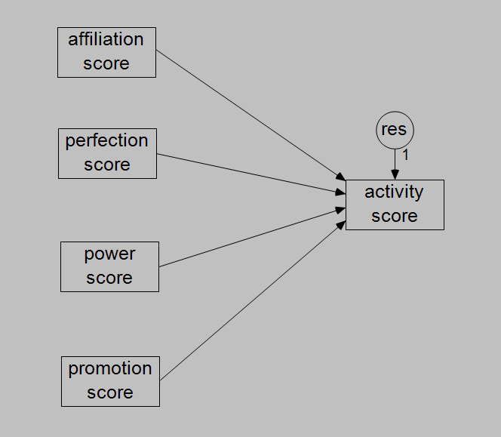
Latent Variable regression
Some real advantages come about when we have latent variables in the model
ie a combined factor-regression analysis

Slide 5
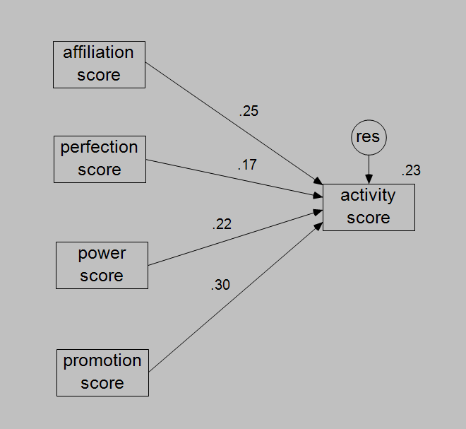
Squared Multiple Correlation = .226

Slide 6
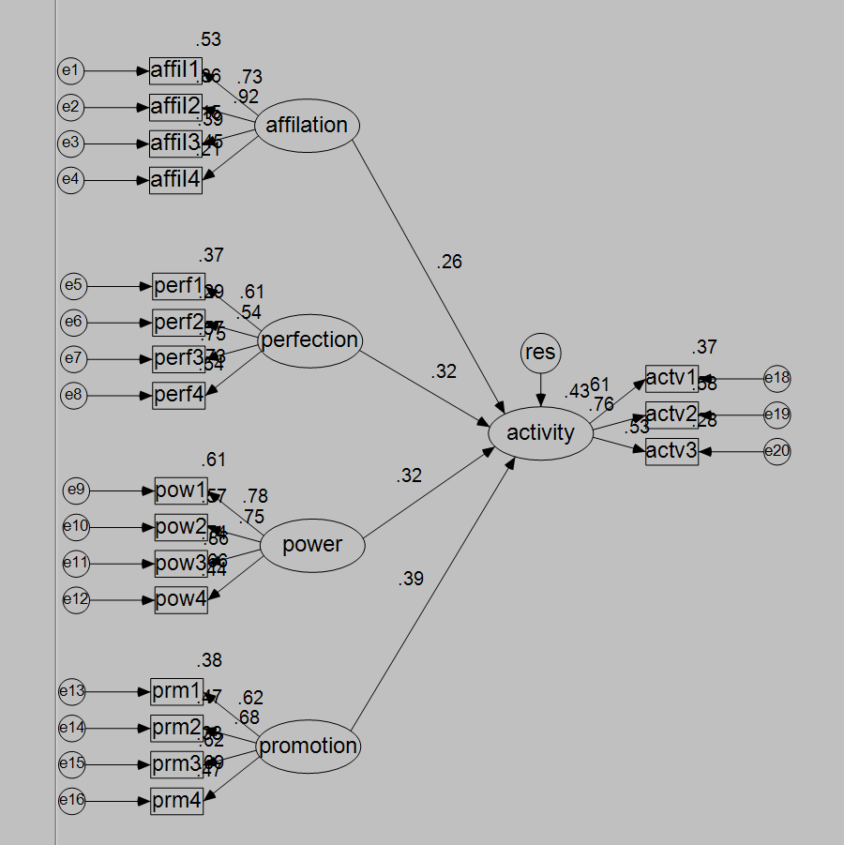
Squared Multiple Correlation = .425

Slide 7
Comparison
 | Manifest | Latent
affiliation | .25 | .26
perfection | .17 | .32
power | .22 | .32
promotion | .30 | .39
Variance Accounted for | .226 | .425

Slide 8
Multi step regressions
Section 2

Slide 9
Multi-Step Path Analysis
Some variables are predictors [A]
Some variables are predicted [B]
Some variables are both predictors and predicted [M]
A → M → B
Such intervening variables [like M] may be considered as mediating the relationship between A and B.

Slide 10
A simple example: Women’s health study
Survey of 465 females on a variety of health issues (Hoffman & Fidell, 1979 – reported in Tabachnik & Fidell, 2013).
One interest was in usage of health facilities (eg. Frequency of visits to health professionals – TIMEDRS).
Other variables:
Age, Stress, Self esteem (esteem), Self reported Physical health (phyheal)

Slide 11
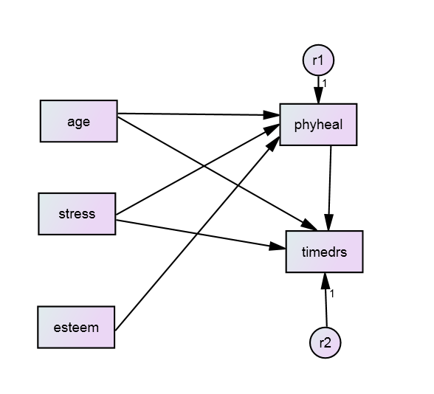
A simple example: Women’s health study
Proposed theoretical model
Requires two regressions:
Regress phyheal on age, stress, esteem
Regress timedrs on age, stress, phyheal

Slide 12
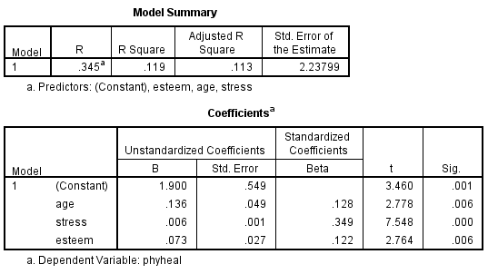
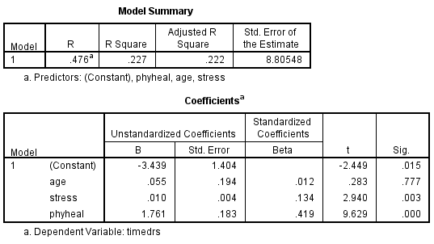
A simple example: Women’s health study
Two regressions:
Regress phyheal on age, stress, esteem
Regress timedrs on age, stress, phyheal

Slide 13
But how do we combine them?
Overall Fit:
No overall significance test
Can estimate ‘generalized squared multiple correlation’ R_{m}² = 1 – Π(1- R_{i}² ) where R_{i}² is the SMC for each of the i regression equations.
R_{m}² = 1 – (1 - .119) × ( 1 - .227)
= 0.32

Slide 14
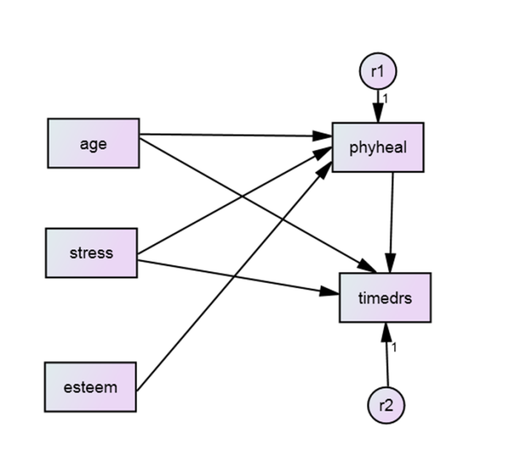
But how do we combine them?
The impact of antecedent variables on the dependent variable:
Directly antecedent variables: β [called Direct Effects]
Indirect (multiple sequential arrows) = Π β (ie multiply the β’s together) [called Indirect Effects]

Slide 15
Direct and indirect effects
Direct Effects on Timedrs
β_{age} = 0.012
β_{stress} = 0.134
β_{phyheal} = 0.419
Indirect effects
β_{age (via phyheal)} = 0.128 × 0.419 = 0.054
β_{stress (via phyheal)} = 0.349 × 0.419 = 0.146
β_{esteem (via phyheal)} = 0.122 × 0.419 = 0.051

Slide 16
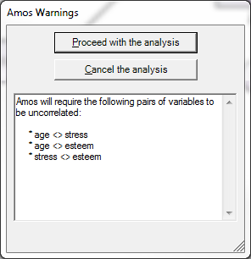
Structural equation model
AMOS is suspicious of uncorrelated predictors (exogenous)

Slide 17
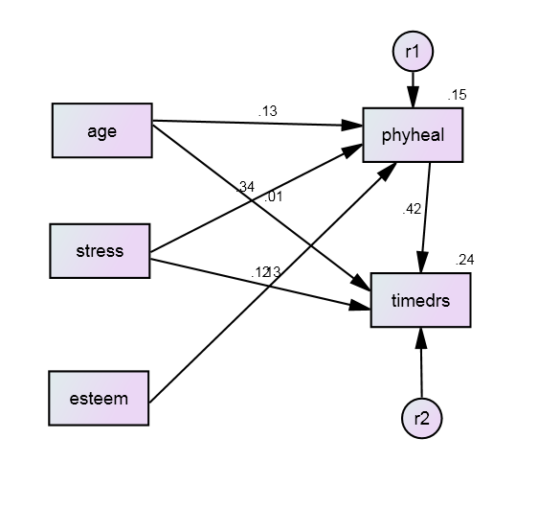
Standardized estimates

Slide 18
Unstandardized estimates
 |  |  | Estimate | S.E. | C.R. | P | Label
phyheal | <--- | age | .136 | .047 | 2.913 | .004
phyheal | <--- | stress | .006 | .001 | 7.948 | ***
phyheal | <--- | esteem | .073 | .026 | 2.785 | .005
timedrs | <--- | phyheal | 1.761 | .182 | 9.661 | ***
timedrs | <--- | age | .055 | .186 | .297 | .767
timedrs | <--- | stress | .010 | .003 | 3.055 | .002
Squared Multiple Correlations: Estimate
phyheal .148
timedrs .237

Slide 19
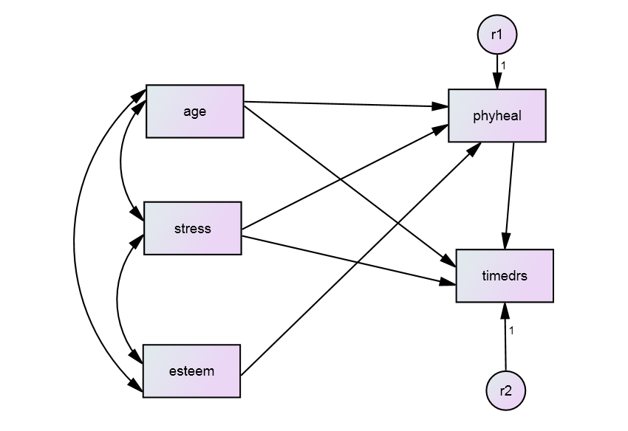
Include correlations among exogenous predictors

Slide 20
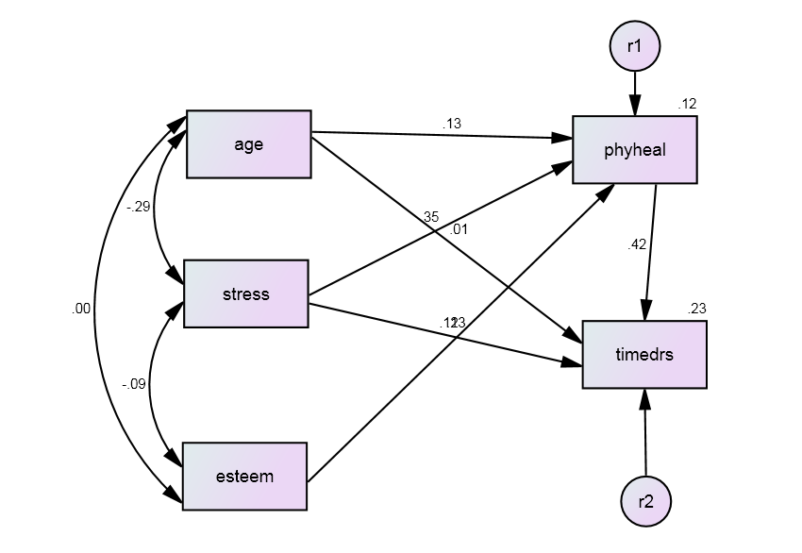
Include correlations among exogenous predictors
Squared Multiple Correlations: Estimate
phyheal .119
timedrs .227

Slide 21
Model fit
Section 3

Slide 22
Assessing fit
"With respect to model fit, researchers do not seem adequately sensitive to the fundamental reality that there is no true model [...], that all models are wrong to some degree, even in the population, and that the best one can hope for is to identify a parsimonious, substantively meaningful model that fits observed data adequately well. At the same time, one must recognize that there may well be other models that fit the data to approximately the same degree. Given this perspective, it is clear that a finding of good fit does not imply that a model is correct or true, but only plausible. These facts must temper conclusions drawn about good-fitting models. (MacCallum & Austin 2000, p.218)

Slide 23
Model Test Statistics
Model Test Statistics ask: “Is the variance-covariance matrix implied by your model sufficiently close to your observed variance-covariance matrix that the difference could plausibly be due to sampling error?”
Model Chi-Square Test (χ² test)
χ² = 0 with perfect model fit, and increases as model misspecification increases. p = 1 with perfect model fit, and decreases as model misspecification increases.
Non-significant Chi-Square test indicates the model is consistent with the observed variance-covariance matrix.
Significant Chi-Square insufficient in itself to determine whether a model should be rejected, but can be treated as a ‘smoke alarm’ in relation to model fit.
χ² is strongly affected by multivariate non-normality, correlation size, the size of unique variances, and sample size.

Slide 24
Approximate Fit Indices
Approximate Fit Indices ignore the issue of sampling error and take different perspectives on providing a continuous measure of model-data correspondence.
Three main flavours available under ML estimation:
1. Absolute Fit Indices (proportion of the observed variance-covariance matrix explained by model), e.g. SRMR.
2. Comparative Fit Indices (relative improvement in fit compared to a baseline), e.g. CFI.
3. Parsimony-adjusted-indices (compare model to observed data but penalise models with greater complexity) e.g. RMSEA.

Slide 25
Absolute Fit Indices
RMR: Root mean square residual
Average differences between observed and model-estimated covariance matrices
Small indicates good fit, 0 = perfect fit
Hard to interpret because RMR’s range depends on the range of the observed variables
SRMR: Standardized RMR
Transforms the sample and model-estimated covariance matrices into correlation matrices.
Ranges from 0 to 1, with 0 = perfect fit.
SRMR < 0.08 regarded as good fit by Hu and Bentler, 1999 – beware that this average value can hide some big residuals.

Slide 26
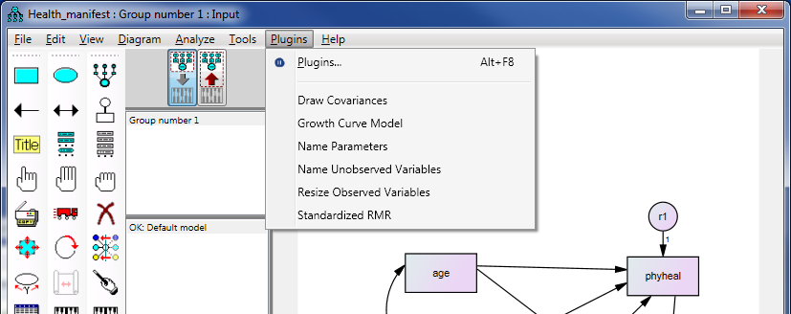
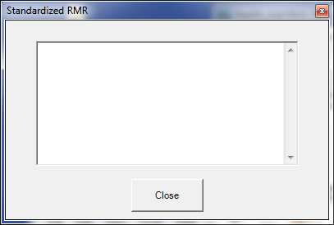
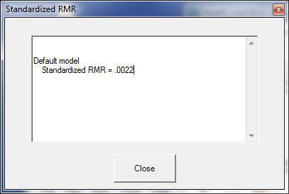
To get SRMR in Amos
Run the analysis
Then click ‘Plugins’ on Menu Bar to get
Select “Standardized RMR”
Click Run
The SRMR appears in the window

Slide 27
Comparative Fit Indices
GFI: Goodness of fit index.
Estimates the proportion of covariances in the observed data that are explained by the model
Analogous to R² in a regression, and is meant to range from 0 (worst model fit) to 1 (best).
Limitations: expected values vary with sample size, doesn’t always stick to the range 0-1.
CFI: Bentler’s Comparative Fit Index
Similar rationale to GFI, but stays normed to 0-1.
High values (> 0.95) regarded by Hu and Bentler (1999) as indicating good fit – again this has been much criticized.

Slide 28
Parsimony-adjusted indices
RMSEA: Root Mean Square Error of Approximation.
Acts to ‘reward’ models analysed with larger samples, and models with more degrees of freedom.
Badness of fit statistic – lower is better and zero is best.
If it turns out to be less than zero, treat it as zero.
RMSEA less than 0.05 – close fit
RMSEA between 0.05 and 0.08 – fair fit
RMSEA between 0.08 and 0.10 – mediocre fit
RMSEA over 0.10 – unacceptable fit.
Browne & Cudeck (1993)

Slide 29
Limitations of fit statistics
Kline (2016) lists six main limitations of fit statistics:
1. They test only the average/overall fit of a model.
2. Each statistic reflects only a specific aspect of fit.
3. They don’t relate clearly to the degree/type of model misspecificiation.
4. Well-fitting models do not necessarily have high explanatory power.
5. They cannot indicate whether results are theoretically meaningful.
6. Fit statistics say little about person-level fit.

Slide 30
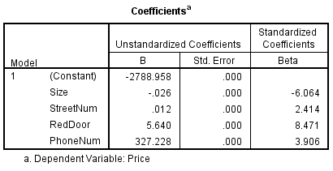
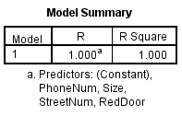
Overfitting
An example from my life: predicting house prices in Brunswick. I want to predict the results of future auctions from information gained from past auctions.
Price ($m) | Size (m²) | Street number | Red front door | Phone number /10,000,000
2.0 | 280 | 4 | 1 | 8.5340100
1.2 | 142 | 72 | 0 | 8.5353242
1.6 | 172 | 180 | 0 | 8.5349900
1.9 | 202 | 9 | 0 | 8.5445452
2.1 | 350 | 22 | 1 | 8.5392342
R² = 1! But this model is severely overfit and won’t generalise well to new auctions.

Slide 31
Path models with latent variables
Section 4

Slide 32
Our example: Women’s health study
Survey of 465 females on a variety of health issues (Hoffman & Fidell, 1979 – reported in Tabachnik & Fidell, 2013).
The research question involves the usage of health facilities.
Now we will assume latent constructs: sense of self (self), Perception of health (perchealth), Use of health facilities (Usehealth)
Measured by:
Self: Self esteem (esteem); Attitudes to marriage (attmar); Locus of control (control)
Perchealth: Self reported mental health problems (menhealth); physical health problems (phyhealth)
Usehealth: use of medicines (druguse); visits to health professionals (timedrs)
Control variables:
Age, Stress will be used as manifest control variables

Slide 33
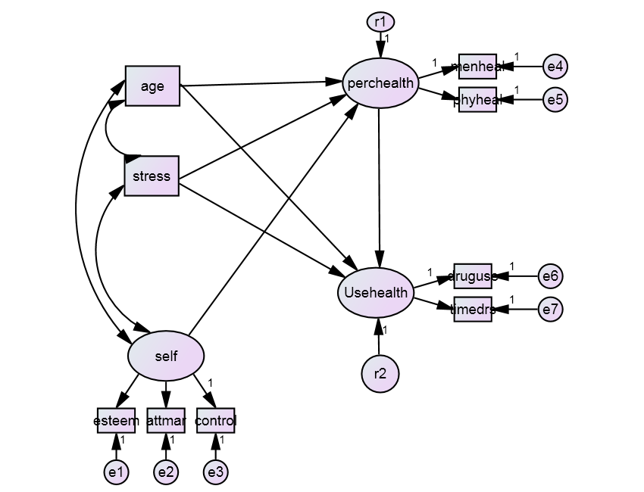
The theoretical model

Slide 34

Standardized estimates

Slide 35
Model Fit
Chi-square = 99.942
Degrees of freedom = 20
Probability level = .000
SRMR is OK, but CFI and RMSEA do not look great,
So this is not a well fitting model.
Default model
Standardized RMR = .0592

Slide 36
Modification indices: Improving the model?
Direct paths
Largest MIs often involve self and the observed measures
Theoretically, the most interesting MI here is whether self directly predicts Usehealth.

Slide 37
Modification indices: Improving the model?
Correlations
Indications here that some important correlations among measures might be missing.
Correlations among the residuals of measures induces correlations among latent outcome variables

Slide 38
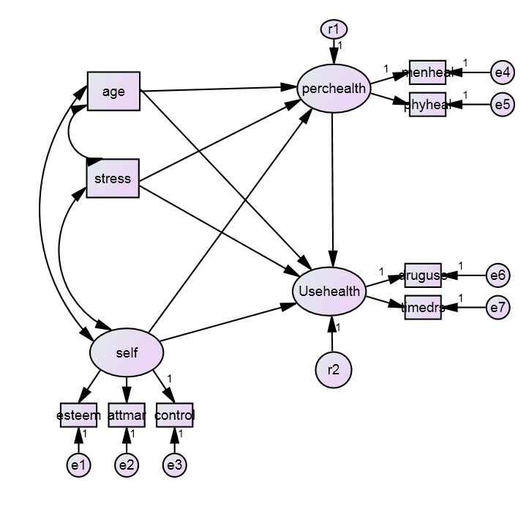
Improve the model? Try self->usehealth
Uh-oh! We don’t want negative variances, this model is NOT good!

Slide 39
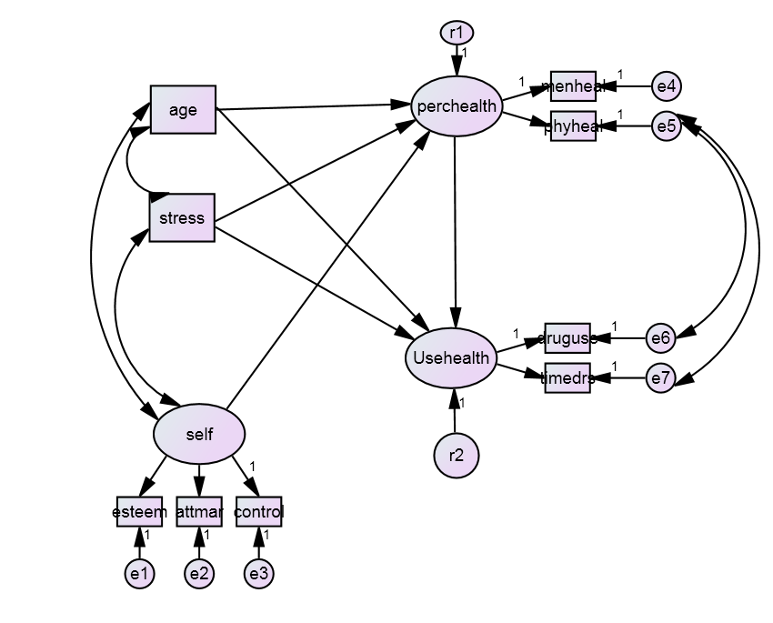
One solution provided in T&F: Correlations among residuals

Slide 40
Model fit
Chi-square = 44.721
Degrees of freedom = 18
Probability level = .000
Previous chi-square = 99.9
Improvement of 55.2 at cost of 2 df
This is highly significant!
This is a much better fitting model.
This type of comparison can done for nested models.
SRMR, CFI and RMSEA are all now acceptable.
AIC has decreased from 150 to 99.
Default model
Standardized RMR = .0442

Slide 41
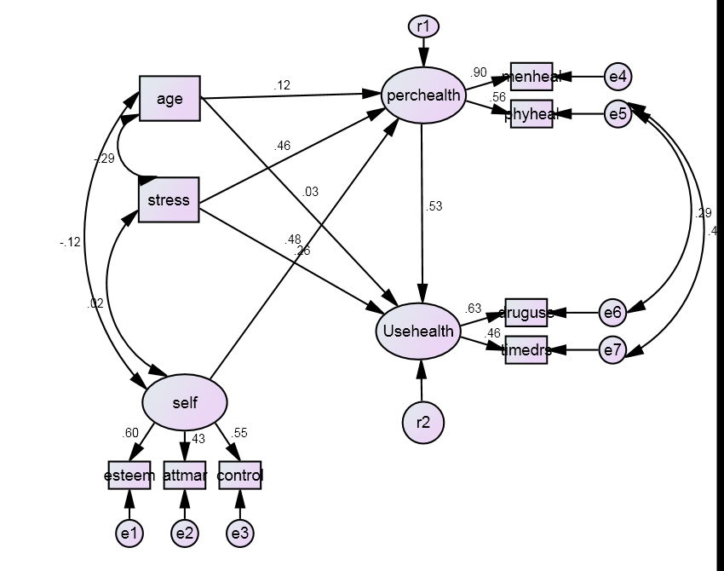
Standardized parameter estimates

Slide 42
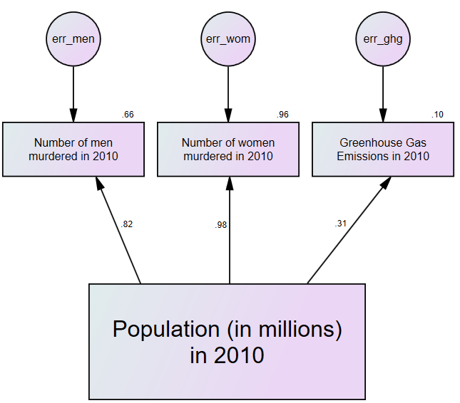
When might it make sense to correlate errors?
A cheesy example Using a country’s population
to predict:
1. Number of men murdered
2. Number of women murdered
3. Greenhouse gas emissions

Slide 43
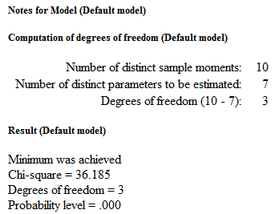
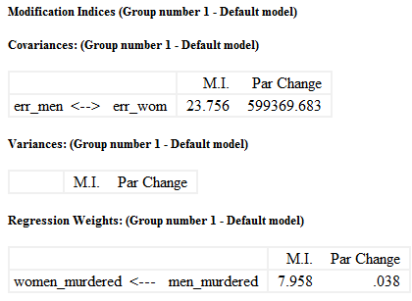
The model fits very poorly

Slide 44
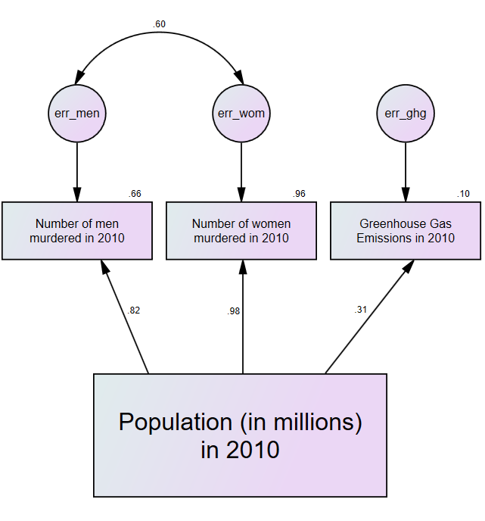
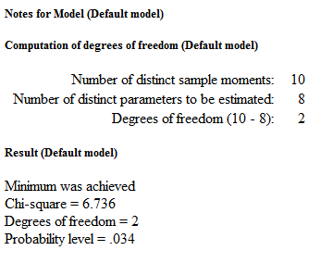
A somewhat better fitting model

Slide 45
What caused the difference?
If the model’s prediction is too high for males murdered, it will also tend to be too high for females murdered.
If the model’s prediction is too low for males murdered, it will also tend to be too low for females murdered.
The point is illustrated by comparing Australia (AUS) and South Africa (RSA)
Nation | Population (Millions) | Males murdered | Males predicted to be murdered | Residual (Males) | Females Murdered | Females predicted to be murdered | Residual (Females)
AUS | 22.30 | 141 | 890.44 | -749.44 | 89 | 207.98 | -118.98
RSA | 49.99 | 13182 | 1498.10 | 11683.90 | 2758 | 598.23 | 2159.77

Slide 46
bootstrapping
Section 5

Slide 47
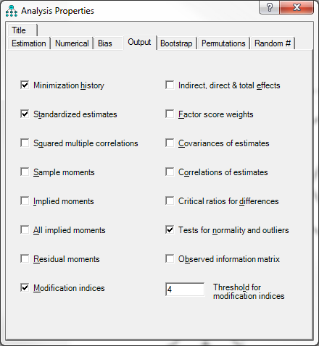
Let’s check normality assumptions
The critical statistic is kurtosis. According to https://stat.utexas.edu/software-faqs/amos
“Practically, very small multivariate kurtosis values (e.g., less than 1.00) are considered negligible while values ranging from one to ten often indicate moderate non-normality. Values that exceed ten indicate severe non-normality.”

Slide 48
Normality checks
Some big problems with normality, including multivariate kurtosis
Mahalanobis distance
p1 … probability that any observation could be so far out
– want this small
p2 … probability that this particular case should be so far out
– want this large
– here lots of observations with small p2, so lots of outliers

Slide 49
What happens when assumptions not met?
Model can be incorrectly rejected as not fitting
Standard errors will be smaller than they really are (i.e., parameters may seem significant when they are not)
Solve these problems through bootstrapping

Slide 50
Bootstrap
Takes repeated samples of the data
Allow each observation to be included more than once in any sample
Each observation could represent any number of similar cases in the population.
This can be thought of as ‘sampling with replacement’.
Calculate the statistic for each boot-strapped sample to produce a bootstrap distribution.
Calculate a standard error as the standard deviation of the bootstrap distribution.

Slide 51
Using the bootstrap in Amos
When distribution not normal
To assess overall fit: Bollen-Stine test (Bollen & Stine, 1992)
To obtain accurate standard errors
Unfortunately cannot be done at the same time
Need to do two analysis runs
An excellent webpage on bootstrapping in Amos is at:
https://stat.utexas.edu/software-faqs/amos

Slide 52
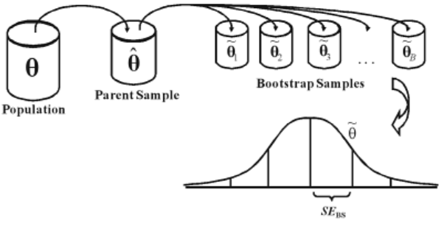
Naïve Bootstrapping

Slide 53
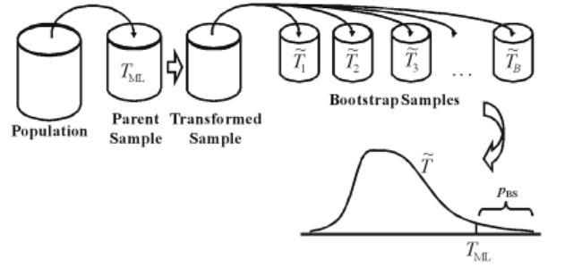
Bollen-Stine bootstrapping

Slide 54
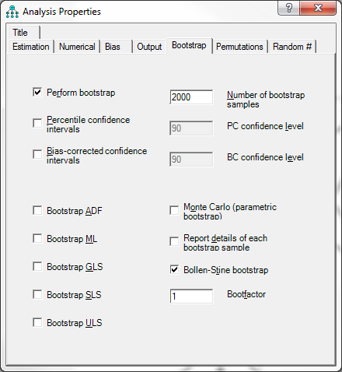
1. Bollen-Stine bootstrap for overall fit

Slide 55
some diagnostic information.
Method 1 is the standard
Method 2 is used if method 1 fails.
Method 0 does not exist
Uh-oh! Fit isn’t as good as we thought!

Slide 56

2. ML bootstrap for path estimate confidence intervals

Slide 57
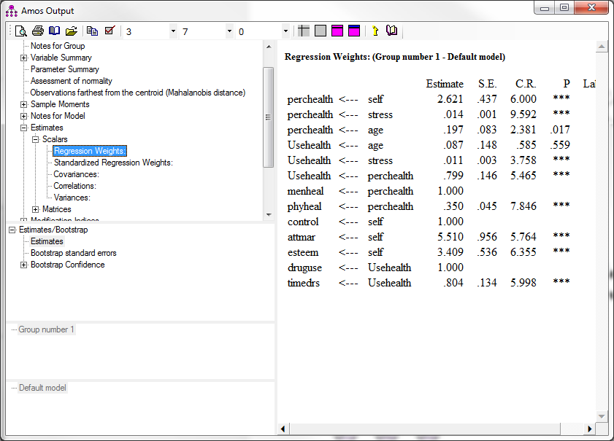

Slide 58
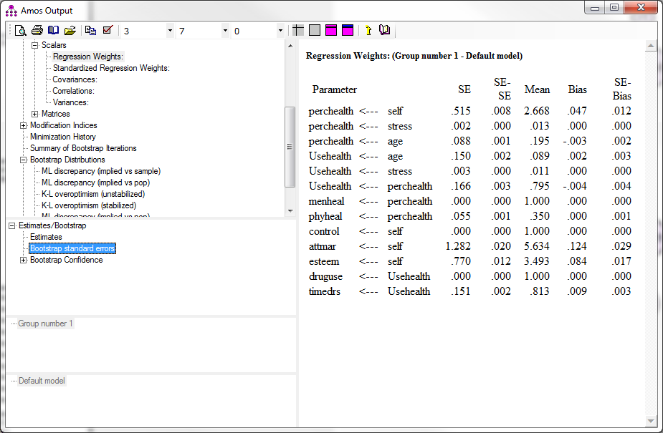
SE is the bootstrap
standard error
SE-SE is the
difference between
bootstrap & usual

Slide 59
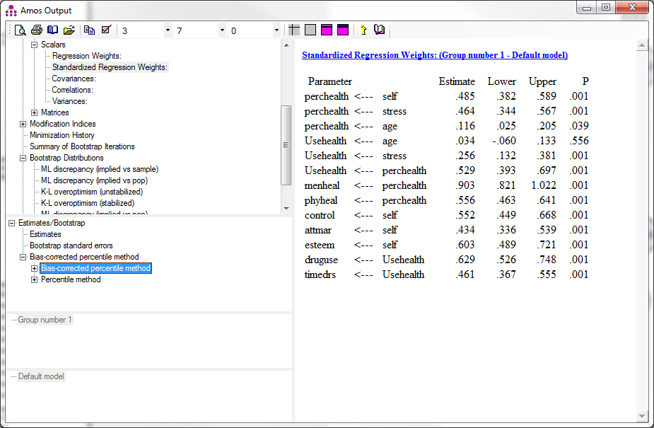

Slide 60
IN THIS LECTURE, you learnt
how SEM is akin to a combination of regression and CFA
how to conduct multi-stage regressions (path analyses) in AMOS
about the different types of SEM indices of model fit
why overfitting is evil, and a bit about how to detect it
how to fit a latent variable model in AMOS, and how to use modification indices to improve the model.
about bootstrapping methods that can be applied in AMOS when assumptions of normality are not met.

Slide 61
References
Bollen, K. A., & Stine, R. A. (1992). Bootstrapping goodness-of-fit measures in structural equation models. Sociological Methods & Research, 21(2), 205-229.
Browne, M. W., & Cudeck, R. (1993). Alternative ways of assessing model fit. In K. A. Bollen and J. S. Long (Eds.), Testing structural equation models (pp. 136-162). Newbury Park, CA Sage.
Hu, L., & Bentler, P. M. (1999). Cutoff criteria for fit indexes in covariance structure analysis: Conventional criteria versus new alternatives. Structural Equation Modeling, 6, 1–55.
Kline, R. B. (2016). Principles and practice of structural equation modeling. Guilford Press.
MacCallum, R. C., & Austin, J. T. (2000). Applications of structural equation modeling in psychological research. Annual Review of Psychology, 51, 201–236.
Tabachnick, B. G., & Fidell, L. S. (2013). Using multivariate statistics. Pearson.
Wright, S. (1921). Correlation and causation. Journal of agricultural research, 20, 557-585.
Wright, S. (1934). The method of path coefficients. The annals of mathematical statistics, 5, 161-215.

