Slide 1
Pre-lecture 5: Structural equation modelling 1: Confirmatory factor analysis
Notes:
This week, we’re going to be talking about structural equation modelling and confirmatory factor analysis

Slide 2
The agenda for this pre-lecture
What is structural equation modeling?
Confirmatory vs exploratory factor analysis
Notes:
In this pre-lecture, we’re going to describe what SEM is, and make the distinction between exploratory and confirmatory factor analysis at least somewhat clear

Slide 3
Drawing conventions
observed variable: rectangle
unobserved or latent variable: ellipse
An error term or residual: circle
relationship
correlation: curved, double-headed arrow;
regression: straight single-headed arrow aligned with direction of prediction.
Notes:
First off, it’s important to know the basics of path diagram notation – READ

Slide 4
SEM in a nutshell (Tabachnik & Fidell, 2007)
SEM enables a combined analysis that otherwise requires multiple techniques
Notes:
SEM allows us to combine multiple analytic techniques, and can be loosely thought of as a combination of factor analysis and regression.

Slide 5
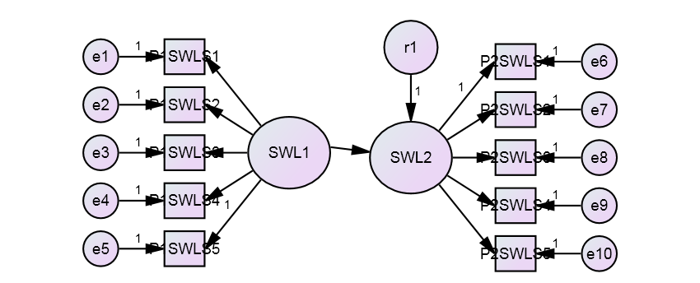
Combining factor and regression analysis
Notes:
This is a path diagram of a structural equation model that we’ll be talking about today

Slide 6
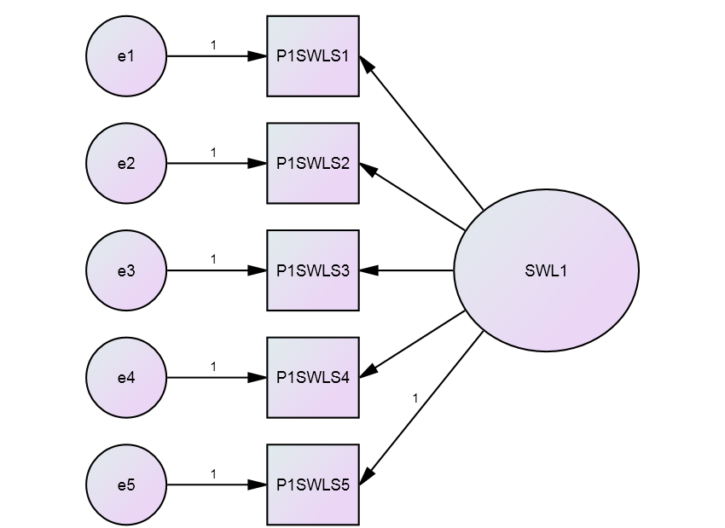
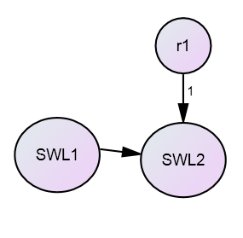
Combining factor and regression analysis
The measurement model
The structural model
Confirmatory factor analysis is a measurement model.
Notes:
We can break this model into two main parts – the measurement and structural models

Slide 7
Combining factor and regression analysis
What have we done here?
Then we run a regression on two latent factors (remembering there is also a residual r in the regression equation)
Notes:
First we have the structural model, the model which specified how our constructs relate to each other. In this case we are predicting SWL at tp1 with SWL at tp2

Slide 8
Combining factor and regression analysis
We’re going to largely ignore the structural mode until next week’s classes, and instead focus on the measurement model – CFA
Confirmatory factor analysis is a measurement model.
Notes:
And we have our measurement model, the bit which specified how our constructs were measured. We’re going to focus on the measurement model today.

Slide 9
Confirmatory factor analysis
What have we done here?
The observed measures (manifest variables) are represented in boxes.
The latent factor is represented in an oval.
Each observed measure also has some residual variance (the e’s) because it is not fully explained by the factor.
Notes:
To break what our measurement model means down, We are saying here, that (for each time point) we have combined five measures into one underlying factor. In our path diagram we have the observed measures in boxes, all of them here are measures of SWL taken at time point one. And we have the latent variable, SWL at time point one, which is represented by an ellipse. We also have error terms for each of the observed variables, as our factor SWL1 does not explain all of the variance observed scores – we also have other sources of variance. We assume that these errors are normally distributed.

Slide 10
Confirmatory vs exploratory factor analysis
Section 2
Notes:
An important question at this point is how does this differ from exploratory factor analysis

Slide 11
CFA vs EFA
Exploratory factor analysis can impose two kinds of restrictions.
restrict the number of factors
constrain the factor loadings to be uncorrelated with an orthogonal rotation.
Confirmatory factor analysis can restrict factor loadings (or factor correlations or variances) to take certain values.
A common value: zero
If a factor loading was set to zero, the hypothesis is that the observed variable score was not due to the factor
Notes:
The most important difference between what we’re doing today and exploratory factor analysis is that in CFA confirmatory factor analysis, we have much greater scope to constrain relationships. In exploratory factor analysis we can only constrain the number of factors and whether we allow factors to be correlated or uncorrelated. CFA on the other hand allows us to constrain factor loadings, and then test the fit of our model in the structural equation model framework.

Slide 12
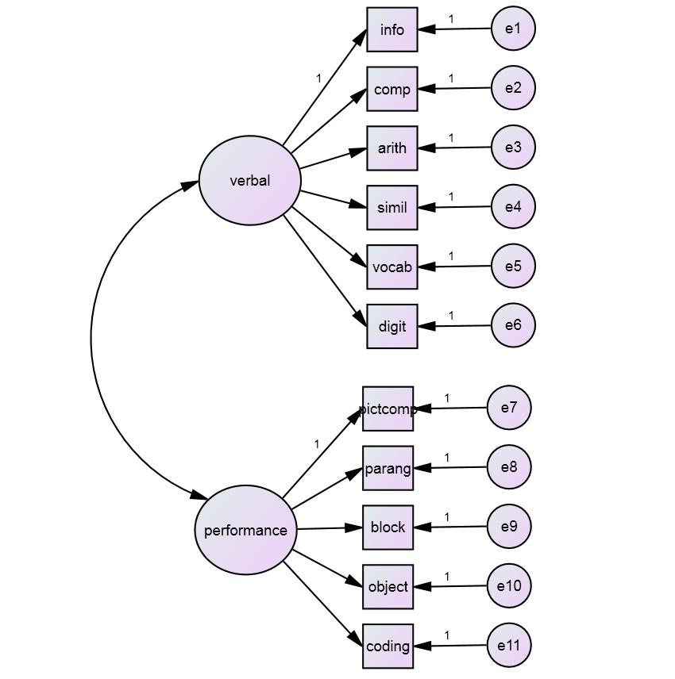
The hypothesized model
Notes:
This means that in CFA we can model something like this, where we are saying that we have two independent factors, and the only reason for a relationship between for example, coding down the bottom here, and info is the correlation between the performance and verbal factors.

Slide 13
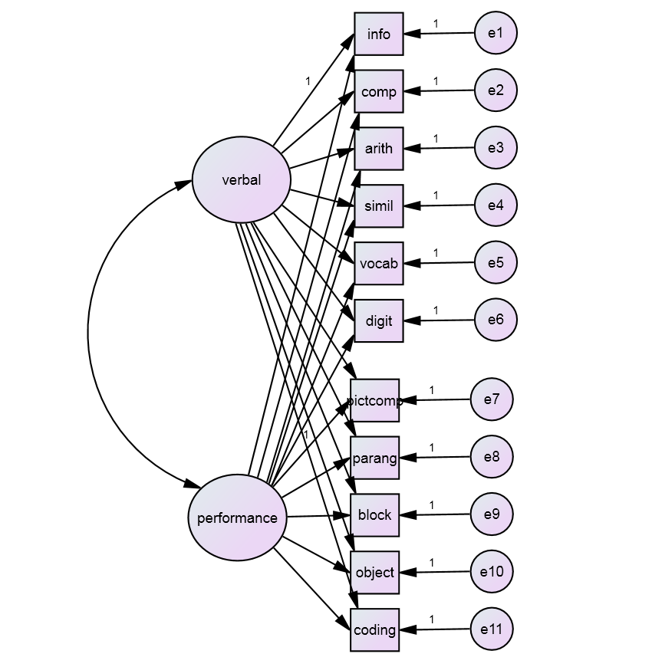
The EFA model
Notes:
This is in comparison to exploratory factor analysis which, if drawn in a path diagram would look like this. Implicitly, EFA models a relationship between every observed variable and every hypothesised factor.
And that’s it for today! In the labs we’ll be building and evaluating these models ourselves!

