Slide 1
Lecture 6: Structural equation modelling 2: Path analysis

Slide 2
The agenda for this lecture
Basic ideas in Structural Equation Modeling (SEM)
Multi-step regressions
Model fit
Path models with latent variables
Bootstrapping
GOALS OF THIS LECTURE
To present SEM as a combination of regression and CFA
To show how multi-stage regressions can be done simultaneously in an SEM framework
To introduce measures of model fit
To illustrate how to fit a latent variable model in AMOS
To introduce Bootstrapping methods and to show how they can be conducted in AMOS

Slide 3
Basic ideas in Structural equation modeling (SEM)
Section 1

Slide 4
Models & Equations
The regression model:
y_{p} = β_{p1}x₁ + β_{p2} x₂ + … β_{pk} x_{k} + e_{p} [1]
or in matrix form
y = βx + e
where we have a dependent variable y being predicted by a series of independent variables x.
The factor model:
An observed variable x is predicted by a series of unobserved factors [latent variables] f.
x_{p} = λ_{p1}f₁ + λ_{p2}f₂ + … λ_{pk}f_{k} + u_{p} [2]
or in matrix form
x= λf + u

Slide 5
Combining these models
Notice however that we have the observed variable x in both equations.
We could build a composite by substituting for x in [1] from x in [2] and carry out the kind of predictive modelling we do in the regression model with the latent variables involved in equation [2].

Slide 6
An advantage of latent variable modelling
Models the characteristic of interest, say depression, rather than scores on a depression test.
How do the two differ?
Test theory: O = T + E
Observed score O, true score T, error E
Observed score O is x in equation 1 or 2
True score T is latent variable f in equation 2
Reliability is the proportion of observed score variance that is true score variance
α = σ_{T}²/ σ_{O}²
Reliability never equals 1.0
Therefore our observed score never fully captures the information in the latent variable

Slide 7
Structural Equation Modelling
The modelling of data by jointly by equations [1] and [2] is known as structural equation modelling.
That aspect of the model concerned with equation [2] is often called the measurement model, and
that part focussing on equation [1] is known as the structural model. It is what is known in regression terms, path analysis.

Slide 8
Correlation & Regression
We have always taught you that “correlation is not causation”
A correlation coefficient is a symmetric measure, i.e. it doesn’t distinguish between predicting a from b and b from a.
But regression does predict.
although this does not necessarily mean “cause”
And regression & correlation are (almost) the same thing

Slide 9
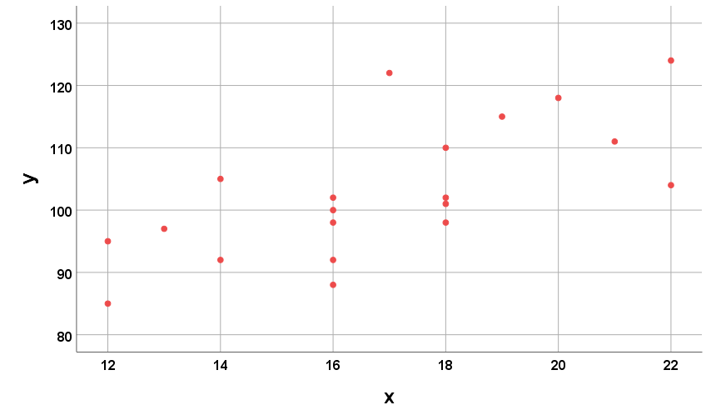
Some example data
Pearson’s r = 0.686

Slide 10
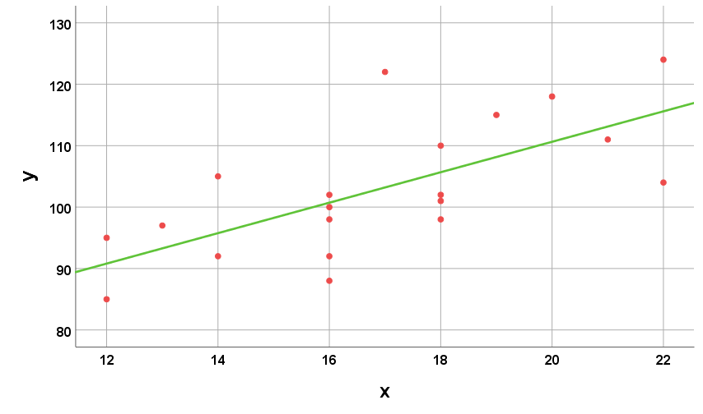
Minimizing the sum of squared vertical errors
ŷ = 61.1 + 2.48x
Regressing y on x

Slide 11
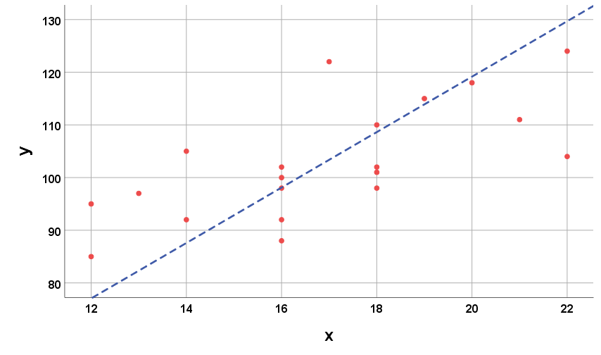
Minimizing the sum of squared horizontal errors
x̂ = -2.63 + 0.19y
Regressing x on y

Slide 12
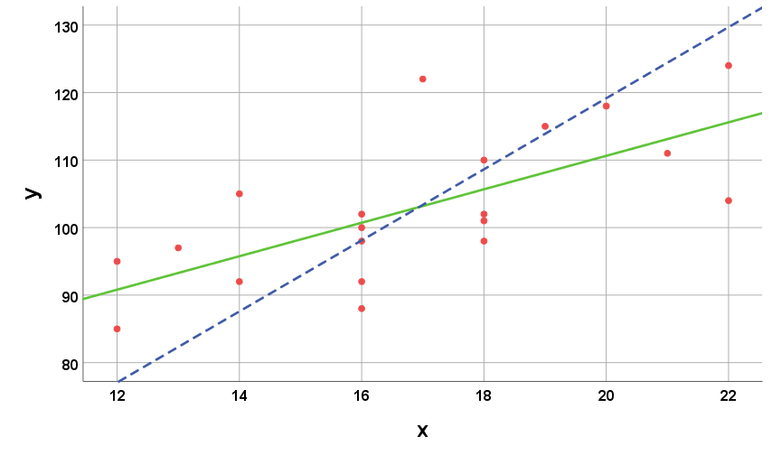
Both together
ŷ = 61.1 + 2.48x
Regressing y on x
x̂ = -2.63 + 0.19y
Regressing x on y

Slide 13
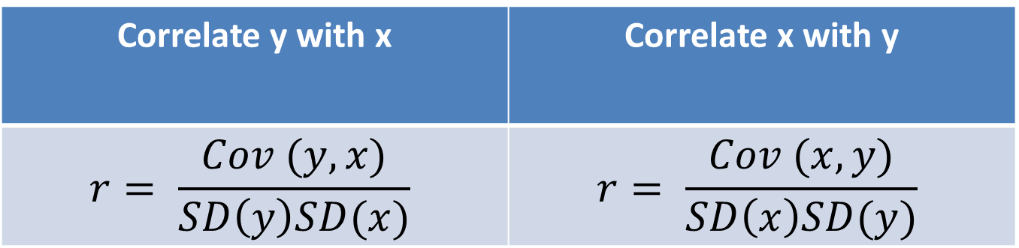
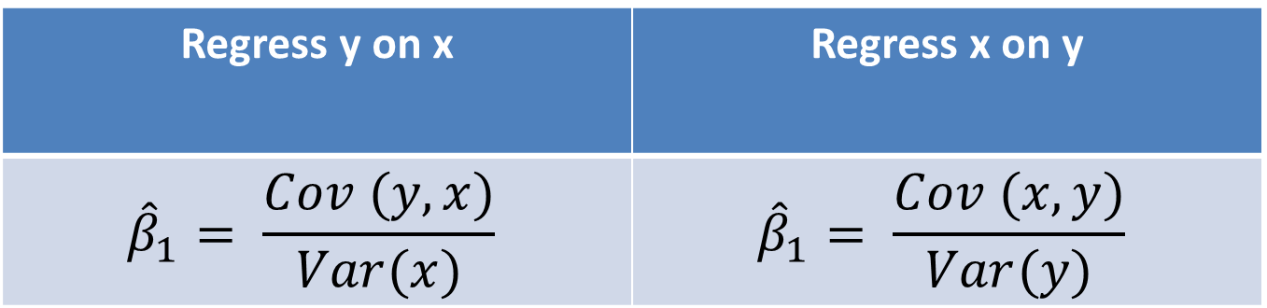
Regression vs Correlation
Regress y on x | Regress x on y
$${\hat{β}}_{1}= \frac{Cov (y,x)}{Var(x)}$$ | $${\hat{β}}_{1}= \frac{Cov (x,y)}{Var(y)}$$
Correlate y with x | Correlate x with y
$$r= \frac{Cov (y,x)}{SD\left(y\right)SD(x)}$$ | $$r= \frac{Cov (x,y)}{SD\left(x\right)SD(y)}$$

Slide 14
Back to the raw data

Slide 15
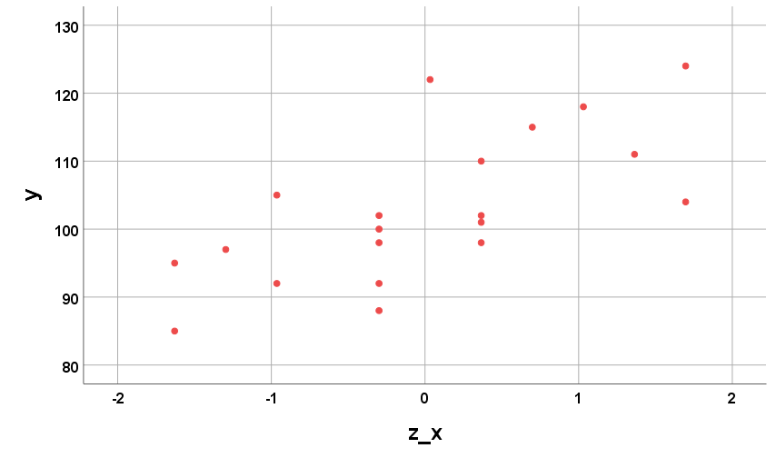
Standardizing the x-values

Slide 16
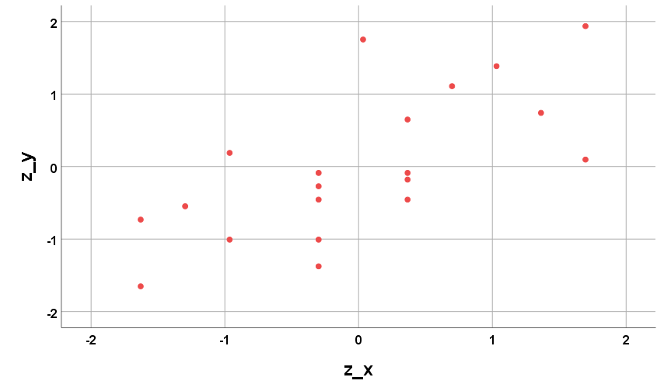
Standardizing the y-values as well

Slide 17
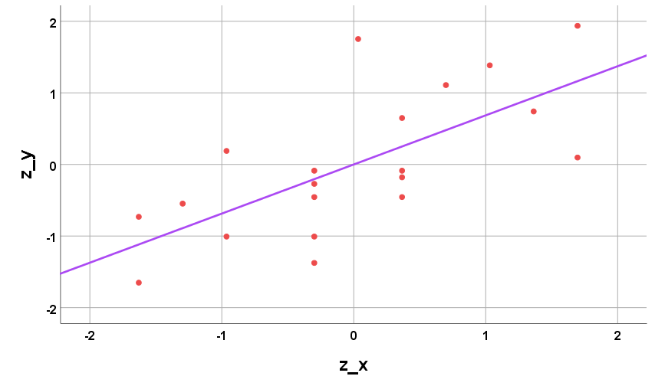
Minimizing the sum of squared vertical errors
ŷ = 0 + 0.686x
Regressing y on x

Slide 18
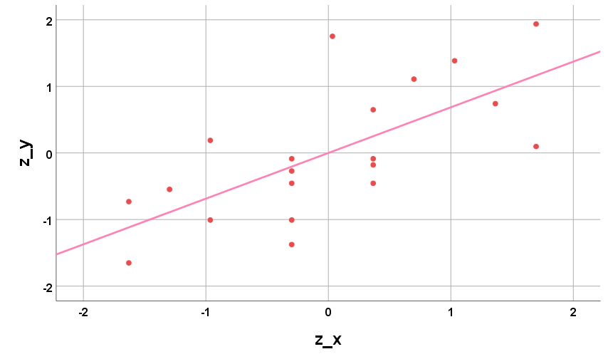
Minimizing the sum of squared horizontal errors
Regressing x on y
x̂ = 0 + 1.458y

Slide 19
Correlation & Causation: 1921

Slide 21
Contemporary Path Models
Path models are expressed as diagrams.
The drawing convention is the same as in confirmatory factor analysis:
observed variables are drawn as rectangles,
unobserved variables as circles/ellipses and
relations are expressed as arrows;
straight single-headed arrows are used to indicate causal or predictive relationships and
curved double-headed arrows indicate a non-directional relationship such as a correlation or covariance.
Notes:
C

Slide 22
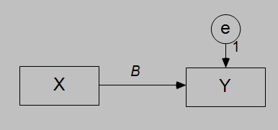
Bivariate regression
y = βx + e

Slide 23
Two kinds of path models
One is called recursive, the other non-recursive.
Recursive models are simpler:
The paths are unidirectional and
the residual [error] terms are independent.
Such models can be tested with standard multiple regression.
Non-recursive models can have
bidirectional paths,
correlated errors and
feedback loops.
Such models need structural equation software to fit them.

Slide 24

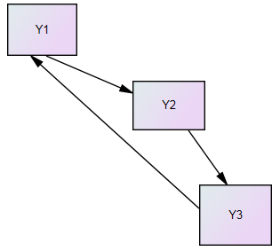
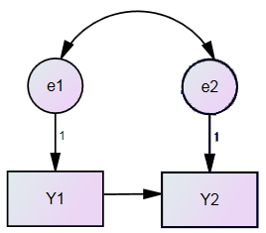
The terminology illustrated
Direct feedback loop (also, bidirectional path)
Indirect feedback loop
Correlated errors

Slide 25
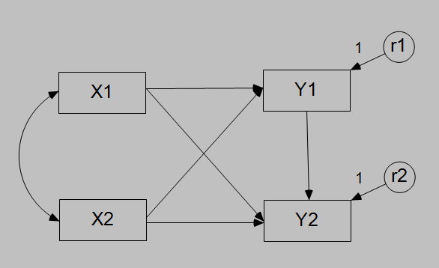
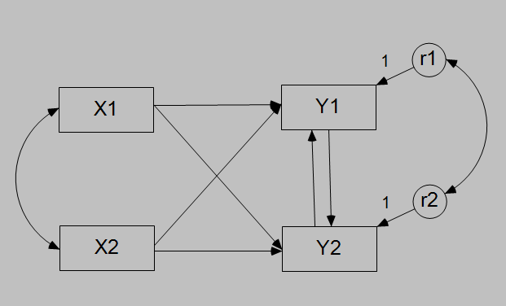
The terminology illustrated
Recursive Model | Non-Recursive Model

Slide 26
Modelling data for path analysis
Can be done via
Multiple regression
Structural Equation Modelling
An example
some data from attitude modelling of factors affecting the perceived risk in genetically modified food
Scores on four attitude scales [measuring attitudes to technology, attitudes to nature, neophobia, and alienation] were used to predict scores on a perceived risk scale

Slide 27
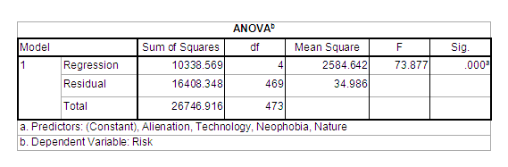
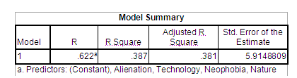
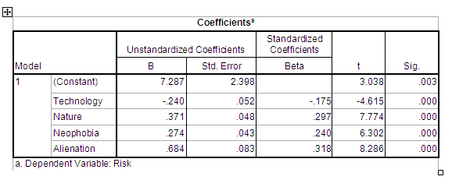

Slide 28
Our model then would be
Predicted Risk = 7.287 – 0.240*Technology
+ 0.371*Nature + 0.274*Neophobia
+ 0.684*Alienation
or in standard scores
Predicted Risk = -0.175*Technology
+ 0.297*Nature
+ 0.240*Neophobia + 0.318*Alienation
or in terms of actual risk scores
Risk = 7.287 – 0.240*Technology
+ 0.371*Nature + 0.274*Neophobia
+ 0.684*Alienation + residual

Slide 29
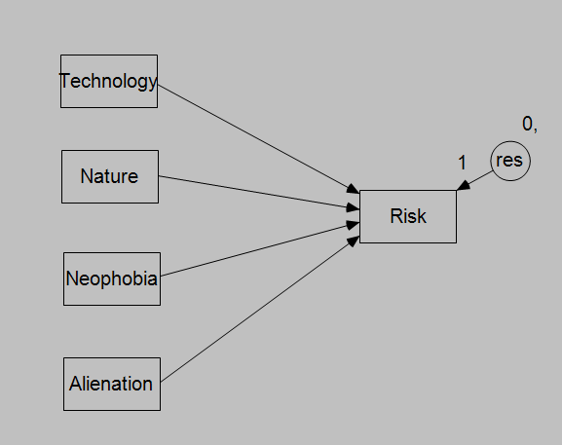
In Amos the multiple regression model
would look like this:

Slide 30
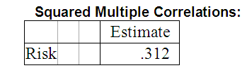
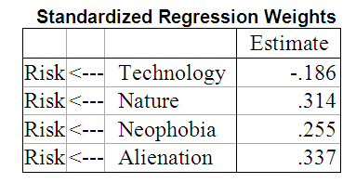
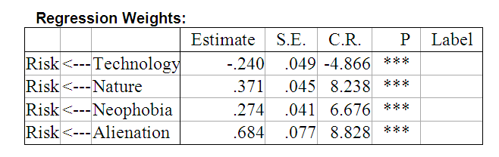
In Amos the multiple regression model
would look like this:

Slide 31
Comparing regression & SEM
Regression weights agree perfectly, but
standard errors differ
standardized regression weights differ
and the squared multiple correlation is rather less in Amos.
and we did get a warning in Amos
(uncorrelated predictors)

Slide 32
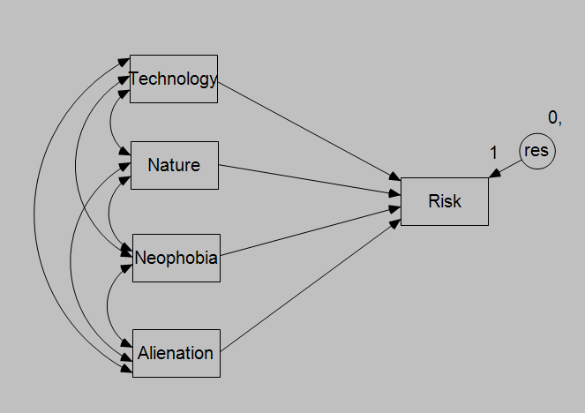

Slide 33
 | Regression |  |  | Structural Equation Modelling
 |  |  |  | No Exogenous Correlation |  |  | Exogenous Correlations
 | B | S.E. | Beta | B | S.E. | Beta | B | S.E. | Beta
Technology | -.240 | .052 | -.175 | -.240 | .049 | -.186 | -.240 | .052 | -.175
Nature | .371 | .048 | .297 | .371 | .045 | .314 | .371 | .048 | .297
Neophobia | .274 | .043 | .240 | .274 | .041 | .255 | .274 | .043 | .240
Alienation | .684 | .083 | .318 | .684 | .077 | .337 | .684 | .082 | .318
SMC |  |  | .387 |  |  | .312 |  |  | .387

Slide 34
Conclusion
Multiple regression must model the correlations among the independent variables, although this is not shown.
A path analytic representation is thus a much more accurate representation.
And gives more information

Slide 35
For example,
in modelling the associations among the exogenous variables,
we can see that not all are significantly different from zero
and could be deleted from the model.
 |  |  | Covariance | S.E. | C.R. | P |  | Correlation
Neophobia | <--> | Alienation | 2.411 | 1.065 | 2.263 | .024 |  | .105
Nature | <--> | Neophobia | 1.487 | 1.825 | .815 | .415 |  | .037
Technology | <--> | Nature | -1.098 | 1.517 | -.724 | .469 |  | -.033
Nature | <--> | Alienation | 6.651 | 1.012 | 6.572 | *** |  | .317
Technology | <--> | Alienation | .167 | .881 | .189 | .850 |  | .009
Technology | <--> | Neophobia | -10.863 | 1.738 | -6.249 | *** |  | -.300

Slide 36
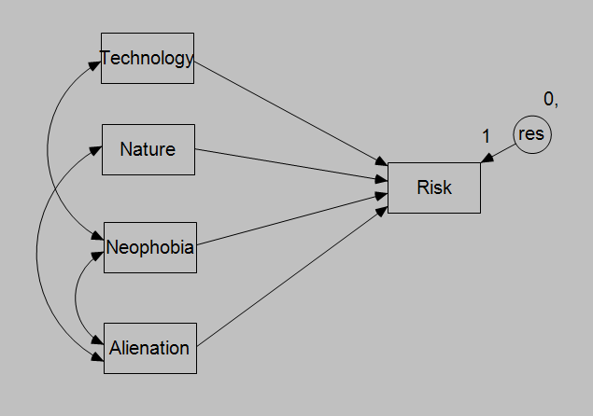
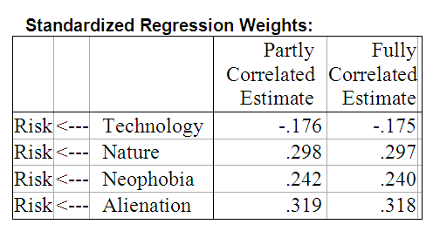
This model is ‘over-identified’ and thus can be tested for significance.

Slide 37
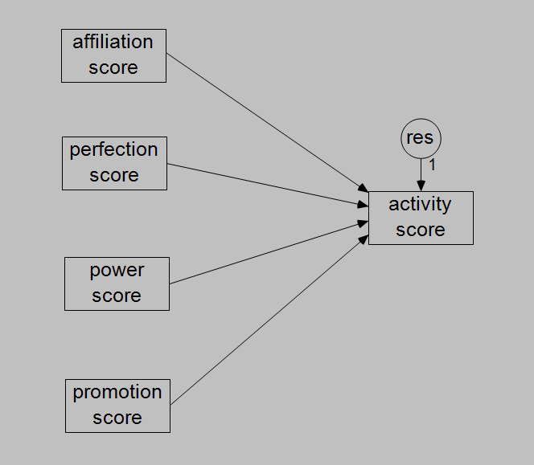
Latent Variable regression
Some real advantages come about when we have latent variables in the model
ie a combined factor-regression analysis

Slide 38
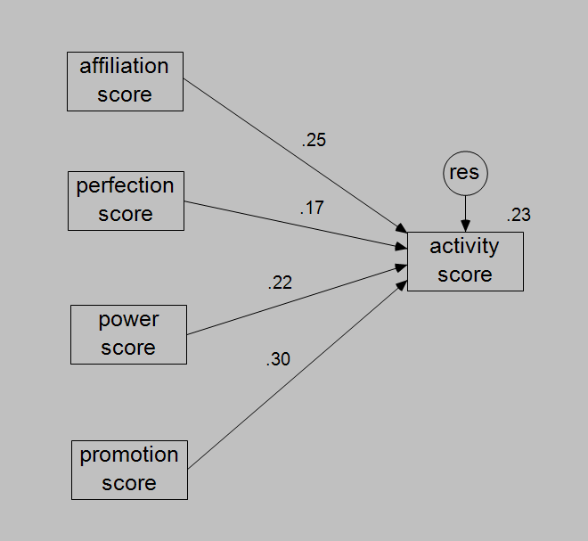
Squared Multiple Correlation = .226

Slide 39
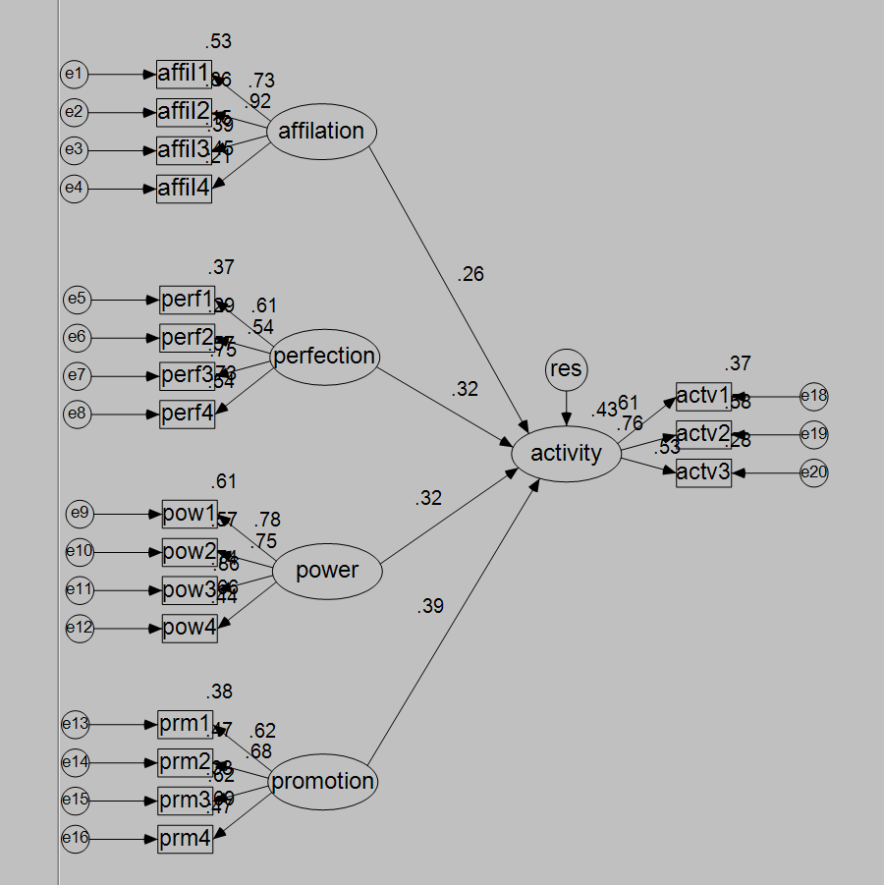
Squared Multiple Correlation = .425

Slide 40
Comparison
 | Manifest | Latent
affiliation | .25 | .26
perfection | .17 | .32
power | .22 | .32
promotion | .30 | .39
Variance Accounted for | .226 | .425

Slide 41
Multi step regressions
Section 2

Slide 42
Multi-Step Path Analysis
Some variables are predictors [A]
Some variables are predicted [B]
Some variables are both predictors and predicted [M]
A → M → B
Such intervening variables [like M] may be considered as mediating the relationship between A and B.

Slide 43
A simple example: Women’s health study
Survey of 465 females on a variety of health issues (Hoffman & Fidell, 1979 – reported in Tabachnik & Fidell, 2013).
One interest was in usage of health facilities (eg. Frequency of visits to health professionals – TIMEDRS).
Other variables:
Age, Stress, Self esteem (esteem), Self reported Physical health (phyheal)

Slide 44
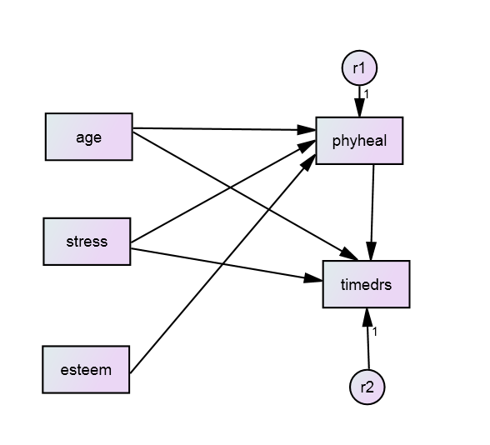
A simple example: Women’s health study
Proposed theoretical model
Requires two regressions:
Regress phyheal on age, stress, esteem
Regress timedrs on age, stress, phyheal

Slide 45
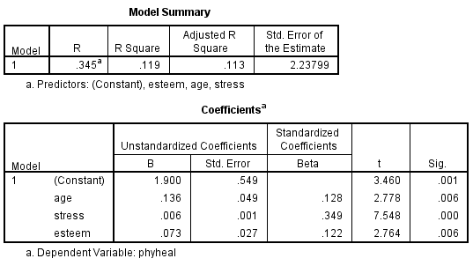
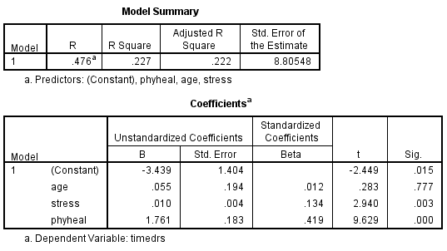
A simple example: Women’s health study
Two regressions:
Regress phyheal on age, stress, esteem
Regress timedrs on age, stress, phyheal

Slide 46
But how do we combine them?
Overall Fit:
No overall significance test
Can estimate ‘generalized squared multiple correlation’ R_{m}² = 1 – Π(1- R_{i}² ) where R_{i}² is the SMC for each of the i regression equations.
R_{m}² = 1 – (1 - .119) × ( 1 - .227)
= 0.32

Slide 47
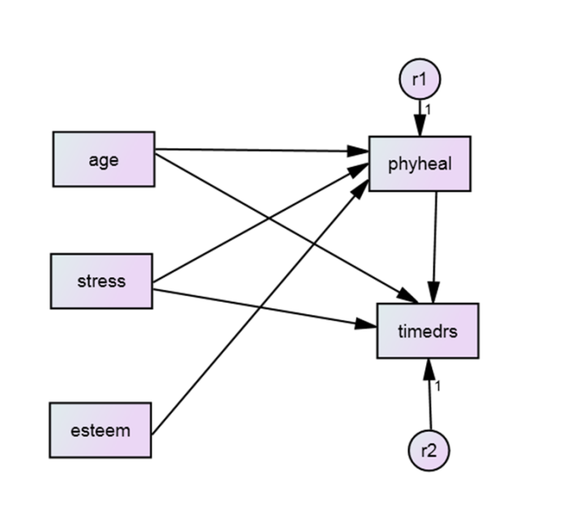
But how do we combine them?
The impact of antecedent variables on the dependent variable:
Directly antecedent variables: β [called Direct Effects]
Indirect (multiple sequential arrows) = Π β (ie multiply the β’s together) [called Indirect Effects]

Slide 48
Direct and indirect effects
Direct Effects on Timedrs
β_{age} = 0.012
β_{stress} = 0.134
β_{phyheal} = 0.419
Indirect effects
β_{age (via phyheal)} = 0.128 × 0.419 = 0.054
β_{stress (via phyheal)} = 0.349 × 0.419 = 0.146
β_{esteem (via phyheal)} = 0.122 × 0.419 = 0.051

Slide 49
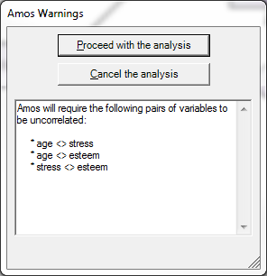
Structural equation model
AMOS is suspicious of uncorrelated predictors (exogenous)

Slide 50
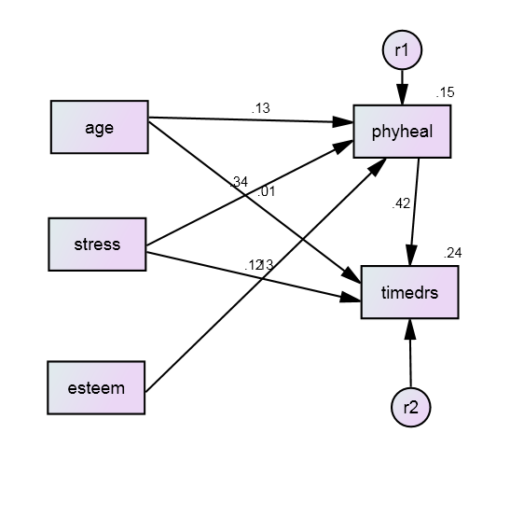
Standardized estimates

Slide 51
Unstandardized estimates
 |  |  | Estimate | S.E. | C.R. | P | Label
phyheal | <--- | age | .136 | .047 | 2.913 | .004
phyheal | <--- | stress | .006 | .001 | 7.948 | ***
phyheal | <--- | esteem | .073 | .026 | 2.785 | .005
timedrs | <--- | phyheal | 1.761 | .182 | 9.661 | ***
timedrs | <--- | age | .055 | .186 | .297 | .767
timedrs | <--- | stress | .010 | .003 | 3.055 | .002
Squared Multiple Correlations: Estimate
phyheal .148
timedrs .237

Slide 52
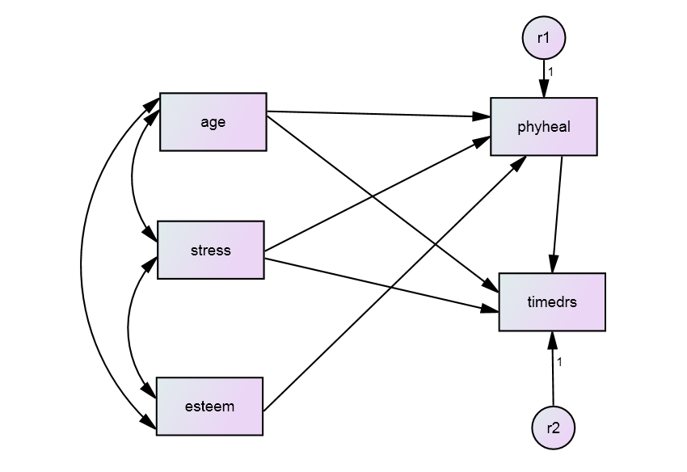
Include correlations among exogenous predictors

Slide 53
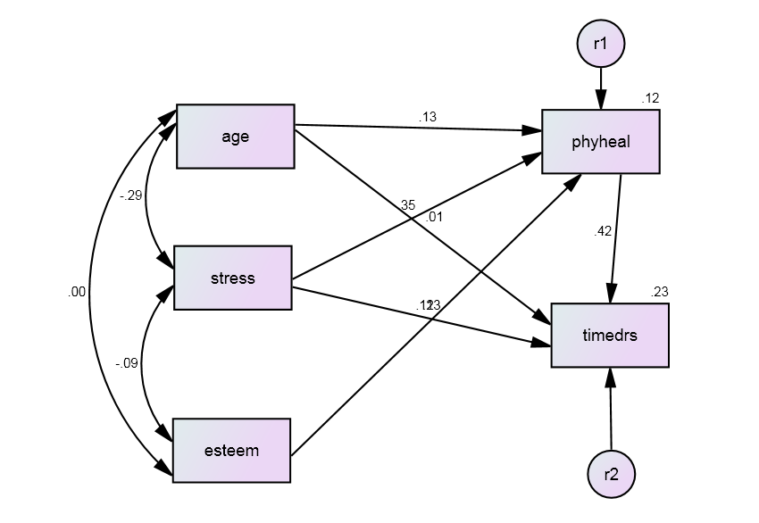
Include correlations among exogenous predictors
Squared Multiple Correlations: Estimate
phyheal .119
timedrs .227

Slide 54
Model fit
Section 3

Slide 55
Assessing fit
"With respect to model fit, researchers do not seem adequately sensitive to the fundamental reality that there is no true model [...], that all models are wrong to some degree, even in the population, and that the best one can hope for is to identify a parsimonious, substantively meaningful model that fits observed data adequately well. At the same time, one must recognize that there may well be other models that fit the data to approximately the same degree. Given this perspective, it is clear that a finding of good fit does not imply that a model is correct or true, but only plausible. These facts must temper conclusions drawn about good-fitting models. (MacCallum & Austin 2000, p.218)

Slide 56
Model Test Statistics
Model Test Statistics ask: “Is the variance-covariance matrix implied by your model sufficiently close to your observed variance-covariance matrix that the difference could plausibly be due to sampling error?”
Model Chi-Square Test (χ² test)
χ² = 0 with perfect model fit, and increases as model misspecification increases. p = 1 with perfect model fit, and decreases as model misspecification increases.
Non-significant Chi-Square test indicates the model is consistent with the observed variance-covariance matrix.
Significant Chi-Square insufficient in itself to determine whether a model should be rejected, but can be treated as a ‘smoke alarm’ in relation to model fit.
χ² is strongly affected by multivariate non-normality, correlation size, the size of unique variances, and sample size.

Slide 57
Approximate Fit Indices
Approximate Fit Indices ignore the issue of sampling error and take different perspectives on providing a continuous measure of model-data correspondence.
Three main flavours available under ML estimation:
1. Absolute Fit Indices (proportion of the observed variance-covariance matrix explained by model), e.g. SRMR.
2. Comparative Fit Indices (relative improvement in fit compared to a baseline), e.g. CFI.
3. Parsimony-adjusted-indices (compare model to observed data but penalise models with greater complexity) e.g. RMSEA.

Slide 58
Absolute Fit Indices
RMR: Root mean square residual
Average differences between observed and model-estimated covariance matrices
Small indicates good fit, 0 = perfect fit
Hard to interpret because RMR’s range depends on the range of the observed variables
SRMR: Standardized RMR
Transforms the sample and model-estimated covariance matrices into correlation matrices.
Ranges from 0 to 1, with 0 = perfect fit.
SRMR < 0.08 regarded as good fit by Hu and Bentler, 1999 – beware that this average value can hide some big residuals.

Slide 59
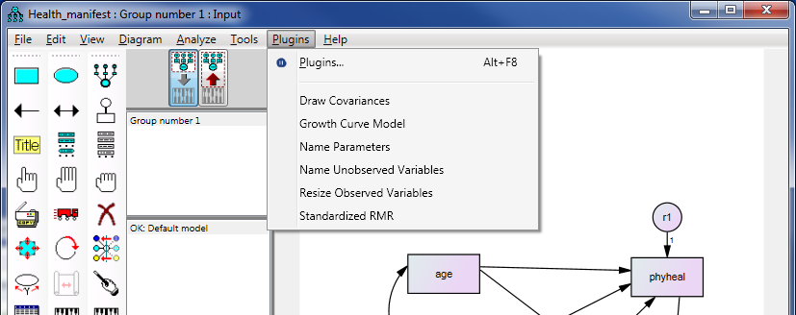
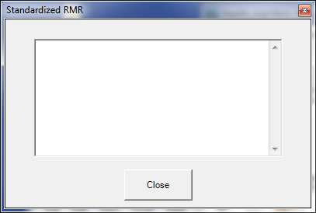
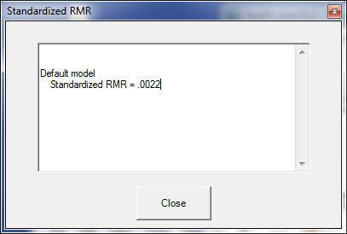
To get SRMR in Amos
Run the analysis
Then click ‘Plugins’ on Menu Bar to get
Select “Standardized RMR”
Click Run
The SRMR appears in the window

Slide 60
Comparative Fit Indices
GFI: Goodness of fit index.
Estimates the proportion of covariances in the observed data that are explained by the model
Analogous to R² in a regression, and is meant to range from 0 (worst model fit) to 1 (best).
Limitations: expected values vary with sample size, doesn’t always stick to the range 0-1.
CFI: Bentler’s Comparative Fit Index
Similar rationale to GFI, but stays normed to 0-1.
High values (> 0.95) regarded by Hu and Bentler (1999) as indicating good fit – again this has been much criticized.

Slide 61
Parsimony-adjusted indices
RMSEA: Root Mean Square Error of Approximation.
Acts to ‘reward’ models analysed with larger samples, and models with more degrees of freedom.
Badness of fit statistic – lower is better and zero is best.
If it turns out to be less than zero, treat it as zero.
RMSEA less than 0.05 – close fit
RMSEA between 0.05 and 0.08 – fair fit
RMSEA between 0.08 and 0.10 – mediocre fit
RMSEA over 0.10 – unacceptable fit.
Browne & Cudeck (1993)

Slide 62
Limitations of fit statistics
Kline (2016) lists six main limitations of fit statistics:
1. They test only the average/overall fit of a model.
2. Each statistic reflects only a specific aspect of fit.
3. They don’t relate clearly to the degree/type of model misspecificiation.
4. Well-fitting models do not necessarily have high explanatory power.
5. They cannot indicate whether results are theoretically meaningful.
6. Fit statistics say little about person-level fit.

Slide 63
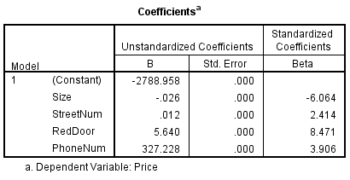
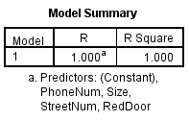
Overfitting
An example from my life: predicting house prices in Brunswick. I want to predict the results of future auctions from information gained from past auctions.
Price ($m) | Size (m²) | Street number | Red front door | Phone number /10,000,000
2.0 | 280 | 4 | 1 | 8.5340100
1.2 | 142 | 72 | 0 | 8.5353242
1.6 | 172 | 180 | 0 | 8.5349900
1.9 | 202 | 9 | 0 | 8.5445452
2.1 | 350 | 22 | 1 | 8.5392342
R² = 1! But this model is severely overfit and won’t generalise well to new auctions.

Slide 64
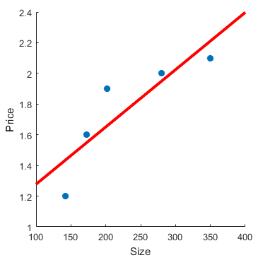
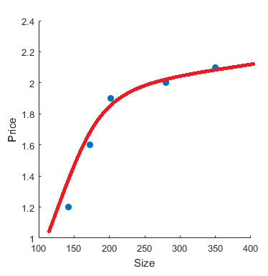
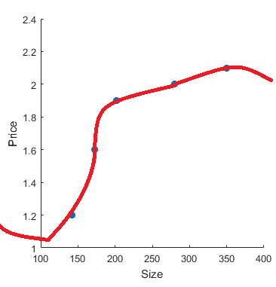
Overfitting vs Underfitting
Price ($m) | Size (m²)
2.0 | 280
1.2 | 142
1.6 | 172
1.9 | 202
2.1 | 350
Underfitting occurs when the model is overly simple.
Overfitting occurs when the model is overly complex.
θ₀ + θ₁x (Probably underfitting)
θ₀ + θ₁x + θ₂x² (Looks good)
θ₀ + θ₁x + θ₂x² + θ₃x³ + θ₄x⁴ (Overfitting)

Slide 65
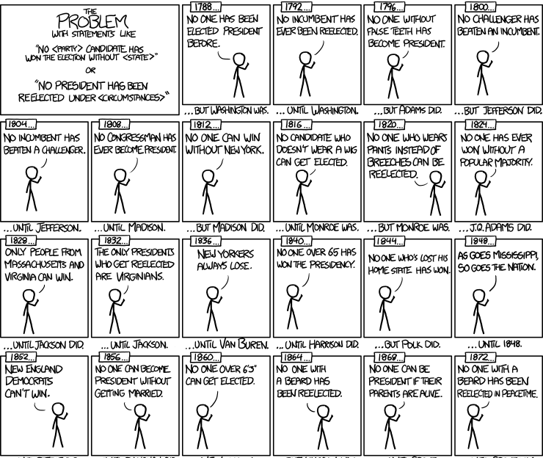
Overfitting and Electoral Precedent
An example of how overfitting can creep into everyday conversation
Full cartoon can be viewed at https://xkcd.com/1122/

Slide 66
Path models with latent variables
Section 4

Slide 67
Our example: Women’s health study
Survey of 465 females on a variety of health issues (Hoffman & Fidell, 1979 – reported in Tabachnik & Fidell, 2013).
The research question involves the usage of health facilities.
Now we will assume latent constructs: sense of self (self), Perception of health (perchealth), Use of health facilities (Usehealth)
Measured by:
Self: Self esteem (esteem); Attitudes to marriage (attmar); Locus of control (control)
Perchealth: Self reported mental health problems (menhealth); physical health problems (phyhealth)
Usehealth: use of medicines (druguse); visits to health professionals (timedrs)
Control variables:
Age, Stress will be used as manifest control variables

Slide 68
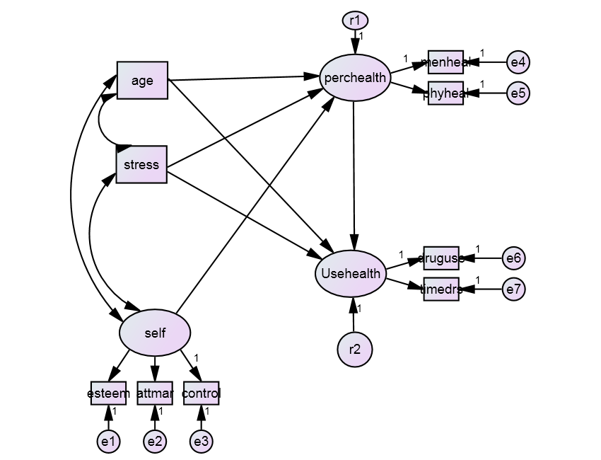
The theoretical model

Slide 69

Standardized estimates

Slide 70
Model Fit
Chi-square = 99.942
Degrees of freedom = 20
Probability level = .000
SRMR is OK, but CFI and RMSEA do not look great,
So this is not a well fitting model.
Default model
Standardized RMR = .0592

Slide 71
Modification indices: Improving the model?
Direct paths
Largest MIs often involve self and the observed measures
Theoretically, the most interesting MI here is whether self directly predicts Usehealth.

Slide 72
Modification indices: Improving the model?
Correlations
Indications here that some important correlations among measures might be missing.
Correlations among the residuals of measures induces correlations among latent outcome variables

Slide 73
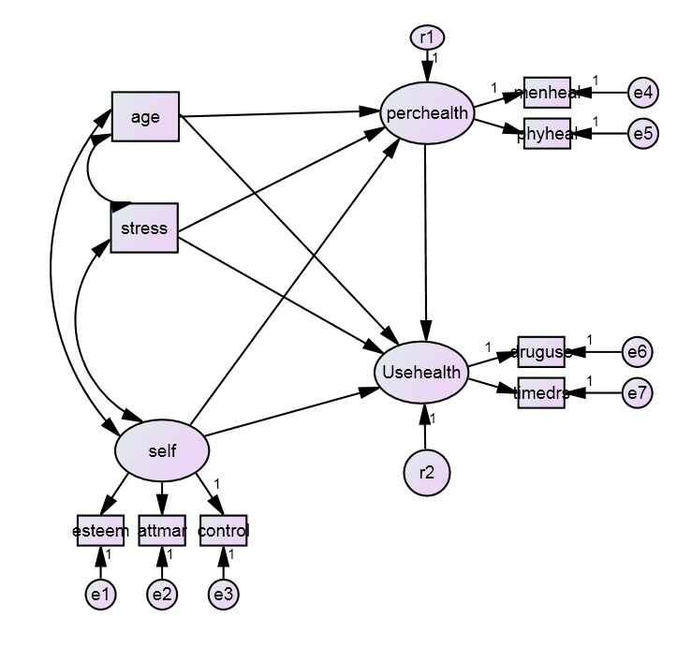
Improve the model? Try self->usehealth
Uh-oh! We don’t want negative variances, this model is NOT good!

Slide 74
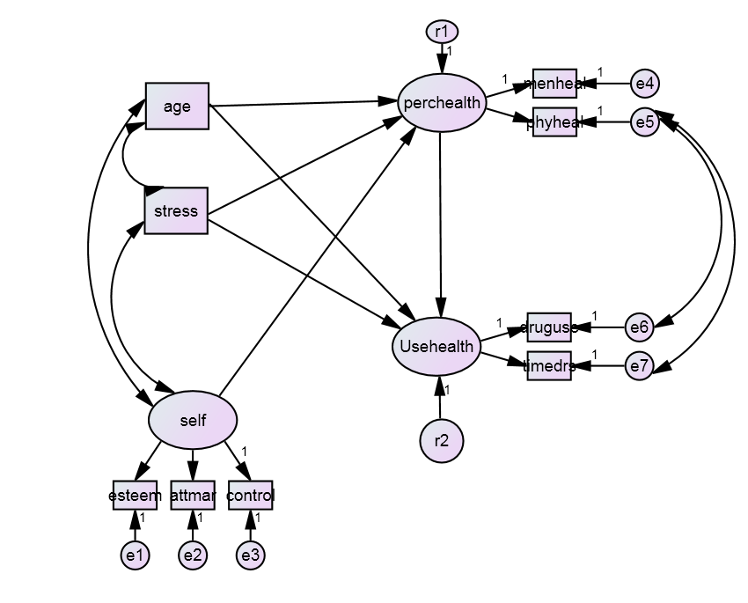
One solution provided in T&F: Correlations among residuals

Slide 75
Model fit
Chi-square = 44.721
Degrees of freedom = 18
Probability level = .000
Previous chi-square = 99.9
Improvement of 55.2 at cost of 2 df
This is highly significant!
This is a much better fitting model.
This type of comparison can done for nested models.
SRMR, CFI and RMSEA are all now acceptable.
AIC has decreased from 150 to 99.
Default model
Standardized RMR = .0442

Slide 76
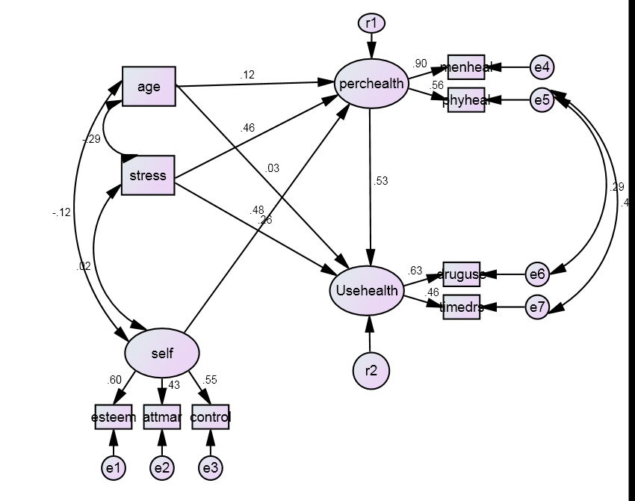
Standardized parameter estimates

Slide 77
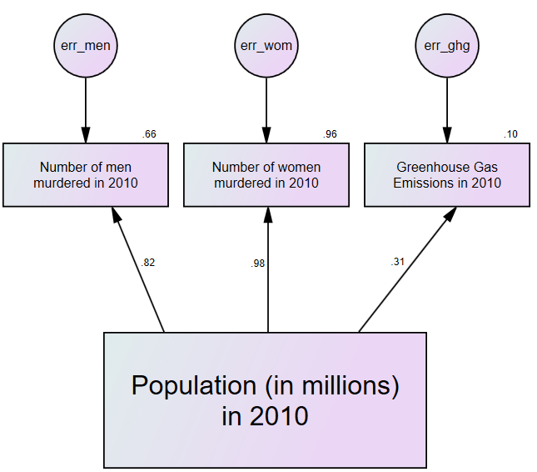
When might it make sense to correlate errors?
A cheesy example Using a country’s population
to predict:
1. Number of men murdered
2. Number of women murdered
3. Greenhouse gas emissions

Slide 78


The model fits very poorly

Slide 79


A somewhat better fitting model

Slide 80
What caused the difference?
If the model’s prediction is too high for males murdered, it will also tend to be too high for females murdered.
If the model’s prediction is too low for males murdered, it will also tend to be too low for females murdered.
The point is illustrated by comparing Australia (AUS) and South Africa (RSA)
Nation | Population (Millions) | Males murdered | Males predicted to be murdered | Residual (Males) | Females Murdered | Females predicted to be murdered | Residual (Females)
AUS | 22.30 | 141 | 890.44 | -749.44 | 89 | 207.98 | -118.98
RSA | 49.99 | 13182 | 1498.10 | 11683.90 | 2758 | 598.23 | 2159.77

Slide 81
bootstrapping
Section 5

Slide 82

Let’s check normality assumptions
The critical statistic is kurtosis. According to https://stat.utexas.edu/software-faqs/amos
“Practically, very small multivariate kurtosis values (e.g., less than 1.00) are considered negligible while values ranging from one to ten often indicate moderate non-normality. Values that exceed ten indicate severe non-normality.”

Slide 83
Normality checks
Some big problems with normality, including multivariate kurtosis
Mahalanobis distance
p1 … probability that any observation could be so far out
– want this small
p2 … probability that this particular case should be so far out
– want this large
– here lots of observations with small p2, so lots of outliers

Slide 84
What happens when assumptions not met?
Model can be incorrectly rejected as not fitting
Standard errors will be smaller than they really are (i.e., parameters may seem significant when they are not)
Solve these problems through bootstrapping

Slide 85
Bootstrap
Takes repeated samples of the data
Allow each observation to be included more than once in any sample
Each observation could represent any number of similar cases in the population.
This can be thought of as ‘sampling with replacement’.
Calculate the statistic for each boot-strapped sample to produce a bootstrap distribution.
Calculate a standard error as the standard deviation of the bootstrap distribution.

Slide 86
Using the bootstrap in Amos
When distribution not normal
To assess overall fit: Bollen-Stine test (Bollen & Stine, 1992)
To obtain accurate standard errors
Unfortunately cannot be done at the same time
Need to do two analysis runs
An excellent webpage on bootstrapping in Amos is at:
https://stat.utexas.edu/software-faqs/amos

Slide 87

Naïve Bootstrapping

Slide 88

Bollen-Stine bootstrapping

Slide 89

1. Bollen-Stine bootstrap for overall fit

Slide 90
some diagnostic information.
Method 1 is the standard
Method 2 is used if method 1 fails.
Method 0 does not exist
Uh-oh! Fit isn’t as good as we thought!

Slide 91

2. ML bootstrap for path estimate confidence intervals

Slide 92


Slide 93

SE is the bootstrap
standard error
SE-SE is the
difference between
bootstrap & usual

Slide 94


Slide 95
IN THIS LECTURE, you learnt
how SEM is akin to a combination of regression and CFA
how to conduct multi-stage regressions (path analyses) in AMOS
about the different types of SEM indices of model fit
why overfitting is evil, and a bit about how to detect it
how to fit a latent variable model in AMOS, and how to use modification indices to improve the model.
about bootstrapping methods that can be applied in AMOS when assumptions of normality are not met.

Slide 96
References
Bollen, K. A., & Stine, R. A. (1992). Bootstrapping goodness-of-fit measures in structural equation models. Sociological Methods & Research, 21(2), 205-229.
Browne, M. W., & Cudeck, R. (1993). Alternative ways of assessing model fit. In K. A. Bollen and J. S. Long (Eds.), Testing structural equation models (pp. 136-162). Newbury Park, CA Sage.
Hu, L., & Bentler, P. M. (1999). Cutoff criteria for fit indexes in covariance structure analysis: Conventional criteria versus new alternatives. Structural Equation Modeling, 6, 1–55.
Kline, R. B. (2016). Principles and practice of structural equation modeling. Guilford Press.
MacCallum, R. C., & Austin, J. T. (2000). Applications of structural equation modeling in psychological research. Annual Review of Psychology, 51, 201–236.
Tabachnick, B. G., & Fidell, L. S. (2013). Using multivariate statistics. Pearson.
Wright, S. (1921). Correlation and causation. Journal of agricultural research, 20, 557-585.
Wright, S. (1934). The method of path coefficients. The annals of mathematical statistics, 5, 161-215.

