Slide 1
Educational Data Mining
Idk which kind of design we should use, if you have some template feel free to apply it…
Project work – Group JYUEF01
Giulia Ortolani, Johanna Riihimäki

Slide 2
Dataset
… since we all did the project on the same dataset maybe we can skip this slide (or present it very quickly) and go directly to the variables that we selected for our analysis

Slide 3
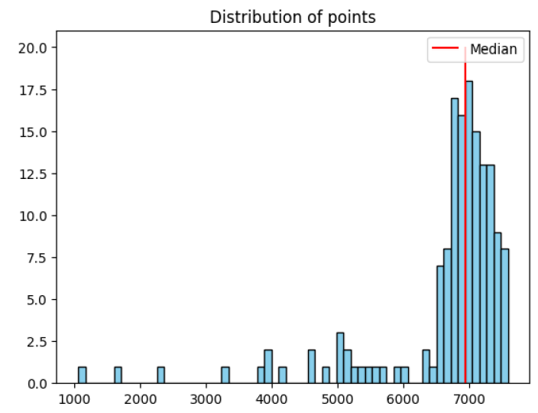
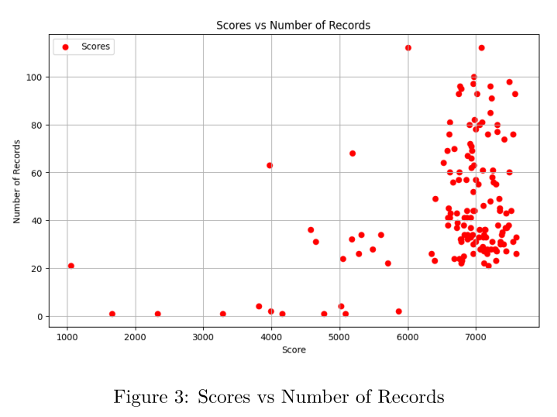
Distribution of the scores
Maybe this slide can be organized better + add a comment on the other graph idk
Looking at the graph on the right, we can see that a lot of students get high grades and very few of them get low grades, as pointed out also by the median (red line)

Slide 4
Our hypothesis
Will being consistently active lead to a better learning?
Is the preferred time of day for working on the course having an effect on the score?
.. Others?
Based on that questions we decided to select our features for building the models […]

Slide 5
Features
Score : the score that each student obtained
Comp_t : the time each student took to complete the course (difference between the last and the first log of the student.
Logs : the number of different timestamps that we have for each student
Pref_work_time : the time of day in which a student tends to work (morning/day/night)
Log_days : amount of days in which the student has been active in the course area.

