Slide 1
Educational Data Mining
Project work – Group JYUEF01
Giulia Ortolani, Johanna Riihimäki

Slide 2
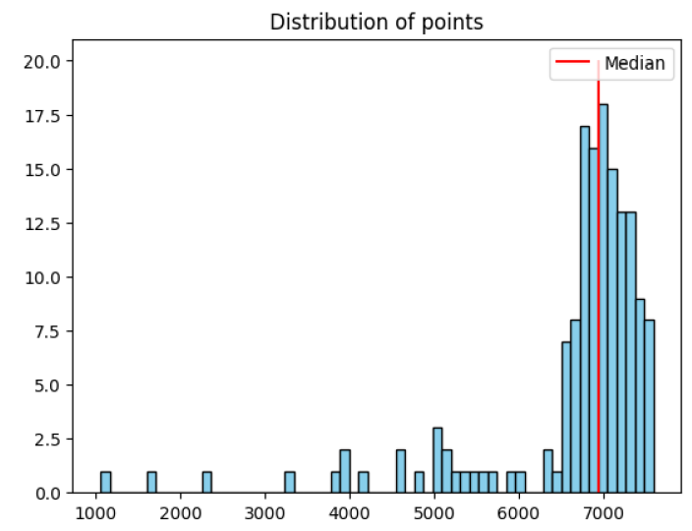
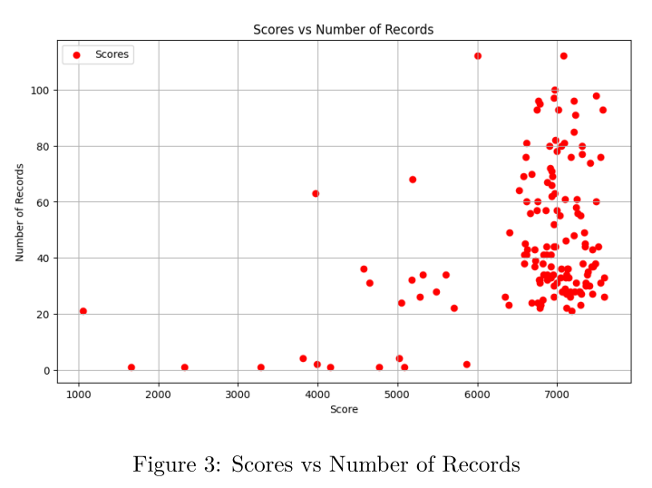
Distribution of the scores
Looking at the graph on the right, we can see that a lot of students get high grades and very few of them get low grades, as pointed out also by the median (red line)

Slide 3
Our hypothesis
Will having more timestamps/logs lead to a better score?
Will being consistently active lead to a better scores?
Will the preferred time of day for working influence the score?
Does the compilation time affect the score?

Slide 4
Features
score: the score that each student obtained;
comp_t: the time each student took to complete the course (difference between the last and the first log of the student);
logs: the number of different timestamps that we have for each student;
pref_work_time: the time of day in which a student tends to work (morning/day/night);
log_days: the amount of days in which the student has been active in the course area.

Slide 5
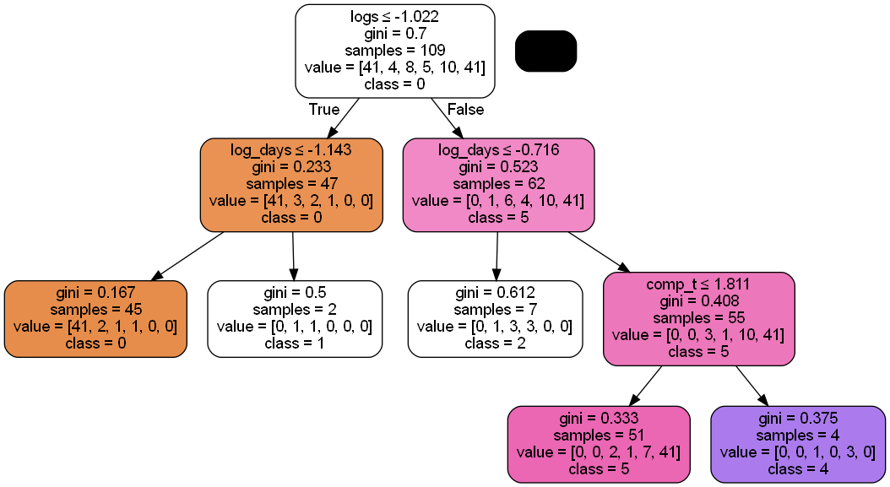
Approach 1: Decision Tree
Score categories: 0-5
Data split 70/30
Oversampling the data
Hyperparameter tuning
Standardization
Evaluation metric:
F1-score: above 0.70

Slide 6
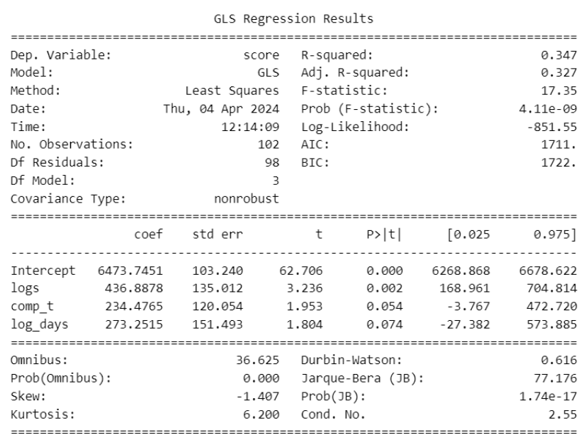
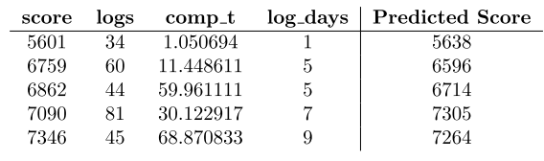





Approach 2: Regression
Goal: predict the exact value of the score
Feature selection
Final model:
Examples of predictions:
Evaluation metric:
R-squared: 0.347

Slide 7
Final words
Compilation time, number of active days and logs does have a significant effect on the score
Preferred time of day for working not (at least based on trees, how about regression? - Not even in regression)
Something else?

