Slide 1
Educational Data Mining
Project work – Group JYUEF01
Giulia Ortolani, Johanna Riihimäki

Slide 2
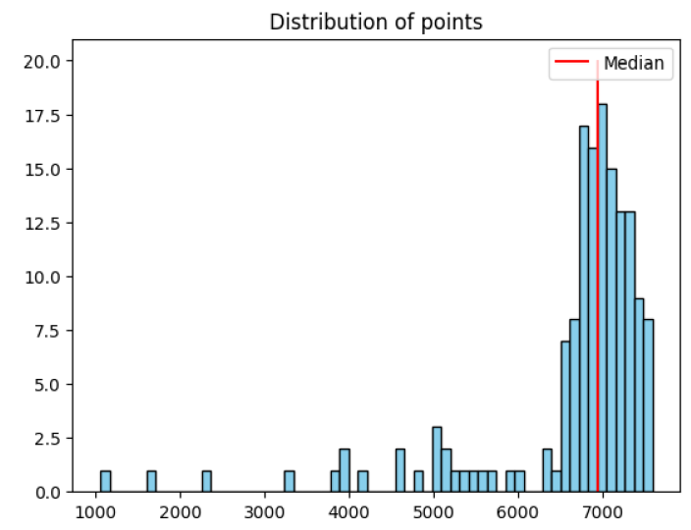
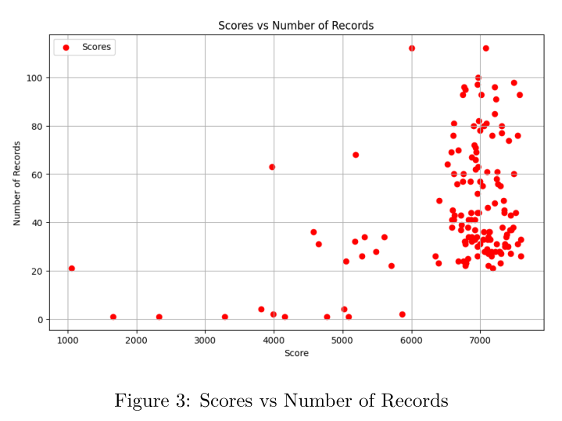
Distribution of the scores
Looking at the graph on the right, we can see that a lot of students get high grades and very few of them get low grades, as pointed out also by the median (red line)

Slide 3
Our hypothesis
Will having more timestamps/logs lead to a better score?
Will being consistently active lead to a better scores?
Willthe preferred time of day for working influence the score?
Does the compilation time affect the score?

Slide 4
Features
Score : the score that each student obtained
Comp_t : the time each student took to complete the course (difference between the last and the first log of the student)
Logs: the number of different timestamps that we have for each student
Pref_work_time the time of day in which a student tends to work (morning/day/night)
Log_days: amount of days in which the student has been active in the course area.

Slide 5
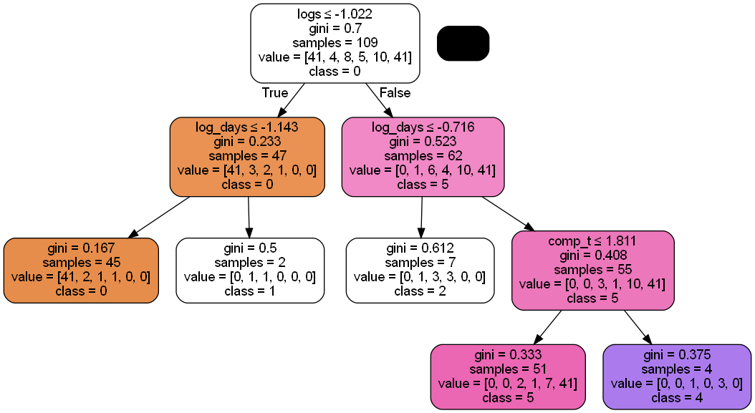
Approach 1:Decision Tree
Score categories: 0-5
Data split 70/30
Oversampling the data
Hyperparameter tuning
Standardization
Results:
F1-score: above 0.70

Slide 6
Approach 2: Regression
Something
Something
Something
Results

Slide 7
Final words
Compilation time, number of active days and logs does have an effect on the score
Preferred time of day for working not (at least based on trees, how about regression?)
Something else?

