Slide 1
Educational Data Mining
Project work – Group JYUEF01
Giulia Ortolani, Johanna Riihimäki

Slide 2
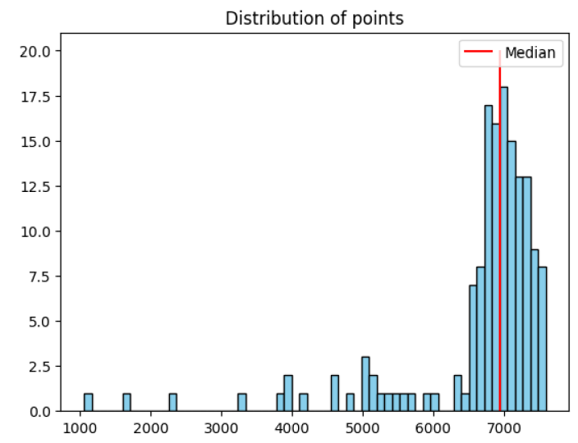
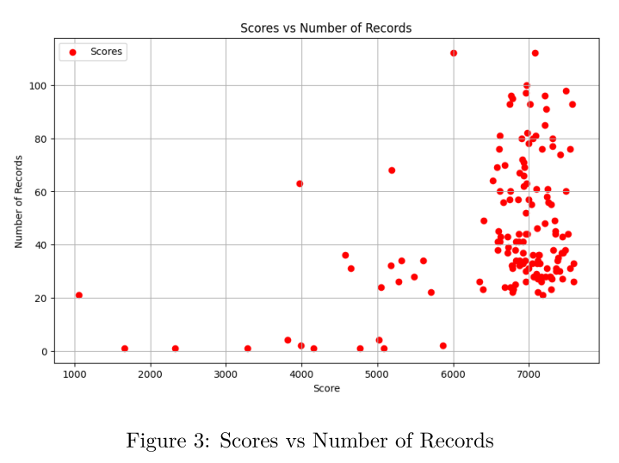
Distribution of the scores
Looking at the graph on the right, we can see that a lot of students get high grades and very few of them get low grades, as pointed out also by the median (red line)

Slide 3
Our hypothesis
Will having more timestamps/logs lead to a better score?
Will being consistently active lead to a better scores?
Will the preferred time of day for working influence the score?
Does the completion time affect the score?

Slide 4
Features
score: the score that each student obtained;
comp_t: the time each student took to complete the course (difference between the last and the first log of the student);
logs: the number of different timestamps that we have for each student;
pref_work_time: the time of day in which a student tends to work (morning/day/night);
log_days: the amount of days in which the student has been active in the course area.

Slide 5
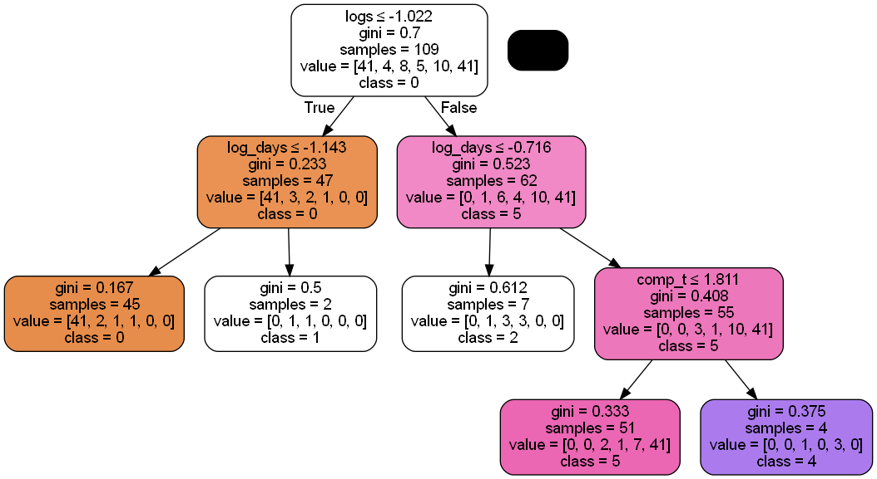
Approach 1: Decision Tree
Goal: predict the category of the score (classification)
Score categories: 0-5
Data split 70/30
Oversampling the data
Hyperparameter tuning
Standardization
Evaluation metric:
F1-score: above 0.70

Slide 6
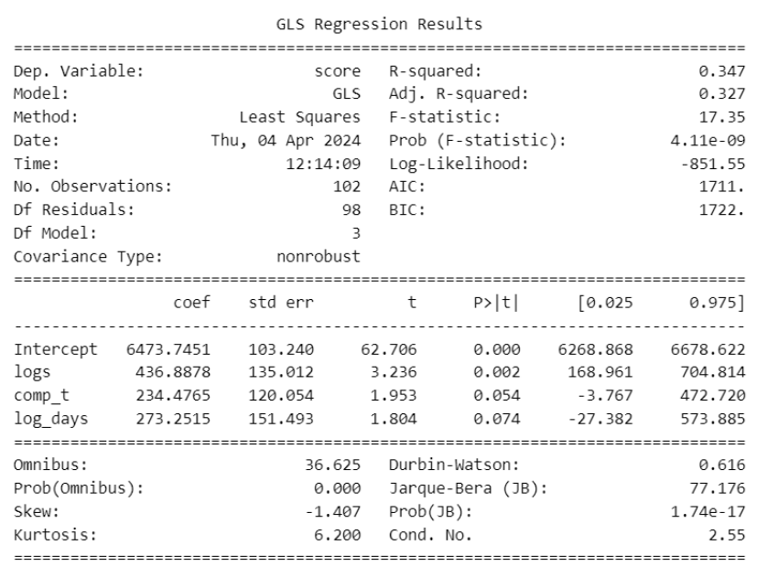
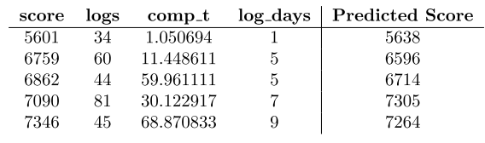





Approach 2: Regression
Goal: predict the exact value of the score
Feature selection
Final model:
Examples of predictions:
Evaluation metric:
R-squared: 0.347
$$score_{i}=β_{0}+β_{1}logs_{i}+β_{2}comp_t+β_{3}{log_days}_{i}$$

Slide 7
Summary
Compilation time, number of active days and logs does have a significant effect on the score.
We can say that spending more time working on the problem (measured in time and the amount of activity) lead to better results in terms of score.
Weaknesses of this analysis:
Decision trees focus too much on the training data, the reliability of our results could be affected by this overfitting.
The R-squared value of 0.347 in the linear model indicates that we haven’t captured all the features influencing our target variable: there are other factors contributing to the variability in the data that our current model hasn’t accounted for.

