Slide 1
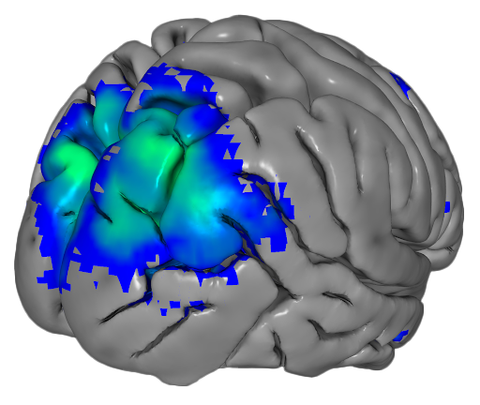
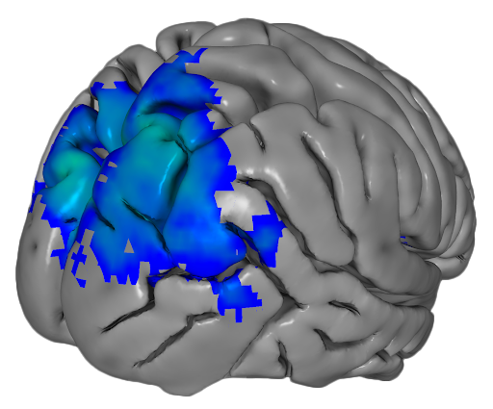
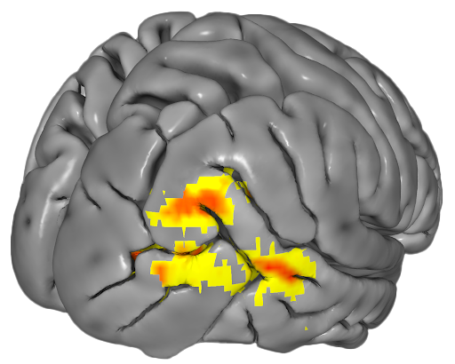
Pre-treatment
Post-treatment
Pre- to Post-treatment changes
A
B
C
0 6.25 12.5
z-stat
0 3 6
t-stat
Caption: A. Maps of resting state network activation. Resting state network activation at pre-treatment (blue/green) over significant increases in resting state network from pre-treatment to post-treatment (red/yellow).
B. Map of resting state network activation at post-treatment (blue/green).

Slide 2
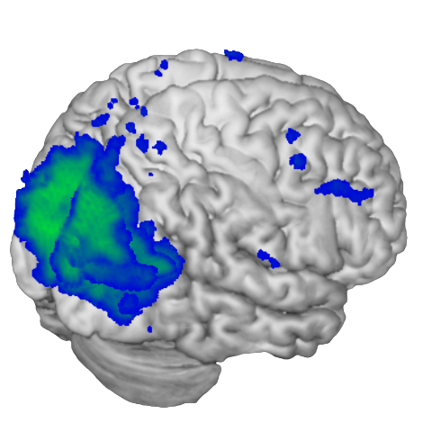
0 6.25 12.5
z-stat
Caption: Maps of resting state network activation at post-treatment.

Slide 3
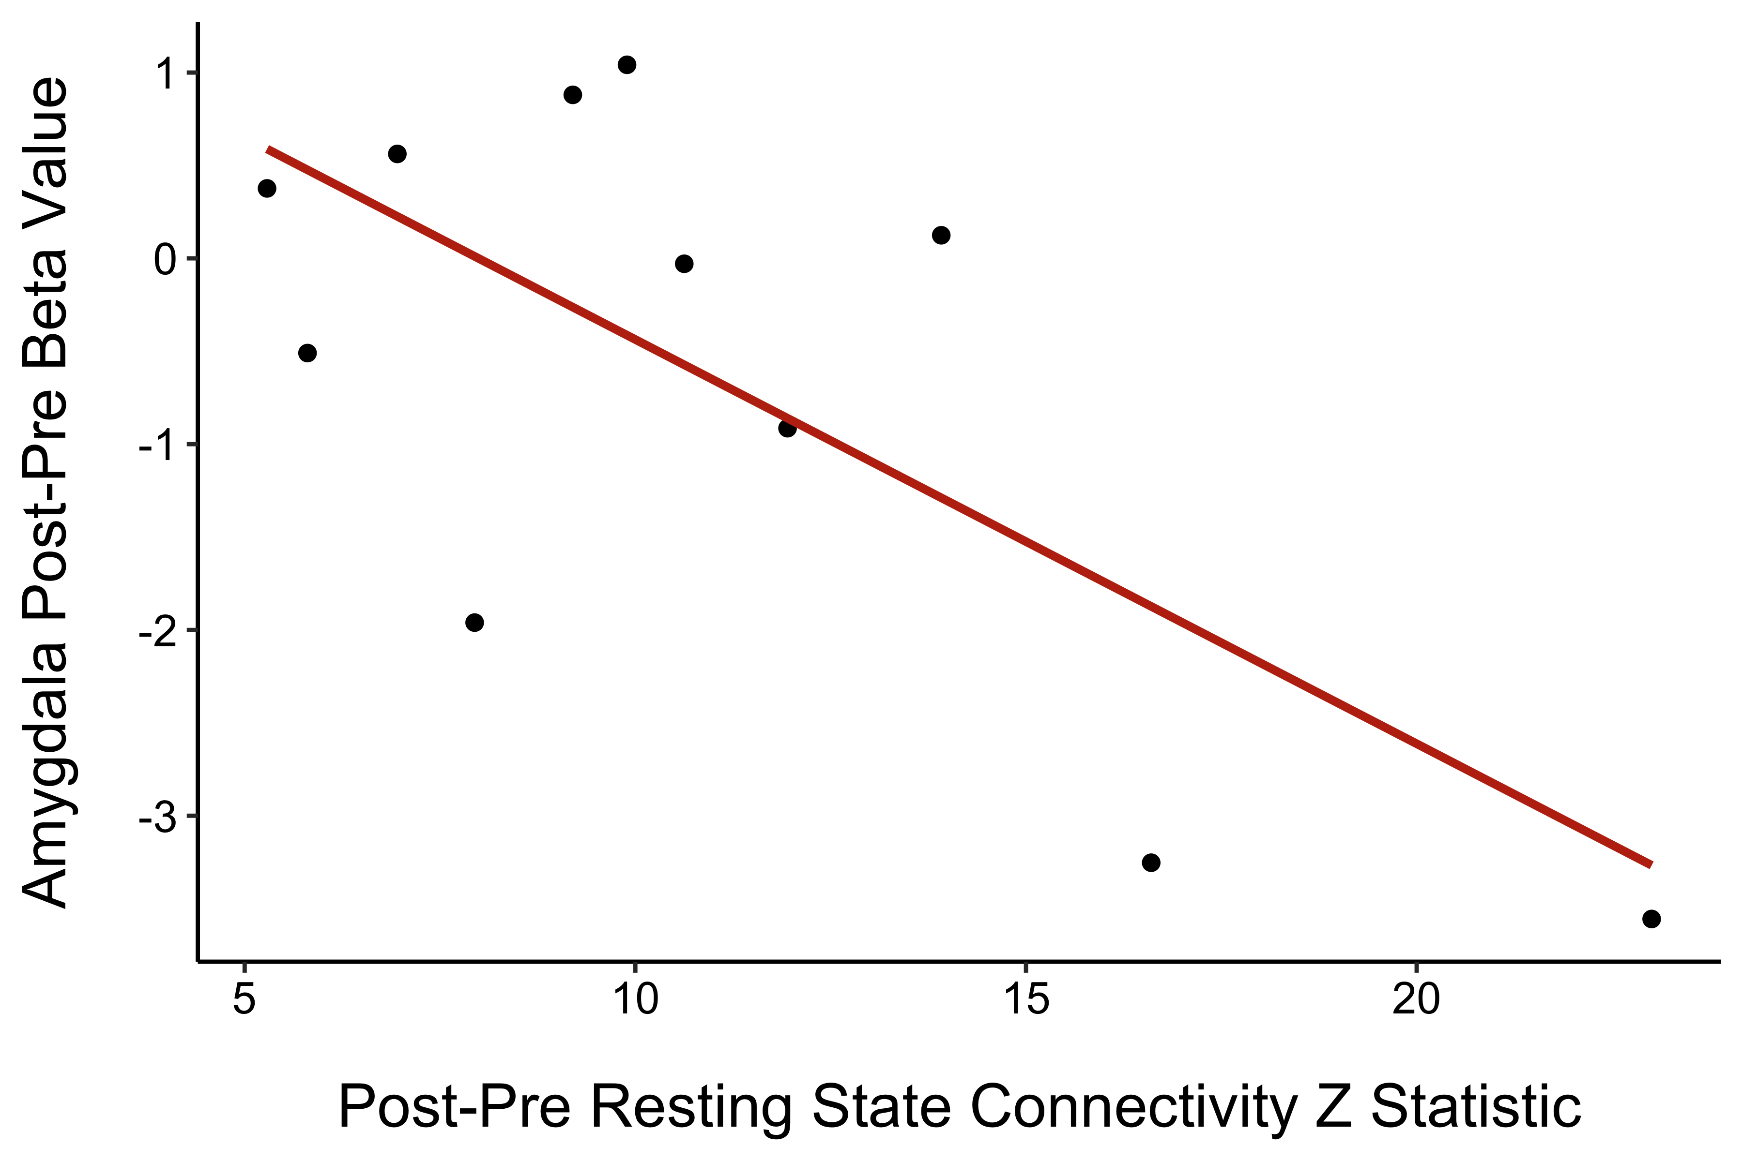
Connectivity Predicts Amygdala Decrease
Caption: Change in amygdala response correlated with change in resting state network connectivity. Greater increases in network connectivity post-treatment minus pre-treatment were significantly correlated with greater reductions in amygdala responses post-treatment minus pre-treatment when controlling for time between assessments, number of phobias, and days of neuro-reinforcement (p < 0.05).

Slide 4
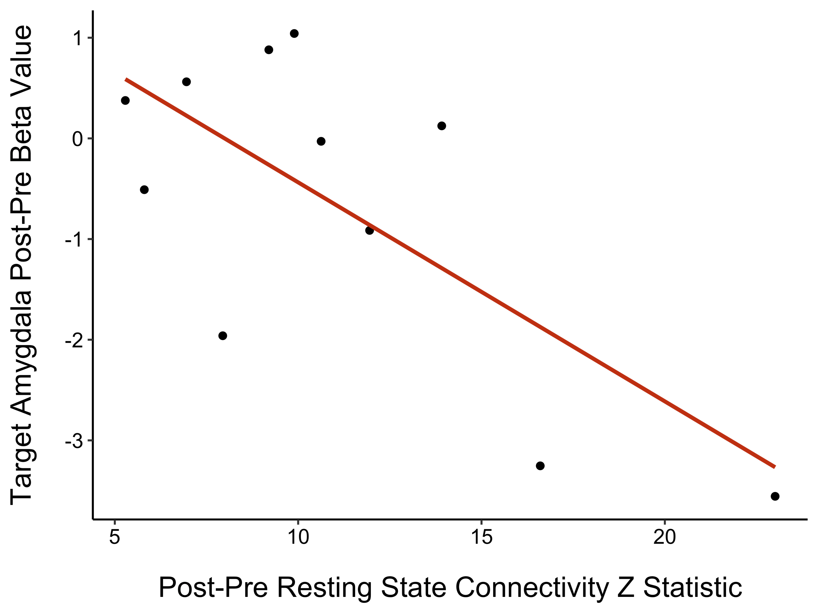
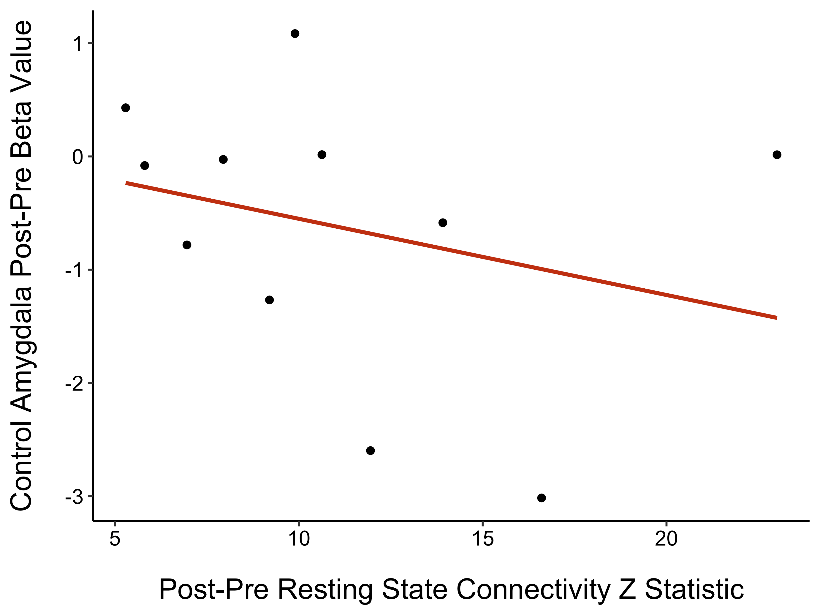
A
B
Target
Control
* p = .021

