Slide 1
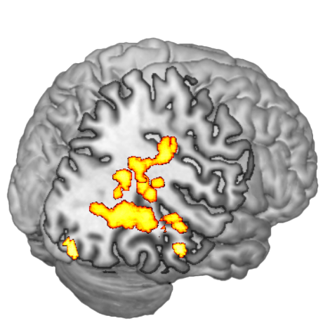
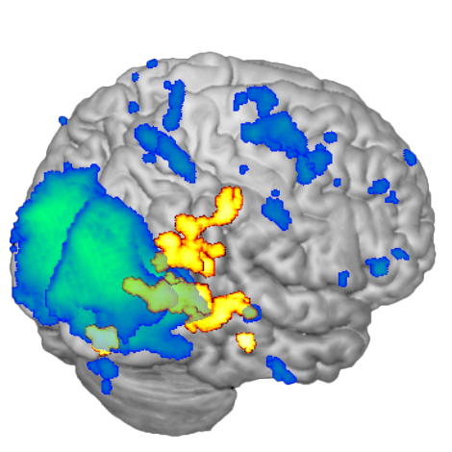
A
B
0 1.5 3 4.5 6
0 3.25 6.50 9.75 12.5
0 1.5 3 4.5 6
Caption: Maps of resting state network activation. (A) Significant increases in resting state network activation from pre-treatment to post-treatment. (B) Resting state network activation at pre-treatment (blue/green) over significant increases in resting state network from pre-treatment to post-treatment (red/yellow).

Slide 2
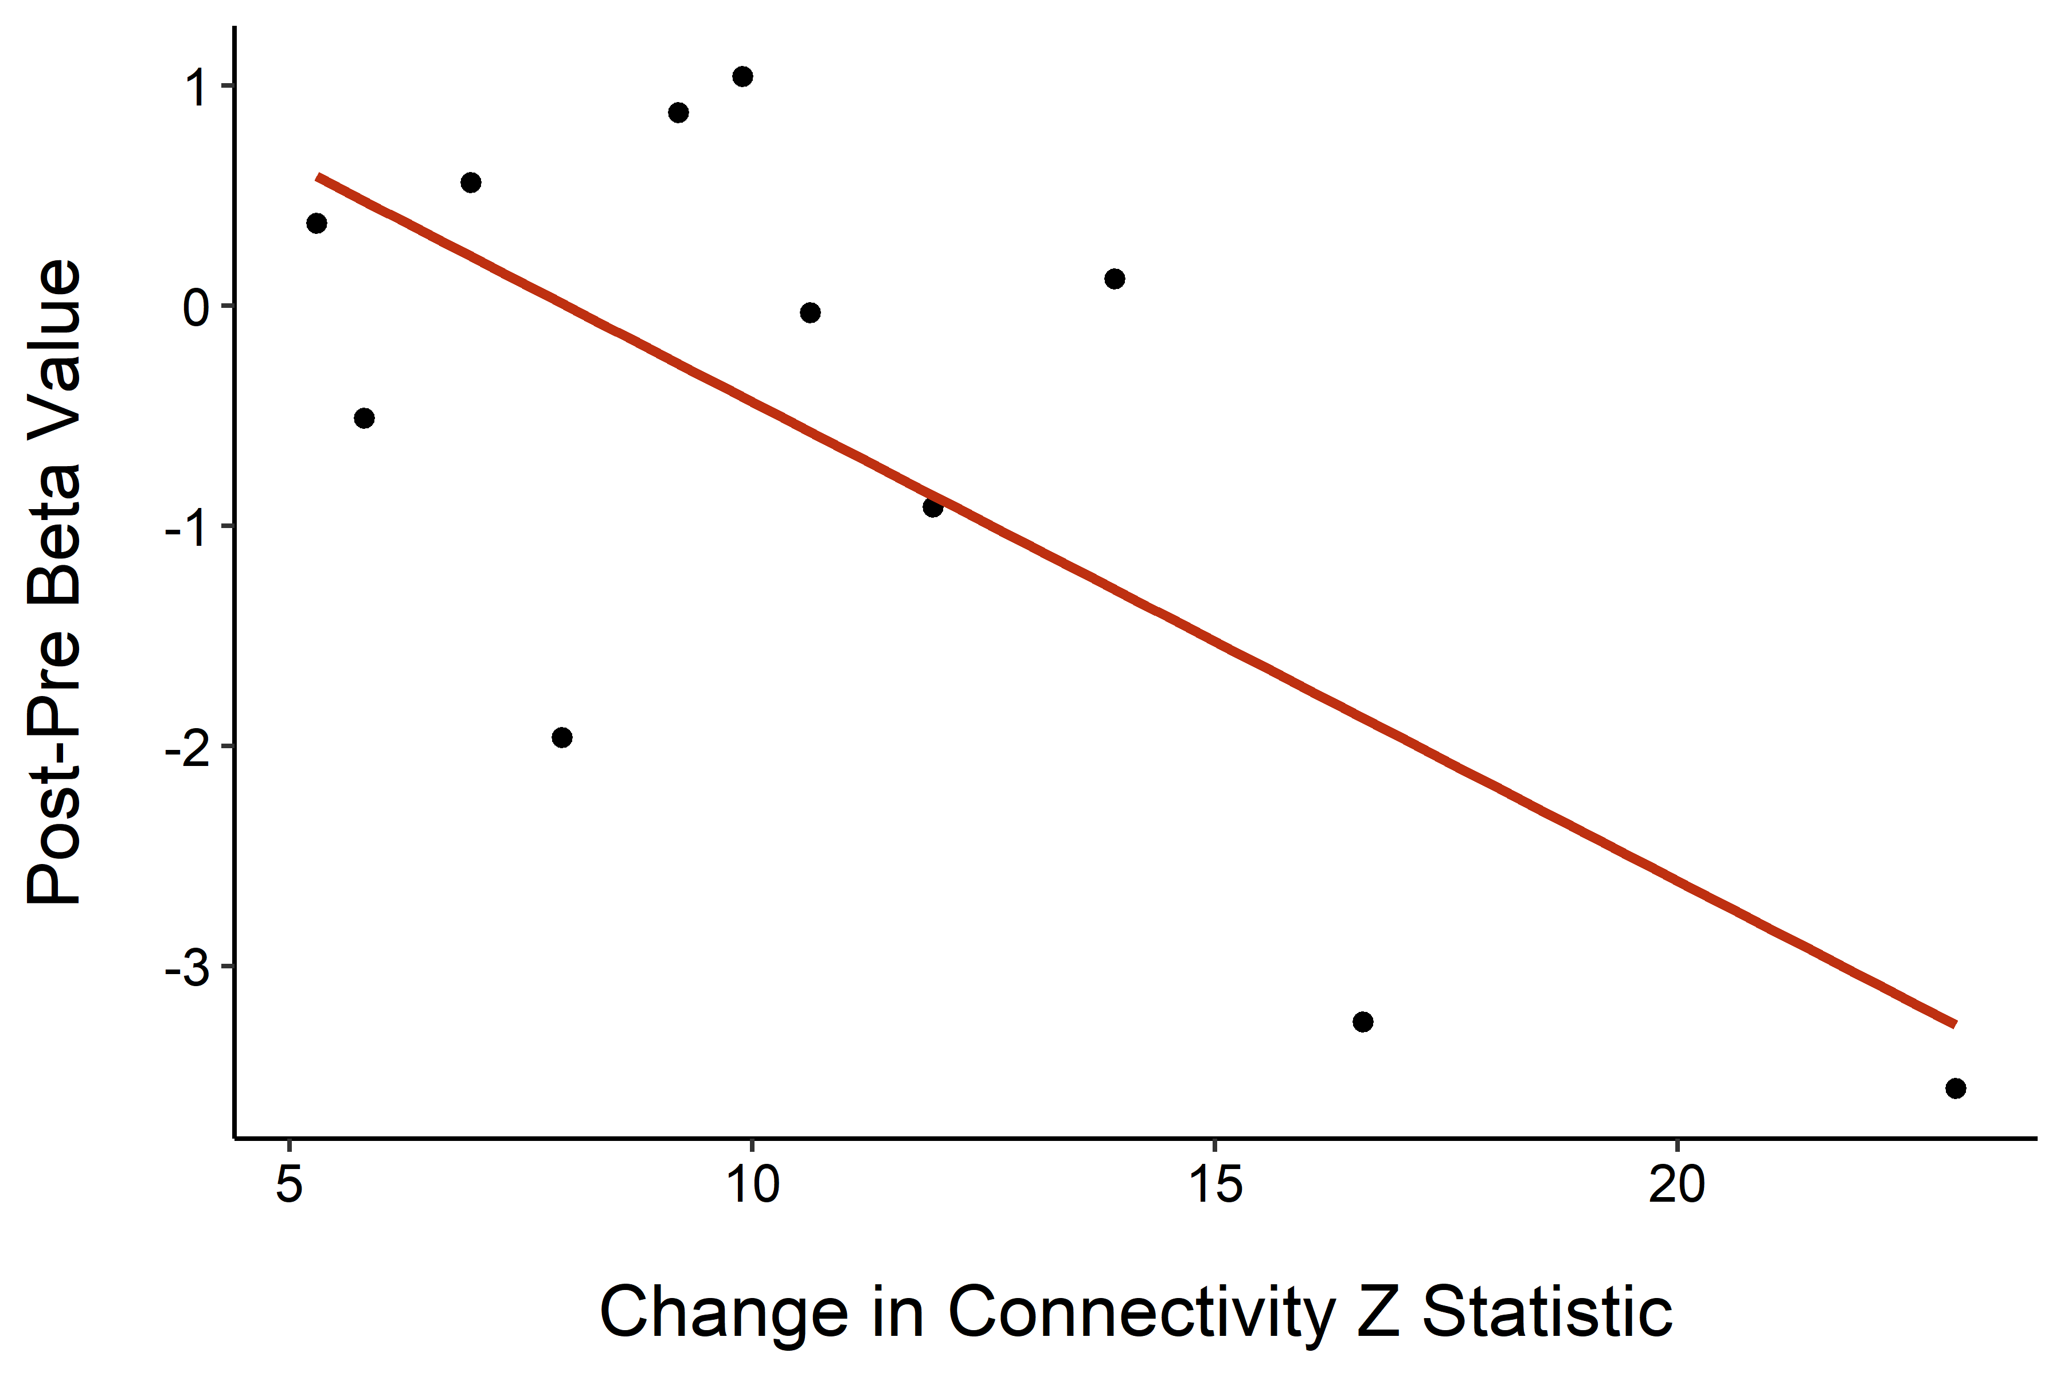
Amygdala
Caption: Change in amygdala response correlated with change in resting state network connectivity. Greater increases in network connectivity post-treatment minus pre-treatment were significantly correlated with greater reductions in amygdala responses post-treatment minus pre-treatment when controlling for time between assessments, number of phobias, and days of neuro-reinforcement (p < 0.05).

