Slide 1
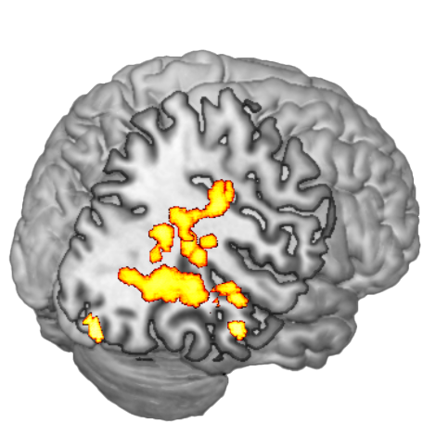
Red: Significant changes in network activation pre to post

Slide 2
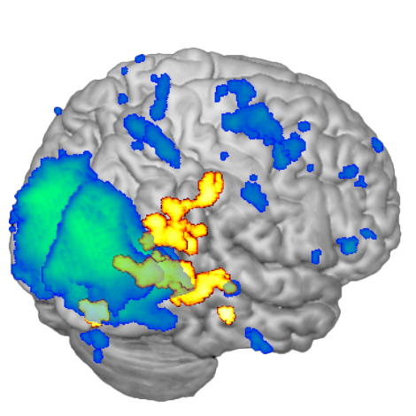
Blue: network activation at pre-treatment

Slide 3
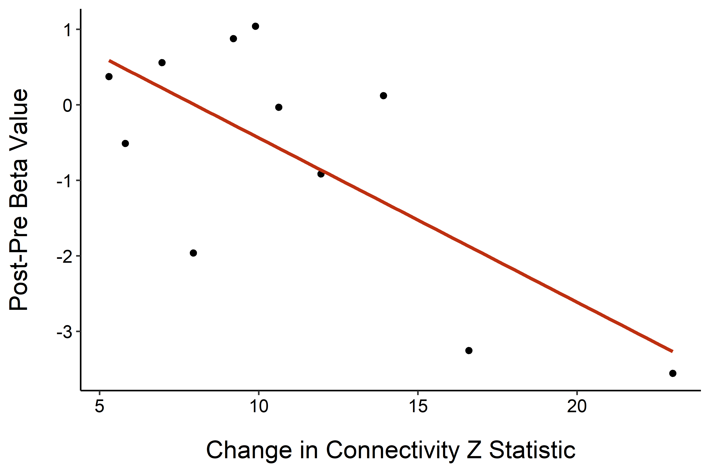
Amygdala

