Slide 1
Bearings for Bridges
Dr. Shahzad Rahman
NWFP University of Engg & Technology, Peshawar

Slide 2
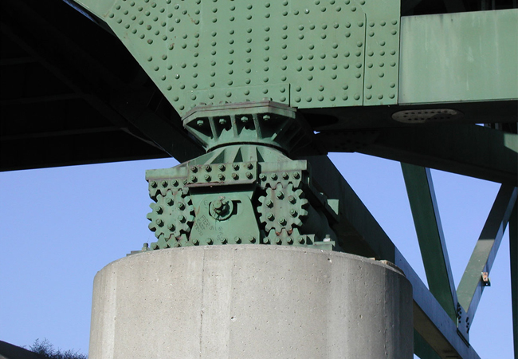
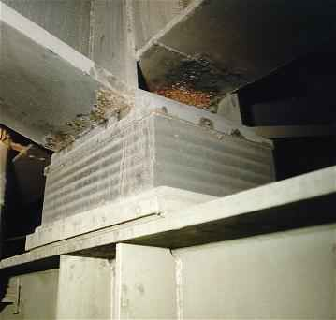
Bridge Bearings

Slide 3
Bridge Bearings
Function Of Bearings
Bridge bearings are used to transfer forces from the superstructure to the substructure, allowing the following types of movements of the superstructure:
Translational movements; and
Rotational movements

Slide 4
Bridge Bearings
Until the middle of this century, the bearings used consisted of following types:
Pin
Roller
Rocker
Metal sliding bearings

Slide 5
Pin Bearing
A pin bearing is a type of fixed bearings that accommodates rotations through the use of a steel
Translational movements are not allowed.
The pin at the top is composed of upper and lower semicircularly recessed surfaces with a solid circular pin placed between.
Usually, there are caps at both ends of the pin to keep the pin from sliding off the seats and to resist uplift loads if required.
The upper plate is connected to the sole plate by either bolting or welding. The lower curved plate sits on the masonry plate.

Slide 6
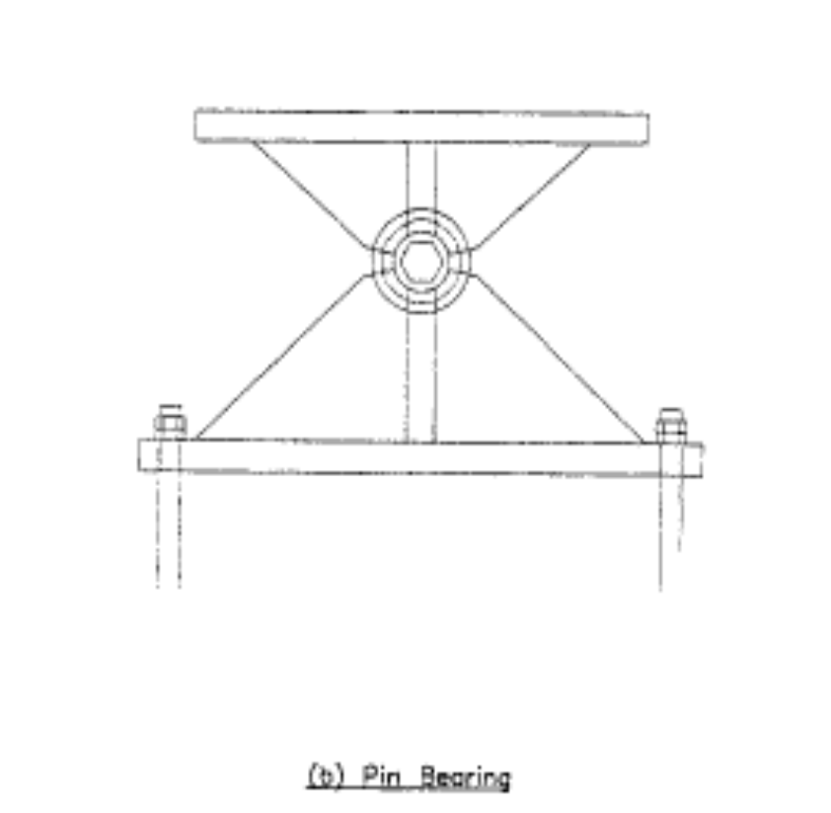
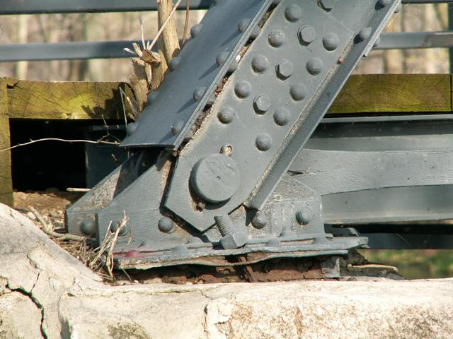
Pin Bearing
Steel Pin
Rotational Movement is allowed
Lateral and Translational Movements are Restricted

Slide 7

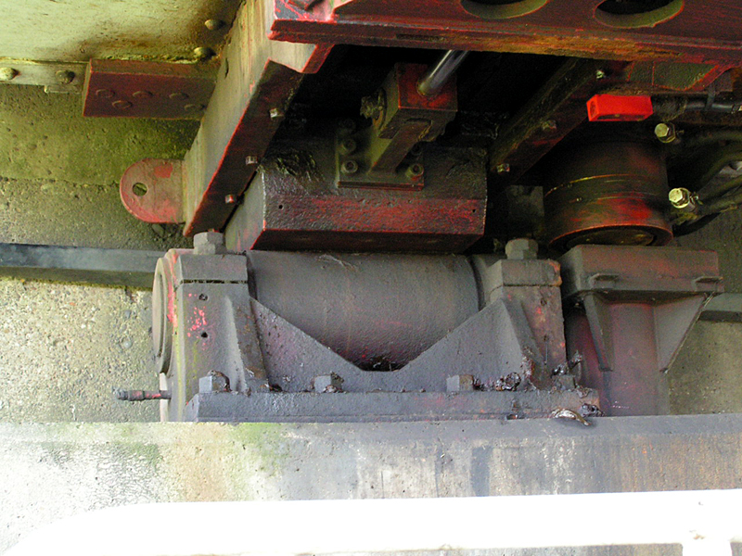
Roller Type Bearings
Single Roller Bearing
Multiple Roller Bearing
AASHTO requires that expansion rollers be equipped with “substantial side bars” and be guided by gearing or other means to prevent lateral movement, skewing, and creeping (AASHTO 10.29.3).
    A general drawback to this type of bearing is its tendency to collect dust
    and debris.

Slide 8
Roller Type Bearings
Roller Type Bearing with Gear Arrangement
Longitudinal movements are allowed
Lateral Movements and Rotations are
Restricted

Slide 9
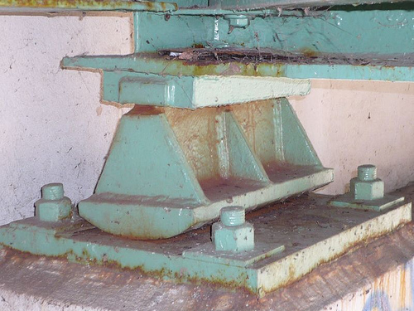
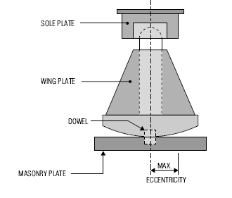
Rocker Type Bearing
A rocker bearing is a type of expansion bearing that comes in a great variety.
It typically consists of a pin at the top that facilitates rotations, and a curved surface at the bottom that accommodates the translational movements
Rocker and pin bearings are primarily used in steel bridges.

Slide 10
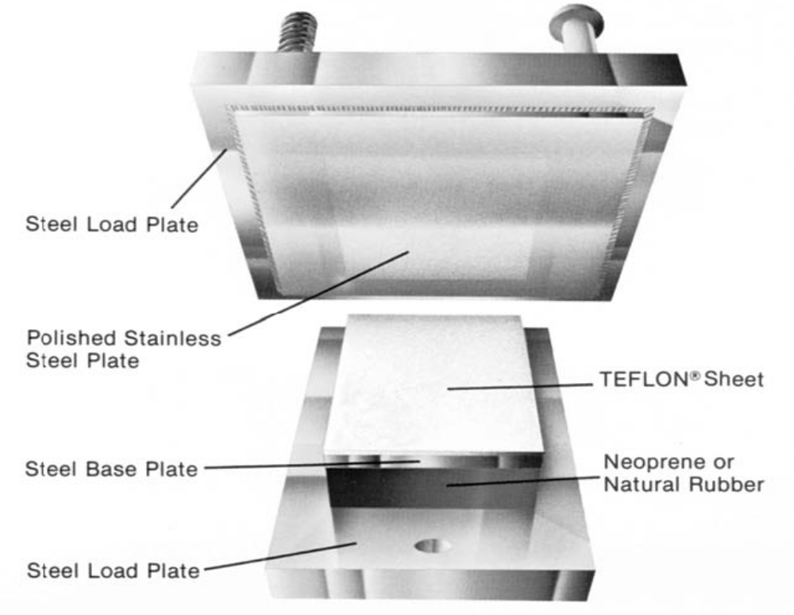
Sliding Bearings
A sliding bearing utilizes one plane metal plate sliding against another to accommodate translations.
The sliding bearing surface produces a frictional force that is applied to the superstructure, substructure, and the bearing itself.
To reduce this friction force, PTFE (polytetrafluoroethylene) is often used as a sliding lubricating material. PTFE is sometimes referred to as Teflon, named after a widely used brand of PTFE

Slide 11
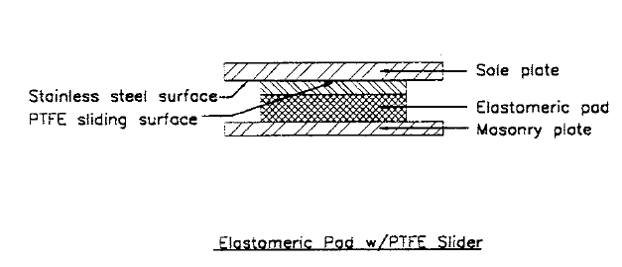
Sliding Bearings
Sliding Bearings be used alone or more often used as a component in other types of bearings
Pure sliding bearings can only be used when the rotations caused by the deflection at the supports are negligible. They are therefore limited to a span length of 15 m or less by ASHTTO [10.29.1.1]

Slide 12
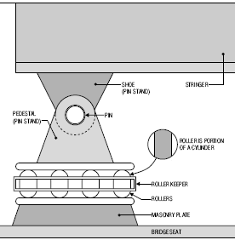
Knuckle Pinned Bearing
It is special form of Roller Bearing in which the Knuckle pin is provided for easy rocking. A knuckle pin is inserted between the top and bottom casting. The top casting is attached to the Bridge superstructure, while the bottom casting rests on a series of rollers
Knuckle pin bearing can accommodate large movements and can accommodate sliding as well as rotational movement

Slide 13
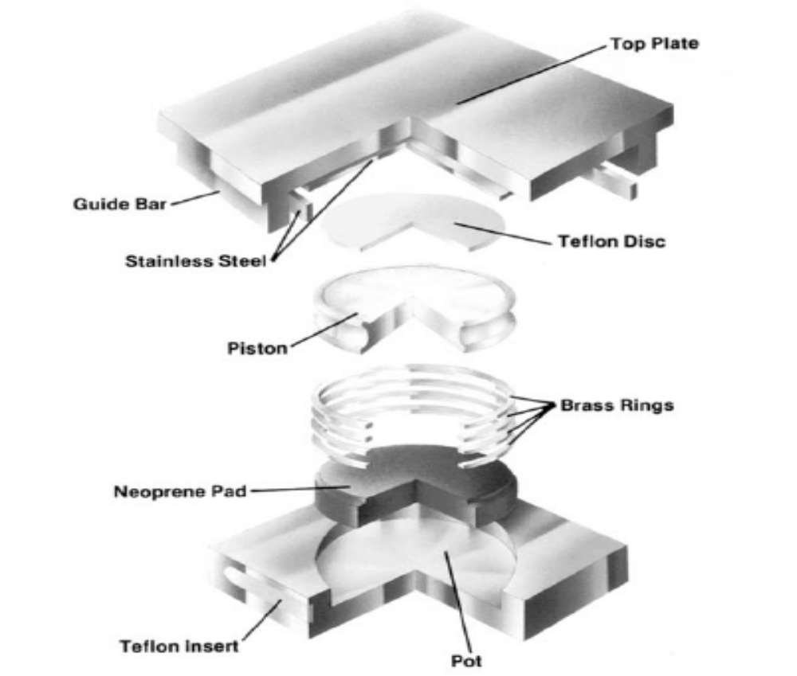
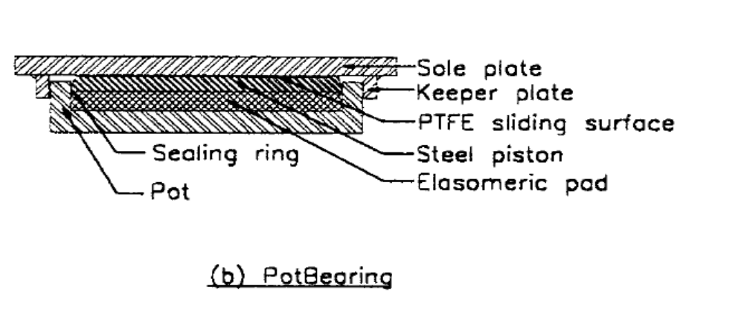
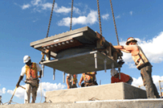
Pot Bearings

Slide 14
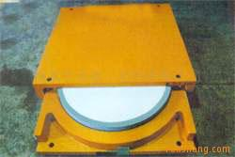
Pot bearing

Slide 15
Pot Bearings
A POT BEARING consists of a shallow steel cylinder, or pot, on a vertical axis with a neoprene disk which is slightly thinner than the cylinder and fitted tightly inside.
A steel piston fits inside the cylinder and bears on the neoprene.
Flat brass rings are used to seal the rubber between the piston and the pot.
The rubber behaves like a viscous fluid flowing as rotation may occur.
Since the bearing will not resist bending moments, it must be provided with an even bridge seat.

Slide 16
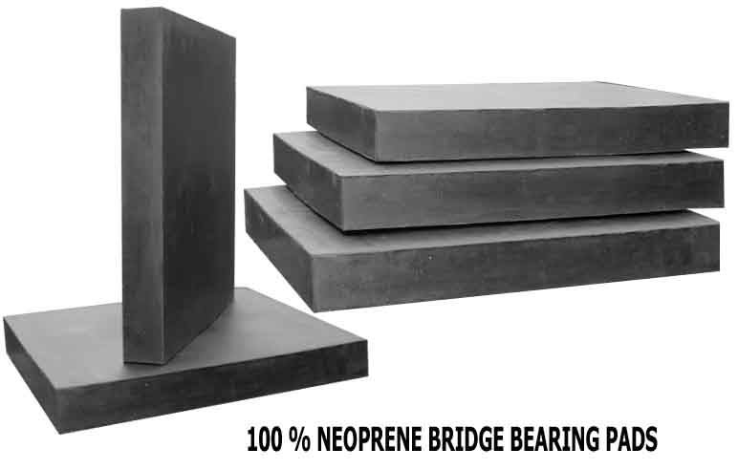
Plain Elastomeric Bearings

Slide 17
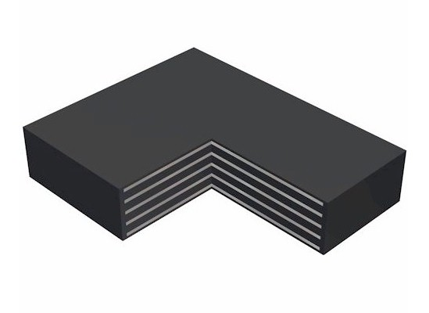
Laminated Elastomeric Bearings
Elastomeric material interspersed with steel plates

Slide 18
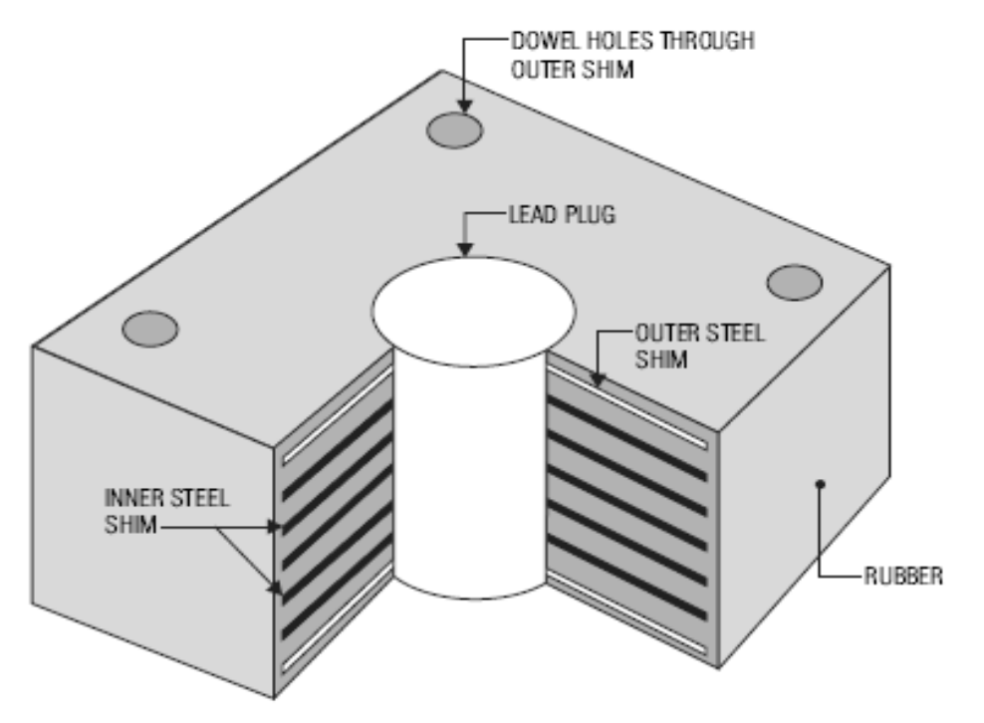
Laminated Elastomeric Bearings
consist of a laminated elastomeric bearing equipped with a lead cylinder at thecenter of the bearing.
The function of the rubber-steel laminated portion of the bearing is to carry the weight of the structure and provide post-yield elasticity.
The lead core is designed to deform plastically, thereby providing damping energy dissipation.
Lead rubber bearings are used in seismically active areas because of their performance under earthquake loads.

Slide 19
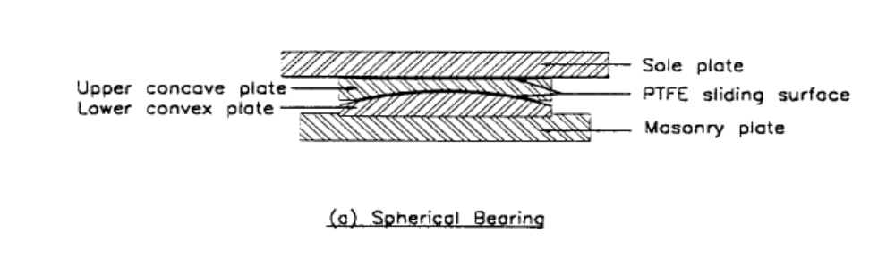
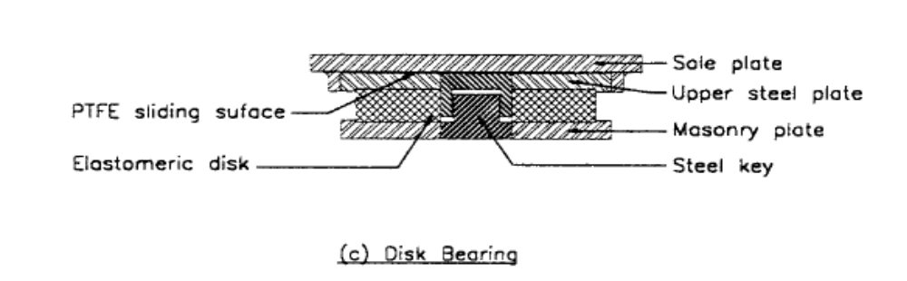
Other Types of Bearings

Slide 20
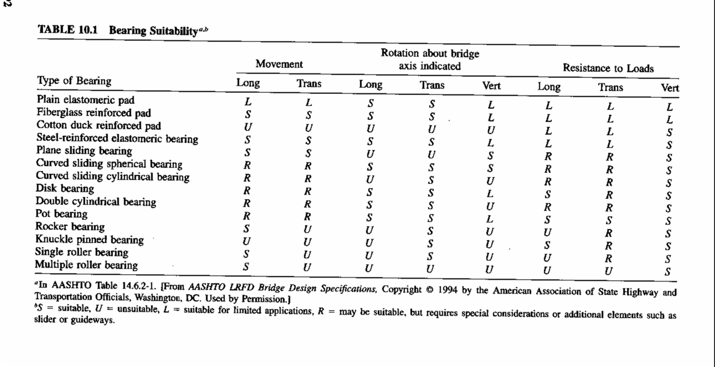
Selection of Bearing Type
AASHTO LRFD provides guidelines for selection of suitable bearings for bridges as per requirements in Table 14.6.2-1

Slide 21
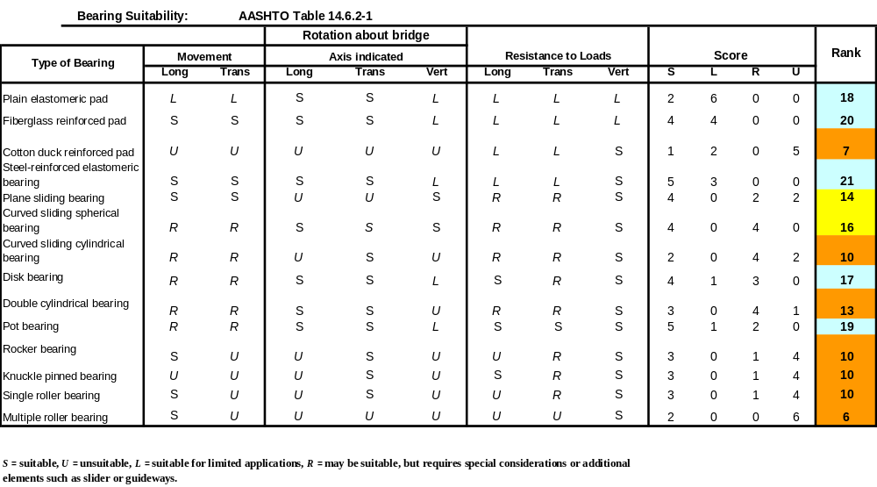
Selection of Bearing Type

Slide 22
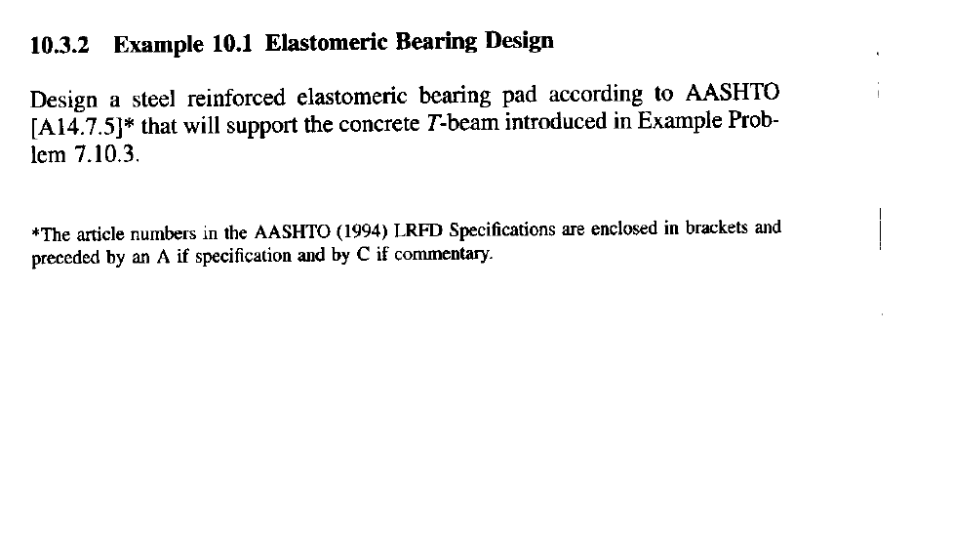
Elastomeric Bearing Design -Example

Slide 23
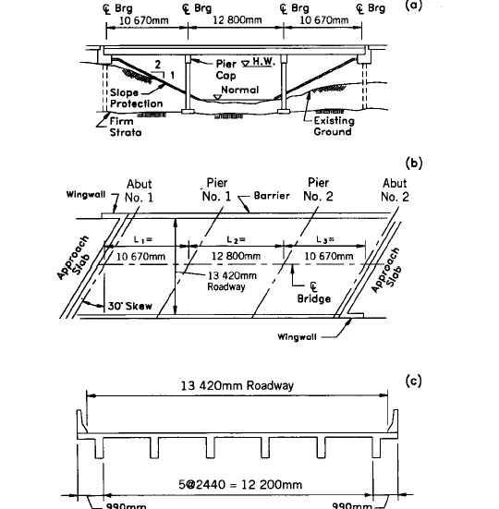
Elastomeric Bearing Design -Example

Slide 24
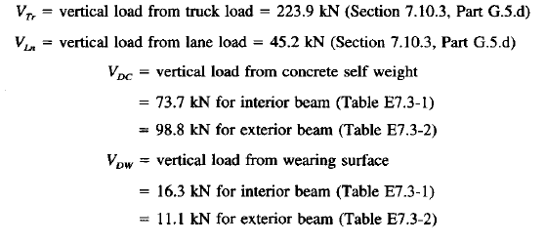
Elastomeric Bearing Design -Example
Loading Data

Slide 25
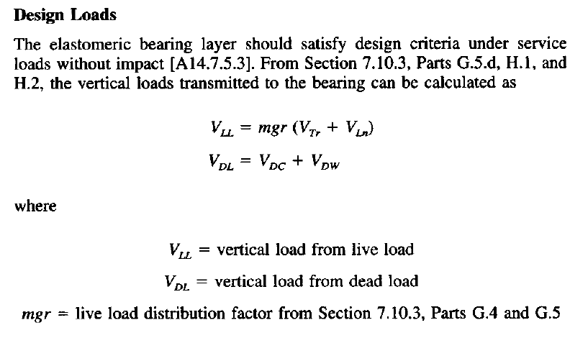
Elastomeric Bearing Design -Example
Corrected for skew
mgr = r_{skew} x mg
Where,
r_{skew} = Correction Factor for Skew
mg = Uncorrected Distribution Factor neglecting skew

Slide 26
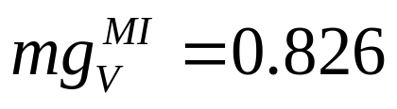
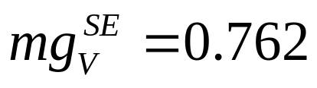
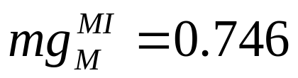
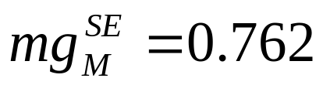
Elastomeric Bearing Design -Example
Uncorrected Distribution Factor =
For Shear, Interior Beams
Uncorrected Distribution Factor =
For Shear, Exterior Beams
Uncorrected Distribution Factor =
For Moment, Interior Beams
Uncorrected Distribution Factor =
For Moment, Exterior Beams

Slide 27
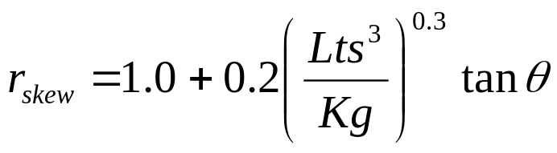

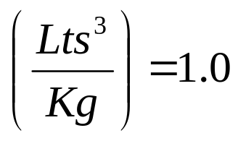
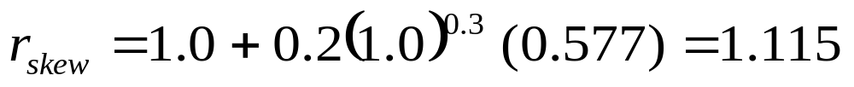
Elastomeric Bearing Design -Example
Correction Factor for Skew
For skewed bridges the Distribution Factor for Shear may be modified by
Multiplying it with a Modification Factor given as: [A4.6.2.2.3 c-1]

Slide 28
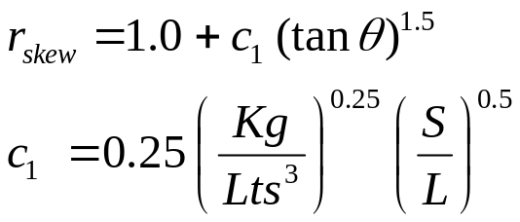
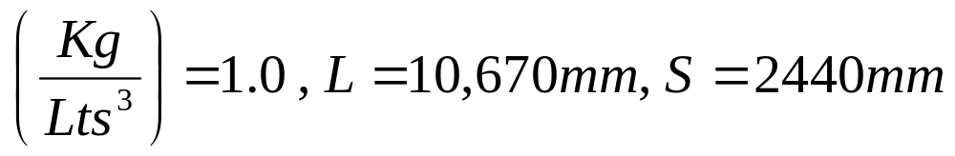
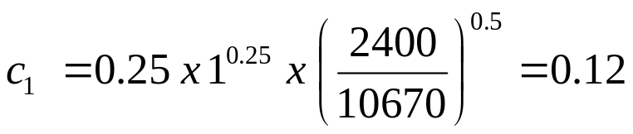

Elastomeric Bearing Design -Example
Correction Factor for Moment
For skewed bridges the Distribution Factor for Moment may be modified by
Multiplying it with a Modification Factor given as: [A4.6.2.2.2 e]

Slide 29
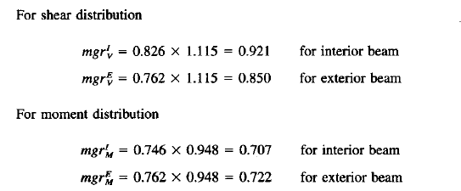
Elastomeric Bearing Design -Example
Modified Distribution Factors for Shear and Moment

Slide 30

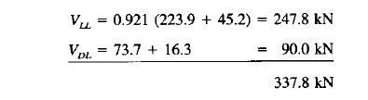
Elastomeric Bearing Design -Example
Bearing Load Calculation

Slide 31
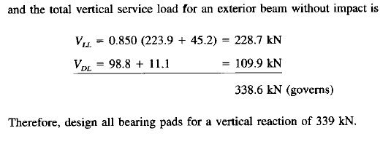
Elastomeric Bearing Design -Example
Bearing Load Calculation

Slide 32
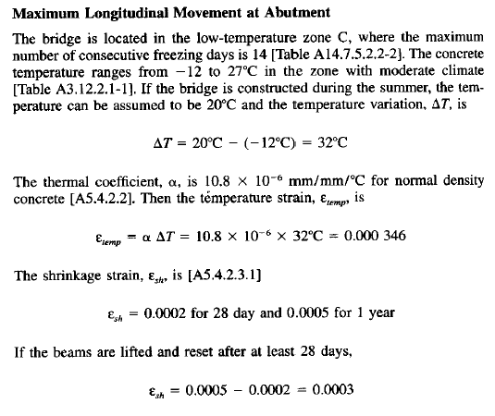
Elastomeric Bearing Design -Example

Slide 33

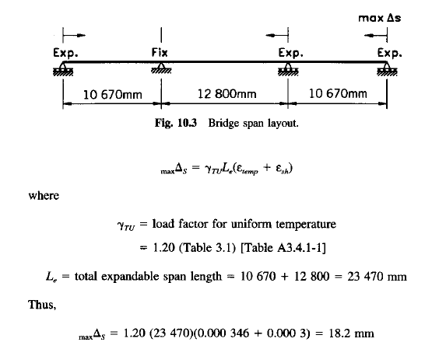
Elastomeric Bearing Design -Example
Maximum Longitudinal Movement at the Abutment

Slide 34
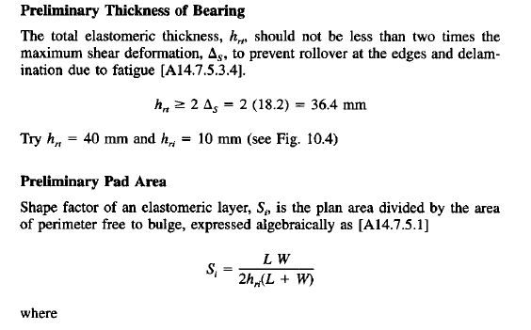
Elastomeric Bearing Design -Example

Slide 35
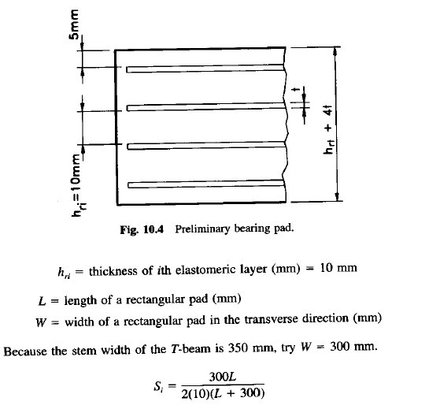
Elastomeric Bearing Design -Example
Preliminary Thickness of Bearing

Slide 36
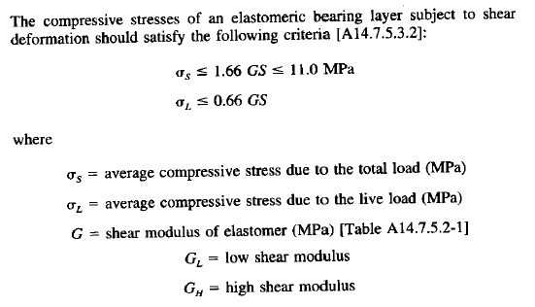
Elastomeric Bearing Design -Example
Preliminary Thickness of Bearing

Slide 37
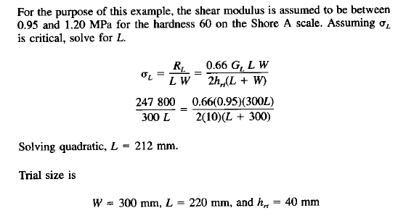
Elastomeric Bearing Design -Example
Preliminary Thickness of Bearing

Slide 38
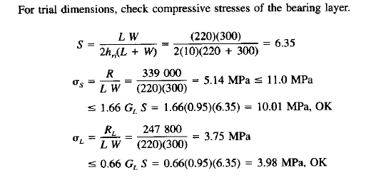
Elastomeric Bearing Design -Example
Check Stresses in Trial Bearing Size

Slide 39
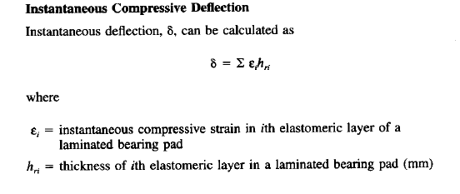
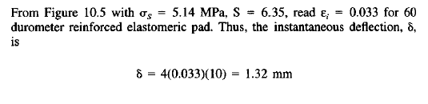
Elastomeric Bearing Design -Example

Slide 40
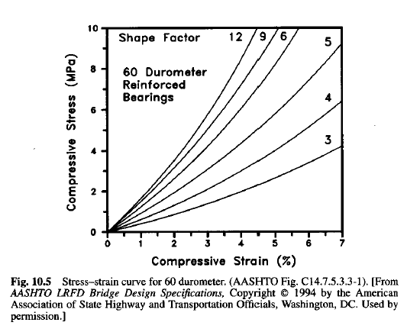
Elastomeric Bearing Design -Example
0.033

Slide 41
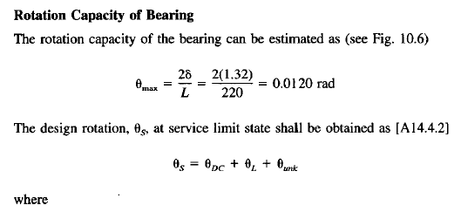
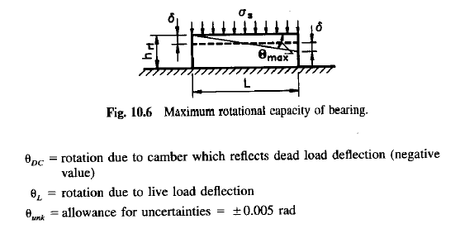
Elastomeric Bearing Design -Example

Slide 42


Elastomeric Bearing Design -Example

Slide 43


Elastomeric Bearing Design -Example

Slide 44


Elastomeric Bearing Design -Example

Slide 45


Elastomeric Bearing Design -Example

Slide 46

Elastomeric Bearing Design -Example

Slide 47

Elastomeric Bearing Design -Example

Slide 48

Elastomeric Bearing Design -Example

Slide 49

Elastomeric Bearing Design -Example

Slide 50


Elastomeric Bearing Design -Example

Slide 51

Elastomeric Bearing Design -Example

Slide 52


Elastomeric Bearing Design -Example

Slide 53
Elastomeric Bearing Design -Example
W = 350 mm
7mm
0.6mm
15mm
62.4mm
L = 240 mm
FINAL DESIGN

