Slide 1
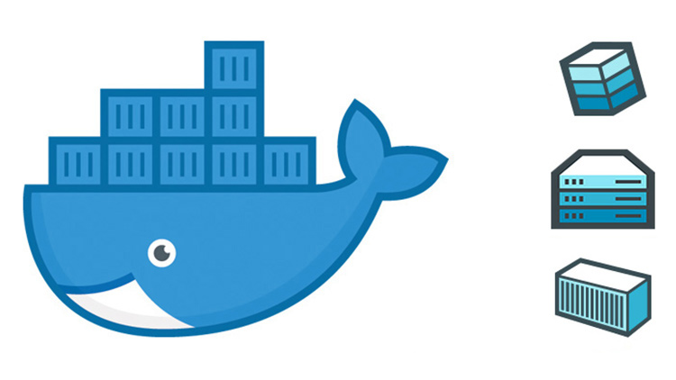
Automating Dev Ops with Docker Automation Script
Franklin Smith
CIS 410 Winter 2019

Slide 2
Docker
Docker is a platform for engineers, developers, and sysadmins to create, develop, run, and deploy applications with containers
Using Linux containers to launch applications is called containerization.
Containers and growing in popularity due to the fact that they make it possible to get more apps running on the same old servers and its easy to ship and package programs.

Slide 3
Dev Ops
Dev ops is the practice of operations and development engineers working together in entire service lifecycle from design through development process to production support
Sparked IT talent war
“60 % of hiring managers looking to fill dev ops engineer positions”
-2017 open source jobs report
“The flexibility of the [DevOps engineer] role and ability to be nimble is very attractive as employers look for tech pros who can understand the many sides of the tech organization”
- Random Tech CEO

Slide 4
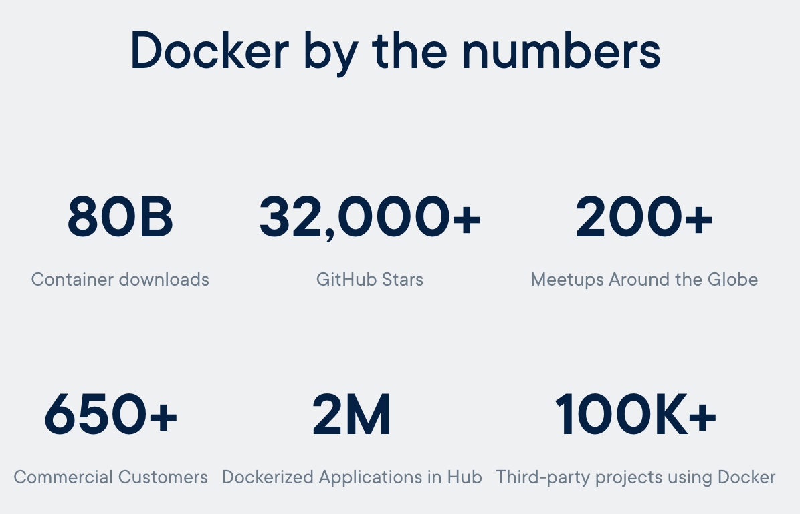
Docker Company Background
Originally founded called dot cloud in 2010 in san Francisco by YC alum Solomon Hykes
1.3 Billion $ Valuation last year
Funding
January 21, 2014 - $15 million Series B - Led by Greylock Partners^{[14]}
September 16, 2014 - $40 million Series C - Led by Sequoia Capital
April 14, 2015 - $95 million Series D - Led by Insight Venture Partners
November 2015 - $18 million Series D
October 2018 - $92 million Venture Round

Slide 5
Big companies using docker
The New York Times
PayPal
Business Insider
Cornell University (Not a company but still can be considered)
Splunk
The Washington Post
GE
Groupon
Yandex
Uber
Ebay
Shopify
Yelp
Quora

Slide 6
Incoming Competition for market share
Docker 48%
Kubernetes 29%
Vagrant 5.9%
Apache Mesos 5.59%
Rancher OS 3.25%
Red Hat OpenShift%

Slide 7
Problem
New technology like docker, has tutorials that are difficult, especially when you are trying to learn fast
Most find them
Time consuming
Annoying
Hard to remember certain commands
Not all resources, libraries, dependencies, files needed are provided or shown how to setup
Stack overflow can be misleading

Slide 8
Problem Importance
This is an issue because for any creator/user of the technology, one can not learn/use it efficiently in an appropriate time manner.
This applies to:
Students
Professors
Software Engineers
Companies
Managers
Startups
Anyone that wants to use it for any purpose

Slide 9
Solution
My solution is a shell script that automates basic onboarding commands with minimal user input and setup
Solution is good because user can run the script fast, and its does the grunt work for them.
Is not time consuming or annoying and allows user allocate their time where its most needed
User can view shell script commands in one file

Slide 10
What the script does
What the script does
Sets up environment
Builds Image
Runs as containers
Scales app and runs multiple containers
Distributes App across cluster
Takes around 2-3 minutes to run depending on network connection and machine capabilities

Slide 11
Results
Shell script, necessary files, and readme file available to download quickly from a repo.

Slide 12
Future Work
For new technologies, creators can make a shell script that can install and get the program up and running for the user.
User can modify script or input to represent their specific project ideas or technology they want to create
Don’t have to watch time consuming you tube tutorials anymore

Slide 13
Accomplishments
Gained knowledge of docker
Shell scripting skills
Trouble shooting the script and docker technologies setup
What I would have done differently:
Gathered users to do research about the behavior, likes and dislikes of the user experience for the script. Allows me to collect feedback and create improvements
Add user interface

Slide 14
Acknowledgements
Professor Ramakrishnan Durairajan

Slide 15
References
https://kubernetes.io/docs/concepts/overview/what-is-kubernetes/
https://www.contino.io/insights/whos-using-docker
https://en.wikipedia.org/wiki/Docker,_Inc.#cite_note-15
http://mcnair.ucsb.edu/documents/HowtoCreateaResearchPresentation_000.pdf
https://docs.docker.com/get-started/

