Slide 1


Slide 2


DevOps
Welcome to the world of DevOps!

Slide 3
System Administrator
A system administrator, or sysadmin, is a person who is responsible for the upkeep, configuration, and reliable operation of computer systems; especially multi-user computers, such as servers.
The system administrator seeks to ensure that the uptime, performance, resources, and security of the computers he or she manages meet the needs of the users, without exceeding the budget.
To meet these needs, a system administrator may acquire, install, or upgrade computer components and software; provide routine automation; maintain security policies; troubleshoot; train and/or supervise staff; or offer technical support for projects.
Source : Wikipedia

Slide 4
System Administrator
system administration
system administration in Technology
Activities performed by a system administrator (or "admin", "sysadmin", "site admin") such as monitoring security configuration, managing allocation of user names and passwords, monitoring disk space and other resource use, performing backups, and setting up new hardware and software.
system administrators often also help users, though in a large organisation this may be a separate job.
Compare postmaster, sysop, system management, systems programmer.
[Other tasks?]
(1999-05-02)
The Free On-line Dictionary of Computing, © Denis Howe 2010 http://foldoc.org
Cite This Source
Source : http://dictionary.reference.com/browse/system+administration

Slide 5
Generalists and Specialisations
Desktop Administration
System Administration
Network Administration
Storage Administration
DataCenter Administration
Security Operations
Application Operations
DevOps

Slide 6
Introduction to Shell Commands
Linux System Architecture
CLI vs GUI
Console
Terminal
SSH
Basic Commands

Slide 7
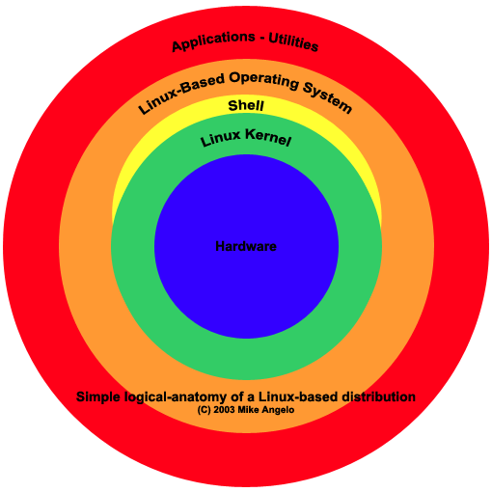
Introduction to Shell Commands

Slide 8
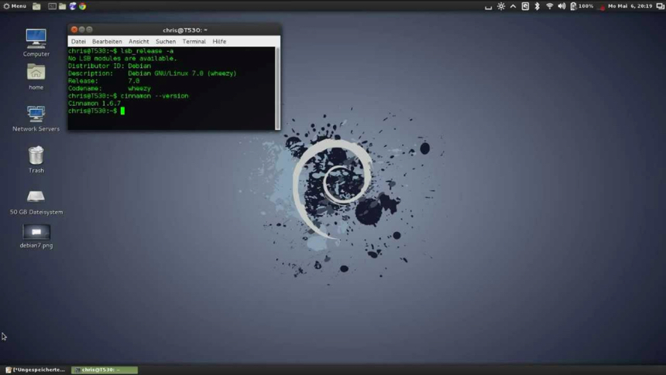
Graphical User Interface - GUI

Slide 9
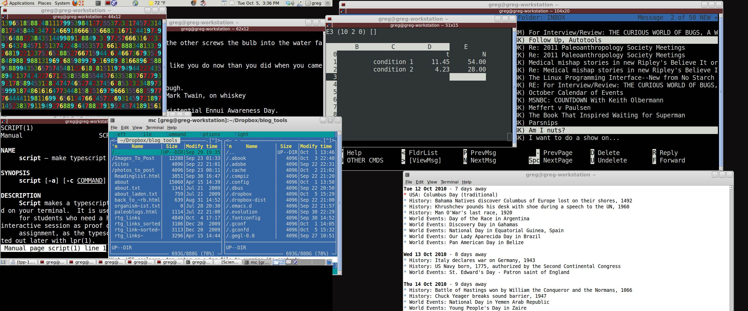
Command Line Interface - CLI

Slide 10
TTY
Alt – Control – F1
Alt – Control – F2
.
.
.
Alt – Control – F7

Slide 11
Basic Commands – abc..
$ aplay
$ mplayer
$ script mylearnings
$ ls
$ cd
$ chmod
$ chown
$ chgrp
$ tree
$ pwd
$ rmdir
$ rm
$ touch
$ which

Slide 12
Basic Commands - System
$ hostname
$ uname
$ date
$ cal
$ w
$ who am i
$
$ cat /etc/hosts
$ cat /etc/resolv.conf

Slide 13
Basic Commands - Filesystem
$ cat
$ date
$ df
$ du
$ man
$ locate
$ find
$ diff
$ less
$ more
$ vi
$ gedit
$ tail
$ head
$ updatedb

Slide 14
Basic Commands - User
# useradd
# adduser
# groupadd
# usermod
# groupmod
$ passwd
$ cat /etc/passwd
$ cat /etc/group
$ env $SHELL
$ df -hP /home
Root Shell vs Normal shell
$ sudo

Slide 15
Basic Commands – Data
$ diff
$ echo
$ grep
$ awk
$ sed
$ cut
$ sort
$ uniq
$ wc

Slide 16
Basic Commands - Compression
$ compress
$ zip
$ gzip
$ tar cvfz
$ uncompress
$ unzip
$ gunzip
$ tar xvfz

Slide 17
Basic Commands - Copy
$ cp
$ mv
$ scp
$ rsync

Slide 18
Basic Commands - Process
$ ps
$ kill
$ top
$ free
$ vmstat
$ memstat
$ runlevel
$ init
$ cd /etc/init.d
# service
$ cd /proc
$ uptime

Slide 19
Commands – Remote Connections
$ telnet
$ rsh
$ ssh
$ vnc
$ ssh-keygen
- password less ssh

Slide 20
Server Installations
1. Media Wiki https://www.mediawiki.org/wiki/Download
2. Icinga http://docs.icinga.org/icinga2/latest/doc/module/icinga2/toc
3. Install Drupal https://help.ubuntu.com/community/Drupal
4. Diaspora https://wiki.diasporafoundation.org/Installation/Ubuntu/Trusty
5. Gluster http://gluster.readthedocs.org/en/latest/Install-Guide/Quick_start/
6. Uptime https://github.com/fzaninotto/uptime
7. Setup Moodle https://docs.moodle.org/26/en/Step-by-step_Installation_Guide_for_Ubuntu
8. Ticketing System http://osticket.com/download
9. Configure Cassandra on Ubuntu http://docs.datastax.com/en/cassandra/2.1/cassandra/install/installDeb_t.html
10. Install IRC Server https://help.ubuntu.com/lts/serverguide/irc-server.html
11. Setup Docker Image Repository https://www.digitalocean.com/community/tutorials/how-to-set-up-a-private-docker-registry-on-ubuntu-14-04
12. Rundeck

Slide 21
Scripting
Alt – Control – F1
Alt – Control – F2
.
.
.
Alt – Control – F7

Slide 22
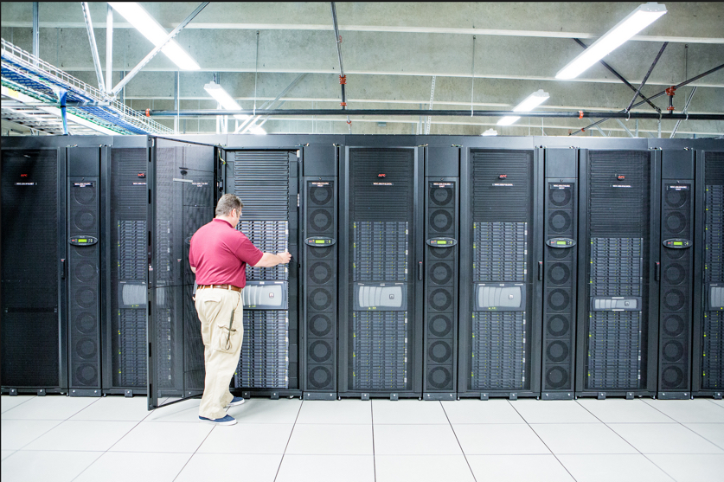
DataCenter

Slide 23
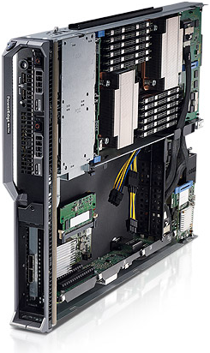
Blade Computer

Slide 24
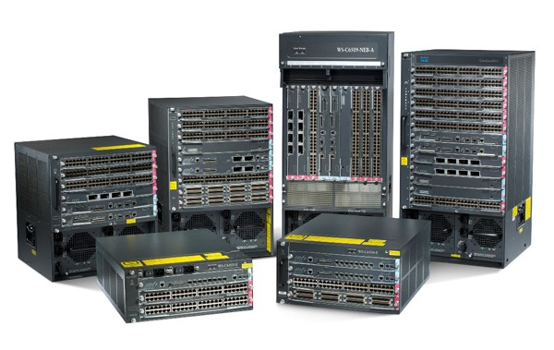
Switches

Slide 25
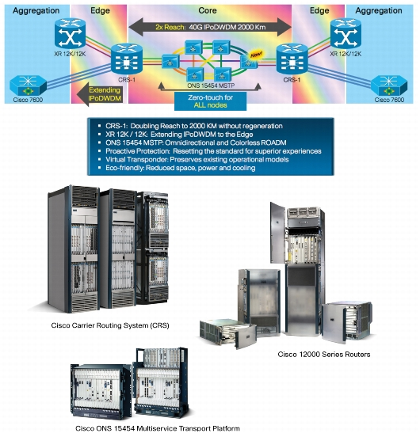
Routers

Slide 26
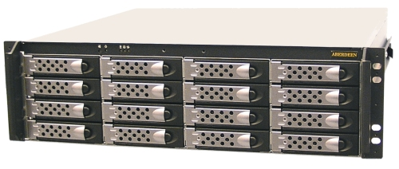
Storage (JBOD)

Slide 27
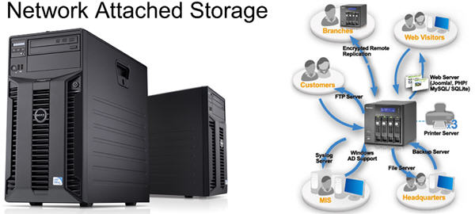
Storage (NAS)

Slide 28
GIT
http://viggy.in/fstalks/Introduction-to-Git/Introduction-to-Git.html

Slide 29
Reference
http://tldp.net/HOWTO/HOWTO-INDEX/categories.html
http://www.comptechdoc.org/os/linux/usersguide/index.html

Slide 30
GIT
http://viggy.in/fstalks/Introduction-to-Git/Introduction-to-Git.html

